Slide 1

OpenEdge RDBMS
Transparent Data Encryption
I left the new sports database on a barstool and lost it. No worries.
Marv Stone, Progress Software
PUG Challenge Americas

Slide 2
Abstract
Do you ever worry about accidentally leaving your laptop at a bar--or losing high-value data that could put your business at jeopardy in some other way? Learn how to protect your data with OpenEdge Transparent Data Encryption (TDE). If you are a DBA, or if your job has DBA-like characteristics, then attend this session to hear why TDE is your best choice for meeting the regulatory and organizational security requirements for data at rest.

Slide 3

Please ask questions as we go
sometimes I do not explain something well enough, or
you may want to know more, or
y’all may have a problem with my accent!

Slide 4
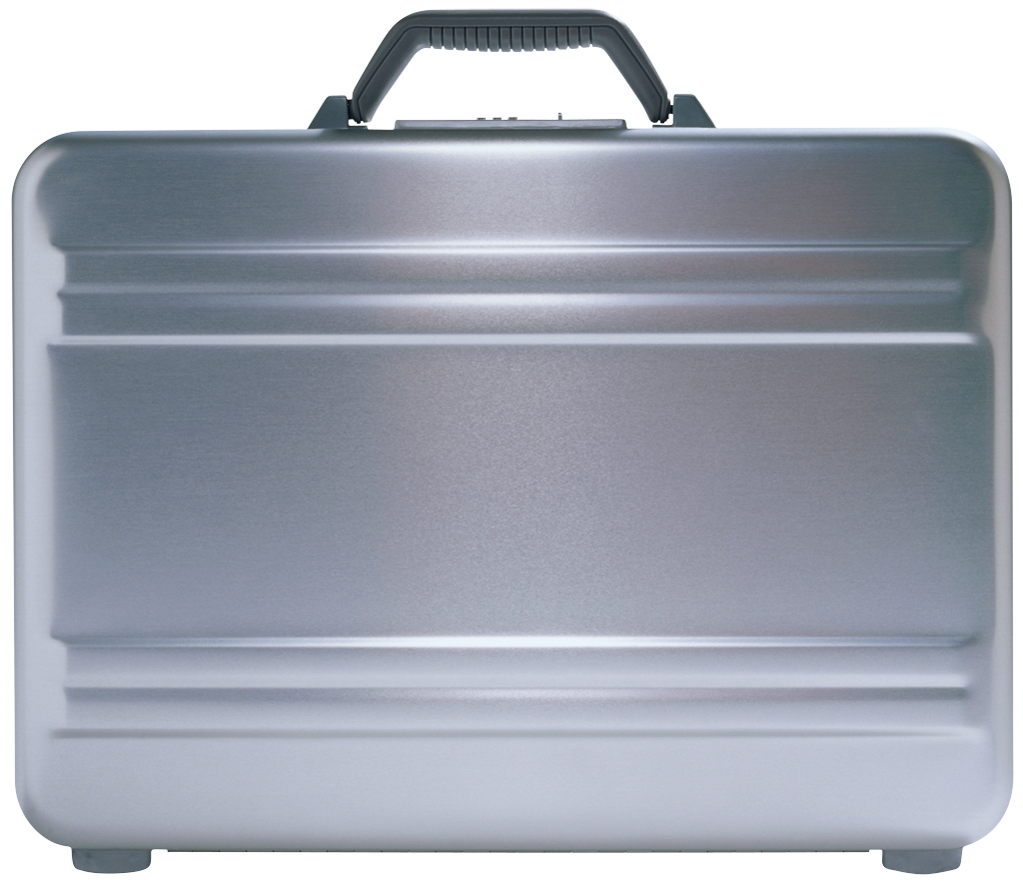
A (not very) fictional scenario
You have a laptop with a database on it
The database contains customer info with credit card numbers, maybe patient records
You forget the laptop in a taxi (or a pub)
Someone finds it, looks at what it contains, and sells the data to some bad people
The newspapers print yet another data-loss story which surprises no one
Your customers suffer losses and are upset
Your company suffers losses

Slide 5
What is OpenEdge TDE?

Slide 6
OpenEdge Transparent Data Encryption (TDE)
Provides data privacy while data is ‘at rest’
(i.e. stored on disk) in your OpenEdge database
  Performs database block-level encryption
  Uses industry standard encryption algorithms
  Works regardless of who has a copy or where it resides
To use TDE you need two OpenEdge 10.2B products
  Enterprise OpenEdge Database
  Transparent Data Encryption

Slide 7
Security Layers in OpenEdge
TDE is one part of an overall security strategy
Custom 4GL application provided security features
CLIENT-PRINCIPAL
4GL compile-time authorisation
DBAuthkey
Runtime table and column access controls
RDBMS user authentication
SSL/TLS communication channel encryption
Operating system file security settings, etc.
OpenEdge Auditing
Encryption key management (TDE)
Keystore encryption & authentication (TDE)
Storage access encryption (TDE)
Encrypted private data on disk (TDE)
Notes:
TDE is just a part of a total security solution

Slide 8
Learn more at
Chris Longo talk today at 1:15:
045 - User Authentication using the Client Principle Object

Slide 9
Advantages of OpenEdge RDBMS
Transparent Data Encryption
Easy to implement and maintain
Simple to configure
Proven industry encryption agorithms
  No need to change your queries or other code
  "The best thing since instant grits!"

Slide 10
Other OpenEdge Encryption Stuff
Communication channel encryption
  Support for Secure Sockets Layer (SSL) over the tcp/ip network transport layer
  Used to secure data in transit
4GL encryption functions
  DIY field level encryption of OpenEdge RDBMS data stored on disk and other data
  Requires 4GL coding and DIY key management
  Encryption of most index keys impractical

Slide 11
What do we mean by "Transparent" ?
Data in database on disk are encrypted and decrypted automatically
Encryption key management is (mostly) automatic
No changes needed to
  a 4GL application’s code
  a SQL application's code
  Application security infrastructure
Indexes work the same when encrypted and not
Low performance impact
In other words: you don't see much evidence of it being there !
It just works !

Slide 12
What You Get
Transparent & configurable encryption for
  Table data (by table)
  Index data (by index)
  Before Image Transaction Logs
  After Image Journals
  Audit data
OpenEdge Replication (of database files)
Encrypted backup media (files)
Optional encryption of binary & data dump
Restricted database utility access to encrypted data

Slide 13
How Does OpenEdge TDE Work?

Slide 14
TDE Concepts
Block-level encryption
Database key store (.ks file)
Passphrases
Key store user accounts
Key store service
Ciphers
Manual mode vs. Auto mode
Encryption policies

Slide 15
Block-Level Encryption
IV
clear
text
Crypt Service
cipher
text
security context:
- cipher-algorithm - encryption key
on-disk
data
NOT
encrypted
data
blocks
in shared memory
IV
cipher
text
clear
text
Crypt Service
encrypted data
blocks on disk

Slide 16
Encrypted Data Paths
Temp OS
file cache
4GL runtime
Encrypted
Clear-text
nc layer
Hidden
misc
Bckup
Dump
Archive
(SSL/TLS)
ns layer
4GL runtime &
SQL Server
_mprosrv
_dbutil
Shared Memory
Database Manager
Block I/O manager (disk read / write)
schema
blob
table
audit
index
AI
BI
Enc-key
storage
Replication
Notes:
Overall encryption map

Slide 17
Database Key Store
Key Store
One for each encrypted database
Not part of the database
Database Master Key (DMK)
  Each TDE-enabled database has one unique DMK
  Limits risk since if compromised only that db is accessible
  Managed by a DBA
Data object encryption keys
  Unique key(s) for EACH db object
  If key cracked, intruder only has access to that db object

Slide 18
Keystore Passphrase
A sequence of text used to control access to a program or data such as an encryption key
Similar to a password in usage but …
  May include whitespace and punctuation
  Generally longer than a password for added security

Slide 19
Database Key Store Built-in Accounts
Admin Account
User Account
Must be used to change any key store value
Used to administer off-line
  Encryption configuration
  Key store access
  Manual/autostart mode
Use for daily non admin-tasks
For example use to start database servers and to access data
There are no tools available from Progress to allow a key store file to be opened if the key store admin account passphrase is lost
Recommendation: Use the admin account exclusively for administration

Slide 20
Select the Right Cipher
Based on the Value Of the Data
Considerations when selecting a cipher:
Is it strong enough to provide desired security?
Is it fast enough for the applications requirements?
The strength is based on three factors
  Algorithm type – mathematical formula
  Mode - used to manipulate the key data
  Key size – In bits

Slide 21
Encryption Ciphers Compared
Balance strength against performance
DES-56/PBE
AES-192
DES3-168
RC4-128
AES-128
AES-256
Performance
fast
slow
DES-PBE
DES-56
AES-128
AES-192
RC4-128
DES3-168
AES-256
Strength
weak
strong
Which one should you choose? more on that later

Slide 22
Key Store Service Passphrase Delivery
Manual start mode
Default mode
More secure
Requires a key store user passphrase every time the database is opened
Can impact automated database tools
Options:
  Type in passphrase
  Write ‘secure’ scripts to automate delivery of passphrase (very hard to do)
Autostart mode
Less secure
Automatically delivers account passphrase to open the key store
Gives access to key store and data automatically
Can be set to either key store account
Account becomes default account for all users
Recommendation: Never turn on Autostart for a TDE database that may have a copy outside of the development lab
Notes:
.

Slide 23
Encryption Policies
Encryption attributes of database objects are managed through encryption policies
Policies are stored in the Encryption Policy Area
To administer policies you must be a DBA and have access to the key store admin account
Built-in to TDE security protects policy records
Access requires command be run locally

Slide 24
Setting Up OpenEdge TDE

Slide 25
Setting Up TDE
1
Add encryption policy storage area to the database
2
Enable the database for encryption
3
Configure encryption policies
4
Encrypt existing unencrypted data (optional)

Slide 26
Encryption Policy Storage Area
Create a data area for encryption policies
  Type II area added to the database
  Name is "Encryption Policy Area"
Create structure definition file with policy area
e “Encryption Policy Area”:12,64;8 .
Add the encryption policy area using PROSTRCT Add
PROSTRCT ADD mydb encrypt_policy_area.st
Policy area will normally not have much data in it.
One or two records per encrypted object

Slide 27
Enabling TDE
proutil db-name -C enableencryption
[-Cipher cipher-number] [-Autostart {user | admin}]
[-biencryption enable|disable]
[-aiencryption enable|disable]
[-Passphrase]
[[-userid userid][-password password]]
Enables the database for TDE
  Must be run on a command line
Does not encrypt any data
Creates the key store file
proutil tdeSport -C enableencryption

Slide 28
Encryptable Database Objects
OpenEdge Database
Type I data area
Type II data area
Entire area encrypted
Selected objects encrypted
Tables
Table
LOB
Table
Index
Indexes
Index
LOB
Table
Index
LOBs
LOB
Index
Table
LOB
Index
LOB
Table
Index
Index
Cannot be encrypted
Cannot be encrypted
Schema Area
Encryption Policy Area

Slide 29
Creating an Encryption Policy
Database
Database
object type
Action is encrypt
Database
area name
proenv> proutil tdeSport
-C epolicy manage area encrypt "DataArea100"
OpenEdge Release 10.2B as of Mon May 18 19:01:43 EDT 2010
Encryption policy setting for Area DataArea100 in Area 100
Cipher specification setting to AES_CBC_128 completed.
Policy uses default cipher
Putting the pieces together:
The policy for this data base object is created and placed in the encryption policy storage area of the database

Slide 30
Which cipher should you choose?
Always choose AES_CBC_128,
unless someone gives you a very strong
and compelling reason to do otherwise
It is fast and secure
AES_CBC_128 is the default

Slide 31
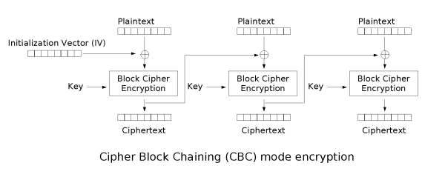
Dive: What does AES_CBC_128 mean ?
AES = the "Advanced Encryption Standard" encryption algorithm
CBC = Cipher Block Chaining encryption mode
128 = length of encryption block and key in bits (16 bytes)
Notes:
Database block is 4K or 8K
Encryption block is much smaller. You have to do a bunch of 16bit encrypts. Output from previous block is used as input for next.

Slide 32

Unencrypted image

Slide 33

Encrypted with cipher block chaining

Slide 34

Encrypted without cipher block chaining

Slide 35
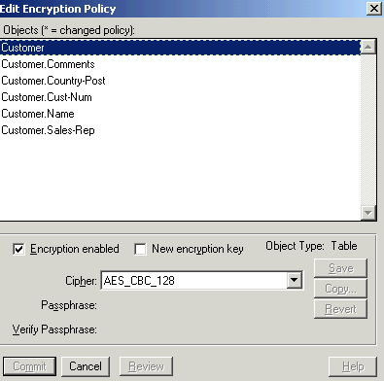
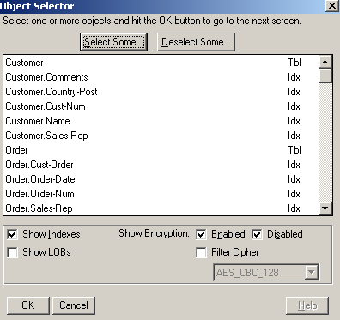
Setting policy with data admin tool
Type II “PUB” schema only
Multi select UI
Local access only
Admin
Security
Encryption Policies
Edit Encryption Policies . . .

Slide 36
Setup: so far, we did the following
Added encryption policy storage area
Enabled encryption for the database
Created an encryption policy
What about the existing data in the database ????

Slide 37
Options for Encrypting Existing Data
1
Data are encrypted, when updated, by the normal course of database updates each time a block is written to the database
2
Dump and load data objects,
  encrypting data during the load operation
3
Run EPOLICY MANAGE UPDATE command to encrypt all data in a database object

Slide 38
How do you know what data are encrypted,
and what are not ????

Slide 39
Viewing Database Object Encryption Status
Provides information on the encryption policy for the selected database object
proenv> proutil t1demo -C epolicy scan
area "DataArea101"
OpenEdge Release 10.2B1P as of Thu Oct 29 …
AREA DataArea101 /
101 CURRENT AES_CBC_128 V:0 200 of 627 blocks encrypted
Number of blocks encrypted
Total number
of blocks

Slide 40
Encrypting Data
Encrypts all blocks in the database object that are not already encrypted using the current policy
Action is update
proenv> proutil t1demo -C epolicy manage
area update "DataArea101"
OpenEdge Release 10.2B1P as of Thu Oct 29 19:01:53 EDT 2010
AREA DataArea101 /
101 CURRENT AES_CBC_128 V:0 427 of 627 blocks encrypted
Number of blocks encrypted
Total number
of blocks

Slide 41
Encryption Policy Reports
Quick Encryption Policies report
  Shows current cipher name and policy version
Detailed Encryption Policies report (shown)
  Information similar to Detailed Table report, but includes encryption information
Reporting only objects with encryption enabled at the object level
=========================================================================
============================= Table: Customer ===========================
Object Name : Customer
Object Type : Table
Storage Area: Customer/Order Area
Policy Version Cipher Name Policy State
-------------- -------------------- --------------------
1 AES_CBC_128 Current
0 AES_CBC_256 Previous
Object Name : Comments (Table: Customer)
Object Type : Index
Storage Area: Customer Index Area
No policy information available for object.
Policies
version
Current and
Previous policies

Slide 42
Using OpenEdge When TDE Is Active

Slide 43
About Running with TDE Enabled
Database connections
Temporary file storage
Deployment
Maintenance

Slide 44
Connecting to TDE Enabled Databases
You can supply a passphrase using
  -Passphrase for commands
  -KeyStorePassPhrase on the ABL CONNECT statement
    Can only be used on for a local connection
Use with manual mode or to override autostart mode
> proserve myDB 1234 -Passphrase
Please enter the Passphrase for database myDB
CONNECT myDB -1 -KeyStorePassPhrase VALUE(QUOTER(myVar))
Recommendation: Create a dialog box to prompt for the passphrase prior to CONNECT statement and do not echo the characters

Slide 45
More on Database Connections
No passphrase is needed when connecting to a database server using a client-server or self-service client if the server is already started
  Virtual encryption keys are securely pre-loaded and available to decrypt and encrypt data in the database
For manual mode a database server cannot be started using OpenEdge Explorer or Progress Explorer
  It can be added as a scripted database
    OpenEdge Explorer supports viewing the log file
    OpenEdge Management supports alerts, monitoring the database and log file

Slide 46
Temporary Files
Both ABL and OpenEdge SQL clients create temporary storage files when accessing databases
-t startup parameter (save temp files)
  You cannot connect when an ABL client uses the -t parameter
  Using OpenEdge SQL client the -t startup parameter is ignored
In a TDE database temporary files:
  Are hidden and readable (not encrypted and may be read)
  Are forcibly removed when a 10.2B client process ends
When working with TDE update all clients to 10.2B.
Clients prior to 10.2B are security risk since they do not assure that temporary files are removed

Slide 47
Deploying TDE Enabled Databases
1
Dump the schema and the data
2
Create new empty db and load the schema
3
Enable Transparent Data Encryption
4
Configure policies
(load policies on site)
5
Load the data

Slide 48
Other things that ARE encrypted
Data automatically encrypted
  PROBKUP
  After image hot-standby databases
  OpenEdge Replication targets
  (some setup required)
Data optionally encrypted
  Binary dump and load
  Audit archive and load
Recommendation: Backup the database and the key store to different media

Slide 49
Maintaining TDE Enabled Databases
Modifying a virtual data encryption keys
Changing the cipher of an encrypted database object
PROUTIL dbname -C epolicy manage
object-type rekey object-name
PROUTIL dbname -C epolicy manage
object-type cipher object-name
-Cipher cipher-num
Notes:
Given table. Generate key from master key.

Slide 50
A Few Final Comments

Slide 51
Things that are NOT encrypted
  RAW-TRANSFER
  EXPORT
  BUFFER-COPY
  DISPLAY
  MESSAGE
  OUTPUT TO
  OUTPUT THROUGH
  etc.

Slide 52
Testimonial from Fiserv – a TDE user
Benefits
  TDE will ensure data privacy across the entire lifecycle
  Maintain competitive advantage and ability to interface with third parties by adhering to PCI DSS
  Increased IT performance will save time and reduce costs
“We always try to improve our performance and get things to run faster. We tested a fully encrypted database and there was only a 4% decrease in performance versus an unencrypted database. We tested that with alternative data pools, we actually gained back almost 2% of that initial performance degradation. We believe with additional fine tuning the performance will continue to improve.”

Slide 53
The Alternate Buffer Pool
A second shared-memory resident buffer pool, just like the one you are already used to
Set size with –B2 nnnn
Only objects you specify are cached there
Could put encrypted data in alternate buffer pool
32-bit shared-memory limit may be a problem
(all database servers should be 64-bit anyway)

Slide 54

Documentation
OpenEdge Getting Started: Core Business Services
OpenEdge Data Management: Database Administration

Slide 55



Summary
Good stuff ! Best thing since instant grits.
Easy to set up, use, and maintain !
Important part of the overall security plan

Slide 56
?
Questions

