Slide 1
The B2 Buzz
The Buzz About Buffer Pools

Slide 2
A Few Words about the Speaker
Tom Bascom; Progress 4gl coder & roaming DBA since 1987
President, DBAppraise, LLC
  Remote database management service for OpenEdge.
  Simplifying the job of managing and monitoring the world’s best business applications.
  tom@dbappraise.com
VP, White Star Software, LLC
  Expert consulting services related to all aspects of Progress and OpenEdge.
  tom@wss.com
Notes:
I have been working with Progress since 1987
… and today I am both President of DBAppraise;
The remote database management service…
where we simplify the job of managing and monitoring the worlds best business applications;
and Vice President of White Star Software;
where we offer expert consulting services covering all aspects of Progress and OpenEdge.

Slide 3
What is a “Buffer”?
A database “block” that is in memory.
Buffers (blocks) come in several flavors:
  Type 1 Data Blocks
  Type 2 Data Blocks
  Index Blocks
  Master Blocks

Slide 4
Block Layout
Block’s DBKEY
Type
Chain
Backup Ctr
Block’s DBKEY
Type
Chain
Backup Ctr
Next DBKEY in Chain
Block Update Counter
Next DBKEY in Chain
Block Update Counter
Num
Dirs.
Free
Dirs.
Free Space
Rec 0 Offset
Rec 1 Offset
Top
Bot
Index No.
Reserved
Rec 2 Offset
Rec n Offset
Num Entries
Bytes Used
Dummy Entry . . .
Free Space
. . . Compressed Index Entries . . .
Used Data Space
…….
row 1
. . . Compressed Index Entries . . .
row 2
Free Space
row 0
Data Block
Index Block

Slide 5
Type 1 Storage Area
Block 1
1 | Lift Tours |  |  | Burlington
3 | 66 | 9/23 | 9/28 | Standard Mail
1 | 1 | 54 | 4.86 | Shipped
1 | 2 | 55 | 23.85 | Shipped
Block 3
14 | Cologne |  |  | Germany
2 | Upton Frisbee |  |  | Oslo
1 | Koberlein |  |  | Kelly
1 | 53 | 1/26 | 1/31 | FlyByNight
Block 2
1 | 3 | 53 | 8.77 | Shipped
2 | 1 | 19 | 2.75 | Shipped
2 | 2 | 49 | 6.78 | Shipped
2 | 3 | 13 | 10.99 | Shipped
Block 4
BBB |  | Brawn, Bubba B. |  | 1,600
DKP |  | Pitt, Dirk K. |  | 1,800
4 | Go Fishing Ltd |  | Harrow
16 | Thundering Surf Inc. |  | Coffee City
Notes:
Of course Progress databases store all data as variable length fields so this “block layout” is a bit misleading – row lengths rarely come out so even ;)

Slide 6
Type 2 Storage Area
Block 1
1 | Lift Tours | Burlington
2 | Upton Frisbee | Oslo
3 | Hoops | Atlanta
4 | Go Fishing Ltd | Harrow
Block 3
9 | Pihtiputaan Pyora | Pihtipudas
10 | Just Joggers Limited | Ramsbottom
11 | Keilailu ja Biljardi | Helsinki
12 | Surf Lautaveikkoset | Salo
Block 2
5 | Match Point Tennis | Boston
6 | Fanatical Athletes | Montgomery
7 | Aerobics | Tikkurila
8 | Game Set Match | Deatsville
Block 4
13 | Biljardi ja tennis | Mantsala
14 | Paris St Germain | Paris
15 | Hoopla Basketball | Egg Harbor
16 | Thundering Surf Inc. | Coffee City
Notes:
Of course Progress databases store all data as variable length fields so this “block layout” is a bit misleading…

Slide 7
Tangent…
If you are neat and orderly sort of person the preceding slides should be all you need to see in order to be convinced that type 1 areas are a bad place to be putting data.
The schema area is always a type 1 area. Should it have data, indexes or LOBs in it?

Slide 8
What is a “Buffer Pool”?
A Collection of Buffers in memory that are managed together.
A storage object (table, index or LOB) is associated with exactly one buffer pool.
Each buffer pool has its own control structures that are protected by “latches”.
Each buffer pool can have its own management policies.

Slide 9
Why are Buffer Pools
Important?

Slide 10
Locality of Reference
When data is referenced there is a high probability that it will be referenced again soon.
If data is referenced there is a high probability that “nearby” data will be referenced soon.
Locality of reference is why caching exists at all levels of computing.
Notes:
Local variables & temp-tables, -B, filesystem cache, SAN cache, controllers, disks, CPU L1 & L2 caches…

Slide 11
Which Cache is Best?
Layer | Time | # of Recs | # of Ops | Cost per Op | Relative
Progress 4GL to –B | 0.96 | 100,000 | 203,473 | 0.000005 | 1
-B to FS Cache | 10.24 | 100,000 | 26,711 | 0.000383 | 75
FS Cache to SAN | 5.93 | 100,000 | 26,711 | 0.000222 | 45
-B to SAN Cache | 11.17 | 100,000 | 26,711 | 0.000605 | 120
SAN Cache to Disk | 200.35 | 100,000 | 26,711 | 0.007500 | 1500
-B to Disk | 211.52 | 100,000 | 26,711 | 0.007919 | 1585
Notes:
Sequential reads, no –B2, hit ratio 87%

Slide 12
What is the “Hit Ratio”?
The percentage of the time that a data block that you access is already in the buffer pool.*
To read a single record you probably access 1 or more index blocks as well as the data block.
If you read 100 records and it takes 250 accesses to data & index blocks and 25 disk reads then your hit ratio is 10:1 – or 90%.
* Astute readers may notice that a percentage is not actually a “ratio”.

Slide 13
How to “fix” your Hit Ratio…
/* fixhr.p -- fix a bad hit ratio on the fly */
define variable target_hr as decimal no-undo format ">>9.999".
define variable lr as integer no-undo.
define variable osr as integer no-undo.
form target_hr with frame a.
function getHR returns decimal ().
define variable hr as decimal no-undo.
find first dictdb._ActBuffer no-lock.
assign
hr = ((( _Buffer-LogicRds - lr ) - ( _Buffer-OSRds - osr )) /
( _Buffer-LogicRds - lr )) * 100.0
lr = _Buffer-LogicRds
osr = _Buffer-OSRds
.
return ( if hr > 0.0 then hr else 0.0 ).
end.

Slide 14
How to “fix” your Hit Ratio…
do while lastkey <> asc( “q” ):
if lastkey <> -1 then update target_hr with frame a.
readkey pause 0.
do while (( target_hr - getHR()) > 0.05 ):
for each _field no-lock: end.
diffHR = target_hr - getHR().
end.
etime( yes ).
do while lastkey = -1 and etime < 20: /* pause 0.05 no-message. */
readkey pause 0.
end.
end.
return.
Notes:
Efficiency is obviously not an objective here…

Slide 15
Isn’t “Hit Ratio” the Goal?
No. The goal is to make money*.
But when we’re talking about improving db performance a common sub-goal is to minimize IO operations.
Hit Ratio is an indirect measure of IO operations and it is often misleading as performance indicator.
“The Goal” Goldratt, 1984; chapter 5

Slide 16
Misleading Hit Ratios
Startup.
Backups.
Very short samples.
Overly long samples.
Low intensity workloads.
Pointless churn.

Slide 17
Big B, Hit Ratio
Disk IO and Performance
MissPct = 100 * ( 1 – ( LogRd – OSRd ) / LogRd ))
m2 = m1 * exp(( b1 / b2 ), 0.5 )
98.5%
98%
95%
90.0%
95% = plenty of room for improvement
Notes:
If you have a workload of 100,000 logical reads/sec and a 95% HR…
You might think that is “good enough” – but there is plenty of room for improvement.
You can easily make things a lot worse by making –B even just a bit smaller.
But to make them better you have to increase –B *substantially*.

Slide 18
Hit Ratio Summary
If you must have a “rule of thumb” for HR:
    90% terrible.
    95% plenty of room for improvement.
    98% “not bad”.
The performance improvement from improving HR comes from reducing disk IO.
Thus, “Hit Ratio” is not the metric to tune.
In order to reduce IO operations to one half the current value –B needs to increase 4x.

Slide 19
So, just set –B really high and we’re done?

Slide 20
What is a “Latch”?
Only one process at a time can make certain changes.
These operations must be atomic.
Bad things can happen if these operations are interrupted.
So access to shared memory is governed by “latches”.
If there is high activity and very little disk IO a bottleneck can form – this is “latch contention”.

Slide 21
What is a “Latch”?
Ask Rich Banville!
OPS-28 A New Spin on Some Old Latches
http://www.psdn.com/ak_download/media/exch_audio/2008/OPS/OPS-28_Banville.ppt
PCA2011 Session 105: What are you waiting for? Reasons for waiting around!
Wednesday June 8th, 8:30am

Slide 22
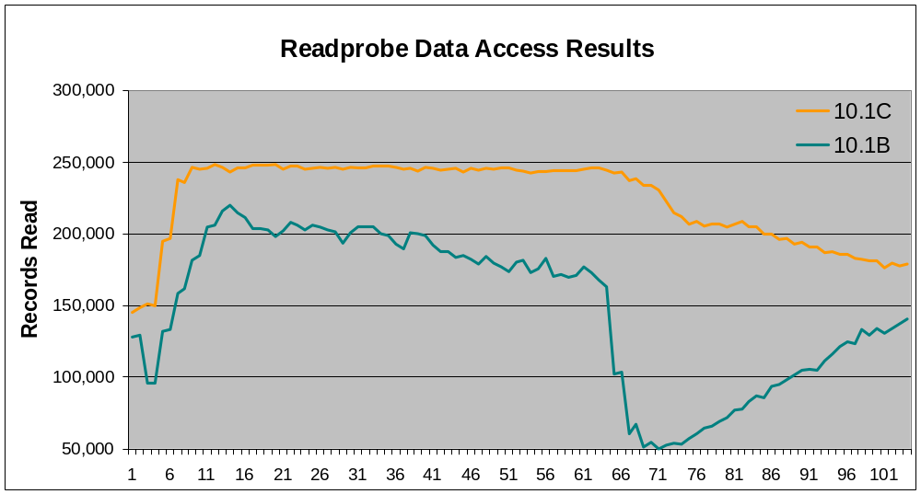
Disease? Or Symptom?

Slide 23
Latch Contention
05/12/11 Activity: Performance Indicators 10:29:37 (10 sec)
Total Per Min Per Sec Per Tx
Commits 771 4626 77.10 1.00
Undos 21 126 2.10 0.03
Index operations 2658534 15951204 265853.40 3448.16
Record operations 2416298 14497788 241629.80 3133.98
Total o/s i/o 1455 8730 145.50 1.89
Total o/s reads 1107 6642 110.70 1.44
Total o/s writes 348 2088 34.80 0.45
Background o/s writes 344 2064 34.40 0.45
Partial log writes 36 216 3.60 0.05
Database extends 0 0 0.00 0.00
Total waits 84 504 8.40 0.11
Lock waits 0 0 0.00 0.00
Resource waits 84 504 8.40 0.11
Latch timeouts 10672 64032 1067.20 13.84
Buffer pool hit rate: 99%
Notes:
Don’t worry about OS writes – they’re in the background.

Slide 24
What Causes All This Activity?
Tbl# Table Name Create Read Update Delete
---- ------------------------------ --------- ------ ------- -------
186 customer 0 43045 0 0
624 sr-trans-d 0 21347 0 0
471 prod-exp-loc-q 0 14343 5 0
387 loc-group 0 13165 0 0
91 bank-rec-doc 0 10293 0 0
23 ap-trans 0 8411 0 0
554 so-pack 0 7784 2 0
Idx# Index Name Create Read Split Del BlkD
---- ------------------------------ -- ------ ------ ----- ---- ----
398 customer.customer PU 0 46508 0 0 0
1430 sr-trans-d.sr-trans-d PU 0 23234 0 0 0
961 prod-exp-loc-q.prod-exp-loc-q PU 0 16869 0 0 0
3 _Field._Field-Name U 0 16576 0 0 0
786 loc-group.loc-group PU 0 14171 0 0 0
650 im-trans.link-recno 1 7953 0 0 0
45 ap-trans.ap-trans-doc 0 7554 0 0 0

Slide 25
Which Latch?
Id Latch Type Holder QHolder Requests Waits Lock%
--- ---------- ----- ------- ------- -------- ------ -------
23 MTL_LRU Spin 813 -1 445018 1067 99.53%
20 MTL_BHT Spin -1 -1 434101 114 99.97%
28 MTL_BF4 Spin -1 -1 245144 1 100.00%
26 MTL_BF2 Spin -1 -1 240142 1 100.00%
25 MTL_BF1 Spin -1 -1 199484 0 100.00%
27 MTL_BF3 Spin -1 -1 197823 0 100.00%
18 MTL_LKF Spin 811 -1 3077 0 100.00%
12 MTL_LHT3 Spin -1 -1 1062 0 100.00%
13 MTL_LHT4 Spin -1 -1 925 0 100.00%
10 MTL_LHT Spin -1 -1 758 0 100.00%
2 MTL_MTX Spin 195 -1 704 0 100.00%
11 MTL_LHT2 Spin -1 -1 685 0 100.00%
5 MTL_BIB Spin 73 -1 640 0 100.00%
15 MTL_AIB Spin 63 -1 514 0 100.00%
16 MTL_TXQ Spin 1332 -1 432 0 100.00%
9 MTL_TXT Spin 195 -1 395 0 100.00%
Notes:
Don’t worry about OS writes – they’re in the background.

Slide 26
How Do I Tune Latches?
-spin, -nap, -napmax
None of which has much of an impact except in extreme cases.

Slide 27
What is an “LRU”?
Least Recently Used
When Progress needs room for a buffer the oldest buffer in the buffer pool is discarded.
In order to accomplish this Progress needs to know which buffer is the oldest.
And Progress must be able to make that determination quickly!
A “linked list” is used to accomplish this.
Updates to the LRU chain are protected by the LRU latch.

Slide 28
My LRU is too busy, now what?
When there are a great many block references the LRU latch becomes very busy.
Even if all you are doing is reading data with no locks!
Only one process can hold it – no matter how many CPUs you have.
The old solution: Multiple Databases.
    2-phase commit
    More pieces to manage
    Difficult to modify

Slide 29
The
Buzz

Slide 30
The Alternate Buffer Pool
10.2B supports a new feature called “Alternate Buffer Pool.”
This can be used to isolate specified database objects (tables and/or indexes).
The alternate buffer pool has its own distinct –B2.
If the database objects are smaller than –B2, there is no need for the LRU algorithm.
This can result in major performance improvements for small, but very active, objects.
proutil dbname –C enableB2 areaname
Table and Index level selection is for Type 2 only!

Slide 31
Readprobe – with and without B2

Slide 32
Finding Active Tables & Indexes
You need historical RUNTIME data!
_TableStat, _IndexStat
-tablerangesize, -indexrangesize
You can NOT get this data from PROMON or proutil.
OE Management, ProMonitor, ProTop
Or roll your own VST based report.

Slide 33
Finding Active Tables & Indexes
15:18:35 ProTop xx -- Progress Database Monitor 05/30/11
Table Statistics
Tbl# Table Name Create Read Update Delete
---- ---------------- ------- ------- ------- -------
544 so-manifest-d 0 62,270 0 0
330 im-trans 1 34,657 3 0
186 customer 0 31,028 0 0
387 loc-group 0 19,493 0 0
554 so-pack 0 8,723 2 0
Index Statistics
Idx# Index Name Create Read
---- ------------------------------ -- ------ -------
1216 so-manifest-d.so-manifest-d PU 0 57,828
398 customer.customer PU 0 40,227
650 im-trans.link-recno 1 31,731
786 loc-group.loc-group PU 0 22,309
3 _Field._Field-Name U 0 16,152
Surprising!

Slide 34
Finding Small Tables & Indexes
_proutil dbname –C dbanalys > dbanalys.out
50MB = ~12,500 4K db blocks
If RPB = 16 then 103,472 records = ~6,500 blocks
Set –B2 to 15,000 (to be safe).
$ grep "^PUB.customer " dbanalys.out
PUB.customer 103472 43.7M 235 667 443 103496 1.0 1.0
PUB.customer 43.7M 1.1 6.5M 0.7 50.2M 1.0

Slide 35
Designating Objects for B2
Entire Storage Areas (type 1 or type 2) can be designated via PROUTIL:
Or individual objects that are in Type 2 areas can be designated via the data dictionary.
  (The dictionary interface is “uniquely challenging”.)
proutil db-name -C enableB2 area-name

Slide 36
Verifying B2
find first _Db no-lock.
for each _storageObject no-lock where
_storageObject._Db-recid = recid( _Db ) and
get-bits( _object-attrib, 7, 1 ) = 1:
if _Object-Type = 2 then
do:
find _index no-lock where _idx-num = _object-number.
find _file no-lock of _index.
end.
if _Object-Type = 1 then
find _file no-lock where _file-number = _object-number.
display _file-name _index-name when available( _index ).
end.

Slide 37
Verifying B2
File-Name Index-Name
──────────────────────────────── ────────────────────────────────
customer
entity
loc-group
oper-param
supplier
s_param
unit
customer customer
customer city
customer postal-code
customer search-name
customer telephone
entity entity
entity control-ent
entity entity-name
loc-group loc-group

Slide 38
Making Sure They DO Fit
05/30/11 OpenEdge Release 10 Monitor (R&D) 14:50:51
Activity Displays Menu
1. Summary
2. Servers
==> 3. Buffer Cache <==
4. Page Writers
5. BI Log
6. AI Log
7. Lock Table
8. I/O Operations by Type
9. I/O Operations by File
10. Space Allocation
11. Index
12. Record
13. Other
Enter a number, <return>, P, T, or X (? for help):

Slide 39
Making Sure They DO Fit
14:56:53 05/30/11 07:02 to 05/30/11 14:46 (7 hrs 44 min)
Database Buffer Pool
Logical reads 9924855K 365104.60
Logical writes 11456779 411.58
O/S reads 4908573 176.34
O/S writes 675370 24.26
Checkpoints 16 0.00
Marked to checkpoint 564552 20.28
Flushed at checkpoint 0 0.00
Writes deferred 10769375 386.89
LRU skips 0 0.00
LRU writes 0 0.00
APW enqueues 0 0.00
Database buffer pool hit ratio: 99 %
…
Notes:
A familiar sight…

Slide 40
Making Sure They DO Fit
Primary Buffer Pool
Logical reads 5000112K 183938.60
Logical writes 10794002 387.77
O/S reads 4436717 159.39
O/S writes 633473 22.76
LRU skips 0 0.00
LRU writes 0 0.00
Primary buffer pool hit ratio: 99 %
Alternate Buffer Pool
Logical reads 4924743K 181166.00
Logical writes 662777 23.81
O/S reads 471856 16.95
O/S writes 41897 1.51
LRU2 skips 0 0.00
LRU2 writes 0 0.00
Alternate buffer pool hit ratio: 99 %
LRU swaps 0 0.00
LRU2 replacement policy disabled.

Slide 41
Making Sure They DO Fit
Primary Buffer Pool
Logical reads 5000112K 183938.60
Logical writes 10794002 387.77
O/S reads 4436717 159.39
O/S writes 633473 22.76
LRU skips 0 0.00
LRU writes 0 0.00
Primary buffer pool hit ratio: 99 %
Alternate Buffer Pool
Logical reads 4924743K 181166.00
Logical writes 662777 23.81
O/S reads 471856 16.95
O/S writes 41897 1.51
LRU2 skips 0 0.00
LRU2 writes 0 0.00
Alternate buffer pool hit ratio: 99 %
LRU swaps 0 0.00
LRU2 replacement policy disabled.

Slide 42
Making Sure They DO Fit
05/30/11 OpenEdge Release 10 Monitor (R&D) 14:50:51
1. Database
2. Backup
3. Servers
4. Processes/Clients ...
5. Files
6. Lock Table
==> 7. Buffer Cache <==
8. Logging Summary
. . .
14. Shared Memory Segments
15. AI Extents
16. Database Service Manager
17. Servers By Broker
18. Client Database-Request Statement Cache ...
Enter a number, <return>, P, T, or X (? for help):

Slide 43
Making Sure They DO Fit
05/31/11 Status: Buffer Cache 14:19:47
Total buffers: 5750002
Hash table size: 1452281
Used buffers: 5508851
Empty buffers: 241151
On lru chain: 5000001
On lru2 chain: 750000
On apw queue: 0
On ckp queue: 25931
Modified buffers: 35598
Marked for ckp: 25931
Last checkpoint number: 46
Notes:
A familiar sight…

Slide 44
Making Sure They DO Fit
find _latch no-lock where _latch-id = 24.
display _latch with side-labels 1 column.
_Latch-Name: MTL_LRU2
_Latch-Hold: 171
_Latch-Qhold: -1
_Latch-Type: MT_LT_SPIN
_Latch-Wait: 0
_Latch-Lock: 542058
_Latch-Spin: 0
_Latch-Busy: 0
_Latch-Locked-Ti: 0
_Latch-Lock-Time: 0
_Latch-Wait-Time: 0

Slide 45

The Best Laid Plans…
$ grep "LRU on alternate buffer pool" dbname.lg
… BACKUP 93: (-----) LRU on alternate buffer pool now established.
Notes:
Usr 36: …
One possible workaround for BACKUP issue is –Bp 100

Slide 46
Case
Study

Slide 47
Case Study
A customer with 1,500+ users.
Average record reads 110,000/sec.
-B is already quite large (40GB), IO rate is low.
48 CPUs, very low utilization.
Significant complaints about poor performance.
Latch timeouts average > 2,000/sec with peaks much worse.
Lots of “other vendor” speculation that “Progress can’t handle blah, blah, blah…”

Slide 48
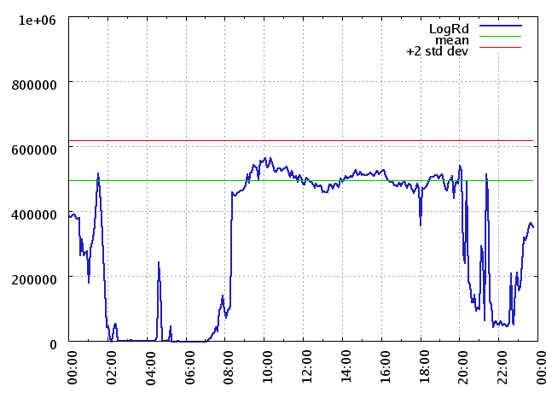
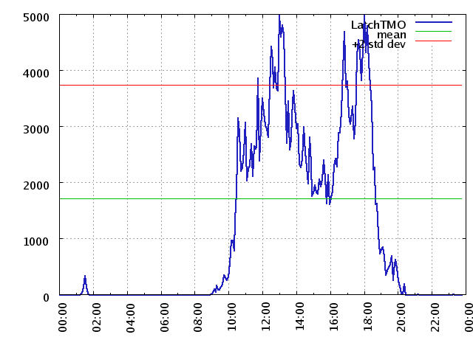
Baseline
Logical Reads
“The Wall”
Latch Timeouts

Slide 49
Case Study
Two tables, one with just 16 records in it, the other with less than 100,000 were being read 1.25 billion times per day – 20% of read activity.

Slide 50
Case Study
Two tables, one with just 16 records in it, the other with less than 100,000 were being read 1.25 billion times per day – 20% of read activity.
Fixing the code is not a viable option.
A few other (much less egregious) candidates for B2 were also identified.

Slide 51
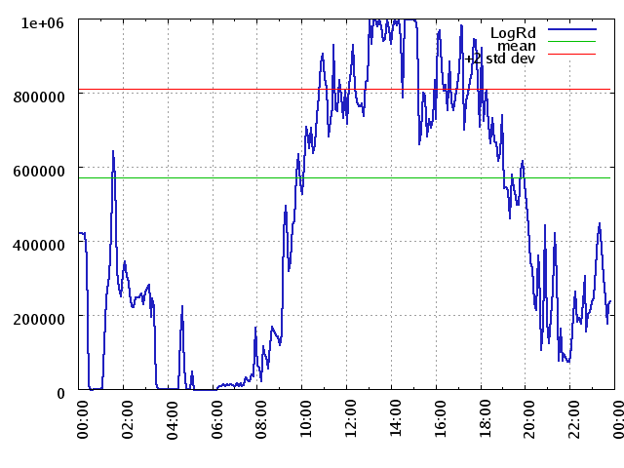
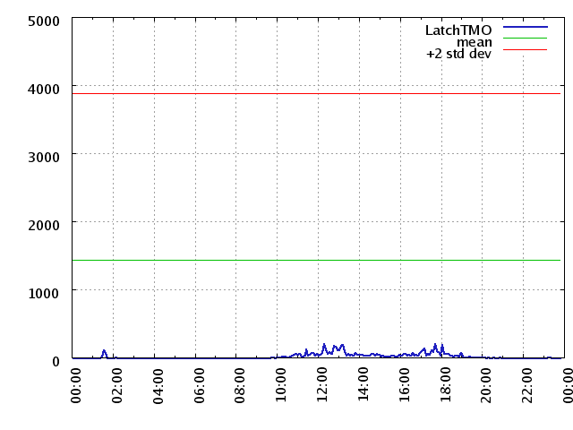
Baseline -B2
Logical Reads
Latch Timeouts

Slide 52
Post Mortem
Peak throughput doubled.
Average throughput improved +50%.
Latch Waits vanished.
System Time as % of CPU time was greatly reduced.
The company has been able to continue to grow!
Notes:
(A certain “other vendor” was shown to have sold the customer 3x more hardware than they really needed…)

Slide 53
Summary
The improvement from increasing –B is proportional to the square root of the size of the increase.
Increase –B by 4x, reduce IO ops to ½.
-B2 can be a powerful tool in the tuning toolbox IF you have a latch contention problem.
But -B2 is not a cure-all.

Slide 54
Questions?
Notes:
So I should get enough memory to put the entire db into –B2?
Is B2 for everyone?
What if my objects are too big for B2?
What about LOBs?
What about other latches?
What if I am still having latch contention problems?
Why are there only 2 buffer pools? Why can’t there be X buffer pools?
What else is B2 good for?

Slide 55
Thank-you!
Don’t forget your surveys!

