Slide 1

Performance Tuning Workshop - Architecture
Adam Backman
President and Pretty Nice Guy
White Star Software, LLC

Slide 2
Overview
OpenEdge Architecture
  Shared memory
  Server-less
  Multi-server
Networking
  Primary broker
    Splitting clients across servers
  Secondary broker
    Splitting clients across brokers

Slide 3
Overview
Database block size
Setting records per block
Using OE Type II Storage areas

Slide 4
Overview
Disk Stuff
Use RAID 10
Use large stipe widths
Match OpenEdge and OS block size

Slide 5
Architecture
I think Ms. Monroe’s architecture is extremely good architecture
-Frank Lloyd Wright

Slide 6
OpenEdge Memory Architecture
Shared memory
Server-less
Multi-server
Multi-broker

Slide 7
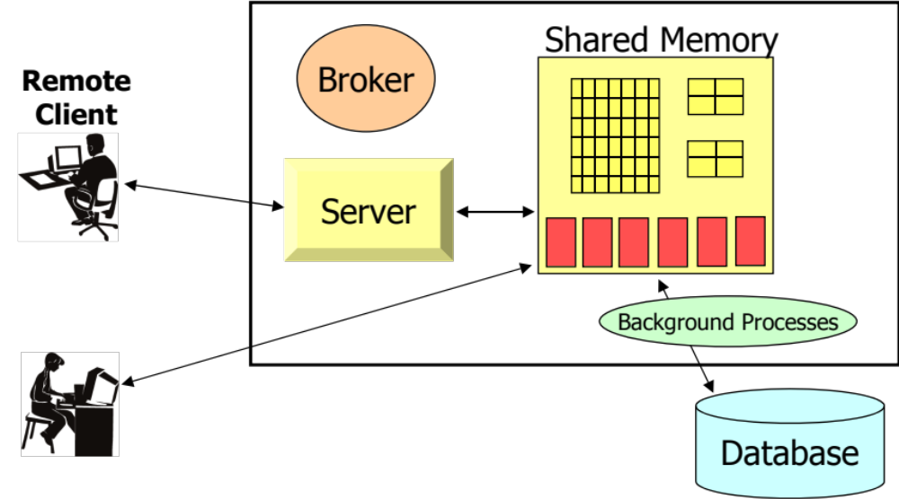
OpenEdge Memory Architecture
7
Notes:
Notes:
The listen socket “listens” for requests for connection to come in over the network and then spawns servers or connects the user to an existing server for the duration of their session. All subsequent requests from that session will be directed to the server.
A session will maintain a connection to a single server until it is disconnected.

Slide 8
OpenEdge Network Architecture
Primary broker
  Splitting clients across servers
Secondary broker
  Splitting clients across brokers

Slide 9
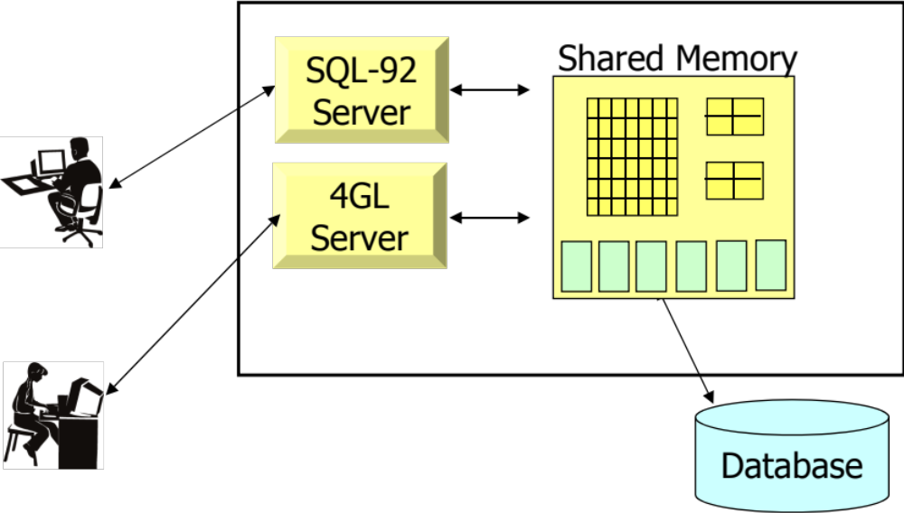
OpenEdge Architecture Client/Server Overview
The OpenEdge Server
  A process that accesses the database for 1 or more remote clients
9
Notes:
Notes:

Slide 10
OpenEdge Storage Considerations
Database block size
Setting records per block
Type II Storage areas

Slide 11
Database Block Size
Generally, 8k works best for Unix/Linux
4k works best for Windows
Remember to build filesystems with larger block sizes (match if possible)
There are exceptions so a little testing goes a long way but if in doubt use the above guidelines

Slide 12
Determining Records per Block
Determine “Mean” record size
  Use proutil <dbname> -C dbanalys
Add 20 bytes for record and block overhead
Divide this product into your database block size
Choose the next HIGHER binary number
  Must be between 1 and 256
Notes:
Notes:

Slide 13
Example: Records /Block
Mean record size = 90
Add 20 bytes for overhead (90 + 20 = 110)
Divide product into database blocksize
  8192 ÷ 110 = 74.47
Choose next higher binary number 128
Default records per block is 64 in version 9 and 10
Notes:
Notes:
If you choose the next higher binary number for records per block you ensure that your blocks will be full. Choosing the next lower number would use all of the “slots” before filling the block. This would waste space (empty portion of block could not be used) and reduce performance (a request would get only 64 records when it could get 74 in the case above)

Slide 14
Records Type I Storage Areas
Data blocks are social
  They allow data from any table in the area to be stored within a single block
  Index blocks only contain data for a single index
Data and index blocks can be tightly interleaved potentially causing scatter

Slide 15
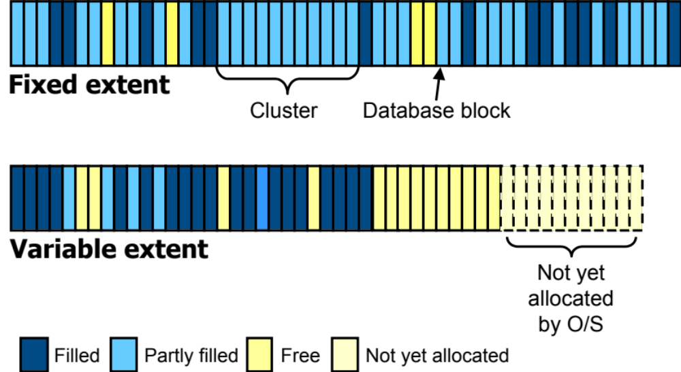
Database Blocks
Notes:
Notes:

Slide 16
Type II Storage Areas
Data is clustered together
A cluster will only contain records from a single table
A cluster can contain 8, 64 or 512 blocks
This helps performance as data scatter is reduced
Disk arrays have a feature called read-ahead that really improves efficiency with type II areas.
Notes:
Records/Block Blocks/Cluster Min records
---------------------------+----------------------------------+--------------------------------
32 | 8 | 256
32 | 64 | 2048
32 | 512 | 16384
---------------------------+----------------------------------+--------------------------------
64 | 8 | 512
64 | 64 | 4096
64 | 512 | 32768
---------------------------+----------------------------------+--------------------------------
128 | 8 | 1024
128 | 64 | 8192
128 | 512 | 65536
---------------------------+----------------------------------+--------------------------------
256 | 8 | 2048
256 | 64 | 16384
256 | 512 | 131072

Slide 17
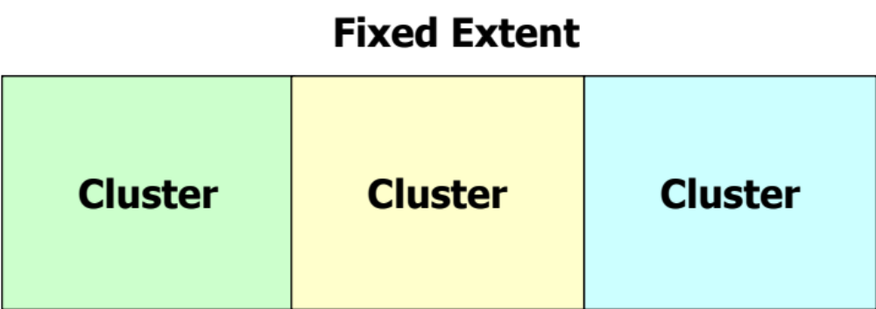
Type II Clusters
Order Index
Customer
Order
Notes:
Notes:
Each cluster will only contain one type of object (table, index)

Slide 18
Storage Areas Compared
Type I
Type II
Data Block
Data Block
Index Block
Data Block
Data Block
Data Block
Index Block
Index Block
Data Block
Index Block
Data Block
Data Block
Data Block
Data Block
Data Block
Data Block
Data Block
Data Block
Index Block
Index Block

Slide 19
Operating System Storage Considerations
Use RAID 10
Avoid RAID5 (There are exceptions)
Use large stripe widths
Match OpenEdge and OS block size

Slide 20
Causes of Disk I/O
Database
  User requests (Usually 90% of total load)
  Updates (This affects DB, BI and AI)
Temporary file I/O - Use as a disk utilization leveler
Operating system - usually minimal provided enough memory is installed
Other I/O

Slide 21
Disks
This is where to spend your money
Goal: Use all disks evenly
Buy as many physical disks as possible
RAID 5 is still bad in many cases, improvements have been made but test before you buy as there is a performance wall out there and it is closer with RAID 5

Slide 22
Disks – General Rules
Use RAID 10 (0+1) or Mirroring and Striping for best protection of data with optimal performance for the database
For the AI and BI RAID 10 still makes sense in most cases. Exception: Single database environments

Slide 23
Performance Tuning
General tuning methodology
Get yourself in the ballpark
Get baseline timings/measurements
Change one thing at a time to understand value of each change
This is most likely the only thing where we all agree 100%

Slide 24
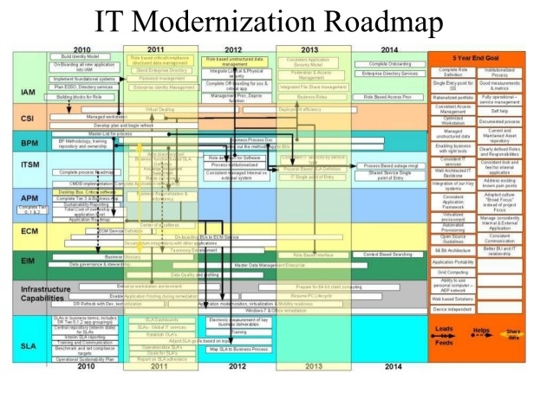
Remember: Tuning is easy just follow our simple plan

Slide 25

Performance
Tuning
Basics
(Very basic)
Gus Björklund
PUG Challenge Americas, Westford, MA
Database Workshop, 5 June 2011

Slide 26
A Rule of Thumb
The only "rule of thumb"
that is always valid is this one.
I am now going to give you some other ones.

Slide 27
Subjects
Out of the box performance
Easy Things To Do
Results
Try It For Yourself

Slide 28
First Things First
>
> probkup foo
>

Slide 29
The ATM benchmark ...
The Standard Secret Bunker Benchmark
  baseline config always the same since Bunker#2
Simulates ATM withdrawal transaction
150 concurrent users
  execute as many transactions as possible in given time
Highly update intensive
  Uses 4 tables
  fetch 3 rows
  update 3 rows
  create 1 row with 1 index entry

Slide 30
The ATM database
the standard baseline setup
account rows | 80,000,000
teller rows | 80,000
branch rows | 8,000
data block size | 4 k
database size | ~ 12 gigabytes
maximum rows per block | 64
allocation cluster size | 512
data extents | 6 @ 2 gigabytes
bi blocksize | 16 kb
bi cluster size | 16384

Slide 31
The ATM baseline configuration
-n 250 # maximum number of connections
-S 5108 # broker's connection port
-Ma 2 # max clients per server
-Mi 2 # min clients per server
-Mn 100 # max servers
-L 10240 # lock able entries
-Mm 16384 # max TCP message size
-maxAreas 20 # maximum storage areas
-B 64000 # primary buffer pool number of buffers
-spin 10000 # spinlock retries
-bibufs 32 # before image log buffers

Slide 32
“Out of the Box” ATM Performance
>
> proserve foo
>

Slide 33
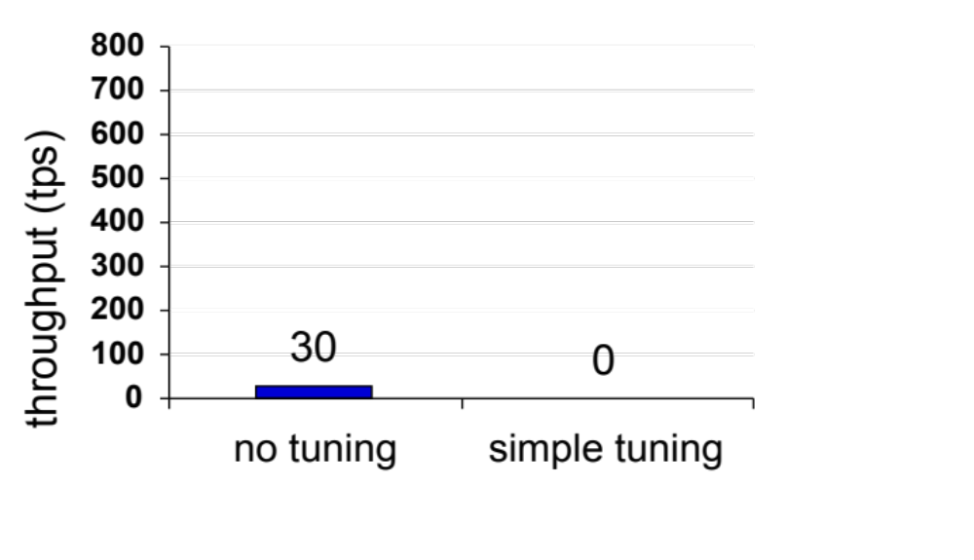
“Out of the box” Performance
YMMV. Box, transportation, meals, and accomodations not included

Slide 34
Some EASY Things
To Do
For Better Results

Slide 35
1: Buffer Pool Size
>
> proserve foo -B 32000
>

Slide 36
2: Spinlock retry count
>
> proserve foo -B 32000 -spin 5000
>

Slide 37
3: Start BI Log Writer (BIW)
>
> proserve foo -B 32000 -spin 5000
> probiw foo
>

Slide 38
4: Start Async Page Writer (APW)
>
> proserve foo -B 32000 -spin 5000
> probiw foo
> proapw foo
> proapw foo
>

Slide 39
5: Increase BI Log Block Size
>
> proutil foo -C truncate bi \
> -biblocksize 8
> proserve foo -B 32000 -spin 5000
> probiw foo
> proapw foo
> proapw foo
>

Slide 40
6: Increase BI Log Cluster Size
>
> proutil foo -C truncate bi \
> -biblocksize 8 -bi 4096
> proserve foo -B 32000 -spin 5000
> probiw foo
> proapw foo
> proapw foo
>

Slide 41
7: Add BI Log buffers
>
> proutil foo -C truncate bi \
> -biblocksize 8 -bi 4096
> proserve foo -B 32000 -spin 5000 \
> -bibufs 25
> probiw foo
> proapw foo
> proapw foo
>

Slide 42
8: Fix Database Disk Layout
here everything on same disk, maybe with other stuff
d "Schema Area" /home/gus/atm/atm.d1
d "atm":7,64;512 /home/gus/atm/atm_7.d1 f 2000000
d "atm":7,64;512 /home/gus/atm/atm_7.d2 f 2000000
d "atm":7,64;512 /home/gus/atm/atm_7.d3 f 2000000
d "atm":7,64;512 /home/gus/atm/atm_7.d4 f 2000000
d "atm":7,64;512 /home/gus/atm/atm_7.d5 f 2000000
d "atm":7,64;512 /home/gus/atm/atm_7.d6 f 2000000
d "atm":7,64;512 /home/gus/atm/atm_7.d7
b /home/gus/atm/atm.b1

Slide 43
8: Move Data Extents to Striped Array
d "Schema Area" /home/gus/atm/atm.d1
d "atm":7,64;512 /array/atm_7.d1 f 2000000
d "atm":7,64;512 /array/atm_7.d2 f 2000000
d "atm":7,64;512 /array/atm_7.d3 f 2000000
d "atm":7,64;512 /array/atm_7.d4 f 2000000
d "atm":7,64;512 /array/atm_7.d5 f 2000000
d "atm":7,64;512 /array/atm_7.d6 f 2000000
d "atm":7,64;512 /array/atm_7.d7
b /home/gus/atm/atm.b1

Slide 44
9: Move BI Log To Separate Disk
d "Schema Area" /home/gus/atm/atm.d1
d "atm":7,64;512 /array/atm_7.d1 f 2000000
d "atm":7,64;512 /array/atm_7.d2 f 2000000
d "atm":7,64;512 /array/atm_7.d3 f 2000000
d "atm":7,64;512 /array/atm_7.d4 f 2000000
d "atm":7,64;512 /array/atm_7.d5 f 2000000
d "atm":7,64;512 /array/atm_7.d6 f 2000000
d "atm":7,64;512 /array/atm_7.d7
b /bidisk/atm.b1

Slide 45
Can you predict the results ?

Slide 46
Now Our Results Are
YMMV. Transportation, meals, and accomodations not included

Slide 47
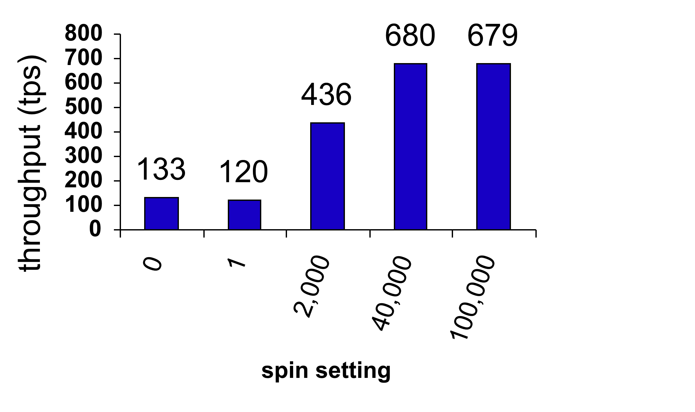
Effect of Tuning -spin

Slide 48
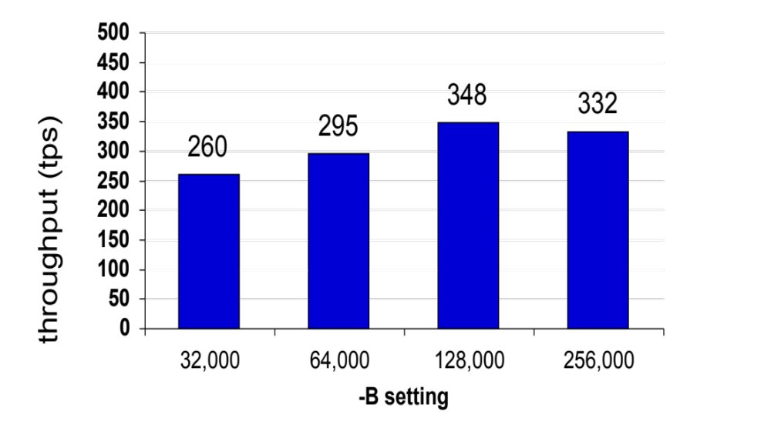
Effect of Tuning -B

Slide 49
?
Next, the lab,
but first:
Questions

Slide 50


Big B
Database Performance Tuning Workshop

Slide 51
A Few Words about the Speaker
Tom Bascom; free-range Progress coder & roaming DBA since 1987
VP, White Star Software, LLC
  Expert consulting services related to all aspects of Progress and OpenEdge.
  tom@wss.com
President, DBAppraise, LLC
  Remote database management service for OpenEdge.
  Simplifying the job of managing and monitoring the world’s best business applications.
  tom@dbappraise.com
Notes:
I have been working with Progress since 1987
… and today I am both President of DBAppraise;
The remote database management service…
where we simplify the job of managing and monitoring the worlds best business applications;
and Vice President of White Star Software;
where we offer expert consulting services covering all aspects of Progress and OpenEdge.

Slide 53
What is a “Buffer”?
A database “block” that is in memory.
Buffers (blocks) come in several flavors:
  Type 1 Data Blocks
  Type 2 Data Blocks
  Index Blocks
  Master Blocks

Slide 54
Block Layout
Block’s DBKEY
Type
Chain
Backup Ctr
Block’s DBKEY
Type
Chain
Backup Ctr
Next DBKEY in Chain
Block Update Counter
Next DBKEY in Chain
Block Update Counter
Num
Dirs.
Free
Dirs.
Free Space
Rec 0 Offset
Rec 1 Offset
Top
Bot
Index No.
Reserved
Rec 2 Offset
Rec n Offset
Num Entries
Bytes Used
Dummy Entry . . .
Free Space
. . . Compressed Index Entries . . .
Used Data Space
…….
row 1
. . . Compressed Index Entries . . .
row 2
Free Space
row 0
Data Block
Index Block

Slide 55
Type 1 Storage Area
Block 1
1 | Lift Tours |  |  | Burlington
3 | 66 | 9/23 | 9/28 | Standard Mail
1 | 1 | 54 | 4.86 | Shipped
1 | 2 | 55 | 23.85 | Shipped
Block 3
14 | Cologne |  |  | Germany
2 | Upton Frisbee |  |  | Oslo
1 | Koberlein |  |  | Kelly
1 | 53 | 1/26 | 1/31 | FlyByNight
Block 2
1 | 3 | 53 | 8.77 | Shipped
2 | 1 | 19 | 2.75 | Shipped
2 | 2 | 49 | 6.78 | Shipped
2 | 3 | 13 | 10.99 | Shipped
Block 4
BBB |  | Brawn, Bubba B. |  | 1,600
DKP |  | Pitt, Dirk K. |  | 1,800
4 | Go Fishing Ltd |  | Harrow
16 | Thundering Surf Inc. |  | Coffee City
Notes:
Of course Progress databases store all data as variable length fields so this “block layout” is a bit misleading – row lengths rarely come out so even ;)

Slide 56
Type 2 Storage Area
Block 1
1 | Lift Tours | Burlington
2 | Upton Frisbee | Oslo
3 | Hoops | Atlanta
4 | Go Fishing Ltd | Harrow
Block 3
9 | Pihtiputaan Pyora | Pihtipudas
10 | Just Joggers Limited | Ramsbottom
11 | Keilailu ja Biljardi | Helsinki
12 | Surf Lautaveikkoset | Salo
Block 2
5 | Match Point Tennis | Boston
6 | Fanatical Athletes | Montgomery
7 | Aerobics | Tikkurila
8 | Game Set Match | Deatsville
Block 4
13 | Biljardi ja tennis | Mantsala
14 | Paris St Germain | Paris
15 | Hoopla Basketball | Egg Harbor
16 | Thundering Surf Inc. | Coffee City
Notes:
Of course Progress databases store all data as variable length fields so this “block layout” is a bit misleading…

Slide 57
What is a “Buffer Pool”?
A Collection of Buffers in memory that are managed together.
A storage object (table, index or LOB) is associated with exactly one buffer pool.
Each buffer pool has its own control structures which are protected by “latches”.
Each buffer pool can have its own management policies.

Slide 58
Why are Buffer Pools
Important?

Slide 59
Locality of Reference
When data is referenced there is a high probability that it will be referenced again soon.
If data is referenced there is a high probability that “nearby” data will be referenced soon.
Locality of reference is why caching exists at all levels of computing.
Notes:
Local variables & temp-tables, -B, filesystem cache, SAN cache, controllers, disks, CPU L1 & L2 caches…

Slide 60
Which Cache is Best?
Layer | Time | # of Recs | # of Ops | Cost per Op | Relative
Progress 4GL to –B | 0.96 | 100,000 | 203,473 | 0.000005 | 1
-B to FS Cache | 10.24 | 100,000 | 26,711 | 0.000383 | 75
FS Cache to SAN | 5.93 | 100,000 | 26,711 | 0.000222 | 45
-B to SAN Cache | 11.17 | 100,000 | 26,711 | 0.000605 | 120
SAN Cache to Disk | 200.35 | 100,000 | 26,711 | 0.007500 | 1500
-B to Disk | 211.52 | 100,000 | 26,711 | 0.007919 | 1585
Notes:
Sequential reads, no –B2, hit ratio 87%

Slide 61
What is the “Hit Ratio”?
The percentage of the time that a data block that you access is already in the buffer pool.*
To read a single record you probably access 1 or more index blocks as well as the data block.
If you read 100 records and it takes 250 accesses to data & index blocks and 25 disk reads then your hit ratio is 10:1 – or 90%.
* Astute readers may notice that a percentage is not actually a “ratio”.

Slide 62
How to “fix” your Hit Ratio…
/* fixhr.p -- fix a bad hit ratio on the fly */
define variable target_hr as decimal no-undo format ">>9.999".
define variable lr as integer no-undo.
define variable osr as integer no-undo.
form target_hr with frame a.
function getHR returns decimal ().
define variable hr as decimal no-undo.
find first dictdb._ActBuffer no-lock.
assign
hr = ((( _Buffer-LogicRds - lr ) - ( _Buffer-OSRds - osr )) /
( _Buffer-LogicRds - lr )) * 100.0
lr = _Buffer-LogicRds
osr = _Buffer-OSRds
.
return ( if hr > 0.0 then hr else 0.0 ).
end.

Slide 63
How to “fix” your Hit Ratio…
do while lastkey <> asc( “q” ):
if lastkey <> -1 then update target_hr with frame a.
readkey pause 0.
do while (( target_hr - getHR()) > 0.05 ):
for each _field no-lock: end.
diffHR = target_hr - getHR().
end.
etime( yes ).
do while lastkey = -1 and etime < 20: /* pause 0.05 no-message. */
readkey pause 0.
end.
end.
return.
Notes:
Efficiency is obviously not an objective here…

Slide 64
Isn’t “Hit Ratio” the Goal?
No. The goal is to make money*.
But when we’re talking about improving db performance a common sub-goal is to minimize IO operations.
Hit Ratio is an indirect measure of IO operations and it is often misleading as performance indicator.
“The Goal” Goldratt, 1984; chapter 5

Slide 65
Misleading Hit Ratios
Startup.
Backups.
Very short samples.
Overly long samples.
Low intensity workloads.
Pointless churn.

Slide 66
Big B, Hit Ratio
Disk IO and Performance
MissPct = 100 * ( 1 – ( LogRd – OSRd ) / LogRd ))
m2 = m1 * exp(( b1 / b2 ), 0.5 )
98.5%
98%
95%
90.0%
95% = plenty of room for improvement
Notes:
If you have a workload of 100,000 logical reads/sec and a 95% HR…
You might think that is “good enough” – but there is plenty of room for improvement.
You can easily make things a lot worse by making –B even just a bit smaller.
But to make them better you have to increase –B *substantially*.

Slide 67
Hit Ratio Summary
If you must have a “rule of thumb” for HR:
    90% terrible.
    95% plenty of room for improvement.
    98% “not bad”.
The performance improvement from improving HR comes from reducing disk IO.
Thus, “Hit Ratio” is not the metric to tune.
In order to reduce IO operations to one half the current value –B needs to increase 4x.

Slide 68
Exercises

Slide 69
Exercise 0 - step 1
# . pro102b_env
# cd /home/pace
# proserve waste –B 3250000
# start0.0.sh
OpenEdge Release 10.2B03 as of Thu Dec 9 19:15:20 EST 2010
16:42:02 BROKER The startup of this database requires . . .
16:42:02 BROKER 0: Multi-user session begin. (333)
16:42:02 BROKER 0: Before Image Log Initialization . . .
16:42:02 BROKER 0: Login by root on /dev/pts/0. (452)
# pace.sh s2k0
. . .

Slide 70
Exercise 0 - step 2
┌──────────────────────────────────────┐
│Target Sessions: 10 │
│ │
│ Target Create: 50/s │
│ Target Read: 10,000/s │
│ Target Update: 75/s │
│ Target Delete: 25/s │
│ │
│ Q = Quit, leave running. │
│ │
│ X = Exit & shutdown. │
│ │
│ E = Exit to editor, leave running. │
│ │
│ R = Run Report workload. │
│ │
│ M = More, start more sessions. │
│ │
│ │
│ Option: __ │
└──────────────────────────────────────┘

Slide 71
Exercise 0 - step 3
In a new window:
# . pro102b_env
# cd /home/pace
# protop s2k0
. . .

Slide 72
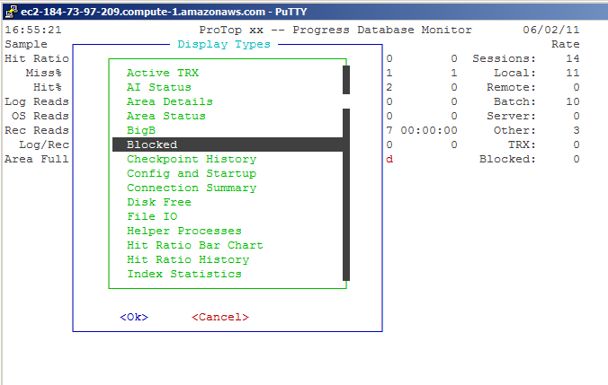
Exercise 0 - step 4
Type “d”, then “b”, then <space>, then ^X:

Slide 73
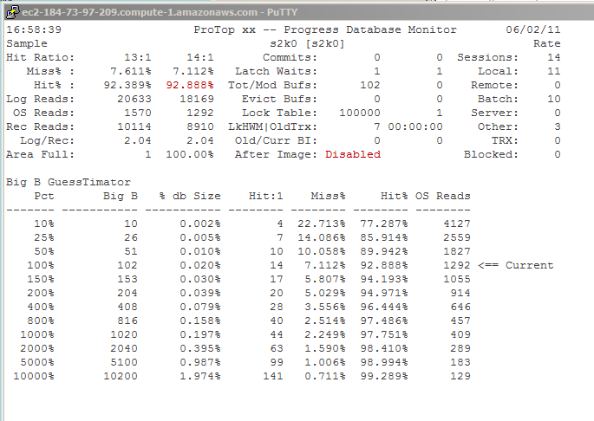
Exercise 0 - step 5

Slide 74
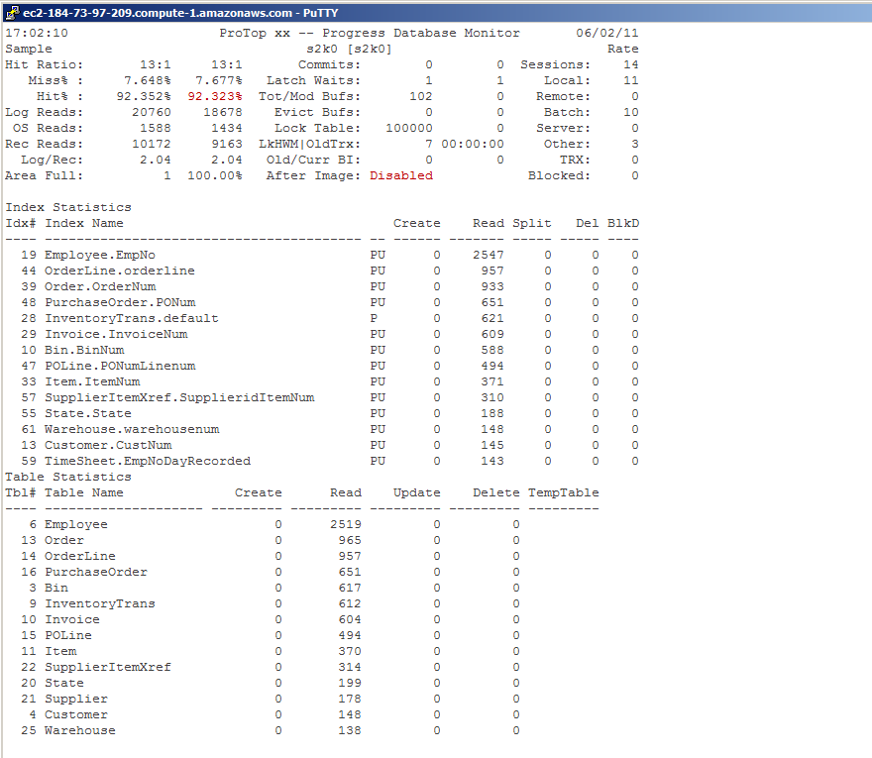
Exercise 0 - step 6
Type “d”, then “b”, then <space>, then “i”, then <space>, then “t”, arrow to “table statistics”, then <space> and finally ^X:

Slide 75
Exercise 0 - step 7
On the “pace” menu, select “r”:
repOrder repLines repSales
otherOrder otherLines otherSales
──────────────────────────────────────────────────
20,436 247,478 $2,867,553,227.50
11,987 145,032 $1,689,360,843.35
Elapsed Time: 172.8 sec
-B: 102 -B2: 0
LRU: 47,940/s LRU2: 0/s
LRU Waits: 3/s LRU2 Waits: 0/s
-B Log IO: 47,928/s -B2 Log IO: 0/s
-B Disk IO: 3,835/s -B2 Disk IO: 0/s
-B Hit%: 92.00% -B2 Hit%: ?
My Log IO: 5,931/s
My Disk IO: 654/s
My Hit%: 88.97%

Slide 76

PUG Challenge USA
Performance Tuning Workshop
Latching
Dan Foreman
Progress Expert, BravePoint

Slide 77
Introduction – Dan Foreman
Progress User since 1984 (longer than Gus)
Since Progress Version 2 (there was no commercial V1)
Presenter at a few Progress Conferences

Slide 78
Introduction – Dan Foreman
Publications
  Progress Performance Tuning Guide
  Progress Database Administration Guide
  Progress Virtual System Tables
  Progress V10 DBA Jumpstart

Slide 79
Introduction – Dan Foreman
Utilities
  ProMonitor – Database monitoring
  ProCheck – AppServer/WebSpeed monitoring
  Pro Dump&Load – Dump/load with minimum downtime
  Balanced Benchmark – Load testing tool

Slide 80
Apology
Due to a flurry of chaos in my life the last few weeks, I prepared this presentation while riding an airport shuttle at 4am in the morning….

Slide 81
Terminology
Latch
Latch Timeout (seen in promon)
Spinlock Retries (-spin)

Slide 82
Server Components
CPU – The fastest component
Memory – a distant second
Disk – an even more distant third
Exceptions exist but this hierarchy is almost always true

Slide 83
CPU
Even with the advent of more sophisticated multi-core CPUs, the basic principle of a process being granted a number of execution cycles scheduled by the operating system

Slide 84
Latches
Exist to prevent multiple processes from updating the same resource at the same time
Similar in concept to a record lock
Example: only one process at a time can update the active output BI Buffer (it’s one reason why only one BIW can be started)

Slide 85
Latches
Latches are held for an extremely short duration of time
So activities that might take an indeterminate amount of time (a disk I/O for example) are not controlled with latches

Slide 86
-spin 0
Default prior to V10 (AKA OE10)
User 1 gets scheduled ‘into’ the CPU
User 1 needs a latch
User 2 is already holding that latch
User 1 gets booted from the CPU into the Run Queue (come back and try again later)

Slide 87
-spin <non-zero>
User 1 gets scheduled into the CPU
User 1 needs a latch
User 2 is already holding that latch
Instead of getting booted, User 1 goes into a loop (i.e. spins) and keeps trying to acquire the latch for up to –spin # of times

Slide 88
-spin <non-zero>
Because User 2 only holds the latch for a short time there is a chance that User 1 can acquire the latch before running out of allotted CPU time
The cost of using spin is some CPU time is wasted doing “empty work”

Slide 89
Latch Timeouts
Promon R&D > Other > Performance Indicators
Perhaps a better label would be “Latch Spinouts”
Number of times that a process spun –spin # of times but didn’t acquire the Latch

Slide 90
Latch Timeouts
Doesn’t record if the CPU Quanta pre-empts the spinning (isn’t that a cool word?)

Slide 91
Thread Quantum
How long a thread (i.e. process) is allowed to keep hold of the CPU if:
  It remains runnable
  The scheduler determines that no other thread needs to run on that CPU instead
Thread quanta are generally defined by some number of clock ticks

Slide 92
How to Set Spin
Old Folklore (10000 * # of CPUs)
Ballpark (1000-50000)
Benchmark
The year of your birthday * 3.14159

Slide 93
Exercise
Do a run with –spin 0
Do another run with a non-zero value of spin
Percentage of change?

Slide 94

PUG Challenge Americas
Performance Tuning Workshop
After Imaging
PAUL KOUFALIS
PRESIDENT
PROGRESSWIZ CONSULTING

Slide 95
Progresswiz Consulting
Based in Montréal, Québec, Canada
Providing technical consulting in Progress®, UNIX, Windows, MFG/PRO and more
Specialized in
  Security of Progress-based systems
  Performance tuning
  System availability
  Business continuity planning

Slide 96
Extents - Fixed versus variable
In a low tx environment there should be no noticeable difference
  Maybe MRP will take a 1-2% longer
  Human speed tx will never notice
Best practice = fixed
  AIFMD extracts only active blocks from file
  See rfutil –C aimage extract

Slide 97
Extent Placement - Dedicated disks?
Classic arguments:
  Better I/O to dedicated disks
  Can remove physical disks in case of crash
Modern SANs negate both arguments
  My confrères may argue otherwise for high tx sites
For physical removal:
  Hello…you’re on the street with a hot swap SCSI disk and nowhere to put it

Slide 98
Settings – AI Block Size
16 Kb
  No brainer
  Do it before activating AI
  $ rfutil atm -C aimage truncate -aiblocksize 16
  After-imaging and Two-phase commit must be disabled before AI truncation. (282)
  $ rfutil atm -C aimage end
  $ rfutil atm -C aimage truncate -aiblocksize 16
  The AI file is being truncated. (287)
  After-image block size set to 16 kb (16384 bytes). (644)

Slide 99
Settings - aibufs
DB startup parameter
Depends on your tx volume
Start with 25-50 and monitor Buffer not avail in promon – R&D – 2 – 6.

Slide 100
Helpers - AIW
Another no-brainer
Enterprise DB required
$ proaiw <db>
Only one per db

Slide 101
ATM Workshop – Run 1
Add 4 variable length AI extents
Leave AI blocksize at default
Leave AIW=“no” in go.sh
Leave –aibufs at default
Enable AI and the AIFMD
Add –aiarcdir /tmp –aiarcinterval 300 to server.pf
This is worst case scenario

Slide 102
ATM Workshop – Run 2
Disable AI
Delete the existing variable length extents
Add 4 fixed length 50 Mg AI extents
Change AI block size to 16 Kb
Change AIW=“yes” in go.sh
Add –aibufs 50 in server.pf
Compare results

Slide 103
ATM Workshop – Run Results
No AI
Cl Time Trans Tps Conc Avg R Min R 50% R 90% R 95% R Max R
--- ---- ------ ------ ----- ----- ----- ----- ----- ----- -----
50 900 309493 343.9 48.0 0.1 0.0 0.1 0.3 0.5 3.1
Event Total Per Sec |Event Total Per Sec
Commits 332959 344.7 |DB Reads 436582 451.9
Undos 0 0.0 |DB Writes 184426 190.9
Record Reads 998874 1034.0 |BI Reads 4 0.0
Record Updates 998877 1034.0 |BI Writes 15952 16.5
Record Creates 332957 344.7 |AI Writes 0 0.0
Record Deletes 0 0.0 |Checkpoints 2 0.0
Record Locks 2663667 2757.4 |Flushed at chkpt 0 0.0
Record Waits 0 0.0 |Active trans 48
Rec Lock Waits 0 % BI Buf Waits 0 % AI Buf Waits 0 %
Writes by APW 100 % Writes by BIW 98 % Writes by AIW 0 %
DB Size: 19 GB BI Size: 1152 MB AI Size: 0 K
Empty blocks:1965372 Free blocks: 1144 RM chain: 2
Buffer Hits 93 % Primary Hits 93 % Alternate Hits 0 %

Slide 104
ATM Workshop – Run Results
Variable extents + AIW
Cl Time Trans Tps Conc Avg R Min R 50% R 90% R 95% R Max R
--- ---- ------ ------ ----- ----- ----- ----- ----- ----- -----
50 900 289131 321.3 50.0 0.2 0.0 0.1 0.4 0.6 5.6
Event Total Per Sec |Event Total Per Sec
Commits 319874 310.6 |DB Reads 472166 458.4
Undos 0 0.0 |DB Writes 154856 150.3
Record Reads 959193 931.3 |BI Reads 4 0.0
Record Updates 959152 931.2 |BI Writes 15359 14.9
Record Creates 319688 310.4 |AI Writes 30095 29.2
Record Deletes 0 0.0 |Checkpoints 2 0.0
Record Locks 2557766 2483.3 |Flushed at chkpt 0 0.0
Record Waits 0 0.0 |Active trans 0
Rec Lock Waits 0 % BI Buf Waits 0 % AI Buf Waits 0 %
Writes by APW 100 % Writes by BIW 94 % Writes by AIW 99 %
DB Size: 19 GB BI Size: 1152 MB AI Size: 52 MB
Empty blocks:1965372 Free blocks: 1144 RM chain: 2
Buffer Hits 92 % Primary Hits 92 % Alternate Hits 0 %

Slide 105
ATM Workshop – Run Results
Fixed extents + AIW
Cl Time Trans Tps Conc Avg R Min R 50% R 90% R 95% R Max R
--- ---- ------ ------ ----- ----- ----- ----- ----- ----- -----
50 900 310227 344.7 50.0 0.1 0.0 0.1 0.3 0.5 5.2
Event Total Per Sec |Event Total Per Sec
Commits 311800 332.4 |DB Reads 439748 468.8
Undos 0 0.0 |DB Writes 182776 194.9
Record Reads 935035 996.8 |BI Reads 4 0.0
Record Updates 934992 996.8 |BI Writes 13639 14.5
Record Creates 311620 332.2 |AI Writes 27058 28.8
Record Deletes 0 0.0 |Checkpoints 2 0.0
Record Locks 2493336 2658.1 |Flushed at chkpt 0 0.0
Record Waits 0 0.0 |Active trans 0
Rec Lock Waits 0 % BI Buf Waits 0 % AI Buf Waits 0 %
Writes by APW 100 % Writes by BIW 97 % Writes by AIW 99 %
DB Size: 19 GB BI Size: 1152 MB AI Size: 19 MB
Empty blocks:1965372 Free blocks: 1144 RM chain: 2
Buffer Hits 92 % Primary Hits 92 % Alternate Hits 0 %

Slide 106
ATM Workshop - Conclusion
No AI = 343.9 tps
AI + fixed extent + AIW = 344.7
Difference is “noise”
  I.e. there’s no difference
  And this is a high tx benchmark!

Slide 107

Questions?

