Slide 1
Rich Internet Applications:
Using Microsoft Silverlight with OpenEdge
Shelley Chase
Software Architect, OpenEdge
Progress Software Corporation

Slide 2
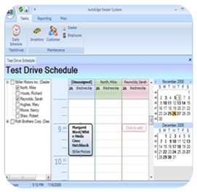
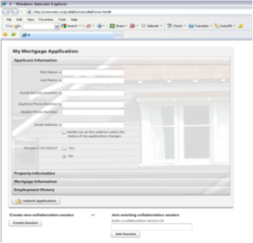
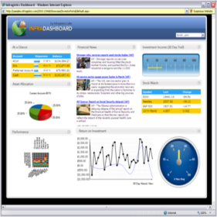
Rich Internet Applications – Three Models
Desktop application
  Richest UI
  Limited reach
  Full install over web
Browser plug-in application
  Richer UI
  Good reach
  Limited install
Native Web application
  Rich UI – Ajax
  Best reach
  No install

Slide 3

Rich Internet Applications – Three Models
Many Choices with OpenEdge
Desktop application
  GUI for .NET / Classic GUI (with WebClient)
  Character UI (with Terminal Services)
  Third party UI with Open Client for .NET/Java
Browser plug-in application
  Web application with
    Open Client for .NET/Java
    WebSpeed
    Web Services
Native Web application
  WebSpeed with Ajax features
  Web UI with Open Client for .NET/Java

Slide 4
RIA Desktop Application (“Smart Client”)
Available Technologies
Richest UI with full desktop integration
User productivity is top priority
UI requires a specific platform
  Limited reach
    Runs on local machine
    Runs remote using Terminal Services
Provisioned over the Web
  Automated install
  Automatic updates as needed
OE GUI for NET/GUI
OE GUIs w/WebClient
OE CHUI
MS WPF/WinForms
Java SWT/Swing
Adobe AIR
Native Apps (iPad…)
“Smart Client” From Wikipedia
http://en.wikipedia.org/wiki/Smart_client

Slide 5
RIA Browser Plug-in Application
Available Technologies
  Richer UI using proprietary browser plug-in
  Balance of UI richness and reach to users
  UI runs on limited platforms
  In web browser
  On local machine in a sandbox (off-line)
Microsoft Silverlight
Adobe Flash/Flex
“Flex\Flash\AIR vs. Silverlight: conquering the land of RIA”
http://www.yumasoft.com/node/49

Slide 6
RIA Native Browser Web Application
Available Technologies
  Rich UI with Ajax – asynchronous updates
  Lightweight Ajax
    Client-side libraries
  Heavyweight Ajax
    Server-side frameworks
  Reach as many users as possible
    Runs anywhere
UI is platform independent
  In web browser only
Lightweight Ajax
  ExtJS
  DOJO
  jQuery
  …
Heavyweight Ajax
  Google Web Toolkit
  Open Laslo
  ASP.NET Ajax
  …
Ruby on Rails
JSPs
“Which Open Source AJAX Framework is Right for You?”
http://www.mrbool.com/articles/viewcomp.asp?comp=5311

Slide 7
Rich Internet Applications:
Many Choices with OpenEdge
Desktop application
  GUI for .NET / Classic GUI (with WebClient)
  Character UI (with Terminal Services)
  Third party UI with Open Client for .NET/Java
Browser plug-in application
  Silverlight with
    Open Client for .NET/Java
    WebSpeed
    Web Services
Native Web application
  WebSpeed with Ajax features
  Ajax Framework with Open Client for .NET/Java

Slide 8

What is Microsoft Silverlight?
“A powerful development platform for creating engaging, interactive applications for the Web, desktop, and mobile devices”
Full-featured development environment
  High quality development tools
  Fully-supported; large user community
  Single full featured library familiar .NET programming model
  Robust, full-featured controls
Rich Internet Application (RIA) platform
  Rich, interactive user experience of the desktop
  Provisioned over the web
Cross platform, cross-browser runtime
  Free plug-in powered by .NET (~4 MB)
  Runs on non-Microsoft platforms
  Runs in and out of browser, online and off-line
Notes:
http://www.codeproject.com/KB/silverlight/QuestionsOnSilverlight.aspx
So what is Silverlight. Silverlight was first introduced in 2007. It is Microsoft’s next-generation Ui for the Web. Silverlight is defined by Microsoft as “A powerful development platform for creating engaging, interactive applications for the Web, desktop, and mobile devices.”
Lets look at what that means. Silverlight is “a powerful development platform“ because it is integrated into Microsoft’s Visual Studio IDE which has been a commercial product for almost 20 years. This environment has full technical support available unlike most open source products. The user base for .NET technologies is large and Silverlight is quickly becoming a UI technology of choice.
“Creating engaging and interactive applications” refers to rich internet applications. RIAs bring the best features of a desktop application with the best features of a web application. RIAs provide the rich, interactive nature of a desktop application and provision that application over the world wide web. With the reach of the web including cloud computing RIAs open up a new market for many applications that were only available as desktop applications especially within the SaaS application space. RIAs are is typically delivered with a web browser, either as web pages that run in a browser or by dowloading a browser plug-in such as Adobe Flash, Java or Microsoft Silverlight.
The last part of the definition means that Silverlight runs in many environments. It is a cross-platform cross-browser plug-in that supports most browsers including IE, Firefox, Safari and Google Chrome. The Silverlight runtime is also available to run out-of-the-browser in a sandbox environment and on some mobile devices such as Windows Mobile 7. With Silverlight you can building applications that wouldn’t be possible using only AJAX and HTML such as applications which integrate media, animation and text.

Slide 9
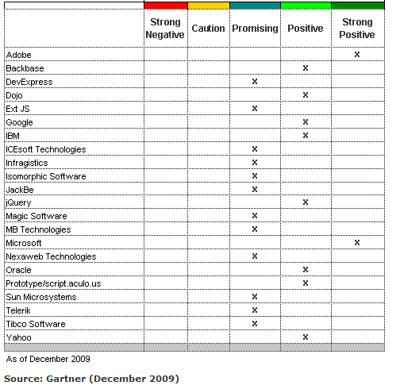
Gartner: MarketScope for Ajax and RIA Technologies
Evaluation criteria:
Product and Services
Product Strategy
Overall Viability
Sales Execution/Pricing
Market Responsiveness
Market Adoption/Interest
Ecosystem Activity
Technology Roadmap
http://www.gartner.com/technology/media-products/reprints/microsoft/vol13/article4/article4.html

Slide 10
But Isn’t Silverlight Dead?
“Silverlight is our development platform for Windows Phone…
“Our strategy has shifted, HTML is the only true cross platform solution for everything, including (Apple’s) iOS platform”
-Bob Muglia (Microsoft SVP)
“The purpose of Silverlight has never been to replace HTML, but rather to do the things that HTML can’t, and to do so in a way that’s easy for developers to use.
Make no mistake; we’ll continue to invest in Silverlight and enable developers to build great apps and experiences with it in the future.”
-Bob Muglia (Microsoft SVP)
http://team.silverlight.net/announcement/pdc-and-silverlight

Slide 11
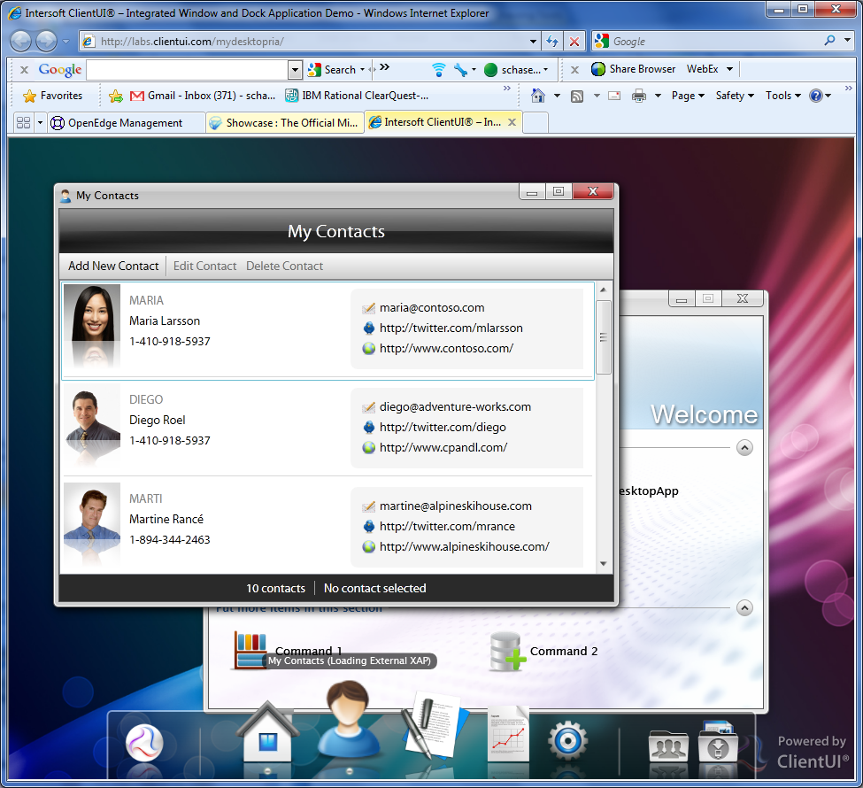
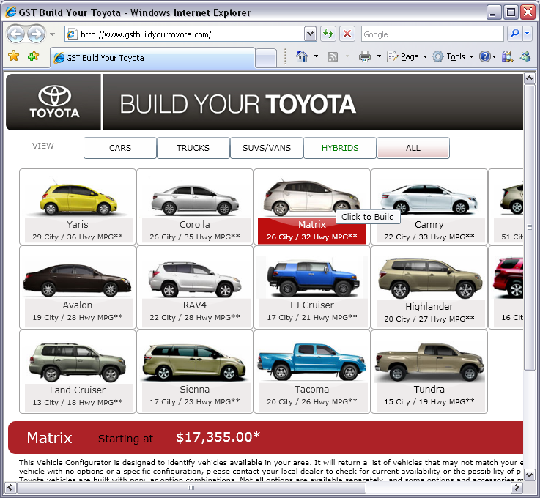
Silverlight Sample Applications: http://www.silverlight.net/showcase/
Notes:
http://www.gstbuildyourtoyota.com/
http://labs.clientui.com/mydesktopria/
http://www.bktsupply.com/

Slide 12
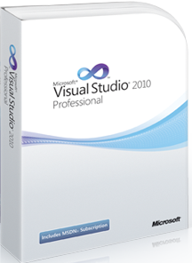

Silverlight Development and Designer Tools
Visual Studio
Expression Studio
Define application projects
Code for:
  Event handlers
  Data model
Build and test
WYSIWYG Designer
Shares project with Visual Studio
Notes:
The development of Silverlight applications are done using two separate tools – one for a graphical designer to build the UI layout and one for the developer to use to code the behavior of the UI.
The developer uses the standard Microsoft IDE- Visual Studio. In Visual Studio the developer defines the Silverlight project, write the event logic and data access code for the Silverlight application and tests the application on their local machine. The
The graphical designer uses Microsoft Expression Studio to build the user interface with a WYSIWYG page designer. They share the project definition created in Visual Studio by the developer. The terminology and layout of the tools is centered around a graphical designer rather than a developer.

Slide 13
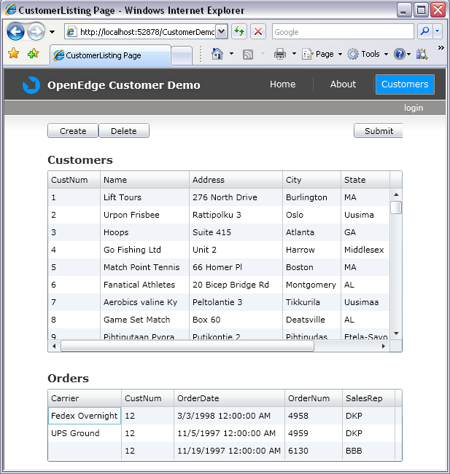
Visual Studio (Code) and Expression Studio (GUI) = Running Application
MainPage.xaml.cs
MainPage.xaml
C# Code
(Data / events)
XAML
(UI Layout)
Notes:
In the first project you can see that the new project wizard created two files automatically, App.xaml and MainPage.xaml. These files are written in Microsoft’s EXtensible Application Markup Language – or XAML (pronounced like “camel”). XAML is a declarative language that is used to define the layout of the UI. The components used in XAML are real user interface classes such as grids, tree view or edit boxes that can be validated at compile time.
One thing that needs to happen before we can run is code that will pull together the xaml elements with the C# code. This is done automatically when the project is built. The resulting code is put into a file with the extension .g.cs.
The C# file is often referred to as the “code-behind” file since it is the code that is behind the page. It is not necessary to read the code shown here. It is basically a partial class file that is implementing a Silverlight user control, loads the XAML layout file and is compiled with the rest of the class which is the code behind file that we would put event handlers into.
In our example, during the build a file called MainPage.g.cs is automatically generated to bring together the XAML layout and the C# code.

Slide 14
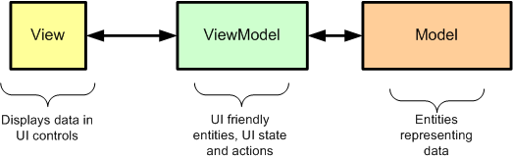
Silverlight Model-View-ViewModel (MVVM)
Your Views, View Models, and Models are all separate entities that are loosely coupled. They communicate with one another, but only through well defined interfaces
  View displays UI with data from the ViewModel
  ViewModel has Commands and ObservableCollections
  Model provides data – this can be your business layer
Notes:
The View holds a reference to the ViewModel. The View basically displays data by Binding to entities in the View Model
The ViewModel exposes Commands, Notifiable Properties, and Observable Collections to the View. The View Binds to these ViewModel entities/members
The Model is your data and or application objects that move data while applying Application Logic. If you have a Business Layer then you might not need this.

Slide 15
Silverlight Release Landscape
Version 1 & 2
Version 3
  First line-of-business release with data-centric controls (Grid)
  Developer responsible for communicating with middle-tier

Slide 16
Silverlight Release Landscape
Version 1 & 2
Version 3
  First line-of-business release with data-centric controls (Grid)
  Developer responsible for communicating with middle-tier
Version 4
  Released with WCF RIA Services V1.0
  Simplifies n-tier architecture with built-in network/data access
  Single UI source runs on desktop and web
  Drag and drop data binding

Slide 17
Silverlight Release Landscape
Version 1 & 2
Version 3
  First line-of-business release with data-centric controls (Grid)
  Developer responsible for communicating with middle-tier
Version 4
  Released with WCF RIA Services V1.0
  Simplifies n-tier architecture with built-in network/data access
  Single UI source runs on desktop and web
  Drag and drop data binding
Version 5 (In Beta now)
  Premium Media Experiences
  Business Application Development
    MVVM and Databinding enhancements for XAML
    Complex type support for WCF RIA Services

Slide 18
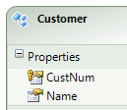
Use WCF RIA Services to Integrate Silverlight and OpenEdge
Treats n-tier applications as one logical application
  Hides plumbing of n-tier communication
  Built on top of WCF Services
    Supports Web Services, REST and binary .NET protocol
Middle-tier is just an ASP.NET program
  Needs IIS Web Server
  Can use Open Client for .NET proxies
Data model is Entity Framework
  Data model is shared by Silverlight
  Maps to ADO.NET datasets with a little work
Notes:
RIA Services is a set of end-to-end experiences that makes it as easy to build Silverlight based n-tier applications as it is to build traditional 2 tier apps – some would say that it’s basically the new paradigm for client-server development in the 21st century…
RIA Services focuses on writing n-tier apps by treating them as one logical application, a great way to achieve n-tier goodness from the architecture/pattern without the plumbing getting in your way.
RIA Services provides a pattern for encapsulating application logic on the middle tier that can be useful in a variety of scenarios. It is DAL-agnostic and available for Multiple presentation layers.

Slide 19
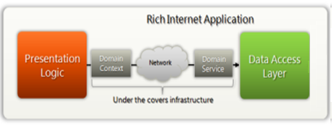
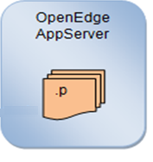
WCF RIA Services: Two Major Components
DomainContext
  Auto-generated at development
  Client-side proxy
  Hides all communication
DomainService
  Set of related operations as a service layer
  One per OERA business entity
    ProDataSet / Temp-table
  Server-side (on Web Server)
  Uses Open Client for .NET

Slide 20
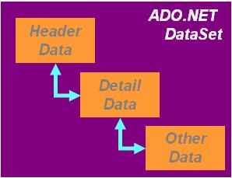
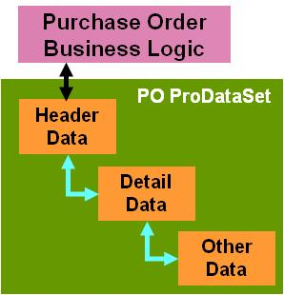
Order Entry Application in Silverlight:
Runtime Architecture
Browser
Web Server
OpenEdge AppServer
Web Server
.NET Open Client
.p
Customer.cs
Order.cs
Silverlight Runtime
CustomerDomain Service.cs
(DomainService)
.NET Open Client
.NET
binary
AppServer
binary
Business
Application. Web. g.cs (DomainContext)
ABLDomain Service.cs
(DomainService)
Notes:
Now that we can build a Silverlight application let’s look at one that can get data from OpenEdge. There are many ways to access the AppServer from Silverlight.

Slide 21
Demo:
Building an Order Entry Business Application in Silverlight

Slide 22
Order Entry Application in Silverlight:
Step 1: Generate .NET Proxy Using ProxyGen
GetCustOrders1.p
Open Client for .NET
C# AppObject
ADO.NET DataSet
DEFINE TEMP-TABLE ttCustomer
FIELD CustNum AS INT…
DEFINE TEMP-TABLE ttOrder
FIELD OrderNum AS INT
FIELD CustNum AS INT…
DEFINE DATASET CustOrders FOR
ttCustomer, ttOrder
DATA-RELATION CustOrd FOR
ttCustomer, ttOrder
RELATION-FIELDS (CustNum, CustNum ).
DEFINE OUTPUT PARAMETER DATASET FOR CustOrders.
…
void GetCustOrders1 ( OUTPUT CustOrdersDataSet )
{ …}
ProxyGen
class CustOrdersDataSet : DataSet
ttCustomerDataTable ttCustomer
DataColumn CustNumColumn …
ttOrderDataTable ttOrder
…

Slide 23
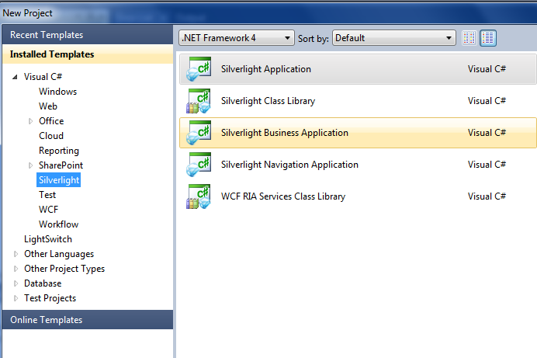
DEMO - Working in Visual Studio:
Create a Silverlight Business Application
Silverlight 4.0 Client + WCF RIA Services V1.0 SP1
http://blogs.msdn.com/b/brada/archive/2010/03/15/silverlight-4-ria-services-ready-for-business-index.aspx
http://www.silverlightshow.net/items/WCF-RIA-Services-Part-1-Getting-Started.aspx

Slide 24
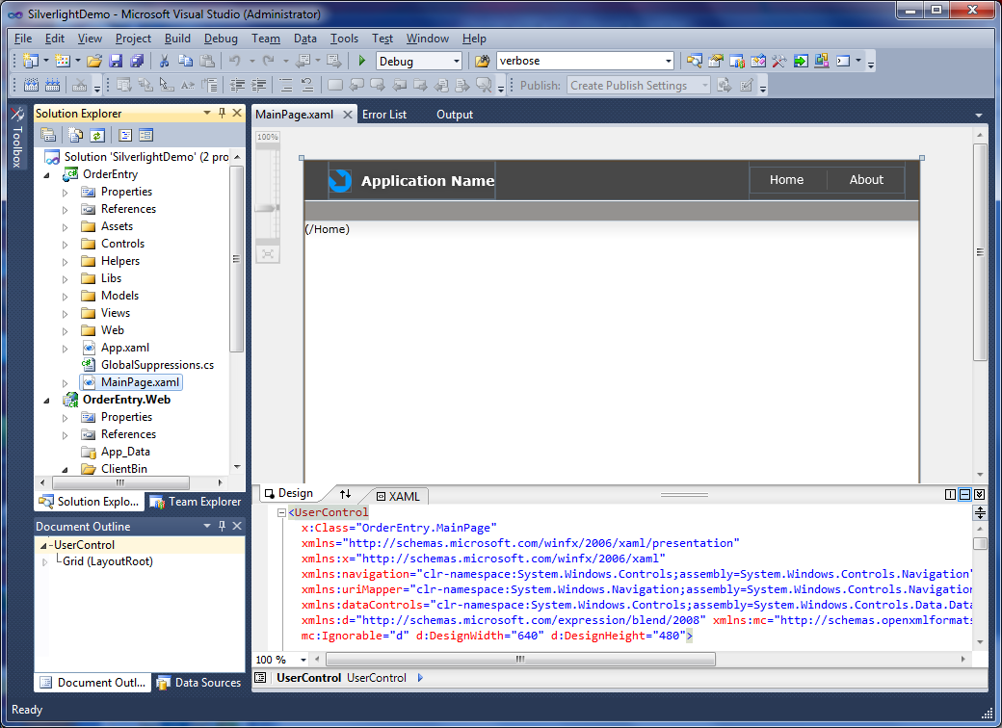
Silverlight Business Application:
In Visual Studio

Slide 25
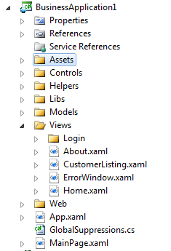
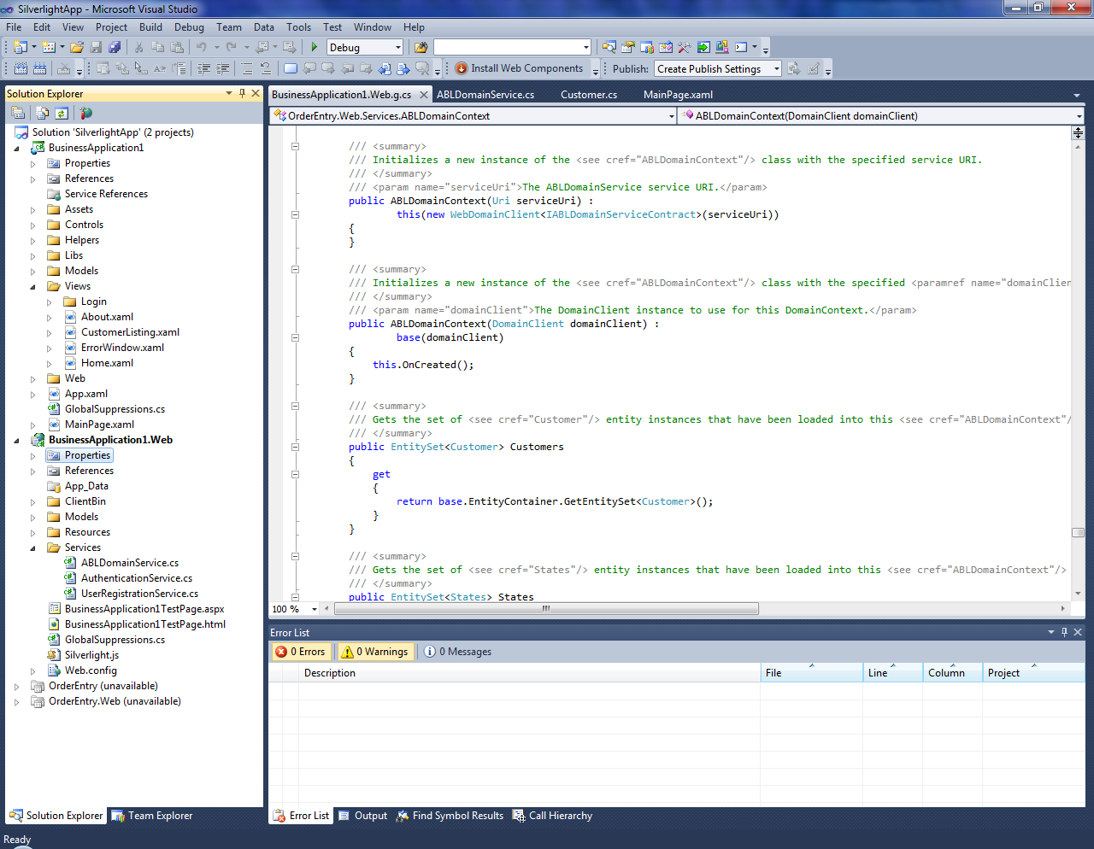
Silverlight Business Application:
Two Projects
Silverlight Client project BusinessApplication1
RIA Services project BusinessApplication1.Web

Slide 26
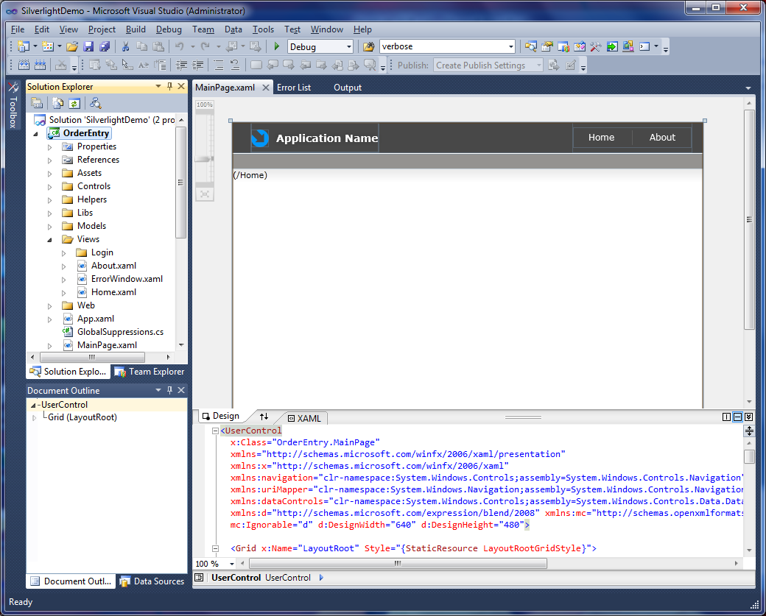
Silverlight Business Application:
Silverlight Client project – Runs on Client
Silverlight project – BusinessApplication1

Slide 27
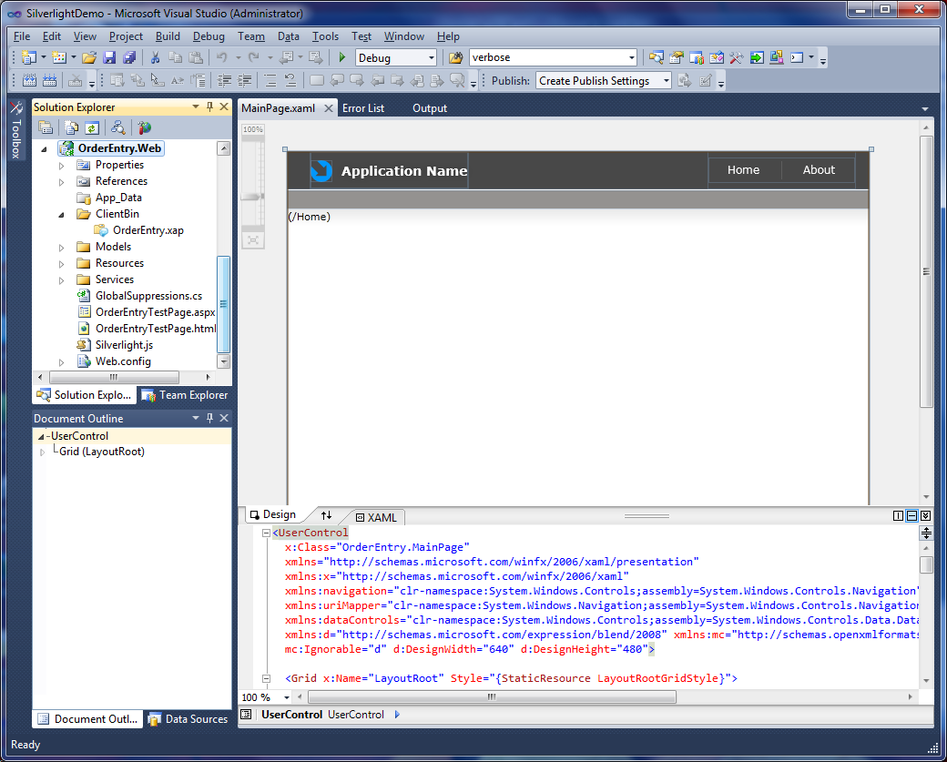
Silverlight Business Application:
RIA Services Project – Runs on Web Server
RIA Services project – BusinessApplication1.Web

Slide 28
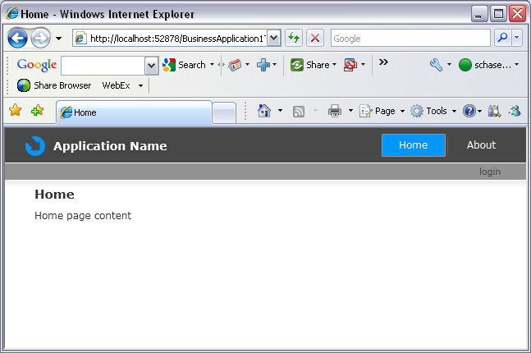
Running a Silverlight Business Application

Slide 29
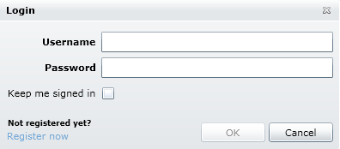
Running a Silverlight Business Application - Login

Slide 30
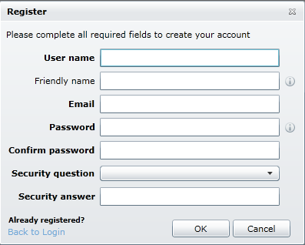
Running a Silverlight Business Application – Register User

Slide 31
Order Entry Application in Silverlight:
Step 2: Create Entity Classes
C# Entity Classes
public class Customer
{
[Key]
public int CustNum { get; set; }
public string NAME { get; set; } …
[Association("CustOrd", "CustNum", "CustNum")]
public IEnumerable<Order> Orders { get; set; }
}
public class Order
{
[Key]
public int OrderNum { get; set; }
public int CustNum { get; set; } …
}

Slide 32
Order Entry Application in Silverlight:
Step 3: Create Domain Service Classes
C# Domain Service : ABLDomainService.cs
class ABLDomainService :
System.ServiceModel.DomainServices.Server.DomainService {
private CustOrdersDataSet CustOrdersObj = null;
…
[Query]
public IEnumerable<Customer> GetCustomers()
{
_appObj.GetCustOrders1(out CustOrdersObj);
EnumerableRowCollection<Customer> query =
from row in CustomerDataTableObj.AsEnumerable()
…
return query.AsEnumerable();
}
}

Slide 33
Order Entry Application in Silverlight:
Step 3: Create Domain Service Classes
C# Domain Service : ABLDomainService.cs
class ABLDomainService :
System.ServiceModel.DomainServices.Server.DomainService {
private CustOrdersDataSet CustOrdersObj = null;
…
[Query]
public IEnumerable<Customer> GetCustomers()
{
_appObj.GetCustOrders1(out CustOrdersObj);
EnumerableRowCollection<Customer> query =
from row in CustomerDataTableObj.AsEnumerable()
…
return query.AsEnumerable();
}
}

Slide 34
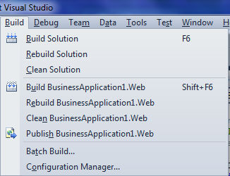
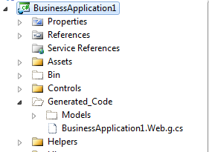
Order Entry Application in Silverlight:
Step 4: Build Project in Visual Studio to Generate Code

Slide 35
Order Entry Application in Silverlight:
Step 4: Build Project in Visual Studio to Generate Code
C# Domain Context: BusinessApplication1.Web.g.cs
class ABLDomainContext :
System.ServiceModel.DomainServices.Client.DomainContext
{
public ABLDomainContext() :
this( new WebDomainClient<IABLDomainServiceContract>(
new Uri("OrderEntry-Web-Services-
ABLDomainService.svc", UriKind.Relative) ) )
{…}
public EntityQuery<Customer> GetCustomersQuery()
{
this.ValidateMethod("GetCustomersQuery", null);
return base.CreateQuery<Customer>( "GetCustomers", …);
}
}

Slide 36
Order Entry Application in Silverlight:
Step 4: Build Project in Visual Studio to Generate Code
C# Domain Context: BusinessApplication1.Web.g.cs
class ABLDomainContext :
System.ServiceModel.DomainServices.Client.DomainContext
{
public ABLDomainContext() :
this( new WebDomainClient<IABLDomainServiceContract>(
new Uri("OrderEntry-Web-Services-
ABLDomainService.svc", UriKind.Relative) ) )
{…}
public EntityQuery<Customer> GetCustomersQuery()
{
this.ValidateMethod("GetCustomersQuery", null);
return base.CreateQuery<Customer>( "GetCustomers", …);
}
}

Slide 37
Order Entry Application in Silverlight:
Step 4: Build Project in Visual Studio to Generate Code
C# Domain Context: BusinessApplication1.Web.g.cs
class ABLDomainContext :
System.ServiceModel.DomainServices.Client.DomainContext
{
public ABLDomainContext() :
this( new WebDomainClient<IABLDomainServiceContract>(
new Uri("OrderEntry-Web-Services-
ABLDomainService.svc", UriKind.Relative) ) )
{…}
public EntityQuery<Customer> GetCustomersQuery()
{
this.ValidateMethod("GetCustomersQuery", null);
return base.CreateQuery<Customer>( "GetCustomers", …);
}
}

Slide 38
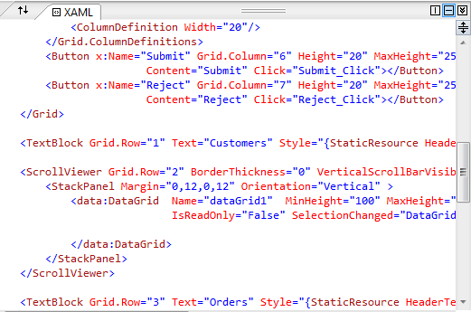
Order Entry Application in Silverlight:
Step 5: Build Web Page
Web Page “XAML”: CustomerListing.xaml.cs

Slide 39
Order Entry Application in Silverlight:
Step 6: Bind Data
Web Page “Code Behind”: CustomerListing.xaml.cs
class CustomerListing : Page
{
OrderEntry.Web.Services.ABLDomainContext _DomainContext;
public CustomerListing() {
InitializeComponent();
_DomainContext = new ABLDomainContext();
dataGrid1.ItemsSource = _DomainContext.Customers;
}
}

Slide 40
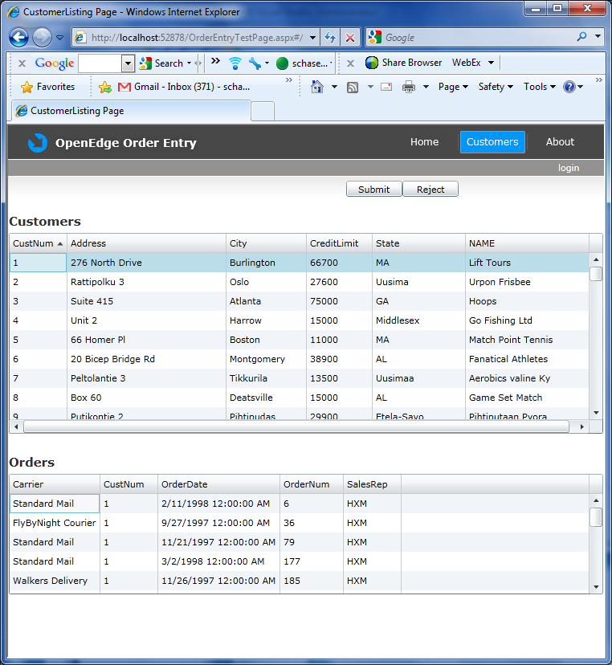
Silverlight Business Application

Slide 41
Order Entry Application in Silverlight:
Runtime Architecture
Browser
Web Server
OpenEdge AppServer
Web Server
.NET Open Client
.p
Customer.cs
Order.cs
Silverlight Runtime
CustomerDomain Service.cs
(DomainService)
.NET Open Client
.NET
binary
AppServer
binary
Business
Application. Web. g.cs (DomainContext)
ABLDomain Service.cs
(DomainService)
Notes:
Now that we can build a Silverlight application let’s look at one that can get data from OpenEdge. There are many ways to access the AppServer from Silverlight.

Slide 42
RIA Services Nuances
RIA Services is state-free
  New DomainService instance created for each call
  Use Cache for singleton AppObject
System.Web.Caching.Cache myCache = HttpRuntime.Cache;
_appObj = (TestAO) myCache.Get("TestAO");
if (_appObj == null)
{
// Connect to OpenEdge AppServer
_appObj = new TestAO(_connObj);
myCache.Insert("TestAO", (object)_appObj);
}

Slide 43
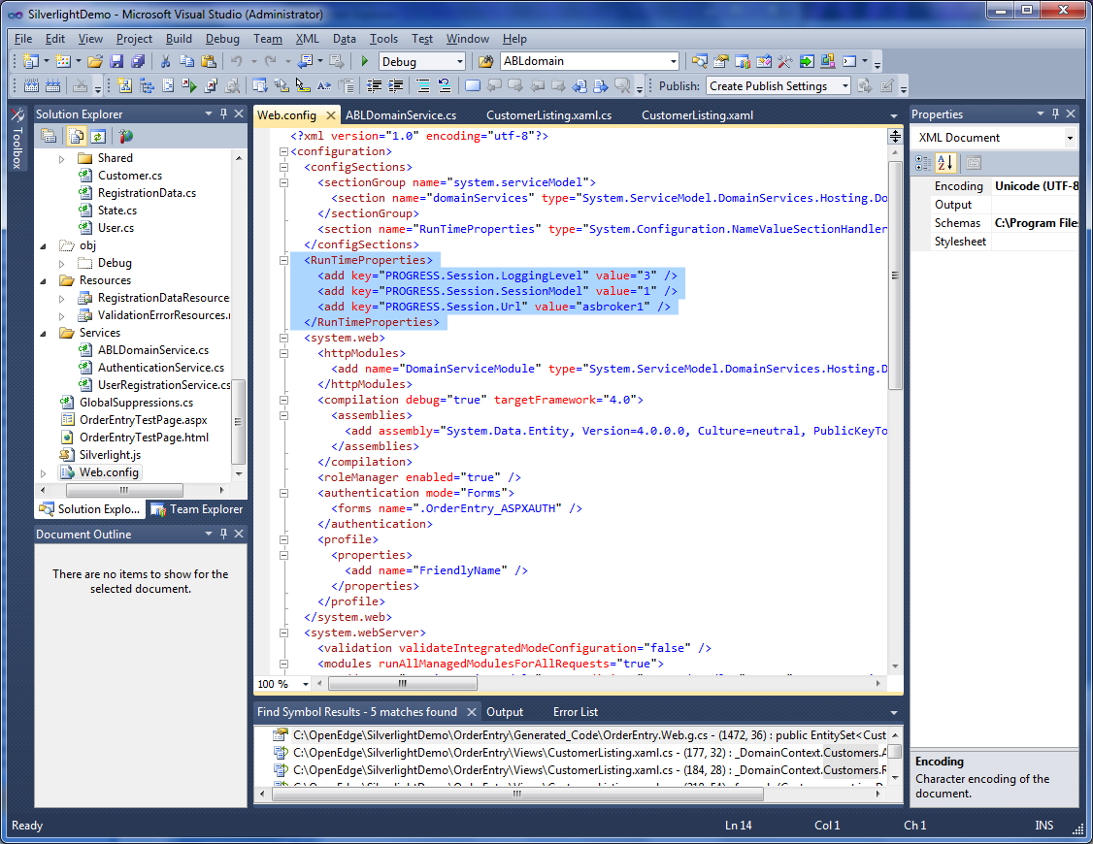
Configuration Settings
Put runtime properties in Web.config file
Access using System.Configuration.ConfigurationManager
NameValueCollection config = (NameValueCollection) System.Configuration.ConfigurationManager.GetSection("RunTimeProperties");
Progress.Open4GL.Proxy.Connection _connObj = new Connection(…);
Progress.Open4GL.RunTimeProperties.SetConnectionProperties( _connObj, config );

Slide 44
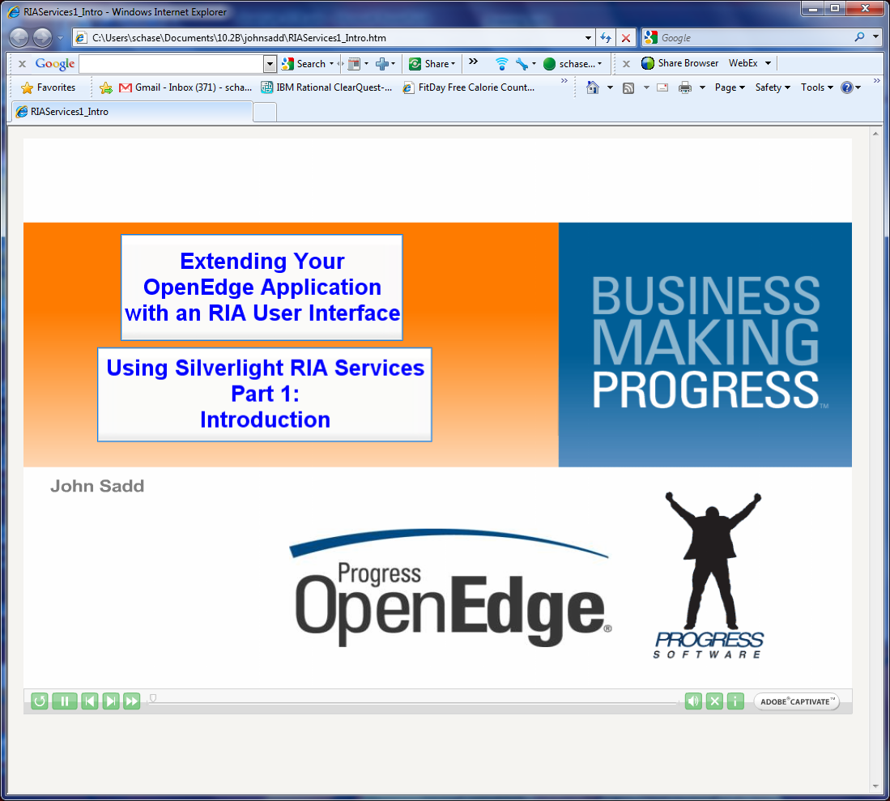
How To Video Series

Slide 45
Microsoft Silverlight
  Pros
  Leverages skills of an estimated 6 million .NET developers
  Rich proven development and runtime platform
  Runs in browser or on desktop
  Broad ecosystem of Microsoft service providers, SIs, ISVs
  Silverlight Open Client in 11.x
  Cons
  Need to learn new set of development tools
  Limited platforms (no iPad, etc.)
  Microsoft brand is a negative to some

Slide 46




In Summary
  Powerful Development Platform
Engaging, Interactive User Experiences
OpenEdge works with Silverlight today
Follow OERA to be ready for the future
OpenEdge 11.1: Purposed Silverlight Adapter
OpenEdge 11.1: Generated Domain Services

Slide 47
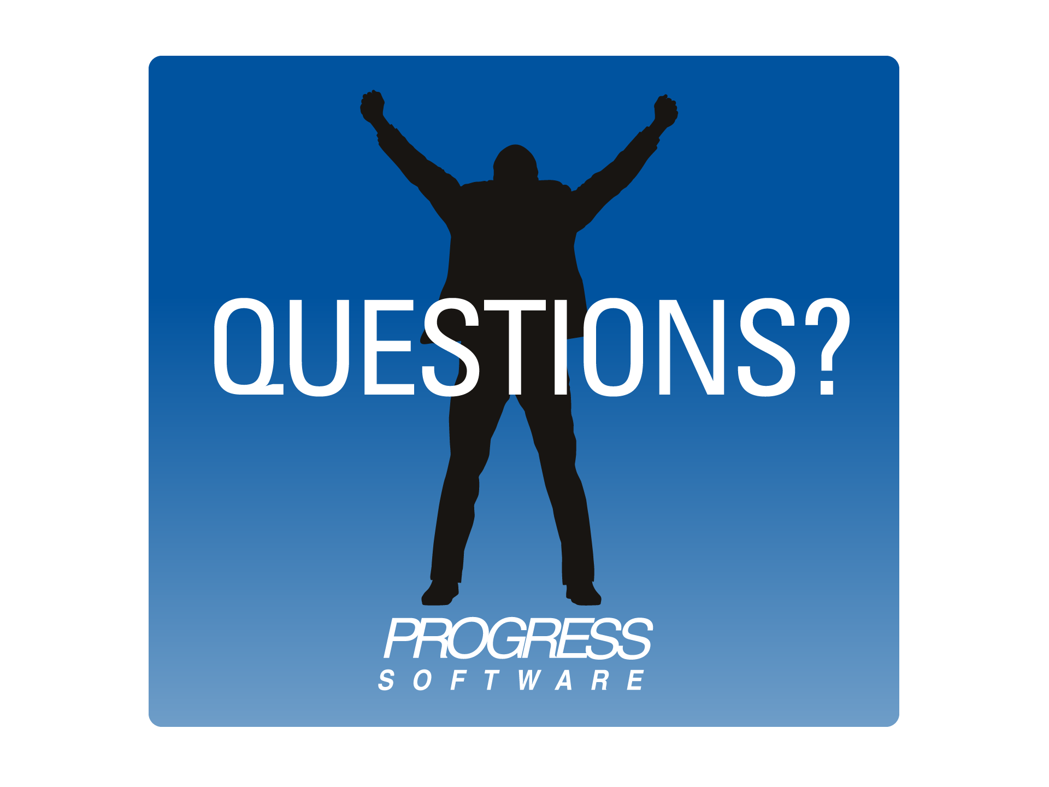
Notes:
47

Slide 48


