Slide 1
Recovery Planning
A Holistic View
Adam Backman, President
White Star Software
adam@wss.com

Slide 2
What We Will Cover
Where to Start?
Creating a plan
  Who is involved?
  What are you going to protect?
  Where is it going to go?
  When (how often) are you going to backup?
Implementing the plan
Automation
Testing

Slide 3
Before we start
Before starting any recovery of your system, backup what you have now as it may be your route of last resort if some part of your recovery plan fails.
It is generally better to leave the “damaged” things alone and recover to a new piece of hardware or different disks.

Slide 4
What is recovery planning?
Known by many names
  Disaster recovery plan
  Business process contingency plan
A description of how an organization is to deal with events that make the continuation of business impossible
Describes precautions taken to minimize or eliminate the effects of a disaster

Slide 5
Where to start?
Determine who owns the data
Determine the value of the data
Determine the value of lost productivity
  Time to rekey
  Inventory worth less (no audit trail)
  Cannot process as much or any business
Determine stake holders (users of the data)

Slide 6
Creating a plan
Goals (Event-based goals)
  If we lose or corrupt data (Human error)
  If we lose a disk (DB gone)
  If we have a fire (Machine gone)
  If we have a natural disaster (Facility gone)
Hardware
Software
Data
Other stuff

Slide 7
Where to start?
Use your current plan
  It is there, you do have a tested plan don’t you?
  We have been using it for years and has always “worked”
  If it is not broken why change, we might even test it
Start from scratch
  Your current plan was written by dummies (unless it was written by you, of course)
  Archiving is more than throwing the tape in a drawer in the computer room.
  You mean we have a plan now?
  When is the last time you tested your backup?

Slide 8
Creating a plan - Goals
Acceptable downtime (Generally cost based)
  Everyone wants zero but it is generally cost prohibitive
Planned outages
  Hardware install and maintenance
  Software upgrade
  O/S upgrade or patch
Notifications (Both before and during outage)
  Who
  When
  What do they do?

Slide 9
Goals
Minimize the impact to the customers
Lose a minimal amount of data
Don’t build a plan that costs more than the data is worth
Don’t build a process you cannot support
  Too complex
  Hard coded so maintenance is a problem
  Build in the ability to change with the environment
  Support multiple “exceptions”

Slide 10
Creating a plan - Hardware
What to include
  Computer hardware
  Network
  Phone, handheld devices, …
Options
  Duplication
  Replication (Same storage capacity but less resources)
  Co-location
  External service

Slide 11
Hardware – What users need to access your application
Database engine (Where your database resides)
Application server(s) for n-tier application
Web server(s)
Client PC’s
Network to connect it all together
Internet
Phone, FAX, External Interfaces, …

Slide 12
Creating a plan – Apps and software
Applications
Supporting applications
Operating system
Production data
Transient data

Slide 13
Software – Keeping applications current
Application
  Remote mirroring
  Automated via formal application deployment
  Formal process-based application deployment
Supporting application
  Remote mirroring
  Vendor supported deployment process to deal with applications that are licensed to a specific machine

Slide 14
Software – Keeping data current
Replication
  Real-Time with OpenEdge replication
  Quasi Real-Time with Log-based replication
  Disaster only recovery via restore and application of after image files.
Transient Data (Example: EDI drops, ftp transfers, …)
  Remote mirroring
  Automated replication

Slide 15
Software – Keeping OS files current
Operating system
  Running virtualization to allow for quick cloning of your environment
  Automated via customized scripts
  Keeping two systems in sync via a formalized process
  Use network definitions for users, printers, and other operating system resources

Slide 16
Creating a plan – Other stuff
What makes your business run?
  Phones
  Faxes
  Business to Business (EDI, XML Feed, …)
Can people work from home?
Do you have/need another location?
Contact lists in case of major catastrophe
  Kept up-to-date
  Kept online and printed in an accessible location

Slide 17
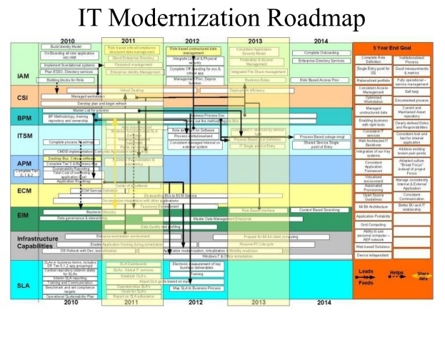
Remember: Keep your plan simple

Slide 18
Implementing your plan
First implementation should be a totally manual process to insure the steps work and allow for documentation
Document the process as you go
  Who are you logged in as?
  Exactly what you typed
  Where you were (console, remote, …)
  Can things be done in parallel or sequentially
  Where are the logs and what to look for in the logs

Slide 19
Documentation
All recovery documentation should be VERY specific
Create documents for normal maintenance
  Backups
  Database growth
  Modification of OS, Application, printers, …
Create scenario based recovery plans
  Lose a disk (or disk pair)
  Fire
  Flood

Slide 20
Automation: Why automate your plan?
When it is needed it will be a stressful time
The person who best knows the plan will be on vacation
Reduces the chance of human error
You can duplicate the process for multiple databases
The process can be audited provided logging is adequate

Slide 21
Automation: General rules
Make sure you back things up before proceeding
Automate as much as possible
Have the process broken up logically to enable easier easier implementation and testing
Make sure you create log(s)
Checking the log(s) is part of implementation and testing

Slide 22
Single System – Testing decisions
Questions
  Do you have enough space?
    If not, you really do not care about recovery
  Do you have enough throughput potential if you do have enough space?
  Can you take an outage?
    If so, how long?
    May still need to test while running.

Slide 23
Dual Systems – Testing decisions
Are the two systems sharing disks?
  If yes
    Do you have enough space
    Do you have enough throughput potential to test recovery while production is running
  If no
    Is there enough space to duplicate the whole system?
    Will throughput capacity allow you to give reliable time estimates?
Are the two systems evenly configured for other resources beyond disks

Slide 24
Testing your plan
Recovery plan testing is an ongoing process not test once then pray
Test various different types of recoveries including a tape failure (Rolling forward multiple days of transactions)
Make recovery plan testing part of someone’s job responsibilities and evaluation criteria or it is less likely to get done

Slide 25
Testing your plan
Who does the test?
  Not the person who wrote it
  The backup person for the implementation
  Someone who is “always” there regardless of technical ability
How often to test?
  Material data change (10% increase is a good target)
  Any change in database configuration
  Do you have a second site or redundant hardware?
  Do you have enough disk capacity (space and throughput)

Slide 26
How to test your plan
Fail over to your backup system
Fail back to your primary system
Contingency planning for personnel, physical plant and equipment (Lead time for resources)

Slide 27
Summary: Recovery planning
Be inclusive when building your team
Always backup what you have now, however little, before starting to recover
Create and maintain a comprehensive plan
  Include everything needed to use the application:
    Hardware, applications, and data
Create and maintain a contact list both online and physical
Test your plan periodically (At least annually)

Slide 28
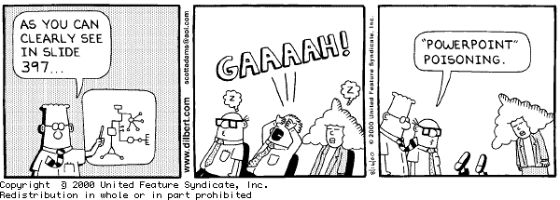
Questions?
THANK YOU

