Slide 1
Progress and Oracle
Same and Different
Notes:
Progress vs Oracle
Compare bicycle to a car.
I will not talk about languages, i.e. 4GL vs PL/SQL

Slide 2
Points to consider
Database Size
Notes:
Points to consider

Slide 3
Database Size
Progress
Oracle
Small < 10 GB
Medium 10-100 GB
Large 100-500 GB
VLDB 0.5-5 TB
Small < 1 TB
Medium 1-50 TB
Large 50-200 TB
VLDB 200 TB
Notes:
More important criteria – High Availability – possibility of downtime.

Slide 4
Points to consider
Database Size
High Availability
Notes:
Downtime: planned or unplanned.
Planned downtime: Software and hardware upgrade, schema change.

Slide 5
Cluster db
Active - Passive
Active – Active
Server 1 Memory
Apw, Biw, Aiw, Wdog
Server 2
Server 1 Memory
DBWn, LGWR ARCn, SMON
Server 2 Memory
DBWn, LGWR ARCn, SMON
DB

Slide 6
Cluster db 2
Server 1
Server 2 Memory
Apw, Biw, Aiw, Wdog
Server 1
Server 2 Memory
DBWn, LGWR ARCn, SMON

Slide 7
Planned Downtime
Schema change
Software upgrade
Progress
proutil –C conv910
30 seconds
Oracle
42 steps upgrade project
40-50 min

Slide 8
Points to consider
Database Size
High Availability
Licenses
Notes:
Downtime: planned or unplanned.
Planned downtime: Software and hardware upgrade, schema change.

Slide 9
Licenses
Enterprise Database $$
Workgroup Database $
OE Replication
OE Management
TDE
Enterprise Edition $$$$
Standard Edition $$
Standard Edition One $
Express Edition Free
Partitioning
Real Application Clusters
DataGuard
Diagnostics Pack
Tuning Pack

Slide 10
Points to consider
Database Size
High Availability
Licenses
Hardware costs
IT Stuff
Notes:
Downtime: planned or unplanned.
Planned downtime: Software and hardware upgrade, schema change.

Slide 11
Additional Products
OpenEdge Management
Oracle Enterprise Manager

Slide 12
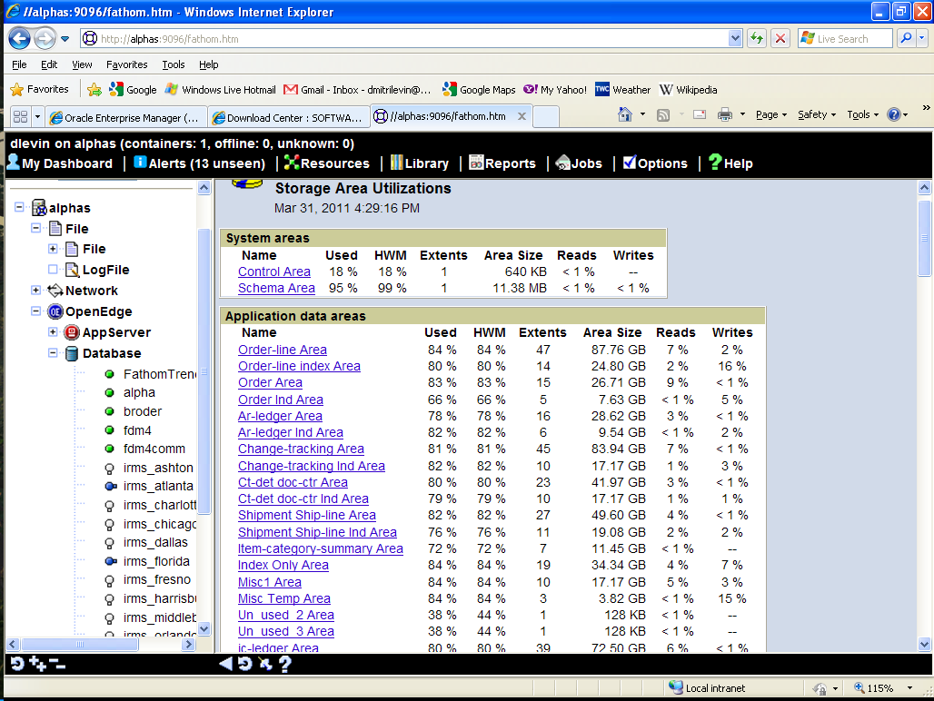

Slide 13
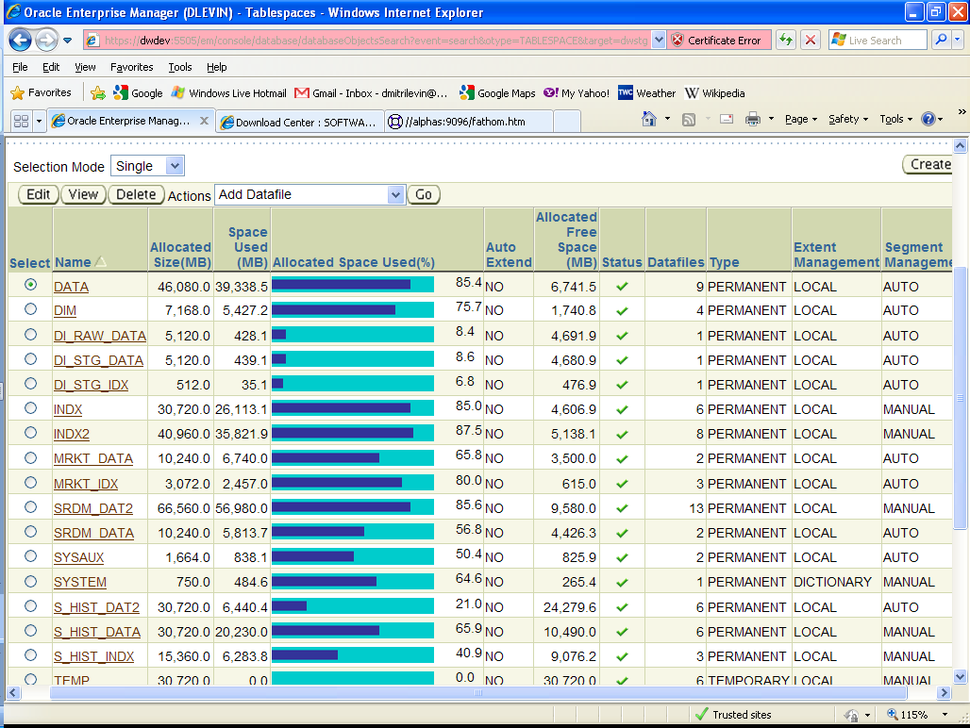
OEM Tablespaces

Slide 14
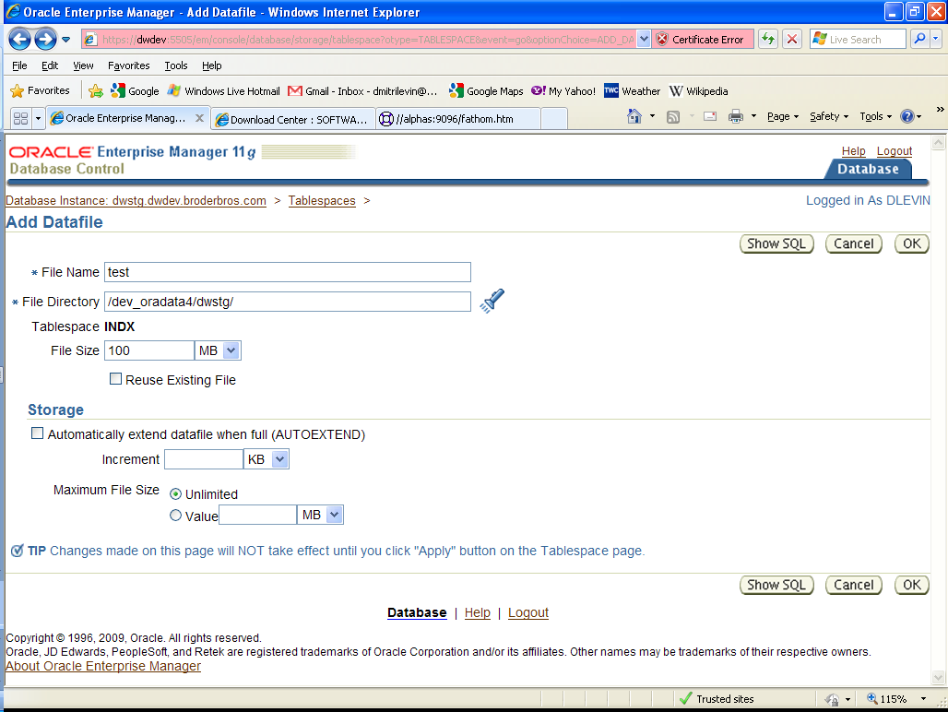

Slide 15
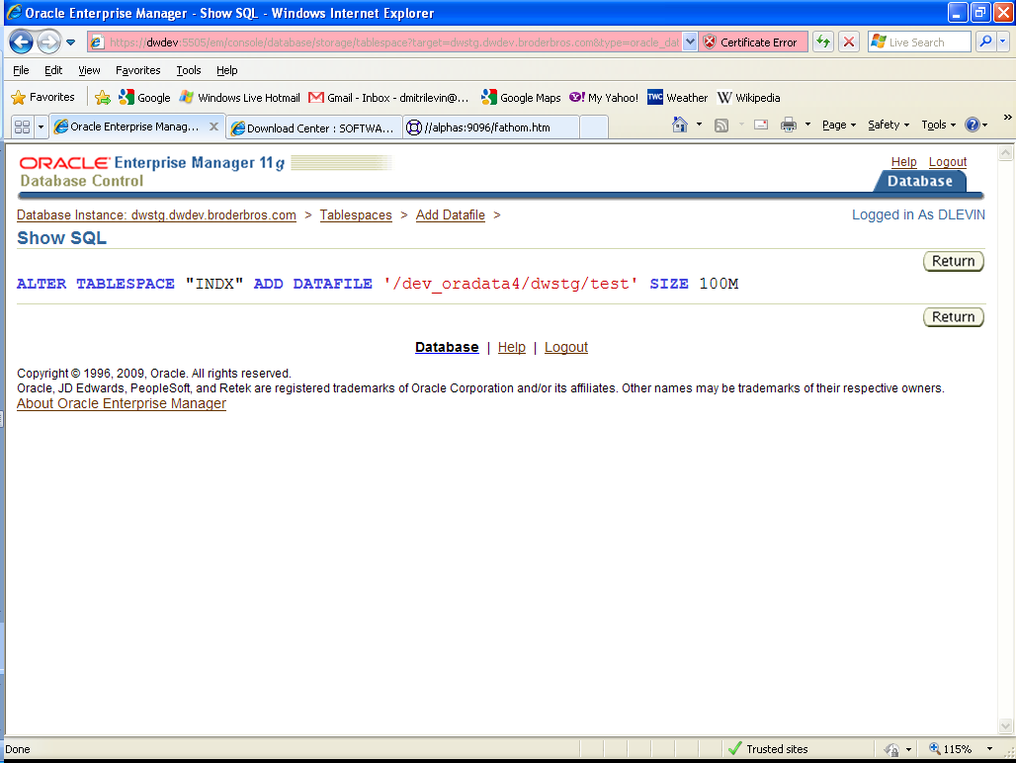
OEM show SQL

Slide 16
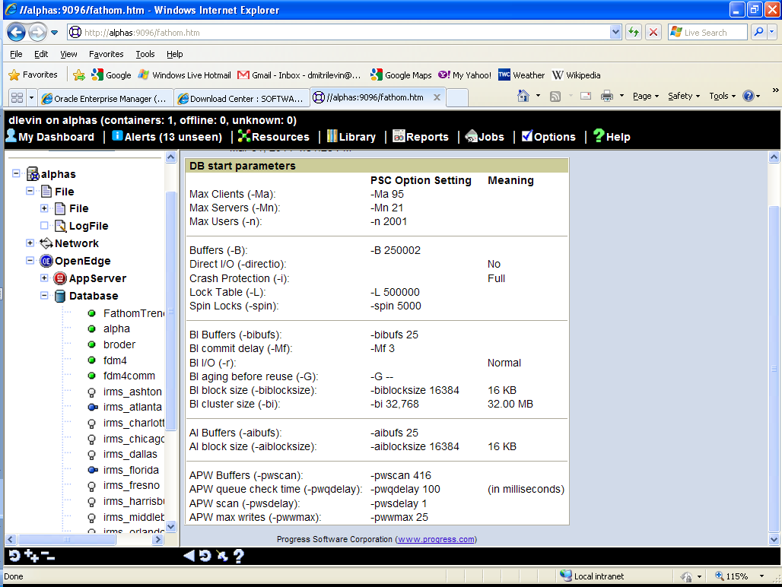
Notes:
proutil db-name -C increaseto -B n -L n -bibufs n -aibufs n

Slide 17
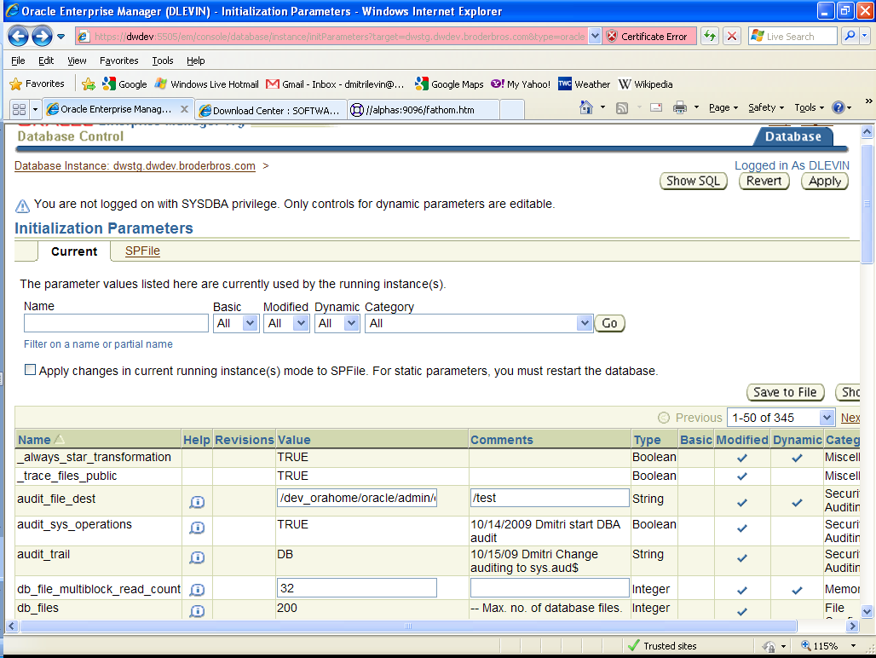
OEM parameters
Notes:
Static and dynamic parameters

Slide 18
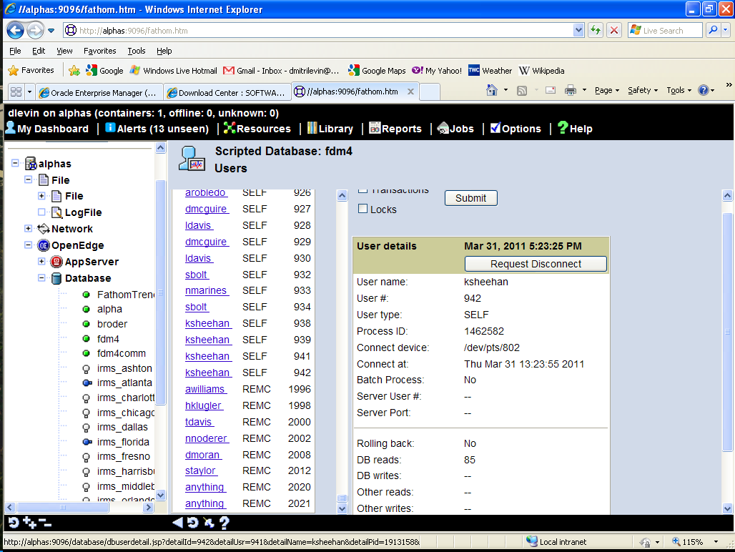

Slide 19
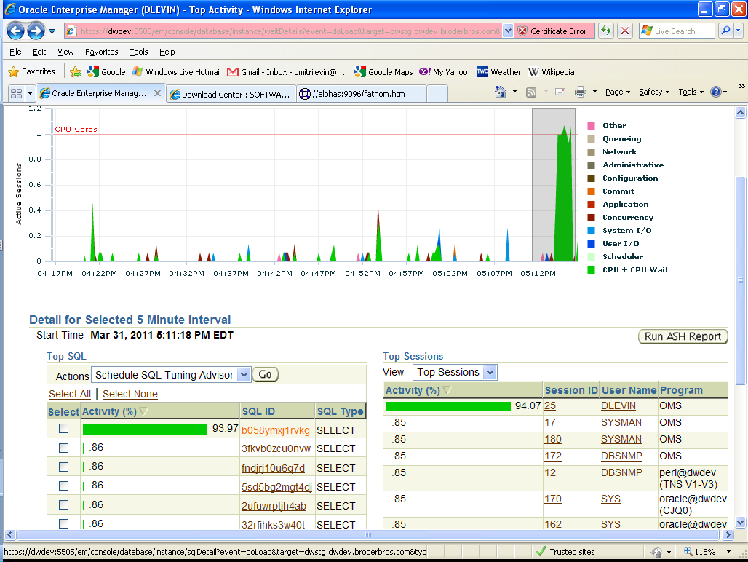
OEM Users

Slide 20
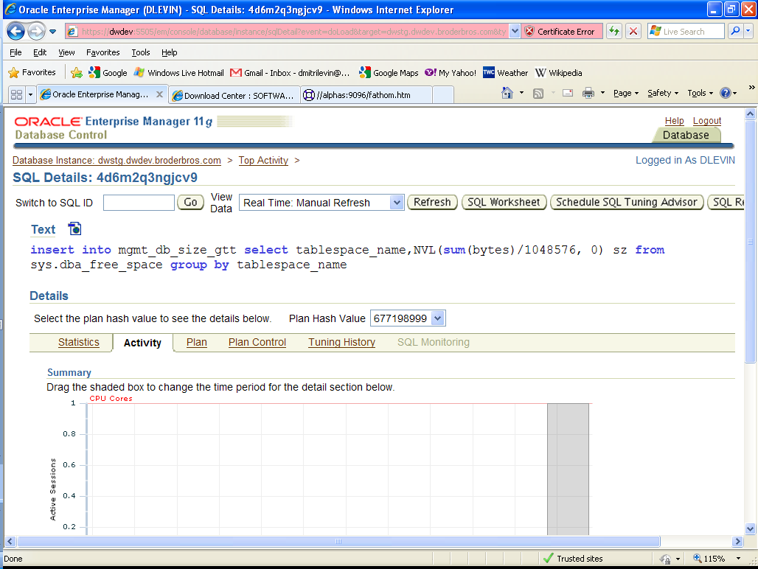

Slide 21
Additional Products
OpenEdge Management
OpenEdge Replication
OpenEdge Replication Plus
BravePoint Pro2SQL
Oracle Enterprise Manager
Oracle DataGuard
Oracle Active DataGuard
Oracle Golden Gates
Real Application Clusters (RAC)
Oracle Data Integrator
Notes:
OE Replicatioin -- DataGuard with physical replication
DataGuard could use logical replication ( sql statements ). Partial replication, replication on different OS.
OGG support: DB2, MS SQL Server, Sybase, MySQL, Teradata
Remove/Add unglue/reglue
$DLC/addons
Remove/Add detach/attach
oraInventory/ContentsXML/inventory.xml

Slide 22
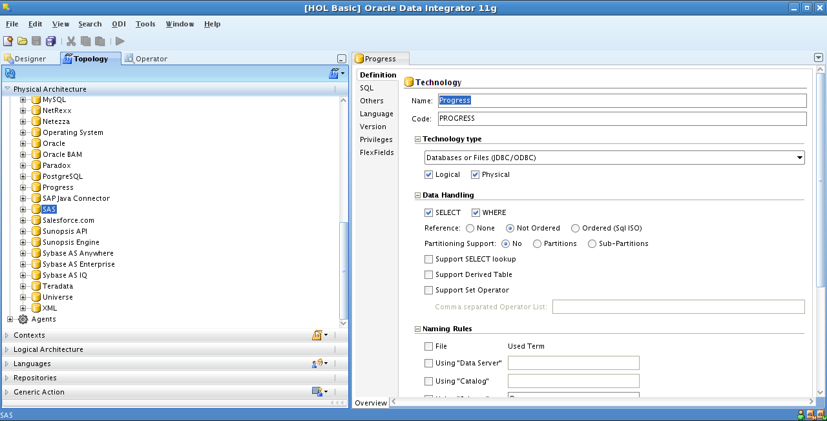

Slide 23
Physical Structure (data files)
Database File | sports.db | Control File(s) | control01.ctl
System Area | sports.d1 | System Tablespace | system.dbf
D Files | area.d | Datafiles | tablespace.dbf
Before-Image File + After-Image File | sports.b1 + sports.a1 | Undo tablespace + Redo Log | undotbs.dbf + redo01.log
Copy of After-Image File | sports.date_time_etc | Archive Log | sports.date_time_etc
Structure file | sports.st | Backup of control file to trace file
Log File | sports.lg | Alert Log | alert_sports.log
Parameter File | sports.pf | pfile (or spfile) | initsports.ora
Notes:
Progress and Oracle are quite different in transaction processing. No direct map of .bi and .ai
Alert Log: All startup parameter, but no user connect/disconnect

Slide 24
Logical Structure
Area | Schema Area | Tablespace | System Tablespace
Area consists of objects | Objects are Tables or Indexes | Tablespace consists of segments | Segments: Tables, Indexes, Undo, etc
Each Object has one or more Clusters | Clusters size could be 8,64 or 512 blocks | Each Segment has one or more Extents | An extent is a series of blocks that are consecutively numbered within a datafile
Clusters consist of blocks | blocks 1,2,4 or 8K | Extents consist of blocks | blocks 2,4,8,16,32 or 64K
Notes:
Progress: one block size for database
Oracle: one block size for tablespace

Slide 25
Background Processes
Asynchronous Page Writer | APW | Database Writer | DBWn
Before Image Writer | BIW | Log Writer | LGWR
AI Management | AIMGT | Archive Process | ARCn
Watch Dog | WDOG | Process Monitor | PMON
Database Broker | _mproserv | System Monitor | SMON
 |  | Many other ….
Login Broker | _mproserv | Listener | lsnrctl
-H server –S db_port
Server, Listener port, db name
Notes:
Log Writer, like BIW is only one.

Slide 26
Meta-schema and VST
Progress Meta-schema tables -80 < _file-number < 0
Progress VST _file-number < -16384
Progress Table | Field | Oracle View | Column
_Area | _Area-name | DBA_TABLESPACES | TABLESPACE_NAME
_AreaExtent | _Extent-Path | DBA_DATA_FILES | FILE_NAME
_StorageObject | _Object-type (1,2 or 3) | DBA_OBJECTS | object_type (38 types)
_File | _File-name | DBA_TABLES | TABLE_NAME
_Field | _Field-name | DBA_TAB_COLUMNS | COLUMN_NAME
_Index | _Index-name | DBA_INDEXES | INDEX_NAME
_Sequence | _Seq-name | DBA_SEQUENCES | SEQUENCE_NAME
Notes:
Every Progress table has _file record
Every Oracle view has DBA_VIEW record

Slide 27
Meta-schema and VST
Virtual System Tables | V$ (Vee dollar) Views
_Connect | v$session, v$process
_DbStatus | v$instance, v$sysstat
_Trans | v$transaction
_Lock | v$lock
_Latch | v$latch
_AreaStatus | v$tablespace
_Filelist | v$datafile
_Startup (some) | v$parameter
Notes:
The Dynamic Performace Views

Slide 28
Oracle simplify memory parameter settings (-B)
V9 db_cache_size log_buffer shared_pool_size large_pool_size java_pool_size streams_pool_size pga_aggregate_target | V10 SGA_TARGET pga_aggregate_target | V11 MEMORY_TARGET

Slide 29
Environment Variables and Installation
DLC | /usr/dlc102B | ORACLE_HOME | /usr/oracle/11.2.0
PATH | $DLC/bin | PATH | $ORACLE_HOME/bin
To install | proinst | To install | runInstaller

Slide 30
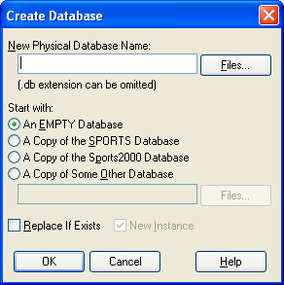
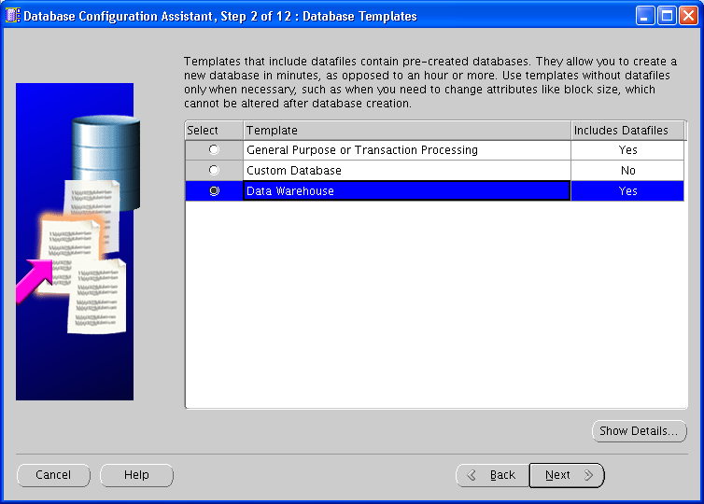
Create Database

Slide 31
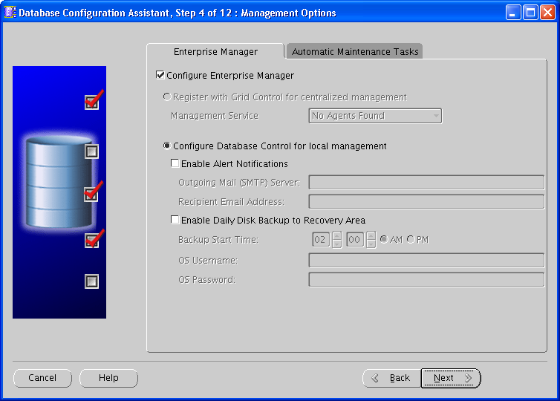

Slide 32
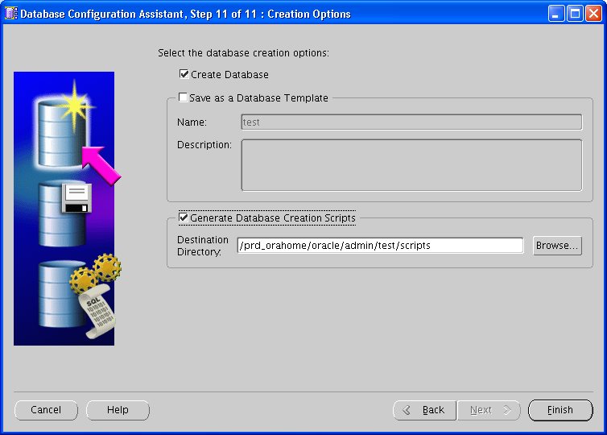

Slide 33
Create Database
prodb mydb
procopy empty8 mydb
Min size 5 MB
Min memory 160KB
Time to create 1 second
A set of .sql scripts
create database mydb;
Min size 512 MB
Min memory 512MB
Time from 20 min to 1.5 hr
Notes:
Create empty Progress database 1 second. Create empty Oracle db is from 15 min to 2 hours.

Slide 34
Shutdown
Unconditional Shutdown
Emergency Shutdown
Shutdown Normal
Shutdown Transactional
Shutdown Immediate
Shutdown Abort

Slide 35
Startup
Closed | Closed
 | Nomount mode
 | Mount mode
Open | Open

Slide 36
Backup
Progress backup – simple | Oracle RMAN – More complicated
probkup db_name file_name
Progress and Oracle : Online and Offline (Hot and Cold)
Progress and Oracle : Complete and Incremental
 | Oracle backup : could be Full and Partial
Notes:
Progress could restore to any structure, Oracle needs to know it.

Slide 37
Compressed Backup
700 GB Progress DB makes about 600 GB probkup
1.4 TB Oracle DB makes either 1.2 TB regular backup or
250 GB RMAN compressed backup (BZIP2 is default).

Slide 38
Dump and Load
Dictionary Dump and Load in ASCII format (.d) or 4GL export/import | SQL select/insert “SQL Loader” or External Tables 10g
Binary Dump (proutil –C dump) | Oracle export (exp tables=tbl_name)
Binary Load (proutil –C load) | Oracle import (imp file=file_name)
Binary Dump multithreaded V10 | Oracle Data Pump Export (expdp) 10g
 | Oracle Data Pump Import (impdp) 10g
Dump/Load .df | Export/Import (exp full=y rows=n)

Slide 39
Flashback
Flashback Database
Flashback Table
Flashback Drop
Flashback Query
Flashback Version Query
Flashback Transaction Query
Notes:
Six types of Flashback in 10g. They are designed to fix human errors.

Slide 40
Flashback Database
-- Flash database 1 hour back
SQL> flashback database to timestamp sysdate-(1/24);
Using Standby Database for Testing
SQL> ALTER DATABASE RECOVER MANAGED STANDBY DATABASE CANCEL;
SQL> CREATE RESTORE POINT Standby_flashback_testing
GUARANTEE FLASHBACK DATABASE;
SQL> ALTER DATABASE OPEN;
--- Make a Test on a Standby DB
SQL> FLASHBACK DATABASE TO RESTORE POINT Standby_flashback_testing ;
SQL> ALTER DATABASE CONVERT TO PHYSICAL STANDBY;

Slide 41
Flashback Table
SQL> delete from employees
10000 rows deleted.
SQL> commit
Commit complete.
SQL> select count(*) from employees;
COUNT(*)
----------
0 … Oops …
SQL> flashback table employees to timestamp systimestamp - interval '15' minute;
Flashback complete.
SQL> select count(*) from employees;
COUNT(*)
----------
10000

Slide 42
Flashback Drop
SQL> drop table Customer; -- DDL … Oops …
SQL> select object_name, original_name, type, droptime from recyclebin;
OBJECT_NAME ORIGINAL_NAME TYPE DROPTIME
BIN$U/9fvJKbXOzgQKjAYAIWhw==$0 Customer Table 2011-06-07 10:57:01
SQL> flashback table "BIN$U/9fvJKcXOzgQKjAYAIWhw==$0" to before drop;

Slide 43
Flashback Query
SQL> delete from employees where employee_id in (195,196);
2 rows deleted.
SQL> commit;
Commit complete. … Oops …
SQL> insert into employees
select * from employees
as of timestamp systimestamp - interval ‘30' minute
where employees.employee_id not in
(select employee_id from employees);
2 rows created.
SQL> commit;
Commit complete.
Notes:
Flashback version shows all versions of the record between two time stamps or SCNs
Flashback transaction: Oracle provides SQL statements that will reverse transaction. If create --- delete, update with old values.

Slide 44
Raid 5
RAID 5

Slide 45

Questions
www.proora.com
levin-d@hotmail.com
dlevin@broderbros.com
www.peg.com

