Slide 1
Progress® Arcade™
Rob Straight
Senior Manager, OpenEdge Product Management
Mike Ormerod
Architect, SaaS and Cloud Computing
June 6, 2011

Slide 2
Vision
OpenEdge is the leading SaaS Platform for ISVs and Business Service Providers to simplify service development and delivery for the Cloud resulting in greater Operational Responsiveness
Progress Arcade accelerates moving ISVs and BSPs into the Cloud, an enticing hosting alternative, as they adopt a SaaS business model.
Progress Arcade also makes use of the Cloud to help OpenEdge developers learn about the product features offered by Progress and by Complimentary Solution Providers.

Slide 3

OpenEdge Cloud Strategy: Progress Arcade
An Extensible Environment Supporting Customer-Oriented Cloud-Based Activities
Goals:
  Accelerate SaaS partner business: facilitate deployment in the Cloud
  App modernization: help customers utilize OpenEdge product features
  Demonstrate the synergy of OpenEdge and the Cloud
Available in Popular Cloud Environments
  Initial target is Amazon EC2
  Utilize RightScale (3rd-party product, “OEM” agreement) to be Cloud agnostic over time, including Private Clouds that DEUs may utilize
Phase 1: June 2011
  Focus on getting existing OE applications running in the Cloud
  Educate developers on the features of OpenEdge, Sonic, OE BPM

Slide 4
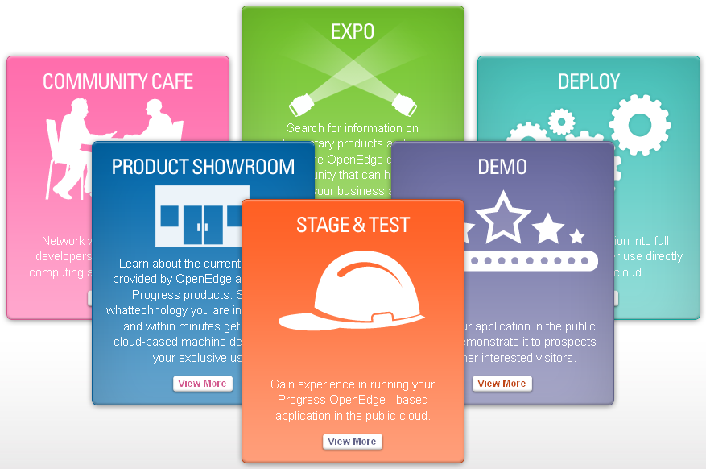
Progress Arcade!
Community Features
Premium User Features
  http://web.progress.com/openedge/arcade.html

Slide 5
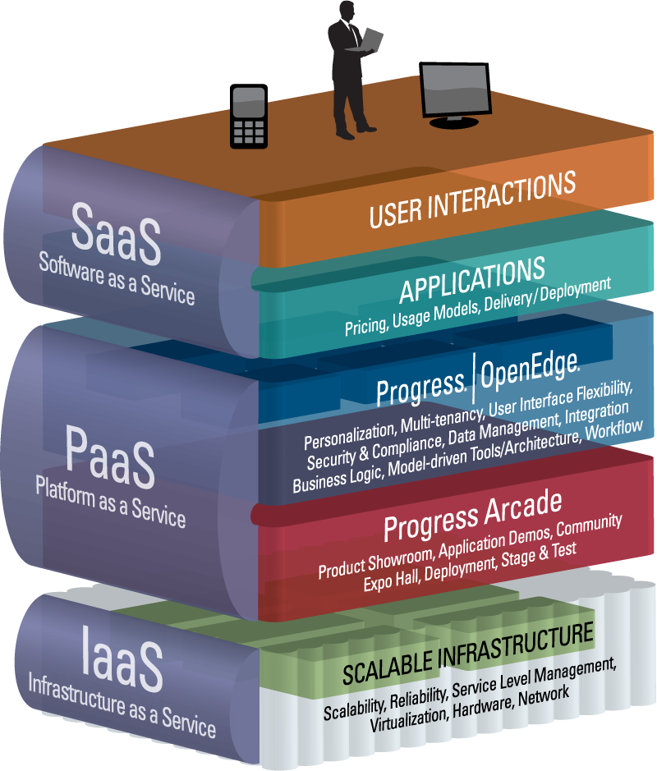
Positioning Progress® Arcade™

Slide 6
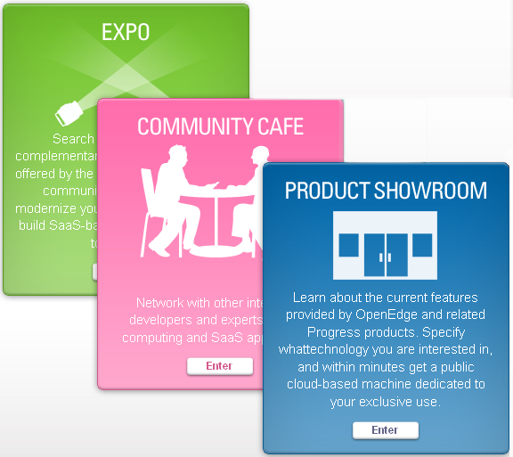
Progress Arcade Community Features
No Charge for the OpenEdge Community to Access
“Community” Use
Complementary Solution Providers Host Booths in the Expo

Slide 7
For The OpenEdge Development Community,
Progress Arcade Provides:
Improved Access to Product Feature/Benefit Information
  Cloud-based product evaluations (no download/install) immediately available
  Supporting collateral: videos, tutorials, lab exercises, etc.
Integrated Access to Progress Communities
Access to Information on Products and Services Available from the Overall OpenEdge Community
  CSO’s advertise in the Expo

Slide 8
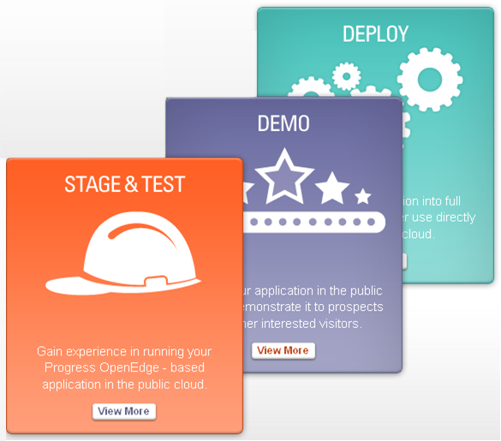
Progress Arcade Premium Use Features
Using These Features Results in Fees for Use of the Underlying Infrastructure
“Premium” Use
Registration is Required to Gain Access and for Billing Purposes

Slide 9
For Application Partners, Progress Arcade Provides:
A Powerful Yet Easy-to-use Interface to the Cloud
A Structured Environment Tuned to Getting OpenEdge Applications Running in the Cloud
  Direct access to more technically advanced features is available for those who are interested
OpenEdge Products Pre-populated & Configured as a Starting Point, Covering a Range of Single- and Multi-system Deployments
  OpenEdge 10.2B initially, with other recent versions coming
Support for Product Demos in the Cloud
Sophisticated Management and Monitoring Capabilities

Slide 10
Progress Arcade Architecture Overview
Progress Arcade Web Access
RightScale
Amazon EC2

Slide 11
Why RightScale?
Insulates Progress Arcade From Cloud Vendors
  Seamlessly support multiple Cloud vendors and private Clouds (e.g. Eucalyptus) over time
  Amazon today, others going forward
Supplies a Unique Scripting Capability
  Virtual “images” can be defined by script and built on-the-fly
  ISVs could utilize to streamline implementation and maintenance of their Cloud images
Provides Superior Monitoring Tools
  Enhanced visibility and control, auto-scaling based on demand, etc.
However, ISVs Can Deploy Outside of Progress Arcade and Not Use RightScale If They Choose Not To

Slide 12
Progress Arcade Status
Beta Testing Underway
Early Adopter Program: starts 2nd half of June 2011
  Fees waived for the Premium User services and for hosting a booth in the Expo
  Reasonable limits on use will be in place
Target Launch: September 1, 2011

Slide 13


Progress Arcade Demo

Slide 14




Notes:
Progress helps businesses make progress.

