Slide 1
Introducing OpenEdge BPM:
Integrating Business Process Management Capabilities Into Your OpenEdge Application
Ken Wilner, VP of Technology, OpenEdge

Slide 2
Agenda
OpenEdge BPM Strategy and Value Proposition
Integrating BPM with Your OpenEdge Application
OpenEdge BPM Roadmap
Wrap-up & Q&A

Slide 3
Challenges with Today’s Business Applications
  Companies business processes change rapidly
  Difficult to keep up with changes to application requirements
  Business processes are difficult to change
  Processes should be explicit – not buried within an application or handled thru “tribal knowledge”
  Every company’s processes are unique to that business
  Processes should be configurable.
Difficult to get visibility into business processes
Businesses need insight and control over business processes

Slide 4
The Evolution of Business Applications
Requirements
End Users’ requirements
Automation and management of business transactions
On going improvement of business operations
Developers’ requirements
Developing robust applications within a given budget
On going and rapid customization and improvement of complex applications

Slide 5

Traditional Business Application Architecture
No explicit notion of business process or processes hard-coded
Hard to customize
Limited or no visibility into process execution
Hard to align with the goals of the business
Business Logic
DBMS
Traditional Application

Slide 6
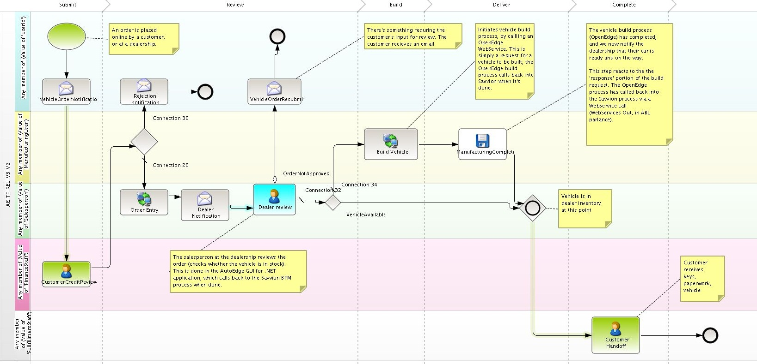
Explicit Business Process is Key

Slide 7

Business Process Application Architecture
Explicit notion of business process
Process is modeled – not coded
Process layer tightly integrated with business transactions layer
Business Logic
DBMS
Business Process Application

Slide 8
OpenEdge Reference Architecture (OERA)
Best Practice Approach to Building Applications using the OpenEdge Platform
Accommodates evolving business requirements
Anticipates trends in technology
Provides agile
and flexible
architecture
Enterprise
Services
Presentation
Business
Workflows
Business
Tasks
Business
Entities
Business Components
Data Access
Data Sources
OpenEdge Application Platform

Slide 9
Business Process Application
Business Logic
Business Logic
DBMS
DBMS
Traditional Application
Business Process Application
To build Business Process Applications, a
BPM-enabled Application Platform is needed.

Slide 10

Business Process Management Lifecycle
Model
Automate
Improve
Monitor
Notes:
This is a basic BPM cycle that allows for continuous process improvement.
It starts with modeling of your processes and you can use the same process model to create process based application. You use that application to execute your process, meaning the end users interact with it and create orders, review orders, approve, ship etc.
You monitor the process using dashboards to see if you are meeting your SLAs or not, if any tasks are getting delayed or not etc.
You perform analysis on the process and get information to further improve the process. Once you have ideas on how to improve the process you can add those in the newer versions of the process model and deploy the new and improved version of the process and create new versions of applications.

Slide 11
OpenEdge BPM Brings the Power of Business Process and Transaction Processing Together
Progress OpenEdge BPM
Enabling the development of business process applications
Progress Savvion BPM Suite
Leading BPM suite for defining, executing and monitoring
business processes
+
Progress OpenEdge
Robust DBMS and business language for automating steps
in business processes

Slide 12



Key Roles in BPM
Business Analysts
Application Developers
Business Managers
Business Process Analyses
Business Process Automation
Business Process Improvement

Slide 13
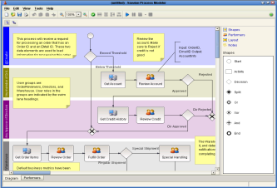
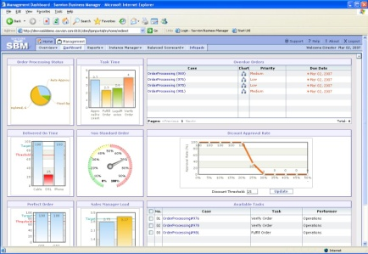
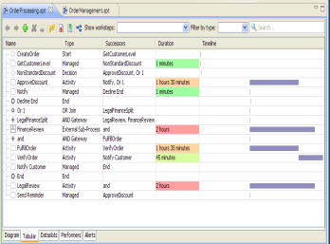
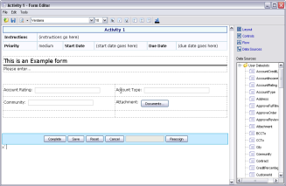
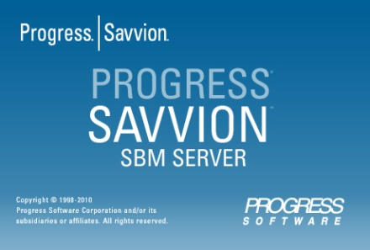
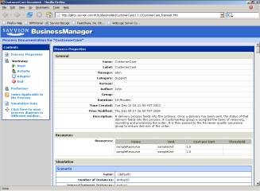
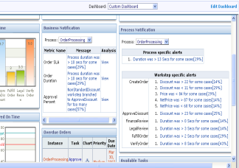
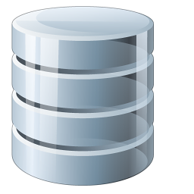
Key Components of Progress Savvion BPM Suite
Process Modeler
BPM Portal
BPM Studio
BPM Server
Process Asset Manager
BusinessExpert

Slide 14
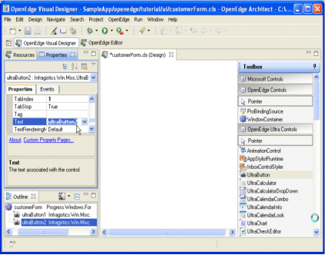

OpenEdge and Progress Savvion BPM Interoperate Already
You can benefit from using BPM with OpenEdge today.
Model and analyze business processes.
Add-on new business processes or improve existing ones.
BPM
Studio
OpenEdge
Architect
BPM
Run-time
OpenEdge Run-time
Available today
OpenEdge
DB
DB
OpenEdge
DB

Slide 15
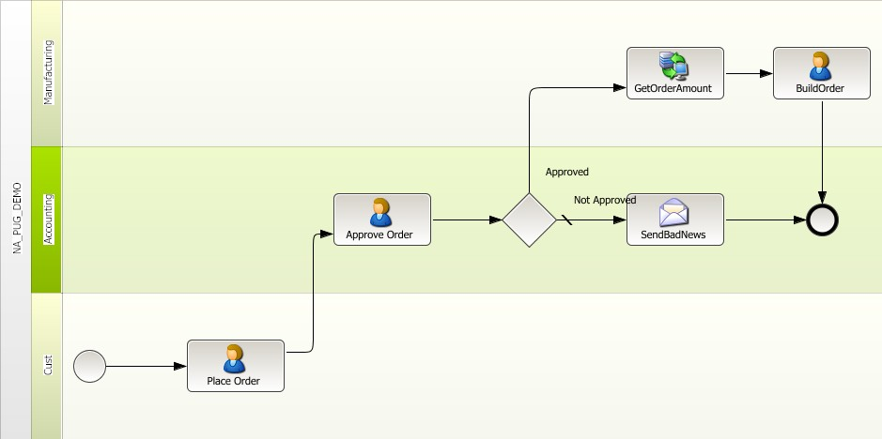
Demo

Slide 16
How Applications Developers Benefit From
Business Process Applications
Benefit
Means
Reduced cost and time of development
New apps can be built faster and with more customer value
Easier customization
of applications
Users’ requirements can
be better met more quickly
More agile and maintainable applications
Ability to deliver better apps faster is a competitive edge

Slide 17
How Your End-users Benefit from Business Process Applications
Benefit
Means
Visibility
Gain visibility into the effectiveness of each process
Agility
Easily modify processes to meet changing requirements
Continuous Improvement
Processes can be monitored and easily improved
Businesses Empowered
Business managers gain insight and control of their business

Slide 18
Agenda
OpenEdge BPM Strategy and Value Proposition
Integrating BPM with Your OpenEdge Application
OpenEdge BPM Roadmap
Wrap-up & Q&A

Slide 19

Existing OpenEdge Applications Can Be Easily BPM-enabled using OpenEdge BPM – No Rip n’ Replace
A-GUI
R-GUI
Q-GUI
S-GUI
Qualify Account
Review Account
OtherFunc
No
Email Campaign
Assign
Account
Func 2
Email Camp.
Other Func
No
Return Opp
Qualify
Opp?
Review
App?
OpenEdge Lead Gen Application
Yes
Assign Acct Mgr
Moving to a BPM-enabled application
  Business analysts models process
  Developers:
    Reuse existing UIs and functions
    Build new UIs and functions where needed
    Connects UIs and functions to process
Inside sales
  Qualify lead1
  Qualify lead2
Yes
Sales Mgr
  Review opp1
  Review opp3
Acct Mgr
  Assign prosp1
  Assign prosp4
A-GUI
R-GUI
V-GUI
Qualify Service
Review Service
Email Camp
Assign Service

Slide 20





Partners Making Progress with OpenEdge BPM

Slide 21
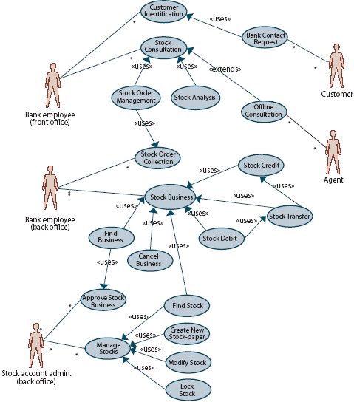
Technical Use Cases
Five primary use cases:
  Savvion Portal with OpenEdge AppServer
  WebSpeed UI Embedded in Savvion Portal
  WebSpeed-based Stand-alone Portal
  Application Portal with Embedded Workflow, Server Driven
  Application Portal with Embedded Workflow, Client Driven
Notes:
More readable
tune bullets
Which ones are in demo?

Slide 22
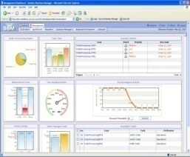
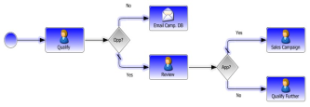
Use Case 1:
Savvion Calls OpenEdge AppServer
Runtime
Architecture
Portal: Savvion BPM Portal
Presentation Flow: Savvion BPM Server
Forms: Savvion Bizlogic
OE System Steps: Savvion executes OE business logic by calling OpenEdge AppServer via Web Services
Customers: Van Meijel, Echo Managed Services
BPM Portal
BPM Server
Web Services
OpenEdge
AppServer

Slide 23
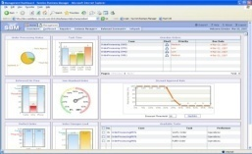
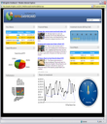
Use Case 2:
WebSpeed UI Embedded in Savvion Portal
Runtime
Architecture
Portal: Savvion BPM Portal
Presentation Flow: Savvion BPM Server
Forms: OE WebSpeed
  Displayed in Savvion BPM Portal using iframe control within a Bizsolo form or the iframe redirector
  Dataslot values passed as query parameters or fetched from Savvion BPM server
OE System Steps: None
Customers: Skyward
WebSpeed UI in BPM Portal
BPM Server
Web Services
WebSpeed Transaction
Server

Slide 24
Use Case 3:
WebSpeed UI – Stand alone
Runtime
Architecture
Portal: WebSpeed-based Portal
Presentation Flow: Application-specific and embedded within WebSpeed
Forms: OE WebSpeed
  Displayed in Savvion BPM Portal using iframe control within a Bizsolo form or the iframe redirector
  Dataslot values passed as query parameters or fetched from Savvion BPM server
OE System Steps: None
Customers: Skyward
WebSpeed Portal
BPM Server
Web Services
WebSpeed Transaction
Server

Slide 25
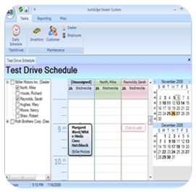
Use Case 4:
Embedded Workflow, Server Driven
Portal: Application-specific
Presentation Flow: Application-specific and embedded within AppServer
Forms: Application-specific
OE System Steps: None
Customer: ProALPHA
Runtime
Architecture
UI
UI
UI
OpenEdge
AppServer
BPM Server
Notes:
Add Web Services

Slide 26

Use Case 5:
Embedded Workflow, Client Driven
Runtime
Architecture
Portal: Application-specific based on OpenEdge UI or other UI
Presentation Flow: Application-specific
  BPM Server does not know anything about other UI types
Forms: Application-specific
OE System Steps: None
Customers: QAD (.NET UI)
UI
UI
UI
BPM Server
OpenEdge
AppServer
(optional)
Notes:
Add Web Services

Slide 27
Agenda
OpenEdge BPM Strategy and Value Proposition
Integrating BPM with Your OpenEdge Application
OpenEdge BPM Roadmap
Wrap-up & Q&A

Slide 28
Our Vision for OpenEdge BPM
Easy-to-use BPM-enabled application development platform.
Higher business values
Excellent customer and developer experience
Lowest total cost of ownership
Provides unified business process and transaction-oriented execution environments.
BPM-enabled
OpenEdge
Architect
BPM-Enabled OpenEdge
Run-time

Slide 29
Phase I: OpenEdge DBMS Support
Requires only OpenEdge DBMS.
OpenEdge data is accessed from BPM.
Reduces the cost and complexity of application deployment.
OpenEdge database support
  BPM Server
  Managed Database adapter
BPM
Studio
OpenEdge
Architect
BPM
Studio
BPM
Run-time
OpenEdge Run-time
OpenEdge
DB
OpenEdge
DB
Available TODAY
Windows/Linux
Savvion 7.6.1, OE10.2B04

Slide 30
Phase II: Unified Development Environment
Adds:
Savvion adapter for OE AppServer
Savvion API’s built into OpenEdge
Savvion dataslots support OpenEdge data types
Consistent Eclipse environment
Simplifies business process application development and improves developers’ experience.
BPM functionality is invoked natively from ABL and vice versa.
Data storage and access are unified.
Integrated
OpenEdge Architect
and
BPM Studio
BPM
Run-time
OpenEdge Run-time
OpenEdge
DB
OpenEdge
DB
Available December 2011
All OpenEdge Platforms
Savvion 8.0, OpenEdge 11.0

Slide 31
Agenda
OpenEdge BPM Strategy and Value Proposition
Integrating BPM with Your OpenEdge Application
OpenEdge BPM Roadmap
Wrap-up & Q&A

Slide 32
Summary – OpenEdge BPM
A powerful platform for building business process applications
Enables rapid development, easier customization, and reuse and modernization of existing applications
Provides visibility into business operations, supporting streamlined business operations, and continuous operations
Allows you to be more competitive!!

Slide 33





