Slide 1
Latest in OpenEdge Architect ®
Sunil Belgaonkar
Software Architect, Progress Software Corp

Slide 2
OpenEdge Architect Use Cases
Build ABL GUI / ADM2 / CHUI based applications
Build Webspeed/ AJAX based applications
Add Integration support to ABL Applications – Sonic
Build ABL GUI for .NET UI
Build AppServer based applications
Database Schema management
Create, Edit, Compile, Run and Debug ABL code

Slide 3
What is new and exciting with OpenEdge Architect?
What’s new in OpenEdge Architect 10.2B
What’s coming in OpenEdge Architect 11.0

Slide 4
Enhancements In OpenEdge Architect 10.2B
Build ABL GUI / ADM2 / CHUI based applications
Build Webspeed/ AJAX based applications
Add Integration support to ABL Applications – Sonic / REST
Build ABL GUI for .NET UI
Build AppServer based applications
Database Schema management
Create, Edit, Compile, Run and Debug ABL code
Installation and Getting Started
New and improved Welcome page
Installing OpenEdge Architect 10.2b plug-ins into existing Eclipse installation
OpenEdge Architect 10.2b - Supported Eclipse Platforms

Slide 5
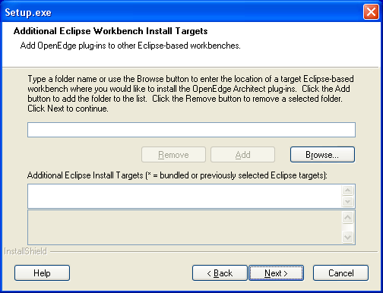
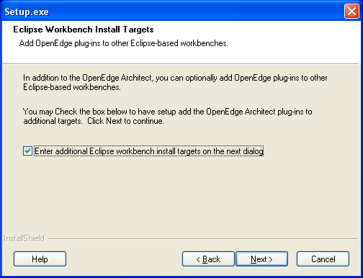
Installing OpenEdge Architect 10.2B Plug-ins In Existing Eclipse installation
At install time, you can provide additional install targets

Slide 6
Enhancements In OpenEdge Architect 10.2B
Create, Edit, Compile, Run and Debug ABL code
Build Webspeed/ AJAX based applications
Add Integration support to ABL Applications – Sonic / REST
Build ABL GUI for .NET UI
Build AppServer based applications
Database Schema management
Build ABL GUI / ADM2 / CHUI based applications
AppServer and Web tooling enhancements
Iterative N-tier development - AppServer Support
Web Tooling Enhancements

Slide 7
AppServer Support In OpenEdge Architect 10.2B
Build ABL GUI / ADM2 / CHUI based applications
Build Webspeed/ AJAX based applications
Add Integration support to ABL Applications – Sonic / REST
Build ABL GUI for .NET UI
Build AppServer based applications
Database Schema management
Create, Edit, Compile, Run and Debug ABL code
Goal: Simplify iterative development – Allow OpenEdge developers to iteratively develop and test OpenEdge AppServer based applications from within OEA
Functionality:
Added AppServer project type to identify AppServer resources
Added AppServer Broker support for resources / Broker Association
Can publish AppServer resources to local AppServer

Slide 8
Web Tooling In OpenEdge Architect 10.2B
Build ABL GUI / ADM2 / CHUI based applications
Build Webspeed/ AJAX based applications
Add Integration support to ABL Applications – Sonic / REST
Build ABL GUI for .NET UI
Build AppServer based applications
Database Schema management
Create, Edit, Compile, Run and Debug ABL code
Goal: As a first step, allow OpenEdge developers to create, edit and publish static web resources like HTML, JS, CSS from within OpenEdge Architect
Functionality:
Added Static Web Project type and provides HTML, JavaScript and CSS Editors
Provided Local Web Server support for static resource/ Web server association
Can publish static resources to local Web server

Slide 9
Enhancements In OpenEdge Architect 10.2B
Build ABL GUI / ADM2 / CHUI based applications
Build Webspeed/ AJAX based applications
Add Integration support to ABL Applications – Sonic / REST
Build ABL GUI for .NET UI
Build AppServer based applications
Database Schema management
Create, Edit, Compile, Run and Debug ABL code
General
Environment Enhancements
Shared AVM - Performance Improvements with Multiple Projects in the Workspace
Support for new language features
  Events
  Generics
Data-aware Content Assist

Slide 10
Shared AVM For OpenEdge Architect 10.2B
Build ABL GUI / ADM2 / CHUI based applications
Build Webspeed/ AJAX based applications
Add Integration support to ABL Applications – Sonic / REST
Build ABL GUI for .NET UI
Build AppServer based applications
Database Schema management
Create, Edit, Compile and Run ABL code
Goal: Improve performance and scalability of OpenEdge Architect environment by reducing resource utilization.
Functionality:
Sharable Workspace level AVM
OpenEdge Project can now use either a project-specific AVM or shared workspace level AVM

Slide 11
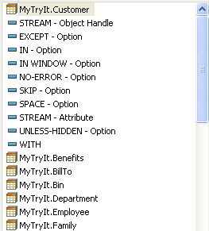
Data-aware Content Assist
Build ABL GUI / ADM2 / CHUI based applications
Build Webspeed/ AJAX based applications
Add Integration support to ABL Applications – Sonic / REST
Build ABL GUI for .NET UI
Build AppServer based applications
Database Schema management
Create, Edit, Compile, Run and Debug ABL code
DO FOR Order:
DISPLAY Order.
END.
DO FOR Customer:
FOR EACH Customer:
DISPLAY | EXCEPT comments.
END.
END.
Customer shown first in list
Content assist opened here
(ctrl + space)
Notes:
In the code box, for the DISPLAY statement, the scope is the enclosing FOR EACH and DO FOR statements with Customer buffer. The cursor is in the FOR EACH block after the DISPLAY statement. In this case, the previous DO FOR statement for Order is not considered since it comes within a previous completed block.
~B~ A content assist request after the DISPLAY keyword suggests Customer as top option in the list, based on the context of the DO FOR block which uses the Customer record.
10.2B Beta OpenEdge
PSC Internal Use Only
11

Slide 12
Enhancements in OpenEdge Architect 10.2B
Visual Designer Enhancements
Build ABL GUI / ADM2 / CHUI based applications
Build Webspeed/ AJAX based applications
Add Integration support to ABL Applications – Sonic / REST
Build ABL GUI for .NET UI
Build AppServer based applications
Database Schema management
Create, Edit, Compile, Run and Debug ABL code
Migration Tool for Upgrading OpenEdge Ultra Controls to 2009.2
ProBindingSource Improvements at Design Time
Global Toolbox

Slide 13
What is new and exciting with OpenEdge Architect?
What’s new in OpenEdge Architect 10.2B
What’s coming in OpenEdge Architect 11.0

Slide 14
Future Strategy
D I S C L A I M E R
D I S C L A I
This presentation includes information about future products and/or product enhancements.
What I am going to say reflects our current thinking, but the information contained herein is preliminary and subject to change. Any future products we ultimately deliver may be materially different from what is described here.
D I S C L A I M E R

Slide 15
Project Types in OpenEdge Architect 11.0
Build ABL GUI / ADM2 / CHUI based applications
Build Webspeed/ AJAX based applications
Add Integration support to ABL Applications – Sonic / REST
Build ABL GUI for .NET UI
Build AppServer based applications
Database Schema management
Create, Edit, Compile, Run and Debug ABL code
Goal: Allow OpenEdge developers a flexible and customizable project environment
Functionality:
Out of the box project types e.g.
  AppServer
  Webspeed
  GUI for .NET
  ABL GUI etc…
Ability to define your own project types

Slide 16
Webspeed support in OpenEdge Architect 11.0
Build ABL GUI / ADM2 / CHUI based applications
Build Webspeed/ AJAX based applications
Add Integration support to ABL Applications – Sonic / REST
Build ABL GUI for .NET UI
Build AppServer based applications
Database Schema management
Create, Edit, Compile, Run and Debug ABL code
Goal: Allow OpenEdge developers to iteratively develop, test and debug OpenEdge WebSpeed applications from within OEA
Functionality:
WebSpeed project type and WebSpeed Broker support
  Similar to AppServer Broker in 10.2B
WebSpeed programming models like SpeedScript, CGI Wrapper
Remote Server support for WebSpeed Broker

Slide 17
AppServer Support In OpenEdge Architect 11.0
Build ABL GUI / ADM2 / CHUI based applications
Build Webspeed/ AJAX based applications
Add Integration support to ABL Applications – Sonic / REST
Build ABL GUI for .NET UI
Build AppServer based applications
Database Schema management
Create, Edit, Compile, Run and Debug ABL code
Goal: Simplify iterative development – Allow OpenEdge developers to iteratively develop, test and debug OpenEdge AppServer based applications from within OEA
Functionality:
Remote Server support for AppServer Broker

Slide 18
Improved Debugger in OpenEdge Architect 11.0
Build ABL GUI / ADM2 / CHUI based applications
Build Webspeed/ AJAX based applications
Add Integration support to ABL Applications – Sonic / REST
Build ABL GUI for .NET UI
Build AppServer based applications
Database Schema management
Create, Edit, Compile, Run and Debug ABL code
Goal: Allow OpenEdge developers to connect to remote AVM sessions and provide better AppServer / Webspeed debugging capability
Functionality:
Source code based debugging – no debug listing required for debugging using OpenEdge Architect
Ability to connect OpenEdge Architect debugger to already running AVM sessions
Ability to debug programs on AppServer and Webspeed brokers

Slide 19
OpenEdge Architect On Non-Windows Platforms
Goal: Provide OpenEdge Architect support on Linux platforms
List of Platforms supported:
  Red Hat Enterprise Linux 5 – 32 and 64 bit
  SuSE Enterprise Server 11 - 32 and 64 bit
OpenEdge Architect
Different Platforms + SDLC integration
Integrate other Progress products

Slide 20
General Improvements To OpenEdge Architect Environment
Build ABL GUI / ADM2 / CHUI based applications
Build Webspeed/ AJAX based applications
Add Integration support to ABL Applications – Sonic / REST
Build ABL GUI for .NET UI
Build AppServer based applications
Database Schema management
Create, Edit, Compile and Run ABL code
Support for Eclipse 3.6
Pre Processor support in OpenEdge Architect ABL Editor
Ability to Mark files/folders as non-compilable
  Leverage Working Sets for large project compilation
  Support for Build order
Project Explorer view to replace Resources view

Slide 21
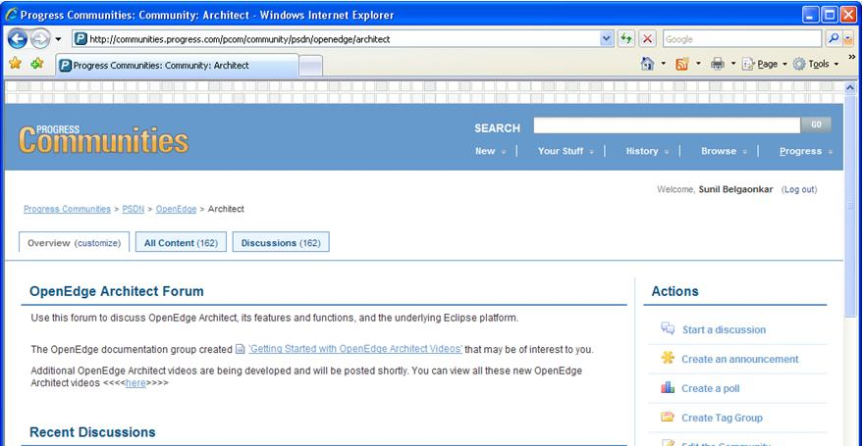
Got Questions?
  OpenEdge Architect forum on Progress Communities: http://communities.progress.com/pcom/community/psdn/openedge/architect

Slide 22
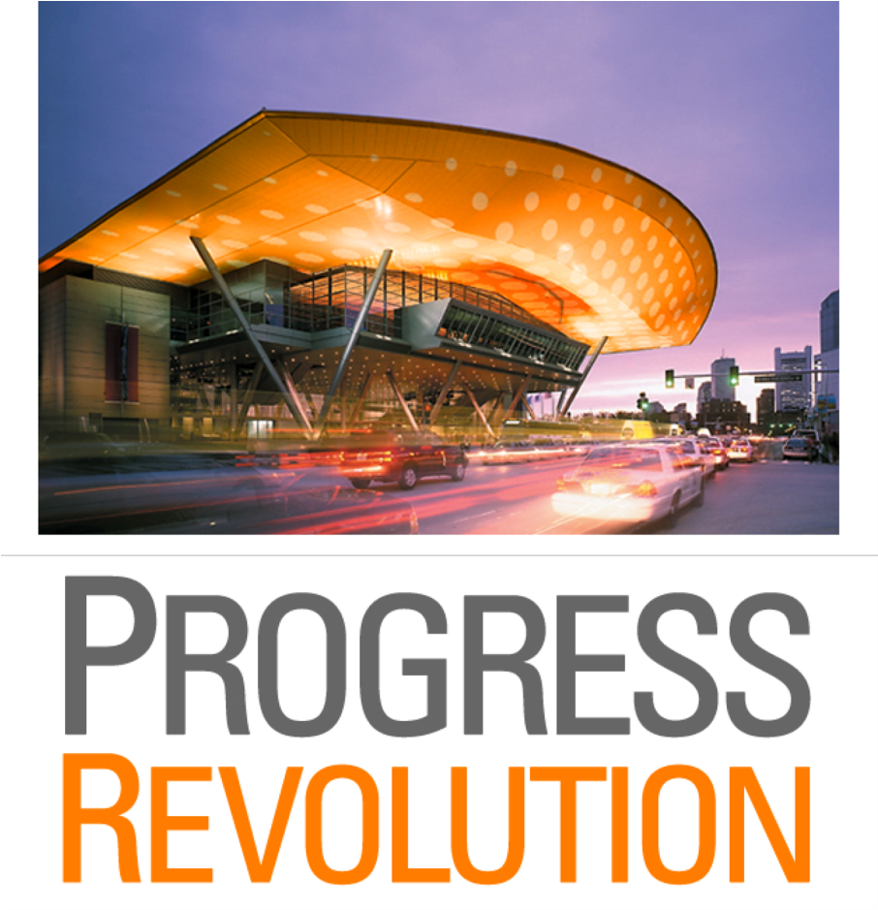
Sept. 19 – 22, 2011
Boston Westin Waterfront Hotel
and Boston Convention & Exhibition Center
Notes:
22

