Slide 1
OpenEdge BPM Demo for
NA PUG Challenge
Brian Bowman
Sr. Solutions Consultant
bowman@progress.com

Slide 2



Key Capabilities Required for Building Business Process Applications
Business Analyst
Business Solution
Developer
Business Manager
BPA
Business Process Analyses
BPMS
Business Process Automation
BPI
Business Process Improvement

Slide 3

Avoid “Rip and Replace”
A-GUI
R-GUI
Q-GUI
S-GUI
Qualify Account
Review Account
OtherFunc
No
Email Campaign
Assign
Account
Func 2
Email Camp.
Other Func
No
Return Opp
Qualify
Opp?
Review
App?
OpenEdge Lead Gen Application
Yes
Assign Acct Mgr
Move to a business process-enabled application
  Business analysts models process
  Developers:
    Reuse existing UIs and functions
    Build new UIs and functions where needed
    Connects UIs and functions to process
Inside sales
  Qualify lead1
  Qualify lead2
Yes
Sales Mgr
  Review opp1
  Review opp3
Acct Mgr
  Assign prosp1
  Assign prosp4
Q-GUI
R-GUI
A-GUI
Qualify Service
Review Service
Email Camp
Assign Service

Slide 4
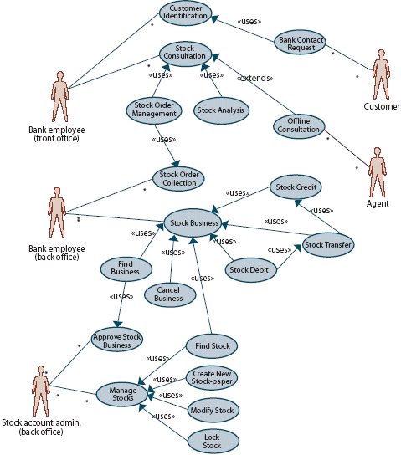
Technical Use Cases
Four primary use cases have been identified:
  Savvion Calls OpenEdge AppServer
  WebSpeed UI Embedded in Savvion Portal
  Embedded Workflow, Server Driven
  Embedded Workflow, Client Driven
All customers want the ability to store process information in an OpenEdge database

Slide 5
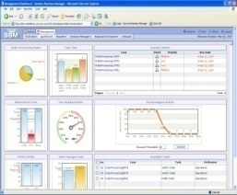
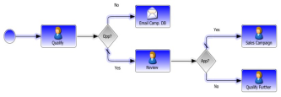
Use Case 1:
Savvion Calls OpenEdge AppServer
Runtime
Architecture
Portal: Savvion BPM Portal
Presentation Flow: Savvion BPM Server
Forms: Savvion Bizlogic
OE System Steps: Savvion executes OE business logic by calling OpenEdge AppServer via Web Services
Customers: Van Meijel, Echo Managed Services
BPM Portal
BPM Server
Web Services
OpenEdge
AppServer

Slide 6
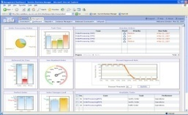
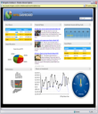
Use Case 2:
WebSpeed UI Embedded in Savvion Portal
Runtime
Architecture
Portal: Savvion BPM Portal
Presentation Flow: Savvion BPM Server
Forms: OE WebSpeed
  Displayed in Savvion BPM Portal using iframe control within a Bizsolo form or the iframe redirector
  Dataslot values passed as query parameters or fetched from Savvion BPM server
OE System Steps: None
Customers: Skyward
WebSpeed UI in BPM Portal
BPM Server
Web Services
WebSpeed Transaction
Server

Slide 7
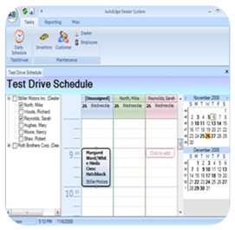
Use Case 3:
Embedded Workflow, Server Driven
Runtime
Architecture
Portal: Application-specific
Presentation Flow: Application-specific and embedded within AppServer
Forms: Application-specific
OE System Steps: None
Customer: ProALPHA
UI
UI
UI
OpenEdge
AppServer
BPM Server
Notes:
Add Web Services

Slide 8

Use Case 4:
Embedded Workflow, Client Driven
Runtime
Architecture
Portal: Application-specific based on OpenEdge UI or other UI
Presentation Flow: Application-specific
  BPM Server does not know anything about other UI types
Forms: Application-specific
OE System Steps: None
Customers: QAD (.NET UI)
UI
UI
UI
BPM Server
OpenEdge
AppServer
(optional)
Notes:
Add Web Services

Slide 9
OpenEdge BPM Demo
Brian Bowman
Senior Solutions Consultant

Slide 10

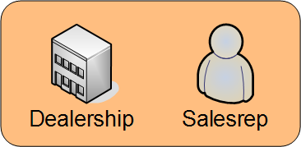
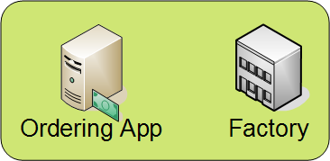

Business Requirements

Slide 11
Business Requirements
Order Placed

Slide 12
Business Requirements
Order
reviewed

Slide 13
Business Requirements
Notify Dealer

Slide 14

Business Requirements
Customer
takes
possession

Slide 15

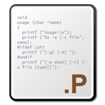
Business Requirements

Slide 16
Business Requirements

Slide 17

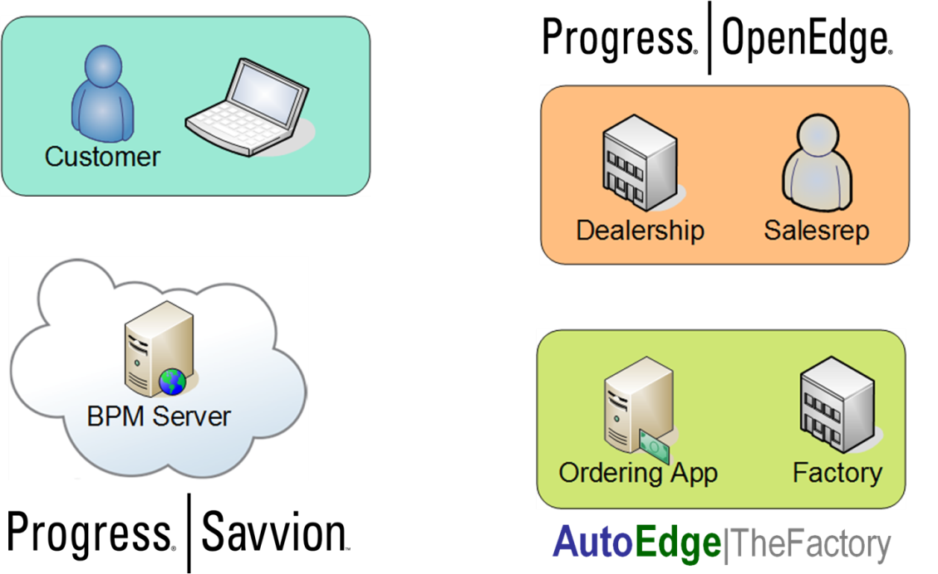
Demo

Slide 18
Example Code: Finance Approving an Order
method protected void ApproveOrder():
cast(CurrentTask:DataSlots:
Get(new String('OrderReviewed')),
DataSlotInstance):value = 'true'.
cast(CurrentTask:DataSlots:
Get(new String('OrderApproved')),
DataSlotInstance):value = 'true'.
cast(CurrentTask:DataSlots:
Get(new String('VehicleInStock')),
DataSlotInstance):value =
string(uxInStock:Checked, 'true/false').
TaskListManager:CompleteTask(CurrentTask).
end method.

Slide 19
Populating the Dealer Order Screen
assign oGroup = uxAccordion:
Groups:Item['AssignedTasks']
oTaskList = BizLogicService:
GetAssignedWorkItemList(SessionId)
no-error.

Slide 20





