Slide 1
Guidelines for OpenEdge in a Virtual Environment
(Plus more knowledge from the Bunker Tests)
John Harlow
JHarlow@BravePoint.com

Slide 2
About John Harlow & BravePoint
John Harlow
  Unix user since 1982
  Progress developer since 1984
  Linux user since 1995
  VMware® user since earliest beta in 1999
BravePoint is an IT Services Company
    Founded in 1987.
    80 employees
  Focus on:
    Progress Software technologies
    AJAX
    Business Intelligence
    MFG/PRO and Manufacturing
    Managed Database Services
    Training, Consulting, Development, Support

Slide 3
Questions for today
What is virtualization?
Why virtualize?
How are virtualized resources managed?
How is performance impacted?

Slide 4
Assumptions and Background
This presentation assumes that you have some familiarity with virtualization in general and VMware® specifically
This presentation is specifically geared to the Vmware vSphere/ESX/ESXi environments.
We won’t be covering:
  Xen
  MS Hyper-V
  Others

Slide 5
Virtualization at BravePoint
  All of our production systems run in VMware® VMs
  All Development/Test Servers run as Virtual Machines in a VMware® Server Farm
  Mac/Linux/Windows users use desktop VMs to run Windows Apps
  Support Desk and Developers use desktop VMs to deal with conflicting customer VPNs
    Centralized VM server for VPN guests improves security and flexibility
  Production systems D/R is done via VMs

Slide 6
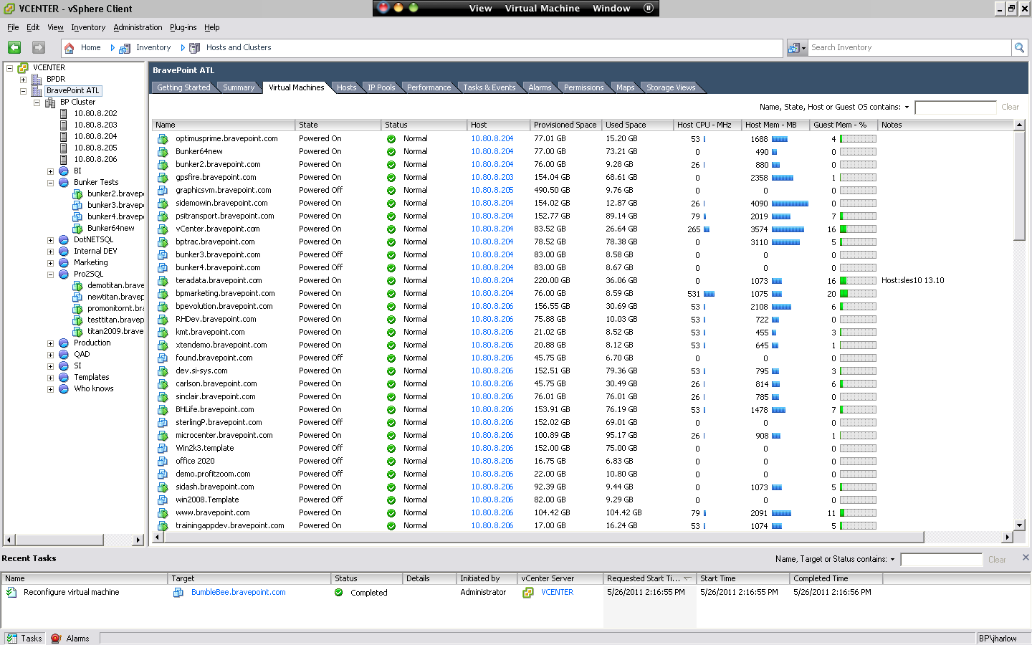
VSphere Console

Slide 7
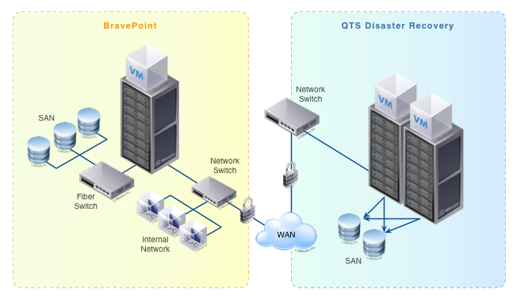
BravePoint VM Diagram

Slide 8
Some Key Definitions
Virtualization is an abstract layer that decouples the physical hardware from the operating system.
Paravirtualization is a less abstracted form of virtualization where the guest operating system is modified to know about and communicate with the virtualization system hardware to improve performance

Slide 9
Benefits of Virtualization
Partitioning Multiple applications, operating systems and environments can be supported in a single physical system
Allows computing resources to be treated as a uniform pool for allocation
Decouples systems and software from hardware and simplifies hardware scalability

Slide 10
Benefits of Virtualization
Isolation
  VM is completely isolated from the host machine and other VMs.
  Reboot or crash of a VM shouldn’t affect other VMs.
  Data is not shared between VMs
  Applications can only communicate over configured network connections.
Notes:
Really important for more vulnerable OS’s like Windows
Communications typically occur using TCP/IP plus SMB or FTP

Slide 11
Benefits of Virtualization
Encapsulation
  Complete VMs typically exist in a few files which are easily backed up, copied, or moved.
  The ‘hardware’ of the VM is standardized
    So compatibility is guaranteed.
  Upgrades/changes in the real underlying hardware are generally transparent to the VM
Notes:
This makes processes like D/R, testing updates, creating test environments very easy, easy to restore

Slide 12
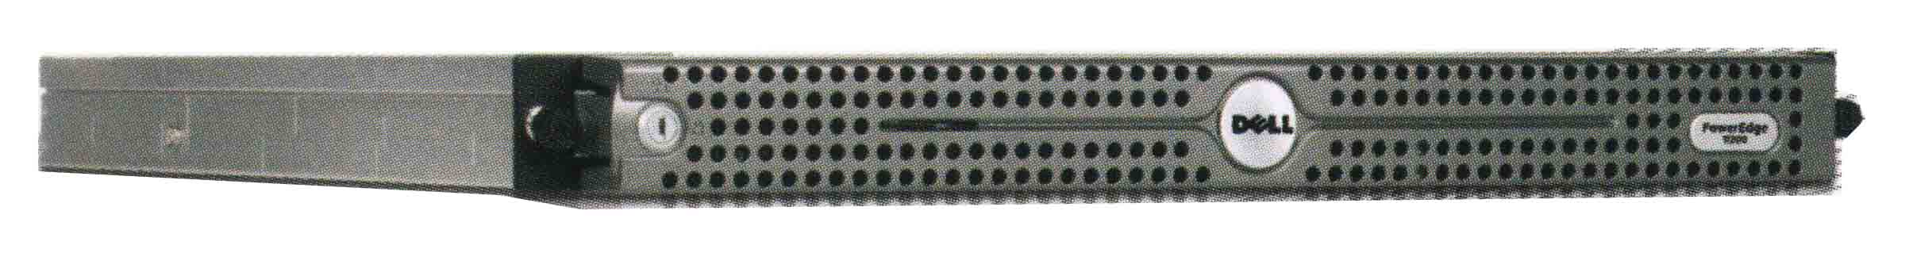
Why use virtualization at all?
Let’s look at a typical SMB computer systems
System | CPU Load
Domain Controller | 10%
Print Server | 20%
File Server | 20%
Exchange Server | 20%
Web Server | 7%
Database Server | 30%
Citrix Server | 50%

Slide 13
Why use virtualization?
In the typical SMB setup:
  CPU/RAM Utilization is typically low and unbalanced
  Backup and recovery are complex and may be hardware dependent
  Administration is complicated
  Many points of failure

Slide 14
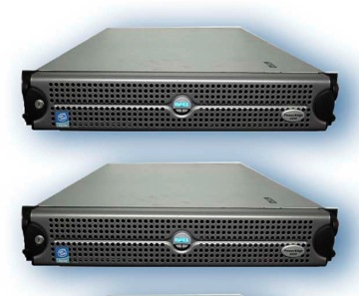
Why use virtualization?
Less hardware
Higher utilization
Redundancy and higher availability
Flexibility to scale resources
Lower administrative workload
Hardware upgrades are invisible to virtual systems
The list goes on and on..
Virtualized Servers

Slide 15
Does virtualization affect tuning?
We already know how to administer and tune our real systems.
  Besides, when virtualized they don’t even know that they are in a VM!
  How different could a VM be from a real machine?
We’re going to look under the covers at these 4 areas:
  Memory
  CPUs
  Networking
  Storage

Slide 16
Benchmark Hardware
The benchmarks quoted in the presentation were run on the same hardware that was used for the 2011 ‘Bunker’ tests.
These were a series of benchmark tests run with Gus Bjorklund, Dan Foreman and myself in February of 2011
These benchmarks were built around the ATM – Bank teller benchmark.

Slide 17
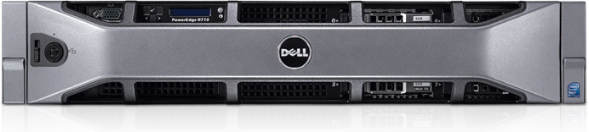
Server Info
Dell R710
  16 CPUs
  32 GB RAM

Slide 18
SAN Info
EMC CX4-120
Fabric: 4GB Fiber Channel
14 Disks + one hot swap spare
300 gb disks
15000 RPM
Configured as RAID 5 for these tests
  Should always be RAID 10 for OpenEdge

Slide 19
Software Info
VSphere Enterprise 4.1
Progress V10.2B SP03
  64-bit
Centos 5.5 (2.6.18-194.32.1.el5)
  64 bit for Java workloads
  64 bit for OpenEdge
Tales From The Bunker

Slide 20
Software Info
Java
  java version "1.6.0_24"
  Java(TM) SE Runtime Environment (build 1.6.0_24-b07)
  Java HotSpot(TM) 64-Bit Server VM (build 19.1-b02, mixed mode)
The DaCapo Benchmark Suite
  http://www.dacapobench.org/
Tales From The Bunker

Slide 21
The DaCapo Benchmark Suite
Totally written in java
Self contained
  Comes as 1 jar file
Open Source
Tests many different workloads
Easy way to tie up CPU and memory resources

Slide 22
What does DaCapo benchmark ?
avrora simulates a number of programs run on a grid of AVR microcontrollers
batik produces a number of Scalable Vector Graphics (SVG) images based on the unit tests in Apache Batik
eclipse executes some of the (non-gui) jdt performance tests for the Eclipse IDE
fop takes an XSL-FO file, parses it and formats it, generating a PDF file.
h2 executes a JDBCbench-like in-memory benchmark, executing a number of transactions against a model of a banking application, replacing the hsqldb benchmark
jython inteprets a the pybench Python benchmark
luindex Uses lucene to indexes a set of documents; the works of Shakespeare and the King James Bibl
Lusearch Uses lucene to do a text search of keywords over a corpus of data comprising the works of Shakespeare and the King James Bible
pmd analyzes a set of Java classes for a range of source code problems
Sunflow renders a set of images using ray tracing
tomcat runs a set of queries against a Tomcat server retrieving and verifying the resulting webpages
tradebeans runs the daytrader benchmark via a Jave Beans to a GERONIMO backend with an in memory h2 as the underlying database
tradesoap runs the daytrader benchmark via a SOAP to a GERONIMO backend with in memory h2 as the underlying database
xalan transforms XML documents into HTML

Slide 23
DaCapo Workloads Used
Eclipse
  executes some of the (non-gui) jdt performance tests for the Eclipse IDE
Jython
  inteprets a the pybench Python benchmark
Tradebeans
  runs the daytrader benchmark via a Jave Beans to a GERONIMO backend with an in memory h2 as the underlying database

Slide 24
Methodology
In the Bunker we used the ATM to establish performance levels for a lone VM running on the hardware
In the real world, most VM servers host multiple clients
I used DaCapo in multiple client VMs on the same VM server to create additional workloads
DaCapo’s workloads are a mix of disk/memory/CPU
Threads and memory use are tuneable as start-up options.

Slide 25
Methodology Used
First, leverage Bunker work and establish an ATM baseline
  Only the Bunker64 System was running
  2 vCPUs (more on this later)
  16 Gig vRAM
  RAID 5 SAN
  150 users
1481 TPS

Slide 26
Additional Workloads
1-3 additional Centos 5.5 x86_64 boxes
  Tested with 1 vCPU
  Tested with 2 vCPUs
  Tested with 512m-8GB vRAM
  Each running one of the DaCapo workloads
    200 threads
Measure degradation in performance of ATM benchmark
Reboot all VMs after each test

Slide 27
Other Tests Included
Changing number of vCPUs in Bunker64 system
  Making related changes to APWs
Changing clock interrupt mechanism in Bunker64

Slide 28
Additional VMs Workload Benchmark

Slide 29
ESX memory management concepts
Each virtual machine believes its memory is physical, contiguous and starts at address 0.
  The reality is that no instance starts at 0 and the memory in use by a VM can be scattered across the physical memory of the server.
Virtual memory requires an extra level of indirection to make this work.
  ESX maps the VMs memory to real memory and intercepts and corrects operations that use memory
  This adds overhead
Each VM is configured with a certain amount of RAM at boot.
    This configured size can not change while the VM is running.
    The total RAM of a VM is its configured size plus a small amount of memory for the frame buffer and other overhead related to configuration.
    This RAM can be reserved or dynamically managed

Slide 30
Memory Overhead
The ESX Console and Kernel use about 300 meg of memory
Each running VM also consumes some amount of memory
The memory overhead of a VM varies
  The memory allocated to the VM
  The number of CPUs
  Whether it is 32 or 64 bit.
Interestingly, the total amount of configured RAM can exceed the physical RAM in the real ESX server.
This is called overcommitting memory.

Slide 31
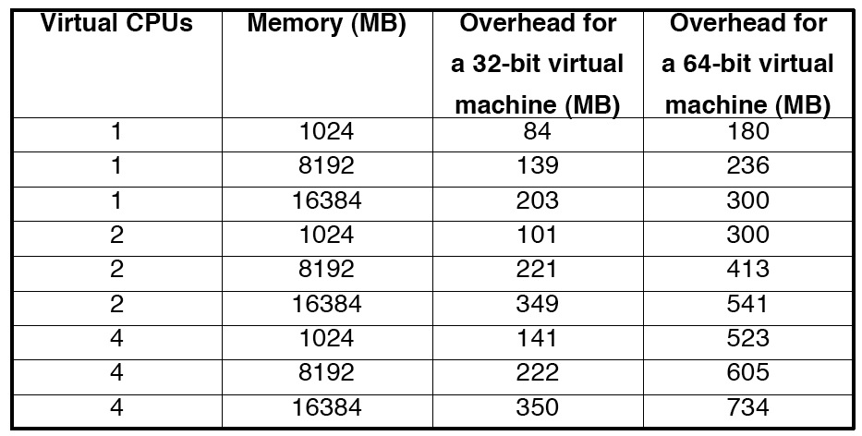
VM Memory overhead

Slide 32
How VMware® manages RAM
  Memory Sharing - mapping duplicate pages of RAM between different VMs
    Since most installations run multiple copies of the same guest operating systems, a large number of memory pages are duplicated across instances
    Savings can be as much as 30%
  Memory Ballooning - using a process inside the VM to ‘tie-up‘ unused memory
    Guests don’t understand that some of their memory might not be available.
    The VMware® Tools driver malloc’s memory from the guest OS and ‘gives’ it back to ESX to use for other VMs
  Physical-to-physical’ memory address mapping is also handled by VMware® and adds overhead

Slide 33
Memory Best Practices
Make sure that the host has more physical memory than the amount used by ESX and the working sets of the running VMs
    ESXTOP is a tool that helps you monitor this
Reserve the full memory set size for your OpenEdge server
    This way VMware® can’t take memory away from the guest and slow it down
Use <= 896 meg of memory for 32bit linux guests
    This eliminates mode switching and overhead of high memory calls

Slide 34
Memory Best Practices
Use shadow page tables to avoid latency in managing mapped memory
Allocate enough memory to each guest so that it does not swap inside its VM
    VMware® is much more efficient at swapping that the guest is
Don’t overcommit memory
  RAM is cheap(ish)
  If you must overcommit memory, be sure to place the ESX swap area on fastest filesystem possible.

Slide 35
RAM Overcommit Benchmark
4 clients, 40G memory allocated on 32G Physical (VMware tools installed)

Slide 36
ESX CPU management
Virtualizing CPUs adds overhead
    The amount depends on how much of the workload can run in the CPU directly, without intervention by VMware® .
    Work that can’t run directly requires mode switches and additional overhead
Other tasks like memory management also add overhead

Slide 37
CPU realities
A guest is never going to match the performance it would have directly on the underlying hardware!
  For CPU intensive guests this is important
  For guests that do lots of disk i/o it doesn’t tend to matter as much
When sizing the server and the workload, factor in losing 10-20% of CPU resources to virtualization overhead

Slide 38
CPU best practices
Use as few vCPUs as possible
  vCPUs add overhead
  Unused vCPUs still consume resources
Configure UP systems with UP HAL
  Watch out for this when changing a systems VM hardware from SMP to UP.
  Most SMP kernels will run in UP mode, but not as well.
  Running SMP in UP mode adds significant overhead
Use UP systems for single threaded apps

Slide 39
Benchmark
8 vCPUs –vs- 2 vCPUs in Bunker64 system
No discernible difference in performance, use 2 CPUs.

Slide 40
CPU best practices
Don’t overcommit CPU resources
  Take into account the workload requirements of each guest.
  At the physical level, aim for a 50% CPU steady state load.
  Easily monitor through the VI Console or ESXTOP
Whenever possible pin multi-threaded or multi-process apps to specific vCPUs
  There is overhead associated with moving a process from one vCPU to another
If possible, use guests with low system timer rates
  This varies wildly by guest OS.

Slide 41
System Timer Benchmark
Use a system timer that generates less interrupts
Needs more investigation
See “Time Keeping in Virtual Machines”

Slide 42
ESX Network Management
Pay attention to the physical network of the ESX system
    How busy is the network?
    How many switches must traffic traverse to accomplish workloads?
    Are the NICs configured to optimal speed/duplex settings?
Use all of the real NICs in the ESX server
    Use server class NICs
    Use identical settings for speed/duplex
    Use NIC teaming to balance loads
Networking speed depends on the available CPU processing capacity
  Virtual switches and NICs use CPU cycles.
  An application that uses extensive networking will consume more CPU resources in ESX

Slide 43
Networking Best Practices
Install VMware® tools in guests
  Use paravirtualized drivers/vhardware whenever possible
Use the vmxnet driver, not e1000 that appears by default
  Optimizes network activity
  Reduces overhead
Use the same vswitch for guests that communicate directly
Use different vswitches for guests that do not communicate directly
Use a separate NIC for administrative functions
  Console
  Backup
Notes:
Shorten

Slide 44
VMware® Storage Management
For OpenEdge applications backend storage performance is critical
Most performance issues are related to the configuration of the underlying storage system
    Its more about i/o channels and hardware than it is about ESX

Slide 45
VMware® Storage Best Practices
Locate VM and swap files on fastest disk
Spread i/o over multiple HBAs and SPs
Make sure that the i/o system can handle the number of simultaneous i/o’s that the guests will generate
Choose Fibre Channel SAN for highest storage performance
Ensure heavily used VMs not all accessing same LUN concurrently
Use paravirtualized SCSI adapters as they are faster and have less overhead.
Guest systems use 64K as the default i/o size
  Increase this for applications that use larger block sizes.
Notes:
Use appropriate caching

Slide 46
VMware® Storage Best Practices
Avoid operations that require excessive file locks or metadata locks
    Growable Virtual Disks do this
    Preallocate VMDK files (just like DB extents)
Avoid operations that excessively open/close files on VMFS file systems
Use independent/persistent mode for disk i/o
    Non-persistent and snapshot modes incur significant performance penalties
Notes:
Use Virtual Infrastructure client to create VMFS partitions since it will align them on 64k boundaries
If you must use SAN/NAS make sure you adequate CPU to support the activity

Slide 47
Other Resource Best Practices
If you frequently change the resource pool (ie: adding or removing ESX servers) use Shares instead of Reservations.
  This way relative priorities remain intact
Use a Reservation to set the minimum acceptable resource level for a guest, not the total amount
Beware of the resource pool paradox.
Enable hyperthreading in the ESX server

Slide 48
Other Mysteries I’ll Mention
The more we run the ATM without restarting the database the faster it gets….

Slide 49
Reference Resources
Performance Best Practices for VMware vSphere 4.0
  http://www.vmware.com/resources/techresources/10041
The Role of Memory in VMware ESX Server 3
  http://www.vmware.com/pdf/esx3_memory.pdf
Time Keeping in Virtual Machines
  http://www.vmware.com/files/pdf/Timekeeping-In-VirtualMachines.pdf
Ten Reasons Why Oracle Databases Run Best on VMware
  http://blogs.vmware.com/performance/2007/11/ten-reasons-why.html

Slide 50
Questions?
John Harlow
President, BravePoint
JHarlow@BravePoint.com

