Slide 1
GitPod: Progress OpenEdge Development in Cloud
JAN MACHOWSKI, SOFTWARE DEVELOPER
September 20th, 2024

Slide 2
About us
36+
2000+
500+
96%
years of experience
projects, including corporations, SME-level companies, and startups
local and international clients
recommendation rate among clients
250+
IT talents
We provide IT and strategic consulting services, including Omnichannel, Self-service, Marketplace, Information security, Enterprise architecture, Cloud solutions, and more.
BALTIC AMADEUS 2024
2

Slide 3

Jan Machowski
Software Developer
BALTIC AMADEUS 2024
3

Slide 4
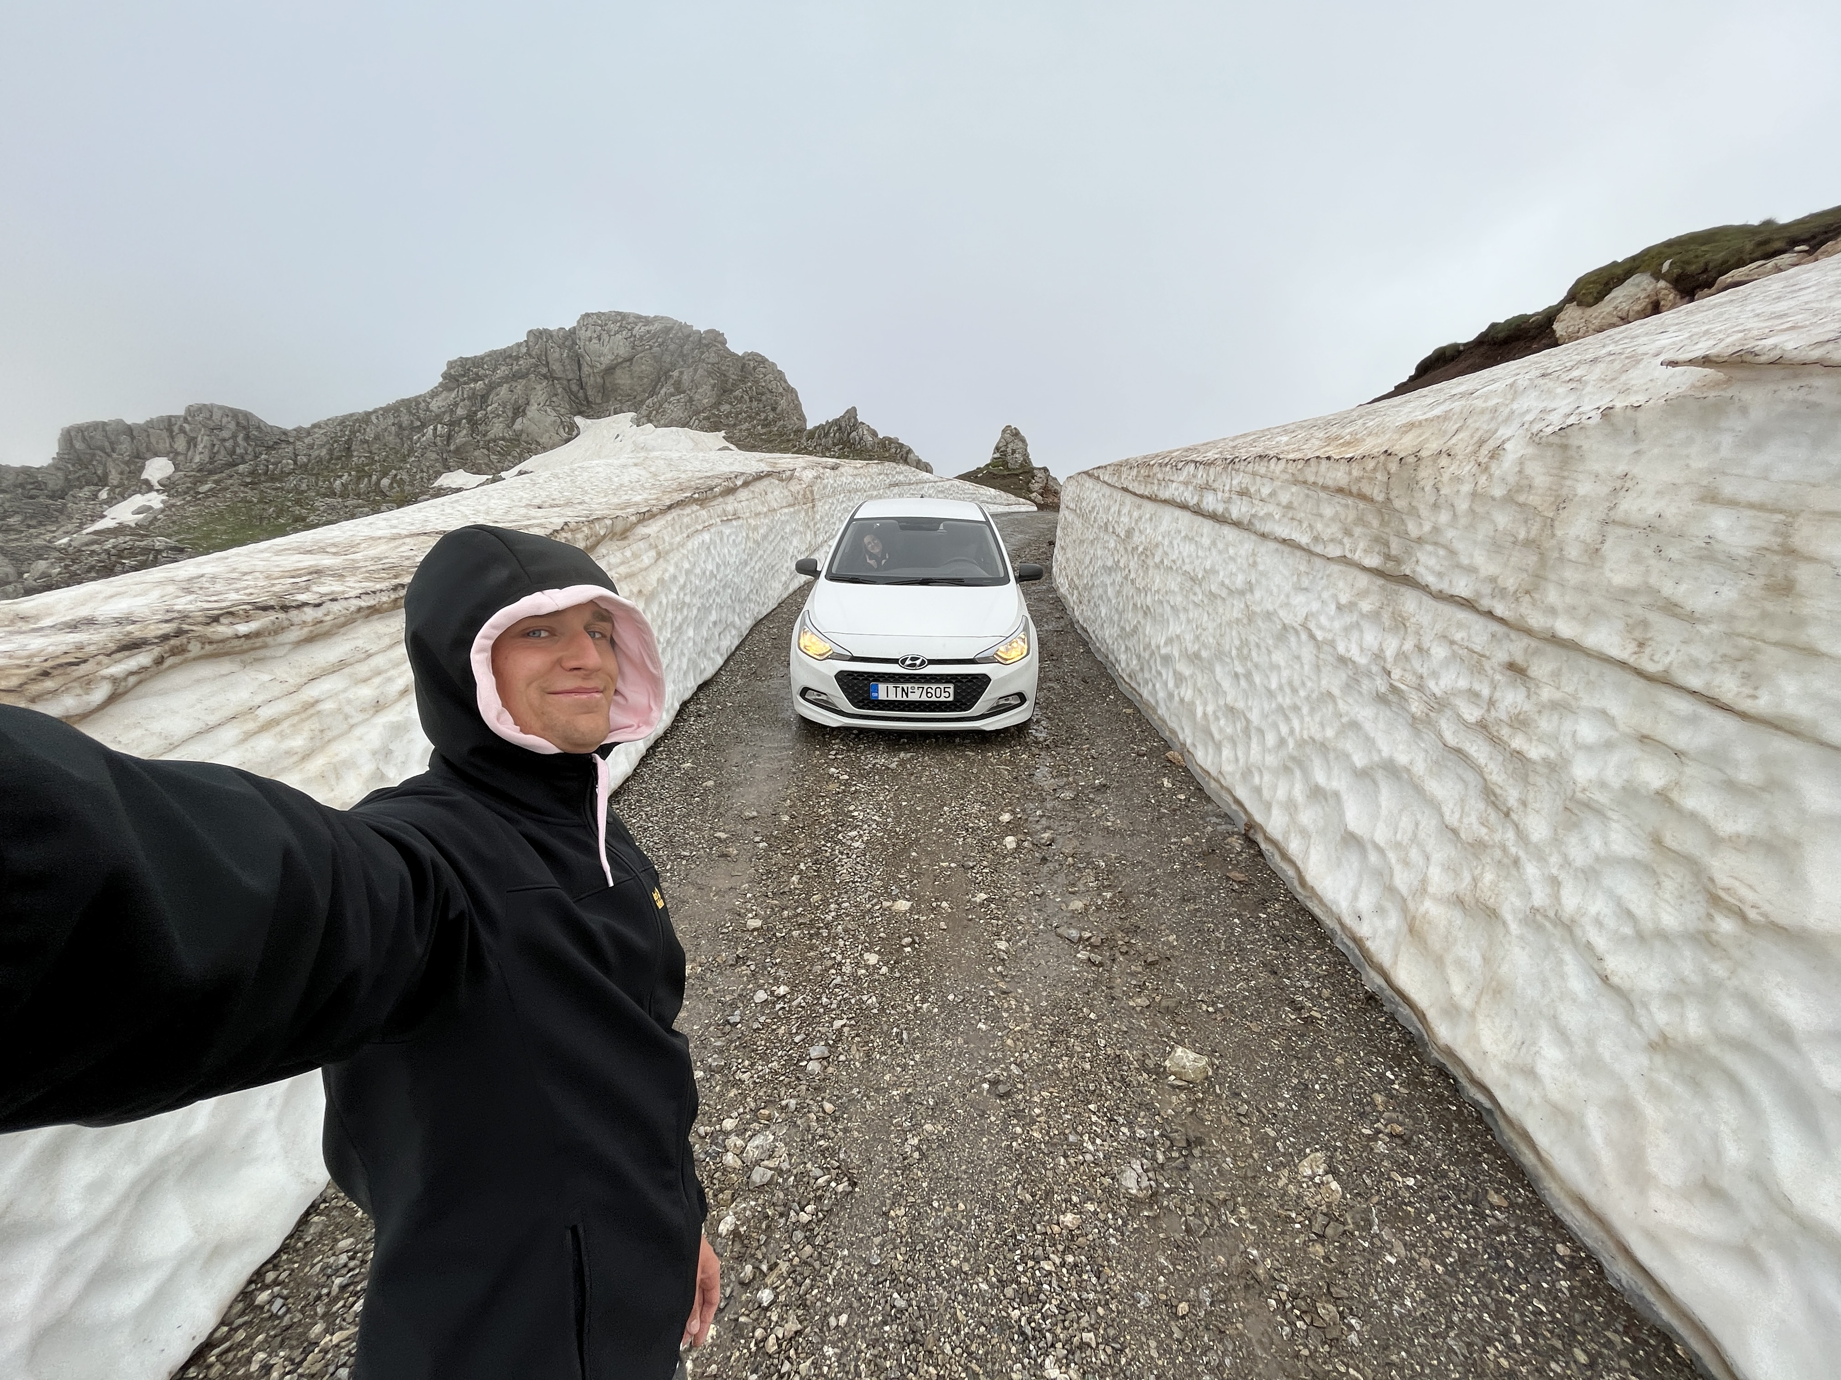

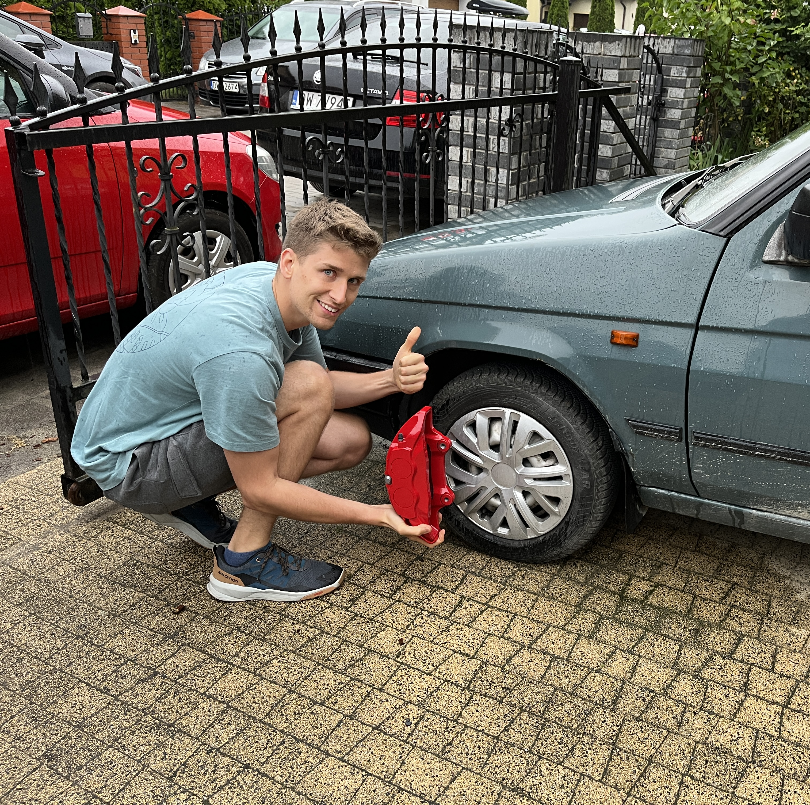
README
BALTIC AMADEUS 2024
4

Slide 5


Docker
GitPod
Introduction to GitPod
AGENDA
DEMO No.1
DEMO No. 2
Pros & Cons
Q&A
BALTIC AMADEUS 2024
5

Slide 6


Slide 7
THEN
Continuous Irritation / Continuous Disappointment
Now
Proper CI/CD solutions
BEYOND
Ideas?
BIG BANG
BALTIC AMADEUS 2024
7

Slide 8



Lightweight Virtualization
Containerization
Packages applications along with dependencies in isolated container
They run consistently across environments.
BALTIC AMADEUS 2024
8

Slide 9
Portability and Consistency
They run on any platform that supports Docker
Doesn't matter where the application is deployed
BALTIC AMADEUS 2024
9

Slide 10
Resource Efficiency
Containers do share host operating system's kernel...
… it makes them more efficient in terms of resources
Faster startups, lower overhead
BALTIC AMADEUS 2024
10

Slide 11
Simplified Deployments
Encapsulating all necessary bits of code
Works on every machine – not only mine
One container – 3 environments (D,T,P)
BALTIC AMADEUS 2024
11

Slide 12
Microservices Architecture
Improving Scalability
Easy to maintain
BALTIC AMADEUS 2024
12

Slide 13
Version Control for Infrastructure
<Heavy breathing>
Possibility to track changes same/similar way as we do for our code
Rollbacks are not that scary
BALTIC AMADEUS 2024
13

Slide 14
Lightweight Virtualization;
Portability and Consistency;
Resource Efficiency;
Simplified Application Deployment;
Microservices Architecture;
Version Control of Architecture.
BALTIC AMADEUS 2024
14

Slide 15
THEN
Continuous Irritation / Continuous Disappointment
Now
Proper CI/CD solutions
BEYOND
Ideas?
BIG BANG
BALTIC AMADEUS 2024
15

Slide 16

Moving IDE to Cloud
GitPod
Need to have an access to the Internet and a browser
Top-shelf hardware is not crucial
Switching to a backup device takes minutes
BALTIC AMADEUS 2024
16

Slide 17
Integrations
GitPod
GitHub, GitLab, Bitbucket …
Starting up dev environment at the click of a button
Starting up new workspace for a specific branch, pull request
BALTIC AMADEUS 2024
17

Slide 18
Efficient Cloud Usage
GitPod
Workspaces shut down automatically after certain period of time
Time = $$$
BALTIC AMADEUS 2024
18

Slide 19
Integrated with editors
GitPod
VS Code
IntelliJ
PyCharm
Jetbrains, Jetbrains, Jetbrains
BALTIC AMADEUS 2024
19

Slide 20

Ok, but how to begin using it?

Slide 21
Ok, but how to begin using it?
it depends!

Slide 22
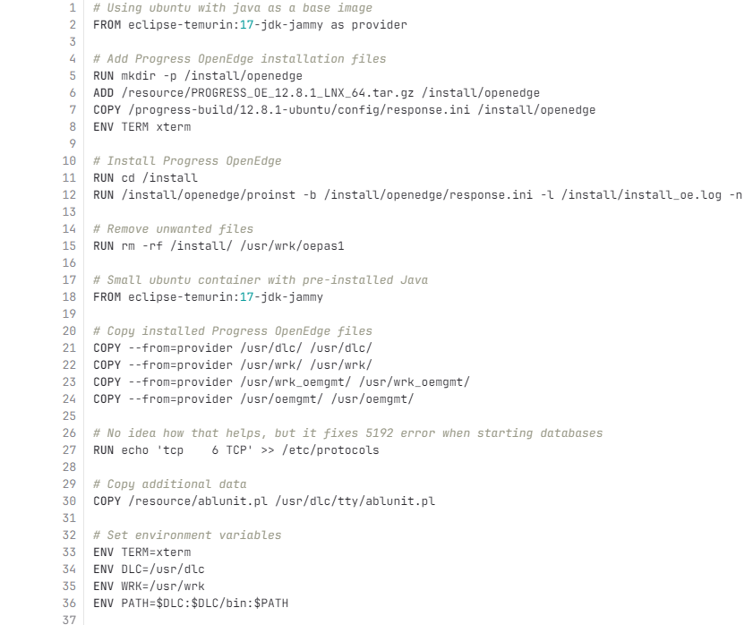

Start with the proper installation file and building the image
BALTIC AMADEUS 2024
22

Slide 23
Might be good idea to create base OE image – it depends on the use case
BALTIC AMADEUS 2024
23

Slide 24
.gitpod.yml
.gitpod.Dockerfile
docker-compose.yml
https://www.gitpod.io/docs/references/gitpod-yml
NB!
Having the code and base image ready – it's time to put it together
BALTIC AMADEUS 2024
24

Slide 25

k
k
v
}
]
v
*
c
]
b
k
*
}
*
]
*
}
}
]
}
}
}
*
}
}
]
}
}
]
*
]
]
]
]
}
]
}
]
k
v
a
c
}
k
a
*
k
c
c
a
b
DEMO No.1
*
}
*
]
*
*
b
*
*
k
*
}
*
v
*
}
*
*
c
]
]
c
]
]
]
}
]
]
k
]
]
}
d
]
v
]
k
]
a
]
]
]
]
c
}
]
b
*
b
*
*
}
*
d
}
*
*
v
c
a
}
*

Slide 26
Feeling overwhelmed?

Slide 27
Let's cure it!

Slide 28
k
k
v
}
]
v
*
c
]
b
k
*
}
*
]
*
}
}
]
}
}
}
*
}
}
]
}
}
]
*
]
]
]
]
}
]
}
]
k
v
a
c
}
k
a
*
k
c
c
a
b
DEMO No.2
*
}
*
]
*
*
b
*
*
k
*
}
*
v
*
}
*
*
c
]
]
c
]
]
]
}
]
]
k
]
]
}
d
]
v
]
k
]
a
]
]
]
]
c
}
]
b
*
b
*
*
}
*
d
}
*
*
v
c
a
}
*

Slide 29

PROS
#1
#2
#3
#4
Efficient onboarding of employees
Perfect sandbox for your R&D projects
Consistent environments
A place to share some bits of code (issues mostly) with your friends
BALTIC AMADEUS 2024
29

Slide 30

CONS
#1
#2
#3
#4
Might get pricey
Not every project can be (easily) moved to Cloud IDE
Bureaucracy and corporate rules might be showstoppers
Integrations with local devices / infrastructure
BALTIC AMADEUS 2024
30

Slide 31





Q&A
session

