Slide 1
System reliability is like Swiss cheese (and that’s a good thing)
PROTOP.COM
Adam Backman, White Star Software
adam@wss.com

Slide 2
About White Star Software
WSS.COM
For over 30 years, we have been helping companies around the world simplify the job of managing and monitoring the world’s best OpenEdge applications.
Our experts, combined with ProTop, the #1 OpenEdge monitoring and alerting tool, deliver unparalleled peace of mind for your OpenEdge environments.

Slide 3
About White Star Software
WSS.COM
Our goals and your goals are the same.
We want you to get no phone calls as we want to be proactive and solve an issue before you or your users see it.

Slide 4
Agenda
PROTOP.COM
What’s the deal with Swiss cheese?
Merging theory and practice
What makes a system reliable?
Eliminating unplanned outages
Managing planned outages
Predictable performance
Secure systems
Why is this all important?

Slide 5

What’s the deal with Swiss cheese?
PROTOP.COM

Slide 6

What’s the deal with Swiss cheese?
PROTOP.COM

Slide 7
Merging theory and practice
Theory is when you know everything but nothing works
Practice is when everything works but nobody knows why
Most strive to merge the two and end up with nothing working and nobody knows why
We are going to work to avoid this

Slide 8
What makes a reliable system?
PROTOP.COM
Is the system available when the users need it?
Performance is predictable
The system is secure
The data is protected both online and through backups

Slide 9
Complexity breeds insecurity
PROTOP.COM
“Proliferating global networks, both physical and virtual, inevitably incorporate more …. risks into a more interdependent and ‘fragile’ system”
- Bernard Avisshai from the New Yorker 4/2020

Slide 10
Avoiding unplanned outages
PROTOP.COM
We have all heard of 5-6 nines of availabilty but what does that really mean and how do I achieve greater reliability
  Buy the right stuff in the first place
  Monitor your database(s) and system(s) continuously
  Keep up-to-date with software and OS
  Have a real tested recovery plan

Slide 11
Buy the right stuff in the first place
PROTOP.COM
  Reliable hardware
    Storage
    Memory
    CPU
  Choose a reliable vendor who can support you in your location
  Maintenance – buy your lifetime of maintenance when you buy the hardware

Slide 12
Reliabile Hardware
PROTOP.COM
Storage
  Closer is faster but likely less redundant
  Redundant (RAID) for data protection
  SANs buy features but at the cost of performance
Memory
  Avoid interleaved memory
CPU
  Fast and few generally beats many and slow
  No NUMA or smart NUMA management

Slide 13
Monitor *caution shameless plug approaching
PROTOP.COM
  CPU
    Not likely to take you out but it will affect performance
  Memory
    More of a performance thing like CPU
  Storage
    Need to know
      Where you are now
      Where you were in the past
      So you can plan for the future
  Database (both for performance and reliability)
  Virtualization

Slide 14

Shameless plug: ProTop
Gain instant, near real-time visibility into your entire OpenEdge environment.

Slide 15
Monitoring
PROTOP.COM
Move from reactive to proactive
Be able to answer “What changed?”
Keep track of all software and schema changes (OS, Application and data)
Correlate OS and database statistics

Slide 16
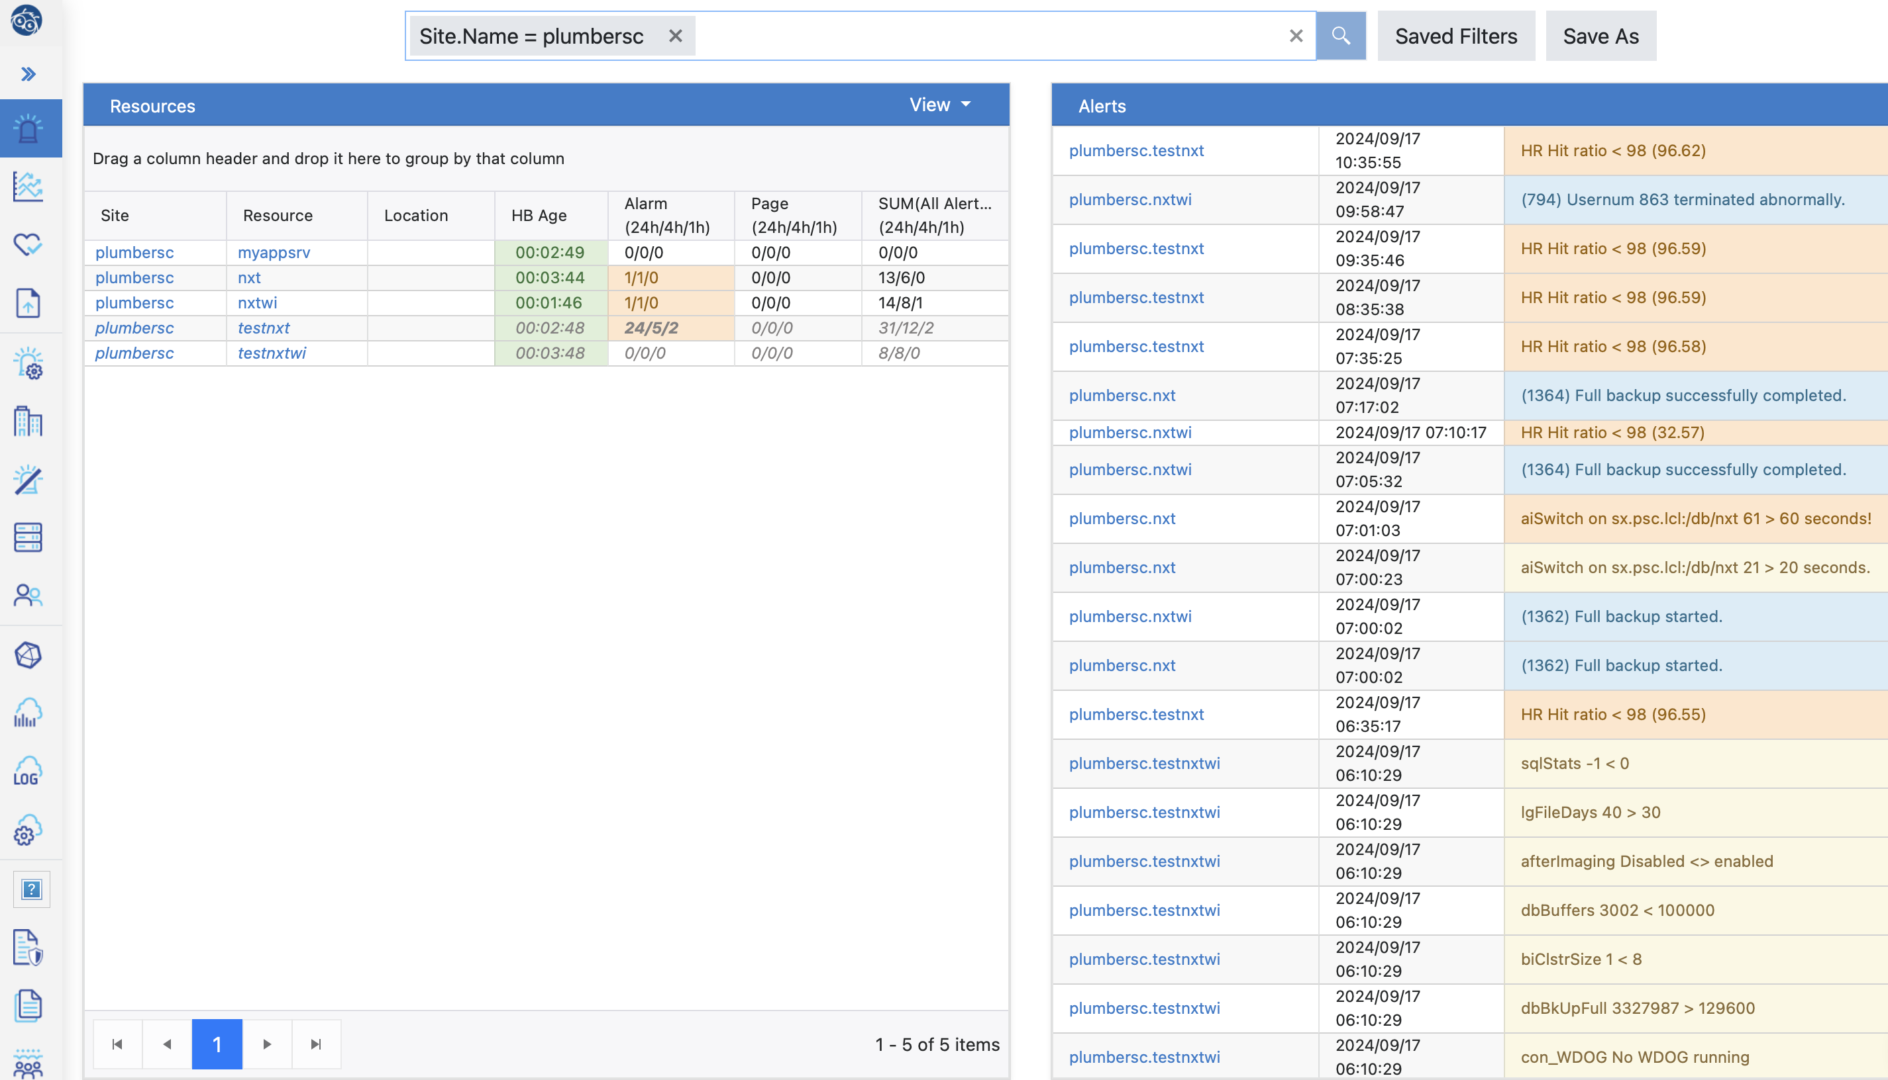
Shameless plug: ProTop

Slide 17
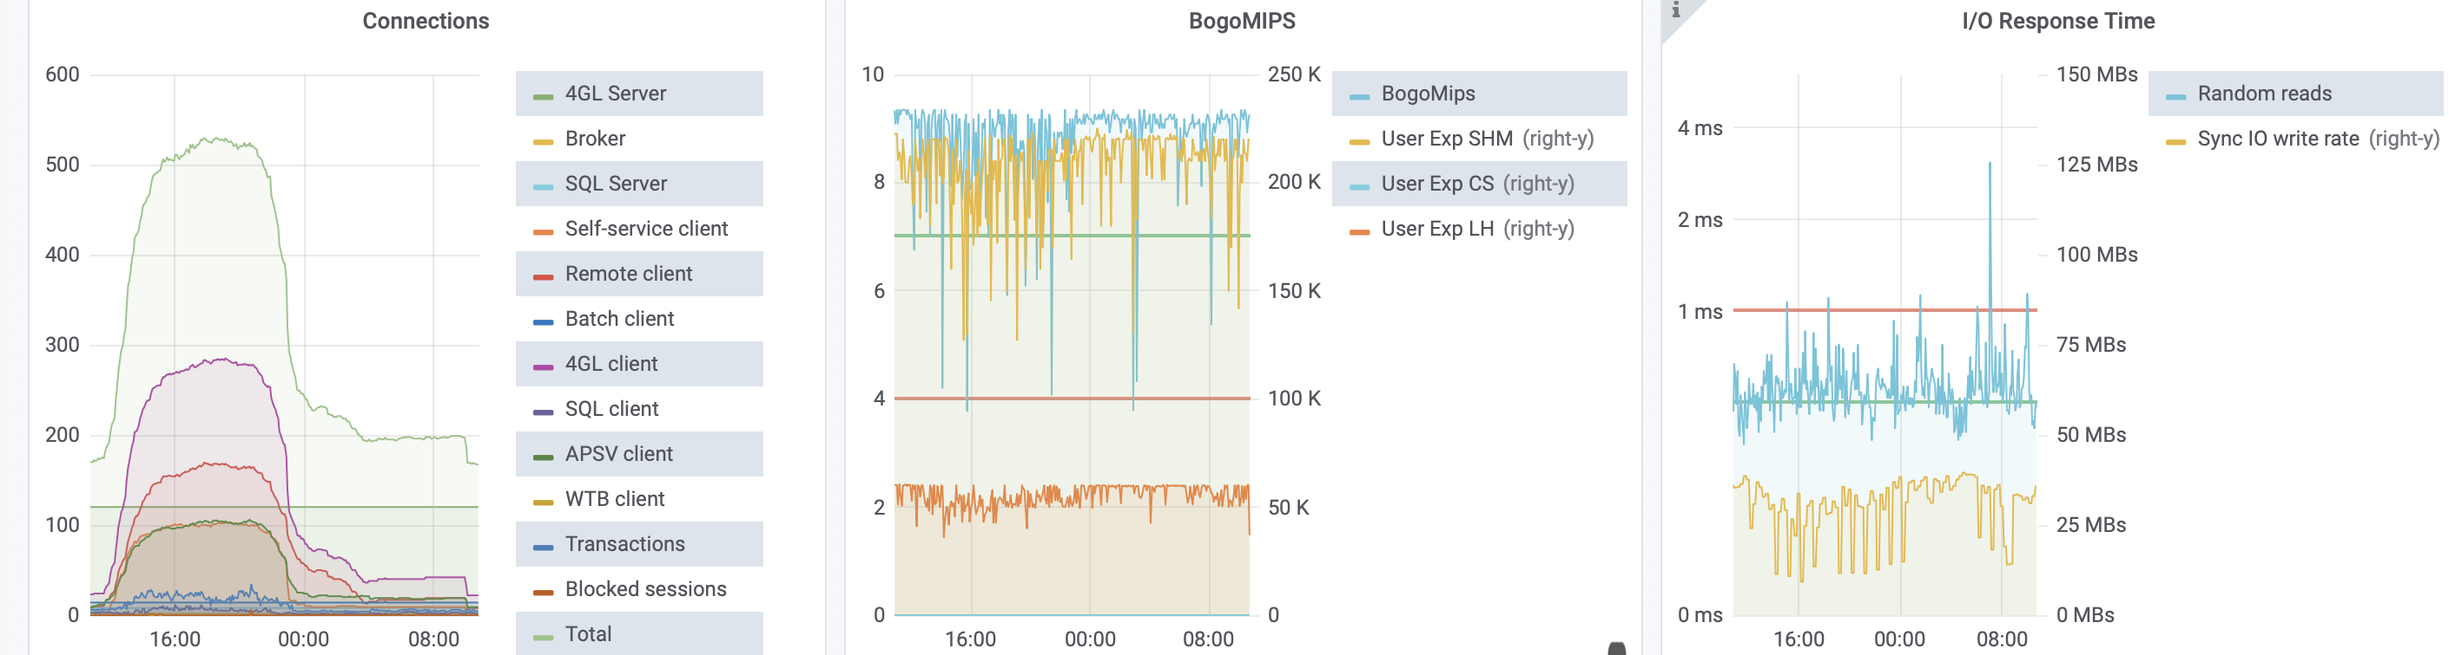
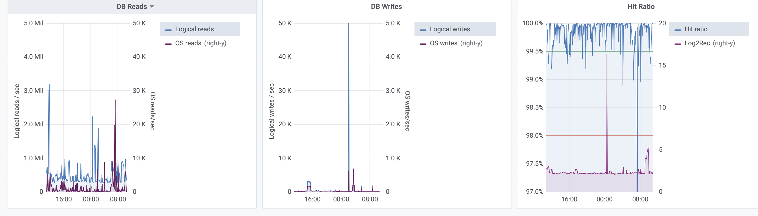
Shameless plug: ProTop

Slide 18
Managing planned outages
PROTOP.COM
Schedule in advance
Work with all stake holders (business and technical)
  When
  What
  Why
Try to combine OS and application changes
Test EVERYTHING in advance for timings, training, and easy to follow documentation
Under promise and over deliver

Slide 19
Provide predictable performance
PROTOP.COM
Predictable is more important than good
Month-end and mid month should be the same
Monitoring and buying right make this much easier

Slide 20
Secure your system
PROTOP.COM
Keep current with updates
  OS
  Application
  Network
Have realistic password and security rules
Make access to your system convenient but controlled and monitorable
Do you need to encrypt some/all of your data?

Slide 21
Protect your data
PROTOP.COM
Develop and test your recovery plan
  When to backup
    Daily (more often?)
    Weekly
    Monthly
    Yearly
  What to backup
    Operating system
    Applications
    Data
    User files

Slide 22
Protect your data
PROTOP.COM
Make the process automatic
  Focus on recovery
  Make sure that anyone can do the restore
  Know how long it takes (vital for restore/recover)
Maintenance of annual backups/archives
  Needed for potential audit
  OS, Application and data are all needed for a complete picture

Slide 23
Archiving backups
PROTOP.COM
Archiving backups
  Where do they go?
    Offsite (Iron mountain, personal address, machine off site, …)
  When do they go there?
    What can you afford to lose
    Push to remote backup node then off site
  How do I get them back?
    Need 24 hour access
    Need quick turnaround
  How long does retrieval take?

Slide 24
Resiliance
“The manner in which societies have responded to stress depends on three things: their complexity, their flexibility and their systematic redundancy” “All of which together determine the resilience of the system”
Princeton professor John Haldon

Slide 25
Flexibility
PROTOP.COM
How does flexibility improve your systems and processes
  Cost
  Staffing
    Who can recover?
    No single point of failure
  Variety of solutions
    Options are good
    Replication or restore from backup and use AI

Slide 26
Why is all of this important?
PROTOP.COM
Data is the lifeblood of most companies
Risks are getting more complex to understand and eliminate/combat
Cost of downtime/recovery
  Hassle
  Monetary cost
  Reputational cost

Slide 27
Reliability
PROTOP.COM
Reliability relies on many layers
  System performance
  Reliability of operating environment
  Protecting the data
  Securing the data
  Having the ability to restore in a timely fashion
All of this needs to be communicated with all of the stake holders before anything bad happens

Slide 28
Questions?
PROTOP.COM

Slide 29

Thank you!
PROTOP.COM

