Slide 1
Wireless
Bob Brennan
Integrated Manufacturing Systems, Inc.

Slide 2
Agenda
Level Setting Concepts
Wi-Fi
Cellular
Convergence
Q&A

Slide 3
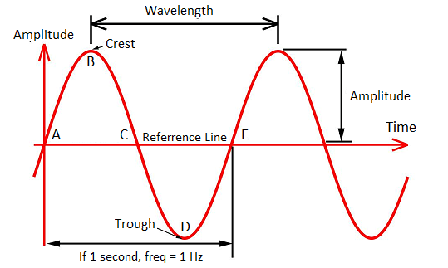
Wave

Slide 4
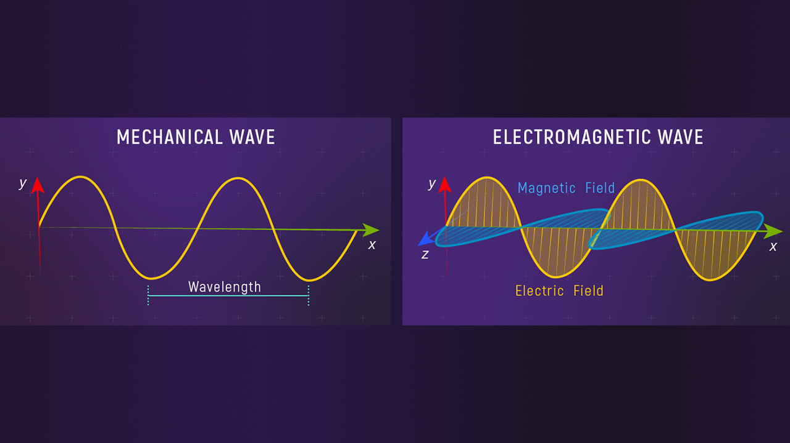
Electro-Magnetic Wave
Propagation: Speed of Light

Slide 5
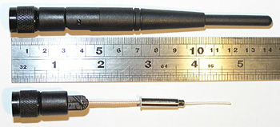
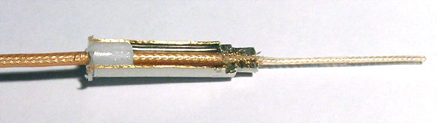
Antenna – Omni-Directional

Slide 6
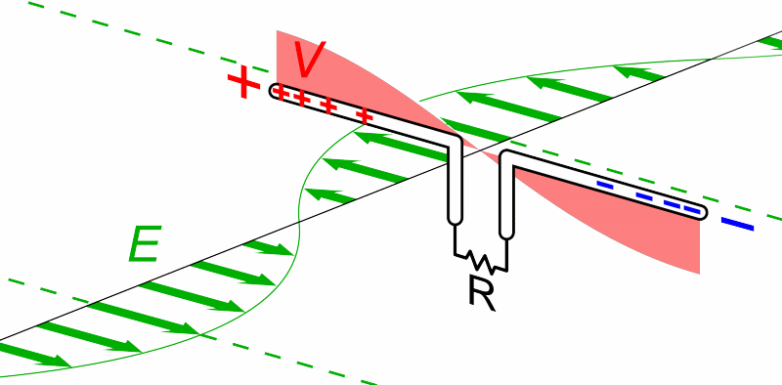
2 Dimensional
Gigahertz Means Billions of Full Waves per Second

Slide 7
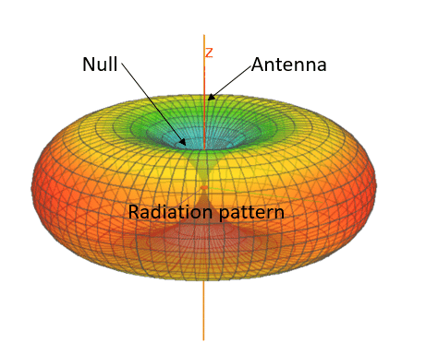
3 Dimensional

Slide 8

Polarity

Slide 9
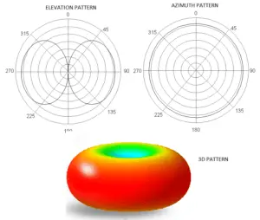
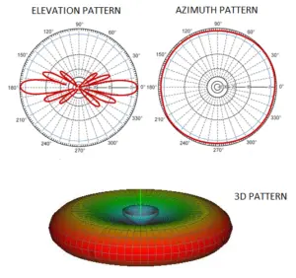
Omni-Directional

Slide 10

What is Gain?

Slide 11

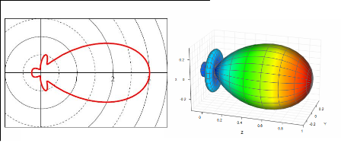
Directional antenna

Slide 12
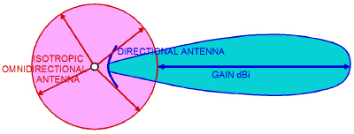
Antenna Gain

Slide 13
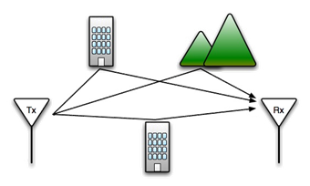
Multipath

Slide 14
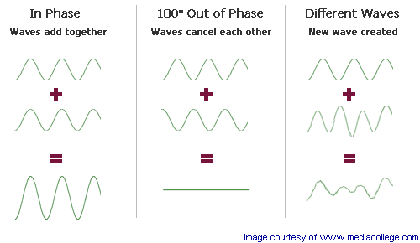
Interference At Antenna

Slide 15
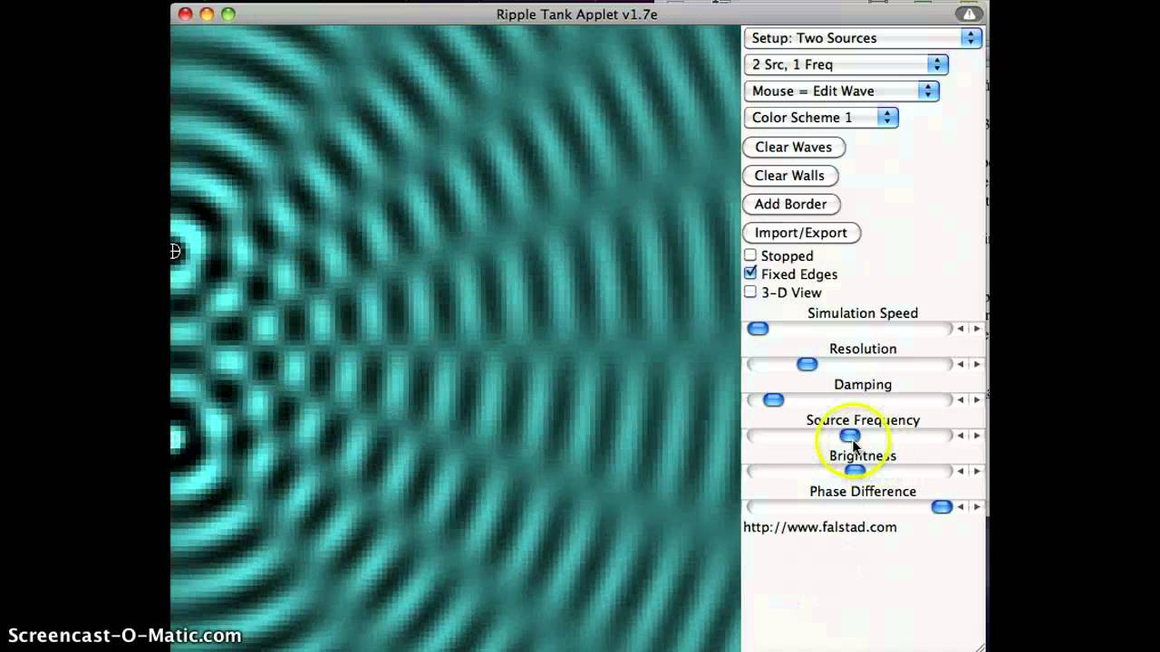
Beam Forming

Slide 16
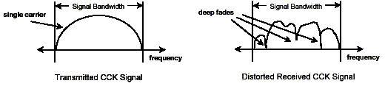
Multipath Distortion
Each path from the transmitter to the receiver has a unique time delay and phase shift associated with it.
Received signal can be severely distorted on that frequency
Foreshadowing…

Slide 17
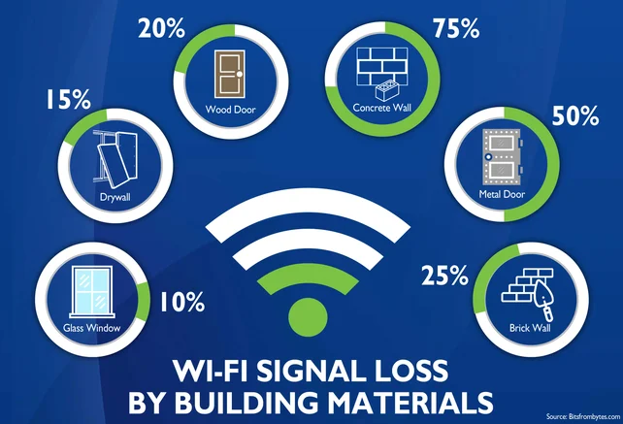
Attenuation

Slide 18
Do More with a Fixed Amount
Get as many user request on the network, processed and off as quickly as possible.
Medium is shared
No one is guaranteed access

Slide 19
Agenda
Level Setting Concepts
Wi-Fi
Cellular
Convergence
Q&A

Slide 20
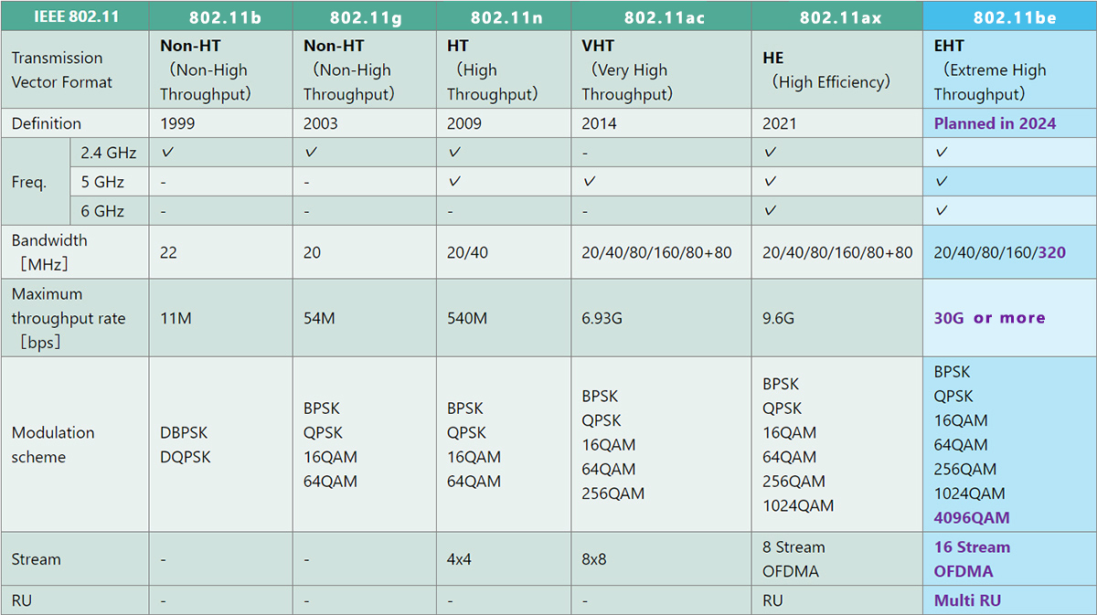
802.11 Evolution

Slide 21
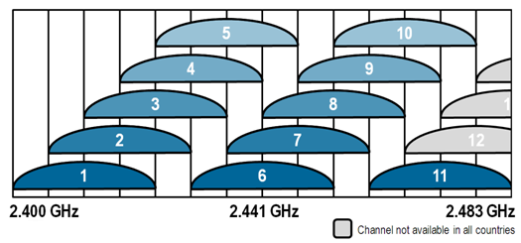
2.4 GHz Band
Range of Frequencies
22 MHz Channels
11 Channels USA, 13 or 14 Europe/Asia

Slide 22
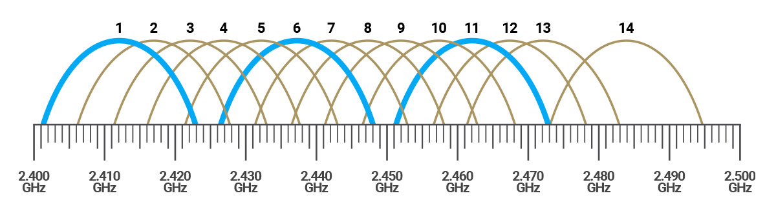
Bands and Channels

Slide 23
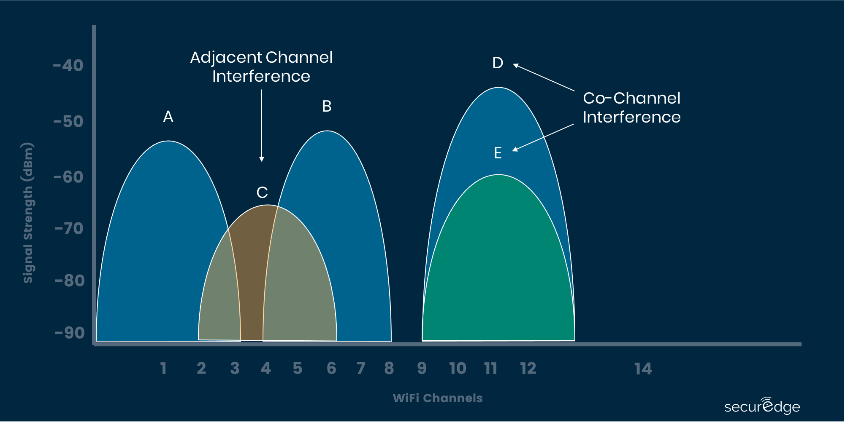
Channel Interference

Slide 24
2.4 and We Are Not Alone
Wi-Fi Wireless
Bluetooth
Zigbee/Industrial Device Connections
Microwave Ovens
Cordless Phones
Baby Monitors
Wireless Video Projectors

Slide 25
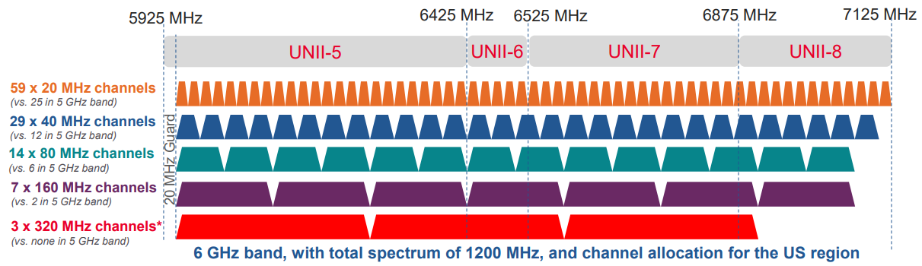
Wi-Fi 7 Channel Comparison

Slide 26
Access Points
Wireless device that provides a bridge between the wired and wireless environments
Single Threaded - Half Duplex
  Only one device talking at a time
  Only sending or receiving data at a time
  Not exactly true starting with Wi-Fi 6 and Beyond
Sort of like an old school HUB → Switch

Slide 27
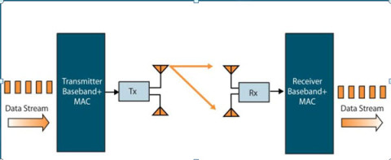
Single In Single Out
State of the art before 802.11N Diversity Antenna
Transmit on one Antenna, Receive on Both

Slide 28
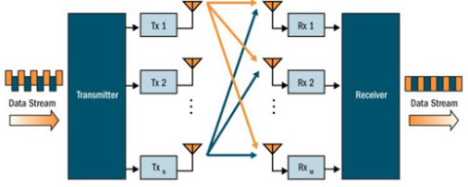
Multiple In Multiple Out MIMO
Single User Mimo

Slide 29
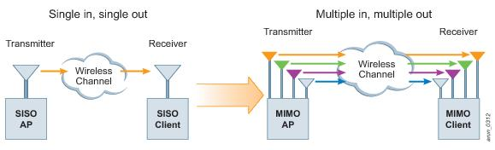
Single to Multiple
Pre - N
N and Beyond

Slide 30
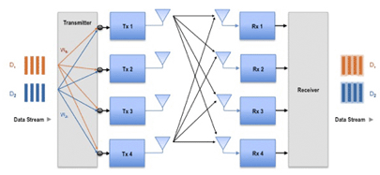
Spatial Multiplexing MIMO
N – N Connections
Sender and Receiver both have a encoder/decoder
First real world use of Linear Algebra Matrices

Slide 31
Wi-Fi Signal Strength
mW - Milliwatts (1 mW = 0 dBm)
  Most accurate but hardest to measure; used by scientists and engineers
dBm - Decibels in relation to milliwatts (usually -30 to -90)
  Mid-accuracy; mid-comprehensible; most common; used by engineers
RSSI - Received Signal Strength Indicator (usually 0-60 or 0-255)
  The least accurate; most arbitrary; easiest to read; used by vendors

Slide 32
What’s a Good Reading
-30 dBm = Excellent - Max achievable signal strength. Your device is most likely only a few feet from the AP to achieve this signal. Neither typical nor desirable in the real world.
-67 dBm = Very Good - Minimum signal strength for most business applications
-70 dBm = Okay - Minimum signal strength required for a decent packet delivery.
-80 dBm = Not Good - Minimum signal strength for basic connectivity. Packet delivery may be unreliable.
-90 dBm = Unusable - Approaching or drowning in the background transmissions (or noise floor) and causing serious interference with the signal. Any functionality is highly unlikely.

Slide 33
802.11N
Multiple-input multiple-output antennas (MIMO).
Up to 4 Radios and 8 Antenna
Operates on both the 2.4 GHz and 5 GHz bands.
Support for 5 GHz bands is optional.
Operates at max net data rate 54 Mbit/s to 600 Mbit/s.
20 MHz Channel Width at 2.4GHz
20 or 40 MHz Channel Width at 5 GHz
ODFM
Power Over Ethernet Issues

Slide 34
802.11ac
MIMO
Up to 8 Streams (Radios) with 2x antennas
Only 5GHz
Channel Widths 20, 40, 80, 160 MHz
* Up to 866 Megabits per second
Power over Ethernet issues
Very Limited range for High Speed ~10 Meters

Slide 35
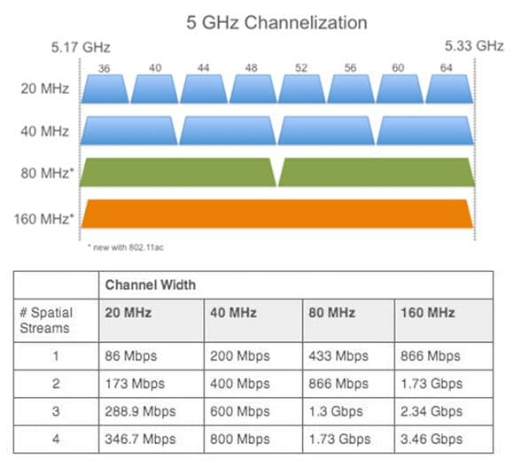
Channel Bonding

Slide 36
802.11 AX * Wi-Fi 6
Was The “Next Big Thing” in 2014
Uses 6 GHz but packaged in Tri-Band to maintain backward compatibility
Up to 7 gigabits per second in first draft
Multi-User MIMO techniques
Very efficient use of power
Wire-like latencies
Lots of head room for improvement
* 2014 Slide – Mostly true

Slide 37
802.11BE Wi-Fi 7
Hardware shipped January 2024
2.4, 5 and 6 GHz (60 20MHz 6 GHz channels)
4096 QAM
Multi-Link Operation – Links frequencies
Multiple Resource units – Multiplex a channel Multi-User

Slide 38
2.4 GHz vs 5 GHz vs 6 GHz
Energy being the same, 5GHz has about half the reach
About Twice as many Access Points Required for the same coverage.
2.4 GHz is crowded / Interference (~0.125m or 4.9” )
5 GHz more susceptible to attenuation (~.06m or 2.36”)
6 GHz Wide Open/Limited Competition (~ .05m or 1.9”)

Slide 39
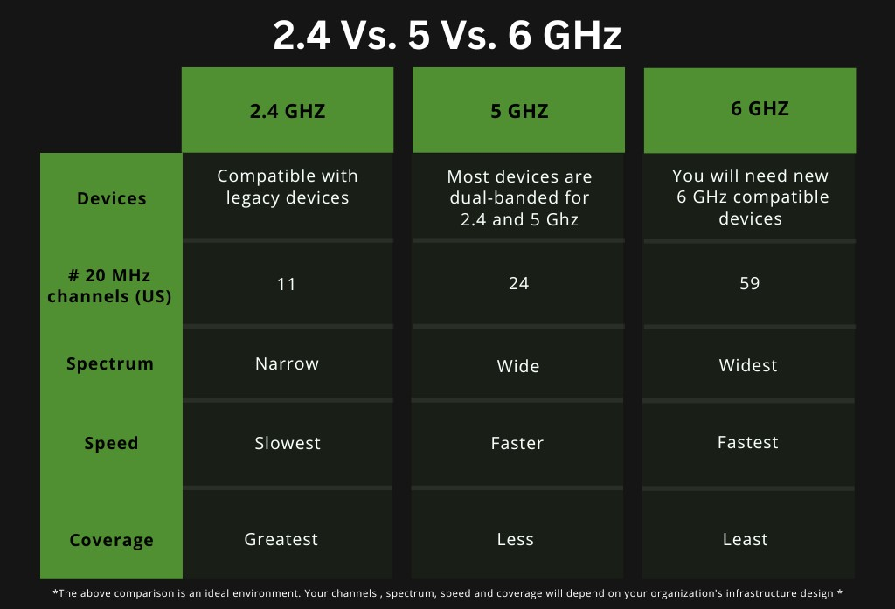
Comparison

Slide 40
Agenda
Level Setting Concepts
Wi-Fi
Cellular
Convergence
Q&A

Slide 41
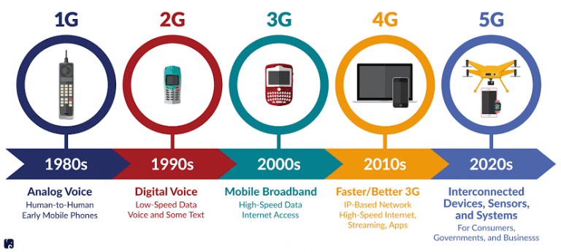
Cellular History

Slide 42
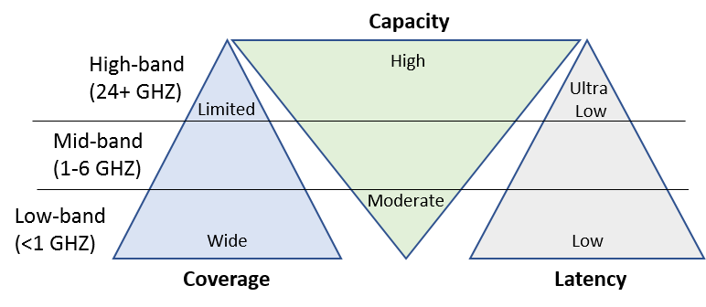
Cellular 5G

Slide 43
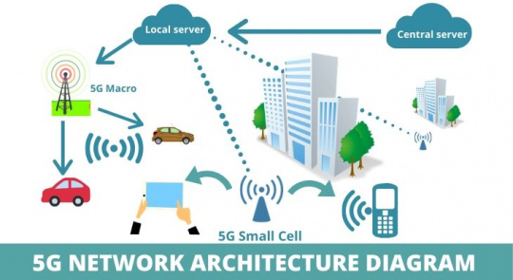
5G Network Architecture

Slide 44
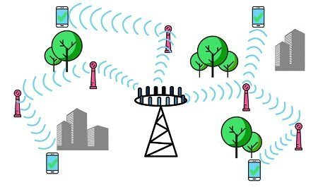
Small Cell & Pico Cell

Slide 45
5G Features
Spectrum – 5G NR
Small cells and Pico-cells
Massive MIMO
Beamforming
Full-duplex mode of transmission

Slide 46
802.11u
Back Haul
Phone companies need to get data off of the cell network
HotSpot 2.0 – Single sign-on via MAC Address and registry
Great idea with a lot of implementation issues

Slide 47
Agenda
Level Setting Concepts
Wi-Fi
Cellular
Convergence
Q&A

Slide 48
Mobility as a Developer
What can you count on for coverage and speed
Remember when coding for memory and disk was important?
Design Patterns for disconnected and ultra slow connections
Cell Radio vs Gigabit (10/100/1000/Beyond)
Lowest Common Denominator Design

Slide 49
What you can control
Great Design for Low/No Bandwidth applications
Security
Networking – if it is your facility.
Network Transitions: WAN-LAN design

Slide 50
What you can’t control
Perhaps the infrastructure
Interference is everywhere
Perhaps Power Consumption
Perhaps Data Consumption

Slide 51
Random Thoughts
Wireless is the future
Security Concerns
Interference is beyond your control
Bridging the LAN to the WAN

Slide 52

Bob Brennan
Integrated Manufacturing Systems, Inc.
(603) 424-0109

