Slide 1





OpenEdge TDE and replication
Dmitri Levin, DBA Manager
Progress, Oracle, SQL Server, MySQL, MongoDB
Alphabroder Co
Philadelphia PA

Slide 2
Three types of data replication
After-Image (Log based) Replication
OpenEdge Replication
Pro2 Replication
Notes:
We will mostly talk about the first 3 methods that are provided by PSC.

Slide 3
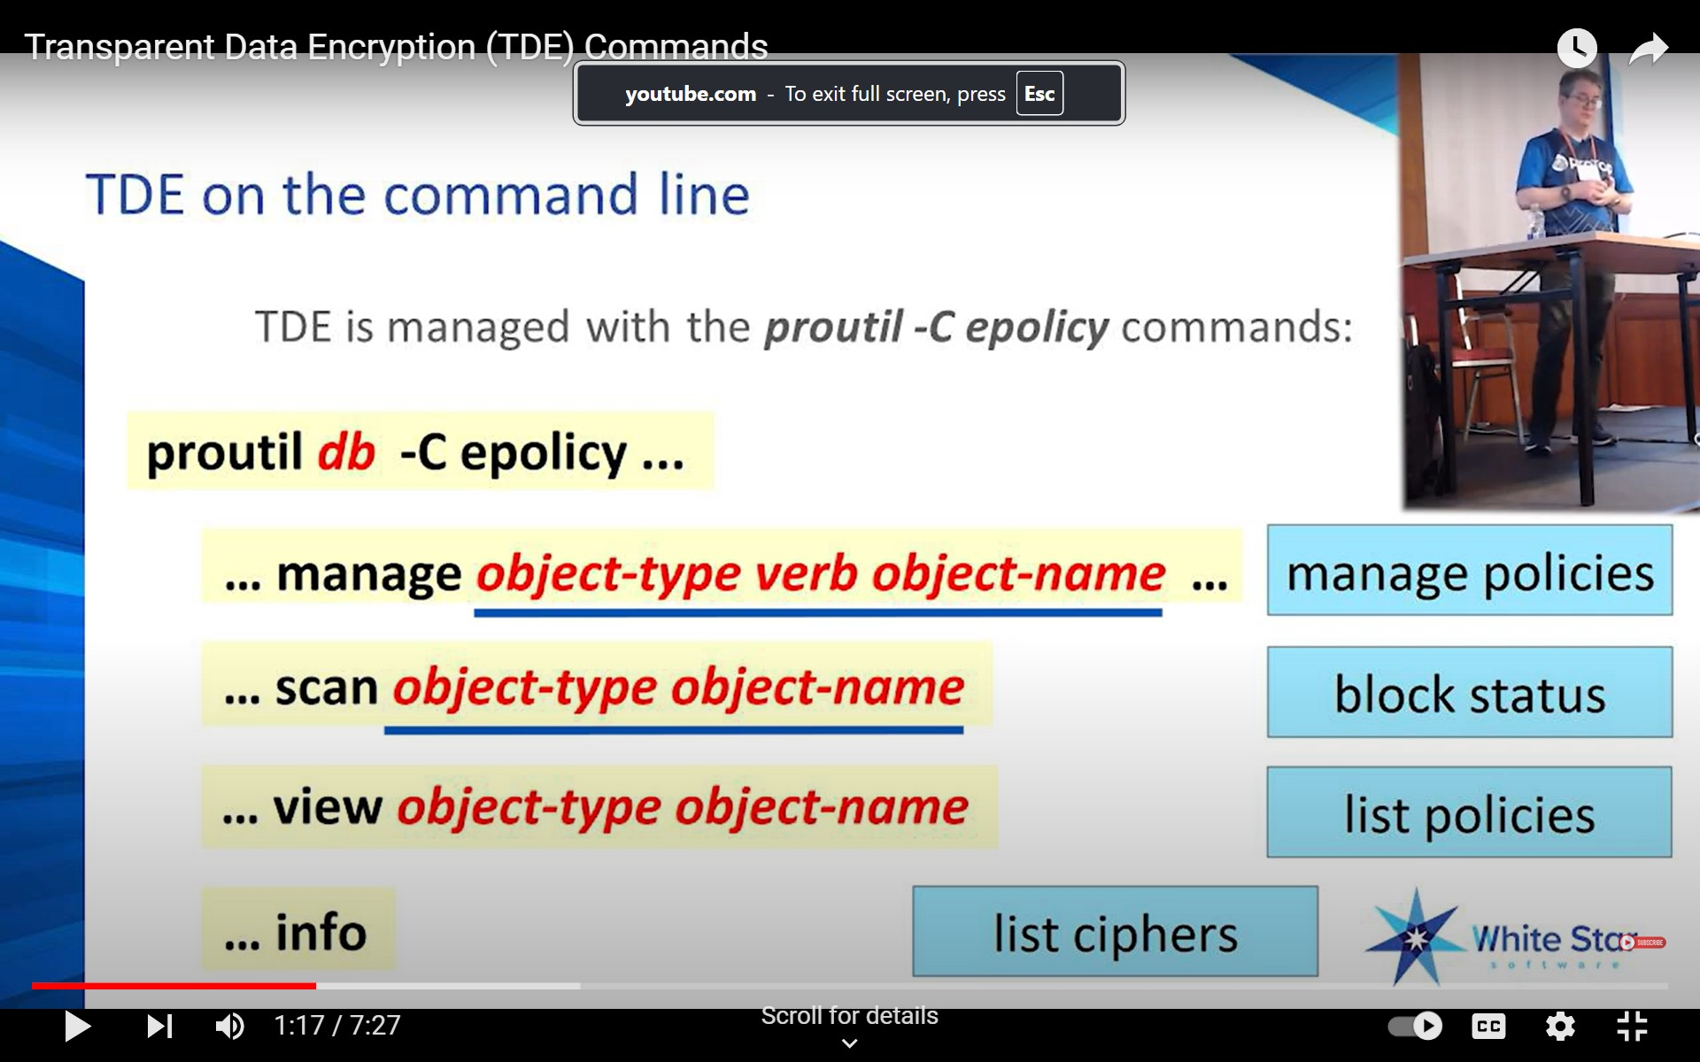
Rob Fitzpatrick TDE presentations

Slide 4


Just enable TDE for piece of mind
DB_NAME
DB_NAME.KS

Slide 5
Create "Encryption Policy Area“ and copy .ks files for all related databases:
Target replication, after-image replication and all development,
test, training databases that you refresh from production.
If after-image replicated database does not have .ks file
after-image roll forward will create core and protrace files.
Notes:
.ks files need to be copied to Target replication, after-image replication and all development, test, training databases that you refresh from production.

Slide 6
Restore database without key-store file

Slide 7
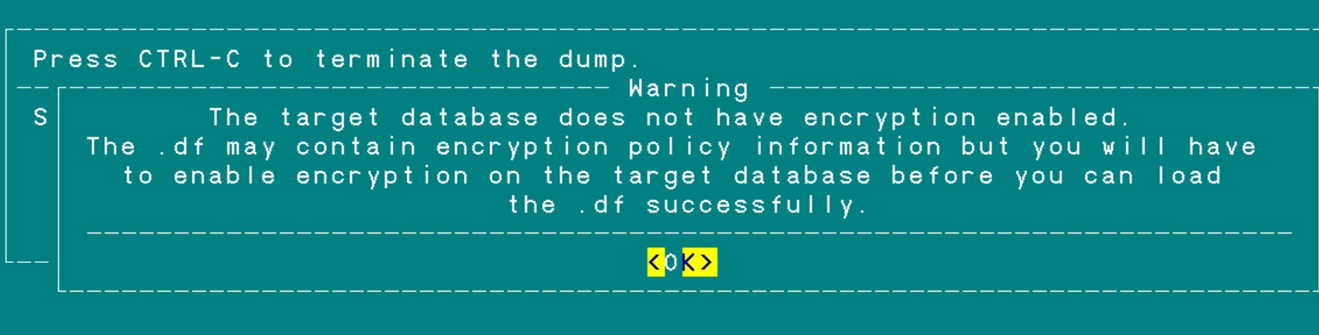
TDE issues and features
Delta.df with TDE database and non-TDE database
Warnings have been written to a file called "incrdump.e"

Slide 8
TDE issues and features
How to blow your after-image space with TDE
-rw-rw-rw- 1 dlevin staff 235012096 Aug 17 18:20 sports.a1
-rw-rw-rw- 1 dlevin staff 239206400 Aug 17 14:17 sports_TDE.a1
-rw-rw-rw- 1 dlevin staff 47022566 Aug 17 18:21 sports.a1.gz
-rw-rw-rw- 1 dlevin staff 213046727 Aug 17 14:18 sports_TDE.a1.gz
1. proutil db_name -C enableencryption [ -aiencryption disable ]
2. expect space for zipped after-images to grow considerably.

Slide 9
TDE issues and features
How scan your after-image file
rfutil sports -C aimage truncate -aiblocksize 16384
rfutil sports -C aimage scan verbose -a ai_file > ai_file.txt
AI extent db_name.240812154600 is encrypted, but there is no encryption
policy loaded to decrypt it. (15500)
roll forward open db_name.240812154600 error: -1. (11014)
Use a real after-image replicated database instead of sports

Slide 10
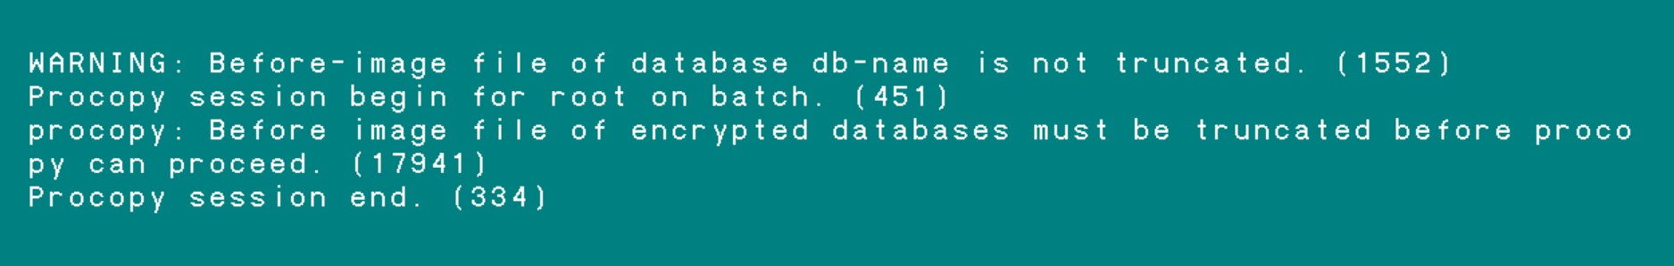
TDE issues and features
Procopy TDE enabled database
$DLC/bin/procopy db-name db-name2
You need to truncate bi of the source database before procopy TDE enabled db

Slide 11
TDE issues and features
System table: _Db-detail
OpenEdge upgrade, cov1011 creates a new _Db-detail
Each “proutil -C enableencryption” also creates a new _Db-detail
Notes:
_Db-detail shows some history of the database

Slide 12
All types of data replication
After-Image Replication
Version 5 (late 80-es)
$DLC/bin/rfutil db-name –C roll forward –a ai-name
$DLC/bin/rfutil db-name –C roll forward retry –a ai-name
$DLC/bin/rfutil db-name –C roll forward oplock –a ai-name
(10.1C)
Notes:
Retry is a very important addition. Now it is not a problem if sysadmin will shutdown the server during roll forward process. I can always re-start it from the moment it was interrupted with a retry option.
Oplock is another useful option. It protects the warm spare database from accidental startup or entry (pro). See the following slide. I use it for all of our after-image replication needs.

Slide 13
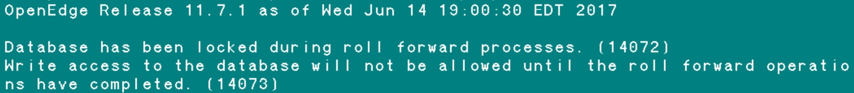
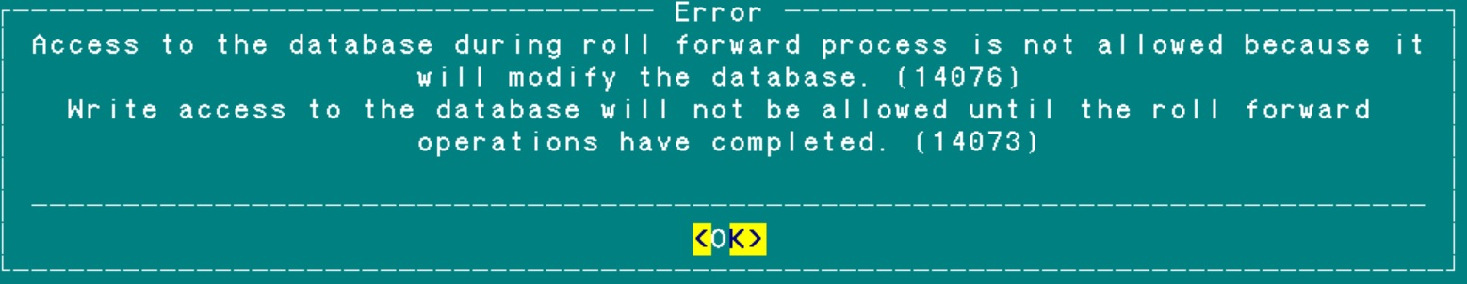
Roll forward oplock
Notes:
Here you see the message OE rfutil displays when the first roll forward oplock is executed. The consequent roll forward oplock will ignore the oplock option. So oplock option could be used all the time with each after-image roll forward.
Next you see the Error that OE displays when someone try to connect to the oplock protected database with “pro”. Similar error will be produced when we attempt to start the server with “preserve” on a locked database.
Same message goes to the log file db_name.lg
[2018/09/13@17:35:02.391-0400] P-13959364 T-1 I RFUTIL : (14072) Database has been locked during roll forward processes.

Slide 14
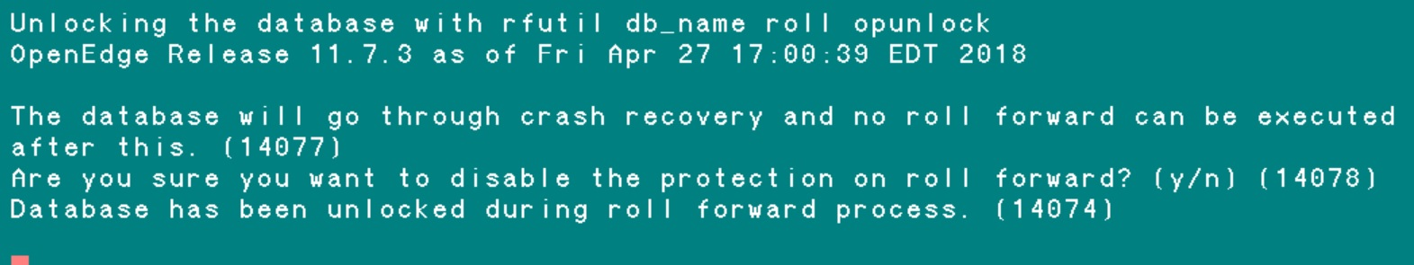
Roll forward oplock
$DLC/bin/rfutil db-name –C roll opunlock
Notes:
After rfutil roll opunlock the database becomes normal database that can be used.

Slide 15
OpenEdge Replication history
FR 1.0A runs against Progress 9.1D05, a separate installation is needed.
FR 2.0A runs against Progress 9.1D07 (SP09 recommended) a separate installation is needed.
FR 3.0A runs against Progress 9.1E, and is built into the core product so it can be installed at the same time.
FR 3.0A runs against OpenEdge 10.0A, and is built into the core product so it can be installed at the same time.
FR 10.0B runs against OpenEdge 10.0B, and is built into the core product so it can be installed at the same time
Since OpenEdge 10.1A, Fathom Replication was rebranded "OpenEdge Replication“
Notes:
Fathom Replication 1.0A was introduced in 2001.

Slide 16
The Recovery Control Block (RCB)
<dbname>.repl.recovery (since 10.1A)
<dbname>.db
Blob (since 11.7)
Also known as Replication blob, Control blob, Recovery Control blob, Builddb blob
Both are used to store synchronization information of RPLS and RPLA processes.
But how synchronization works?
mb_dsrRCBlock
Address of RCB
When there are 2 replication targtes, we have 1 RPLS and 2 RPLA processes.
It becomes more complicated and basically does not work very well.
Notes:
In version 11.7 a blob appears in Control Area and in promsgs it is called: Replication blob or Control Blob or RCB blob or builddb blob.
What information is in that blob I unknown.
<dbname>.repl.recovery exist since at least 10.1A.
The *repl.recovery files for the source and target databases in a Fathom Replication configuration are binary files used by the replication server and agent during the synchronization process. They contain information such as which transaction was last replicated. Removing them will prevent synchronization taking place, and can result in startup errors for the affected databases.
When the repl.recovery file does not exist, it is re-created with information stored in an RCB blob housed in the Control Area.
Control Area could have more than one blob. But only one of them will be “live" (workable), the rest of them are “dead".
Documentation does not say how synchronization between processes works.
And with 2 Targets it becomes more complicated and basically does not work well.

Slide 17
Comparing <dbname>.repl.recovery and RCB blob
 | Last Used Byte | Non-zero Bytes | Total Size
source/sports.repl.recovery | 616 | 92 | 1864
RCB blob in source/sports.db | 148 | 61 | 9000
target/sports.repl.recovery | 1284 | 91 | 1864
RCB blob in target/sports.db | 1161 | 61 | 9000
Notes:
Obviously repl.recovery and RCB blob look the same
Both structures have about 600 bytes for data
In both structures source data is in the first 600 bytes, target data in the consecutive 600 bytes

Slide 18
The Recovery Control Block (RCB)
rm <db-name>.repl.recovery
Do not delete repl.recovery file
proserve –pf <db-name>_source.pf
RPLS will create repl.recovery file but replication will be broken
rm <db-name>.db
Do not delete .db file
prostrct builddb sports (or prostrct repair) creates .db w/o RCB
RPLS will recreate the RCB # replication will work
Notes:
The *repl.recovery files for the source and target databases in a Fathom Replication configuration are binary files used by the replication server and agent during the synchronization process. They contain information such as which transaction was last replicated. Removing them will prevent synchronization taking place, and can result in startup errors for the affected databases.
When the repl.recovery file does not exist, it is re-created with information stored in an RCB blob housed in the Control Area. But that does not help replication.
It is important to consider that when running prostrct builddb on either the source or the target database, the Control Area (.db) is rebuilt from the database structure description file. Effectively the database will then have been disabled for replication although it is still enabled
* The prostrct builddb utility does only minimal validation of the resulting control area and is not able to fully reconstruct all the control information needed by replication.
* Replication keeps recovery information in a blob (RCB) in the Control Area (dbname.db file). The database code cannot recreate this information since it is replication specific and therefore BUILDDB creates an empty replication blob in the new Control.
* When the replication database is restarted, Replication is responsible for restoring the image of the blob from the recovery file (.recovery). If the recovery information is no longer available or there is a problem with the content, this information cannot be recovered.

Slide 19
Messages in <dbname>.lg file about RCB
RPLS 17: (10434) The Replication is adding recovery control information for the agent sportsagent1.
RPLS 16: (-----) Control Blob created from Recovery file.
RPLA 16: (-----) Control Blob created from Recovery file.
RPLU 0: (13958) Beginning Replication Transition operation: Opening RCB.
RPLU 0: (13958) Beginning Replication Transition operation: Restoring prior Recovery Control.
RPLU 0: (13958) Beginning Replication Transition operation: Updating Replication Control Info.
RPLU 0: (13553) The transition of this database failed but recovery was successful.

Slide 20
All types of data replication
Pro2 Replication
BravePoint product
Pro Dump & Load (Dan Foreman and Co)
pro2pro pro2sql pro2ora
Pro2 Version 5 introduced CDC.
Notes:
Pro2 is a BravePoint product. It was based on Pro Dump & Load developed in early 2000s. It comes in three flavors: pro2pro, pro2sql and pro2ora. The last two require an OE DataServer ( for SQL Server or Oracle respectively ).
Pro2 Version 5 includes a CDC license for use with Pro2 only.
The Pro2 product can be purchased and implemented yourself, however 99% of the implementation are done by the Progress Support team ( per Mike Furgal ).

Slide 21
Pro2 Version 6.0
It is browser based vs GUI client
It has background jobs
Notes:
For example schema differential in v5 will freeze the GUI client for a long time. In v6 it is goes into a background.
You can also see the history of all background jobs – that is very helpful.

Slide 22
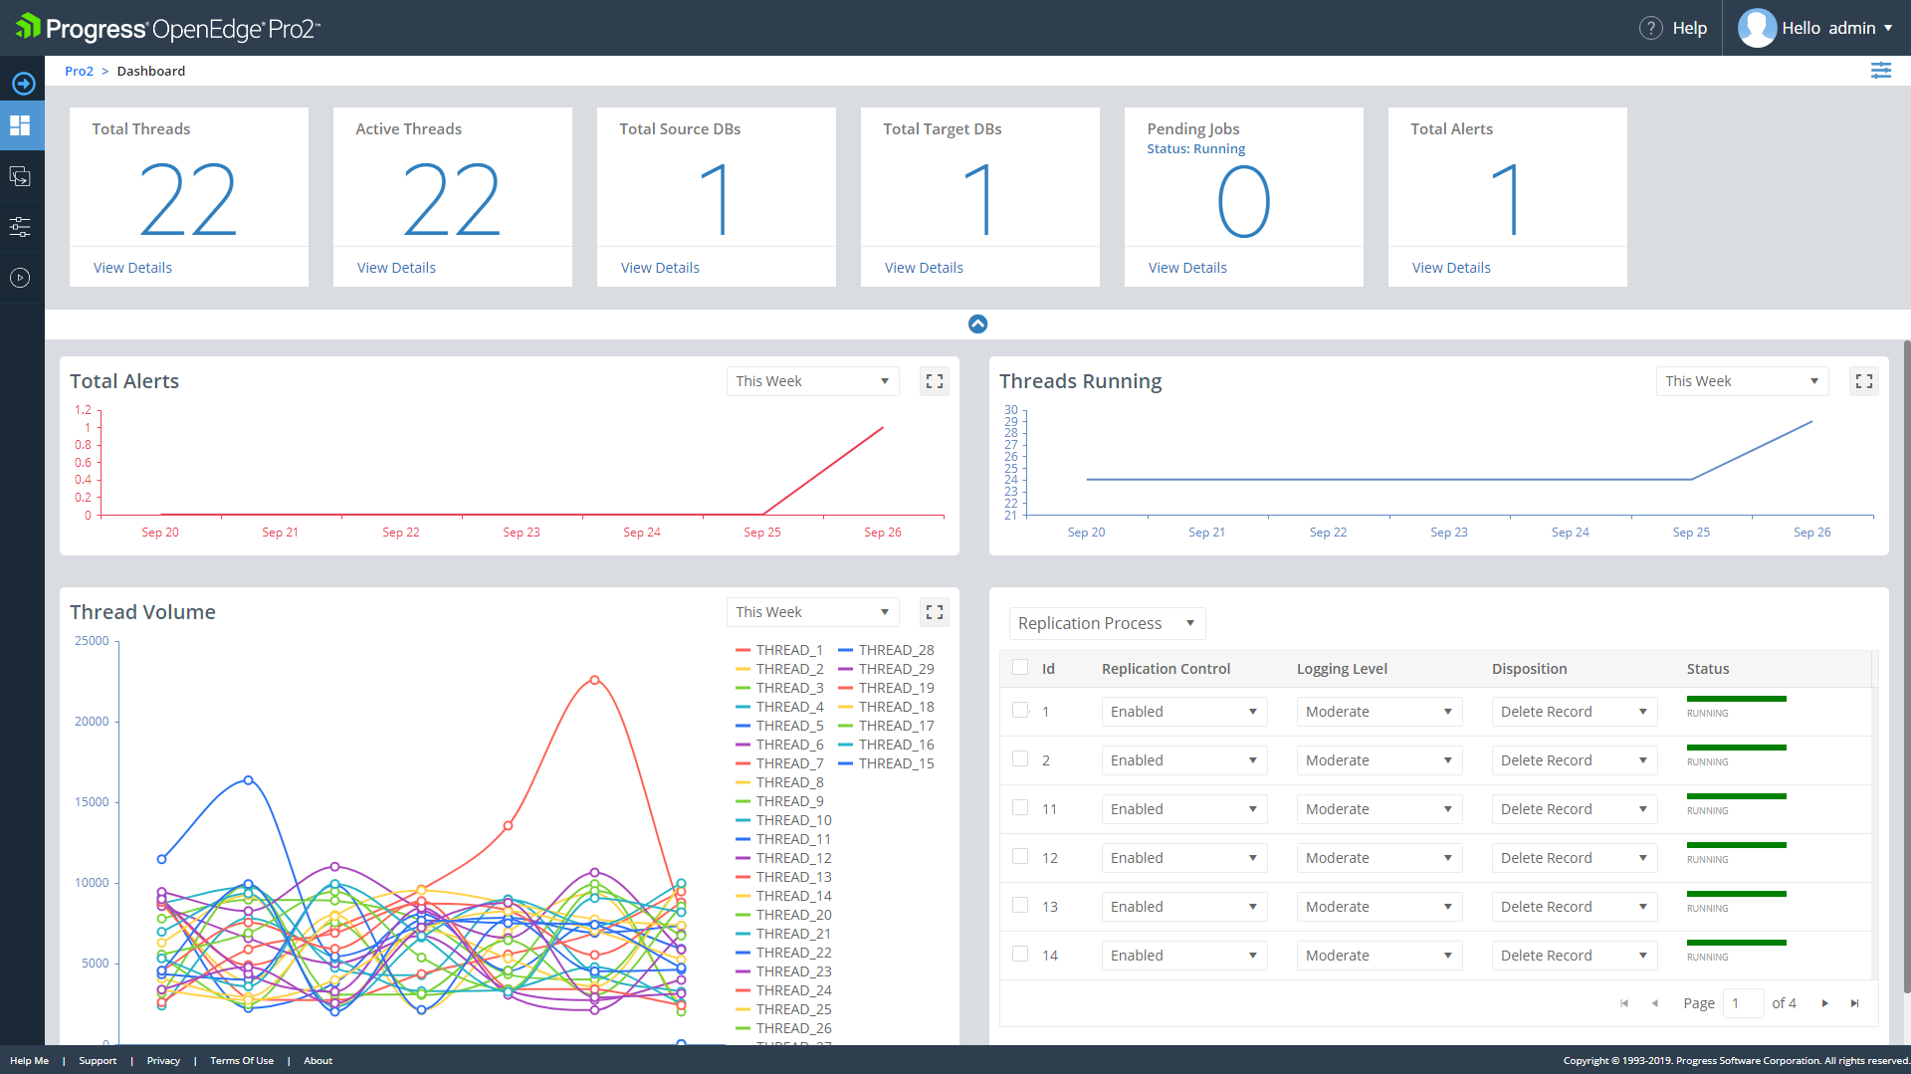

Slide 23
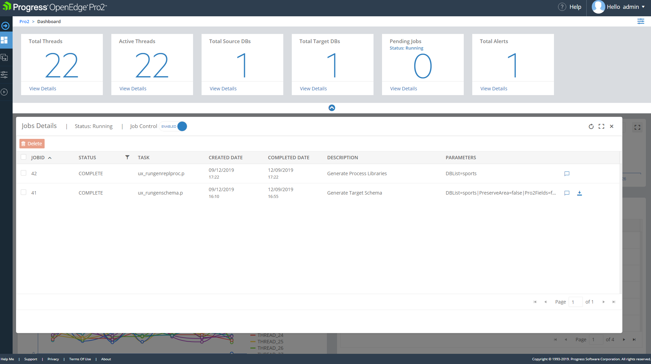

Slide 24
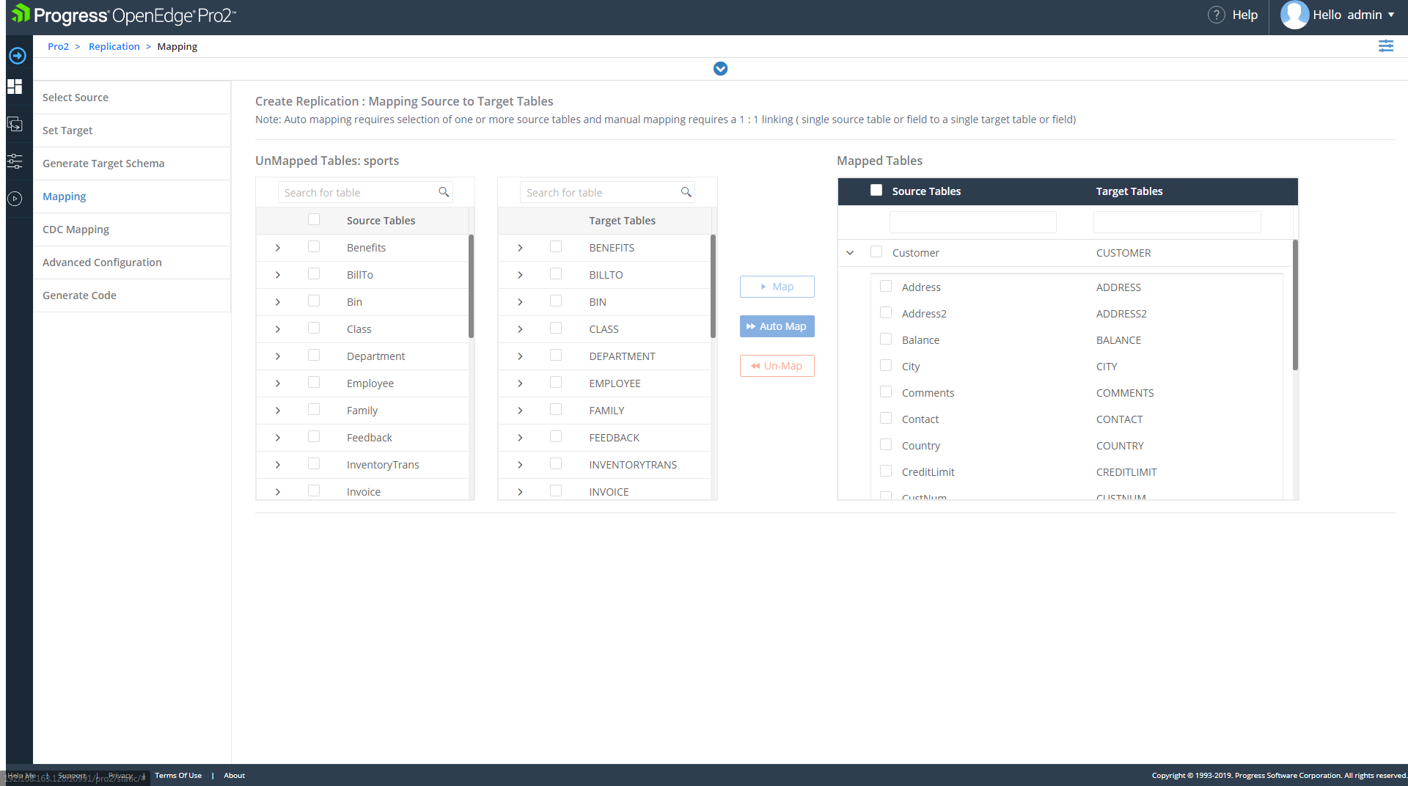

Slide 25
All types of data replication
Oracle
After-Image (Log based) Replication
Redo Log Shipment
OpenEdge Replication
Oracle Data Guard
OpenEdge Replication Plus
Oracle Active Data Guard
Pro2 Replication
Oracle Golden Gate
Notes:
Oracle has very similar options, tools and licenses.
OE Replication Plus is add-on to OE Replication. It allows to start the server against the replication Target Database. And users can query that Target database with ABL and SQL.
It is also part of Advanced Enterprise License that also includes: Table Partitioning, Multi-Tenacy, OE Management, CDC and TDE.

Slide 26
Is it possible to Update Replication Target DB?
Oracle 19c -- Active Data Guard DML Redirect
Set startup parameter “ADG_REDIRECT_DML” to TRUE
ALTER SESSION ENABLE ADG_REDIRECT_DML;
Notes:
Active Data Guard DML Redirect -- changes could be made to Target database.
It is an important twist. Can do transactions against standby database.
For example for reporting that need to do light weight transactions. This transactions immediately redirected back to primary database, committed on the primary, and then made available on a standby. From a user perspective it is like writing to a standard Oracle database.

Slide 27
After-Image
OE Replication
Pro2
Whole / Partial | Whole Database | Whole Database | Partial / Table by Table
Unit | AI-Block | AI-Block | Record
DB Type | Pro to Pro | Pro to Pro | Pro to Other
Can use for DR | Yes | Yes | Usually no
Can use for data reorganization | No | No | Yes (pro2pro)
Throughput | Fast | Faster | Slower
Instant replication | No | Yes | Yes
License | No | Yes | Yes
Access to Target DB | No | Yes (OE Repl Plus) | Yes
How difficult to setup | Very easy | Easy | More difficult / PSC help
Possibility of delay | Yes | No | May be
Notes:
Unlike After-Image and OE Replications Pro2 is not designed for data protection (DR or run backups on Target). It is either for replication to different database vendor (SQL Server, Oracle) or pro2pro to do data reorganization like D&L or move from one type (HP, IBM) to a different type (Linux, Win).
By “Throughput” I mean how fast the data changes from Source DB could be replicated to Target DB. AI and OE Replication only replicate changes, which could be 1 byte, Pro2 replicate the whole record regarless. While After-Image and OE Replications rare have speed bottleneck if configured appropriately, the pro2 limits the load by itself. The default Pro2 version 4 has 5 replication threads. That is a limit by itself. It is increased in version 5.
By “Instant replication” I mean do the changes instantly go to the Target database. Obviously for AI replication they are not.
The possibility to set up a delay in replication is also an important feature described on a later slides

Slide 28
After-Image Block
DB Block ( record )
DB Block ( index )
Recovery note
Recovery note
Recovery note
Recovery note
_StorageObject._Object-number ???
Notes:
Each recovery note describes the change of one particular database object ( table, record, sequence). The fact is that this recovery note does not have information about Object ID it is related to. They only describe the changed to the database block, not knowing which object those changes are for.

Slide 29
After-Image
OE Replication
Pro2
Whole / Partial | Whole Database | Whole Database | Partial / Table by Table
Unit | AI-Block | AI-Block | Record
DB Type | Pro to Pro | Pro to Pro | Pro to Other
Can use for DR | Yes | Yes | Usually no
Can use for data reorganization | No | No | Yes (pro2pro)
Throughput | Fast | Faster | Slower
Instant replication | No | Yes | Yes
License | No | Yes | Yes
Access to Target DB | No | Yes (OE Repl Plus) | Yes
How difficult to setup | Very easy | Easy | More difficult / PSC help
Possibility of delay | Yes | No | May be
Notes:
Unlike After-Image and OE Replications Pro2 is not designed for data protection (DR or run backups on Target). It is either for replication to different database vendor (SQL Server, Oracle) or pro2pro to do data reorganization like D&L or move from one type (HP, IBM) to a different type (Linux, Win).
By “Throughput” I mean how fast the data changes from Source DB could be replicated to Target DB. AI and OE Replication only replicate changes, which could be 1 byte, Pro2 replicate the whole record regarless. While After-Image and OE Replications rare have speed bottleneck if configured appropriately, the pro2 limits the load by itself. The default Pro2 version 4 has 5 replication threads. That is a limit by itself. It is increased in version 5.
By “Instant replication” I mean do the changes instantly go to the Target database. Obviously for AI replication they are not.
The possibility to set up a delay in replication is also an important feature described on a later slides

Slide 30
VST to monitor OE Replication
find first _Repl-Server no-lock no-error.
if available _Repl-Server then
display _Repl-Server._ReplSrv-Starttime
_Repl-Server._ReplSrv-AgentCount
_Repl-Server._ReplSrv-BlocksSent
_Repl-Server._ReplSrv-ServerState
_Repl-Server._ReplSrv-Database
_Repl-Server._ReplSrv-DatabaseRole
_Repl-Server._ReplSrv-LastBlockSentAt
_Repl-Server._ReplSrv-AgentsConnected
_Repl-Server._ReplSrv-ConnectAttempts
_Repl-Server._ReplSrv-CurDelayInterval
_Repl-Server._ReplSrv-RecoveryState
_Repl-Server._ReplSrv-TransitionType
_Repl-Server._ReplSrv-TransitionTimeout
_Repl-Server._ReplSrv-ReplicationSet
_ReplSrv-TransDatabaseRole
_ReplSrv-BackupMethod
substring(_ReplSrv-ConfiguredAgents,1,40) format "x(40)" label "ConfiguredAgents"
_ReplSrv-ReplKeepAlive
_ReplSrv-AgentShutdownAction.
Notes:
Replication monitoring DSRUTIL status codes with VST's
https://community.progress.com/s/article/monitoring-dsrutil-status-codes-with-replication-vst

Slide 31
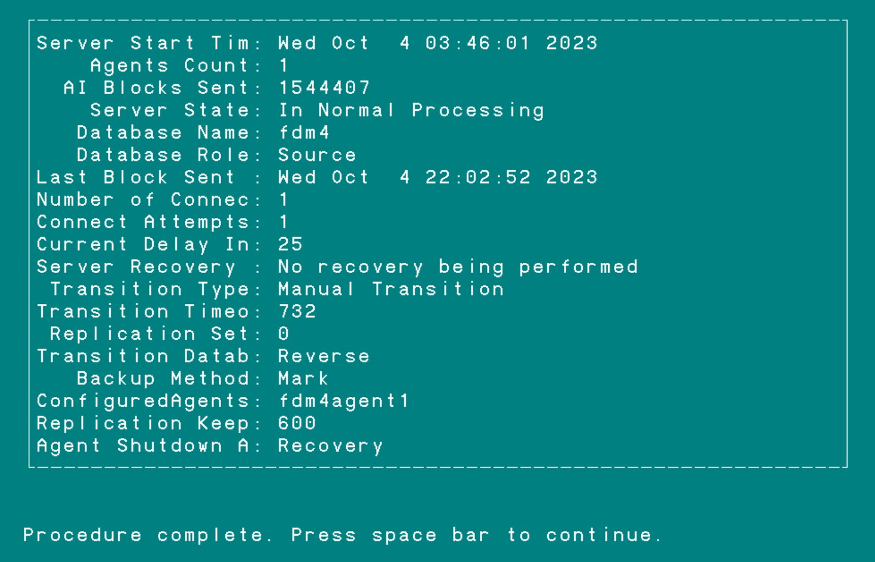
VST to monitor OE Replication
Notes:
DSRUTIL STATUS vs -detail (or verbose) return codes
https://community.progress.com/s/article/P156255

Slide 32
VST to monitor OE Replication agent
find first _Repl-Agent no-lock no-error.
if available _Repl-Agent then
display
_Repl-Agent._ReplAgt-AgentName
_Repl-Agent._ReplAgt-ConnectTime
substring(_Repl-Agent._ReplAgt-DBName,1,40) format "x(40)" label "DBName"
substring(_ReplAgt-ServerHost,1,40) format "x(40)" label "IP"
_Repl-Agent._ReplAgt-Port
_Repl-Agent._ReplAgt-Status
_Repl-Agent._ReplAgt-BlocksProcessed
_Repl-Agent._ReplAgt-DatabaseRole
_Repl-Agent._ReplAgt-TransitionType
_Repl-Agent._ReplAgt-Critical
_Repl-Agent._ReplAgt-ReplicationSet
_Repl-Agent._ReplAgt-ConnectTimeout
_Repl-Agent._ReplAgt-TransDatabaseRole
_Repl-Agent._ReplAgt-BackupMethod
_Repl-Agent._ReplAgt-MinPort
_Repl-Agent._ReplAgt-MaxPort
_Repl-Agent._ReplAgt-MaxMsgSize
_Repl-Agent._ReplAgt-Method
with 1 col.
Notes:
Replication monitoring DSRUTIL status codes with VST's
https://community.progress.com/s/article/monitoring-dsrutil-status-codes-with-replication-vst

Slide 33
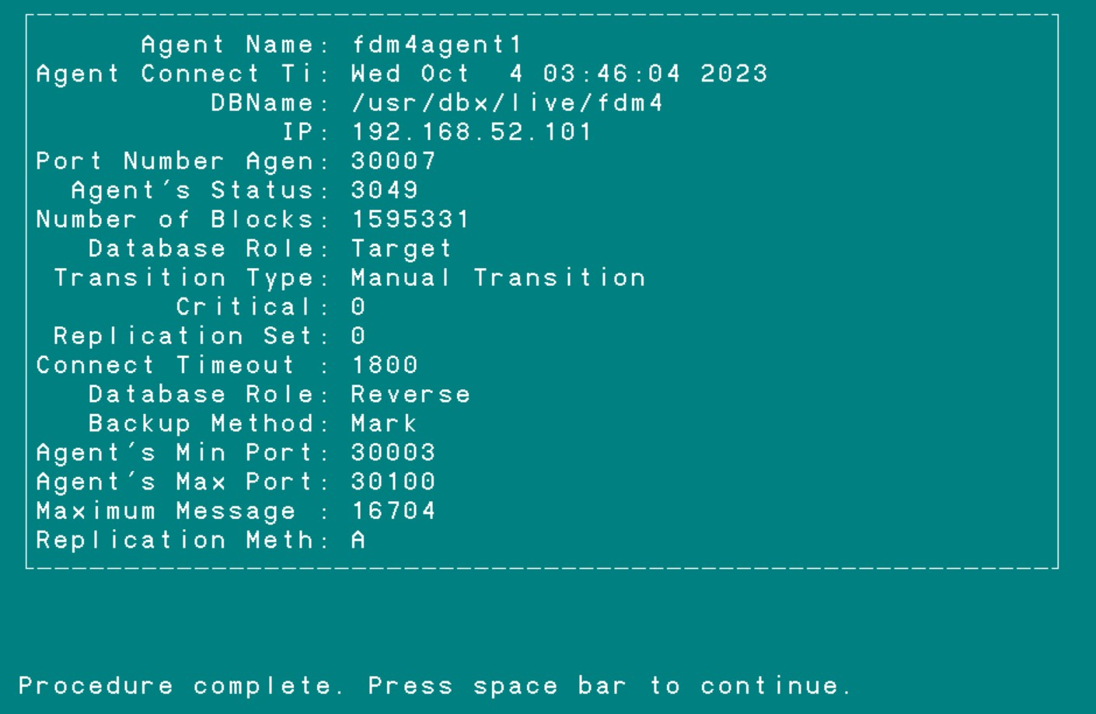
VST to monitor OE Replication
Notes:
DSRUTIL STATUS vs -detail (or verbose) return codes
https://community.progress.com/s/article/P156255

Slide 34
VST to monitor OE Replication Agent Activity
find first _Repl-AgentActivity no-lock no-error.
if available _Repl-AgentActivity then
display
_Repl-AgentActivity._ReplAgtAct-AgentName
_Repl-AgentActivity._ReplAgtAct-ConnectTime
_Repl-AgentActivity._ReplAgtAct-BlocksProcessed
_Repl-AgentActivity._ReplAgtAct-Status
_Repl-AgentActivity._ReplAgtAct-State
_Repl-AgentActivity._ReplAgtAct-ServerLag
_Repl-AgentActivity._ReplAgtAct-WaitingFor
_Repl-AgentActivity._ReplAgtAct-CurDelayInterval
_Repl-AgentActivity._ReplAgtAct-LastBlockReceived
_Repl-AgentActivity._ReplAgtAct-TransStarted
_Repl-AgentActivity._ReplAgtAct-LastSyncTimeTgt
_Repl-AgentActivity._ReplAgtAct-LastSyncTimeSrc
_Repl-AgentActivity._ReplAgtAct-LastSyncDelta
with 1 col.
Notes:
Replication monitoring DSRUTIL status codes with VST's
https://community.progress.com/s/article/monitoring-dsrutil-status-codes-with-replication-vst

Slide 35
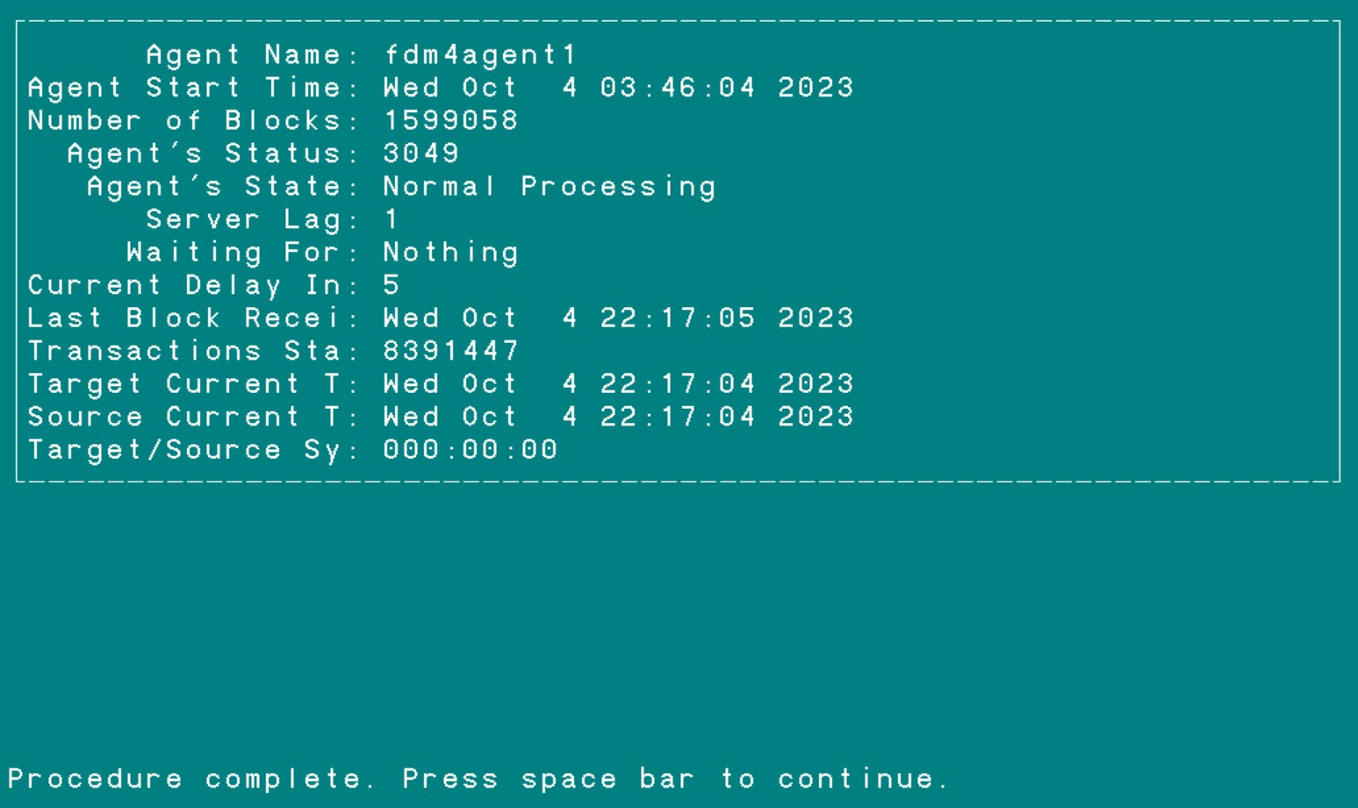
VST to monitor OE Replication
Notes:
DSRUTIL STATUS vs -detail (or verbose) return codes
https://community.progress.com/s/article/P156255
Server to Agent initial connect status codes
1001 Initial Connection
1002 Initialising
1003 Target in Quiet Point
1032 Initial Connection Failed
1033 Recovery Failed
1034 Invalid Target Database Configuration
1035 Agent Failed
1036 Agent is Ignored
1037 Agent is Stopped
1038 Agent is Terminated
1063 Agent is Ended
Replication Server
1100 connecting status
1101 processing status
1102 stalled status
1103 pre_transition status
1104 listening status
1105 transition status
1199 inactive
1255 unknown
6001 Server Initialisation
6002 Connecting to Agent(s)
6003 Configuring Agent(s)
6004 Recovery Processing
6005 Startup Synchronization
6006 Initiating Agent to Agent Connections
6021 Normal Processing
6022 Performing Transition
6023 Replication is Suspended
6060 Server is ended
Control Agent
2100 connecting status
2101 processing status
2102 stalled status
2103 pre_transition status
2104 listening status
2105 transition status
2080 Pre Transition
2081 Applying After-image Extent
2082 Transitioning
2083 Listening
2199 inactive
2255 unknown
Agent
3100 connecting status
3101 processing status
3102 stalled status
3103 pre_transition status
3104 listening status
3105 transition status
3048 Startup Synchronisation
3049 Normal Processing
3050 Recovery Synchronisation
3051 Being Transitioned
3052 Target Database in Quiet Point
3053 Target Database is in a BI stall
3054 Target Database is in an AI stall
3055 Online backup of Target Database
3199 inactive
3255 unknown

Slide 36
How to disable replication
dsrutil db-name -C disablesitereplication
proutil db-name -C disablesitereplication

Slide 37
Replication Recovery Information
dsrutil db-name -C recovery
Online Replication Recovery Information for db-name:
Replication version: 6.0
Date created: Sat Jul 20 03:45:32 2024
Date last written: Mon Sep 16 17:02:27 2024
Replication local agent information:
Last Block: Incomplete
Last block received location: area: 64, seq: 197582, loc: 39239680, offset 0
Last block processed location: area: 64, seq: 197582, loc: 39239680, offset 16242
Last block ACKed location: area: 64, seq: 197582, loc: 0, offset: 128
Last block received: no date
Last block ACKed: no date
ID of the last TX begin: 66693678
ID of the last TX end: 66693678
Time of last TX end: Mon Sep 16 17:02:27 2024
Last AI Extent processed
AIMAGE BEGIN date: Sat Jul 28 07:01:15 2018
AIMAGE NEW date: Mon Sep 16 17:01:27 2024
After-Image File Number: 197582
File Last Opened: Mon Sep 16 17:01:27 2024
Completely Applied to Target: No
When replication was created
Status of replication
Status of replication

Slide 38
Possibility to delay replication using After-Image replication
Physical Corruption
Corruptions leading to errors with standard operations:
Reading, back out of a transaction, crash recovery
Logical Corruption
“Hand made corruptions” – deleting or wrongly changing important data
Both Corruptions could be fixed by delayed replication
Notes:
In some rare cases a corrupted recovery note will be created in Source database. That damaged note will be transferred to the Target database by roll forwarded and corrupting the bi file on the Target.
This can be fixed by restore of the whole database from backup and roll forward, but that is a lengthy process. So it will be faster to recover using a warm spare database with a delayed after-image roll forward.
Sometimes user deletes important data.

Slide 39


Slide 40
Demo slides (in case demo does not work)
(S-Source) proutil /home/job183/demo/sports -C enableSiteReplication source
(S) probkup online /home/job183/demo/sports /home/job183/demo/sports.bkp –REPLTargetCreation
(S) ftp.sh – FTP backup created in previous step from Source to Target
(T-Target) prorest /home/job183/demo/sports sports.bkp –verbose
(T) proutil /home/job183/demo/sports -C enableSiteReplication target
(T) proserve -pf /home/job183/demo/sports_target.pf
(S) dsrutil /home/job183/demo/sports -C restart server
--------------------------------- Monitoring ---------------------------------------------
(S/T) dsrutil /home/job183/demo/sports –C status
(S/T) dsrutil /home/job183/demo/sports –C status –verbose
(S/T) dsrutil /home/job183/demo/sports -C monitor

Slide 41
Demo slides (in case demo does not work)
Sample of sports.repl.properties file
[server]
control-agents=sportsagent1
database=sports
transition=manual
agent-shutdown-action=recovery
transition-timeout=600
defer-agent-startup=5760
[control-agent.sportsagent1]
name=sportsagent1
database=sports
host=<Server-name>
port=65016
connect-timeout=120
replication-method=async
critical=0
[agent]
name=sportsagent1
database=sports
listener-minport=30003
listener-maxport=30100
[transition]
transition-to-agents=sportsagent1
database-role=reverse
auto-begin-ai=1
auto-add-ai-areas=0
source-startup-arguments=-DBService replserv -S
demosports -pica 8192
target-startup-arguments=-S 65016 -DBService
replagent
restart-after-transition=0
Transition →
Transition →
Transition →
Transition →
Transition →
Transition →
Transition →
Transition →
Transition →
Transition →
Notes:
Make sure the following is set
[server]
agent-shutdown-action=recovery
The agent-shutdown-action must be set to recovery (from PKB 18310)
[transition]
transition-to-agents=agent1
To make a transition failover a definition of what agent(s) to transition to must be stated in the <sourcedb>.repl.properties file. (from PKB 18400)

Slide 42
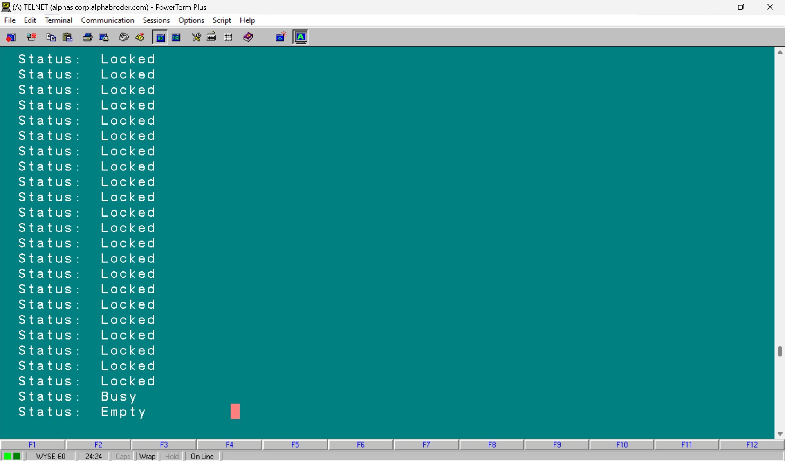
$ rfutil db_name -C aimage list | grep Status
You can roll forward Locked After Images.
So your After-image replication will be independent from OE Replication

Slide 43
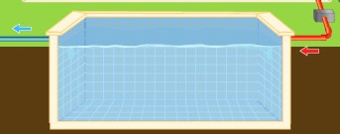
Parameter -pica (Plugin Communication Area)
Database Service Manager Queue
-pica is just a buffer for AI messages to be sent from source to target
Notes:
This buffer has information about AI blocks, not the blocks themselves but messages. Each message is 112 bytes = 14 8-byte pointers.
If the target database cannot keep up, the source will be affected and users will complain.
-pica is essentially a FIFO (first in first out) queue.

Slide 44
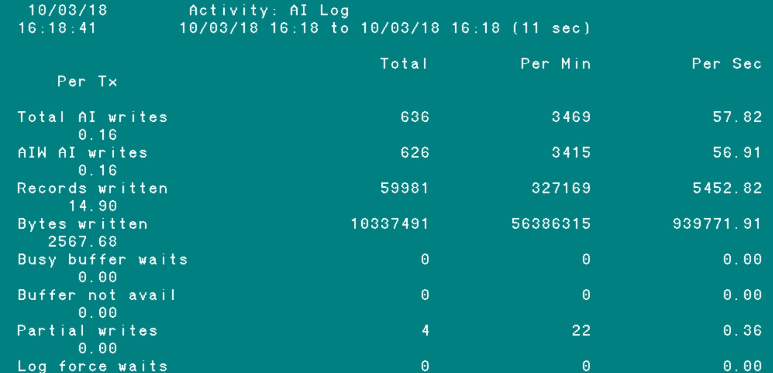
Parameter -pica (Plugin Communication Area)
How to measure “in-pipe”?
Promon / R&D / 2 / 6
_ActAILog VST
AI writes per sec * after-image block size
57.82 * 16,384 = 947,322
Notes:
If we want to be more accurate, the true –pica “in-pipe” through put is the difference between Total AI writes and Partial AI Writes.
So in my case it is ( 57.82 – 0.36 ) * 16,384 = 941,434. But the Partial AI Writes are usually much smaller then Total Ai Writes and so we can ignore them.

Slide 45
Parameter -pica (Communication queue)
Database Service Manager Queue
-pica is just a buffer for AI messages to be sent from source to target
AIW
RPLS
process
Notes:
It is a kind of like Lock Table. And it’s overflow is also bad, though not as bad as Lock Table overflow. When Lock Table overflow happens all transaction processing freezes. Here it does not freeze completely, but it will be rather limited by Replication Server (RPLS) throughput ( blue pipe here )

Slide 46
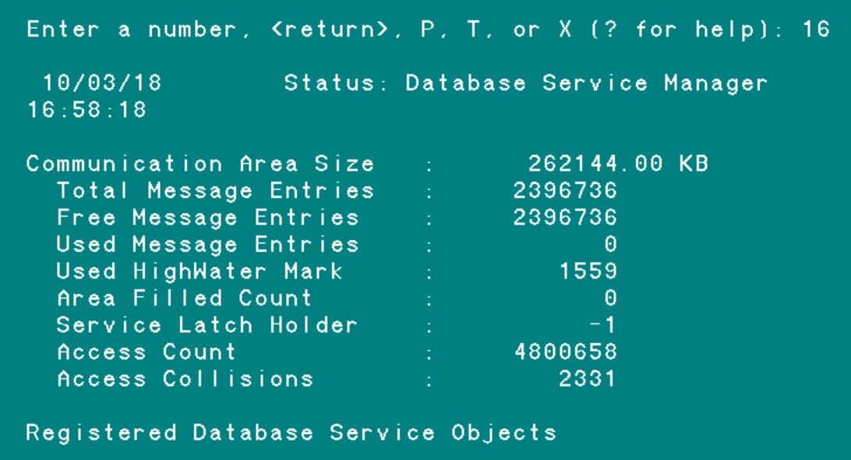
Parameter -pica (Plugin Communication Area)
_dbservicemanager
VST
pool ?
How to measure “out-pipe”?
Promon / R&D / 1 / 16
-pica 262144
Pool Size
Air
Water
2x AI blocks proc
Total Message Entries 2,396,736 * 112 = 262143 KB
Notes:
Here Total Message Entries = 2397636. Each message is 112 bytes.
2397636 * 112 = 262143 KB
Progress uses not the exactly all the memory provided by –pica, but some rounding mechanism to allocate memory designated to pica pool according to –pica parameter value. In the above example we see 1 KB less then –pica value.
For other values of –pica the result will be different.
Area Filled Count – how many times Free Message Entries became zero, which is bad. Zero indicates no problems with OE Repl occurred.
Service Latch Holder – user number that is holding the latch. -1 means nobody is holding the latch
Access Count – twice the number of after-image blocks that went through the queue. One access by AIW to put message (in) and one by Replication Server to process it (out).
Access Collision – collision between those two processes (AIW in and RPLS out attempting simultaneous access to PICA queue). When they both trying to access PICA at the same time one process has to wait. And that wait is 10 milliseconds. That is not a lot. I ignore that access collisions count.

Slide 47

Parameter -pica (Plugin Communication Area)
Notes:
The AI blocks in AI-file are applied by RPLS consequentially. PICA message is only a pointer to the AI block that has to be applied (16 bytes in 112 pica message). The last AI block that was applied is all that is needed for the process.

Slide 48
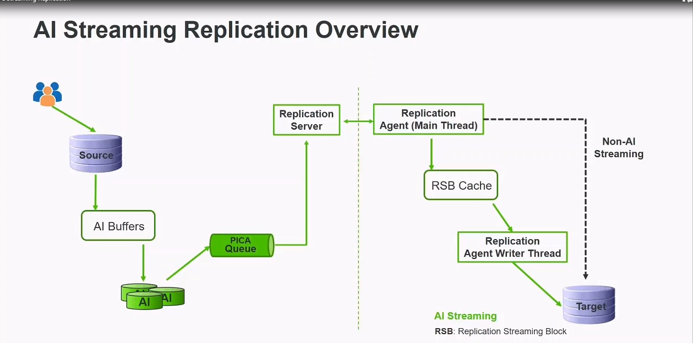
OE version 12 new feature – AI Streaming
Notes:
DBAs want their disaster recovery system to have the most up to date database changes so that in the event
of a failure, recovery can occur quickly and with minimal data loss. OpenEdge Release 12.0 introduces
Replication AI Streaming to meet this requirement To minimize the loss of AI data queued on a source, OpenEdge Replication AI Streaming now transmits AI blocks to the targets as they are generated.

Slide 49
Parameter -pica (Plugin Communication Area)
[agent]
ai-streaming=1
rsb-cache-size=5000
AI Streaming is enabled
Specifies the size of the Replication Streaming cache
in units of an AI block
[agent]
ai-streaming=0
rsb-cache-size=5000
AI Streaming is disabled
ignored
See _Repl-AgentAIStreaming VST for details
Notes:
The Replication server sends AI data in the same way that prior releases did, but the Replication agent caches the incoming AI blocks in the Replication Stream Block (RSB) Cache. The blocks are then read from the RSB cache and applied to the target. Database admins have the ability to observe the Replication AI Streaming operations in the replication log with logging-level set to 3 on the replication agent.
The _Repl-AgentAIStreaming table within the Replication Virtual System Tables (VSTs) provides insight into the configuration and functioning of Replication AI Streaming.

Slide 50
OE version 12 new feature – AI Streaming
Notes:
DBAs want their disaster recovery system to have the most up to date database changes so that in the event
of a failure, recovery can occur quickly and with minimal data loss. OpenEdge Release 12.0 introduces
Replication AI Streaming to meet this requirement To minimize the loss of AI data queued on a source, OpenEdge Replication AI Streaming now transmits AI blocks to the targets as they are generated.

Slide 51
Starting 12.0 only asynchronous commit mode is supported.
Synchronous commit mode no longer supported.
New in version 12.1 Replication properties validation utility
dsrutil db-name -C validate
In version 12.2 -pica could be changed online
Notes:
12.0 In prior releases, you had the option of synchronous or asynchronous commits from your source database to your target.
12.1 The DSRUTIL command line utility enables database administrators to validate the properties. The utility adds the ability for the source database to report on the running status of any target database brokers using messages 19460 and 19461
12.2 The ability to increase -pica value online will give customers an option to tune replication performance. Customers can also start pica queue with a smaller size first, then increase it only when it's necessary. By doing this, customer may save the memory usage as well.

Slide 52
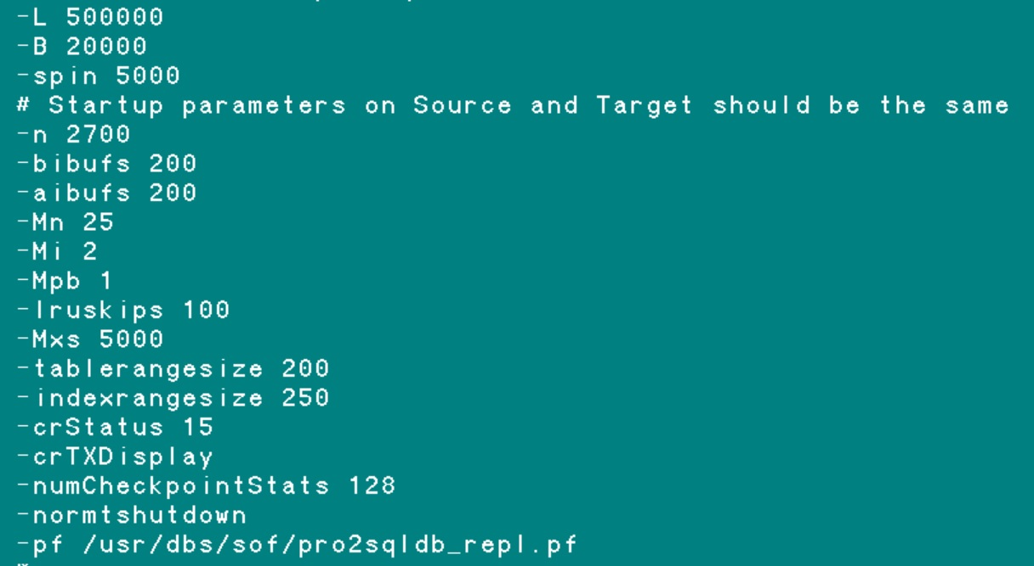
Startup parameters
Startup parameters on Source and Target should be the same
Notes:
Parameters like -n, -Mn, on Target should be the same or bigger than on Source. Other parameters may not affecting replication. I developed a habit to keep parameters on Source and Target exactly the same. That way I do not worry if parameter affects replication or not.

Slide 53
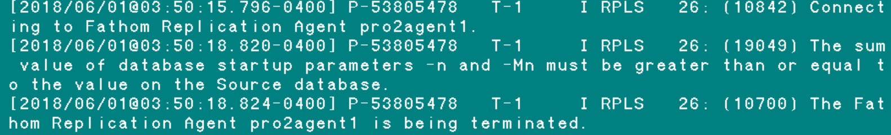
Startup parameters
When Source and Target parameters do not match
Source_DB: status code 6060: Server is ended
Target_DB: status code 1063: Agent is Ended
Notes:
Print screen from the Source DB log

Slide 54
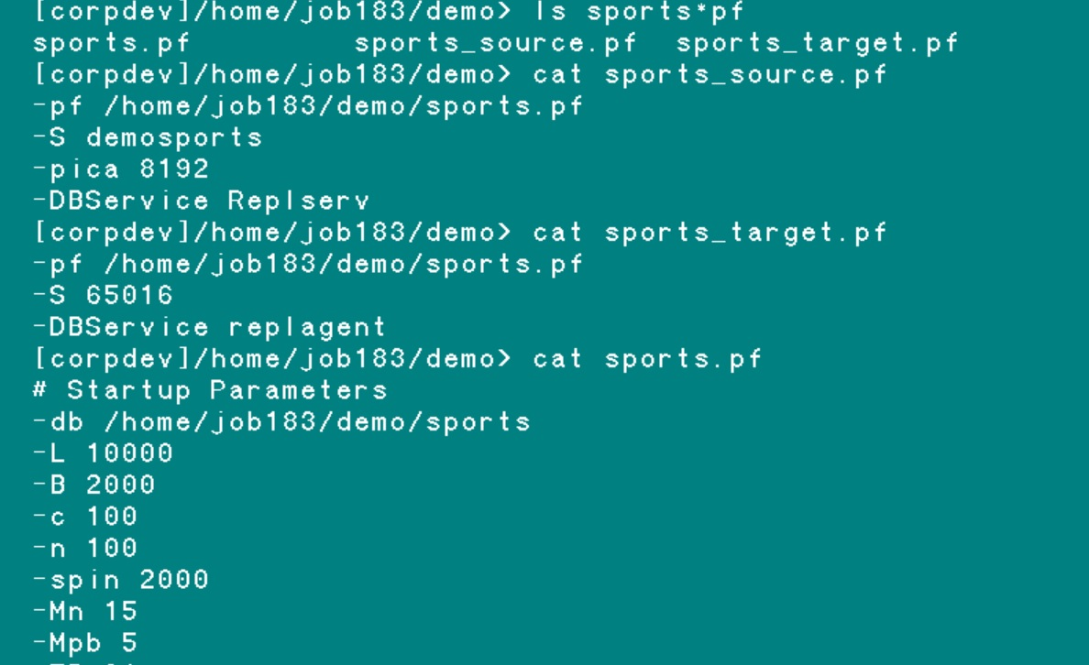
Startup parameters
replication related parameters we put into a separate .pf
Notes:
I create one parameter file where I put all parameters, like here sport.pf. Then I add two additional parameter files: here sports_source.pf and sports_target.pf which include that main parameter file and also specific parameters for source or target respectively.
Then on Source I use sports_source.pf and on Target sports_target.pf. That way I can quickly change roles databases.

Slide 55


