Slide 1

How Healthy is your Database
Mike Furgal,
assistant to the head groundskeeper
the parmington foundation

Slide 2
Agenda
Daily Tasks
Weekly Tasks
Monthly Tasks
Quarterly Tasks
Yearly Tasks

Slide 3
Daily Tasks
Monitor the free space in the database
Watch for long running transactions
Monitor Before Image size
Watch for runaway processes
Look at the database log files for errors
Verify After Image extent switches
Verify backups are successful

Slide 4
Long Running Transactions
Use Virtual System Tables
FOR EACH _trans WHERE _trans-num <> ?:
DISPLAY _trans-duration.
END.
Use PROMON
Promon -> R&D
-> 1 Status Displays
-> 4 Processes/Clients …
-> 3 Active Transactions

Slide 5
Log File Errors
Errors you can ignore (likely)
3: (-----) TCP/IP write error occurred with errno 32
Errors that may need investigation
SRV 14: (9445) SYSTEM ERROR: read wrong dbkey at offset 20480 in file DBI15340a15616
SRV 44: (6072) SYSTEM ERROR: error writing, file = DBI1027880, ret = -1
Errors you should not ignore
20: (5635) SYSTEM ERROR: …….
SRV 3: ** Save file named core for analysis by Progress Software Corporation. (439)

Slide 6
Backups are Successful
Did Backups Complete?
Out of Disk Space?
Extent switch preventing backups from running?
Backup output states:
Switch to new ai extent failed. (3669)
Backup terminated due to errors. (1617)
Database Log states:
BACKUP 1: (3775) Can't switch to after-image extent /ai/x.a1 it is full.
BACKUP 1: (3776) Backup ai extent and mark it as empty.
BACKUP 1: (1617) Backup terminated due to errors

Slide 7
Monitor Free Space
Each Storage Area maintains it’s own management of free space
  Free Chain – Chain of free blocks available to be used for Data or Indexes
  RM Chain – Chain of Data (RM) blocks that have enough space to have more records added to them
  High Water Mark – The largest numbered in-use block in a storage area
  Empty Block – Blocks above the High Water Mark

Slide 8
Storage Area Diagram
Extent Header | Objecd Block | RM Block | RM Block | IX Block | RM Block | IX Block | RM Block | Free Block | Empty Block | Empty Block
High Water Mark

Slide 9
Extents Diagram
Storage Area 7
db_7.d1
db_7.d2
db_7.d3
High Water Mark
Storage Area 8
db_8.d1
db_8.d2
High Water Mark

Slide 10
Extents Diagram
Storage Area 7
db_7.d1
db_7.d2
db_7.d3
High Water Mark
The HWM is in the variable length extent which is growing
This makes it hard to monitor out of space conditions.

Slide 11
Storage Extent Recommendations
Each area should have no more than 10 extents if possible
  5 extents would be better
Each extent should be no larger than…
  Depends on disk speed
  Depends on CPU speed
  Can you copy the extent in 15 minutes? Maybe that is the size
There is a 1 Terabyte limit on extent size
Please please please don’t have a single variable extent that is 500 GB or larger.
  Down stream problems if something goes wrong

Slide 12
Agenda
Daily Tasks
Weekly Tasks
Monthly Tasks
Quarterly Tasks
Yearly Tasks

Slide 13
Weekly Tasks
Archive After Image files
Refresh test and training databases

Slide 14
After Imaging
Point in time recovery
Not turned on by default
Last good backup + After Image files restores to the point of the failure
Can be used to create a warm standby database

Slide 15
Typical Backup
X
Backup 1
Backup 2
Backup 3
Backup 4
12
12
12
12
Mon
Tue
Wed
Thu
Fri
Restore Thursdays backup (hope it’s good) and lose the data
From Midnight Thursday until 3pm Friday

Slide 16
After Image Diagram
After Image 1
After Image 2
After Image 3
After Image 4
X
Backup 1
Backup 2
Backup 3
Backup 4
12
12
12
12
Mon
Tue
Wed
Thu
Fri
Restore Thursdays backup (hope it’s good) and roll forward
After Image file 4 to bring you to the point of the crash. Once complete
normal Crash Recovery occurs and all open transactions are backed out

Slide 17
After Image Diagram
After Image 1
After Image 2
X
After Image 3
After Image 4
X
Backup 1
Backup 2
Backup 3
Backup 4
12
12
12
12
Mon
Tue
Wed
Thu
Fri
Backup 4 turns out to be bad.
Restore backup 3, roll forward After Image files 3 and 4

Slide 18
Enabling After Imaging
Add After Image extents to your database
  Create at least 4 variable length extents
  If running OE Replication, then 16 Fixed Length Extents of 1 GB or more
Backup the database
  Required as the starting point of After Imaging
Enable After Imaging
  rfutil dbname –C aimage begin
Enable the AI Archiver
  rfutil dbname –C aiarchiver enable
Start the database
  Use the –aiarcdir and -aiarcinterval to manage where After Image files are place and how often

Slide 19
Agenda
Daily Tasks
Weekly Tasks
Monthly Tasks
Quarterly Tasks
Yearly Tasks

Slide 20
Monthly Tasks
Generate Storage Area Growth reports
  For Storage Capacity Planning
DB Name | Area | Beg HWM | End HWM | Growth | Total Size | % Full | Proj Growth | Proj Size | Proj % Full
nxt | default | 7,291.99 | 7,607.99 | 316.00 | 8,195.98 | 92.8% | 1,896.00 | 9,503.99 | 116.0%
nxt | transient | 21,895.99 | 22,635.99 | 740.00 | 24,575.98 | 92.1% | 4,440.00 | 27,075.99 | 110.2%
nxt | custom | 439,647.99 | 453,783.99 | 14,136.00 | 507,907.75 | 89.3% | 84,816.00 | 538,599.99 | 106.0%
nxt | addon | 1,771.99 | 1,827.99 | 56.00 | 2,051.98 | 89.1% | 336.00 | 2,163.99 | 105.5%
nxt | aret | 883.99 | 907.99 | 24.00 | 1,027.98 | 88.3% | 144.00 | 1,051.99 | 102.3%
nxt | arett | 335.99 | 343.99 | 8.00 | 387.98 | 88.7% | 48.00 | 391.99 | 101.0%
nxt | glet | 83,455.99 | 85,651.99 | 2,196.00 | 98,307.95 | 87.1% | 13,176.00 | 98,827.99 | 100.5%
nxt | icet | 599.99 | 623.99 | 24.00 | 771.98 | 80.8% | 144.00 | 767.99 | 99.5%
nxt | icsw | 651.99 | 667.99 | 16.00 | 771.98 | 86.5% | 96.00 | 763.99 | 99.0%
nxt | icswu | 571.99 | 595.99 | 24.00 | 771.98 | 77.2% | 144.00 | 739.99 | 95.9%

Slide 21
Agenda
Daily Tasks
Weekly Tasks
Monthly Tasks
Quarterly Tasks
Yearly Tasks

Slide 22
Quarterly Tasks
Run a Database Analysis report
  Keep the reports for trend analysis
  Pay attention to the time it takes to run
Run an Index Rebuild or Index Compact (if required)

Slide 23
Database Analysis Report
Table Analysis
  # of rows per table
  Size of the table
  Fragmentation Factor
  Scatter Factor
Index Analysis
  Size of the index
  Utilization (% used space) of the index

Slide 24
Index Analysis Report Example
INDEX BLOCK SUMMARY FOR AREA "smsew_idx" : 211
-------------------------------------------------------
Table Index Fields Levels Blocks Size % Util Factor
PUB.smsew
k-prod 1358 8 3 20329 71.9M 91.1 1.2
k-prodwh 1359 3 3 9013 20.0M 57.1 1.9
k-smsew 1357 8 4 31636 70.3M 63.7 1.7

Slide 25
4 Level B-Tree Index
Root
A - Z
Poor utilization means extra
index block reads to find a record
A - C
D - F
G - H
I - J
O O O
X - Z
A - B
C - DA
DA - DT
DT - E
E - F
O O O
X - Z
AA -AN
AN- BA
BA - BE
BE- BU
BU - BZ
O O O
X - Z
Record containing the name “Bob”

Slide 26
3 Level B-Tree Index
Index Rebuild or Compact fills the block, hence less levels to traverse. 20% read performance improvement!
Root
A - Z
A - E
F - L
M - O
P - R
O O O
U - Z
A - AT
AU -BU
BU-CU
CU - E
F - H
O O O
X - Z
Record containing the name “Bob”

Slide 27
How to manage the Index utilization
Perform an Index Rebuild
  proutil dbname –C idxbuild all
  Must be run off line
  After Imaging / OE Replication must be off
  Scans the Storage Area(s) front to back, copying out fields that are part of keys, sorts them, then puts them back into the database in the index
Perform an Index Compact
  proutil dbname –C idxcompact <table.index> <target>
  Can be run online
  Works with both After Imaging and OE Replication
  Scans the index blocks in a B-Tree filling the blocks to the desired utilization, working from front to back
  Need to specify each index individually, but can be scripted

Slide 28
Agenda
Daily Tasks
Weekly Tasks
Monthly Tasks
Quarterly Tasks
Yearly Tasks

Slide 29
Yearly tasks
Performance Tune or Health Check
Perform a dump/load (if required)
  Based on the amount of scatter or fragmentation in the database
Archive data and Delete
  Dump and Load is likely required after this event
Test your Disaster Recovery Plan
  Things change, have confidence that you can recover from failure!

Slide 30
Performance Tune
Items Checked
Buffer Hit Ratio
Checkpoint Duration
CPU utilization
Latching
Application Tuning
Etc
Changes Made
Memory Allocation
BI Cluster Size
Latching Settings
  -spin, lruskips, B2, bht, etc
Etc

Slide 31
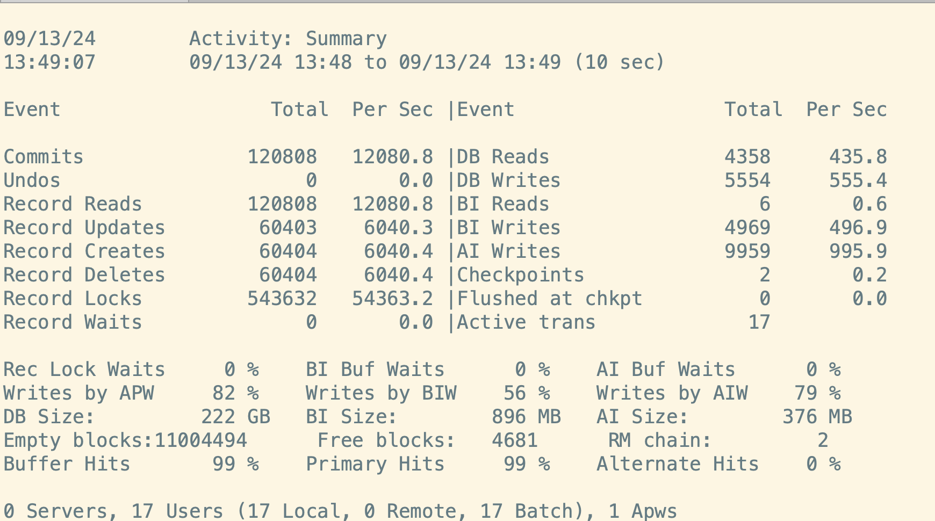
Promon Activity Screen
2 Checkpoints in a 10 second period

Slide 32
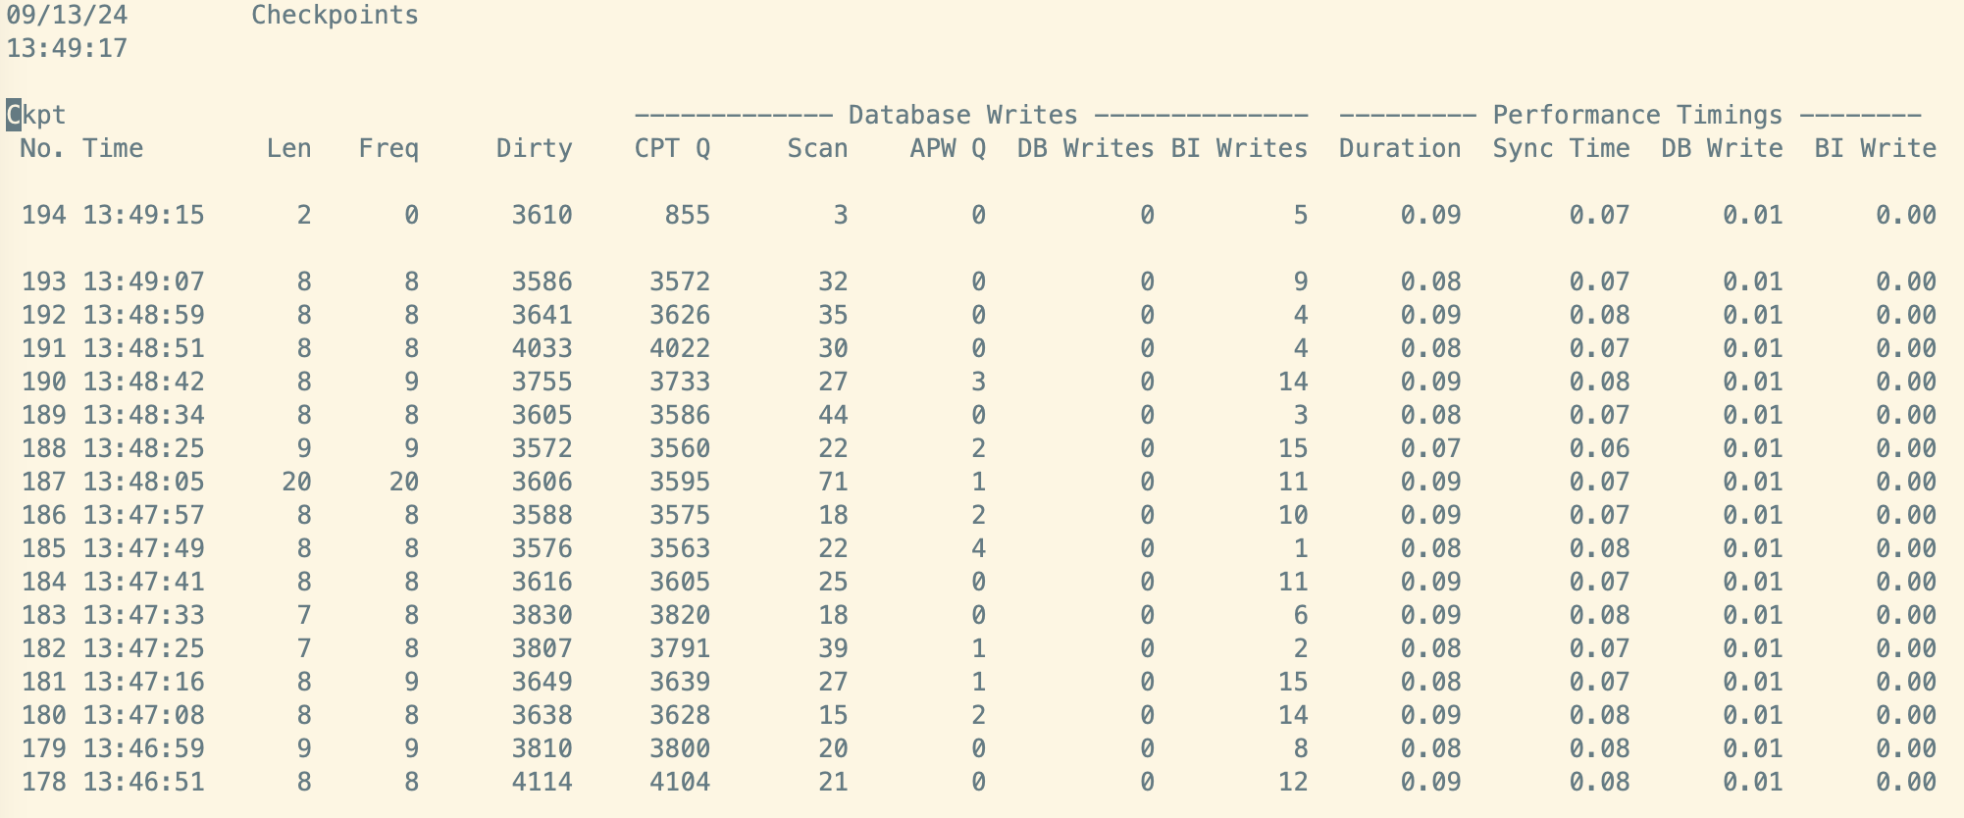
Checkpoints
Checkpoints should be at least 60 seconds apart
  300 Seconds is better

Slide 33
Checkpoints
Checkpoint is the process of synchronizing the database blocks in memory with the database blocks on disks
  Allows the Before Image file to reuse space
  Allows the time to perform crash recovery to be predictable

Slide 34
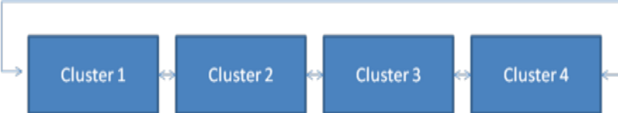
Checkpoints
DB Buffer
Pool
Database block 10
Version 18
Name: Don
Database block 10
Version 17
Name: Mike
BI Note
Changes block 10 version from 17 to 18
Value Mike -> Don
Before Image File
Database on Disk

Slide 35
Checkpoints
DB Buffer
Pool
Before Image File
Database on Disk

Slide 36
Checkpoints
Check Point Queue
DB Buffer
Pool
Before Image File
Database on Disk

Slide 37
Checkpoints
Check Point Queue
DB Buffer
Pool
Before Image File
Database on Disk

Slide 38
Checkpoints
Check Point Queue
DB Buffer
Pool
Before Image File
Database on Disk

Slide 39
Before Image Clusters
Before Image Cluster size determine the amount of updates to the database between checkpoints
  Default (512 KB) is too small
  4096 or 8192 are much better values
Need to test your disk speed to determine how large you can set it
# prodb x demo
# proutil x –C truncate bi –bi 16384
# time proutil x –C bigrow 2 -zextendSyncIO
This grows a 96 MB file.
Determine your disk speed by taking 96 divided by the time
Set your BI Cluster Size no more than 2 times your disk speed

Slide 40
Summary
OpenEdge is easy to manage, but it still needs attention
  Often not a fulltime position
You cannot set it and forget it and expect any environment to run well for years or decades.
Daily, Weekly, Monthly, Annual monitoring and maintenance is required
Seek professional help when needed
  Cost effective way to keep the environment running smoothly

Slide 41
Questions
?
research from the parmington foundation

