Slide 1
Upgrade and Thrive
Elevate your productivity by unleashing new possibilities in ABL
Raphael Ross
Senior Product Manager
PUG Challenge 2024

Slide 2
Agenda
Why upgrade to 12.8?
VAR Enhancements
AGGREGATE Statement
.NET Support
Safe Navigation Operator
ABL Collections
Event Streaming with Kafka
Protect Compiled R-Code
Dynamic Data Masking

Slide 3
Why should you upgrade to OpenEdge 12.8?
Notes:
One question that your organization may be asking is… Why should we upgrade to OpenEdge 12.8?

Slide 4
183
DAYS UNTIL 11.7 RETIRES!

Slide 5
214
88
ABL FEATURES
NEW FEATURES

Slide 6
VAR
Statement

Slide 7

VAR Statement
Released in OpenEdge 12.3
(Before)
(After)
Allows you to define variables more concisely
Short-hand notation for the DEFINE VARIABLE statement.
With VAR, you always get NO-UNDO behavior.
Multiple variables can be defined in a single statement.
Bracket notation is used for defining arrays.
The equal sign (=) is used to assign initial values.

Slide 8

VAR Statement Examples
Define multiple variables in one statement.
Define arrays without the EXTENT keyword, using bracket notation instead.
Assign initial values without the INITIAL keyword, using an equal sign instead.

Slide 9

VAR Enhancements Examples
Released in OpenEdge 12.4
Instantiate an object in a single statement.
Key Benefit
Simplifies code by combining multiple operations into a single statement!
Instantiate and initialize array object variables.
Use expressions to initialize a variable.

Slide 10
AGGREGATE
Statement

Slide 11

AGGREGATE Statement
Released in OpenEdge 12.4
Uses server-side processing – computes aggregate values on the database server-side.
  Previously performed client-side using both the ACCUMULATE statement and ACCUM function.
Simplifies your code by using a single AGGREGATE statement.
Improves performance as the computation is done more efficiently.
AGGREGATE statement is used for the COUNT, TOTAL and AVERAGE aggregate operations.

Slide 12

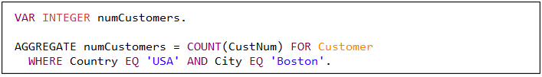
AGGREGATE Statement Examples
Counts the number of records in the Customer table.
Counts the number of customers in Boston.
COUNT includes Unknown (?) values in the count.

Slide 13

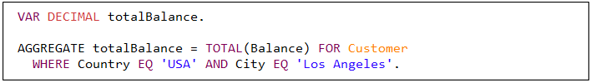
AGGREGATE Statement Examples
Calculates the average balance for customers in Chicago.
Key Benefits
Simplifies code and significantly improves performance!
Sums the customer balances for customers in Los Angeles.

Slide 14
Performance Results *
 | ACCUMLATE and ACCUM (ms) | AGGREGATE (ms) | % Gain
COUNT | 26857 | 119 | 99.55%
AVERAGE | 26709 | 136 | 99.49%
TOTAL | 26640 | 135 | 99.49%
* Performed testing on a non-indexed table with 100K rows

Slide 15
.NET Support

Slide 16
.NET Support
Released in OpenEdge 12.4
Support for .NET added for Open Client Toolkit
Run Open Client apps on any platform*
  Supports .NET Standard 2.0 libraries
  (.NET Framework 4.8, .NET 6, and .NET 8)
  Run on Windows using .NET or .NET Framework 4.8
*Access to GUI functionality (like WinForms) is not supported on Linux.
Notes:
Microsoft stopped feature development .NET Framework in 2019
Open Client applications can run on any platform that supports .NET Standard 2.0 libraries.

Slide 17
.NET 6 on Windows and Linux
Windows
Linux
Released in OpenEdge 12.7
  Key Benefits
  Use newer .NET libraries, .NET-based controls (UI)
  Access .NET classes from ABL
    Character, Batch, GUI clients, and PAS for OpenEdge agent
  Tooling support in PDSOE
  Increased performance over .NET Framework
  Renew applications – support, security, and look and feel without a disruptive architectural redesign
Released in OpenEdge 12.8

Slide 18
How do you enable this feature?
Steps to use .NET with OpenEdge
Install .NET runtime
  .NET Desktop Runtime or SDK
  64-bit or 32-bit install
Load .NET runtime
  Add startup parameter: –clrnetcore
Replace .NET Framework libraries with .NET compatible libraries (if required)
Recompile your r-code
Notes:
If you’re on Windows (you have the option of using .NET Framework or .NET), if you’re on Linux you only have the option of using .NET

Slide 19
Safe Navigation
Operator

Slide 20
Safe Navigation Operator
Released in OpenEdge 12.4
The question mark-colon (?:) is the symbol for the Safe Navigation Operator (aka the Elvis operator) in the ABL.
Supports the conditional execution of a chain of object-oriented ABL cascading elements.
Eliminates elaborate conditional code to validate the return of each element in the chain.
Allows developers to write concise, compact object-oriented ABL code.

Slide 21
Safe Navigation Operator Example
(without operator)
If a NULL value is returned by any of the methods, then the AVM raises an error condition.
To catch the occurrence of the NULL value in the chain, elaborate condition code is needed.
Key Benefit
Eliminates the need for conditional code with compact code (?:) instead!
(with operator)
Terminates the expression if an error occurs in any of the methods.
Expression returns an unknown (?) value.

Slide 22
OOABL Collections

Slide 23
OOABL Collections
ÇÇ
ÇÇ
ÇÇ
List
Collections
SortedSet Collections
HashMap Collections
OpenEdge 12.5
A collection that maintains a set of elements (objects) to be accessed in sequential order.
OpenEdge 12.6
A collection that maintains a unique set of elements (objects) in a specific order.
OpenEdge 12.7
A collection of key-value pairs (referred to as a map) and is backed by a hash table.
Notes:
Before OpenEdge 12.5, the ABL had a limited implementation of Collections with the OpenEdge.Core.Collections package.

Slide 24
List Collections
Released in OpenEdge 12.5
Collection that maintains a set of elements (objects) to be accessed in sequential order.
Preserves the order of elements (as they were inserted)
Allows duplicate elements
Supports a type-safe, generic programming model (generic type reference <T>)
Supports 6 built-in classes and interfaces (with properties and methods)
  Progress.Collections.ICollection<T> interface
  Progress.Collections.IIterable<T> interface
  Progress.Collections.IIterator<T> interface
  Progress.Collections.IList<T> interface
  Progress.Collections.List<T> class
  Progress.Collections.ListIterator <T> class

Slide 25
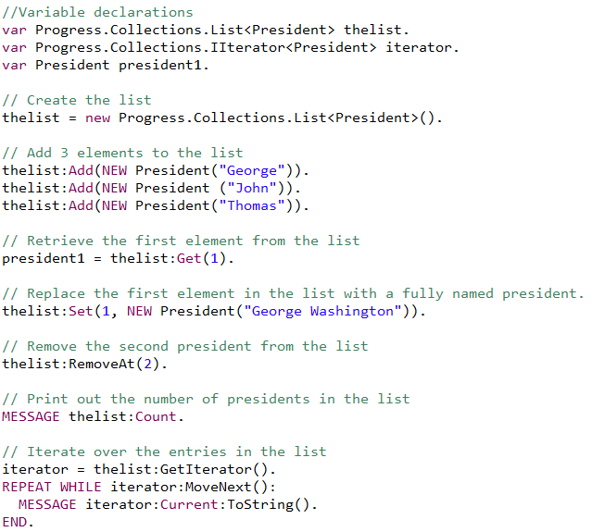
List Collections
Code Example

Slide 26
SortedSet Collections
Released in OpenEdge 12.6
Collection that maintains a unique set of elements (objects) in a specific order
Maintains elements in a sorted order (regardless how they were inserted)
Does NOT allow duplicate elements
Supports a type-safe, generic programming model (generic type reference <T>)
Supports 5 built-in classes and interfaces (with properties and methods)
  Progress.Collections.IComparable <T> interface
  Progress.Collections.IComparer <T> interface
  Progress.Collections.ISet<T> interface
  Progress.Collections.SortedSet<T> class
  Progress.Collections.SortedSetIterator<T> class
Load code example in ABL Dojo!
Notes:
The order of elements in a SortedSet is determined by the comparer implementation for the set.

Slide 27
HashMap Collections
Released in OpenEdge 12.7
Collection of key-value pairs (map) and is backed by a hash table.
Contains unique keys, where each key is associated with a value (allows duplicates)
Supports 8 built-in classes and interfaces (with properties and methods)
  Progress.Collections.HashMap<K,V> class
  Progress.Collections.HashMapIterator<K,V> class
  Progress.Collections.IEqualityComparer<T> interface
  Progress.Collections.IHashable interface
  Progress.Collections.IMap<K,V> interface
  Progress.Collections.KeySet<K> class
  Progress.Collections.KeySetIterator<K> class
  Progress.Collections.KeyValuePair<K,V> class
Key Benefit
Built-in OOABL Collections improves performance over using OpenEdge.Core.Collections

Slide 28
Event Streaming with Kafka

Slide 29
OpenEdge with Apache® Kafka®
Released in OpenEdge 12.5
Enterprises consist of many interconnected business applications.
Applications must respond to events and interact with other business applications in near real time.
Kafka is the industry standard for event streaming.
  Fast, scalable processing of real time messaging and streaming.
  Popular: 80% of Fortune 100 companies use Kafka.
Key Benefit
OpenEdge developers can leverage event-driven architectures that use Kafka directly from within the ABL.

Slide 30
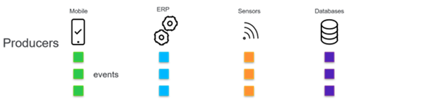

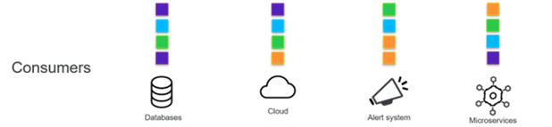
Event Streaming with Kafka
Kafka Producer for OpenEdge ABL
With the OpenEdge.Messaging API you can connect to a Kafka cluster and send messages directly to a Kafka broker within an ABL application.
Kafka Consumer for OpenEdge ABL
The OpenEdge.Messaging API also enables you to connect to a Kafka cluster and receive messages in your ABL applications.

Slide 31
Event Streaming with Kafka
Released in OpenEdge 12.6
Asynchronous Send of Kafka Messages
ABL developers can send messages asynchronously, significantly enhancing the Kafka producer's throughput.
Kafka Transactional Producer
Facilitates that a set of messages, typically associated with a single database transaction, are completely sent (all or nothing).

Slide 32
Kafka
Publish (write) streams of events
Subscribe to (read) streams
of events
Store streams
of events
Process streams of events
(as they occur or later)
ÇÇ
ÇÇ
ÇÇ
ÇÇ
Activity Tracking
Log Aggregation
Data Processing
Messaging
The original use case for Kafka. Clicks, likes, orders, registrations, preferences, etc.
Centralized storage and processing of logs as a stream of messages.
Low-latency data transmission to consumers. Used for financial data, logistics, etc.
Kafka can work as a replacement for message brokers.

Slide 33
Protect Compiled
R-Code

Slide 34
Protect Compiled Application Code
Released in OpenEdge 12.7
Hex
Editor
Code
Injection
Compiled Application Code
Database

Slide 35
Signed Package
Released in OpenEdge 12.7
Signed package for compiled code
Database

Slide 36
Protect Compiled R-Code Features
ÇÇ
ÇÇ
ÇÇ
Archive file with .apl extension
Manifest file
New tools – PROPACK and PROSIGN
ÇÇ
ÇÇ
ÇÇ
Based on Java JAR standard
Like procedure library but with better security
Built-in Class: Progress.Archive.ArchiveInfo

Slide 37
Dynamic Data
Masking

Slide 38

Business Need
ÇÇ
ÇÇ
ÇÇ
Organizations must meet regulations and prevent sensitive information from being viewed by unauthorized users.
Authorized
Dynamic Data Masking
First Name | Last Name | Credit Card
Liam | Smith | 4532 1234 5678 9012
Noah | Jones | 6011 2345 6789 0123
Emma | Brown | 5100 9876 5432 1098
Olivia | Johnson | 3712 3456 7890 1234
No changes code changes
No changes to underlying data
Configuration based
High performance, high availability
Unauthorized
First Name | Last Name | Credit Card
Liam | Smith | XXXXXXXXXXXXX9012
Noah | Jones | XXXXXXXXXXXXX0123
Emma | Brown | XXXXXXXXXXXXX1098
Olivia | Johnson | XXXXXXXXXXXXX1234
Released in OpenEdge 12.8

Slide 39
Dynamic Data Masking
Released in OpenEdge 12.8
Helps in masking sensitive data when displayed at run-time
Key Benefit
Enables better compliance with data regulations (e.g., HIPAA, GDPR) by allowing users to mask fields from unauthorized users.

Slide 40
What Dynamic Data Masking Is
ÇÇ
ÇÇ
ÇÇ
DDM User
Query Resolved Unmasked
CustNum: 3000
Name: Lift Tours
Phone: (617) 450-0086
CustNum: 3000
Name: Lift Tours
Phone: (617) 450-0086
CustNum: 3000
Name: Lift Tours
Phone: (617) 450-0086
ÇÇ
General User
Field mask applied when the data is retrieved by the application
CustNum: 3000
Name: Lift Tours
Phone: XXXXXX0086
Notes:
The masking occurs when the data is moved from the internal memory buffers to the presentation layer. So anything that reads data out of those buffers (like a Display or Export statement).

Slide 41
What Dynamic Data Masking Is Not
Not a true security feature
Not a method for encrypting data in the database
Not a method for encrypting data over the network
Not a tool to replicate databases and obfuscate at the database level
Not a way of masking BLOBs or CLOBs
Not a quick fix for regulatory compliance
Notes:
The point here is that if you need the data encrypted, you can do that too. You can use SSL, you can turn on TDE, but DDM doesn't solve that problem.

Slide 42
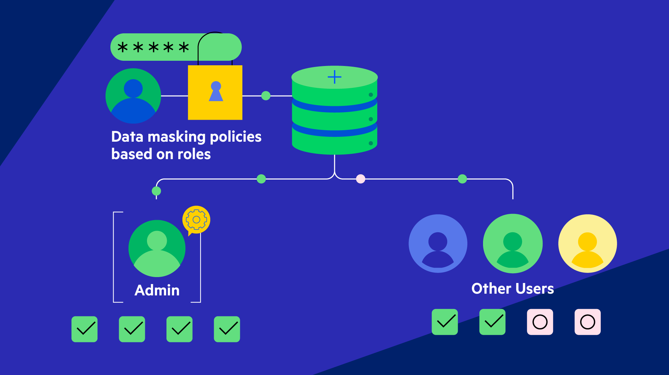
Notes:
A DDM Admin can configure data masking policies and apply them to roles (that they created in the database), then the DDM Admin can assign users to the roles.

Slide 43
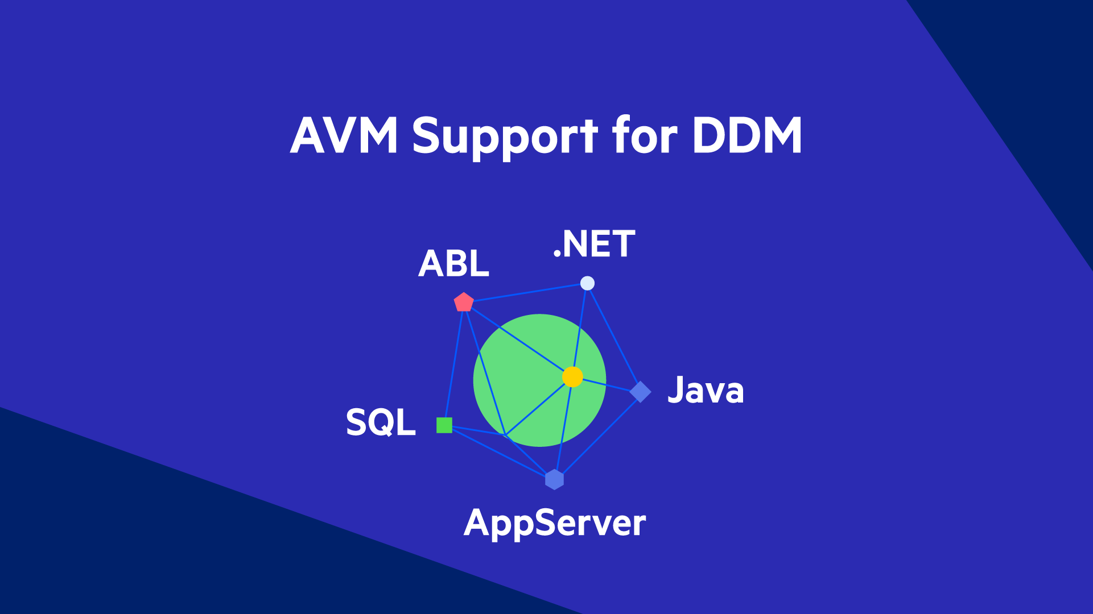
*
*
* DDM is applied by either the ABL Client or PAS for OpenEdge Agent
Notes:
The AVM provides 360 support for DDM by using the user-to-role configuration to determine if the data needs to be masked.

Slide 44
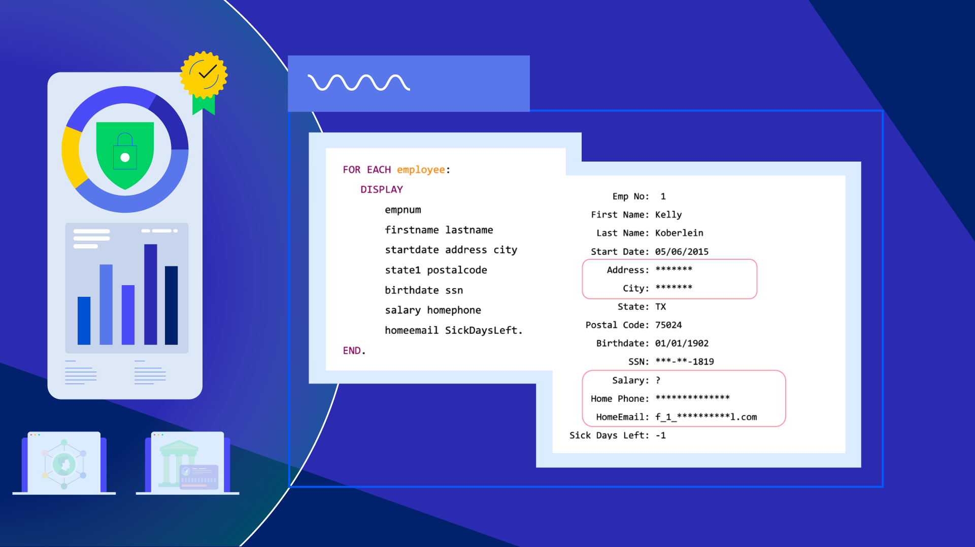

Slide 45
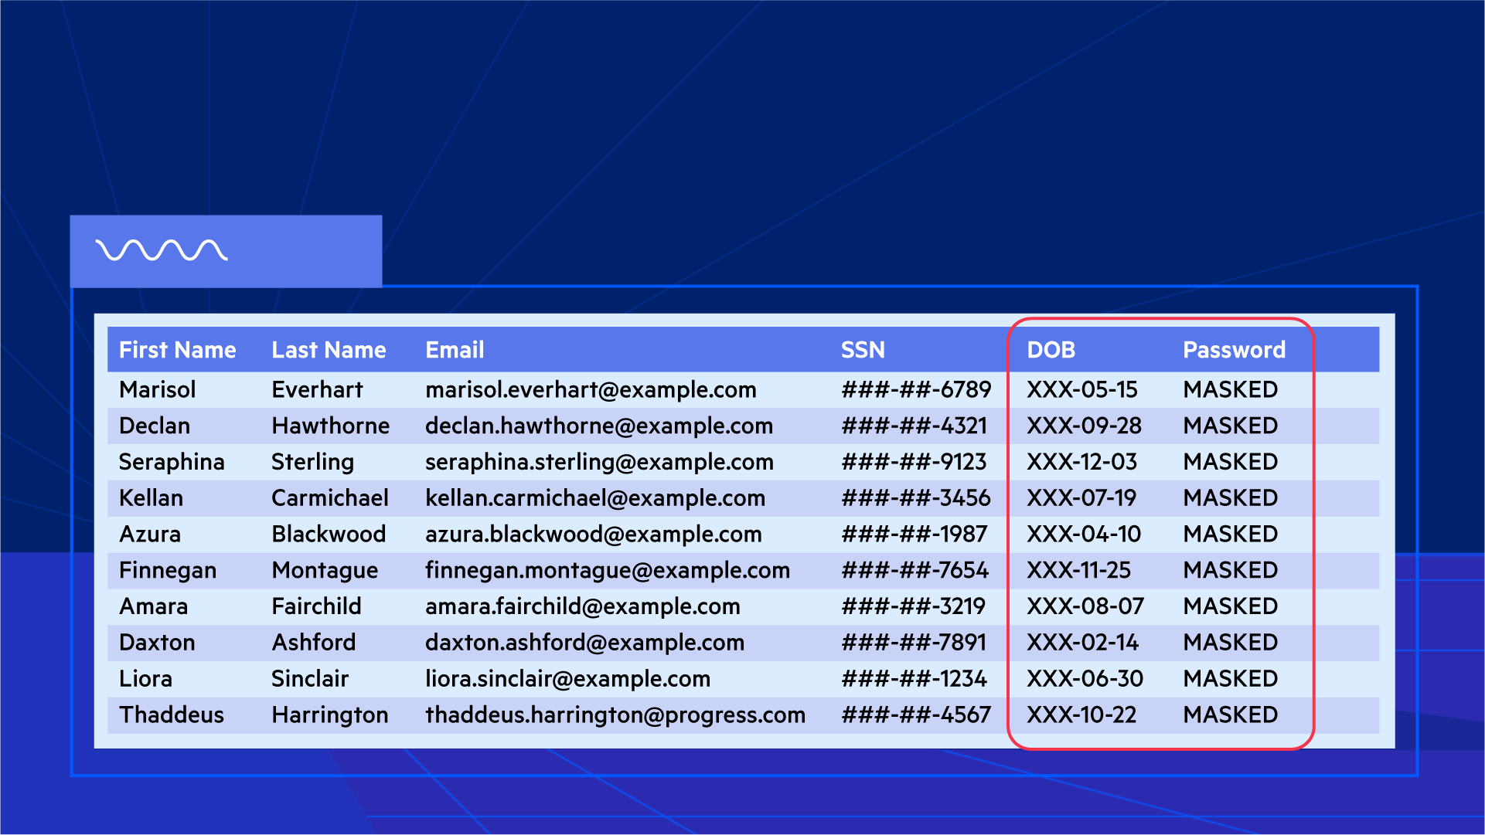

Slide 46
Masking Types
Default:
Partial:
Literal:
Unknown:
Replaces entire field value with X’s
XXXXXXXXXX
Lift Tours
XXXXXXXXXX0086
Replaces a specific part of the value with X’s
(617) 450-0086
UNAUTHORISED
Show a masked literal instead of the value
Burlington
276 North Drive
Field is masked as the unknown value (?)
?

Slide 47
Dynamic Data Masking Features
AVM support for DDM: Allows you to grant or deny access to sensitive data for different users and roles.
Audit Events and User States: Allows you to use audit events to track DDM activities and changes (like enabling, disabling, activating and deactivating DDM), as well as adding, modifying and deleting DDM rules.
Dump and Load DDM Data: Supports the integrity of your DDM-enabled data when performing a dump and load.
Database User Notify Integration: Alerts connected DB clients when DDM schema changes are loaded into a live database (using the database user notification system).

Slide 48
Want to learn more about DDM?
Attend the PUG Challenge session
Dynamic Data Masking - the 5 W's
By Sunil Jardosh

Slide 49
ABL Dojo
Website: https://abldojo.services.progress.com/
Write and run new ABL code
Load existing code snippets
Share code
Supports multiple OpenEdge versions (currently, 12.2.16 and 12.8.3)
Demo!
  ABL Dojo Demo

Slide 50

News You Can Use

Slide 52
Resources
OpenEdge 12.3:
  VAR Statement - https://docs.progress.com/bundle/openedge-whats-new/page/Whats-New-in-OpenEdge-12.3.html#ariaid-title13
OpenEdge 12.4:
  VAR Enhancements - https://docs.progress.com/bundle/openedge-whats-new/page/Whats-New-in-OpenEdge-12.4.html#ariaid-title4
  AGGREGATE Statement - https://docs.progress.com/bundle/openedge-whats-new/page/Whats-New-in-OpenEdge-12.4.html#ariaid-title5
  .NET (Core) Support - https://docs.progress.com/bundle/openedge-whats-new/page/Whats-New-in-OpenEdge-12.4.html#ariaid-title7
OpenEdge 12.5:
  Safe Navigation Operator - https://docs.progress.com/bundle/openedge-whats-new/page/Whats-New-in-OpenEdge-12.5.html#ariaid-title24
  List Collections - https://docs.progress.com/bundle/openedge-whats-new/page/Whats-New-in-OpenEdge-12.5.html#ariaid-title25
  Event Streaming with Kafka - https://docs.progress.com/bundle/openedge-whats-new/page/Whats-New-in-OpenEdge-12.5.html#ariaid-title29
OpenEdge 12.6:
  Kafka Event Streaming - https://docs.progress.com/bundle/openedge-whats-new/page/Whats-New-in-OpenEdge-12.6.html#Kafka-Event-Streaming
  SortedSet Collections - https://docs.progress.com/bundle/openedge-whats-new/page/Whats-New-in-OpenEdge-12.6.html#ariaid-title13
OpenEdge 12.7:
  HashMap Collections - https://docs.progress.com/bundle/openedge-whats-new/page/Whats-New-in-OpenEdge-12.7.html#ariaid-title3
  Support for .NET 6 on Windows in OpenEdge - https://docs.progress.com/bundle/openedge-whats-new/page/Whats-New-in-OpenEdge-12.7.html#ariaid-title20
  Protect Compiled OpenEdge Code - https://docs.progress.com/bundle/openedge-whats-new/page/Whats-New-in-OpenEdge-12.7.html#ariaid-title9
OpenEdge 12.8:
Dynamic Data Masking - https://docs.progress.com/bundle/openedge-whats-new/page/Whats-New-in-OpenEdge-12.8.html#ariaid-title29

