Slide 1

Dbanalys – theory and practice
Database blocks were born not to be free!
Notes:
Blocks in RM chains are serving their time. Sometimes it is almost a Life sentence.
Please send your questions to: dmitrilevin@alphabroder.com

Slide 2
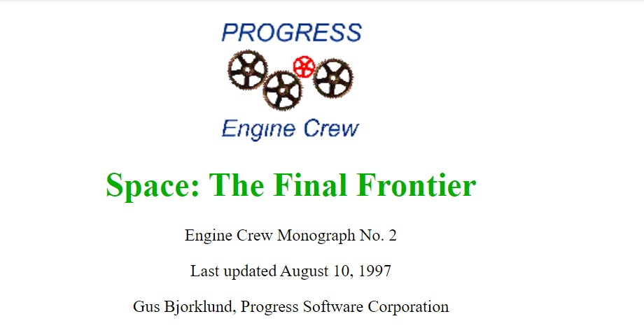
Gus Monograph
https://web.archive.org/web/20050204132510/http://www.peg.com/techpapers/monographs/
Notes:
This monograph written almost 30 years ago describes the behavior of RM chain, among other things. How records are added to the top block at the head of RM chain, what to do with the block if the record does not fit in the top block, send it to the end or completely remove it from RM chain.
If the block is not on the RM chain, has unused record slots, and has at least as much free space as the toss limit, it is added to the RM chain. That is often happen when we purge records from the database or empty some fields in records.
If the block is already on the RM chain, but now has less free space than the toss limit, or all the record slots are filled, then the block should be removed from the RM chain. But, since the RM chain is linked only in the forward direction, it can only be removed if it is the first block on the chain. If it is not the first block, it will be left in the chain.

Slide 3
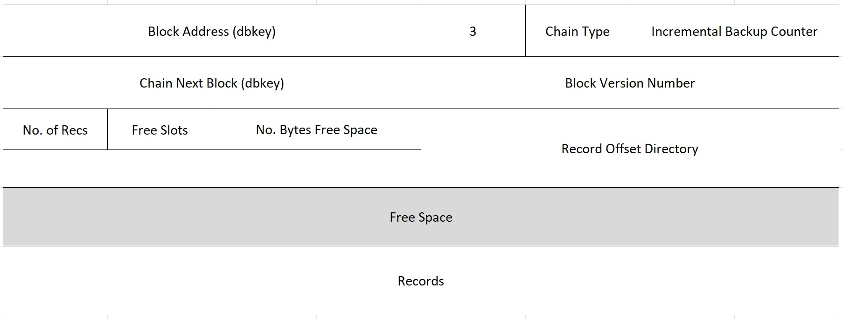
Structure of Data Blocks ( SAT I )
Notes:
We will talk only about record blocks. We will not talk about index blocks. This is how things look 30 years ago in version 8.
No. of Recs (Numdir) – is not the number of records (or fragments) in that block, but it is the maximum number of slots that is used in a block currently. And some of the slots below it could be free.
No. of Free Slots (Freedir) – number of slots that are free.
Numdir + Freedir often equal to RPB, but it could be more than RPB if there are free slots below Numdir.
No. bytes free space – the size of “Free Space”
Record Offset Directory is 16-bit, 13-bit for the address fragment offset (enough for 8K block) and 3-bit header.
000 – Ordinary (non-fragmented) record
001 - CONT (continuation) Record fragment that has predecessor(s).
010 - Next fragment key – head of fragmented record.
011 - Next fragment key + CONT. That is intermediate fragment with predecessor
100 - HOLD – recid holder (see the slide for it).

Slide 4
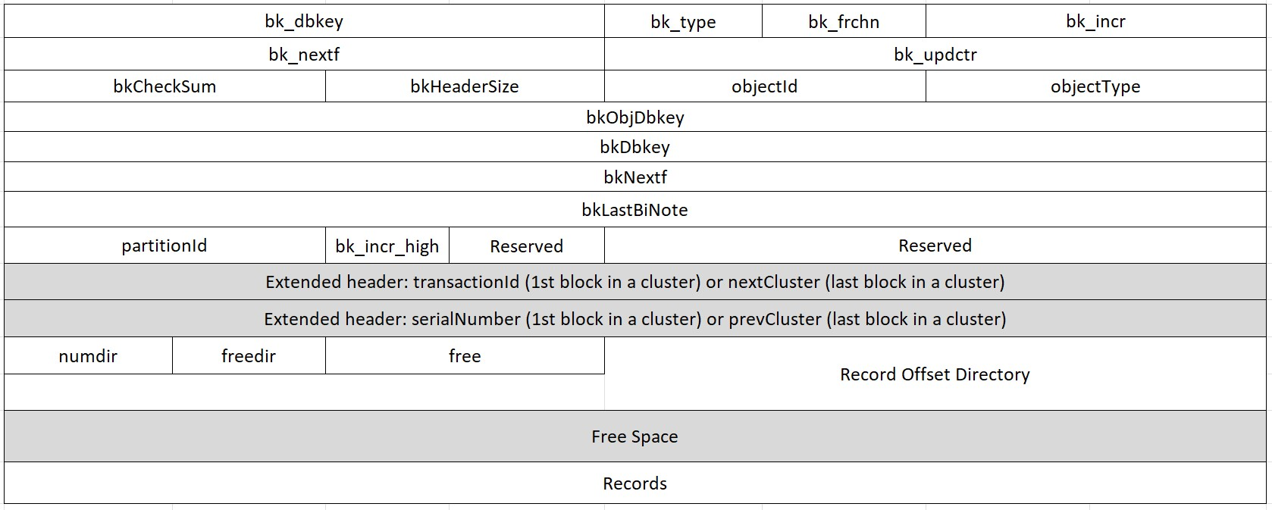
Structure of Data Blocks ( SAT II )
Notes:
This is how things look now, 30 years later. We received that picture by doing dbrpr ( option 13, 8, 7, 1, Go ). The addresses of the blocks (dbkey) have changed from 32bit to 64bit. Some the old fields are not used any more, and the new fields are used instead. All the new fields are 64-bit, but nothing significantly changed for RM chains.
Each line here on the picture is representing 64-bit or 8 byte. The fields that are half line = 4 bytes. The fields that are ¼ line are 2 bytes.
The total size of the normal block header is 64 byte ( 8 line of 8 byte). Extended header (1st and last) are 80 byte.
Fields nextCluster and prevCluster are related to the cluster chain, not RM chain.
Record Offset Directory is an array, it can be expanded and contracted as records are created and deleted.

Slide 5
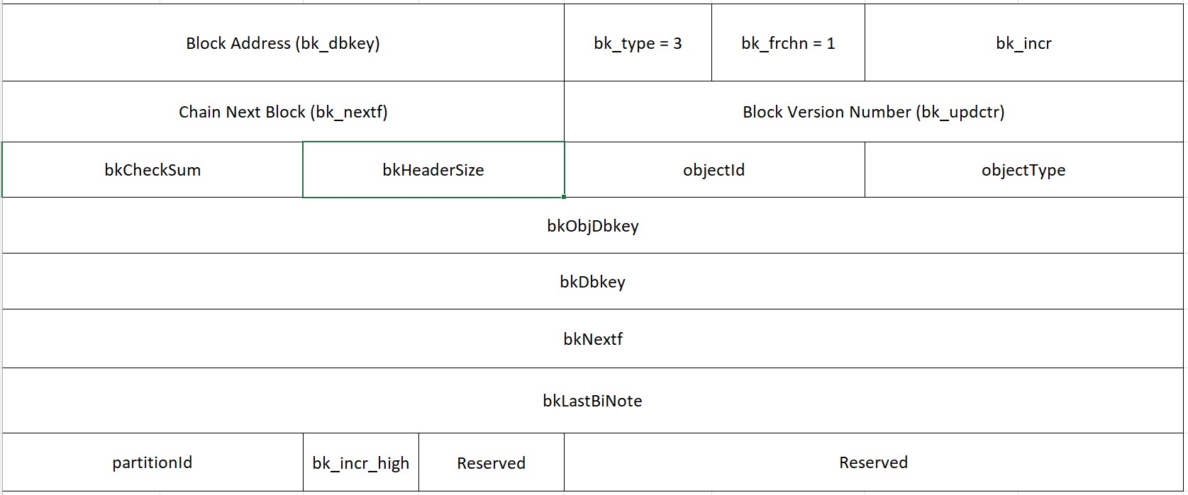
Structure of Data Blocks ( SAT II )
_StorageObject._Object-block
Notes:
We will be talking about bk_type=3.
Incremental Backup counter (bk_incr) – used for online backups and incremental backups. Backups change “master-counter” in the master block of the database. When the block is changed the value “master-counter” is copied into the block header. That is how backup knows if the block was changed before backup or after backup.
Dbkey = logical address of a block
Block version number (bk_updctr) – it is incremented by 1 on every block change. Recovery notes use that counter. When recovery notes are rolled forward or backward this bk_updctr in the block is compared with the one in the note. If they do not match the error will be given.
bk_incr_high is 1 byte, and it is an extension of bk_incr field. So, the total of both fields is 3 bytes. That is the only unorthodox field.
bkObjDbkey = The dbkey of the Object block.
It is stored in _StorageObject._Object-block as well as in every block that belong to that object (bkObjDbkey)

Slide 6
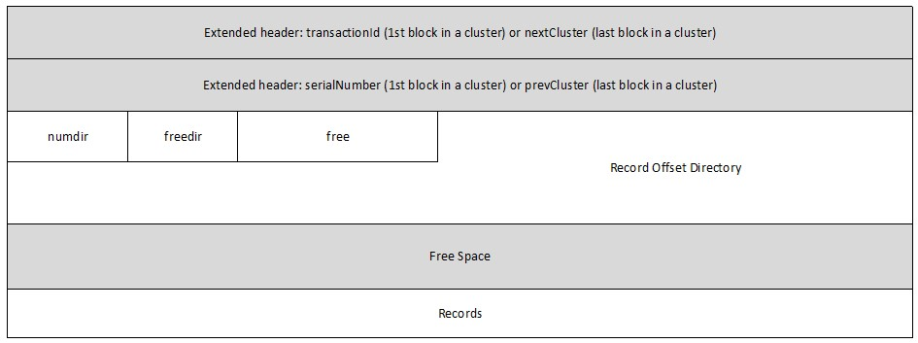
Structure of Data Blocks ( SAT II )
Notes:
The previous slide ( block header is for any block). What you see here is specific for RM blocks. The fields No of Recs (or numdir), Free Slots( freedir here), Free Space (free here) and Record offset directory are specific for RM blocks.
Extended header ( 80-bits = standard 64-bit header + these 16-bit you see at the top 2 lines) are only for 1st or last block in a cluster.
Question: What could be the max number of records in RPB 256 block?
“numdir is 1” byte field, so the maximum value we can store there is 255. The block in the area with RPB 256 can have no more than 255 records.
transactionId – number of transaction in which the object is deleted. It is a special case. When transaction commites, data clusters belonging to the object are put on Free Cluster chain of that area.
serialNumber – unique identifier of the object. Table number, index number are not unique, they could be re-used. And they are also not unique, 123 could be the number of a table or the number of an index. serialNumber is a unique 64-bit identifier of the object.
Example from sports2020 database:
objectId: 0x0000 0
serialNumber: 0x0000000000000000 0
objectId: 0x0001 1
serialNumber: 0x0000000000000001 1
objectId: 0x0002 2
serialNumber: 0x0000000000000003 3
objectId: 0x0003 3
serialNumber: 0x0000000000000005 5
objectId: 0x0004 4
serialNumber: 0x0000000000000009 9
objectId: 0x0005 5
serialNumber: 0x000000000000000f 15
objectId: 0x0006 6
serialNumber: 0x0000000000000011 17
...
objectId: 0x0010 16
serialNumber: 0x0000000000000039 57
Objects in this example are tables of Sport2020. The missing numbers between their serialNumbers are taken by their indexes.

Slide 7
Block Type
proutil –C dbrpr 13/3
1. Master Block
2. Index Block
3. Data Block
4. Free Block
5. Index Dbkey List Block
6. Sequence Block
7. Empty Block
8. Parameter Block (Not Used)
9. Area Block
10. Object Directory Block (Not Used)
11. Extent List Block (Not Used)
12. Object Block
13. Control Block
14. Area Object List Block
15. Area Cluster Allocation Block
16. Object Cluster List Block
17. Object Block Allocation Block
18. RM bit Map List Block
19. Extent Header Block
Chain type
bk_frchn: 0x00 0 (FREECHN)
bk_frchn: 0x01 1 (RMCHN)
bk_frchn: 0x7f 127 (NOCHN)
Notes:
For only Extent Header Block menu number 19 does not match bk_type = 254. For all other blocks dbrpr menu matches bk_type.
14 Area Object List Block – a block that stores a list of objects in the area (in addition to _StorageObject):
OBJLISTBLK:
nextBlock: 0x0000000000000000 0
prevBlock: 0x0000000000000000 0
numObjects: 0x0000001a 26
objListEntry:
Obj Serial Num Type Obj DBkey Obj ID Partition
0 0 8 512 0 0
1 1 1 2048 1 0
…
24 77 1 49152 24 0
25 79 1 51200 25 0
Here are listed all objects (from 0 to 25) and its attributes, including addresses of Object Blocks.

Slide 8
First Cluster of any object starts with
bk_type: 12 (Object Block)
bk_type: 16 (Cluster List Block)
bk_type: 17 (Object allocation Block)
bk_type: 15 (Cluster Allocation Block)
So, the Object Block is the first block of the first cluster

Slide 9
Object Block
0020 bkDbkey: 0x0000000000000800 2048
bk_type: 0x0c 12 (Object Block)
bk_frchn: 0x7f 127 (NOCHN)
objectId: 0x0001 1
partitionId: 0x0000 0
objectType: 0x0001 1
bkObjDbkey: 0x0000000000000800 2048
OBJBLK:
chainFirst[FREECHN]: 0x0000000000000000 0
0050 chainFirst[RMCHN]: 0x0000000000000c00 3072
chainFirst[LOCKCHN]: 0x0000000000000000 0
0070 chainLast[FREECHN]: 0x0000000000000000 0
chainLast[RMCHN]: 0x0000000000000f00 3840
0080 chainLast[LOCKCHN]: 0x0000000000000000 0
objectId: 0x0001 1
objectType: 0x0001 1
totalBlocks: 0x0000000000000008 8
00B0 hiWaterBlock: 0x000000000000000f 15
numBlocksOnChain[FREECHN]: 0x0000000000000000 0
00C0 numBlocksOnChain[RMCHN]: 0x0000000000000004 4
numBlocksOnChain[LOCKCHN]: 0x0000000000000000 0
00D0 partitionId: 0x0000 0
Notes:
The address Object Block’а is stored in _StorageObject._Object-block and in every block that belongs to that object in bkObjDbkey field
chainFirst[RMCHN] = Dbkey of the first block in the chain
chainLast[RMCHN] = Dbkey of the last block in the chain
totalBlocks = number of blocks of that object (the first 4 special blocks that are on the previous slide are also included here)
hiWaterBlock = maximum block number in the area that belong to that object. If we multiply that number by RPB we will get dbkey of that block.
hiWaterBlock will be equal to HWM area only for 1 object of that area. And that object is most likely responsible for the area growth.
numBlocksOnChain = total number of blocks on RM chain, obviously it is less than Totalblocks

Slide 10
Record Offset Directory
3 bit+ 13 bit = 16 bit
000 – Ordinary (non-fragmented) record
001 - CONT or continuation (tail fragment)
010 - Next fragment key (head fragment)
011 - Next fragment key + CONT (Intermediate fragment)
100 - HOLD – Recid place holder
13 bit offset for the fragment in 8K block ( 2¹³ )
Record Offset directory for RPB 256 then is 2 byte * 255 = 510 [ Max size for it ]
Notes:
record offset array:
001 - CONT или continuation. Fragment of the record, i.e. it has predecessor. That is not the head of the record.
010 - Next fragment key – that is the head of fragmented record
011 - Next fragment key + CONT. This is an intermediate fragment. This fragment has predecessor and follower;
100 - HOLD – Recid holder
Question: Can the block become empty after deletion of all records? Introduction of a Record Place holders
numdir is 1 byte, so the maximum value we can store there is 255. The block in the area with RPB 256 can have no more than 255 records.

Slide 11
Record Delete Algorithm
Recid Place Holders
Can the block become empty after deletion of all records?
This is a fragment marked “100” in record offset directory.
4-byte TRID | 4-byte unused
Notes:
When a transaction deletes a record, the record is replaced by a recid lock or record place holder. These locks are sometimes called hold notes. This is done so that the original record can be restored to the same position, allowing it to retain its recid, if the deleting transaction rolls back. Record rowid remains the same for it’s lifetime. The lock prevents another transaction from using the same recid to store a different record. Once the deleting transaction has committed, the lock can be removed. But it is inefficient and time consuming to remove them at commit time. Instead, they are left there and removed later if the block is modified for some other reason.
If transaction is committed, then next time we will deal with the block, the recid place holder will be removed.
Recid Place Holder reserves not only a place, but also a minimum space needed to recreate the record in case of transaction roll back.
When transaction is rolled back, the record should resurrect exactly at the same place where it was removed, regardless of how much space is left in the block. That is why 8-byte is reserved not 4-byte. 8-byte is enough to place “next fragment key” ( 8-byte dbkey for continuation). 8-byte is the minimum space for the head fragment. That is why recid holder is 8-byte, when only 4-byte is used.
When record is fragmented, and progress deletes it, Recid Place Holder is created only for the head fragment. The other fragments are just deleted. For the continuation fragments Recid Holder is not created
The size of holder is 8 bytes. First 4 bytes store the transaction number. Last 4 bytes are zeroes. The leading fragment can consist of only "next fragment dbkey" which uses 8 bytes. So 8 bytes is enough to put the "head" of the record instead of the holder in a block without free space.
Old record placeholders are deleted when a RM block is modified for some reason and the transaction that put it there has committed.
https://community.progress.com/s/question/0D5Pb00000z7KbbKAE/a-few-bad-words-about-online-chanalys

Slide 12
Space management algorithms
But many that are first shall be last, and the last shall be first.
[ Matthew 19:30 ]
Object Block
Partially Filled Record Blocks
Notes:
In version 8 information about RM chain was in Master block, but later it was moved to Object Block – first block in the first cluster of any object.
The task of space management algorithms is to ensure efficient use of space within the database. All blocks have some amount of free space, but it is different for everyone. Of course, wasting resources to save a couple of bytes does not make sense. Therefore, the algorithms select only those blocks that have something to store in. Management assumes lists. Lists can be created in different forms, but Progress mainly uses chains - cluster chains, block chains. But, for example, Object List Blocks store a table with a list of objects in the area. The developers apparently thought about the same option for storing lists for clusters belonging to database objects, but for now they use chains. And there are a lot of blocks with data, and chains are the best solution for them.
Toss limit divides block into two groups “Full Blocks” and “Partially Filled Record Blocks”. The second are those on RM chain.
Blocks are added to RM Chain Front or RM Chain Back
Blocks are removed only from RM Chain Front
After each Create/Update/Delete when the Free Space in an RM block changes the block is evaluated. It could be added to RM chain, it can only be removed if that is the first block of RM chain
RM chains have blocks with 3 conditions met:
1. Table blocks only
2. Blocks that have at least one free slot or at least one Record place holder
3. Free space in that block should be equal or more than the toss limit
RM chain was invented for high usage of disk space, for reuse of disk space.
So, we should judge RM chains for utilization of the space in blocks, not for its length.

Slide 13
Space management algorithms
Small and Large record creation algorithms
Rec Size < FragSizeLimit
Small Algorithm
YES
NO
Large Algorithm
Before 8.2 (1997)
Since 10.1A (2005)
FragSizeLimit = It's the threshold between two algorithms: the small and large record creation algorithms.
Value: FragSizeLimit = dbblocksize – 120
for 8K db block size that is 8,072 bytes
Notes:
If the size of new record is less than FragSizeLimit then the storage manager will use the small record creation algorithm. Otherwise, it will use the large record creation algorithm. The threshold is also used on the next interactions when the storage manager will try to find the space for the rest of the record. It's likely that the storage manager will use the small record creation algorithm for the last fragment of the record.

Slide 14
Space management algorithms: Parameters
Create and Toss Limits a.k.a. Expansion Constant / Free Space Constant (version 8)
Create Limit — The minimum amount of free space in bytes required in a block after a new record is
inserted.
Toss Limit — The minimum amount of free space in bytes required in a block for the block to remain on
the RM chain.
The create limit = between 32 and block size minus 128 bytes, default 150
The toss limit between zero and block size minus 128 bytes, default 300

Slide 15
Space management algorithms
small REC
Free space >= record size + create limit
Big REC
Free space >= FragTossLimit

Slide 16
Space management algorithms
First block is validated for RM chain criteria:
1. If the block has less free space then toss limit, it is tossed from RM chain
2. If all slots are taken, it is tossed from RM chain too
CleaningDepth - That is the maximum number of blocks that could be removed from RM chain in at 1 time. 100 Blocks.
After the block is validated for RM chain criteria, Progress consider if it could place the record there. If not, it is moved to the back of RM chain
-recspacesearchdepth – That is the maximum number of blocks that could be moved to the back of RM chain in at 1 time. ( It used to be 3 ).
Notes:
Big record creation will make a lot of activity in RM chain, moving lots of blocks front2back. Chains work well only when new record sizes are comparable with a typical free size in the blocks. The algorithm is based on the assumption that all records of a table are more or less the same size, which it not true in some cases.

Slide 17
Space management algorithms when we can find space in the block
small REC
Free space >= record size + create limit
Record is placed in the block
Big REC
Free space >= FragTossLimit (approx. 70% block)
Fragment will take all space in the block leaving only:
if there are other records “Expansion space for neighbors”
if the block was free a small “Reserved space”
The following fragment will start the whole process again
Expansion space for neighbors = 25 byte + Reserved space
Reserved space = 4 byte
Notes:
The second fragment of the same Large record will start the process from the very beginning. It could follow the small or the large record creation path.
Expansion space for neighbors = 29 byte
Padding Constant = 4 byte
After fragmented record is updated 4 bytes will be used, and block will have zero space.

Slide 18
Space management algorithms
Large record creation algorithms
FragTossLimit = The minimal free space in the blocks on RM Chain should have to be used to allocate a fragment of large record.
Value: FragTossLimit = (dbblocksize - 118) * 0.7
This is 70% of the estimated maximum free space in data block;
Dbblocksize | FragTossLimit
1K | 634
2K | 1351
4K | 2785
8K | 5652
Notes:
It's not the same as the toss limit used by the small record creation algorithm where it divides the data blocks in two groups: the partially filled blocks vs the full blocks. The first group of blocks is linked in RM chain. FragTossLimit divides the data blocks inside RM chains. If data block has less free space than FragTossLimit the block is moved from the chain's front to its back. The SearchDepth (the -recspacesearchdepth) parameter is used here as well. If after all attempts the storage manager will fail to find a block with the required free space it will use a block from free chain (= from above HWM).

Slide 19
Space management algorithms when we can not find space in the RM Chain blocks
If either CleaningDepth reached, 100 locks removed from RM chain or
If -recspacesearchdepth is exhausted, X number of blocks moved to the back:
1. Progress looks for block in a free chain (SAT I). Places record there and if it satisfies RM chain rule then it is moved the block to the head or tail of the chain
2. Area WHM is raised. The whole cluster is added to the head of RM chain.
Notes:
This algorithm has an obvious flaw, when a big record comes data blocks that have enough free space for small records will be moved to the back of RM chain.

Slide 20
Space management algorithms when a record is updated
If the updated record is in RM chain block, and block becomes full after the update, it will stay on RM chain until it will become the 1st block.
Blocks, other than the 1st block are never removed from RM chain

Slide 21
Space management algorithms parameters and constants
Parameters – those that DBA can change:
RPB (per Area)
Create and toss limits (per Table)
-recspacesearchdepth (per Database)
Constants – hard coded by Progress:
RM chain CleaningDepth = 100 blocks
“Rule of 5 unused slots”
Expansion space for neighbors = 25 + Reserved 4 byte
Reserved 4 byte for 64-bit dbkey
FragSizeLimit
FragTossLimit
All Undocumented
Notes:
Grey area– Large record creation parameters

Slide 22
Space management algorithms
“Rule of 5 unused slots”
If the block was not on RM chain, and after update or delete it has free space more than toss limit Progress puts it on RM chain.
If it has 5 or more unused slots it is put in the head of the chain, otherwise in the tail of the chain.
Notes:
Quote of 5 slots rule by Gus:
"If the block is not on the RM chain, has unused record slots, and has at least as much free space as the free space constant, it is added to the RM chain. If the block has more than 4 unused slots, it is added to the front of the chain. Otherwise, it is added to the end of the chain.“
This rule still works. But works really bad because when we delete a record, assume free space in more than toss limit. We get 1 free slot. And the block goes to the tail. It is almost never goes to the head of RM chain. And why it is 5 ? There is no reason for 5.
If RPB is 4, those blocks never ever go to the front. And for LOBs RPB 4 is a possible choice.
Let's assume 32 records fully fill a data block. The block is not on RM chain - either it does not have free slots or the free space is below the toss limit. Then we delete one record. Or all records. In one transaction or one by one - does not matter. When we delete the first record, the block is added to the RM chain. Progress can't add the block to the chain's front - the deleted record is replace by recid holder. The holder can't be removed until transaction is committed. This may happen a few milliseconds later but right now the slot is in use. That is why it's reasonable to add the block to the back of RM chain
But if RPB is 64 or higher than the block will be added to the front because it has 32 free (unused) slots. Why the rules insists that a block should have more than 4 free slots to buy a front row ticket?
What RPB do you set for the areas that store the LOBs? I used to see the value of 4. The blocks from such areas will never be added to the front of RM chain. Even absolutely free blocks!

Slide 23
Chain Activity Monitoring
for each _ActSpace no-lock:
display _ActSpace with 1 col.
end.
Remove from rm: 493,360
Add to rm, front: 305
Add to rm, back: 325,860
Move front to back: 98,917
Notes:
_ActSpace VST – show examples how many blocks go to front/back same day.
_Space_FrontAdd and _Space_BackAdd. Talk about when block goes to Front vs back.
But that is unfortunately only on the database level. For V8 it was ok when was 1 chain for all tables.
But we got table AREAs, and each table now has it’s own chain. Monitoring is still the same as it was.
Scanning AI and then sorting data (programming it) will give more deltail information about each chain.

Slide 24
RM chains
Object Name RM chain
Table_number_1 86,598,706
136,594 blocks left RM chain in a week
Prison term = 86,598,706 / 136,594 * 7 days = 4438 days = 12+ years
Notes:
We used chanalys for calculations the speed of RM chain movement. It run for more than 7 days for that table. Off-line chanalys
A much easier way to estimate “The Lifetime” of a block on RM chain is to use After-Image scans. George is working on that program.

Slide 25
Chain Activity Monitoring
proutil db-name -C dbanalys [ area area-name ]
[ tenant tenant-name| group group-name| shared ]
[-csoutput [ -fieldsep sep-value][ -csfilePrefix pref-name ]
[ -verbose ]
proutil db-name -C chanalys [ area area-name ]
[ tenant tenant-name| group group-name| shared ]
[ -scan ][-csoutput [ -fieldsep sep-value]
[ -csfilePrefix pref-name ][ -verbose ]
Notes:
Chanalys и dbanalys
Online dbanalys and offline dbanalys are two completely different commands, which nevertheless produce the same result. But offline dbanalys can work 10 times longer than online dbanalys. The reason is that only offline dbanalys does the same job of checking chains as chanalys, but it does not write as much to the log as chanalys.
The -scan option is a must for the online Chanalys but it’s not enabled by default. Online chanalys without the -scan will fight with ABL sessions are locking the same resources – that is why they are waiting one another when resources are locked.
Chanalys primarily deals with Health Checks tasks. Displaying a list of blocks in the chain is a secondary task for it. Health Checks cannot be disabled. This is one of the reasons for the very slow operation of the utility. The second reason is reading blocks scattered here and there on the disk.
Online chanalys is not suitable for the database health check. It’s unreliable in many aspects.
Another problem with the online chanalys with the -scan option that it still checks the correctness of the blocks, but it does not report the warnings as it does without this option. See https://community.progress.com/s/question/0D5Pb00000z7KbbKAE/a-few-bad-words-about-online-chanalys

Slide 26
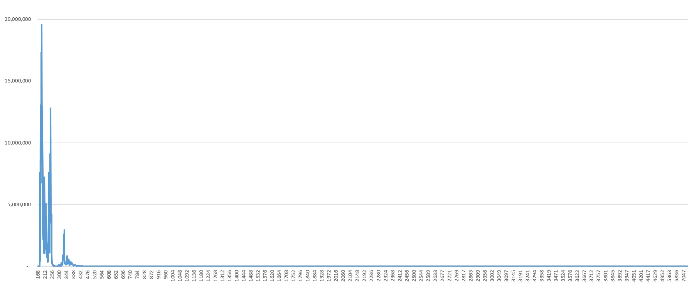
Know your data: Record size distribution
Table # 1 (full range of record sizes)
Notes:
Tom Bascom: It is probably a good idea to "know your data".
The real data does not correspond to our thinking that an average record is somewhere between min and max.
The average record is 231-byte for this table.

Slide 27
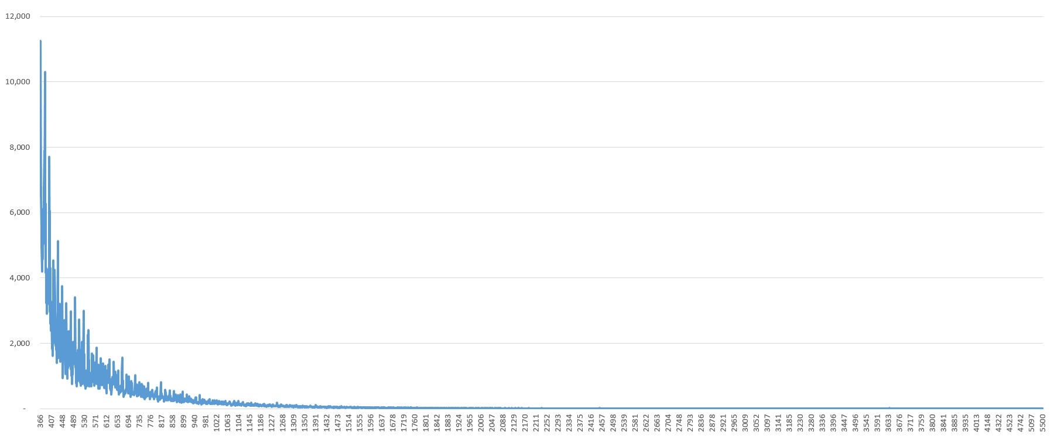
Know your data: Record size distribution
“Snake tail” (Table # 1 with sizes > 300 bytes)
Notes:
There is one field of that table that is responsible for that long “snake like” tail

Slide 28
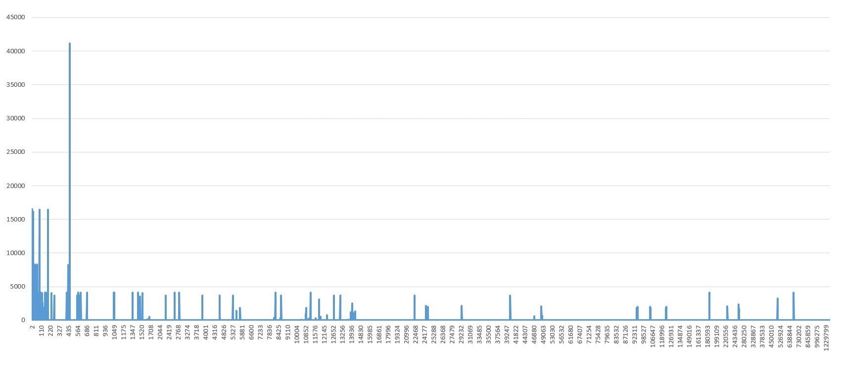
Know your data: LOB record size distribution
“Dragon tail” (full range of LOB sizes)
Notes:
LOB table record size distribution

Slide 29
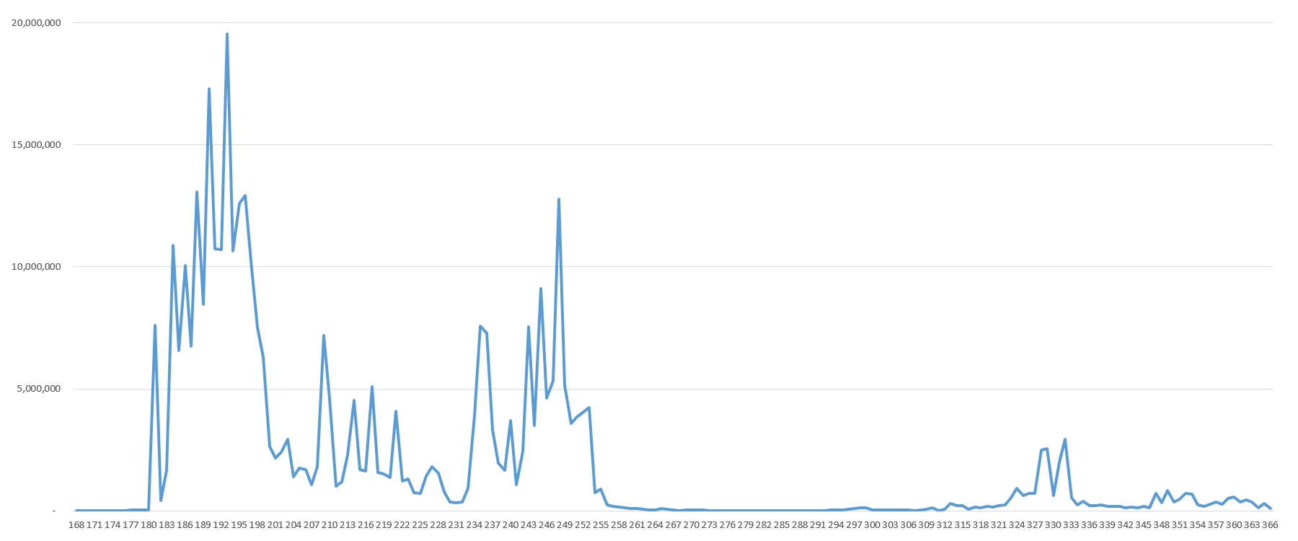
Know your data: Record size distribution
“Mean sizes” (Table # 1 with sizes < 300 bytes)
Notes:
There are two different fields of that table that are responsible for those two Camel humps.
Humps: 180-200 byte and 240-250 byte. The average record is 231-byte for this table.
We usually think of the records of the table as identical entities, but in fact, within one table there are groups of records, where their size is determined by their own character field. And from the point of view of the record sizes, each such group is an independent entity.

Slide 30
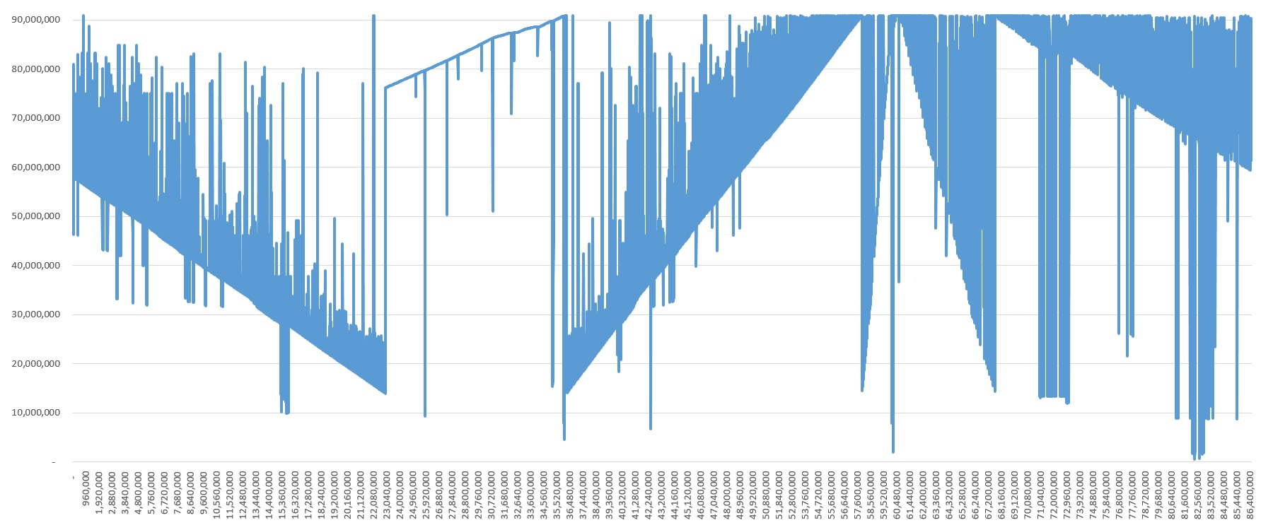
Know your data: Block Age
Table # 1
90,800,000 |2021-04-30
76,200,000 | 2021-01-25
Notes:
Each db block has a birthday – the day when the area’s HWM jumped over the block thereby allowed to the block to store data, the day when the block lost its “empty” status.
If you persistently control the area’s HWMs then you know the age of any block.
If not, then you can use a block number as equivalent of the block’s age – the higher block number the younger the block.
I know a little bit what to say here
X is the number of the first block in the RM chain segment of 10,000 blocks.
Y is the largest block number (dbkey) of the segment of 10,000 blocks. Dbkey is converted to a block number so we can compate it with area HWM.
You can see that RM chain is very sick here. Note the linear part in the middle, I will explain it on the next slide.

Slide 31
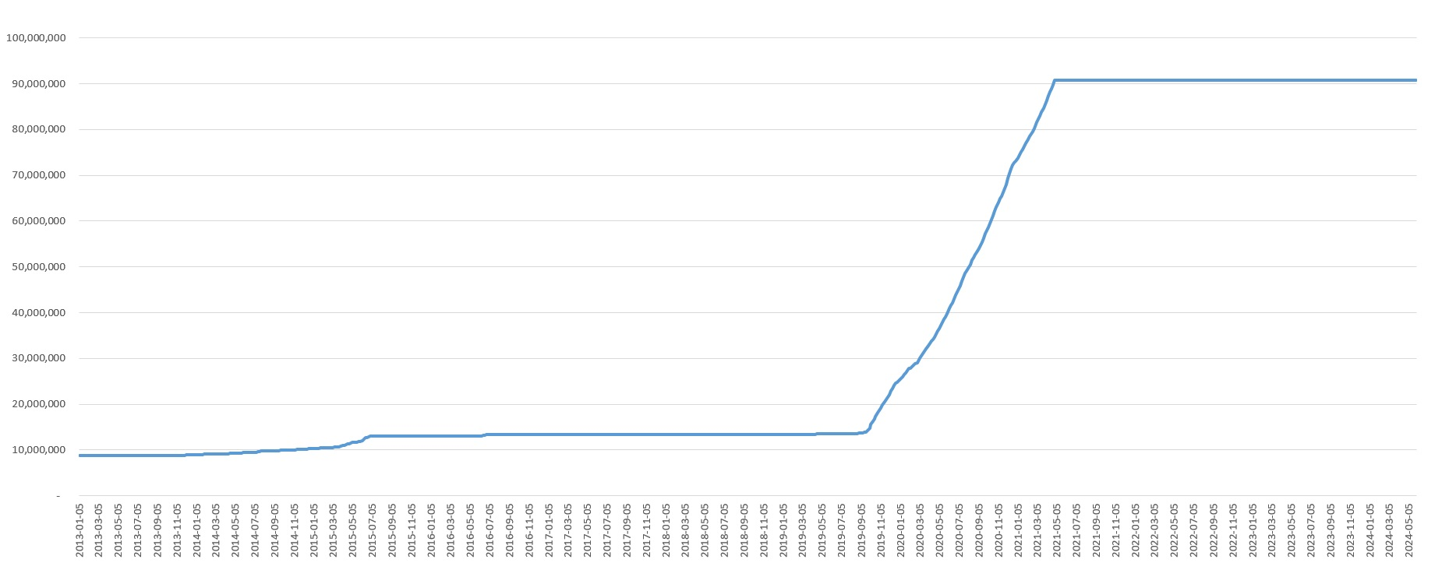
Know your data: HWM
Area of table # 1
Notes:
I know what to say here
X is the date
Y HWM of the area

Slide 32
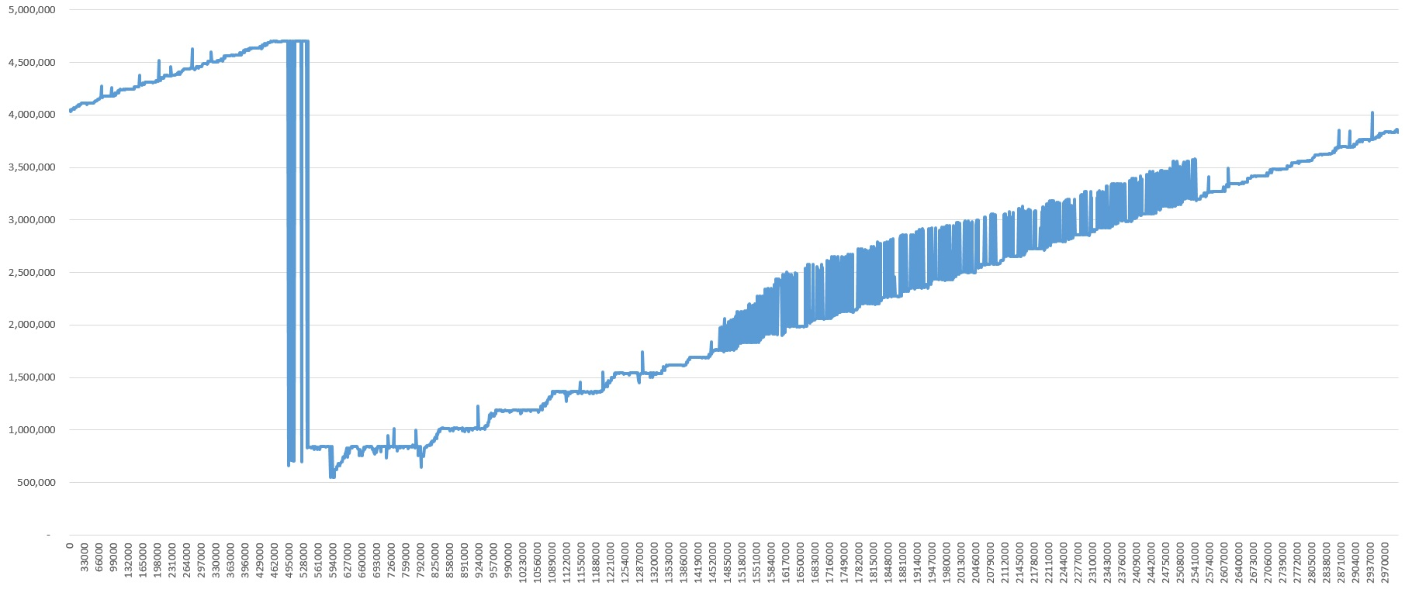
Know your data: Block Age
RM Chain of table # 2
Notes:
RM Chain of the "inv-synch" table
Note how large are the changes of the block numbers! Some blocks where added to the chain when area’s HWM was about 1,000,000. The youngest blocks are from the times when HWM grown to 4,500,000. It’s, of course, a huge time difference. It’s about how long the blocks are prisoned in RM Chains.
The block at the beginning of the chain are younger than the ones that are on the right side.

Slide 33
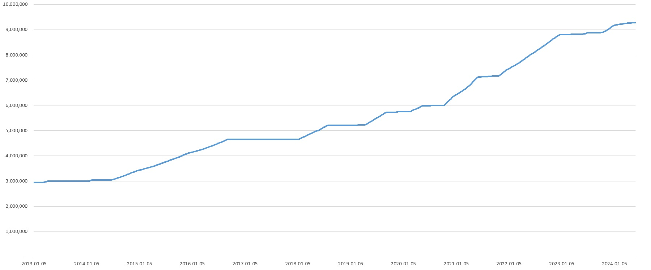
Know your data: HWM
Area of table # 2
Notes:
Note how large are the changes of the block numbers! Some blocks where added to the chain when area’s HWM was about 1,000,000. The youngest blocks are from the times when HWM grown to 4,500,000. It’s, of course, a huge time difference. It’s about how long the blocks are prisoned in RM Chains.
It’s the "inv-synch" table

Slide 34
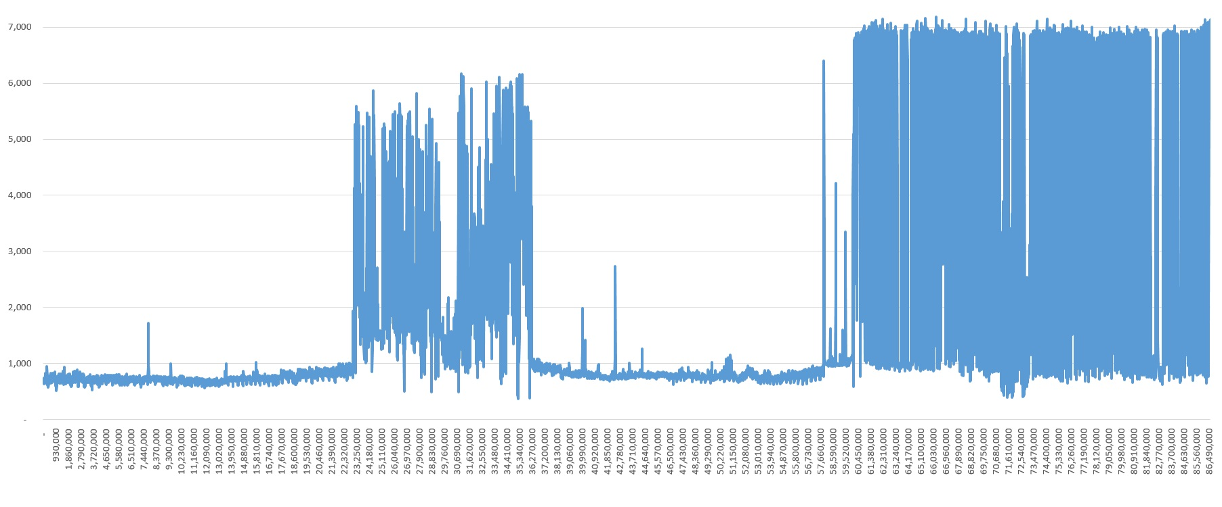
Know your data: Used Space
Table # 1
Notes:
What is “used space?” Is that a space that is used in the block, we have 8 million blocks, so X is the number of the block in the RM chain
And “Y” is how much space is used in that section of blocks. So, we have a bunch of full blocks, towards the tail, and empty blocks toward the head.
Note: the highest possible value on all “Used Space” graphics is db block size = 8000 bytes.

Slide 35
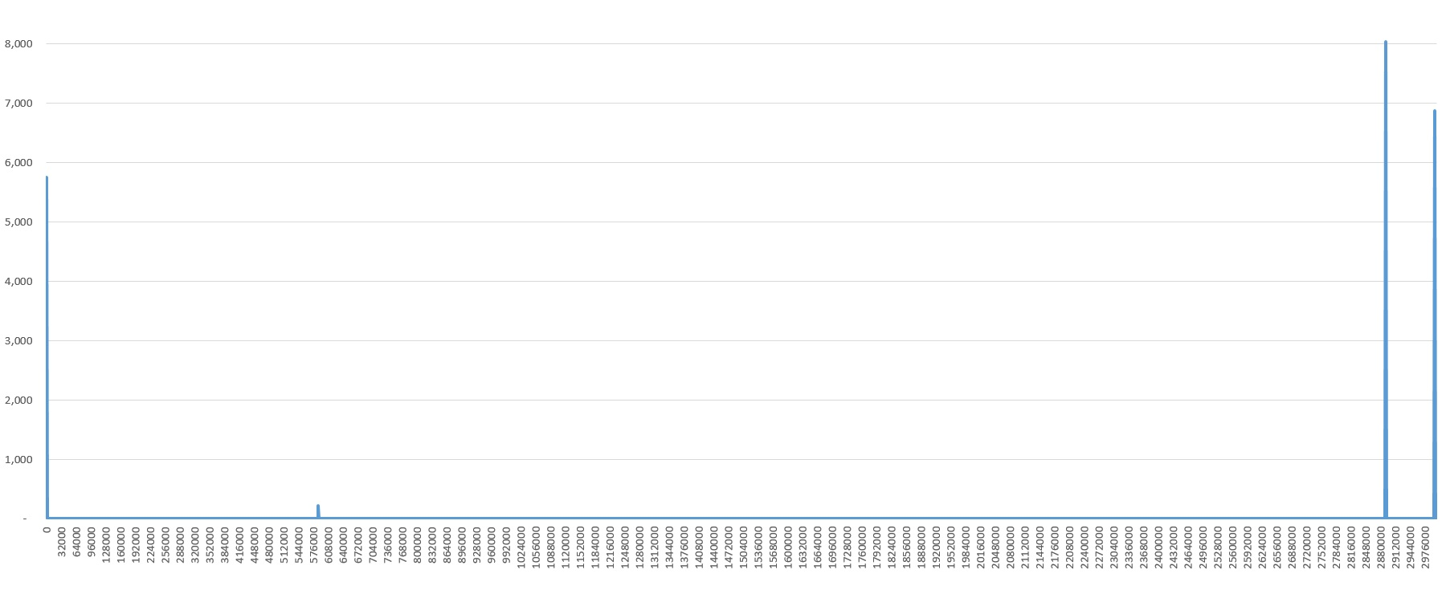
Know your data: Used Space
Table # 2
Notes:
Long RM Chain of almost empty blocks!
It’s the “inv-synch” table.

Slide 36
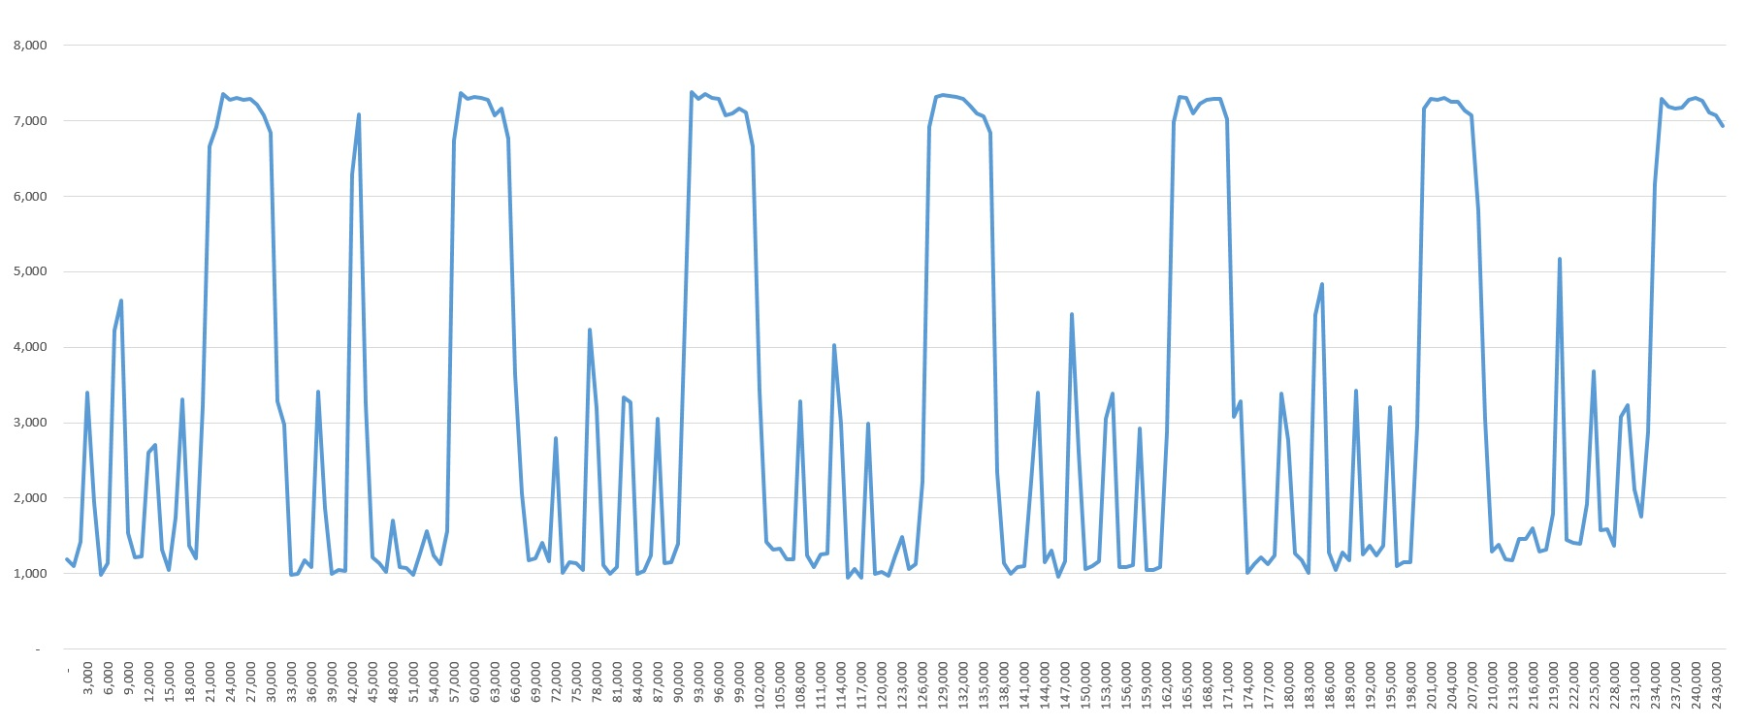
Know your data: Used Space
Table # 3
Notes:
Waves! Long fragments of the chain are almost 90% full but they are followed by long fragments with 10% space utilization.
It’s the “order” table.

Slide 37
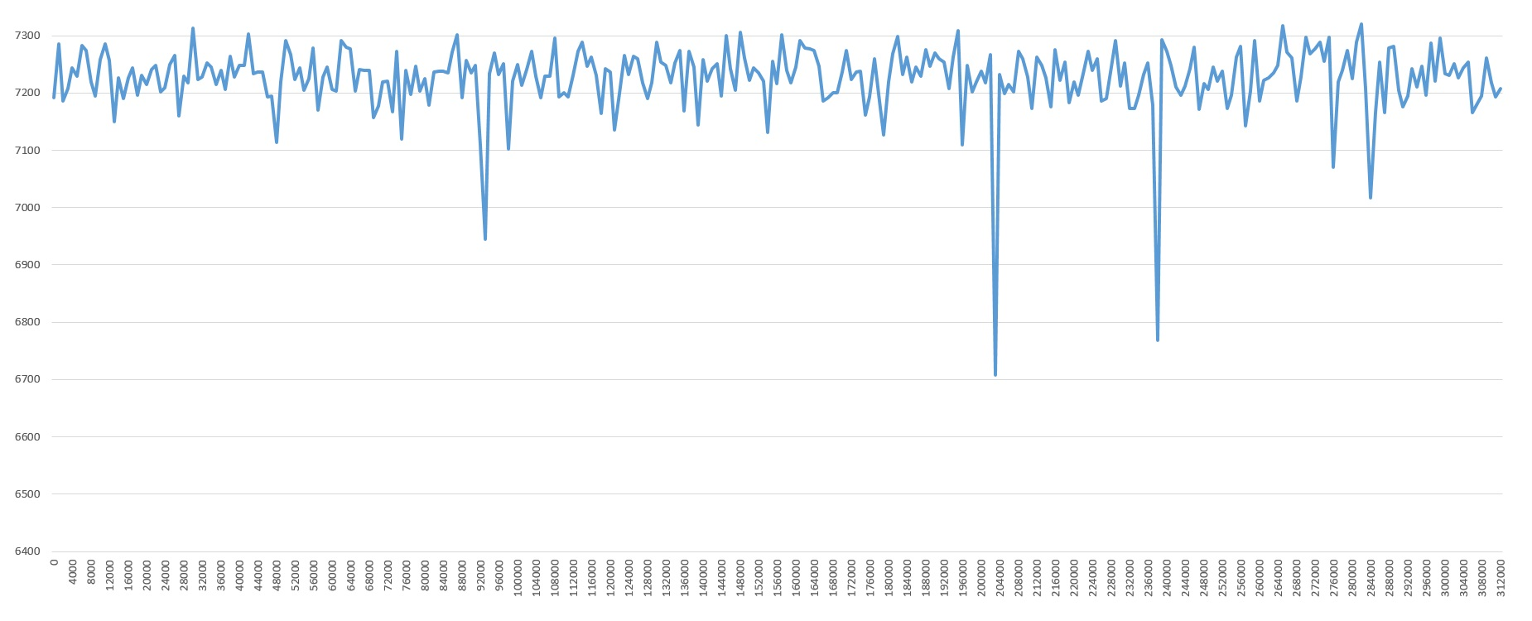
Know your data: Used Space
RM Chain of LOB
Notes:
It’s static_content.content

Slide 38
Record Update Algorithms
Updates after creates
Let’s look at Customer table from sports2020
Tabanalys: Min Size = 98 Max Size = 226 Mean Size = 134
Typical code:
CREATE Customer.
ASSIGN Customer.Name = ...
Customer.Country = ...
Customer.City = ...
Customer.Address = ...
Question: Why both Create and Update counters increase?
Notes:
Wrong answer: because there are two operators – CREATE и ASSIGN.
CREATE does not create a record in the database and thus does not increase _Record-RecCreat counter in _ActRecord.

Slide 39
Record Update Algorithms
Updates after creates
TRIGGER PROCEDURE FOR Create OF Customer.
ASSIGN Customer.CustNum = NEXT-VALUE(NextCustNum).
Template Size: 48 byte
49-50 byte Customer record is created
Then increased in size, for example 226 byte (Max Size), that is 176 byte increase
Ask developers not to write updates after creates. Ideally all values should be assigned at the same time. That will minimize transactions and fragmentation.
Notes:
The ASSIGN operator in the trigger assigns the index field CustNum, which requires from ASSIGN to create an index key, and for that Progress needs the address of the record, and for that reason record should be created. This happen before the ASSIGN in the code, which assigns the other fields of the table.
In fact, Customer table in sports2020 does not have fragmented records, because all records were loaded with Data Load with triggers disabled.

Slide 40
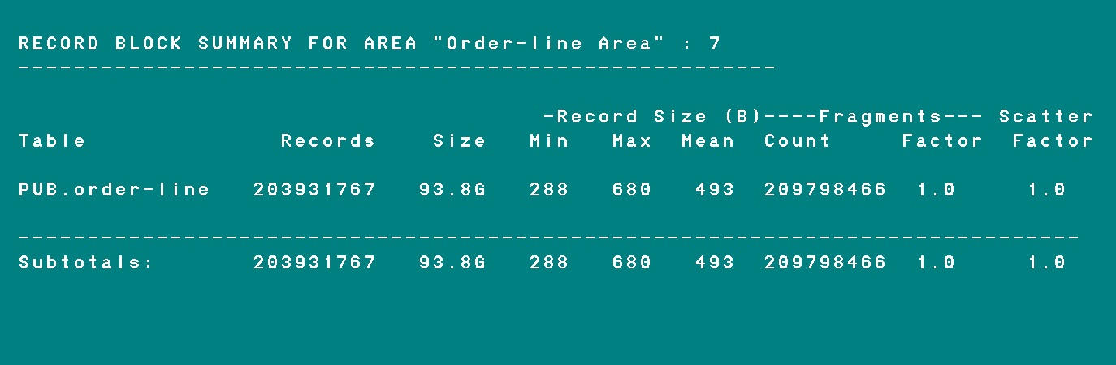
Fragmentation
Fragmentation = ( Fragments Count – Record count ) / Record count
Why Fragmentation is bad?

Slide 41
Fragmentation
Reading a record
When reading records with any lock except the NO-LOCK option – Lock Table is needed
When reading records with NO-LOCK option – Lock Table is not needed
if the record is not fragmented
If the record is fragmented, we need some kind of a lock for consistent read
The session creates Record Get Lock in the Lock Table
This lock prevents any other user from modifying or deleting that record while the engine is piecing it together for a fetch
The lock is removed when the last record fragment is read
Notes:
A fragmented record must be read in 2 or more blocks, and everyone knows it, besides ....When reading records with any lock except the NO-LOCK option, the session first puts a lock (if it can) in the Lock Table and then reads the record itself (regardless of whether the record is fragmented or not). When reading records with the NO-LOCK option, the session does not create anything in the Lock Table if the record is not fragmented. If, however, the first fragment of a record contains an indication of a continuation (one of the bits in offset says that the fragment begins with the Next Fragment Dbkey field), the session creates (if it can) Record Get Locks in the Lock Table. To understand why, imagine that a record is fragmented across several database blocks. When you fetch a record, the database engine has to piece together the complete record before it gives it to the 4GL.
The lock is removed when the last record fragment is read. I.e. the lock hangs only for a moment. Creation and release of Share and Exclusive Locks is controlled by the application. Record Get Locks are not controlled by the application and therefore stand apart. In particular, it is not included in the counting of activity created by a session, although it is the session that creates this activity, but not by its own will.

Slide 42

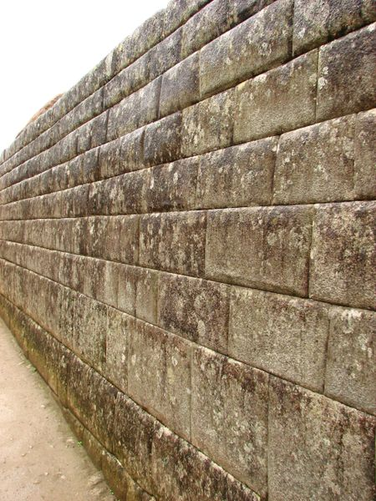
Locks
Exclusive Lock
Record Get Lock
(Exclusive)
Shared Lock
Record Get Lock
(Shared)
Normal Record Locks are
controlled by application
Low-level Locking Methods
Not controlled by application
Much longer time
Much shorter time
Not needed if record 1 piece
Notes:
The record-get lock is used during no-lock reads in order to ensure that fragment 2 does not get updated while fragment 1 is being read, and so on.
Record-get locks can be shared or exclusive. They do not conflict with exclusive regular record locks because it is only while an exclusive record lock holder is actually updating a record (which may or may not occur and when it does so, for a much shorter time than the duration of the exclusive record lock) that the conflict might occur. Recall that the exclusive record lock lasts until the end of the transaction which is normally much longer than an update operation (single or multi-block) or a multi-block read operation.
And: when the exclusive lock holder goes to update the record it also obtains a record-get lock (in exclusive mode), preventing no-lock readers from overtaking it while updating the second and following fragments.
Also, record-get locks are not used and not needed when the record has only one piece in one data block.

Slide 43
Real Database example
Date Record Reads Rec Get Locks Get% Waits Exclusive Locks
2024-07-30 23,074,906,260 3,543,933,829 15.4% 3 274,416,846
2024-08-06 24,989,873,192 3,971,623,570 15.9% 11 412,638,162
2024-08-12 24,868,524,428 3,803,673,083 15.3% 4 485,768,429
2024-08-17 22,271,783,794 3,333,837,966 15.0% 1 260,898,557
Records Fragmented
Dbanalys 7,675,546,149 151,521,444 2.0% We do not see Fragments for LOBs
"Get%" = Rec Get Locks / Record Reads
"Waits" = _ActLock._Lock-RecGetWait or Waits: Record Get Lock on the promon screen “Activity: 7 Lock Table”
We do not know if those are waits for Exclusive Rec Get Locks only or for both Shared and Exclusive, we do not know.

Slide 44
Why my application likes to read fragmented Records?
1. Maybe LOBs contribute? - NO
2. Can we see in which tables we read fragmented records? – NO
_TableStat does not provide that information
3. Can we see which processes create Record Get Locks? – NO
Record Get Locks are not counted in session statistics
We want to find which table needs defrag the most. No answer from PSC
Notes:
The reason the OpenEDge RDBMS does not use the record-get lock for LOB fields is that the locks on the record (regular and record-get) cover the lob fields as well. Conceptually, the LOB fields are just part of the record, just like other fields even though they are store separately.
_TableStat shows record reads, create, update, delete, but not the fragment reads
_LockReq. _LockReq-RecLock does not have Record Get Locks

Slide 45
What resources are used for a Record Get Lock ?
1 Record Get Lock = 2*LKF Latches + 2*LHT Latches + 1 Record Get Queue Request
LKF latch = Lock Table Free Chain (Free Entry List);
LHT latches (LKT in promon) = Lock Table Hash Chain Latches
Readprobe test - reads per sec:
4,903,696 - large db: 11.6% (247,084 of 2,132,913) records are fragmented;
6,645,010 - large db: no fragmented records.
26 % improvement without fragmentation
Notes:
One shared Get Lock requests two LKF latches and two latches from LHT family.
And also, it requests resource that is called Record Get Queue.
Record Get Locks are very “special”, and PSC does not show statistics on them.
We could not find the source of fragmentation of records

Slide 46
Fragmentation
Creating a record
The next fragment dbkey
Blocks with fragments are always changed twice
Notes:
When it creates the first fragment, it has not even started looking for places for the second fragment. The process memorizes (stores in its memory) where it put the fragments of the record. When all fragments are created, it goes through them again and changes them once more, namely changes the next fragment dbkey field in them. That is, blocks with fragments are always changed twice.

Slide 47
Fragmentation
Updating a record
Is 'i = i + 1’ a costly operation?
For a variable 50 micro-seconds
For a non-indexed field, it will create one 72-byte RL_RMCHG note.
_ActRecord. _Record-RecUpd = 1
_ActRecord. _Record-FragUpd = 1
_ActRecord. _Record-BytesUpd = <size of the record>
Table.Field-integer
Table.Field-character ( 31 K size )
in a 1K block size database, so we have 34 fragments of that record
Notes:
After-image scan will show one 72-byte RL_RMCHG note
_ActRecord. _Record-BytesUpd shows the size of the record, because it show not the bytes that were changed, but the size of the area in which changes happen record size.
Important: These notes size do not depend on the size of the record. The record could be minimal size of 16 byte or the whole block. There is only 1 condition, the record should not be fragmented.

Slide 48
Fragmentation
Updating a record
For a non-indexed field change in the record with 34 fragments
68 notes = 34 RL_RMDEL + 34 RL_RMCR with total size 67344
Non-fragmented record Fragmented record
----------------------------- ---------------------
Recovery notes : RL_RMCHG RL_RMDEL + RL_RMCR
Num of notes : 1 2 * num of fragments
BI byte writes : 72-75 2 * record-length(record)
Record updates : 1 1
Fragment updates: 1 0
Fragment deletes: 0 num of fragments
Fragment creates: 0 num of fragments
Byte updates : record-length(updated record) 0
_ActRecord VST
Notes:
So, you will see 68 notes in AI scan instead of 1, with the total size of 67344 bytes. Which is more than twice the size of the record.
_ActRecord._Record-RecUpd still show 1 Record update
But _ActRecord._Record-FragUpd did not change in the case of fragmented record, it is zero, no Fragment updates.
Instead, we have 34 deletes and 34 creates. So OpenEdge deleted all fragments and re-created each of them.
This is how record update algorithm changed in 10.1A when Large Record creation was introduced.
Fragmented records are not changed in the same sense as non-fragmented records. They are re-created which is not very efficient method.
At the end of update of a fragmented record (or after delete+undo) Progress updates the “next fragment dbkey” in the record’s fragments (a sequence of the RL_RMNXTF notes). And after these changes the highest bit (64 bit) in “next fragment dbkey” changes to 1.
That is to distinguish the next fragment dbkey from a trasaction id of a rowid placholder.
transaction id's are not negative.

Slide 49
Fragmentation
How to fight Fragmentation?
1. D&L
2. Pro2pro
3. D&L using Mike Furgal's partitioning method
4. proutil db-name -C tablereorg table-name (if version 12.3+)
5. Increase the Create Limit
6. Choose smaller RPB

Slide 50
Space management algorithms
How to configure parameters
Rows Per Block (per area)
Create limit (per Table)
Toss limits (per Table)
-recspacesearchdepth (per Database)

Slide 51
Rows Per Block
“Сamel humps”
Typical advice:
RPB = (Dbblocksize - X)/(MeanRecSize + Y)
Notes:
Сamel humps: 180-200 byte and 240-250 byte.
One hum is less than average 231-byte, and the other one is bigger than 231-byte average.
If we put an average 231-byte into the formula we will get RPB 32.
But for the records from the small hump best RPB is 64, for the records from the big hump best RPB is 16. But we can choose only one RPB size.
Tom Bascom: It is probably a good idea to "know your data". Choosing RPB just only based on average record size is not always work fine.

Slide 52
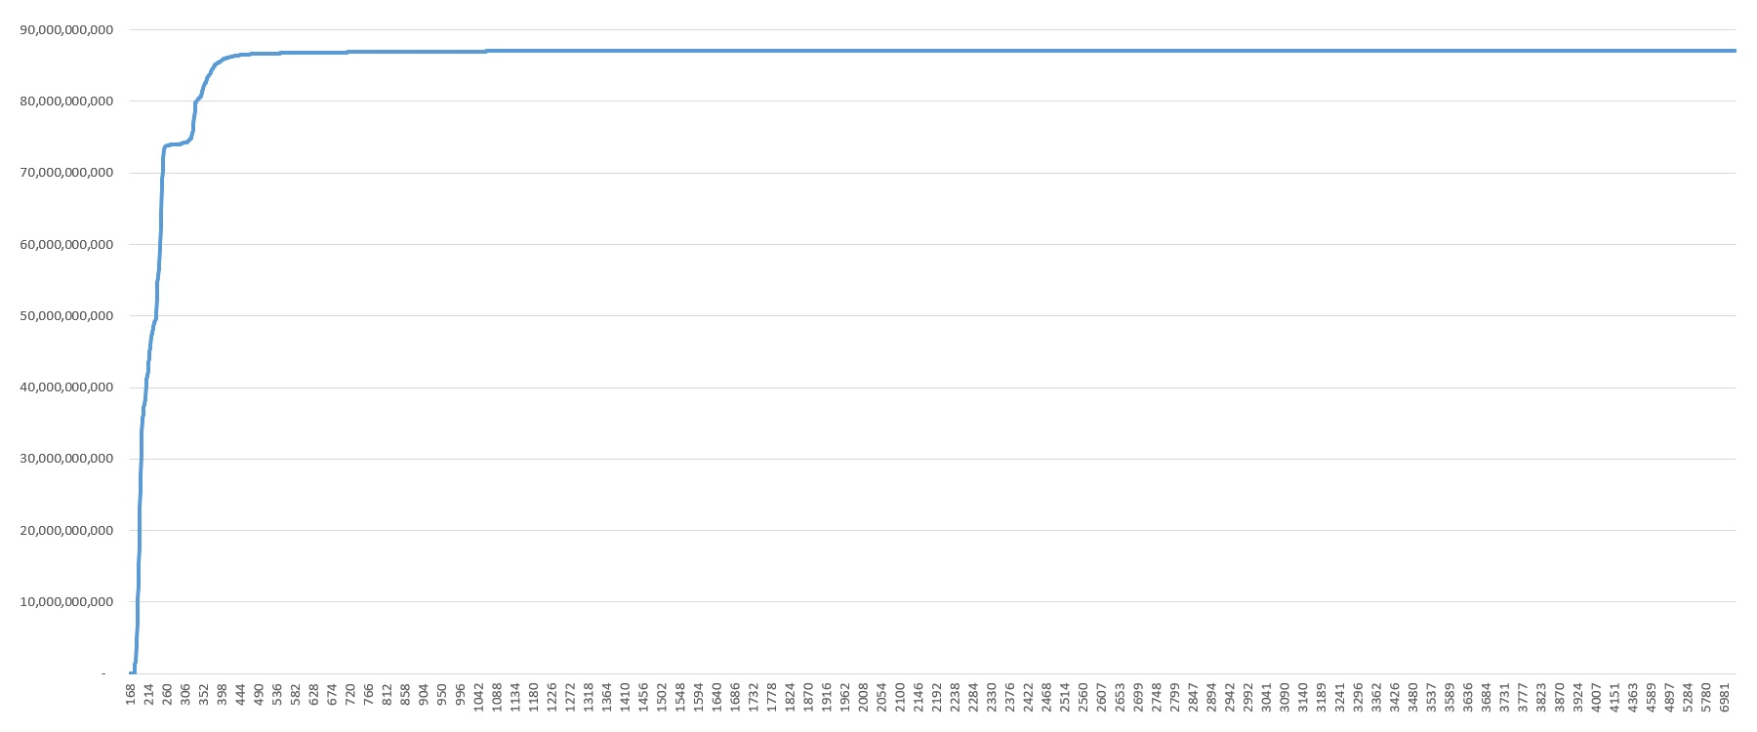
Rows Per Block
Record contribution to the table’s space
Notes:
Space Contribution(X1) = sum per X<X1 of X * Count(X)
where Count(X) is the number of records with record size equals X.
Top value is the table’s space.
Choose the range of record sizes that contribute the most to the table’s space. It’s the first “hump”!

Slide 53
Space management algorithms: Parameters
Create and Toss Limits a.k.a. Expansion Constant / Free Space Constant (version 8)
Create Limit — The minimum amount of free space in bytes required in a block after a new record is
inserted.
Toss Limit — The minimum amount of free space in bytes required in a block for the block to remain on
the RM chain.
The create limit = between 32 and block size minus 128 bytes, default 150
The toss limit between zero and block size minus 128 bytes, default 300
Toss Limit ≥ Create Limit
Since V10.0A
Notes:
The toss limit could be smaller than create limit. They are not tied to each other. TossLimit will be completely ignored if it's less than CreateLimit.
The result of toss limit zero mean all blocks of a table will be on the RM Chain.
The max value block size minus 128 bytes does not have a meaning. The absolutely empty block could have space 84 bytes less than the block size.

Slide 54
Space management algorithms: Parameters
Create and Toss Limits syntax
PROUTIL db_name -C DISPTOS[SCREATELIMITS] area_name
Table object number: 884, Toss Limit: 300, Create limit: 150. (12852)
Table object number: 885, Toss Limit: 300, Create limit: 150. (12852)
Find _file where _file-num = 884. Display _file-name.
# Use VST for (SAT II) Table
_StorageObject._Toss-Limit
_StorageObject._Create-Limit
PROUTIL db_name -C SETTABLECRE[ATELIMIT] table-name create-limit
PROUTIL db_name -C SETTABLETOS[SLIMIT] table-name toss-limit
PROUTIL db_name -C SETLOBCREA[TELIMIT] lob-name create-limit
PROUTIL db_name -C SETLOBTOS[SLIMIT] lob-name toss-limit
PROUTIL db_name -C SETAREACRE[ATELIMIT] area-name create-limit
PROUTIL db_name -C SETAREATOS[SLIMIT] area-name toss-limit
Notes:
Here is how to see the create/toss limits and how to set them up. The names of the proutil’s options can be abbreviated – see [].
It the area has no tables SETTABLECRE will say:
No storage objects found in area <area-name>:<area-number>. (16371)
At the end SETTABLECRE will display
Area default set to <value> for area <areaname>:<areaNumber>. (19510)
Create limit is not the exact limit progress will use. For a default 150, progress will probably reserve 170-175 bytes. It is line –n parameter, you set it and the database will use slightly different number for user connections, close but different. See in the database log.

Slide 55
Toss Limit
Typical advice:
higher than create limit
smaller than average row size
Notes:
And again, in this recommendation we use MeanRecSize.
We have seen on previous slides with record distribution that it does work well often.
Let’s look at the LOB distribution now. Where in this picture is the MeanLobSize

Slide 56
Create Limit
Typical advice:
Reduce create limit for tables that do not change (_TableStat-update = 0),
set create limit to the minimum.
Increase create limit for tables with fragmentation where records expand
after creation.
Notes:
If _TableStat-update = 0 all the time then set create limit to 32

Slide 57
Space management algorithms: Parameters
Record free chain search depth factor (-recspacesearchdepth)
Specifies how far into the record free chain the database engine searches for a block with enough
free space to store the data associated with a record create or update before a new cluster of data
is allocated. The value is a percentage of the cluster size with a minimum of 3 blocks
Default : 5 Range: 0-100
To change this parameter while the database is running, use PROMON or the _DbParams VST
In Progress Knowledgebase Article # 000129723 :
The recspacesearchdepth value is specified in tenths of Cluster Size.
The default value is 5, being 5/10 or 50% of the cluster size worth of RM blocks to move from the front the the back of the RM chain before allocating a new cluster for data.
Front2Back (blocks) = truncate(-recspacesearchdepth * Area’s DCS / 10, 0) + 3
Notes:
At the time Gus wrote monograph –recspacesearchdepth was a constant = 3. But when data started added by clusters, a new variable was added to control how many blocks go from front to end.
Setting one value (for –recspacesearchdepth parameter) is not good because all RM chains are different. The value for a “healthy” RM chain will not be good for a “sick” RM chain (long one). PSC should have set one parameter for each table individually.
proserve sports -recspacesearchdepth 200
SERVER : The recspacesearchdepth maximum value of 100 exceeded
So, Progress allow to set it higher, but treats the value of 100 instead of giving an error.
How often did the recspacesearchdepth maximum value was used? Progress does not give answer to that question.
When the abnormally fat record is created lots of blocks are shifted to front to back. Space Management algorithm works well when the size of created records is close to the average free space in the blocks. When all records of the table are close to the average size it works well, but that is not always happening.
Formula:
Front2Back (blocks) = truncate(-recspacesearchdepth * Area’s DCS / 10, 0) + 3
Area’s DCS = Area Data Cluster Size = the third value in Area definition
d "Misc Data":7,128;512 = 512 in this case

Slide 58

-recspacesearchdepth
Notes:
The best we can do today - scan after-image files. We can see for each RM chain when more than 3 blocks moved front2back in 1 record creation step.

Slide 59
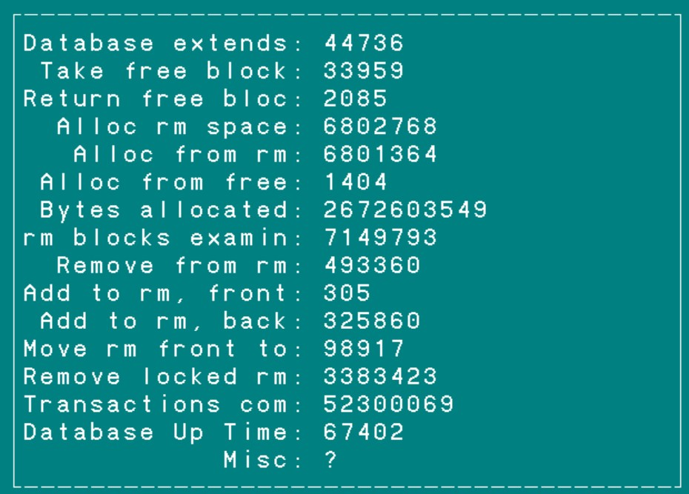
Chain Activity Monitoring
for each _ActSpace no-lock:
display _ActSpace with 1 col.
end.
Notes:
_ActSpace VST – show examples how many blocks go to front/back same day.
_Space_FrontAdd and _Space_BackAdd. Talk about when block goes to Front vs back.
But that is unfortunately only on the database level. For V8 it was ok when was 1 chain for all tables.
But we got table AREAs, and each table now has it’s own chain. Monitoring is still the same as it was.
Scanning AI and then sorting data (programming it) will give more deltail information about each chain.

Slide 60
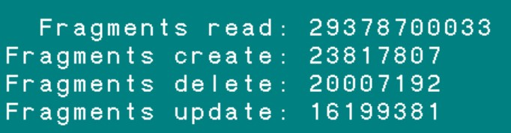
Chain Activity Monitoring
for each _ActRecord no-lock:
display
_ActRecord._Record-FragRead
_ActRecord._Record-FragCreat
_ActRecord._Record-FragDel
_ActRecord._Record-FragUpd
with 1 col.
end.
Notes:
Same here, only on the database level we can see Fragments information. Though create limit we can set for each table. But how do we know if statistics is collected for the whole database only.
We know how many table creates we have, but we do not know how many table fragments are created. Monitoring need to be expanded for all tables.

Slide 61
Conclusion
Fragmentation is bad.
The conclusions about the long RM chain are not so clear. The RM chain serves its purpose -- reuse of space. But long chains, as shown in the "Used space" slide, lead to the fact that we can have a huge number of almost empty blocks in the head of the chain that wait for years to be used. And this is a waste of space.
Email: dlevin@alphabroder.com

