Slide 1

Coding for Network Performance
Tom Bascom, White Star Software
Abstract: Are you wondering why your client/server code is so slow? And what you can do about it?
Progress continues to urge people to migrate from shared memory connections to client/server architectures. Many customers are hesitant to do so because the performance penalty is substantial. Over the years Progress has made huge strides in improving the performance of client/server connections. This session will discuss the OpenEdge client/server messaging protocol, its impact on the performance of database queries and how to leverage the many improvements that Progress has made. We will cover coding best practices, tuning opportunities, a test harness, benchmark results and some tips & tricks for getting more out of your client/server connections!

Slide 2

Coding for Network Performance
FOR EACH customer FIELDS ( name balance ) NO-LOCK:
/* ... */
END.
FIND location NO-LOCK WHERE locationId = n NO-ERROR.
Tom Bascom, White Star Software
tom@wss.com

Slide 3
Agenda
What's The Big Deal?
What Are Network Messages?
Improving Existing “Queries”
How to Analyze OpenEdge Client Server Performance
Summary

Slide 4
What’s
The
Big Deal?

Slide 5
Latency Numbers That You Should Know
Operation | ns | µs | ms | Note
L1 cache reference | 0.5ns
Branch mis-predict | 5ns |  |  | Plus the missed instructions
L2 cache reference | 7ns |  |  | 14x L1
MUTEX lock/unlock | 25ns
Main Memory Access | 100ns |  |  | 20x L2, 200x L1
Send 1KB over a 1Gpbs network | 10,000ns | 10µs |  | local
Read 4K randomly from (internal) SSD | 150,000ns | 150µs |  | ~1GB/sec SSD 4x memory
Round trip within a datacenter | 500,000ns | 500µs | 0.5ms | no payload, just a ping
Round trip to a datacenter 100KM away | 1M ns | 1,000µs | 1ms | no payload, just a ping
Disk Seek | 2M ns | 2,000µs | 2ms | (“fast”) rotating rust
Round trip to google.com | 30M ns | 30,000µs | 30ms | typical cloud ping time
3 of the top 4 offenders are network related!
Based on https://gist.github.com/jboner/2841832
Notes:
Time And How To Get Rid Of it -- Revisited
Gus Björklund
11:45 (just missed it)

Slide 6
Shared Memory vs Client/Server
With a shared memory connection:
  The client executes on the server
  The client directly accesses database files & server memory
  Result sets are immediately available in the clients memory
  Performance is very, very good
Client/Server Connections
  The client might be executing anywhere on the network
  The client sends messages to the server asking for data – and then waits
  The server fetches the data and sends responses back to the client
  Performance can be “a lot” slower

Slide 7
How Bad Can It Be?
Notes:
WAN client/server test… ping time 33ms, FIND NO-LOCK dropped to 33 rec/sec, test suite didn’t finish running and was killed after 18 hours
10,000 FIND NO-LOCK scenario localhost = 0.2 seconds, WAN = 306 seconds = OUCH!

Slide 8

How Bad Can It Be?
Notes:
WAN client/server test… ping time 33ms, FIND NO-LOCK dropped to 33 rec/sec, test suite didn’t finish running and was killed after 18 hours
10,000 FIND NO-LOCK scenario localhost = 0.2 seconds, WAN = 306 seconds = OUCH!

Slide 9
Shared Memory vs Client/Server Scenarios
3x
3.5x
4.4x
23x
105x
Notes:
Shared memory is obviously much, much faster…
For reference:
-Mm 8192
-prefetchDelay
-prefetchFactor 100
-prefetchNumRecs 4000
-prefetchPriority 100
-Nmsgwait 1

Slide 10



Bonus Badness…
Geosynchronous Satellite…
Ping = 831.498
Records per second = 54
5,000x worse than shared memory!!!
30cm per nanosecond…
It’s The Law!

Slide 11
What About FIND?

Slide 12

That's a Pretty Big Deal!
Notes:
Ron Burgundy, "Network"

Slide 13

What Are OpenEdge
Network Messages?

Slide 14
OpenEdge Network Messages
When OpenEdge runs over a network data is marshalled into “messages”:
  The client requests data (makes a query with FIND or FOR EACH…)
  The server resolves the query and sends back the results
  The client might upgrade locks
  The client eventually releases locks and ”cursors”
“Messages” are potentially broken up by TCP/IP into multiple “packets”.
A single round trip may only take a few milliseconds – but they add up very quickly.
During peak periods some applications generate hundreds of thousands of messages per second!

Slide 15
FIND NO-LOCK
FIND customer WHERE cust-num = 10 NO-LOCK.
One round trip (two messages) to retrieve the record.
Client ---> Server Requests record
Server ---> Client Sends record back
One more, one way, message to release the cursor.
Client ---> Server Releases the cursor

Slide 16
FOR EACH NO-LOCK
FOR EACH customer NO-LOCK:
Fetch the first record with one round-trip then as many records as can fit in a message per round-trip. Subject to the following limits:
-Mm # message buffer size (oe11 = 1024, oe12 = 8192)
-prefetchDelay # skips the single record initial message (oe 11 disabled)
-prefetchFactor # % full to fill the message (oe11 = 0, oe12 = 100)
-prefetchNumRecs # number of records per message (oe 11 = 16, oe 12 = 64)
A FOR EACH is potentially many fewer messages than the equivalent set of FIND statements. Could return dozens or even hundreds of records in a single round trip!

Slide 17

FOR EACH, With JOIN & SORT
FOR EACH customer NO-LOCK,
EACH order NO-LOCK OF customer
BY ship-date:
Performance depends on if the sort is only on the outer table or not.
This process can use a lot of round trips!
Not recommended, try to use nested FOR EACH statements instead:
FOR EACH customer NO-LOCK:
FOR EACH order NO-LOCK OF customer:
/* would need to resolve ordering issue… */
Or, better-yet, build temp-tables (more on this later)
Notes:
One possible way to resolve ordering problem is by flipping the order of the nested FOR EACHs ;)

Slide 18

FOR EACH, With JOIN & SORT
FOR EACH customer NO-LOCK,
EACH order NO-LOCK OF customer
BY ship-date:
Performance depends on if the sort is only on the outer table or not.
This process can use a lot of round trips!
Not recommended, try to use nested FOR EACH statements instead:
YMMV, but the OpenEdge 12.x Server Side Joins feature addresses this problem!
(More later)
Notes:
One possible way to resolve ordering problem is by flipping the order of the nested FOR EACHs ;)

Slide 19

Improving Existing Queries

Slide 20
-prefetch* and friends
Painless parameter changes that will improve performance without requiring code changes!
Defaults have changed from OpenEdge 11 to OpenEdge 12
But even the new defaults are “modest”, I suggest:
-Mm 16384 # message buffer size (default 1024 pre oe12, 8192 oe12+)
-prefetchDelay # skips the single record initial message (default disabled pre oe12)
-prefetchFactor 100 # % full to fill the message (default 0 pre oe12, 100 in oe 12+)
-prefetchNumRecs 5000 # number of records per message (default 16 pre oe12, 64 in oe12+)
-prefetchPriority 10 # check for messages (poll) from client every X records (default 1)

Slide 21
Impact of Message Size & Prefetch Options
for each _index fields(_field-name) no-lock:
end.
totMsgs | qryRecv | recSent | recs/qry | etime | net time | Description...
198 | 97 | 1758 | 18 | 10 | 208 | -Mm 1024
208 | 102 | 1758 | 17 | 14 | 222 | -Mm 4096
192 | 94 | 1758 | 19 | 9 | 201 | -Mm 8192
180 | 88 | 1758 | 20 | 11 | 191 | -Mm 16384
162 | 79 | 1758 | 22 | 14 | 176 | -Mm 32600
152 | 74 | 1758 | 24 | 8 | 160 | -prefetchDelay
154 | 75 | 1758 | 23 | 12 | 166 | -prefetchDelay -prefetchFactor 100
8 | 2 | 1758 | 879 | 22 | 30 | -prefetchDelay -prefetchFactor 100 -prefetchNumRecs 10000
Notes:
“net time” assumes 1ms per message - this is a decent approximation of uncongested LAN performance, WAN performance will be much worse

Slide 22
Impact of Message Size & PrefetchNumRecs
-prefetchNumRecs dominates!
totMsgs | qryRecv | recSent | recs/qry | etime | net time | Description...
102 | 49 | 1758 | 36 | 8 | 110 | -Mm 1024 -prefetchNumRecs 10000
28 | 12 | 1758 | 147 | 9 | 37 | -Mm 4096 -prefetchNumRecs 10000
16 | 6 | 1758 | 293 | 13 | 29 | -Mm 8192 -prefetchNumRecs 10000
10 | 3 | 1758 | 586 | 9 | 19 | -Mm 16384 -prefetchNumRecs 10000
8 | 2 | 1758 | 879 | 23 | 31 | -Mm 32600 -prefetchNumRecs 10000
8 | 2 | 1758 | 879 | 22 | 30 | -prefetchDelay -prefetchNumRecs 10000
146 | 71 | 1758 | 25 | 13 | 159 | -prefetchDelay -prefetchFactor 100
8 | 2 | 1758 | 879 | 22 | 30 | -prefetchDelay -prefetchFactor 100 -prefetchNumRecs 10000
Notes:
“net time” assumes 1ms per message - this is a decent approximation of uncongested LAN performance, WAN performance will be much worse

Slide 23

Next, Pick Your Battles
The performance enhancement possible with a given improvement is limited by the fraction of the execution time that the improved feature is used.
-- Amdahl’s Law

Slide 24


In other words:
Trying to improve small things that nobody notices probably isn’t the road to fame and fortune.
Big queries that return lots of data and which are frequently used by lots of users will be much more noticeable.

Slide 25

How To Pick Your Battles?
Observe Which Tables and Indexes Have High Activity
Use the Client Statement Cache to Identify the Responsible Code in Real Time
Or… Use the Profiler to Analyze Known Slow Code
Or… Use “Service Telemetry” (Consultingwerk) to Identify Slow Services
Or… Wait for Users to Complain
Notes:
It’s never a good idea to let the other guy pick the battle…

Slide 26
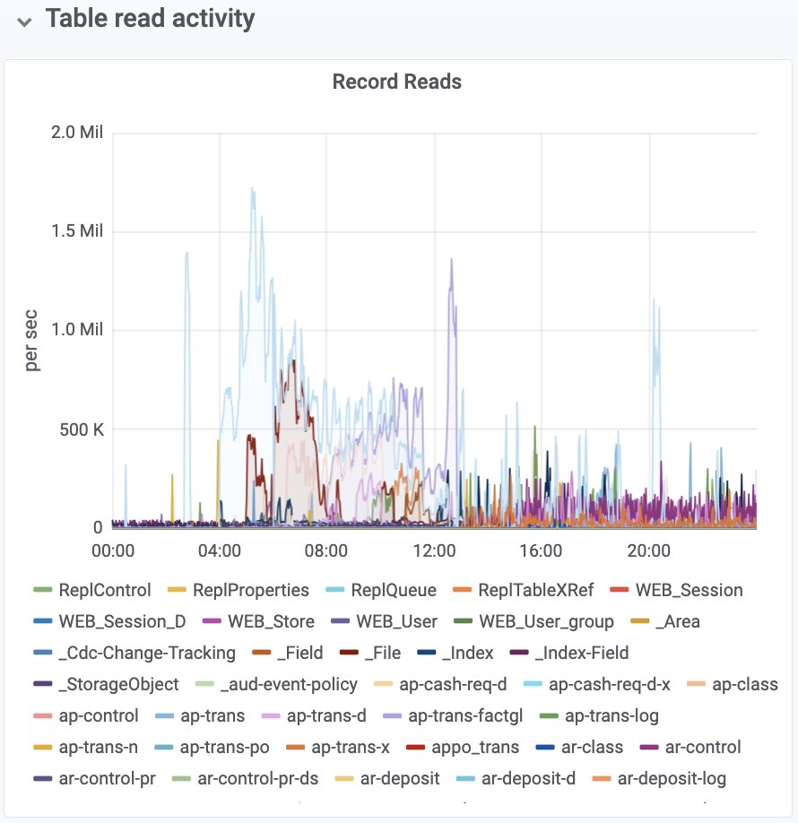
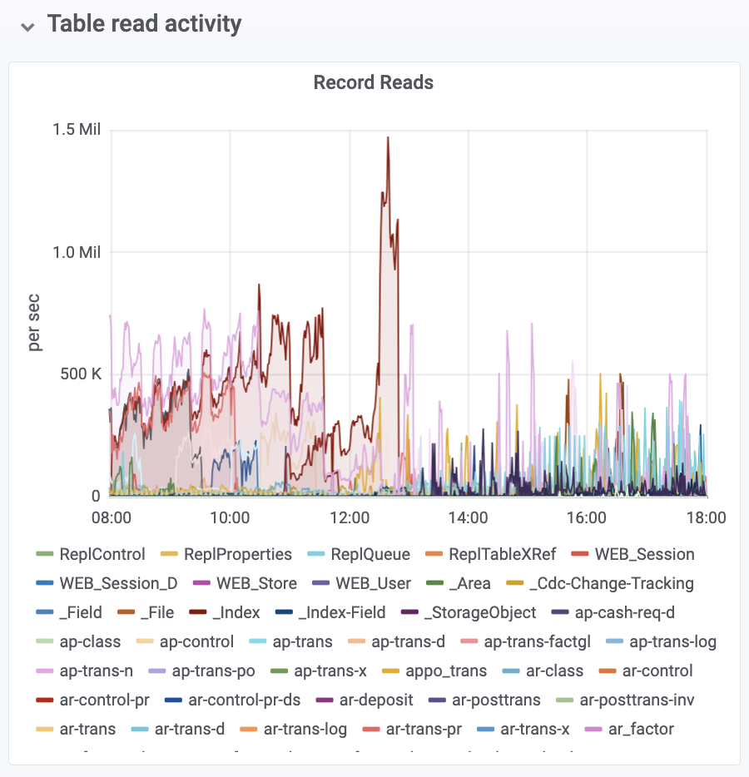

ProTop Portal – Table Read Activity
Notes:
“supplier” is 1.5M+/sec, it is in the middle of the night but that batch job could finish a lot sooner with a little work…
“cust_reb_group_x” is the daytime troublemaker

Slide 27
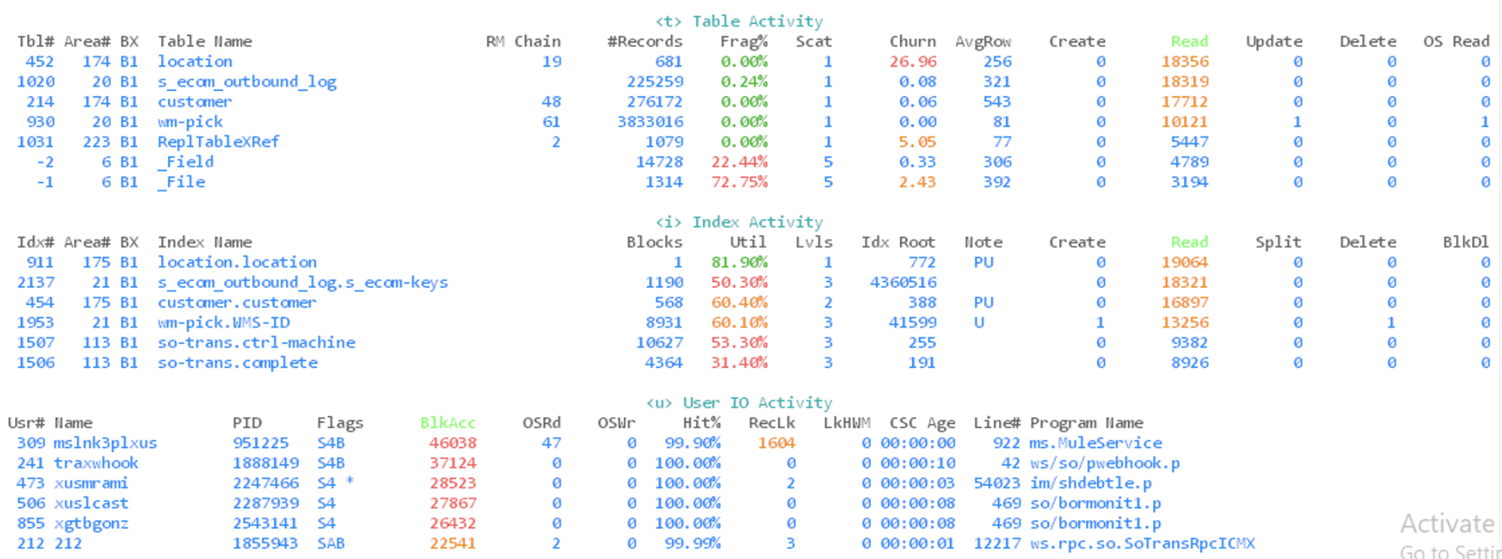
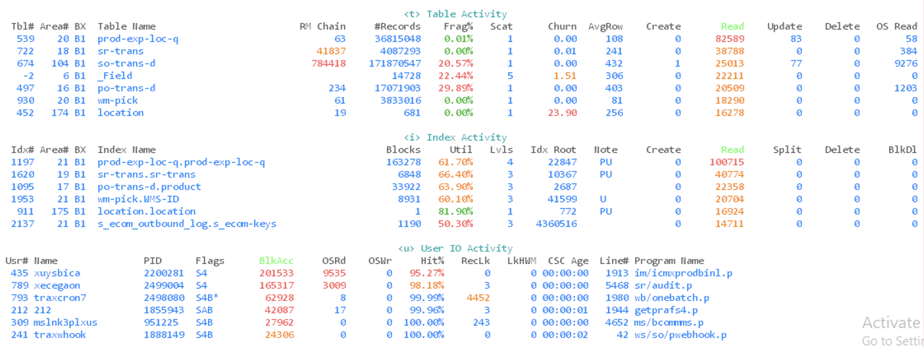

ProTop “RT” Table Activity and CSC

Slide 28
Simple Things That Help Existing Queries
  FIELDS – can reduce the size of records and thus allow more records to be packed into a message, i.e.
  FOR EACH customer FIELDS ( name balance ) NO-LOCK:
  or:
  FOR EACH customer EXCEPT ( photo ) NO-LOCK:
CACHE – client side buffer for records returned (default 50 - supposedly)
DEFINE QUERY q FOR customer FIELDS ( name ) CACHE 1000
Notes:
Note position of FIELDS() & NO-LOCK

Slide 29

Things That Hurt (A Lot)
SHARE-LOCK (frequently accidental)
  Breaks the bundling of records
  For a large result set SHARE-LOCK might be literally 100x worse!
  Easy to accidentally get wrong
Bad WHERE Clauses
Nesting and JOINs (version dependent)
BREAK BY
CAN-DO()
  Is a SECURITY function – not a string function
  Always evaluated on the client
  Has many unexpected behaviors

Slide 30
Impact of Basic Coding Approaches
totMsgs | qryRecv | recSent | recs/qry | shm time | net time | Description...
3519 | 0 | 1758 | ? | 139 | 3658 | do while … find no-lock
5276 | 0 | 1758 | ? | 174 | 5450 | do while … find share-lock
28 | 12 | 1758 | 147 | 7 | 35 | for each no-lock
8 | 2 | 1758 | 879 | 22 | 30 | FENL fields()
5277 | 1758 | 1758 | 1 | 155 | 5432 | FE share-lock
3520 | 1758 | 1758 | 1 | 134 | 3654 | FE exclusive-lock
3519 | 1758 | 1758 | 1 | 87 | 3606 | open query
3519 | 1758 | 1758 | 1 | 84 | 3603 | open query fields()
7 | 2 | 1758 | 879 | 29 | 36 | open query fields() cache 50
7 | 2 | 1758 | 879 | 30 | 37 | open query fields() cache 5000
20 | 8 | 1758 | 220 | 113 | 133 | sql89 select *
8 | 2 | 1758 | 879 | 37 | 45 | sql89 select _field-name
No, I am not endorsing SQL89
Notes:
All tests were run using the final settings from the Message Size & Prefetch slide:
-Mm 32600
-prefetchDelay
-prefetchFactor 100
-prefetchNumRecs 10000

Slide 31
Nesting and Joins (pre OE12, no SSJ)
/* simple nesting */
for each _file no-lock:
for each _field no-lock of _file:
end.
end.
/* ugly sort criteria */
for each _file no-lock,
each _field no-lock of _file
by _field-name:
end.
/* use a join instead of nesting */
for each _file no-lock,
each _field no-lock of _file:
end.
totMsgs | qryRecv | recSent | recs/qry | shm time | net time | Description...
587 | 195 | 1950 | 10 | 33 | 620 | nested FE
587 | 195 | 1950 | 10 | 33 | 620 | joined FE
6183 | 195 | 4748 | 24 | 207 | 6390 | joined FE w/ sort on inner field
33 | 14 | 1951 | 139 | 150 | 183 | TT option
Notes:
All tests were run using the final settings from the Message Size & Prefetch slide:
-Mm 32600
-prefetchDelay
-prefetchFactor 100
-prefetchNumRecs 10000

Slide 32
Nesting and Joins – TT Option
define temp-table tt_file no-undo like _file
field xdbRecid as recid
index xdbRecid-idx is unique xdbRecid.
define temp-table tt_field no-undo like _field.
for each _file no-lock:
create tt_file.
buffer-copy _file to tt_file.
xdbRecid = recid( _file ).
end.
for each _field no-lock:
create tt_field.
buffer-copy _field to tt_field.
end.
for each tt_file no-lock,
each tt_field no-lock where tt_file.xdbRecid = tt_field._file-recid
by tt_field._field-name:
end.
A major reduction in network traffic and a big improvement in “across the network time”!
WARNING - don’t just do this automatically. If your code is designed to be run with shared memory or is already fairly efficient this approach may make it a bit slower.
Notes:
All tests were run using the final settings from the Message Size & Prefetch slide:
-Mm 32600
-prefetchDelay
-prefetchFactor 100
-prefetchNumRecs 10000

Slide 33
Server Side Joins – OE12
OpenEdge 12 Introduces Server Side Joins!
define output parameter ii as integer no-undo.
define output parameter jj as integer no-undo.
define output parameter kk as integer no-undo.
for each customer no-lock where customer.salesRep = "hxm" or customer.salesRep = "jal",
each order no-lock where order.custNum = customer.custNum:
if order.salesRep <> customer.salesRep then
kk = kk + 1.
end.
Notes:
All tests were run using the final settings from the Message Size & Prefetch slide:
-Mm 32600
-prefetchDelay
-prefetchFactor 100
-prefetchNumRecs 10000

Slide 34
Server Side Joins – OE12
scenario | tmSec | customers | orders | rogues | logRd | recRd | idxRd | recSent | msgTotal | rec/msg | qryRecv | recLk
nested FOR EACH | 6.358 | 277 | 1001 | 26 | 3396 | 1278 | 1278 | 1279 | 847 | 1.51 | 283 | 0
add fields() | 6.179 | 277 | 1001 | 26 | 3396 | 1278 | 1278 | 1279 | 839 | 1.524 | 279 | 0
tt_custList cache | 6.261 | 277 | 1001 | 26 | 3396 | 1278 | 1278 | 1279 | 839 | 1.524 | 279 | 0
dynamic query | 0.212 | 277 | 1001 | 26 | 3121 | 1278 | 1278 | 1279 | 29 | 44.103 | 8 | 0
build tt piecemeal | 0.272 | 277 | 1001 | 26 | 3121 | 1278 | 1278 | 1279 | 29 | 44.103 | 8 | 0
add salesRep <> | 0.203 | 277 | 26 | 26 | 3121 | 1278 | 1278 | 304 | 25 | 12.16 | 4 | 0
use global shared TT | 0.196 | 277 | 1001 | 26 | 2564 | 1001 | 1001 | 1002 | 24 | 41.75 | 6 | 0
use static JOIN | 6.287 | 277 | 1001 | 26 | 3120 | 1278 | 1278 | 1280 | 562 | 2.278 | 278 | 0
add fields() | 6.232 | 277 | 1001 | 26 | 3120 | 1278 | 1278 | 1280 | 562 | 2.278 | 278 | 0
add salesRep <> (oe11) | 5.630 | 2 | 26 | 26 | 3396 | 1278 | 1278 | 304 | 839 | 0.362 | 279 | 0
add salesRep <> (oe12) | 0.092 | 2 | 26 | 26 | 3120 | 1278 | 1278 | 30 | 12 | 2.5 | 3 | 0
break-by | 50.601 | 277 | 1001 | 26 | 7124 | 3280 | 1278 | 3282 | 4566 | 0.719 | 278 | 0
share-lock | 12.932 | 2 | 26 | 26 | 3396 | 1278 | 1278 | 304 | 1746 | 0.174 | 581 | 1278
Notes:
All tests were run using the final settings from the Message Size & Prefetch slide:
-Mm 32600
-prefetchDelay
-prefetchFactor 100
-prefetchNumRecs 10000

Slide 35
That’s Nice, But What About FIND Statements?
Your application probably uses a LOT more FIND statements than FOR EACH NO-LOCK “queries”
FIND statements require at least 3 “network messages”:
  Request a record
  Response
  Release the cursor

Slide 36
Solutions for FIND latency
Use Shared Memory Clients:
  Good old character terminal interfaces
  Classic Appservers
  PASOE
Keep Your Clients Close To The Server! (Minimize PING Time)
  1ms is (roughly) a round trip to a server 100 kilometers away (not counting handoffs)
  Within the same data center, preferably the same physical host!
  Azure “proximity placement group”
  AWS “local zones”
Notes:
Light travels 300,000 meters in 1 millisecond. 1 millisecond is 1/1000 of a second. 300,000 meters is 300 kilometers, which is just over 186 miles. However – that is in a vacuum, the speed of light in fiber is only 2/3rds that so 200km or 120miles. Thus the target for a 1ms ping is 100km or 60 miles away. Best case with no additional latency due to repeaters, switches, routers, network cards, firewalls, etc…
https://stackoverflow.com/questions/50653230/difference-between-azure-availability-sets-and-placement-groups#:~:text=Availability%20sets%20are%20used%20with,even%20across%20multiple%20availability%20zones.
https://aws.amazon.com/about-aws/global-infrastructure/localzones/faqs/#:~:text=Q%3A%20How%20are%20AWS%20Local,full%20array%20of%20AWS%20services.

Slide 37

FIND FIRST Does Not Improve Performance!
Notes:
I can do a whole hour long talk on that topic…

Slide 38
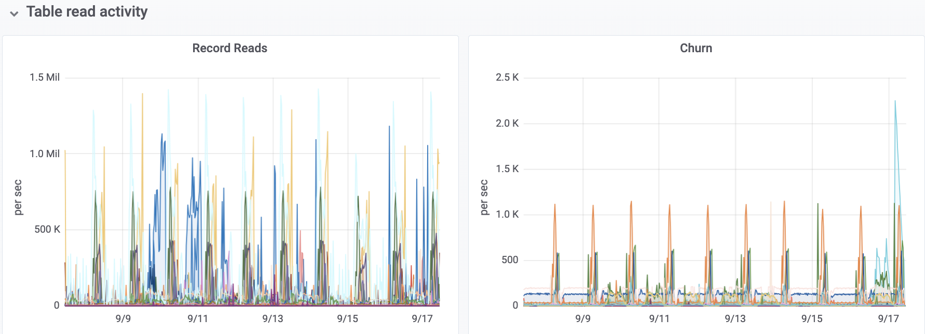
Table Reads and “Churn”
1000 churns/sec = 86M/day, a 1.15 record table = 100M reads
200/sec = 17M/day = 6 records in the table = 100M reads
Notes:
1,000 churns/sec = 86M / day
100M = Churn * Tblsz * 86400

Slide 39

“Lots Of Little Things” Add Up…
Most Applications Have Some Small Read-Only Tables
Many of Those Tables “Churn” Considerably
Eliminating 100M FINDs per day (1157/sec):
 | Seconds Saved | Hours Saved | FTE
local host | 5,301 | 1 | 0.18
virtual | 38,462 | 11 | 1.34
wired | 100,000 | 28 | 3.47
wifi | 454,545 | 126 | 15.78
cloud | 2,000,000 | 556 | 69.44
Notes:
A table with ~1,000 records and churn around one…

Slide 40

The Global Shared TT “Trick”
/* {common.i} */
define new global shared temp-table location no-undo
index locationId-idx is primary unique locationId
.
find first location no-error.
if not available location then
do:
for each dbName.location no-lock:
create location.
buffer-copy dbName.location to location.
end.
end.
Notes:
Remember – the FOR EACH building the TT is just a few messages (maybe even only one). The break-even for using the TT is thus quite low. So even if the TT doesn't last long (app server or PAS connections) it is still worthwhile.

Slide 41
Read-”Mostly”
There are only two hard things in Computer Science: cache invalidation and naming things.
-- Phil Karlton
(https://martinfowler.com/bliki/TwoHardThings.html)
If the churned data is “read mostly” you need a method to know when to refresh that data
More sophisticated caching mechanisms might involve using an OO4GL class rather than that ugly GLOBAL SHARED temp-table
Notes:
In many cases “nightly restart” is good enough…

Slide 42
https://openedge.ideas.aha.io/ideas/OPENEDGE-I-1576
Improve the performance of code using FIND statements
Consider code such as:
find job-act where job-act.job-Id = jobIdNum no-lock no-error.
find job where job.job-id = job-act.job-id no-lock no-error.
The idea: create something along the lines of a "type 2" network message protocol that allows multiple records from mixed tables to be requested and returned together. The compiler would see that the statements above are an opportunity to make one request and receive one response resulting in half the network traffic in this simple example. Far greater reductions would occur in longer examples.

Slide 43

How to Analyze
OpenEdge
Client Server Performance

Slide 44
OpenEdge Network Message Metrics
define variable msgRecv as int64 no-undo.
define variable msgSent as int64 no-undo.
define variable recSent as int64 no-undo.
define variable qryRecv as int64 no-undo.
find _actServer no-lock where _Server-id = 2. /* THIS ONLY WORKS IF YOU ARE THE SOLE CONNECTION */
assign
msgRecv = _Server-msgRec /* “Received” and “Sent” are from the Server POV */
msgSent = _Server-msgSent
recSent = _Server-recSent
qryRecv = _Server-QryRec
.

Slide 45
ProTop Real Time
2024/09/17 ProTop RT 326 04:32:43
xyzzy **PRODUCTION** /db/xyzzy **PRODUCTION** xyzzy.plugh.com
Hit% 99.10 Commits: 10604 Examined: 101 APW Writes: 10 DB UpTime: 29d 22:33 Connections: 171
Log Reads: 4496906 Undos: 0 New RM: 99 APW Write% 103 Backup Age: 03:17 -n % 6
Log Writes: 1404 From RM: 99 Bufs Scanned: 18054 Brokers: 7
OS Reads: 40522 Lock Tbl HWM: 365074 RM Locked: 154 APW Scan Wrs: 5 Oldest TRX: 00:00:00 SQL Servers: 1
OS Writes: 9 Curr # Locks: 25 From Free: 0 APW Q Wrts: 1 Curr BIClstr: 0 SQL Clients: 0
LogRd/LogWr: 3203.72 Lock Tbl% 0.00% Front2Bk: 1 Chkpt Q Wrts: 4 Old BIClstr: 0 4gl Servers: 10
LogRd/RecRd: 2.32 Rec Lk/s: 23042 Flushed Bufs: 0 Num BIClstrs: 0 4gl RemCnx: 0
Rec Reads: 1937263 Lk Dura (ms): 0.11 Mod Bufs: 577 Chkpt Len: 00:01:54 BI MB Used: 0 App Server: 27
Idx Reads: 1971507 Evicted: 0 Web Speed: 0
Rec Creates: 99 BI AI Curr AI Ext: 2 of 12 Local: 62
Idx Creates: 185 BogoMIPS: 8.93 Orders: Notes: 2600 2600 Curr Seq#: 28070 Batch: 56
Rec Updates: 92 Random IO (ms): 0.07 Order Lines: Wrts to Log: 15 15 Empty AI: 11 BIW/AIW/WDOG: 1 1 1
Rec Deletes: 155 Sync IO (MB/s): 121.44 BIW/AIW Wrts: 13 14 Full AI: 0 AI Mgmt: 1
Idx Deletes: 475 BIW/AIW Wrt% 90 96 APWs: 2
Idx Blk Spl: 0 User Exp SHM: 172118 Partial Wr: 0 0 Locked AI: 0 RPLA/RPLS: 0 1
Rec Waits: 0 localhost: 73604 Busy Waits: 7 0 pica Used: 0 Utilities: 1
Resrc Waits: 14 Empty Wts: 0 0 pica Used% 0.00
Latch Waits: 281 TRX: 20
Latch Reqs: 16854776 Blocked Rec: 0
Latch/logRd: 3.75 Other Blkd: 0
<s> Server Activity
Srv Type -S Port Cnx Max QryRcvd recSndQry bytSndQry MsgRcvd RecRcvd rr/msg MsgSent RecSent rs/msg MB Sent MB Rcvd RcvdSz SendSz
9999 Total 0 0 25 185 97 27 7074 3383 0 0.00 3112 2655 0.85 0.65 0.52 162 220
7 ABL 9990 20004 5 10 40 44 9220 1596 0 0.00 1479 1778 1.20 0.35 0.25 162 251
8 ABL 9990 20006 4 10 33 20 7531 1572 0 0.00 1458 656 0.45 0.24 0.24 163 171
11 ABL 9990 20009 2 10 11 8 2609 97 0 0.00 80 91 1.15 0.03 0.01 155 369
12 ABL 9990 20010 1 10 11 8 2608 97 0 0.00 80 91 1.15 0.03 0.01 156 370
14 ABL 9990 20016 1 10 0 53 6131 9 0 0.00 6 16 2.61 0.00 0.00 145 302
15 ABL 9990 20017 1 10 0 53 6314 6 0 0.00 4 11 2.47 0.00 0.00 142 294
13 ABL 9990 20015 1 10 0 53 6126 6 0 0.00 4 11 2.59 0.00 0.00 144 299

Slide 46
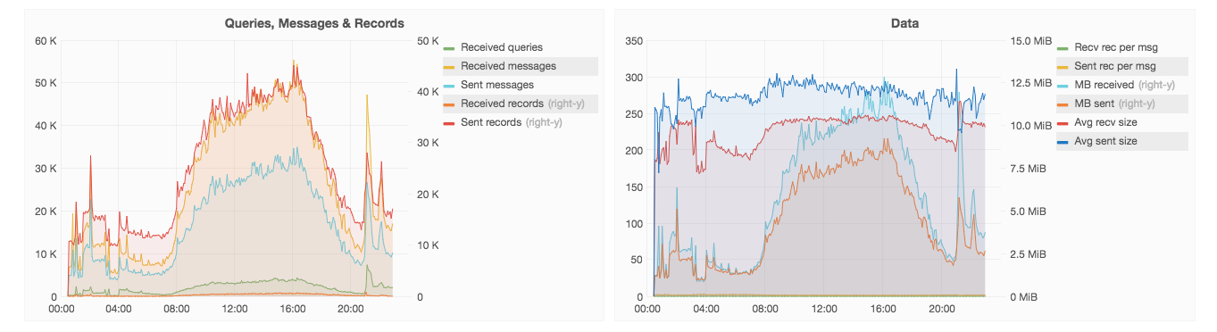
ProTop Portal

Slide 47
OE Network Message Test Harness
File | Description...
csperf.p | Control program that launches test cases and records results
x010.p | a program to be tested (by adding it to csperf.cfg)
csperf.cfg | Configuration file
csperf.rpt | Log of test results
csperf.flg | "Flag" file, if present the benchmark is running or has crashed
lh*.pf | localhost configurations (* = oe version)
aws*.pf | remote servers hosted on AWS (* = oe version)
s2k*.pf | db startup parameters for various sports2000 databases (* = oe version)
start*.sh | script to start a local database (* = oe version)

Slide 48
Example Test Program
/* x010.p
*
* nested FOR EACH query to find orders where order.salesrep <> customer.salesrep for certain salesreps (hxm & jal)
*
* in the sports2000 database:
* - there are 277 customers whose salesRep is either "hxm" or "jal"
* - those customers have 1001 orders
* - 975 of those orders are credited to the salesRep of record
* - 26 orders are credited to a different salesRep
* - 2 customers have such "rogue" orders
*/
define output parameter ii as integer no-undo. /* number of customer records seen */
define output parameter jj as integer no-undo. /* number of order records seen */
define output parameter kk as integer no-undo. /* number of "rogue" records found */
for each customer no-lock where customer.salesRep = "hxm" or customer.salesRep = "jal":
ii = ii + 1.
for each order no-lock where order.custNum = customer.custNum:
jj = jj + 1.
if order.salesRep <> customer.salesRep then
kk = kk + 1.
end.
end.
Notes:
All tests were run using the final settings from the Message Size & Prefetch slide:
-Mm 32600
-prefetchDelay
-prefetchFactor 100
-prefetchNumRecs 10000

Slide 49
Time For A Demo?
Notes:
pugdemo.sh runs for about 5 minutes…

Slide 50
Summary

Slide 51
Summary
Large –prefetchNumRecs is critical with FOR EACH NO-LOCK
Large –Mm message sizes are helpful
Where feasible the FIELDS phrase is very helpful
Use temp tables to cache data locally!
OE12 Server Side Joins can be very effective for complex queries
Small differences in coding approaches can make a big difference
PING time matters
Simple mistakes can be catastrophic!

Slide 52
Questions?
Notes:
And now we have some time for questions…

Slide 53
Thank You!

Slide 55
Kbase 18342
Every FIND, FOR EACH, OPEN QUERY, GET, PRESELECT, ASSIGN, CREATE, DELETE (all data manipulation statements) generates client/server traffic when the database is connected with the -H -S client connection parameters. Being aware of the above and knowing how much traffic each 4GL/ABL statement generates can make the difference in a fast versus a very slow networked application.
SIMPLE FIND
FIND customer WHERE cust-num = 10 NO-LOCK.
No locking is involved.
One round trip to retrieve the record.
One more one way message to release the cursor.
Client ---> Server Requests record
Server ---> Client Sends record back
Client ---> Server Releases the cursor
GENERIC FIND
One round-trip to request record/get the record
No extra message to request a lock (RECID finds don't allocate a cursor).
If the cursor will not be used again it is released immediately, if it might be used later it will only be released when the record goes out of scope which is done with a one way message.
SHARE-LOCKs are released with a one way message.
In a transaction no locks are released until the end of the transaction.
FOR EACH - NO JOIN & NO SORT NO-LOCK
Fetch the first record with one round-trip then as many records as it fits on a message per round-trip.
Can be hundreds of trips for small records and big Message Buffer Size (-Mm) for example. See Article P176713, Is the number of records packed into a network message affected by the use of the NO-LOCK qualifier in a query
NO-LOCK NO-PREFETCH
One roundtrip per record (not a very wise choice due to inefficiency).
SHARE-LOCK outside of a transaction
One roundtrip per record plus a one way message to release lock.
Any lock inside of a transaction
One roundtrip per record, as locks will be held until end of the transaction.
FOR EACH WITH SORT & NO JOIN
Will retrieve a list of RECIDs and sort keys as a prefetch FOR EACH regardless of sort type.
For example: Small sort keys and a large Message Buffer Size (-Mm) parameter may pack hundreds (or thousands) of records on a single network message.
Locks are acquired and released automatically by the server.
Progress then sorts on the client side and behaves like a regular sort but can't do prefetch.
Client sends RECID by RECID as the server returns each record.
If SHARE-LOCK outside of a transaction a one way lock release message is needed for each record.
FOR EACH WITH JOIN & NO SORT
This behaves like nested FOR EACH statements and will generate the same traffic as:
FOR EACH customer SHARE-LOCK:
FOR EACH order OF customer NO-LOCK:
...
END.
END.
FOR EACH WITH JOIN & SORT
Depends if the sort is only on the main table or not.
Can use a lot of round trips.
Not recommended, use nested FOR EACH statements preferably.
OPEN QUERY
Will generate no traffic if SORT or PRESELECT isn't needed.
Will behave like the SORT phase of a FOR EACH if SORT or PRESELECT is required.
Then one round trip per GET (if the requested record is already on the queries cache, then no traffic will be generated).
A REPOSITION statement can behave like multiple GET statements or like a single one depending on whether the query is using INDEXED-REPOSITION.
CREATE
No traffic right away.
When the first key is filled will:
Physically create the record with one round-trip.
Another round-trip to create the key.
Each extra key will use another round trip even if the whole record is created within a single ASSIGN statement.
Then will use another round trip to write the record when it is released.
UPDATE
Records are retrieved according to the rules presented before.
One round trip to update each key as needed even if all key changes are done within the same ASSIGN statement.
One round trip to write the new record.
DELETE
One round trip to delete the record.
One round trip to delete each key.
UPGRADE FROM SHARE-LOCK TO EXCLUSIVE-LOCK
Requires one round trip.
WHEN THE RECORD IS BIGGER THAN THE Message Buffer Size (-Mm) PARAMETER
Progress will send one way messages until the end of the record is finished so the record is efficiently streamed through the network.
Apart from -Mm, further database startup parameters were added in OpenEdge 10.2B06 and 11.1 to tune Network Communication performance. See Article 000031154, Parameters to tune Networked Communication.
TRANSACTIONS AND TRAFFIC
No traffic to open a transaction.
One round trip to commit a transaction.
Subtransaction UNDO will do the inverse operations so it can generate a lot of traffic.
A transaction UNDO is one round trip plus one extra one way message.
CONNECTION AND TRAFFIC
Client/Server connections can generate a lot of traffic.
How much traffic that gets generated on connection depends on how many database objects are in the Database.
Using a local schema cache (SAVE CACHE and the -cache startup parameter), reduces the connection traffic to a couple of round trips and less data.
EXECUTION IN CLIENT/SERVER
At each initial reference to each database table (without using schema cache):
One round trip to retrieve mandatory array, template record and ALL index information.
There is a schema lock that needs to be acquired in shared mode to be able to run any procedure that uses the database.
Any time a program that references a database runs, it will attempt to acquire a shared schema lock with one round trip plus one one way message to release it in the end of the program.
CHECKING TRAFFIC WITH PROMON
Start a database in client/server mode having only one remote user connected to it.
Use the PROMON > R&D > Activity: Servers screen
View how many messages were received from the client and sent back to the server.
Run this with a controlled typical application test and record direct traffic metrics for the application.
Customers worried about client/server performance should use this screen to take measures especially if they are going to deploy on a WAN.
THE APPSERVER ADVANTAGE
It takes just a couple of round trips to establish an AppServer connection and once this is established it is only one network round trip to execute each procedure that is RUN ... ON SERVER.
For every RUN ...ON SERVER:
The client sends a stream of messages (usually only one) with the input parameters.
The server executes the procedure and sends back a stream of messages with the output parameters.
While there are no parameters for regulating packet size for the client to the Appserver, Progress 9.1D08 introduced a new client switch "-mc" that allows the message between the client and the AppServer to be compressed..

