Slide 1


Tales of the Secret Bunker 2024
Version 15, 02 oct 2024 07:41
research from the parmington foundation
Gus Bjorklund,
head groundskeeper
the parmington foundation
Mike Furgal,
assistant to the head groundskeeper
the parmington foundation
Boston, USA
29 sep 2024
02 oct 2024

Slide 2
Abstract
The “Secret Bunker” has been used for many interesting OpenEdge RDBMS investigations in past years. Please join your intrepid explorers for another trip into the bowels of the (recently relocated) bunker.
As databases are used and modified over an extended period, database administrators will gain experience and knowledge of what they should have done. They will discover that various improvements in database organization could be made to improve day-to-day performance and maintenance operations. In this talk we will examine some techniques you might use for “online table dump and load” operations with the database.
OpenEdge Release 12 has a variety of new features and capabilities that can make such maintenance tasks more efficient and less disruptive to normal production operations. In the bunker we test some of these capabilities and now we report the results.

Slide 3
Part 0 of 3
About the Secret Bunker

Slide 4
Established in 2002 to investigate
Progress RDBMS on Linux

Slide 5
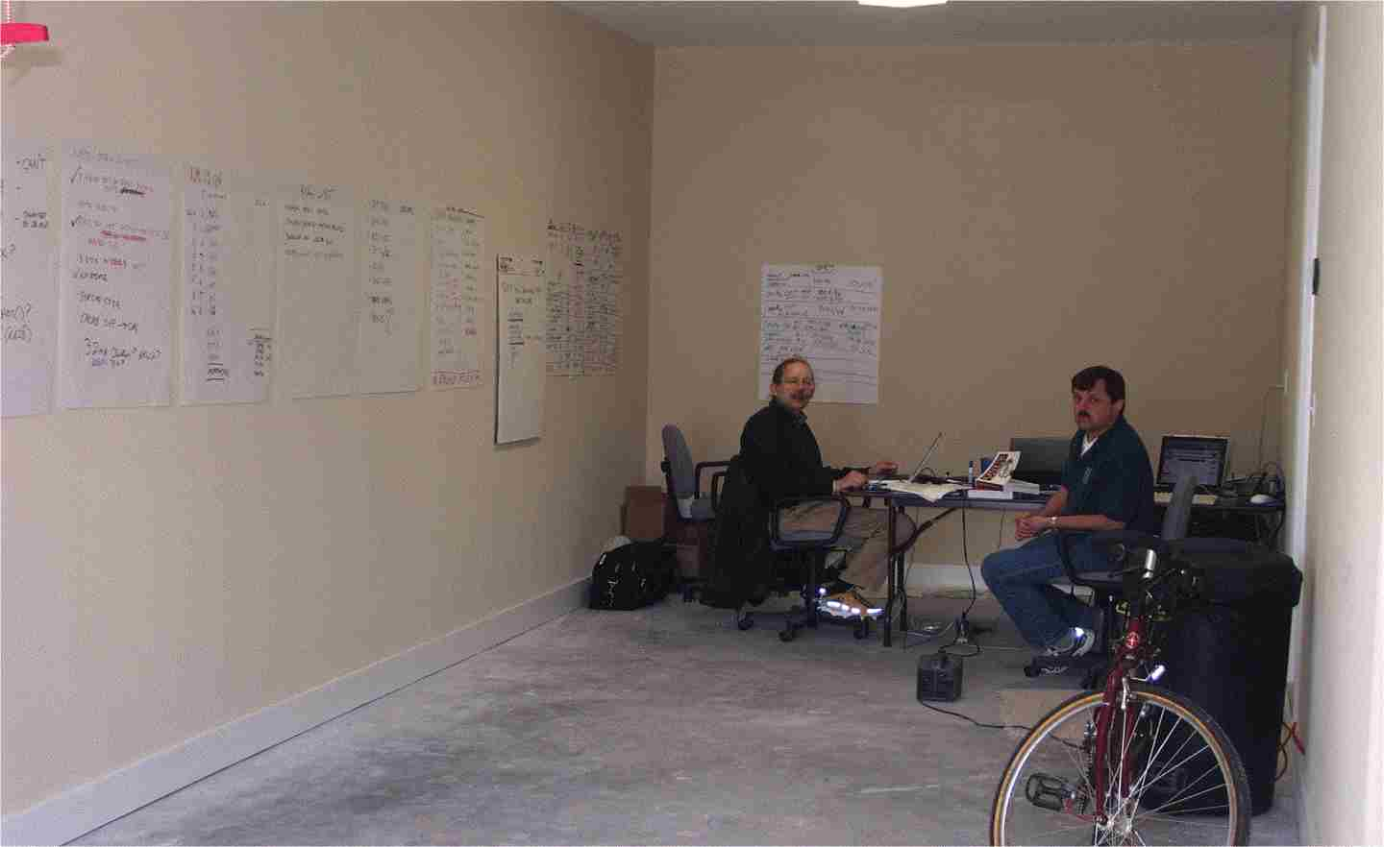
The Original Benchmark Laboratory

Slide 6
Secret Bunker 2023 and 2024

Slide 7
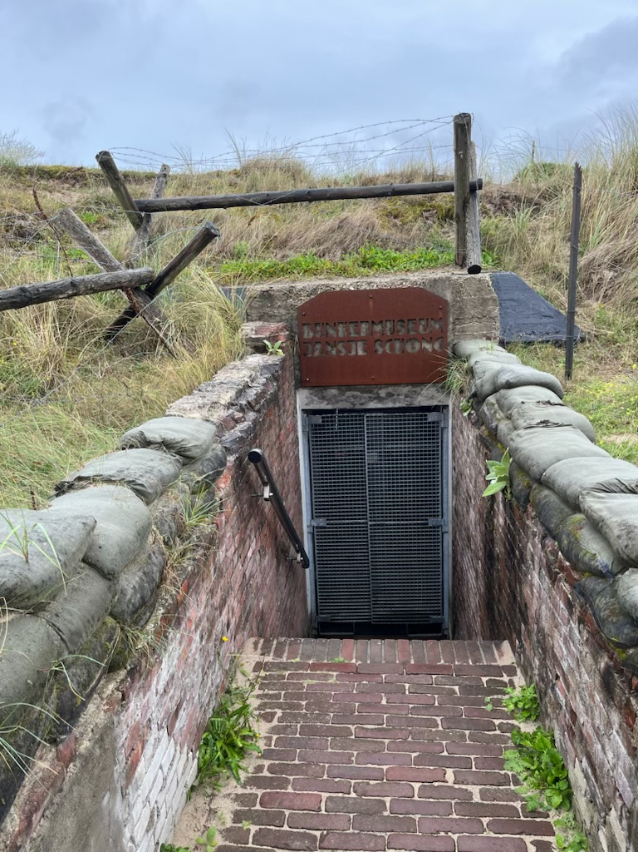

Slide 8
Why are we here today ?

Slide 9
LAST Year’s Topic: Dump and Load Optimization
Test out the new “proutil <dbname> -C tablereorg”
How does it work ?
Can it be run online effectively ?
What can it do for you ?
Benchmarks and results

Slide 10
This Year’s Topic:
Revisit Last Year’s Topic
+
Advanced Tablereorg

Slide 11
Part 1 of 3
Table Reorg Basics

Slide 12
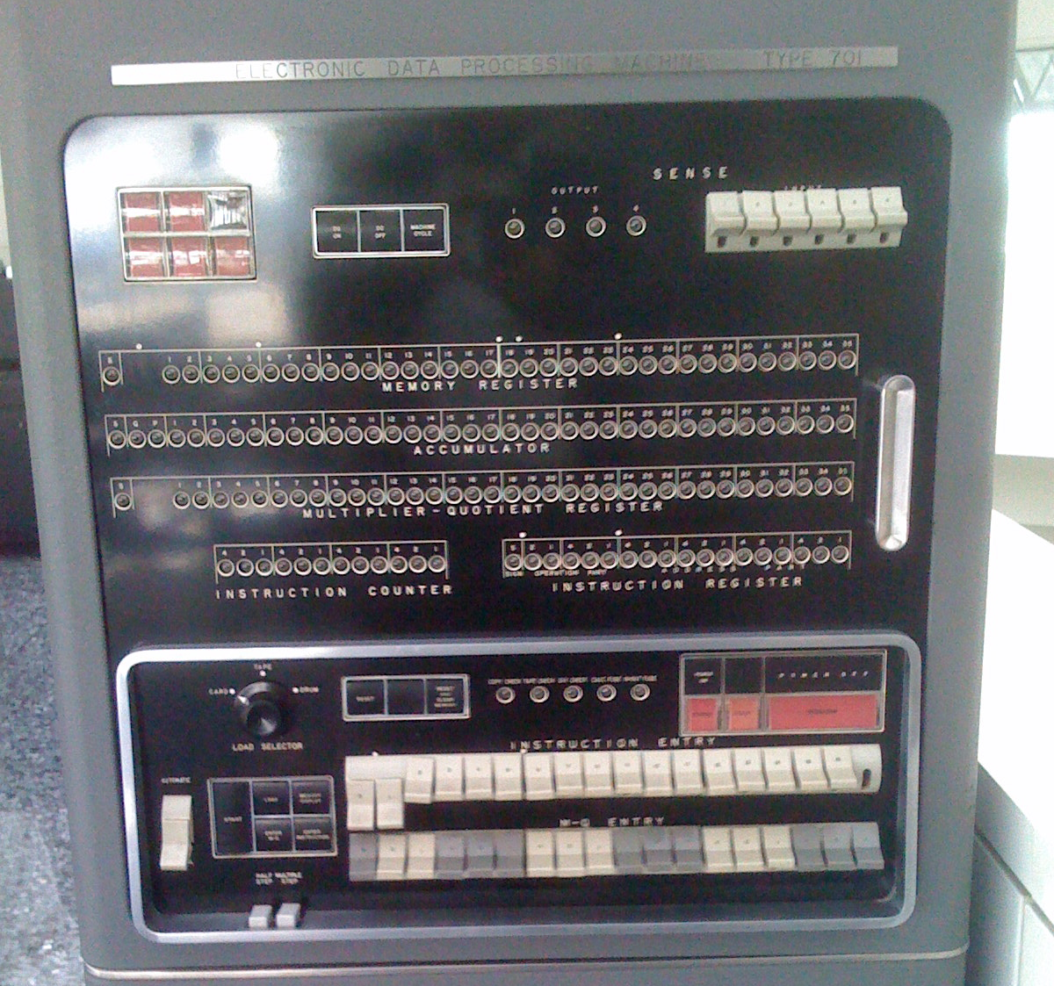
Test Machine
https://en.wikipedia.org/wiki/Mainframe_computer#/media/File:IBM_701console.jpg

Slide 13
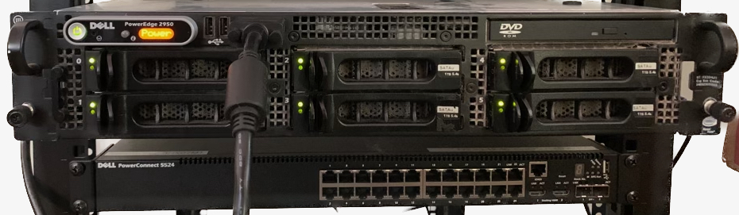
2023 and 2024 Test Machine
Dell PowerEdge 2050 iii (circa 2009)
2 XEON E5450 3 GHz 4-core processors
64 GB ECC RAM
PERC/6 RAID controller
6 Hitachi 2 TB 7200 rpm SATA disk drives
/boot (xfs), /home (xfs) and swap on 4x2 TB sata drives in RAID 0.
/bi (ext3) on 2 tb drive
/ai (ext3) on 2 tb drive
“furgal test” time: 0.42 seconds. (228 mb/sec)

Slide 14
Why do we need the tablereorg utility?

Slide 15
0. make physical storage order match index order
1. reduce or eliminate record fragmentation
(dumping and loading could do both, but with downtime. Maybe a lot of downtime.)

Slide 16
What Is A Rowid ?
0 0 0 0 0 0 0 0 0 0 … 0 0 0 0 0 0 0 0 0 0 0 1
0 0 0 0 0 0 0 0
Unique 64-bit identifier for a record in a table
  Unique within an partition or area
Encodes the “physiological” storage address
  Used to locate record fast
“Constant” for life of record
  Until you delete it or
  Change partition key value

Slide 17
Index Order Vs Storage Order -- NOT Optimal
Index Rowid
BOLONIA 3331
BOLTON 5554
BOLTON 9001
BOLTON 9022
BONN 8001
BOSTON 1111
BOSTON 1118
BOSTON 7001
BOSTON 9002
BOSTON 8124
BOSTON 1003
BOSTON 2005
BOSTON 3332
BOSTON 9999
CARDIFF 1112

Slide 18
Index Order Vs Storage Order -- Optimal
Index Rowid
BOLONIA 3331
BOLTON 3332
BOLTON 3333
BOLTON 3334
BONN 3335
BOSTON 3336
BOSTON 3337
BOSTON 3338
BOSTON 3339
BOSTON 3340
BOSTON 3341
BOSTON 3342
BOSTON 3343
BOSTON 3344
CARDIFF 3345

Slide 19
Index Order Vs Storage Order -- Optimal
Index Rowid
BOLONIA 3331
BOLTON 3332
BOLTON 3333
BOLTON 3334
BONN 3335
BOSTON 3336
BOSTON 3337
BOSTON 3338
BOSTON 3339
BOSTON 3340
BOSTON 3341
BOSTON 3342
BOSTON 3343
BOSTON 3344
CARDIFF 3345
These 15 records can all fit into the same block.
15 * 132 = 1980 bytes
Room for many more in a 4 KB block.

Slide 20
Proutil db –C tablereorg arguments
proutil db-name -C tablereorg [owner-name.] table-name
[ info ] |
[ [ resume | resume-numrecs n | resume rowid n]
[ nosmartscan ]
[ restrict [ EQ value ] |
[ LT | LE high-value ] |
[ GT | GE low-value [ AND LT | LE high-value ] ] ]
[ useindex index-name ] [ recs n ]
[ searchdepth n ]
[ reusepercent n ] ]
[ tenant tenant-name | group group-name |
partition partition-name | composite initial ]

Slide 21
Why Am I Embarrased ?

Slide 22
Scenario 0: starting conditions -- last year
Regular ATM database but small
(only 10,000,000 account records)
Unused after building so account numbers and rowids in same order
All records a little over 100 bytes long
Database is about 1.5 GB
  351,308 blocks (4k)
No fragmented records
98% RM space utilization
No free clusters
3 blocks on account RM chain

Slide 23
Scenario 0: starting conditions -- last year
Regular ATM database but small
(only 10,000,000 account records)
Unused after building
All records a little over 100 bytes long
Database is about 1.5 GB
  371,020 blocks (4k)
No fragmented records
94% RM space utilization
No free clusters
3 blocks on account RM chain
Record ordering was NOT
optimal as I claimed.

Slide 24
Scenario 0: table reorg 1 -- last year
proutil atm -C tablereorg account recs 1000
Took 6 min 57 sec.
Database grew from 1.5 GB to 3.1 GB
  From 371,020 to 574,668 blocks (4k)
No fragmented records
60% RM space utilization
No free clusters
328,100 blocks on the RM chain

Slide 25
Scenario 0: table reorg 1 – last year
proutil atm -C tablereorg account recs 1000
Took 6 min 57 sec.
Database grew from 1.5 GB to 3.1 GB
  From 371,020 to 574,668 blocks (4k)
No fragmented records
60% RM space utilization
No free clusters
328,100 blocks on the RM chain
Record ordering was NOT
optimal as I claimed.
Test result is invalid.

Slide 26
Scenario 0: table reorg 1 – last year
proutil atm -C tablereorg account recs 1000
Took 6 min 57 sec.
Database grew from 1.5 GB to 3.1 GB
  From 371,020 to 574,668 blocks (4k)
No fragmented records
60% RM space utilization
No free clusters
328,100 blocks on the RM chain

Slide 27
Scenario 0: table reorg 1 – this year
proutil atm -C tablereorg account recs 1000
Took 6 min 57 sec.
0 records were processed
  No changes were made

Slide 28
Scenario 0: table reorg 2 – last year
reorg of just reorg’ed database
proutil atm -C tablereorg account recs 1000
Took a few seconds longer than first time (7 min +)
Database grew slightly from 3.1 GB to 4.2 GB
  From 574,668 to 593,676 blocks (4k)
No fragmented records
62% RM space utilization !!!!
No free clusters
531,596 blocks on the RM chain
Records were moved but nothing much was accomplished

Slide 29
Scenario 0: table reorg 2 – this year
reorg of just reorg’ed database
proutil atm -C tablereorg account recs 1000
Took a few seconds longer than first time (7 min +)
0 records were processed
No changes were made

Slide 30
Scenario 1: Same as previous but bigger (100,000,000 accounts) – this year
Database size is now 14 GB
Again unused after building, but rows only partially ordered
(same as last year)
Account area is 3,332,495 blocks
92 % space utilization
Zero fragmentation

Slide 31
Scenario 1: table reorg 1 – this year’s result
proutil atm -C tablereorg account recs 1000
Took 65 min 37 sec.
Database grew from 14 GB to 22.2 GB
Account area grew by 2,049,856 blocks
went from 3,332,495 to 5,382,351 blocks (4k)
No fragmented records
60% RM space utilization
No free clusters

Slide 32
Scenario 1: table reorg 2 – this year’s result
reorg of just reorg’ed database
proutil atm -C tablereorg account recs 1000
Took 66 min 37 sec.
0 records processed

Slide 33
Scenario 2: Make account records vary in size -- this year
100,000,000 accounts
Record size varies from ~100 to ~1500 bytes
1 in 20 records is ~100 to ~1500 bytes
Database size is 9,900,428 blocks – 40 GB
RM chain has 2,021,146 blocks
There are 192.870,695 fragments
95 % RM space utilization

Slide 34
Scenario 2: table reorg 1 – this year
proutil atm -C tablereorg account recs 10000
Took 86 min 35 sec
Database grew from 40 GB to 46 GB
Account area grew by 2,122,944 blocks
From 9,479,887 to 11,602,831 blocks
Zero fragmentation
71.84% RM space utilization
RM chain has gone from 1,760,347 to 10,699,287 blocks

Slide 35
Scenario 2: table reorg 2 – this year
reorg of just reorg’ed database
proutil atm -C tablereorg account recs 100000
Took 1 min 52 sec
0 records processed

Slide 36
Part 2 of 3
Advanced Table Reorg

Slide 37
The Setup
Source Machine as described previously
Introduce a smaller Linux machine as Target
Source ⬄ Target network speed is gigabit ethernet
1 switch between nodes
Enable AI
Enable OE Replication

Slide 38

Target Test Machine
Lenovo ThinkCentre M82
Intel Core i5-3470 Quad-Core CPU
32 GB RAM
1 TB PCIe M.2 SSD
“furgal test” time: 2.0 seconds. (48 MB/sec)

Slide 39
The Scenarios
ATM Standalone (modified to add readers)
Table Reorg Standalone
Table Reorg with modified ATM
Table Partitioning Move Standalone
Table Partitioning Move with modified ATM
Tinkered with Table Partition Move with modified ATM
Dump/Load/Idxbuild/Rebaseline

Slide 40
Database Setup
ATM database with 500,000,000 account records.
Originally had 1,000,000,000 account records.
  Original 500,000,000 removed
  Index Rebuild to remove index place holders
120 GB Accounts Area
Free Space
500,000,000 Account Rows

Slide 41
Modified ATM benchmark
15 Users
12 Users doing updates as normal ATM activity
  Update Account, Teller, and Branch Balance
  Create History Record
3 Users doing reading
  Randomly Read 101 Account Record
  Read a Teller and Branch Record

Slide 42
Modified ATM benchmark - RESULTS
420 Transactions Per Second
Longest Response Time 0.5 seconds
This is our baseline

Slide 43
proutil atm -C tablereorg account recs 1000 searchdepth 5
Tablereorg is the only activity on the database and machine
  Server is up
  OE replication running
10 Hours 11 Minutes
Last Bunker this took 8 Hours and 40 Minutes
  No After Imaging
  No OE Replication

Slide 44
Can you reset the test without rebaselining OE Replication?

Slide 45
Can you reset the test without rebaselining OE Replication?
Have a backup on the source machine with –REPLTargetCreate
Have that same backup on the target machine
Restore them both
Reenable replication
Startup Target, Startup Source
  dsrutil –C status on target 3105 - transition status
  dsrutil –C status on source 1199 - inactive

Slide 46
Can you reset the test without rebaselining OE Replication?
Shutdown both and remove the atm.repl.recovery
file on both target and source, startup and
all is replicating as normal

Slide 47
Tablereorg and Modified ATM - RESULTS
Tablereorg now took 24 Hours and 19 Minutes
  Compared to 10 Hours 11 Minutes
ATM Results
240 Transactions Per Second
Longest Response Time 51.6 seconds
Compared to Baseline ATM
420 Transactions Per Second
Longest Response Time 0.5 seconds

Slide 48
Table Partitioning Move
Enable Table Partitioning
Add a field (myarea) to account with a non-unique index (iarea)
  Partition setup when the value is 0 account resides in Account Area
  Partition setup when the value is 1 account resides in Account1 Area

Slide 49
Table Partitioning Move
set schema 'pub';
alter table pub.accounts <<--- table
partition by list myarea <<--- field
using table area ”Accounts Area"
(
partition "Initial" values in (0) using table area ”Account Area"
)
using index ”iarea";
commit;
alter table pub.accounts
add partition ”Account1" values in (1) using table area ”Account1 Area";
commit;
quit;

Slide 50
Table Partitioning Move
def var i as int no-undo.
etime(yes).
pause 0 before-hide.
for each accounts exclusive-lock by cust-num.
if myarea = 1 then next.
myarea = 1.
i = i + 1.
if i mod 50000 = 0 then display string(time, "HH:MM:SS") " " i.
end.
display etime format ">>>,>>9".

Slide 51
Table Partitioning Move Standalone - RESULT
Time to move all records to Account1 Area
17 Hours, 23 Minutes, 20 Seconds

Slide 52
Table Partitioning Move with ATM - RESULT
Time to move all records to Account1 Area
40 Hours, 45 Minutes
ATM Results
193 Transactions Per Second
Longest Response Time 9.4 seconds
  A small percentage of transactions had this wait time. But if I was the one waiting…
Compared to Baseline ATM
420 Transactions Per Second
Longest Response Time 0.5 seconds

Slide 53
Table Partitioning Move alternative one
Lets add some sleep time
Every 200 records moved, sleep ½ second.
Time to move all records to Account1 Area
432 hours, or 18 days!!!!
ATM Results
339 Transactions Per Second
Longest Response Time 4.2 seconds

Slide 54
Table Partitioning Move Rate
With no sleep time, reassigning to new area has a rate of about 8,000 records per second.
Adding in a ½ second pause every 200 records, reduced the rate to 240 records per second.
What about every 8,000 records, sleep ¼ second?

Slide 55
Table Partitioning Move alternative two
Every 8,000 records moved, sleep ¼ second.
Time to move all records to Account1 Area
51 hours
ATM Results
340 Transactions Per Second
Longest Response Time 0.6 seconds
Time to move decreased dramatically, ATM results stayed the same

Slide 56
Results Summary
ATM Alone
  420 Transactions Per Second (TPS)
  Longest Response Time 0.5 seconds
Tablereorg Alone
  10 hours 11 minutes
ATM and Tablereorg together
  Tablereorg – 24 hours and 19 minutes
  ATM – 240 TPS
Table Partition Move (TPM) Alone
  17 hours 23 minutes
ATM and TPM
  TPM– 40 hours 45 minutes
  ATM 193 TPS
ATM + TPM + 200 rows sleep ½ sec
  TPM – 18 days!!
  ATM - 339 TPS
ATM + TPM + 8000 rows sleep ¼ sec
  TPM – 51 hours
  ATM - 340 TPS

Slide 57
Dump/Load/Idxbuild/Rebaseline
Dump – 27 Minutes
Load – 95 Minutes
Index Rebuild – 19 Minutes
Total 2 Hours, 22 Minutes

Slide 58
Dump/Load/Idxbuild/Rebaseline
Rebaseline LAN
Backup - 20 Minutes
Copy to Target - 30 Minutes
Restore – 40 Minutes
Total LAN – 90 Minutes
Grand Total LAN – 3 Hours 52 Minutes
During this time ATM TPS = 0
Rebaseline WAN
Backup - 20 Minutes
Copy to Target – 2 Hours 21 Minutes
Restore – 40 Minutes
Total WAN – 3 Hours 21 Minutes
Grand Total WAN – 5 Hours, 43 Minutes
During this time ATM TPS = 0

Slide 59
Now What ?
Don’t believe Gus!!!!
Tablereog is a fast and useful tool to remove fragmentation and scatter
  The database may increase in size depending on how contiguous free space is organized
  Can have significant effect on performance
  Should be run at off hours when the user load is not high
Table Partitioning Move is useful
  Takes longer
  You have control over the speed
  Area size doubles
If you can tolerate downtime, traditional D/L still wins
TEST before using in production !!!

Slide 60
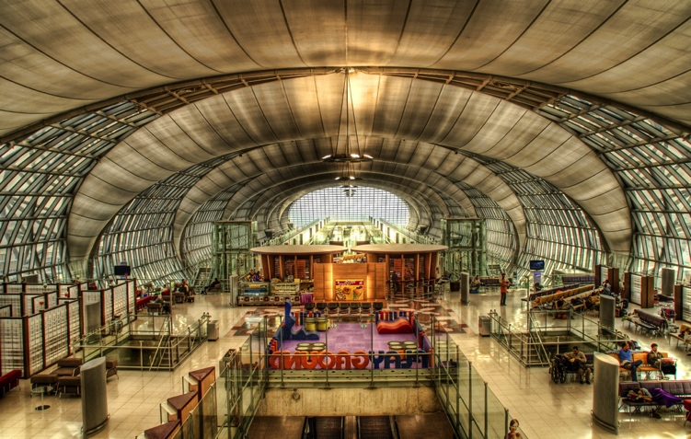
The Next Secret Bunker Location ?

Slide 61
What should we do for the next Secret Bunker talk?
Any ideas?

Slide 62
Questions
?
research from the parmington foundation

