Slide 1
Building systems for reliability and performance
PROTOP.COM
Adam Backman, White Star Software
adam@wss.com

Slide 2
About White Star Software
WSS.COM
For over 30 years, we have been helping companies around the world simplify the job of managing and monitoring the world’s best OpenEdge applications.
Our experts, combined with ProTop, the #1 OpenEdge monitoring and alerting tool, deliver unparalleled peace of mind for your OpenEdge environments.

Slide 3
Agenda
PROTOP.COM
Performance vs. Reliability
  Choose both
  Generally a one time cost and a multi-year benefit
What makes up a system?
  Hardware
  Operating system
  Software
  Data
Do it yourself vs. Outsource some or all

Slide 4
Performance
PROTOP.COM
What factors impact performance
  Application efficiency
  Database design and layout
  Speed and availabilty of hardware resources
  Database startup parameters
  Version of OpenEdge

Slide 5
Application efficiency
PROTOP.COM
The single largest factor in performance is application efficiency
Use indexes – There are many talks on this over the years but choose the most recent one to get the most current rules
Reduction and elimination of data bottlenecks
Move reporting local to the database
Group assigns, use TEMP-TABLES, …

Slide 6
Database design and layout
PROTOP.COM
Layout the database over the available storage optimally (use all storage evenly)
Use a reasonable bi cluster size (64MB+)
Have the right indexes (if you have control)
Always use type II storage areas
Always use 8k block size
  *Please note that you may need to change records/block

Slide 7
Speed and availability of hardware resources (performance & reliability)
PROTOP.COM
Network
Storage
Memory
CPU
Virtualization
Hosted environments

Slide 8
Network
PROTOP.COM
Distance matters – keep runs short
Have multiple connections and use them strategically
Need redundancy at the link and hub/router
Sometimes auto-negotiate does not work so hard setting it to its best speed and duplex is the best policy
No servers with single network drops

Slide 9
Storage – Sources of I/O
PROTOP.COM
Database
Before Image
After Image
Log files
Temporary file access

Slide 10
Storage – General rules
PROTOP.COM
No rotating rust (all SSD/Flash)
  Yes, it is 2024!
Local storage is always better for performance
With SSD Raid 5 is generally OK (RAID 10 is better)
This is where you spend your money

Slide 11
Storage – Network storage
PROTOP.COM
SANs provide better failover options
SAN distance really matters
SAN Fabric matters
Other network storage (generally bad)
  NAS
  iSCSI

Slide 12
Memory
PROTOP.COM
Buy what you need
Use what you have
It is OK to overbuy a little for growth and aggressive setting of the –B and –B2
Do not overbuy buy alot

Slide 13
CPU
PROTOP.COM
Speed first
Quantity next
NUMA… Oh man NUMA

Slide 14
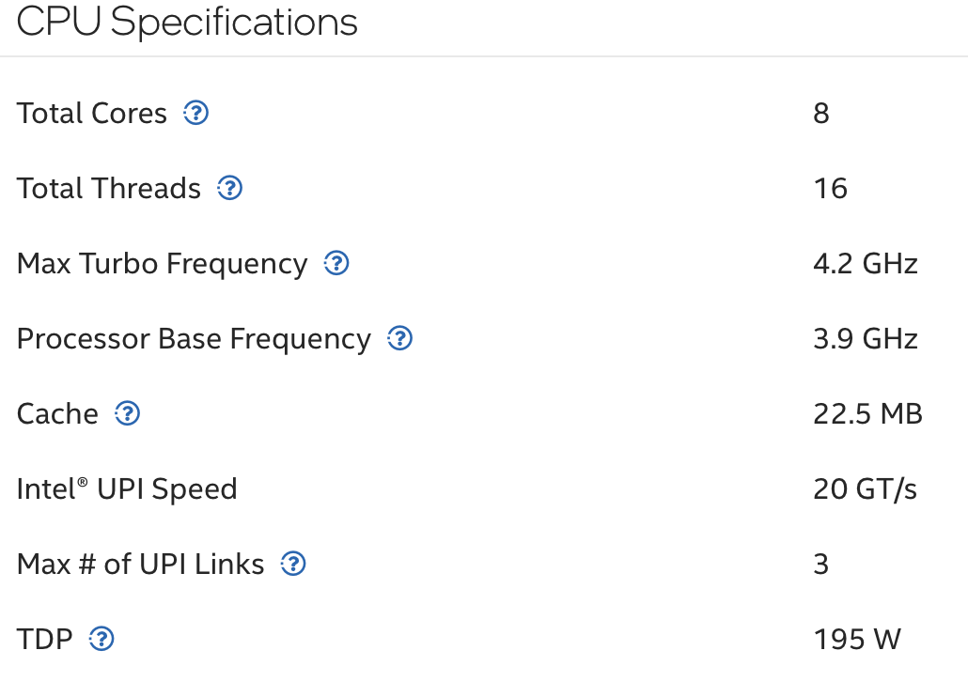
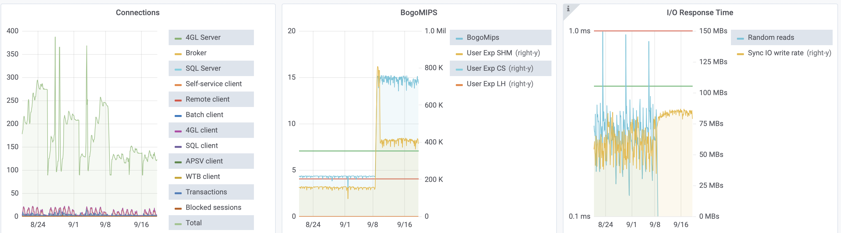
CPU
PROTOP.COM
Xeon Gold 6534

Slide 15
CPU – New stuff Dream big
PROTOP.COM
Example (Available Q3/2024):
Intel w7-2525X 8 cores max turbo 4.5 GHz base 3.5GHz
Intel w7-3575X 44 cores max turbo 4.8 GHz base 2.2GHz
Intel x7-2575X 22 cores max turbo 4.8 GHz base 3.0 GHz

Slide 16
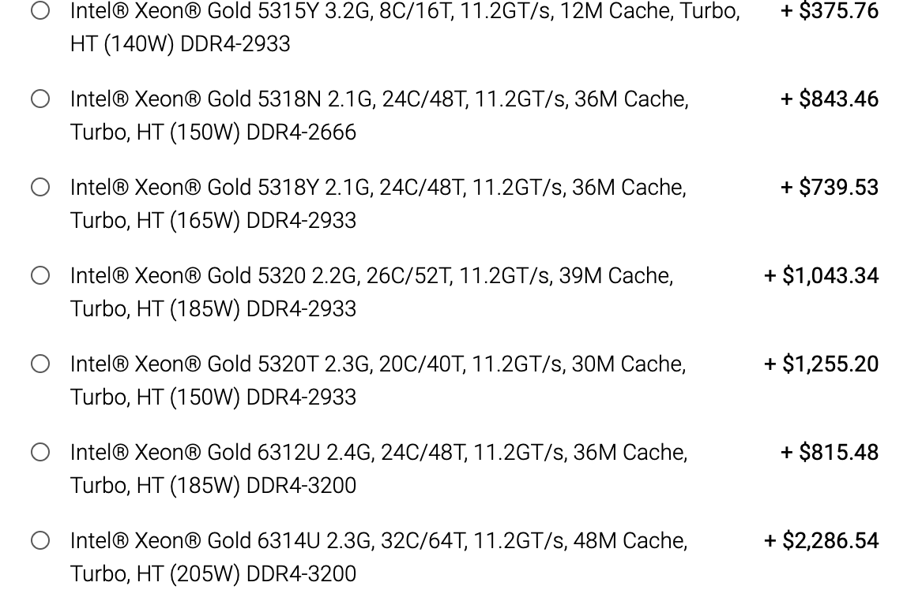
CPU – Let’s go shopping
PROTOP.COM
Example (Dell Server config):

Slide 17
CPU – NUMA (Linux)
PROTOP.COM
This is a potential issue on any multi-socket system
      $ numactl --hardware
      available: 2 nodes (0-1)
      node 0 cpus: 0 1 2 3 4 5 6 7 8 9
      node 0 size: 46963 MB
      node 0 free: 22655 MB
      node 1 cpus: 10 11 12 13 14 15 16 17 18 19
      node 1 size: 48360 MB
      node 1 free: 37787 MB
      node distances:
      node 0 1
      0: 10 21
      1: 21 10

Slide 18
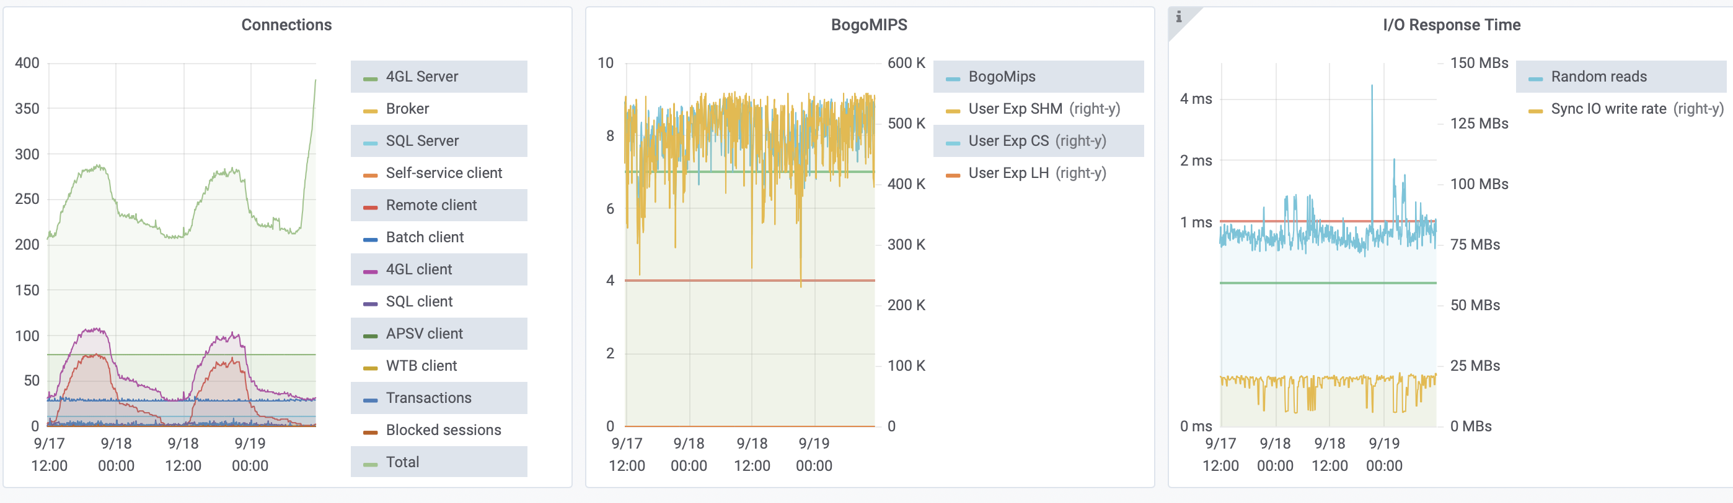
CPU – NUMA Oh my NUMA
PROTOP.COM

Slide 19
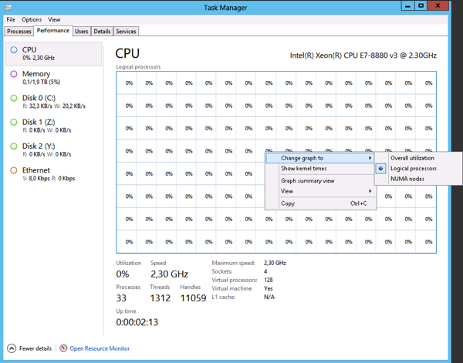
CPU – NUMA (Windows)
PROTOP.COM

Slide 20
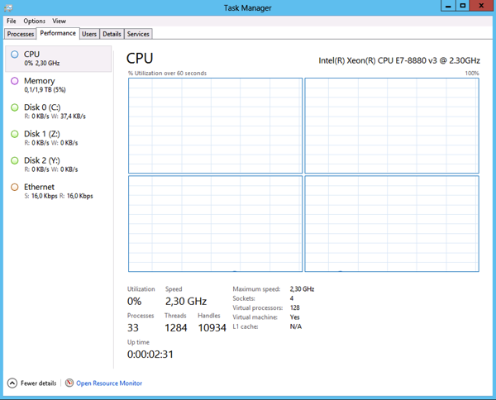
CPU – NUMA (Windows)
PROTOP.COM

Slide 21
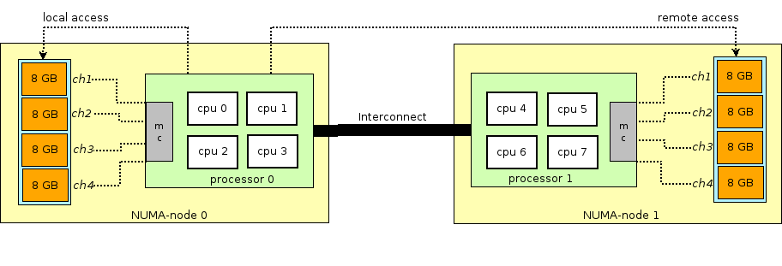
CPU - NUMA
PROTOP.COM

Slide 22
CPU -NUMA
PROTOP.COM
The watchword is affinity
Affinity is keeping the resources pinned to a single node (limited to resources on a single node)
Getting affinity right eliminates far memory calls
Far memory calls are at least 3 times as expensive as near memory calls

Slide 23
Virtualization
PROTOP.COM
Do not over provision CPU or Memory
Virtualization is not magic you cannot use 20 cores when you only have 16
Overprovisioning will affect performance even if the VM clients are allocated but not used (Yes, we tested this)
Use thick (aka not thin) provisioning

Slide 24
Virtualization
PROTOP.COM
Count physical cores not threads (Hardware is not magic either)
Threads provide a benefit of 10-15% not 100%
I generally use the threads for the virtualization overhead and not for more VM clients

Slide 25
Virtualization
PROTOP.COM
Virtualization can help with the NUMA problem by using the affinity features in most (all?) virtualization managers
There are settings for both CPU affinity and memory affinity
You can only use the resources for a single socket (only cores, not threads)
If you have 2 nodes you can only use half of the memory in the system in most cases

Slide 26
Hosted environments – AWS, Azure, …
PROTOP.COM
Basically, the same rules apply for hosted environments as on-prem and virtualized
Be careful (test) that increasing the number of vcores does not make you cross over the numa boundry
A new area of concern is proximity when using client/server
You need the client and the server in the same proximity zone (It makes a huge difference)

Slide 27
Points to remember
PROTOP.COM
Spend your money on good storage first
No single points of failure
  I am looking at you Network
Buy the right things
  Fast CPUs less cores equals more speed
  Buy the correct amount of memory
  Redundancy is not optional
Do not over commit resources in virtualized environments
All rules still apply when hosted

Slide 28

Questions?
PROTOP.COM

Slide 29

Thank you!
PROTOP.COM

Slide 30
Resources
PROTOP.COM
Gain instant, near real-time visibility into your entire OpenEdge environments.

