Slide 1
Barcodes
Bob Brennan
Integrated Manufacturing Systems, Inc.

Slide 2
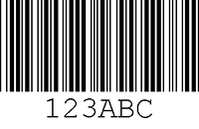
What is a bar code
A bar code is a method of representing data in a visual, machine-readable form.
Historically a set of parallel lines (1 – D)
Bar Code reader would interpret the bars

Slide 3
Why Use a Bar Code
Timely
Accurate
Repeatable
Durable

Slide 4
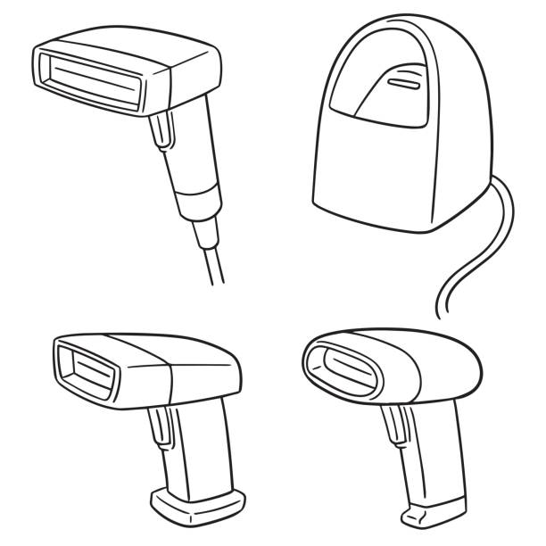
Type of Readers Connections
USB
Serial
Bluetooth
Embedded

Slide 5

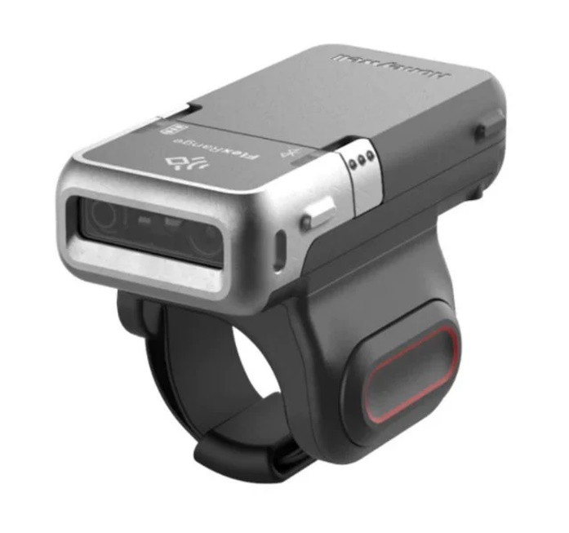
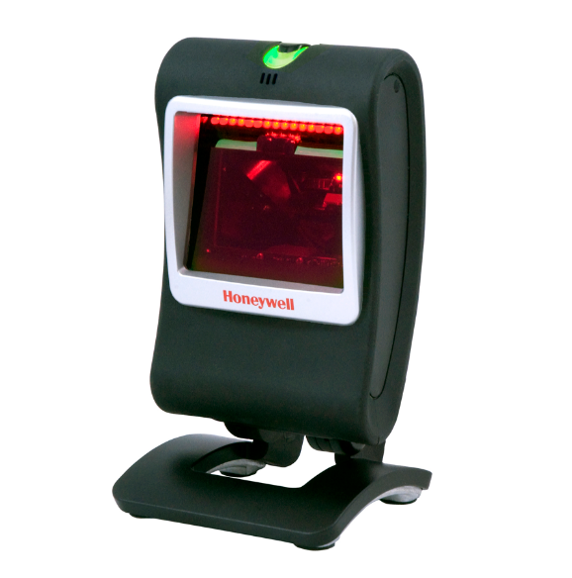
Scan Engines - Reading
Laser
CCD
Imagers

Slide 6
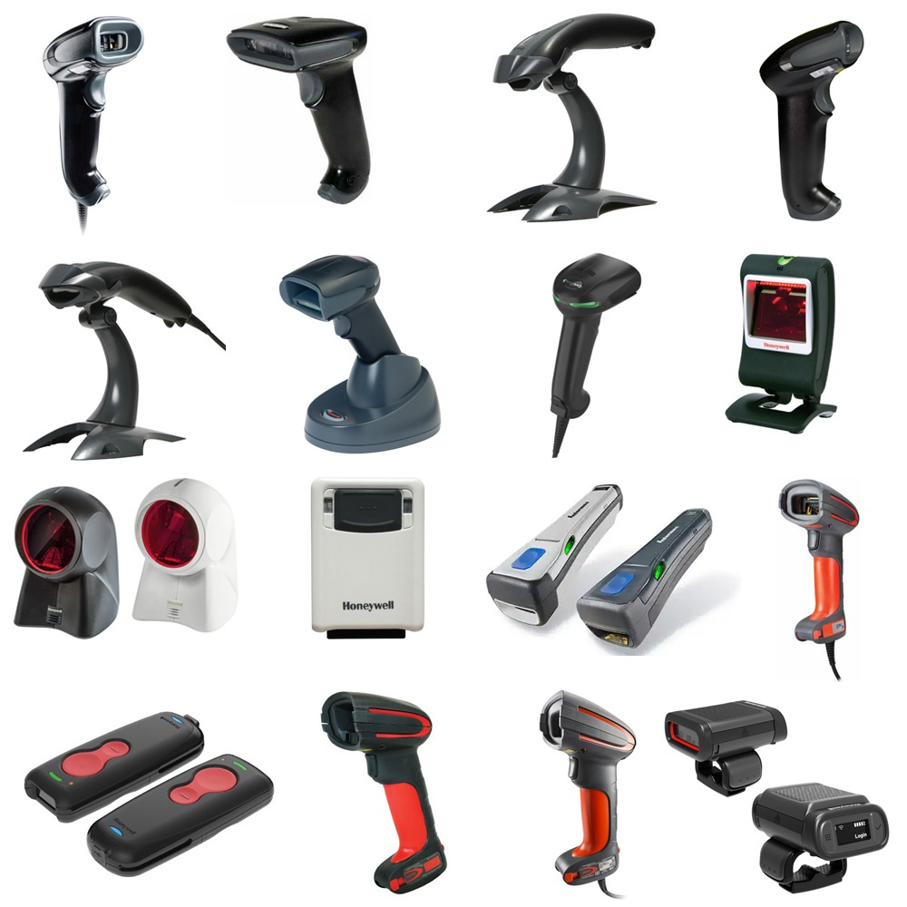
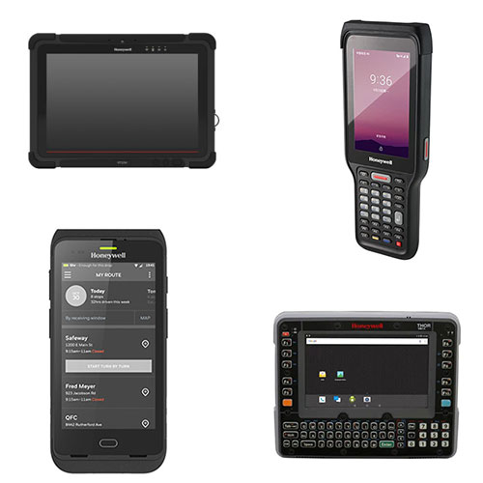
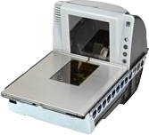
Form Factors

Slide 7
Types of Scan Engines
Near/Standard Range
  6” to Arms Length
Far Range
  Arms Length to 20 Feet
Ultra Far Range
  Arms Length to 75 under Specific Conditions
High Density
  Tiny bar codes like Printed Circuit Boards
Outdoors

Slide 8

How a Reader Works
Physics 101
Light Shines
Reflection
Inverse is Read
Pattern Recognized
Converted Output

Slide 9
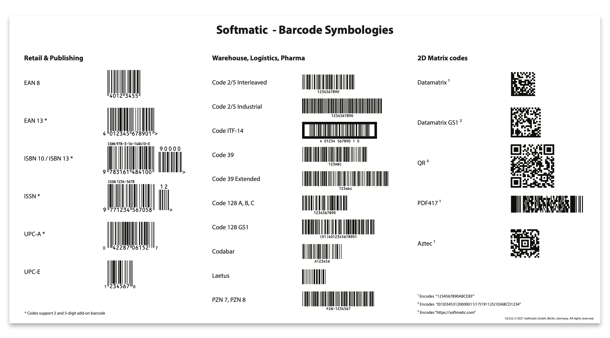
Types of Bar Codes

Slide 10
Symbologies
Set of Rule
Character Sets
Control Codes
Start/Stop bits
Check Digit
Contract between the creator and consumer

Slide 11
Encoding Methods
Linear – One Character = Set of Bars
Interleaved = String of Characters compressed
Look Up Tables – Characters have fixed Representations that follow a defined scheme
Limited Character Sets

Slide 12
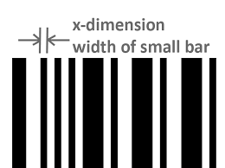
X-Dimension

Slide 13
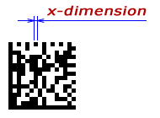
X-Dimension 2D

Slide 14
X-Dimension Math
Symbology determines the Characters allowed
X-Dimension establishes the width
All Bar widths are a multiple X-Dim
Linear Growth

Slide 15
1 D Bar Code
Typically represents a single data element
Not a lot of symbologies allow control codes
You can make up a concatenation scheme
Match your need to the best Symbology

Slide 16
2 D Bar Codes
More of a paragraph or document model
Creator and Generator agree to what separates fields and records.
Both implement the same for the other’s benefit
Business document trading facility
QR Codes are a free form symbology.

Slide 17
What could go Wrong Reading
Lack of Light
Diffraction/Deflection
X-Dimension
Quit Zone Violation
Wrong Scan Engine

Slide 18
Error Correction (The AI Slide)
Smeared
Wrinkled
Torn
Print Head Damage
Shrink Wrapped over Label
Stretched
Obscured

Slide 19
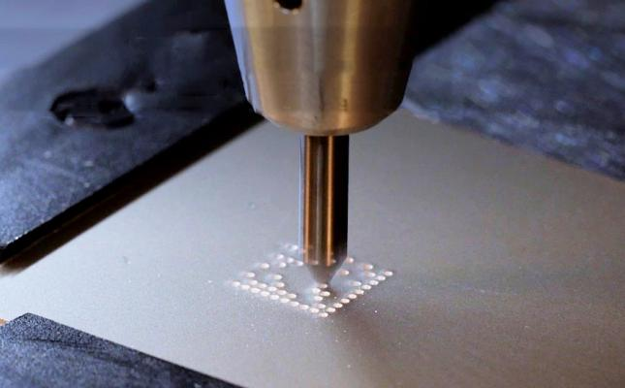
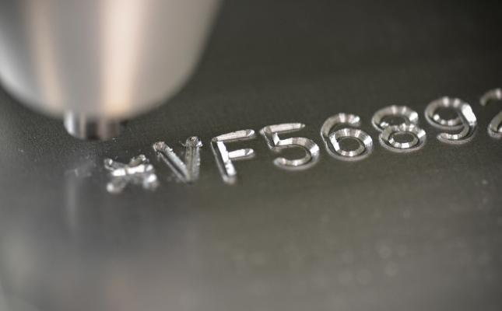
Adjacent Technologies
Direct Part Marking
Peening Dot Scribing

Slide 20
Reader Connectivity Options
USB as HID Includes Blue Tooth
  Keyboard Wedge
  Typing is the same as scanning is the same as typing
  All the traffic and Buffering is done for you
Serial
  All the old issues Baud Rate, Parity XON/Xoff, Buffering
Embedded
  Usually HID or as a web service

Slide 21
How to Generate a Bar Code
Fonts
Code to a Printer Specific Language
Use a tool
  Loftware
  Generator Websites – Ask The Google
  Bartender
  Nice Label

Slide 22
How to Print
Embedded in a normal document
  Word or Excel or Crystal Reports …
QR Code Generators et.al.
Label Printer
  Direct Thermal
  Thermal Transfer
Specialty - Card and Badge Printers

Slide 23
Label Stock and Reader
Paper
Laminates
Permanent
Retro-Reflective

Slide 24

Sense of the Room
Acknowledgement of our Quaker Friends.

Slide 25
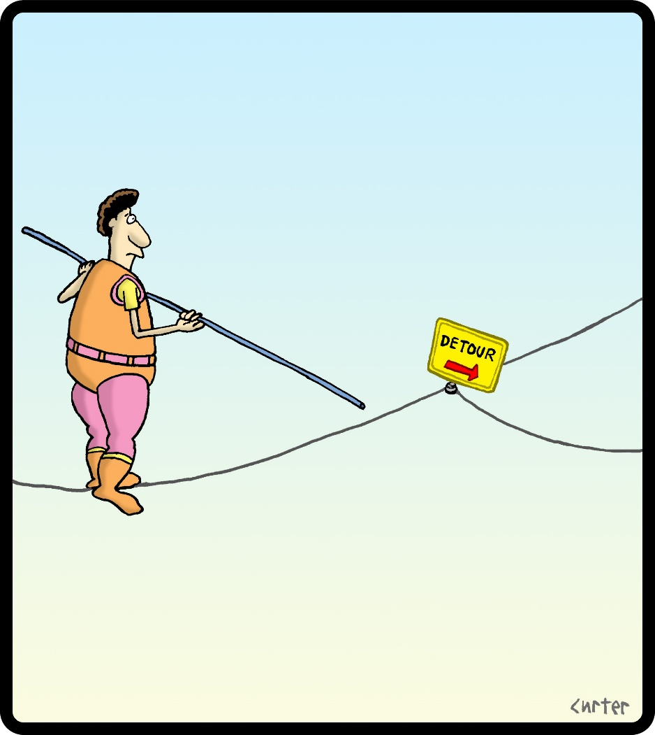
Scanning Demo

Slide 26
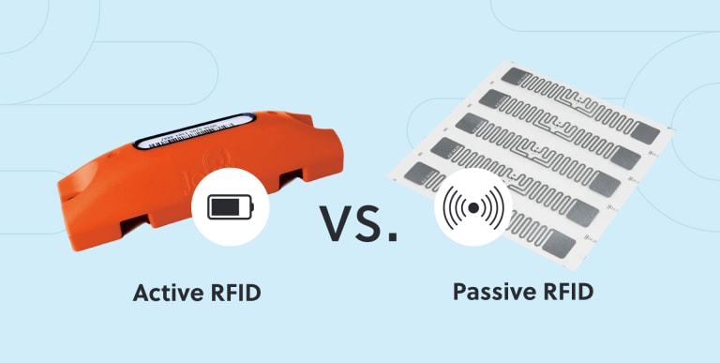
RFID

Slide 27
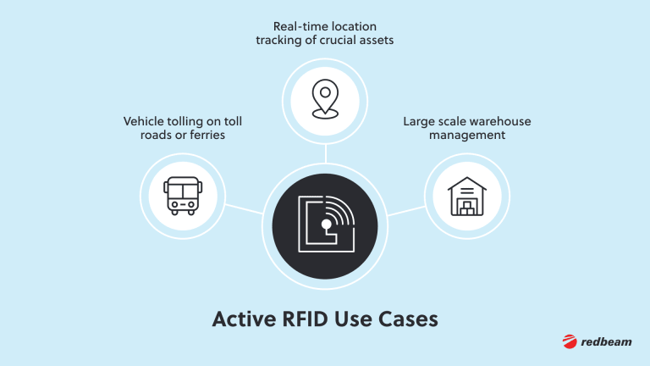
Active Tags – Self Powered

Slide 28
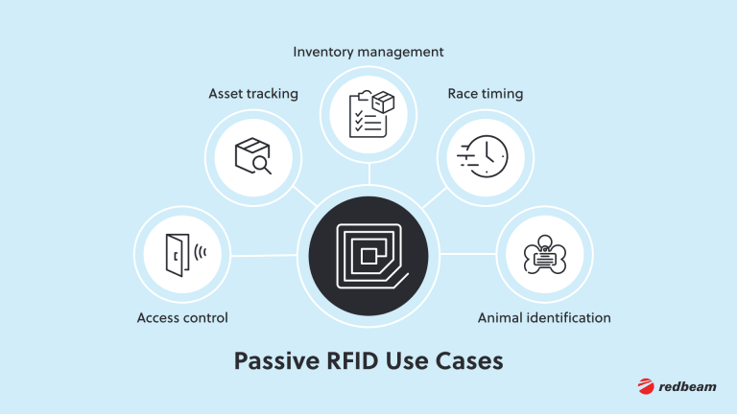
Passive Tags – No Power

Slide 29
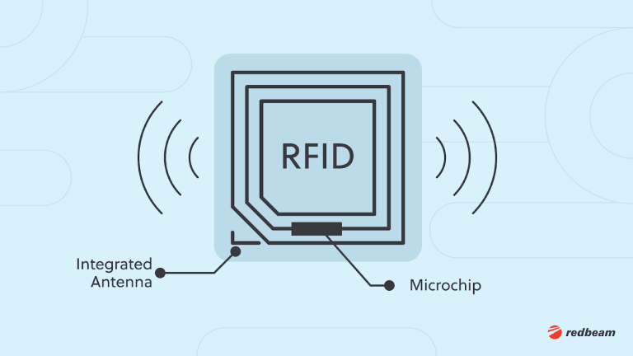
Physical Tag

Slide 30
Industrial Engineering
Reader Location
Point in time versus direction
Placement of Tag
Physics of Tag Radio Propagation

Slide 31

Bob Brennan
Integrated Manufacturing Systems, Inc.
(603) 424-0109

