Slide 1
Real-Time Visibility: Using the Client Database-Request Statement Cache to Troubleshoot OpenEdge Performance Issues
When investigating application performance problems, identifying which users are experiencing issues is just the first step. But what comes next? How do you identify the specific parts of your code that are causing performance problems, and how do you optimize those sections to improve application performance?
In this session, you’ll learn how to leverage Progress’s Client Database-Request Statement Cache feature to gain real-time visibility into client activity. This feature, added way back in release 10.1C, allows you to direct a 4GL or SQL client to send diagnostic information to the server each time it accesses the database. You can then use this data to identify which parts of your code are causing performance problems and optimize them to improve application performance.
Join us to learn how this powerful feature works and how to incorporate it into your OpenEdge troubleshooting workflow. By the end of this session, you’ll have a clear understanding of how to use the Client Database-Request Statement Cache to identify and optimize performance issues, improving the user experience and ensuring optimal application performance. Don’t miss this opportunity to take your OpenEdge performance troubleshooting to the next level!

Slide 2




Real-Time Visibility
Using the Client Database-Request Statement Cache to Troubleshoot OpenEdge Performance Issues
Tom Bascom, White Star Software
tom@wss.com

Slide 3
Agenda
What is That User Doing?
How Do I Setup The Client Statement Cache?
What Is The Impact Of Using CSC?

Slide 4
What Is
That User Doing?

Slide 5


Have You Ever?
Been blissfully happy and completely unconcerned about improving performance?

Slide 6
Or maybe not?
Have you wondered "what code is running?" when:
  You have a session with high activity?
  A connection doesn't seem to want to end?
  Users are in idle transactions (resulting in bi file growth)?
  Users are blocking other users with record lock conflicts?
  Or even just "what is typical for my system?"

Slide 7
The Client Statement Cache
Introduced With OpenEdge 10.1C (circa 2008)
Tracks the most recent statement that accessed the database
For 4GL clients: CSC provides the procedure name and line number
  Optionally tracks the full 4GL stack trace
For SQL clients: the SQL statement
Works for both local and remote clients!
Presents results in the database – not in external logs scattered hither and yon…

Slide 8
Three Ways To Access The Client Statement Cache
PROMON
Virtual System Tables
ProTop

Slide 9
Client Statement Cache: PROMON
R&D, 1, 18, 7 " Client Database-Request Statement Cache ..."
09/05/23 OpenEdge Release 11 Monitor (R&D)
14:52:32 Client Database-Request Statement Caching Menu
1. Activate For Selected Users
2. Activate For All Users
3. Activate For All Future Users
4. Deactivate For Selected Users
5. Deactivate For All Users
6. Deactivate For All Future Users
7. View Database-Request Statement Cache
8. Specify Directory for Statement Cache Files
9. Toggle between User and Tenant Options
10. Database statement cache locks
Enter a number, <return>, P, T, or X (? for help):

Slide 10
Client Statement Cache Output: PROMON
Enter Usr#
09/05/23 OpenEdge Release 11 Monitor (R&D)
14:24:58 View Database-Request Statement Cache
User number : 1119
User name :
User type : SELF/ABL
Login date/time : 09/05/23 14:19
Statement caching type : SQL Statement or Partial ABL Program Stack
Statement caching last updated : 09/05/23 14:24
Statement cache information : 1254 : dynViewerUpdate lib/dynscreen.p
1849 : dynScreenUpdate lib/dynscreen.p
917 : paintScreen protop.p
890 : refresh protop.p
2408 : protop.p

Slide 11
Client Statement Cache: VSTs
define variable userNum as integer no-undo initial 1119.
define variable ii as integer no-undo.
find _connect no-lock where _connect-id = ( userNum + 1 ). /* usr# plus one */
display _connect-id _connect-usr _connect-cachingType _connect-cacheInfoType.
do ii = 1 to 32 while _connect-cacheLineNumber[ii] <> ?:
display
_connect-cacheLineNumber[ii] _connect-cacheInfo[ii] skip
with
frame b
down
.
down with frame b.
end.
Notes:
_connect-cacheInfoType is either "ABL" or "SQL"

Slide 12
Client Statement Cache Output: VSTs
_Connect-Id User-Id Stmt Caching Type (1,2,3) Stmt Cache Type
───────────────────── ─────────── ───────────────────────── ───────────────
1120 1119 02 ABL Stack
Stmt Cache Line Number Stmt Cache Information
────────────────────── ────────────────────────────────────────────────────
1761 snapshotLock lib/vstlib.p
630 mon-update dc/blocked.p
419 doRequest lib/ptsrv.p
904 makeRequest protop.p
883 refresh protop.p
2408 protop.p

Slide 13
Client Statement Cache Output: ProTop
<x> Active Transactions
Usr# Name PID Flags TRX# BIClstr Duration Idle Wait Resrc Line# Program Name
418 xgtgcast 1007259 S4 * 1885303871 773557 00:16:03 00:11:49 -- 0 259 wb/message.p
1664 xpazvida 536623 S4 * 1885566001 773561 00:11:51 00:03:06 -- 0 29380 im/synlocq.y
1268 xcrnzulu 939002 S4 * 1885667525 773565 00:11:05 00:11:02 -- 0 7790 ar/custlu.y
700 jsantos 3824433 S4 * 1885680717 773566 00:10:47 00:09:39 -- 0 259 wb/message.p
959 xecscues 3922245 S4 * 1885780575 773567 00:09:47 00:09:50 -- 0 195 acct/getopars.p
1340 xgtbroca 4188655 S4 * 1885879264 773568 00:08:22 00:08:18 -- 0 259 wb/message.p
1264 xsvlmart 4060245 S4 * 1885930279 773568 00:07:39 00:07:38 -- 0 118801 so/orderle2.p
<u> User IO Activity
Usr# Name PID Flags BlkAcc OSRd OSWr Hit% RecLk LkHWM CSC Age Line# Program Name
1591 traxcron4 1073701 S4B 1065832 0 0 100.00% 0 0 00:00:01 4181 acct/brecloada.p
1213 xcrwhpi 4048873 S4 65032 0 0 100.00% 0 0 00:00:22 358 so/bmonaut1.p
537 xcbavill 3685326 S4 36305 0 0 100.00% 0 0 00:00:00 1067 ar/cnotev.p
277 mslink3pl 2568607 S4B 28629 0 0 100.00% 483 0 00:00:00 244 impwhk/cstfactd.p
217 traxwhook 3346393 S4B 27703 0 0 100.00% 0 0 00:00:07 42 ws/so/.p
452 xusrnune 876302 S4 24447 0 0 100.00% 0 0 00:00:03 469 so/bormonit1.p
Notes:
Show RT screen *and* show some alerts that have been enhanced with CSC info.
Example alerts: oldtrx, many locks, high activity

Slide 14

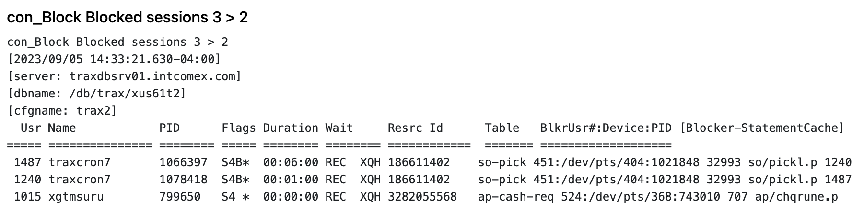
Client Statement Cache Alerts: ProTop
Notes:
Usr 451 is blocking the two traxcron7 jobs, usr 451 is on line 32993 of so/pickl.p and is holding a lock on so-pick RECID 186611402

Slide 15
RECAP: Accessing CSC
Available for all supported Progress releases and all client types
Zero in on exactly what code is being executed at any time
Eliminates an enormous amount of uncertainty about where to look for problems
Simple to use

Slide 17
This slide is intentionally left blank!

Slide 18
How Do I Setup
The Client Statement Cache?

Slide 19
CSC Configuration Options
Top of stack? Or full stack?
Run continuously (until disabled) or run once?
Enable for a few selected clients or all clients?
Enable for all future clients?
Temporary file directory?
  Inconvenient bug: you can only change it once per PROMON session
Notes:
"Top" or "full"?
"Top" is what code you just ran, that is almost always what you want to know. "Full" tells you how you got there. You don't usually need "full" and it greatly increases the amount of data that has to be tracked so usually choose "top".
Running continuously is probably more helpful in production since most real code makes many database calls and you are usually interested in the one that is using resources right now. Picking your moment to run just once might be feasible in a test environment but probably not in production.
If you know which specific clients you want information about then selecting just those clients makes sense. If you don't, then selecting "all" is attractive but – BE AWARE – there are performance implications to that. Take it easy and make sure that your system can handle it.
If you are enabling all then it also makes sense to enable for all future users. Unfortunately "enable all" cannot be done with a VST.

Slide 20
Enabling CSC
With PROMON

Slide 21
Client Statement Cache: PROMON
R&D, 1, 18, 1 " Client Database-Request Statement Cache ..."
09/05/23 OpenEdge Release 11 Monitor (R&D)
14:52:32 Client Database-Request Statement Caching Menu
1. Activate For Selected Users
2. Activate For All Users
3. Activate For All Future Users
4. Deactivate For Selected Users
5. Deactivate For All Users
6. Deactivate For All Future Users
7. View Database-Request Statement Cache
8. Specify Directory for Statement Cache Files
9. Toggle between User and Tenant Options
10. Database statement cache locks
Enter a number, <return>, P, T, or X (? for help):
Notes:
The "All Future Users" and "Specify Directory" options are only available via PROMON

Slide 22
Client Statement Cache: PROMON
R&D, 1, 18, 7 " Client Database-Request Statement Cache ..."
09/05/23 OpenEdge Release 11 Monitor (R&D)
14:55:35 Activate For Selected Users
Usr:Ten Name Domain Type Login time Serv IPV# Remote Address
201 root 0 RPLS 08/02/23 13:59 0
208 pro2sql 0 SELF/ABL 08/02/23 14:00 0
211 0 SELF/ABL 09/02/23 00:01 0
213 0 SELF/APSV 09/05/23 12:30 0
222 dwlink1 0 SELF/ABL 09/05/23 06:00 0
Enter user number, P, T, or X (? for help): 201
Enter the type of statement caching to activate (1-Single, 2-Stack, 3-One Time): 1
Notes:
Continue to select users or "P" to back up…

Slide 23
Client Statement Cache: PROMON
Scripted (Unix):
# enable the client statement cache for all current and future connections
promon ${DB} > /dev/null <<- "EOF" 2> /dev/null
R&D
1
18
2
1
3
1
x
EOF
# done

Slide 24
Viewing CSC
With PROMON

Slide 25
Client Statement Cache: PROMON
R&D, 1, 18, 7 " Client Database-Request Statement Cache ..."
09/05/23 OpenEdge Release 11 Monitor (R&D)
14:52:32 Client Database-Request Statement Caching Menu
1. Activate For Selected Users
2. Activate For All Users
3. Activate For All Future Users
4. Deactivate For Selected Users
5. Deactivate For All Users
6. Deactivate For All Future Users
7. View Database-Request Statement Cache
8. Specify Directory for Statement Cache Files
9. Toggle between User and Tenant Options
10. Database statement cache locks
Enter a number, <return>, P, T, or X (? for help):

Slide 26
Client Statement Cache Output: PROMON
Enter Usr#
09/05/23 OpenEdge Release 11 Monitor (R&D)
14:24:58 View Database-Request Statement Cache
User number : 1119
User name :
User type : SELF/ABL
Login date/time : 09/05/23 14:19
Statement caching type : SQL Statement or Partial ABL Program Stack
Statement caching last updated : 09/05/23 14:24
Statement cache information : 1254 : dynViewerUpdate lib/dynscreen.p
1849 : dynScreenUpdate lib/dynscreen.p
917 : paintScreen protop.p
890 : refresh protop.p
2408 : protop.p

Slide 27
Enabling CSC
With VSTs

Slide 28
Enabling Client Statement Cache: VSTs
define variable userNum as integer no-undo initial 1119.
define buffer updConnect for _connect.
do for updConnect transaction:
find updConnect exclusive-lock where updConnect._Connect-id = userNum + 1 no-error.
if available( updConnect ) and updConnect._Connect-usr <> ? then
do:
updConnect._connect-cachingType = 2. /* 1 = top of stack, 2 = full stack */
end.
else
message "user" userNum "doesn't seem to be connected!".
end.
Notes:
Changing _connect-cachingType clears any existing _connect-cacheInfo[]. New info will not be available until the client accesses the database again.
Using process-id isn't safe if connections come from remote systems. The PID in _connect is from the remote _client_ process and it is not unique (the same PID can simultaneously appear from multiple remote systems).

Slide 29
Viewing CSC
With VSTs

Slide 30
Client Statement Cache Output: VSTs
define variable userNum as integer no-undo initial 1119.
define variable ii as integer no-undo.
find _connect no-lock where _connect-id = ( userNum + 1 ). /* usr# plus one */
display _connect-id _connect-usr _connect-cachingType _connect-cacheInfoType.
do ii = 1 to 32 while _connect-cacheLineNumber[ii] <> ?:
display
_connect-cacheLineNumber[ii] _connect-cacheInfo[ii] skip
with
frame b
down
.
down with frame b.
end.
Notes:
_connect-cacheInfoType is either "ABL" or "SQL"

Slide 31
Client Statement Cache Output: VSTs
_Connect-Id User-Id Stmt Caching Type (1,2,3) Stmt Cache Type
───────────────────── ─────────── ───────────────────────── ───────────────
1120 1119 02 ABL Stack
Stmt Cache Line Number Stmt Cache Information
────────────────────── ────────────────────────────────────────────────────
1761 snapshotLock lib/vstlib.p
630 mon-update dc/blocked.p
419 doRequest lib/ptsrv.p
904 makeRequest protop.p
883 refresh protop.p
2408 protop.p

Slide 32
Enabling CSC
With ProTop

Slide 33
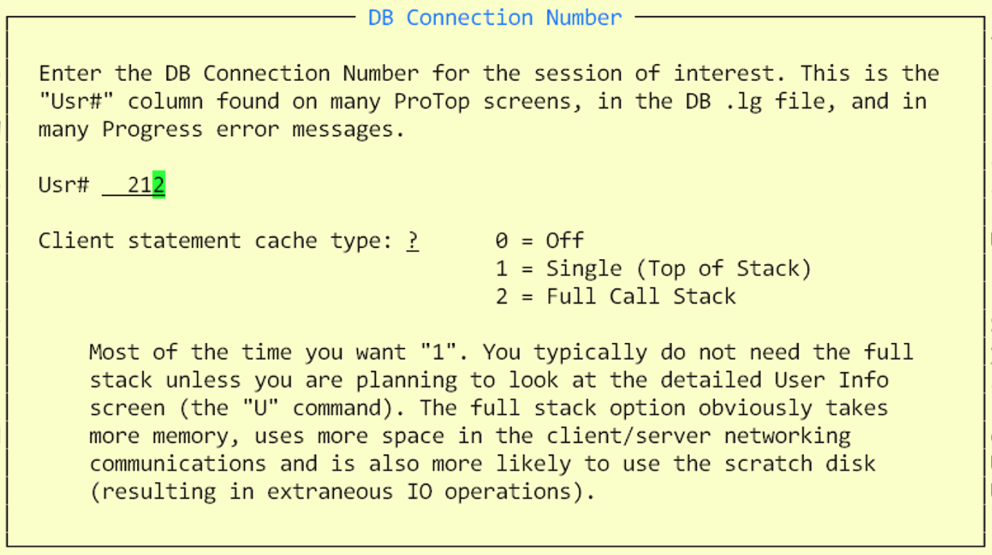
Enabling Client Statement Cache: ProTop
The "#" command for UsrNum or "P" for Process Id
Notes:
Show RT screen *and* show some alerts that have been enhanced with CSC info.
Example alerts: oldtrx, many locks, high activity

Slide 34
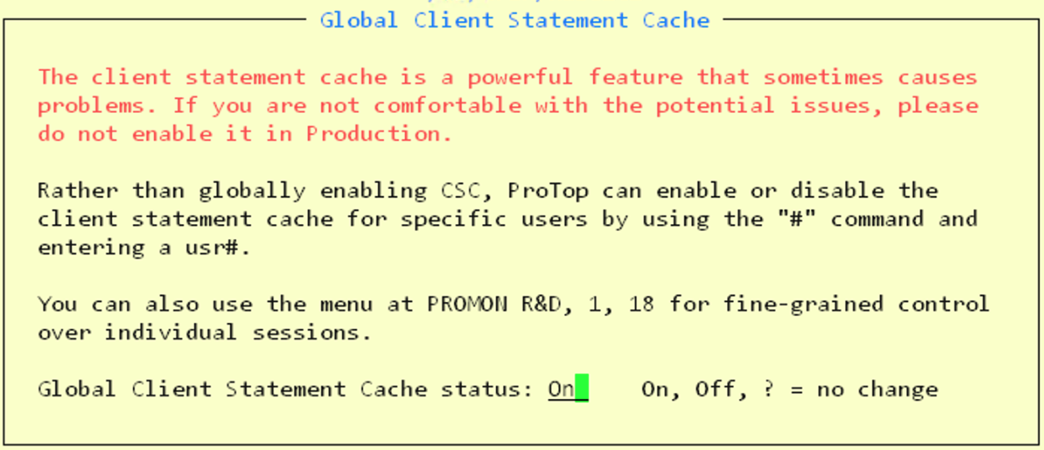
Enabling Client Statement Cache: ProTop
The "*" command will enable (or disable) CSC for all connections
Notes:
Show RT screen *and* show some alerts that have been enhanced with CSC info.
Example alerts: oldtrx, many locks, high activity

Slide 35
Viewing CSC
With ProTop

Slide 36
Client Statement Cache Output: ProTop
<x> Active Transactions
Usr# Name PID Flags TRX# BIClstr Duration Idle Wait Resrc Line# Program Name
418 xgtgcast 1007259 S4 * 1885303871 773557 00:16:03 00:11:49 -- 0 259 wb/message.p
1664 xpazvida 536623 S4 * 1885566001 773561 00:11:51 00:03:06 -- 0 29380 im/synlocq.y
1268 xcrnzulu 939002 S4 * 1885667525 773565 00:11:05 00:11:02 -- 0 7790 ar/custlu.y
700 jsantos 3824433 S4 * 1885680717 773566 00:10:47 00:09:39 -- 0 259 wb/message.p
959 xecscues 3922245 S4 * 1885780575 773567 00:09:47 00:09:50 -- 0 195 acct/getopars.p
1340 xgtbroca 4188655 S4 * 1885879264 773568 00:08:22 00:08:18 -- 0 259 wb/message.p
1264 xsvlmart 4060245 S4 * 1885930279 773568 00:07:39 00:07:38 -- 0 118801 so/orderle2.p
<u> User IO Activity
Usr# Name PID Flags BlkAcc OSRd OSWr Hit% RecLk LkHWM CSC Age Line# Program Name
1591 traxcron4 1073701 S4B 1065832 0 0 100.00% 0 0 00:00:01 4181 acct/brecloada.p
1213 xcrwhpi 4048873 S4 65032 0 0 100.00% 0 0 00:00:22 358 so/bmonaut1.p
537 xcbavill 3685326 S4 36305 0 0 100.00% 0 0 00:00:00 1067 ar/cnotev.p
277 mslink3pl 2568607 S4B 28629 0 0 100.00% 483 0 00:00:00 244 impwhk/cstfactd.p
217 traxwhook 3346393 S4B 27703 0 0 100.00% 0 0 00:00:07 42 ws/so/.p
452 xusrnune 876302 S4 24447 0 0 100.00% 0 0 00:00:03 469 so/bormonit1.p
Notes:
Show RT screen *and* show some alerts that have been enhanced with CSC info.
Example alerts: oldtrx, many locks, high activity

Slide 37


Client Statement Cache Alerts: ProTop
Notes:
Show RT screen *and* show some alerts that have been enhanced with CSC info.
Example alerts: oldtrx, many locks, high activity

Slide 38
RECAP: Setting Up CSC
Something for everyone!
  PROMON interactive, PROMON scripted
  Roll your own with Virtual System Tables
  ProTop per user or for everyone
A wide variety of options:
  Recommendation: usually "Top of Stack" is what you want
  Recommendation: if you have a lot of remote clients be careful about enabling CSC for all connections

Slide 39
This slide is intentionally left blank!

Slide 40
What Is The Impact Of Client Statement Cache?
(not just performance)

Slide 41

It's a Great Feature But…
What is the impact of using the client statement cache?
  SQL Clients
  Shared Memory
  Remote Connections

Slide 42
CSC Memory Usage
Static allocation at db startup:
  28 * ( -n + -Mn + 2 )
Shared Memory at startup:
  80 * ( -n + -Mn + 2 )
Per Enabled Connection:
  32 bytes of control info + 256 for the stack = 288 bytes
Worst case (enable for everyone):
  396 * ( -n + -Mn + 2 ) . . . for 2,000 users = roughly 1MB
Increase -Mxs if you see:
    Unable to allocate shared memory for this user's database request statement cache.
    Statement caching for user %d<NUM> is being deactivated. (15932)
Notes:
"proutil –C increaseto –n" might result in also need to increase -Mxs

Slide 43
Temporary Files (*.cst)
A CST file is created only if the stack exceeds 256 bytes
One file per connection, named: PATH~DB~PID.USR#.cst
There is no startup parameter to control the CST file location
  Does NOT follow –T
  By default, CST files are written to the processes current directory
  Changing it with PROMON only seems to work for future connections
  Can only change it ONCE per PROMON session, after that PROMON only reports the value
CST files are written by SELF clients or REMC/SQL servers
Notes:
Default directory in 12.8 seems to be working dir, for remote servers that is the current directory inherited from proserve
An error 2 occurred while attempting to open the (-o) output file /home/tom/noaccess/db~s2k.128~s2k.98295.3.cst. The operation cannot continue. (12164)
The CST file does not follow the usual –t rule, if it exists, it is always visible.

Slide 44
CSC Notes
Very old OpenEdge releases had some bugs
You must have write permission on the temp file location
The USR latch will become very active if CSC is enabled globally
Does NOT report on temp-tables
Does NOT track non-database related activity
The VST fields for CSC cannot be written to on a replication target
Notes:
The most recent serious bug was in 11.4 and earlier

Slide 45
More Notes
The stack is limited to 32,000 bytes of information
  If the stack overflows the top of the stack is preserved
Procedure names are as specified to RUN, they do not include any added PROPATH
4GL line numbers are DEBUG-LIST line numbers:
  COMPILE VALUE( "program.p" ) DEBUG-LIST VALUE ( "program.dbg" ).
Line# -1 is "end of procedure cleanup"
The time stamp does not change if the cached statement doesn't change (i.e. a FIND inside a DO WHILE with no other db access statements)
A client cannot successfully monitor itself
Notes:
When the stack limit is exceeded the top N entries are preserved. The initial entries are lost.
VSTs only show the top 32 entries
PROMON shows the entire (truncated) 32,000 bytes
proGetStack seems to be limited to about 16k of stack entries

Slide 46
CSC SQL Notes
SQL Information has no additional network performance penalty (the SQL statement is always sent to the server regardless)
SQL line number is always zero
SQL statements are often long so the CST file is more likely to be used
SQL statements often contain formatting (line feeds, indentation) which can be challenging

Slide 47
Some Benchmarks
Actual Data

Slide 48

SQL Clients
No discernable difference, with or without CSC enabled!
I expected that the creation & updates of the CST file might have had a bit of an impact but I couldn't measure it

Slide 49
Shared Memory Clients
Mixed FIND statements are the worst, by a LOT
"Top of Stack" somewhat mitigates the impact
"Long paths" hurt less than anticipated
A couple of strange cases actually improved with CSC enabled
Test Scenario | CSC | Throughput | Impact
Repeated FIND NO-LOCK | None | 324,064
 | Top | 305,791 | -5.64%
 | Full | 291,273 | -10.12%
Mixed FIND NO-LOCK | None | 314,159
 | Top | 191,716 | -38.97%
 | Full | 184,464 | -41.28%
FOR EACH NO-LOCK | None | 446,459
 | Top | 431,564 | -3.34%
 | Full | 398,878 | -10.66%
Repeated FIND NO-LOCK, long path | None | 268,945
 | Top | 301,372 | 12.06%
 | Full | 201,323 | -25.14%
Mixed FIND NO-LOCK, long path | None | 310,082
 | Top | 194,858 | -37.16%
 | Full | 70,781 | -77.17%
FOR EACH NO-LOCK, long path | None | 424,939
 | Top | 435,389 | 2.46%
 | Full | 256,653 | -39.60%
Notes:
In the real world you are almost certainly not executing hundreds of thousands of FIND statements per second, so even though the impact on mixed FINDs is high the incidence is probably low
But you may very well be executing FOR EACH statements that return results sets like that

Slide 50
Remote Clients
Mixed FIND statements are, again, the worst
The impact on repeated FINDs and FOR EACH NO-LOCK is very low
-prefetchNumRecs will help reduce the impact with FOR EACH NO-LOCK
Test Scenario | CSC | Throughput | Impact
Repeated FIND NO-LOCK | None | 14,551
 | Top | 14,760 | 1.44%
 | Full | 14,714 | 1.12%
Mixed FIND NO-LOCK | None | 14,991
 | Top | 8,402 | -43.95%
 | Full | 7,631 | -49.10%
FOR EACH NO-LOCK | None | 222,589
 | Top | 215,118 | -3.36%
 | Full | 225,406 | 1.27%
Repeated FIND NO-LOCK, long path | None | 14,463
 | Top | 14,777 | 2.17%
 | Full | 14,546 | 0.57%
Mixed FIND NO-LOCK, long path | None | 15,297
 | Top | 8,005 | -47.67%
 | Full | 7,580 | -50.45%
FOR EACH NO-LOCK, long path | None | 215,541
 | Top | 212,401 | -1.46%
 | Full | 209,317 | -2.89%
Notes:
Client server FIND statements are 20x slower than shared memory… FOR EACH is only half as slow.
With shared memory -- in the real world you are almost certainly not executing hundreds of thousands of FIND statements per second, so even though the impact on mixed FINDs is high the incidence is probably low.
But with client/server the chances that you are executing thousands of FINDS is much closer to believable so the impact is more noteworthy.

Slide 51
Why Are "Mixed FINDs" So Bad?
What is a "mixed FIND" again?
  Two different FIND statements on different lines of code
  Recall: when the same statement is repeated in a loop no update is made to CSC
With CSC enabled 2 additional "network messages" occur per new db statement
  In the case of a FIND that doubles network messages
With CSC enabled the USR latch is locked twice per new db statement
  Normally the USR latch is only locked rarely – such as at login and logout
Without a large result set to "amortize" the extra latency, throughput suffers
FIND behavior is a proxy for a lot of "bad code" like accidental SHARE-LOCK

Slide 52
RECAP: The Impact of CSC
For SQL Clients there is no measurable impact
With Shared Memory Clients the impact is small
Remote Clients that primarily fetch data with FOR EACH and similar structures will not see much impact
Remote Clients that use a lot of FIND statements may be severely impacted
  A possible mitigation is to cache the targets of the FIND statements in temp-tables, it is often (but not always) the case that these FIND statements are repeated lookups of control values that can be easily cached

Slide 53


https://openedge.ideas.aha.io
1482 Replication targets should allow updateable VST fields to be updated
1495 db startup parameter to specify temp file location for client statement cache
1496 Add a VST field to view the state of and permit enabling (or disabling) of "all future users" option for client statement cache
1519 Increase the threshold for client statement cache "in memory" vs overflow to disk.
1520 Reduce or eliminate USR latch locking associated with client statement cache
1521 Reduce "messages" needed to track client statement cache with remote connections

Slide 54
This slide is intentionally left blank!

Slide 55
What About proGetStack?

Slide 56
proGetStack
Now and then feature from v8 onward…
… permanently available from 10.1C+
Obtains a 4gl stack trace from an _progres or prowin* session
  proenv> proGetStack <process-id>
Output is protrace.pid in the process working directory

Slide 57
proGetStack: protrace.1234 Output (page 1)
PROGRESS stack trace as of Mon Jul 31 15:34:58 2023
Progress OpenEdge Release 11.7 build 2237 SP17 on Linux dbsrv01 4.18.0-348.20.1.el8_5.x86_64
Command line arguments are
/usr/dlc/bin/_progres -p protop.p /db/dbname -param xyzzy -pf /home/pt3/etc/protop.pf -T /home/pt3/tmp . . .
Startup parameters:
-p protop.p,-rereadnolock,-rand 2,-s 256,-Bt 2048,-mmax 8192 . . .
#1 [0xb504c7] uttraceback+0x57 from /usr/dlc/bin/_progres
#2 [0xb53e44] uttrace_withsigid+0x1e4 from /usr/dlc/bin/_progres
#3 [0x4efe4f] drProTrace+0xb3 from /usr/dlc/bin/_progres
#4 [0x4ef14d] drSigDo1+0xa1 from /usr/dlc/bin/_progres
#5 [0x4ef429] drSigDispatch+0x1b0 from /usr/dlc/bin/_progres
#6 [0x4dcface0] __restore_rt+0x0 from /lib64/libpthread.so.0
#7 [0x4dcf9aa4] __libc_read+0x44 from /lib64/libpthread.so.0
#8 [0xb468a6] fgetcxdll+0x56 from /usr/dlc/bin/_progres
#9 [0xb46c50] fgetsxdll+0x70 from /usr/dlc/bin/_progres
#10 [0x69b1f0] umtReadLine+0x260 from /usr/dlc/bin/_progres
#11 [0x5e1889] iotimps+0x149 from /usr/dlc/bin/_progres
#12 [0x79d3b7] rnimport+0x137 from /usr/dlc/bin/_progres
#13 [0x83614a] rnexec_entry+0x1ca from /usr/dlc/bin/_progres
#14 [0x837307] rninterpret+0x37 from /usr/dlc/bin/_progres
#15 [0x4d1443] rnrq+0x83 from /usr/dlc/bin/_progres
#16 [0x45d85f] main+0x3cf from /usr/dlc/bin/_progres
#17 [0x4cc01ca3] __libc_start_main+0xf3 from /lib64/libc.so.6

Slide 58
proGetStack: protrace.1234 Output (page 2)
** ABL Stack Trace **
--> getDFLinux dc/df.p at line 1340 (/home/pt3/dc/df.p)
mon-update dc/df.p at line 1755 (/home/pt3/dc/df.p)
doRequest lib/ptsrv.p at line 419 (/home/pt3/lib/ptsrv.p)
makeRequest protop.p at line 904 (/home/pt3/protop.p)
refresh protop.p at line 883 (/home/pt3/protop.p)
protop.p at line 2408 (/home/pt3/protop.p)
** Persistent procedures/Classes **
Handle File Name
002042 /home/pt3/dc/who.p
002040 /home/pt3/dc/chkpt.p
002038 /home/pt3/dc/bigb.p
002018 /home/pt3/dc/uio.p
002016 /home/pt3/dc/serverio.p
002010 /home/pt3/dc/brokers.p
002009 /home/pt3/dc/txe.p
** PROPATH **
/home/pt3,protop-v11.pl,/usr/dlc/tty,/usr/dlc/tty/OpenEdge.Core.pl,/usr/dlc/tty/adecomm.pl, . . .
** Databases (logical/type/physical) **
dbName PROGRESS /db/dbname
replTarget PROGRESS dbname
** End of Protrace **

Slide 59
Differences Between CSC and proGetStack
CSC is centralized, you only need access to the database
CSC does not require administrator privileges
CSC must be enabled and then you must wait for new db activity
CSC may add network traffic (for networked sessions)
proGetStack does NOT work with PASOE (multi-threading is a problem)
proGetStack reports whatever is running right now
proGetStack requires local access and administrator privileges
proGetStack appends its output to a local file

Slide 60
This slide is intentionally left blank!

Slide 61
Questions?
Notes:
And now we have some time for questions…

Slide 62
Thank You!

