Slide 1
OpenEdge
PUG Challenge 2023
Readying your PASOE Application for the Real World
Shelley Chase
Software Fellow, OpenEdge
November 2023
Notes:
Readying your Progress Application Server for OpenEdge (PASOE)
I’m Shelley Chase a Software Fellow with Progress for over 28 years. It is great to see so many familiar faces.
I am passionate about making sure the OpenEdge product and features work well in customer environments.
OK, so first let’s do a poll,
1. How many of you are using PASOE?
2. If you are not using PASOE, do you plan to move to it in 2024?

Slide 2
Agenda
PASOE Key Concepts
Session & Agent Managers
Journey Into the Unknown
Testing Guidance for Production
Moving to Production
Monitoring PASOE
Focus on 12.2+ with a look ahead to 12.8 LTS
Notes:
In today’s session we will first cover some terminology that is very important to understand to configure your PASOE environment properly.
After that we will discuss some important concepts that did not exist in Classic AppServer
And lastly, we will discuss configuration and monitoring PASOE in production.

Slide 3
Benefits of PASOE
Cloud-ready, scalable, and secure; with well-known server technology
  Tomcat Web Server – PASOE is a web server, first!
  Spring Security Framework – Authentication (AuthN) and Authorization (AuthZ)
Industry-standard protocols with readily-available solutions
  Uses HTTP (or HTTPS/TLS) and can be routed/firewalled using TCP ports
  This also applies to the APSV transport (binary)
Classic AppServer/WebSpeed used proprietary brokers
  WebSpeed was a BYO-Web Server (WebSpeed Messenger)
  PASOE standardizes on Tomcat (Windows/Linux)
Performant / Scalable: Does the most work possible with the OS resources available
Notes:
I know everyone wonders if PASOE is really better that Classic AppServer. Right, I mean we have Classic working, sure we may have to restart them every night and yes, maybe there are some memory leaks… but it is working. Right?
Not really. First, the reason we did not bring Classic AppServer in Release 12 is that the technology it is built on does not provide the scalability, reliability and security needed for today’s business application.
PASOE has many benefits.
It works on-premise and in the cloud, it's scalable, it's made with modern secure server technology.
PASOE is a web server first that is tightly bound to the Tomcat web server.
Tomcat gives you access to many frameworks and tools, one of them being Spring Security framework that brings you your authorization or authentication using industry standard protocols. That is bundled into PASOE
Again, it's a web server, you can easily route HTTP requests over standard ports or HTTPS requests including the OpenEdge transport APSV. No direct connects.
Now for Classic AppServer and WebSpeed. These are proprietary brokers that use technologies popular 15+ years ago.
You also needed WebSpeed Messanger and that's because Web Speed was a bring your own web server approach.
So, you could have a CGI compatible or IIS compatible and those differences across Windows and Linux meant some things could be different.
PASOE standardizes the webserver to Tomcat that runs on Windows and also runs on Linux so the behavior will always be the same.
And lastly, by using Tomcat, PASOE is built to so the most parallel work as possible with the OS resources available.

Slide 4
Notable “Innovation” Features for PASOE in Release 12
12.3: STS server key distribution to STS clients by OEAG
12.4: Introduction of ABL service deployment (.oeds file)
12.5: PASOE session and agent identification for OEDB connections
        Added oepingWebService for APSV and WEB transport, already in REST
        Introduced oeserver command for more runtime info over pasoestart
12.6: OpenEdge.Core.Util.LeakCheck utility for ABL code (DYNOBJECTS)
12.7: Agent Life-Cycle Management, signed ABL procedure libraries
12.8: TLS 1.3, Tomcat 10.1 / Spring Security 6.1, Extended SAML and JWT support
Notes:
PASOE was introduced in the Release 11 family which is over 5 years ago.
Many of you are probably on 12.2 or later and I’m glad.
We have added so many key features since 11.7 that I recommend a direct migration from classic appserver in 11 to pasoe in 12 bypassing pasoe in 11.7
Why, the added years of development offer greater performance, stability, security, and troubleshooting.
If you are on 12.2 I want to let you know of all the advances coming in 12.8 LTS.
Let me highlight a few of the new features:
12.3 Automated STS server key distribution
12.4 New packaging for ABL Services allow incremental deployments
12.5 PASOE session and agent identification when looking at OEDB connections
and even more coming in 12.8

Slide 5

Does this feel a bit too relatable?
Notes:
IT IS CRITICAL TO TEST YOUR APPLICATION UNDER LOAD!
I will say that again… IT IS CRITICAL TO TEST YOUR APPLICATION UNDER LOAD!
PASOE must be tuned properly to work efficiently. A PASOE configuration that works for 20 users, will not work for 200 users.
There are testing techniques that we will discuss later in this session.

Slide 6
PASOE Key Concepts

Slide 7
The Basics
PASOE consists of two parts:
  Tomcat: Java process managing requests and connections; Session-manager
  AVM: Multi-session AVM running ABL code
Supported transports: REST, WEB, APSV, and SOAP
Every request uses standard protocols for enhanced security (HTTP / HTTPS)
PASOE is not simply an upgrade from Classic AppServer / WebSpeed
  It has a lot of moving parts and you MUST configure and test after migration
Notes:
PASOE consists of two parts:
Tomcat: Java process managing requests and connections; Session-manager
AVM: Multi-session AVM running ABL code
There are four supported transports: REST, WEB, APSV, and SOAP
Every request uses standard protocols for enhanced security (HTTP / HTTPS). There is no more direct connect.
AND MOST IMPORTANTLY
PASOE is not simply an upgrade from Classic AppServer / WebSpeed
It is a different animal. It has a lot of moving parts and you MUST configure and test after migration

Slide 8
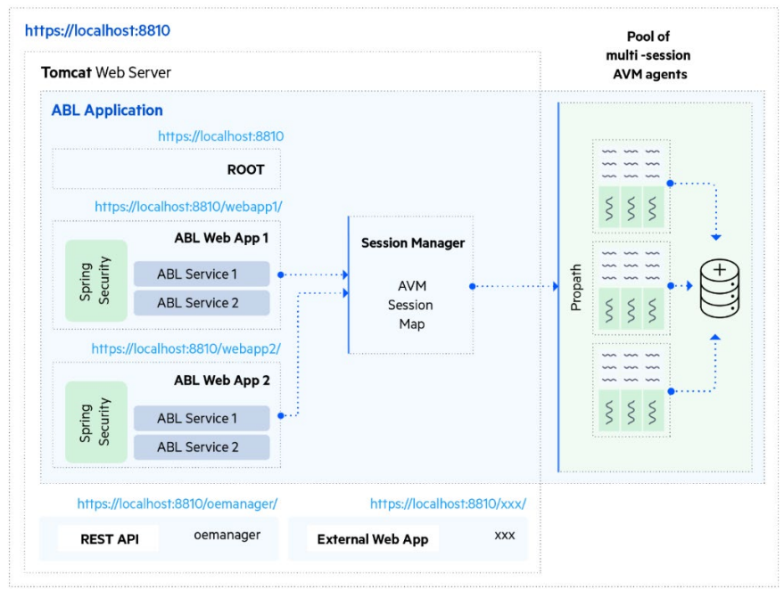
PASOE Architecture
Notes:
Let’s take a quick look at the architecture of PASOE
Tomcat Web Server
One or more ABL Applications, I always recommend to stick with one
One or more WebApps; can be ABL Web Apps or non-ABL Web Apps
One or more ABL Services
One Session Manager
Pool of Multi-session agents (AVMs)

Slide 9
Important PASOE Terminology
Tomcat Executor Threads
  The “worker” responsible for handling Tomcat requests
Agent (Manager)
  Multi-session AVM manages ABL Sessions.
  Memory consumption contributes to process overhead
Session Manager
  Manages connections to ABL Session; starts new Agents when necessary
  More connections = higher # of requests to be handled concurrently (higher CPU)
Notes:
Executor Thread – all Tomcat requests are managed by the executor thread. Running in the Java process
Agents – are multi-session AVMs. All ABL sessions, your runtime environments that live and execute code, all live in an agent. This is where you are going to see the memory footprint for your application.
Each session is started by the agent and those become available as connections for the session manager.
You can think of this as distributing the CPU load because you have many connections that can handle client requests.
But when you increase the connections, you're increasing the number of requests that are running, therefore you're executing more code, therefore higher CPU.
Session Manager routes requests to an ABL Session running in an ABL

Slide 10
Sessions Demystified
ABL Session
  Many ABL Sessions per Agent
  The Agent (AVM) runs ABL Sessions to handle ABL execution requests
Bound ABL Session – reserved for a persistent connection
  Typical for APSV transport with persistent procedures
  Subject to the runtime Session-Model used in the connection
Client (HTTP) Session – Client connection through Tomcat
  Terminating a Client Session will remove its context
Login Session – A time-limited context assigned to an authenticated user
Notes:
On to Sessions, now this one's a little bit tricky because we use sessions a lot in different contexts.
So, when I say ABL Session, I'm talking about the session that is running within an agent. Each of these can be thought of as the stand-alone AVM with its own context but they share the same process space. This is where the code is executed, where your business logic is run. And this is where the memory consumption comes in. Each session needs it own memory space.
A Bound Session. This is often needed to run Classic AppServer logic. A session becomes bound when it is fulfilling a request. More importantly this depends on the session model required by the code. You will see this happen when running persistent procedures. The binding is necessary since future requests from this client need to come back to the same ABL session. This can limit scalability so that is something to keep in mind.
There is concept of what we call a client, HTTP session. This of these as your HTTP sessions. This is a little higher up where Tomcat meets the AVM. This is a TomCat managed session. This is the client request that’s been routed to an ABL Session. It is important to understand that if there is an associated context, it is removed when the client session is terminated. We will talk about this more later.
There is also a login session that exists after a user has been authenticated by an ABL Session and can used to make future requests. They're essentially given their client principal object for identification that has a certain lifetime to it. So, a user is logged in for however long until they logout or the connection times out.
.

Slide 11
Session & Agent Managers

Slide 12
Understanding the Session Manager
AppServer.SessMgr in CATALINA_BASE/conf/openedge.properties
Modern equivalent of the AppServer and WebSpeed Brokers
  Only one per ABL Application, run as a Servlet in Tomcat
  Starts new Agents but does not manage them
  Think of this as a load-balancer for requests to the Agent
Responsible to find an ABL Session to handle an incoming request
  Session manager finds an Agent and an ABL Session in the Agent
  Bound sessions return to same session
  Often oldest to newest, but based on internal list
Subject to the Tomcat server’s Executor Threads
  psc.as.executor.maxthreads in CATALINA_BASE/conf/catalina.properties
Notes:
Understanding the Session Manager.
You can think of the Session Manager as the modern version of the old app server and web speed brokers.
There is only one per ABL application. It routes a request to an ABL Session in an Agent. Its sort of like a load balancer.
The session manager is responsible to find the best Agent and ABL Session/session to use based on what is available and whether the request is on a bound connection.
Basically, where can I execute this ABL code?
It is first to last, it runs through the Agents and then into the ABL sessions of that agent.
But this is an internal list, and it might not be a sequence you expect. Often it is oldest to newest agents but not necessarily so don’t expect to be able to anticipate where a request will go.
The session manager is subject to Tomcat executor threads so you need to have enough executor threads for the request to even get through. Maximum number of concurrent requests, if more come in, they get queued.
And while the session manager can start an Agent, it does not manage the Agent. That is the job of the Agent Manager.

Slide 13
Understanding the Agent Manager
AppServer.AgentMgr in CATALINA_BASE/conf/openedge.properties
Started within each Agent as a background thread (AS-Admin)
Job is to keep ahead of requests by keeping ABLSessions available
  Utilizes the numInitialSessions and minAvailableABLSessions settings
Can become limited by database users available (Dynamic Session Limit)
Handles lifecycles for ABL Sessions (12.7+) for scale-down operations
Let’s look at this in action!
Notes:
Understanding the Agent Manager.
The Agent Manager managers the agents. Based on the initial and min available, and maximum session properties. Its job is to keep ahead of the concurrent requests.
So, as you get requests in, the agent will start up the next available session for use and keep ahead of incoming requests.
And even though there is a maximum number of ABL sessions that can be started, the max is still subject to something that's called the dynamic session limit that this was added some time ago in Open Edge 12.
Basically, it monitors any connected databases. Let's say you have a database that's set with 100 users, but your PASOE instance can take up to 200 concurrent requests. The agent will be limited by the available DB connections. So if the database has 100, then the agent's going to figure that out and say Nope, I have to stop you right there, you can’t. You can't run any more ABL sessions than what the database has available.
Now one additional thing that was added in 12.7. There's new there's a new life cycle management operations. You can specify that the agents kill or terminate sessions after they hit a certain lifetime.
There's a handful of options. Like number of requests and memory consumption.
Let’s take a look at this in action.

Slide 14
PASOE Agents and ABL Sessions
ABL Application
minAgents = 2
maxAgents = 2
numInitialAgents = 2
numInitialSessions = 2
minAvailableABLSessions = 1
Busy Session
Available Session
Agent 1
Session 1
Session 2
Agent 2
Session 1
Session 2
Notes:
This will be our initial state after starting the instance given the configuration options:
1 ABL Application
2 Agents
2 Sessions per Agent
So let's look at what what actually happens during request.
And again this is just to get the context of what's going on with the server because it's going to help you tune your PASOE instance later.
Lets look at a scenario with one ABL application that has two agents (num initial agents)
Now each agent is going to start up two min available sessions as one (num initial sessions per agent)
This picture shows the initial state of the PASOE when it is started up.
Its sitting there, it has all its agents and sessions just waiting for requests.

Slide 15
PASOE Agents and ABL Sessions
ABL Application
minAgents = 2
maxAgents = 2
numInitialAgents = 2
numInitialSessions = 2
minAvailableABLSessions = 1
Busy Session
Requests +2
Available Session
Agent 1
Session 1
Session 2
Agent 2
Session 1
Session 2
Notes:
So lets throw two requests at it.

Slide 16
PASOE Agents and ABL Sessions
ABL Application
minAgents = 2
maxAgents = 2
numInitialAgents = 2
numInitialSessions = 2
minAvailableABLSessions = 1
Busy Session
Available Session
Agent 1
Session 1
Session 2
Agent 2
Session 1
Session 2
Notes:
Well, since we had two sessions ready and waiting, the request went to session 1 and 2 in agent 1.
But now the agent manager says, but wait I am supposed to have a min available sessions of one.
Since both sessions are busy, it will start up another session. This keeps the agent ready for incoming requests.
Making 2 requests “saturates” the available sessions, causing a 3rd to be started courtesy of the minAvailableABLSessions setting.

Slide 17
PASOE Agents and ABL Sessions
ABL Application
minAgents = 2
maxAgents = 2
numInitialAgents = 2
numInitialSessions = 2
minAvailableABLSessions = 1
Busy Session
Available Session
Agent 1
Session 1
Session 2
Session 3
Agent 2
Session 1
Session 2
Notes:
So we now have two busy sessions and one available session for Agent 1
Now lets throw 2 more requests

Slide 18
PASOE Agents and ABL Sessions
ABL Application
minAgents = 2
maxAgents = 2
numInitialAgents = 2
numInitialSessions = 2
minAvailableABLSessions = 1
Busy Session
Requests +2
Available Session
Agent 1
Session 1
Session 2
Session 3
Agent 2
Session 1
Session 2
Notes:
So we now have two busy sessions and one available session for Agent 1
Let’s throw 2 more requests

Slide 19
PASOE Agents and ABL Sessions
ABL Application
minAgents = 2
maxAgents = 2
numInitialAgents = 2
numInitialSessions = 2
minAvailableABLSessions = 1
Busy Session
Available Session
Agent 1
Session 1
Session 2
Session 3
Agent 2
Session 1
Session 2
Notes:
Adding another 2 requests means again saturating available sessions, which in this case will be the newly-started session on Agent 1 while an available session on Agent 2 will be used.
A new session will be started on Agent 1 to fulfill the minAvailableABLSessions.
Well, we had just started that session #3 on the first agent, so it's available.
It takes a request, but Agent 1’s sessions are now full.
It looks and sees that Agent 2 has free sessions.
It does so that second request goes to the second agent.
This is why we recommend starting up a minimum of two agents, so that you have sort of that warm spare sort of arrangement to take additional requests while the first agent is starting up additional sessions.
But wait… Agent 1 has the min available sessions property set to one.
So it needs to start up another ABL session again to keep ahead of coming requests.

Slide 20
PASOE Agents and ABL Sessions
ABL Application
minAgents = 2
maxAgents = 2
numInitialAgents = 2
numInitialSessions = 2
minAvailableABLSessions = 1
Busy Session
Available Session
Agent 1
Session 1
Session 2
Session 3
Session 4
Agent 2
Session 1
Session 2
Notes:
While those are running, the agent manager says, Agent 1 has the min available sessions property set to one.
I need to start up another, so it's going to start a new ABL session again to keep ahead of coming requests.
Agent 2 is ok since only one session was used so it still has one available session and meets the min available ABL sessions property

Slide 21
PASOE Agents and ABL Sessions
ABL Application
minAgents = 2
maxAgents = 2
numInitialAgents = 2
numInitialSessions = 2
minAvailableABLSessions = 1
Busy Session
Available Session
Agent 1
Session 1
Session 2
Session 3
Session 4
Agent 2
Session 1
Session 2
Notes:
As requests are serviced they will return sessions to an available state but will not (by default) decrease the number of sessions running.
So let’s say the request on agent 1, Session 1 finishes. You can see that Session 1 is returned to an available state and can be used to service another request.
But as we discussed earlier, if the connection was bound in some way, Session 1 would still be marked busy since it cannot service requests from any other connection.

Slide 22
Journey Into the Unknown
Notes:
The information so far is just the basics of configuring a PASOE instance and maybe you were familiar with those.
Now we are going to journey into the unknown. Tricks we learned along the way.

Slide 23
Getting to know what you didn’t know
Memory consumption is #1 reason for failures (vs. disk, network, or CPU)
  Linux OS’s have the OOM which can terminate MSAgents
  Goal is to plateau and not climb—requires monitoring
  Documentation: OpenEdge.Core.Util.LeakCheck
OS-COMMAND/INPUT-THROUGH can affect performance
  Transparently use of fork-and-exec subprocesses in Linux
  Agents with a large memory footprint will slow down starting of the subprocess
  Alternative: Offload to a separate PAS instance, tuned specifically for this purpose
Notes:
Take a look at your application, see if these come up and deal with them before you get to production.
Memory consumption is probably going to be your biggest reason for failures beyond maxing out the CPU or the network or disk capacity
And that's because especially on Linux has something called out of memory manager or out of memory killer. This can terminate PASOE Agents if they become so big that it threatens the available free memory available on the system. And the OOM will come in and terminate that that agent because unfortunately it's the biggest target.
The goal with memory consumption is you want it to plateau. As your application runs its footprint will grow but eventually you should get to some sort of steady state and stop climbing.
And that does require some monitoring, mostly of the OS resources. If you find that it keeps climbing, then you need to look at your application and especially looking for memory leaks. OpenEdge ships with a Memory leak detection tool called LeakCheck which you can use to help diagnose memory leaks.
And let’s remember that a memory leak in classic AppServer was a single AVM Session in a single process. With PASOE we now have many AVM Sessions in a single process so a significant memory leak with become critical as the PASOE session continues to run.
OS-Command and Input-through
Basically, these are processes which you would use to like execute command line actions.
These go through a fork and exec sub process. The larger the agent, the more the memory it needs to copy and this will affect performance your performance.
So, what can you do? One technique is to run a separate AVM instance just to run these type of operations.

Slide 24
Getting to know what you didn’t know (cont.)
Other resources which may be of concern:
  Lack of executor threads in Tomcat
    Used by static transport for images, files, etc.
    Can prevent access to monitoring tools, aid in diagnosing problems
      Solution: [ # ABL Applications (# agents x # sessions) ] + static files +(10-20%)
  Stuck ABL sessions may not have terminated or been cleaned up properly
  Database connections: (# agents x # sessions) + # agents + (10-20%)
  Resource contention (eg. locks) in the database, slowing queries
Notes:
Other system resources to look at:
Executor threads. This is a this is a big one. One reason is executor threads are needed even for static content.
So, if you are serving up a lot of images or static files, every single one of those requests takes an executor thread.
PASOE monitoring tools like OE Manager also need executor threads, you can't even get in to view the monitor or view the management apps because you don't have enough threads in Tomcat.
Basically what you should do is for all of your the sum of your ABL applications, agents, time, sessions, lost some amount of spares.
So what should you do?
Times the number of agents and sessions, multiple that by the number of ABL Applications. Then add the static resources (like images and web pages) and finally add a buffer like 10-20%
Stuck ABL Sessions. This is why we talked about terminating sessions earlier.
Ideally you should terminate the client sessions, let those terminate at the session manager Tomcat level and let them kill or terminate their connections which is the ABL session.
This will make sure that any users who have been connected to a database get disconnected properly. Otherwise, you could have stuck HTTP connections in Tomcat still using resources.
Remember our ABL sessions are limited by the dynamic session limit of database connections. Make sure you have enough –N for your concurrent users.
So, take the number of agents times the number of sessions, add the number of agents because each uses a DB connection.
So, if you start up six agents, it's the number of agents times the number of sessions plus the number of agents plus some spares.
Again, maybe 10 - 20% but some number of spare connections so that you have sufficient overhead for maybe additional user connections or management connections to the database
Look at resource contention that could cause locks in the database. What happens if a record becomes locked and a process becomes stuck. How do you get around the record? Locking and just inefficient queries basically standard stuff can consume a PASOE system running many ABL Sessions in a single process.

Slide 25
What To Do When Things Go Wrong…
Can break PAS for OpenEdge into 3 areas of concern:
  Tomcat Web Server – Queues requests and routes to an OE ABL Web App
  OE ABL Web App – Locates an available ABL Session for AVM execution
  ABLSession – Executes request and returns data or errors
Let’s look at the request execution workflow…
Notes:
We’ve looks at a lot of the moving parts of PASOE. Now lets look at what you can do when things go wrong
Let's cover this as three separate areas of concern.
You got the Tomcat web server.
Remember, PASOE is a web server first. This is where all of your requests are queued and get routed to the correct ABL web app.
A key here is if you look at your log files and can determine that you're never even making it to the web app, something is wrong at the Tomcat level.
Check the local host access log and see that the request made it to Tomcat.
Next is in the ABL web app.
At this point you've made it into the PASOE portion of the server.
This is going to locate an available session and then do execution.
There could be an error that's preventing it from finding an available session.
So if you're looking in the logs and you're not getting your code executed, it's probably because it can't find the ABL session.
Check the broker log to find out if the request made it to an ABL session.
And then lastly is the ABL session.
This is where the real work happens, there will be a dedicated agent log.
Here you will see any messages related to the ABL application itself and any errors for the code running in there.

Slide 26
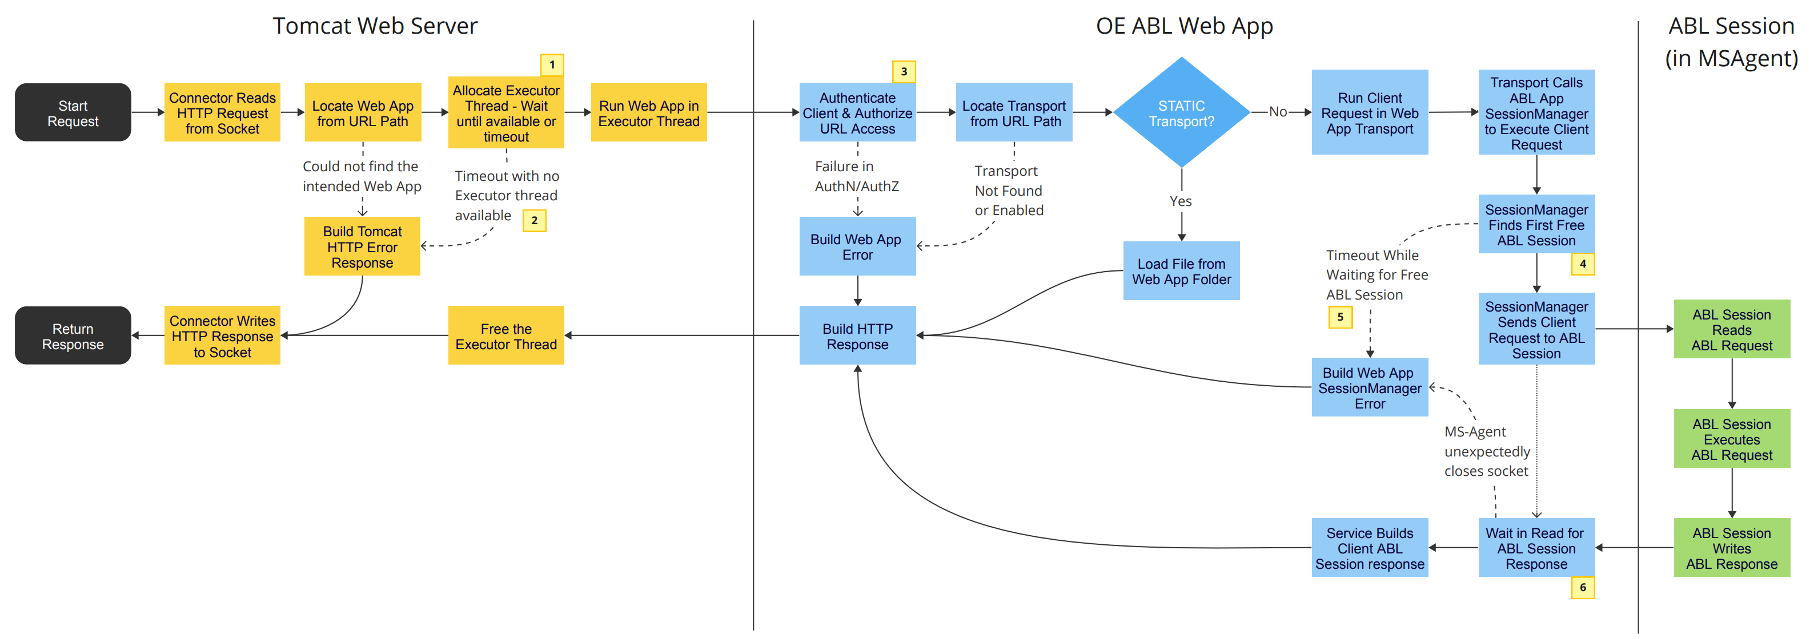
HTTP Request Execution
Java
Java
AVM
https://docs.progress.com/bundle/pas-for-openedge-management/page/PAS-for-OpenEdge-configuration-properties.html
Notes:
This is the flow of the HTTP request through the tomcat server, into PASOE, shown here as OE ABL Web App and finally the code is executed in the multi-session Agent/AVM.
You can use this QR code to get to the documentation

Slide 27
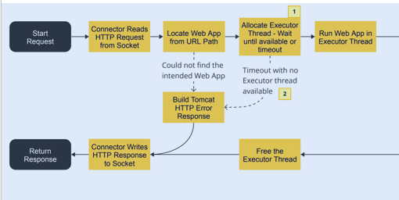
Tomcat
Java
Java
AVM
Notes:
This is governed by the psc.as.executor.maxthreads value in catalina.properties and affects all client connections to the web server container for a PAS instance.
Each request will be serviced from the executor thread pool, which will grow according to the number of active requests plus the value for psc.as.executor.minsparethreads, up to the maxthreads value.
For more information, see Configure Tomcat properties.
This is affected by the psc.as.[http|https].connectiontimeout values in catalina.properties

Slide 28
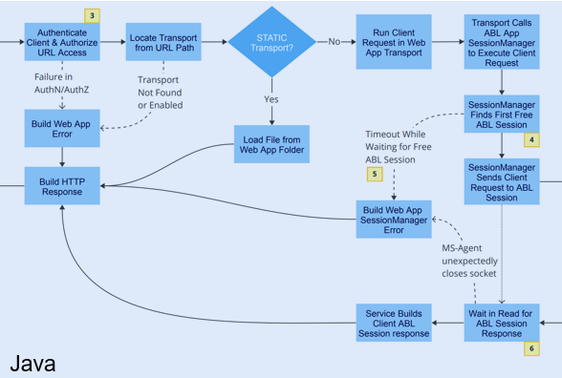
PASOE
Java
Java
AVM
Notes:
This refers to the Spring Security settings in oeablSecurity.properties and oeablSecurity.csv
For more information, see Configure security properties.
Multiple values from the SessMgr sections of openedge.properties file affects this area: connectionWaitTimeout and maxConnectionsPerAgent/maxABLSessionsPerAgent
For stateless connections (read: web, rest, soap transports): A "free" ABL Session is defined as any unused connection in any MSAgent which has an available ABL Session.
For the APSV transport: Bound ABL Sessions define "free" as any unused connection to the same MSAgent which contains the bound ABL Session.
For more information, see Configure OpenEdge properties.
This is affected by the requestWaitTimeout in the SessMgr sections of openedge.properties
This is affected by the completeActiveReqTimeout in the AgentMgr sections of openedge.properties

Slide 29
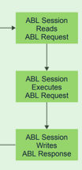
Multi-session Agent (AVM)
Java
Java
AVM
Notes:
And finally the ABL code is executed and a response is sent back to PASOE.

Slide 30
Testing and Tuning Guidance

Slide 31
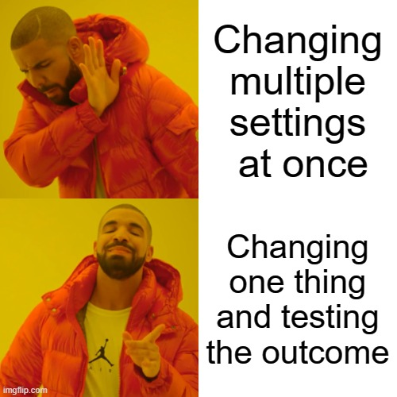
“Turn the crank, smell for smoke”
- Mike Jacobs, Progress Fellow
Create a backup before any changes
Keep scope of changes limited
Always re-test and compare results
Notes:
Mike Jacobs is a software fellow at progress on our engineering team,
I love his quote, turn the crank smell for smoke.
Basically what what should you do when testing?
Well, first create a backup of your of your config files just so you have something to roll back to easily.
Yes, there are tools that we offer that should be doing this for you, but it never help hurts to have an additional backup.
It always hurts when you don't keep the scope of changes limited, meaning won't try to do too much at once and always retest and compare your results.
So basically, don't try to do too much in one go. Change one thing at a time, See how that affects your application.
Test and compare results. See how the application responded to the change, then you have a new baseline and you can go change another thing,

Slide 32

Load Testing for Production
Test all Transports: APSV, REST, WEB and SOAP
  APSV requires a true AppServer client (eg. ABL Procedure)
  REST, WEB, SOAP responds to tools such as JMeter and SoapUI
Expectations vs. Reality (aka. “We can’t replicate production!”)
  Resource starvation through virtualization or network emulation
  Setting artificial limits for Executor Threads, Agents, and ABLSessions
  Establish behavior with hardware limits prior to horizontal scaling
  Documentation: PAS for OpenEdge Tuning Recommendations
Notes:
Load testing for production.
So when we're talking about the transports, again, everything is a web server. APSV is still going to need a PASOE client of some sort: ABL, Java, .NET.
Create an ABL procedure that can make a connection, call some code on the server, disconnect, do whatever your application would do, that's a great start.
You could take something like that and run multiple in batch mode at a time and you can still exercise your code in App Server transport,
REST, Web and SOAP allow you to use tools that send HTTP requests. One good choice we use all the time is JMeter can put load on your exposed APIs.
SOAP UI is another good one for just for testing API level endpoints.
Now how do we test a full production system with a thousand users. You probably can’t. A lot of our customers cannot buy duplicate systems for load testing.
But what you can do is scale back and emulate a smaller version of your production system with less resources.
Instead you need to block the execution like sticking a tanker in the Suez Canal.
Basically, put the system under unnecessary stress, Use virtualization to cut back the amount of memory and CPU available to the server. Starve the system
You can use network emulation to slow down the connection.
Maybe you're trying to push through too much through the pipe, You know, kind of like blocking the Suez Canal.
Set lower limits for executor threads, agents and ABL Sessions. See what happens if you were to exhaust all resources.
So, if you normally run with five agents and 300 sessions per agent and 6000 executor threads to get your production system handling the full load.
Scale that back on your QA or staging system to something that's way smaller. Just to see what happens when the PASOE instance gets starved of availability.
And then once you know what's going on, you could figure out what you need to do:
Do you just need more hardware or do you need to do scaling?
Do you need to do load balancing
Do you have memory leaks
Know your hardware needs on one machine before scaling to multiple machines to spread the load.
And there is a link in the documentation. There's a whole section on tuning recommendations.
We've updated a lot of this over the past few years. If you have not taken a look at it in a while, I encourage you to take another look.

Slide 33
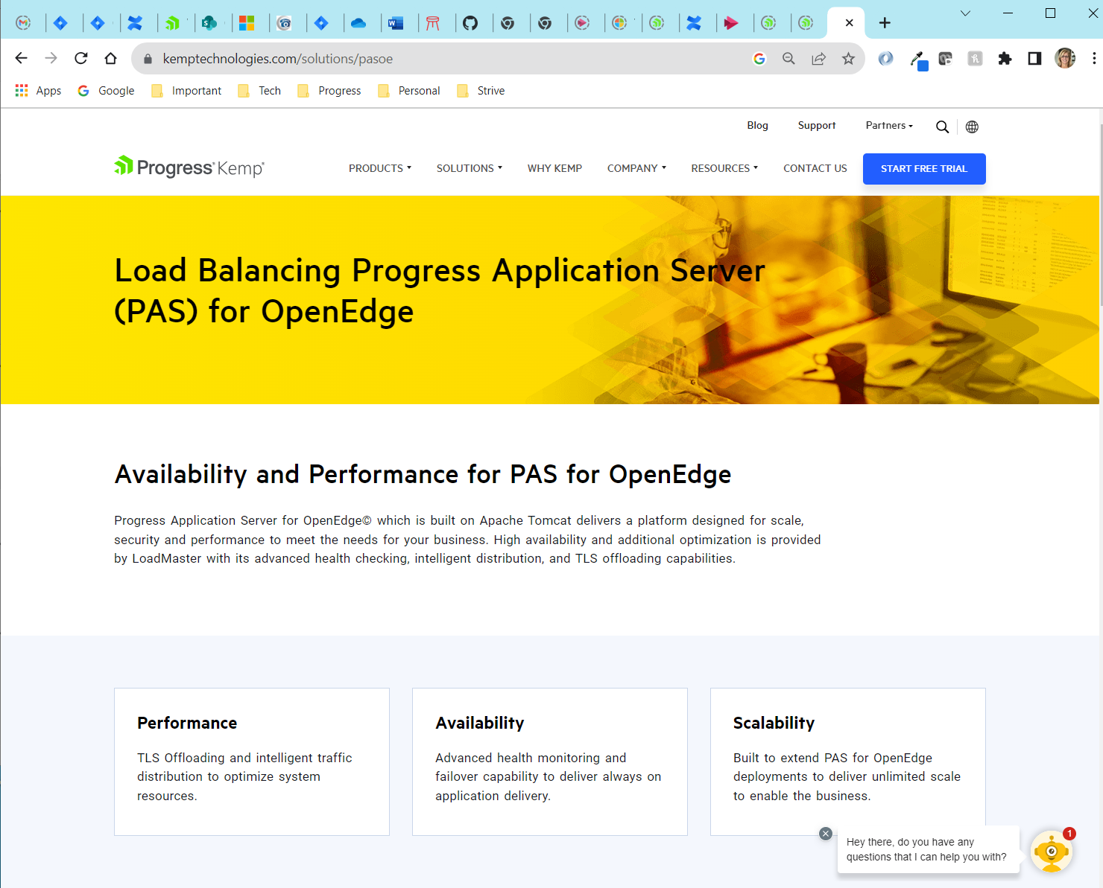
Progress Kemp LoadMaster
Notes:
LoadMaster delivers increased reliability by removing single points of failure both within a single data center or across multiple data centers or clouds.
Increase application performance by offloading unnecessary SSL/TLS overhead from the PAS for OpenEdge servers
and place the burden on the LoadMaster which is optimized to handle the encrypted traffic.
Load balance your PASOE instances for performance and deployment techniques like blue/green deployment.

Slide 34
General Tuning Guidance
Session Manager
  minAgents/maxAgents/initialAgents should be set to 2 as a baseline
  max[ABLSessions|Connections]PerAgent can be set to equal values, ~100
    For APSV bound sessions, maxABLSessions should be > maxConnections
      Connections == user concurrency; ABLSessions == reserved for work
Agent Manager
  numInitialSessions set to 2-10% of Max ABLSessions
  minAvailableABLSessions set to 1 in 99% of cases (max = 2)
Documentation: ABL Session Manager and Session Pool
Notes:
OK, so general guidance, let’s do a recap of what we just saw:
For the Session Manager
Set the min, Max and initial properties to two as a baseline for new applications
The Max ABL sessions per agent and the Max connections per agent should be set to equal values
Connections recycled and reused unless bound by APSV – limits number of connected user at one time; Always have at least one available session
Unless… if you're using APSV and you expect to have bound sessions, you're going to need more ABL sessions than connections because the bound sessions are no longer available to other clients so only the APSV connection that originally was bound to it can come back to use it. We need to make sure that we have new available ABL sessions for work to be done by other connections.
For the Agent Manager
Num initial sessions. A good starting point is at least 2%, up to 10% of your Max ABL sessions. We don't want to start too many sessions because they're just going to sit around unused consuming memory but er want to have enough started that we can handle an initial burst of requests.
Min Available Sessions. This makes sure that there is always an available session around. In most cases one is good. Rarely, if ever, does this need to be increased, and Even so we would not recommend setting it higher than two.
The link at the bottom of this slide explains this is much more detail.

Slide 35
Do The Math! Or Tune for Your Environment
Default values are only a starting point!
  One ABL Application (default)
  Executor Threads = 300
  Max Agents = 2
  Max ABLSessions, Max Connections per Agent = 200
Defaults are not optimized for your application
  Defaults allow 400 ABLSessions, or 100 more than the Executor Threads
  Tomcat will queue excess requests until an ABLSession becomes available
Notes:
The other thing we need to make sure of is we need to do the math so all default values define a good starting point.
You MUST for your ABL applications, for each of your ABL applications for each of your instances.
So, let’s look closely at the shipped defaults which may not be best for your application
By default the executor threads are set to 300. If we have 2 agents and 200 max connections per agent, that allows 400 concurrent ABL sessions that could potentially be started and 100 more than the executor threads. This is ok because Tomcat will queue those are excess requests until an ABL session becomes available. It is important to consider will that work in your situation. Remember every thread, every connection consumes memory just because it exists.

Slide 36
Moving to Production

Slide 37
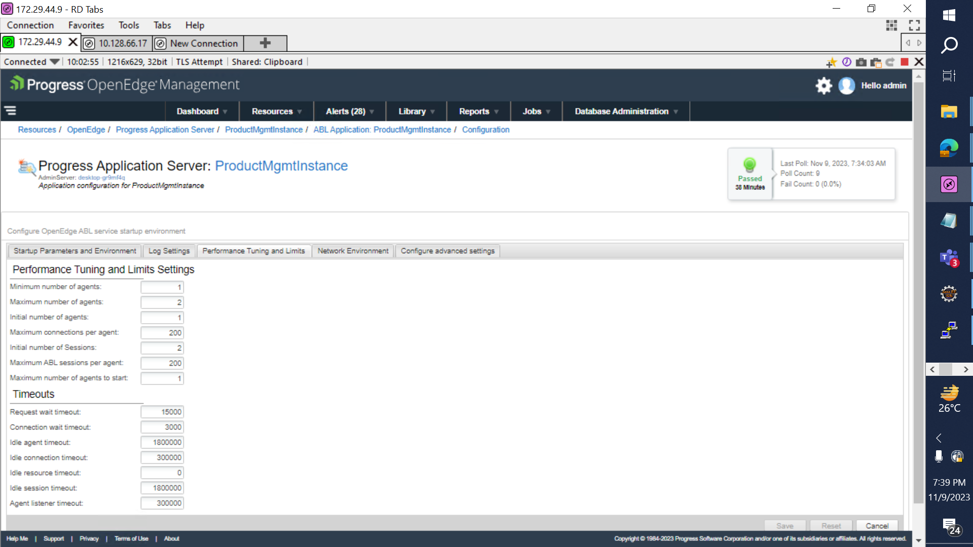
OpenEdge Command Center: PASOE Instance
Notes:
The OpenEdge Command Center (OECC) is a cloud-ready OpenEdge management console capable of managing multiple OpenEdge resources and versions. The vision of OpenEdge Command Center is to offer substantial productivity gains for the day-to-day administration and management of the OpenEdge platform.
This is a look at setting properties that we discussed earlier for a PASOE instance. This is where you can set:
Minimum and Maximum number of agents
Initial number of Agents
Max Connections per Agent
Initial Number of Sessions
Min and Max number of Sessions
And timeouts which are also very important to tune for your application to the expected maximum time for a request, for a session to be idle, etc.

Slide 38
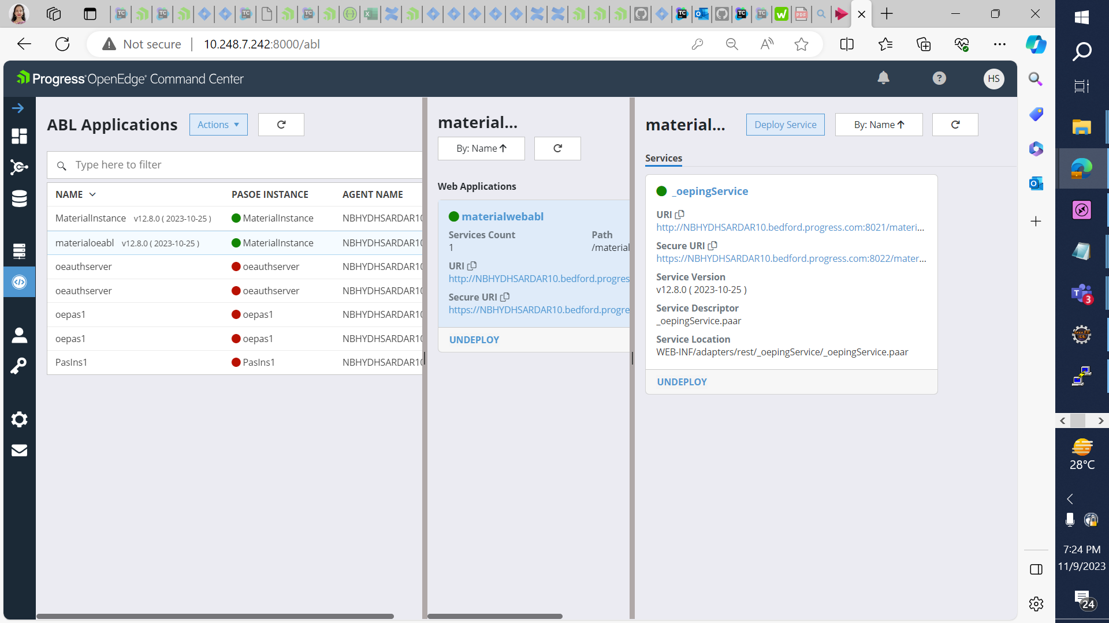
OECC: ABL Applications and Services
Notes:
You can also use OECC to see the deployed ABL Web Apps and Services within each Web App.

Slide 39
Pre-Production Checklists
When, where, and how is your deployment?
  Complete Packaging Options: war and oear
  Incremental Packaging: Procedure Libraries (.pl or .apl)
  Service Packaging: zip, oeds, and paar
  Properties Files: appserver, catalina, and openedge in the /conf/ directory
  Scripting via built-in tools: “tcman feature”, “tcman config”, and “oeprop -f”
Two security models set via the -Z option in “tcman create”
  “pas” and “prod” intended for production deployment and turns off all access
  The “pas” model replaces the ROOT webapp with noaccess.war
  Documentation: PASOE Security Models
Notes:
I know we've we've gone through a lot of server talk.
Let’s move on to real production stuff.
When you roll out to production, do you know where your production servers, Are they on Prem?
Are they in the cloud?
Do you know how to get your new code or artifacts or services or whatever out to the production servers for your deployment?
Some of that questioning comes in with depending on how you've packaged these things.
Complete packaging:
There are WAR files which is a web application package known by Tomcat.
There's a newer package called the Open Edge Archive OEAR which is deployment of the full ABL Application
Incremental packaging:
Are you packaging you code into libraries? In additional to pl files we now have a true zip file named APL which can be signed before deployment
Service packaging:
You can package your services independently. There are options here like just a zip file, OEDS (Open Edge data service) for web transport,
and PAAR, which is the Progress Application Archive for REST services.
Don’t forget configuring your PASOE property files
There's the appserver.properties, Catalina.properties and openedge.properties.
And lastly you will need to create your scripts for deployment using tcman and oeprop –f
You really should script your actions so that you know exactly what commands need to be run and then you can execute them easily and quickly on your test and production environments
=========================================================================
Another thing is when you're running on production, there are actually two production modes.
There's a –Z option for TC man create when you create your instance, there's what's called the PAS or PROD mode.
Both of these are for production deployments. They are the opposite of the development configuration.
They shut off everything, like there is no access, you have to knowingly turn on transports, adapters, etc.
The PAS model goes one step further. The PAS model replaces the root web app with the no access war.
This means the only way to get something to run on the port is to deploy a new web app.
Finally use the –f option to deploy the management and monitoring apps.

Slide 40
Updated Guidance!
Use the –f (full) option on tcman create to deploy management web apps
  Located in DLC/servers/pasoe/extras
  Used by the OpenEdge Management (OEM) Console and OpenEdge Command Center (OECC)
    These provide insight to ABL Applications, their agents, and individual ABLSessions
Remember to secure access
  Credentials can be updated in OECC and OEM Console
    Documentation: Secure the [Tomcat] manager and oemanager webapps
Notes:
We recommend you Install the management web apps into production.
Previously it was stated that these should not be run in production. That is not true as long as they are secured properly.
But the PASOE monitoring and management tools need these be deployed to work
The OpenEdge Command Center (OECC), use these APIs to get information about your running PASOE instance.
As well as OpenEdge management (OEM), require these manager web apps to be deployed.

Slide 41
Log Files

Slide 42
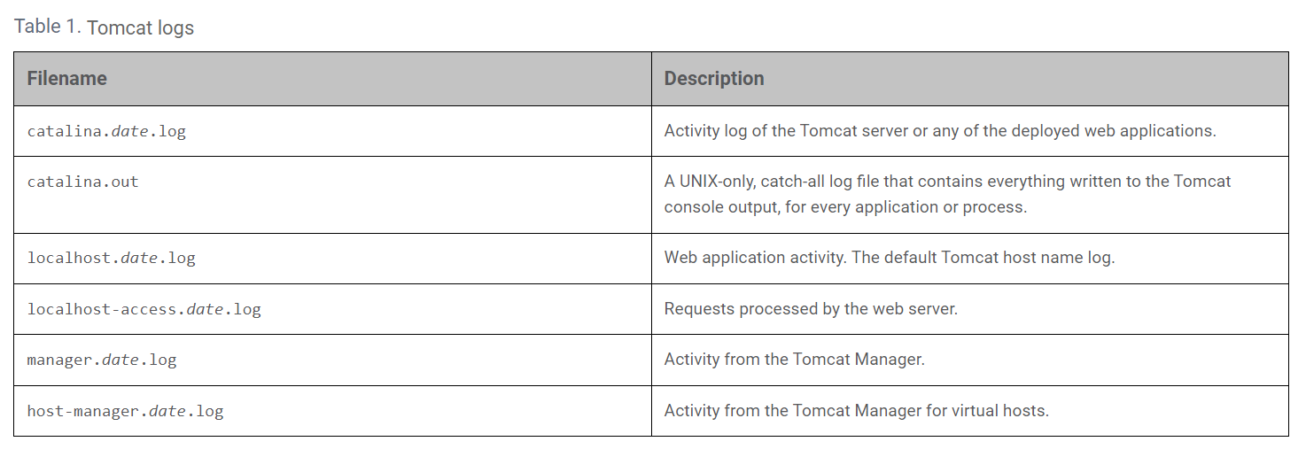
PASOE Log Files: Tomcat
Documentation: PASOE Log Files
Notes:
Logfiles. There are three levels of log files
- Tomcat
- ABL Application/Agent
- Management web apps
Tomcat logs contain logging information for the web server and JSP servlet container of a particular PAS for OpenEdge instance. These logs include Catalina logs for the core server, localhost logs for the Tomcat virtual server, server access logs, and Tomcat Manager logs.

Slide 43
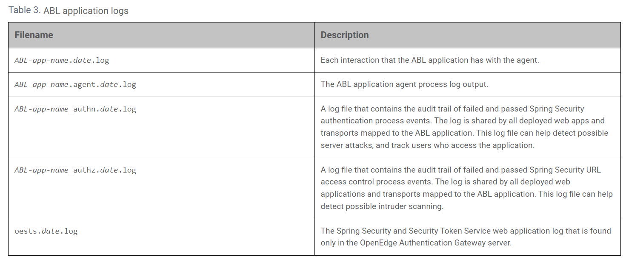
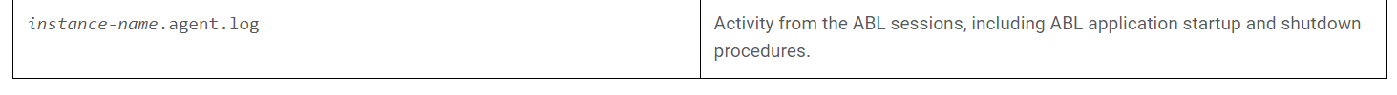
PASOE Log Files: ABL Application / Agent
Notes:
PAS for OpenEdge creates log files at three distinct levels:
ABL application-level logs contain logging information for ABL applications running on a PAS for OpenEdge instance.
This includes Spring Security authentication and authorization process event logs,
and multi-session agent logs containing logging information for the ABL Session Manager running on a PAS for OpenEdge instance.

Slide 44
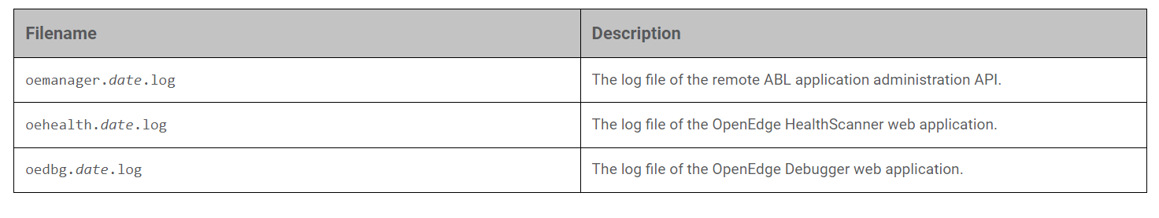
PASOE Log Files: Management Apps
Notes:
Instance-level independent logs include remote management and server support logs, and user-deployed Java web applications.
For more information, see Configure logging in PAS for OpenEdge in Manage Progress Application Server (PAS) for OpenEdge.

Slide 45
Monitoring PASOE

Slide 46
Why Monitor?
Identify under performing system components by monitoring response times and fixing the root cause of any performance issues
Proactively watch load come into your system and validate the request routing is efficient and the system is well balanced
Determine if your deployment environment is healthy before disaster strikes
  Consider setting thresholds for your environment
  Terminate ABL Sessions under certain conditions
Gather trending data to make sure you are running at peak performance
Notes:
Identify under performing system components by monitoring response times and fixing the root cause of any performance issues
Proactively watch load come into your system and validate the request routing is efficient and the system is well balanced
Determine if your deployment environment is healthy before disaster strikes
Consider setting thresholds for your environment
Terminate ABL Sessions under certain conditions
Gather trending data to make sure you are running at peak performance

Slide 47
Monitoring PAS for OpenEdge
Use “tcman pasoestart” or “tcman oeserver -start” (12.5+) for startup error checks
  “tcman start” only reports Tomcat errors
Use “tcman oeserver -status” (12.5+) to get agent and session status
OpenEdge HealthScanner (12.0+)
  Requires adjustment from out-of-the-box values—these are just a starting point!
  Score can be used to identify deeper issues, based on OS health metrics
  Does not record or log data for trending/analysis but feed data into other tools
Use either OEJMX (command-line) vs. oemanager (runs over a network)
Documentation: Monitor PAS for OpenEdge Instances
Notes:
There are numerous tools available to monitor PASOE instances.
Use tcman pasoestart or in 12.5 and newer use tcman oeserver -start to get the agent and session statuses.
These do a few more things but the important part is these do start up error checks and tcman does not.
Just because tomcat started doesn't mean all the open edge components started and the tcman -oeserver start checks log files for error.
You can use tcman oeserver –status to get the agent and session statuses.
That is different from what we've had previously, which just gave you the list of your agent Pids.
This now gives you information about what is actually going on with each agent and tells you if it's agent and it's sessions
Run the OpenEdge HealthScanner. You can think of this like the check engine light for a vehicle.
This doesn't trend any data. It just returns information as you request it. So, it's an instant snapshot of the server health.
There's a score that comes back, a weighted score based on factors like disk space, CPU usage, memory availability, and that gets fed into a formula and outcomes a number.
You can also go into a detail view that will actually tell you why it failed.
One usage of this is to set up a load balancer to look at each of the servers and check the score. If you consider the server to be unhealthy it can be taken out of rotation.
And then lastly, you can use OEJMX which is a command line utility or the OEManager which we covered earlier that can run over a network. There is a Swagger API for oemanger which is nice to try out the API using tools like POSTMAN. I highly recommend using those to get introspection and information out of your instance.

Slide 48
Monitoring Tools
ANNOUNCING in 12.8 LTS: OEManager Command Line Tools
  Formerly called the “Iceberg tools” or the “PROANT scripts”
  Run “oemanager[.sh] status” to see instance status & config values
  Uses the oemanager web app to monitor and manage a PAS instance
  Deployed to the CATALINA_BASE/bin directory and automatically tailored
PulseMetrics for 12.2+ github.com/progress/iceberg repository
  Monitored results with relation to a timestamp can be visualized… Let’s take a look
  Code: Experimental monitoring solution: PulseMetrics for 12.2+ in Iceberg repository
Notes:
A new, easier to use monitoring tool is available in 12.8, the OEManger Command Line ToolsS
These have been available for a while in the public Progress GitHub Iceberg repro as the proant command line tool.
In 12.8 they are part of every PASOE instance and are automatically tailored for the instance. You don't have to do any post installation.
You can just run the oemanager status script to see the instance status and config values. This is a great way to monitor your instances over time especially in your early deployment phase.
It also has a trim operation to remove idle sessions. Ability to start and stop Agents.
Under the covers this calls the oemanager REST APIs and abstracts all of the work you needed to do when calling those APIs directly.
Still left in the Iceberg repository for 12/2 is an “experimental” monitoring solution.
This trends data over time. How much memory is used by the sessions, how many agents are actually running, how many requests have been pushed through each session.
The data is time stamped so we can recreate a timeline of how the system is running.
For this session, I did some benchmarks for an ABL Application. Lets take a look.

Slide 49
A tale of 3 virtual machines…

Slide 50
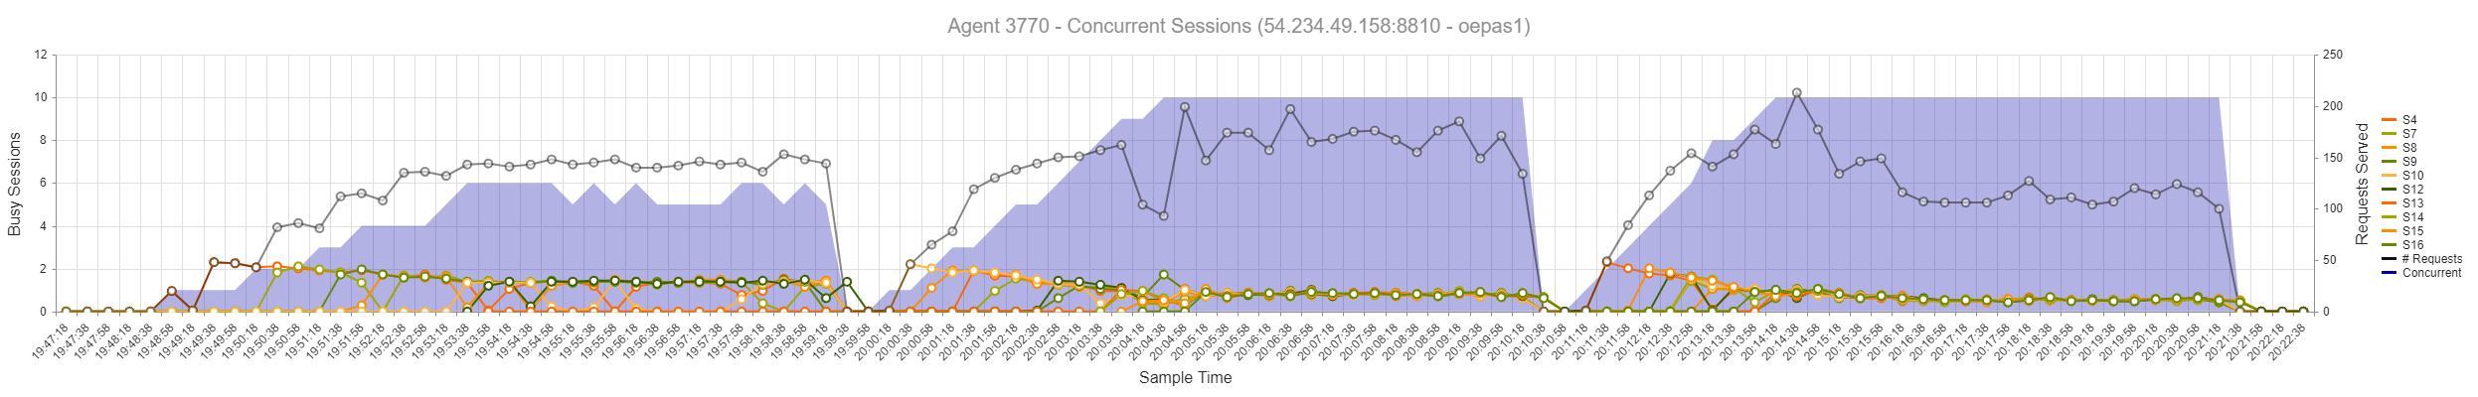
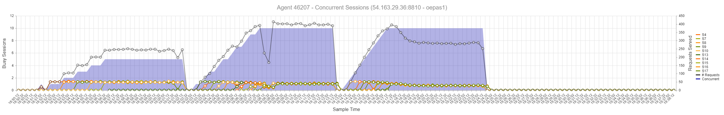
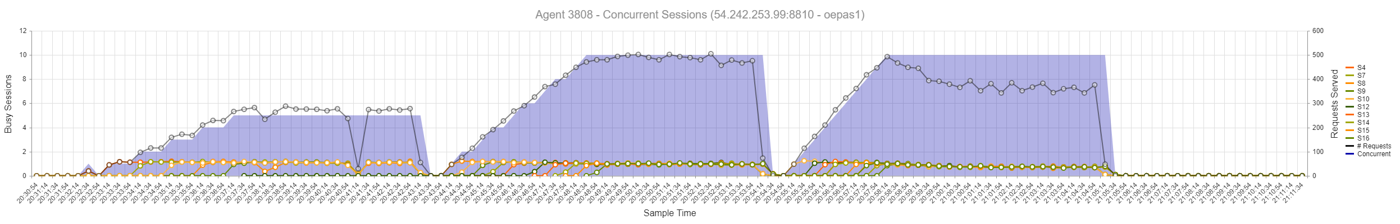
Requests Served
t3.medium
Peak 200
t3.xlarge
Peak 375
m6i.xlarge
Peak 500
Notes:
This shows the results of load-testing the same application on 3 different EC2 machine types: t3.medium, t3.xlarge, and m6i.xlarge.
The tests run were designed to push the limits on connections, not CPU or memory. There were no database connections in use.
On the lowest tier the application could not serve more than ~200 requests at any time. Upgrading the CPU and memory nearly doubled that to ~375 requests, and again upgrading pushed to ~500.
I was running a benchmark test on a small AWS instance, then I upped it to a larger machine and then upped it again and I and I could actually see improvements by going to larger hardware where basically the number of requests that could be serviced increased as I scaled up on the hardware.

Slide 51
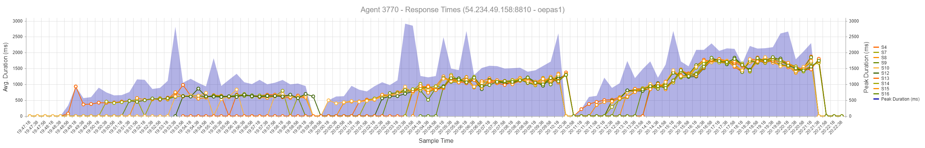
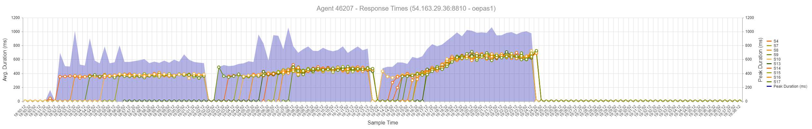
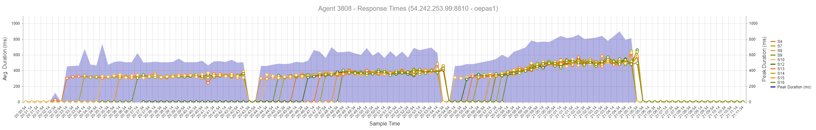
Response Times
t3.medium
Peak 2.5s
t3.xlarge
Peak 1s
m6i.xlarge
Peak 800ms
Notes:
I also noticed that not only was I serving more requests, I could also get information out of this about how the response times.
So on the on the lower hardware it was taking upwards of 2.5 seconds at peak to return response which for an end user usually sub second response time is what you're going for.
And so I finally got that I found my sweet spot for this particular test on on my third instance on my 3rd EC2 instance and that that got me the response times I wanted and I got more throughput.

Slide 52
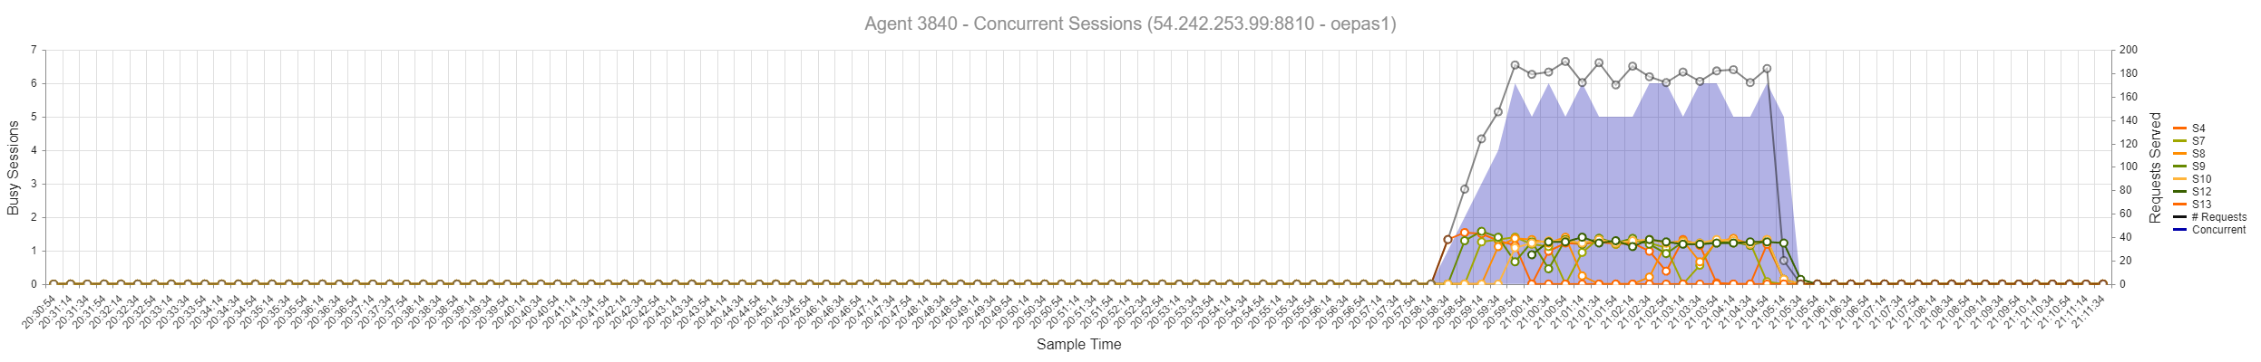
Multiple Agent Activity
m6i.xlarge – Agent #1
m6i.xlarge – Agent #2
Notes:
So it wasn't until we really ramped up the test that we saw that second agent come into play and that just showing it graphically, what does that look like?
Looking at only the m6i.xlarge machine instance over the same time interval, we can see where the 2nd agent began handling requests which exceeded the 10 sessions available on the first agent.
This is a runtime picture of the example we looked at to see how requests were routed to sessions.
So same time stamps, same PASOE instance, Agent One, Agent Two.
You can see when agent One got saturated and it needed time to spin up an additional sessions, those requests started going to the second agent as you can see in this slide.
So, this is the type of analysis you can do with the pulsemetrics. Compare different configurations, fine tune and figure out where is your hardware sweet spot.

Slide 53
What if I haven’t Migrated Yet?
Notes:
OK, you’ve made it this far but what if I haven’t migrated to PASOE from Classic AppServer or WebSpeed.
12.8 is the time to do it.

Slide 54
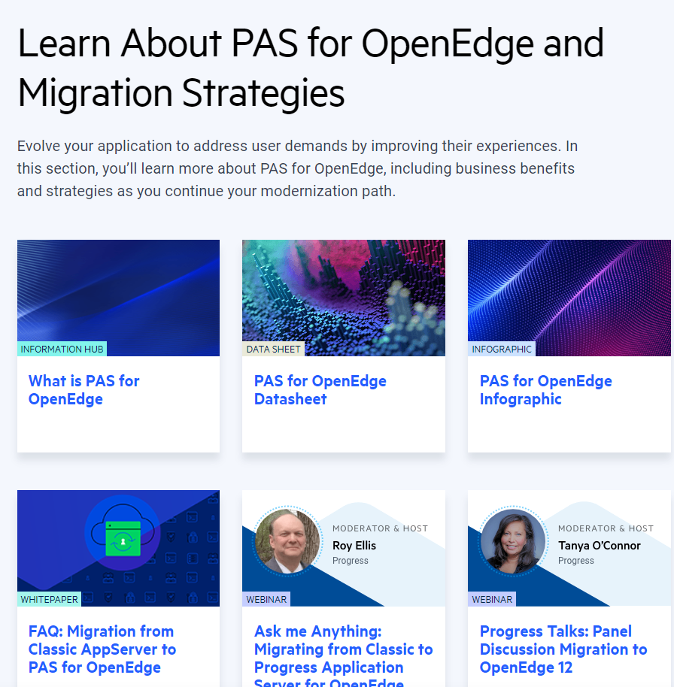
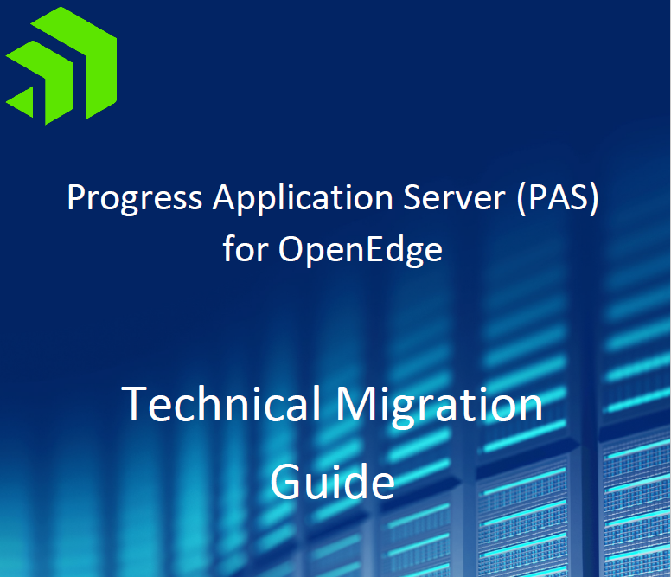
How Do I Move From Classic to PASOE?
Technical Migration Guide
https://www.progress.com/resources/papers/ progress-application-server-(pas)-for-openedge-technical-migration-guide
Migration Strategies and Resources
https://www.progress.com/openedge/components/ progress-app-server-for-openedge/resources
Notes:
And we will help you.
- technical migration guide
- migration strategy resources, webinars, whitepapers, how to’s, etc.

Slide 55
Summary
Deploy and secure the management webapps for insights
Utilize the OEM Console or OECC, and HealthScanner
Keep clearly-defined pass/fail indicators in check
Check on PASOE metrics regularly, in addition to OS resources
Learn how your application responds to strained resources
Understand how and where to terminate sessions and agents
Identify when to scale up (hardware) before you scale out (quantity)
Notes:
So in summary:
Deploy and secure the management webapps for insights
Utilize the OEM Console or OECC, and HealthScanner
Keep clearly-defined pass/fail indicators in check
Check on PASOE metrics regularly, in addition to OS resources
Learn how your application responds to strained resources
Understand how and where to terminate sessions and agents
Identify when to scale up (hardware) before you scale out (quantity)

Slide 56
Q&A

Slide 57
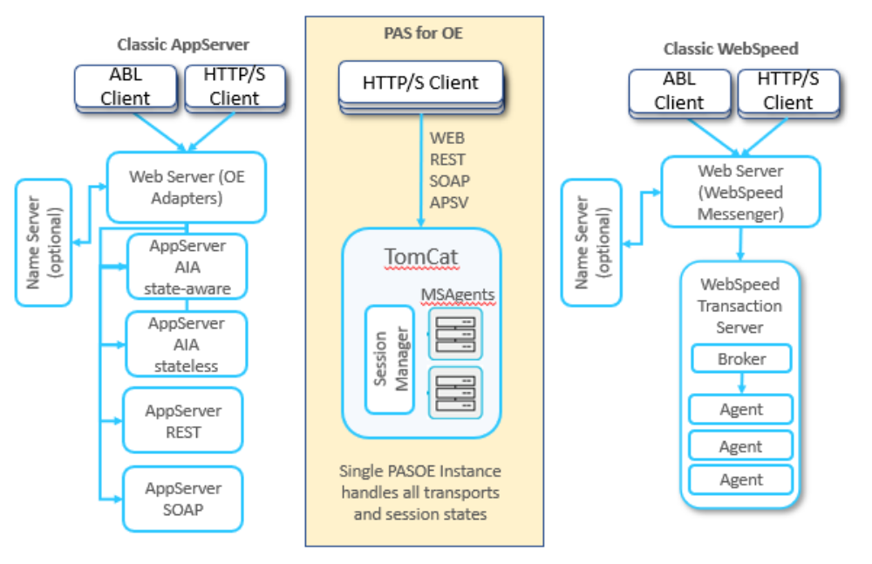
Comparison of PASOE to Classic AppServer and WebSpeed

Slide 58
Past Presentations
EMEA PUG 2023 “Are You Vulnerable? Securing PAS for OpenEdge” with Anil Kotha
EMEA PUG 2023 “Customer Migration Success Stories” with Cameron Wright and Dustin Grau
Progress NEXT 2019: “PASOE Troubleshooting with Pulse Metrics”
Virtual NEXT 2020: “Best Practices for Migrating to OpenEdge 12”
EMEA PUG 2018: “Why Migrate to the Progress Application Server?”
Want a Feature in PASOE? Submit and Vote on Ideas!
https://openedge.ideas.aha.io/

