Slide 1




Progress in the world of other databases
Dmitri Levin, DBA Manager
Frank Cepeda, Jr DBA
Progress, Oracle, SQL Server, MySQL
Alphabroder Co
Philadelphia PA

Slide 2




Alphabroder Inventory
36 Databases
13 Databases
250+ Databases
4 Databases

Slide 3
Databases
RDBMS
Oracle
MySQL
MS SQL Server
PostgreSQL
IBM DB2
MariaDB
AWS Aurora
Progress
Key-Value Store
Redis
AWS DynamoDB
Memcached
MS Azure Cosmos
Oracle No-SQL Db
Document Databases
MongoDB
Couchbase
CouchDB
Google Cloud
PostgreSQL (EDB)
AWS DocumentDB
FounaDB
Search Engines
Elasticsearch
Splunk
AWS CloudSearch
MS Azure Search
Time Series DBMS
InFluxDB
AWS Timestream
Graph Databases
Neo4j
MS Azure Cosmos
Oracle Spatial and Graph
AWS Neptune
In-Memory DB
IBM dashDB/DB2
Oracle Times Ten
SAP HANA
AWS
Wide Column Store
Cassandra (FB)
HBase
Most popular
Open Source

Slide 4
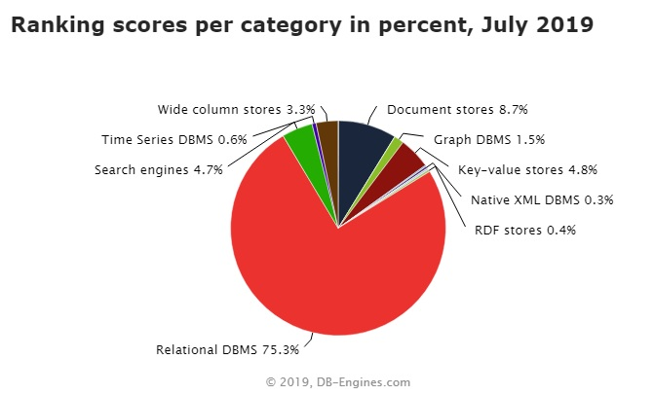
Notes:
There is a recent trend to provide a merged database solution. i.e. both SQL and NOSQL in one box.

Slide 5
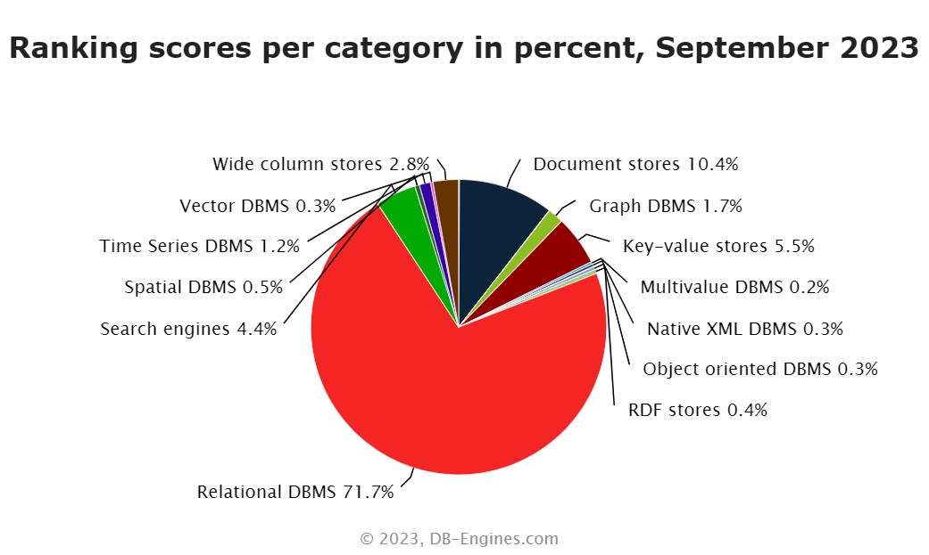

Slide 6
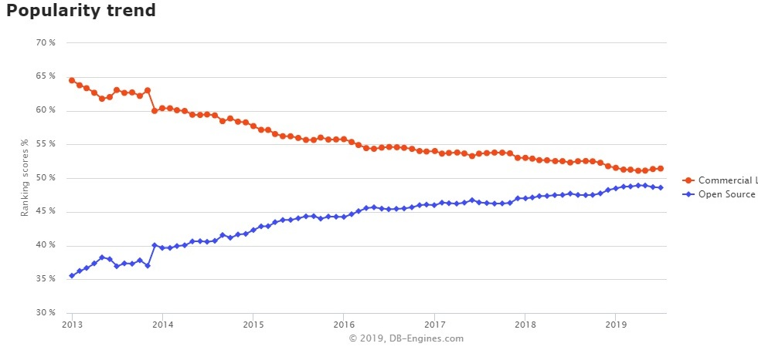
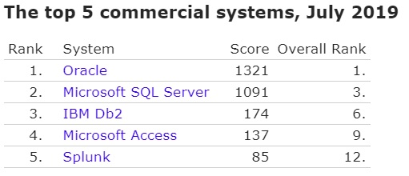
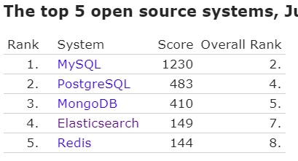

Slide 7
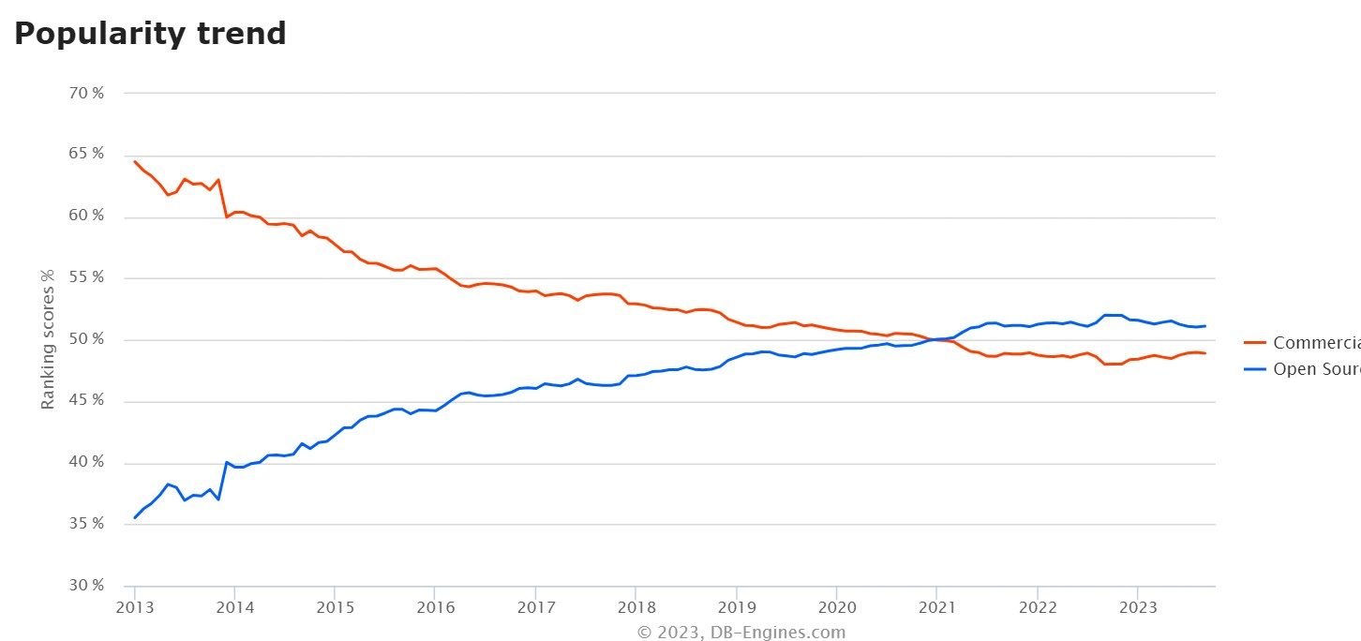
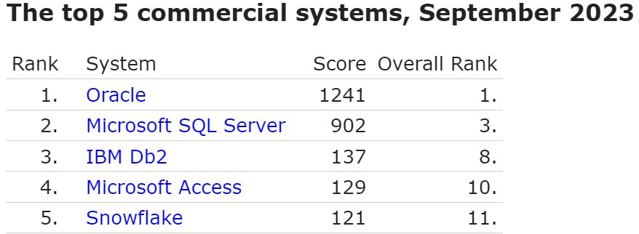
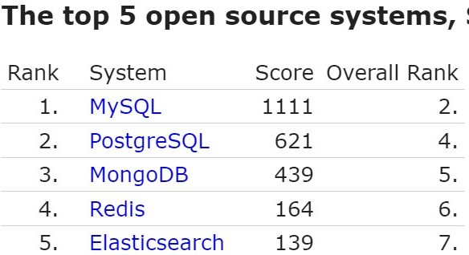

Slide 8
Progress vs Oracle vs MSSQL
-pf file | initSID.ora or spfileSID | Registry/Configuration Console (Windows Only)
anywhere | ORACLE_HOME ( aka DLC ) | Environmental Variables/anywhere(Linux Only)
proutil db-name -C increaseto | alter system set parameter
VST _DbParams find _DbParams where _DbParams-Name = "-spin". assign _DbParams-value = "2000". | V$ V$PARAMETER V$ V$spParameter | Sys Views [sys].[dm_server_registry]

Slide 9
Prorgess vs Oracle vs MSSQL
After-imaging | Archiving | Recovery Model
By default, turned off | By default, turned on | By default, turned on FULL
Does not remove old AI files | Does remove old archive logs | Does remove completed transactional log records after log backup
Progress
Oracle
MS SQL Server
PROD
With After-images
W/O After-images
ARCHIVELOG Mode
NOARCHIVELOG Mode
FULL Recovery Model
SIMPLE Recovery Model
Bulk-logged Recovery Model
DEV

Slide 10
Physical Structure (data files)
Progress |  | Oracle |  | MSSQL
Database File | sports.db | Control File(s) | control01.ctl | Master.mdf
Structure file | sports.st | N/A |  | N/A
System Area | sports.d1 | System Tablespace | system.dbf, | master db
Seed to create | $DLC/empty8 |  | PDB$SEED | model db
D Files | sports_7.d | Datafiles | tablespace.dbf | dbname.mdf
Before-Image File + After-Image File | sports.b1 + sports.a1 | Undo tablespace + Redo Log | undotbs.dbf + redo01.log | dbname.ldf
Copy of After-Image File | sports.date_time_etc | Archive Log | sports.date_time_etc | Copy of .ldf
Log File | sports.lg | Alert Log | alert_SID.log | MS SQL Studio
Parameter File | sports.pf | pfile (or spfile) | initSID.ora | Registry
Notes:
Progress and Oracle are quite different in transaction processing. No direct map of .bi and .ai
Oracle alert Log: All startup parameter, but no user connect/disconnect
SQL Server keeps by default 6 ERRORLOGs: ERRORLOG, ERRORLOG.1, etc.
C:\Program Files\Microsoft SQL Server\MSSQL.n\MSSQL\LOG\ERRORLOG

Slide 11
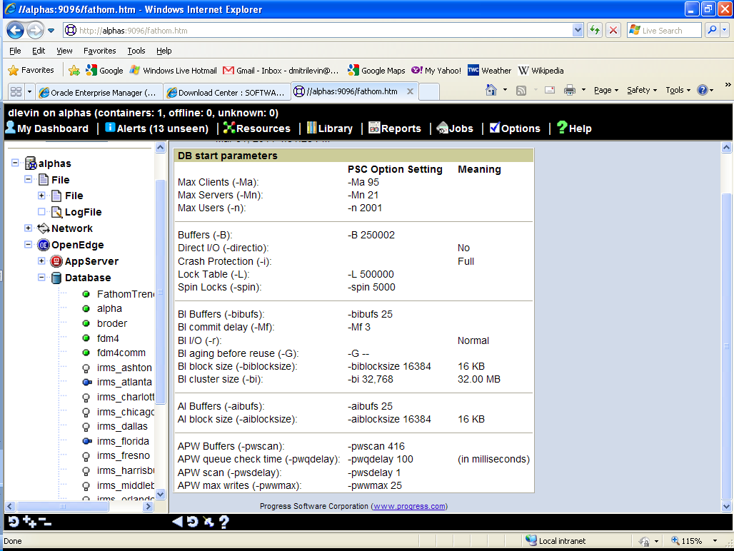
Notes:
proutil db-name -C increaseto -B n -L n -bibufs n -aibufs n

Slide 12
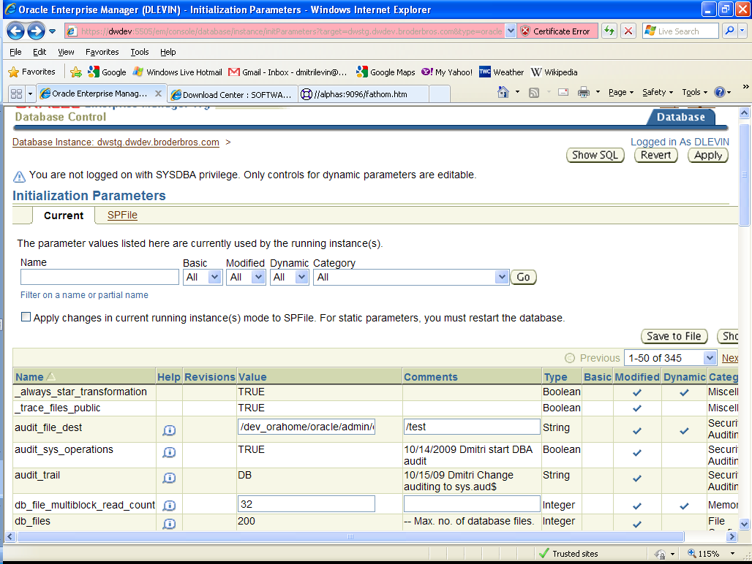
OEM parameters
Notes:
Static and dynamic parameters

Slide 13
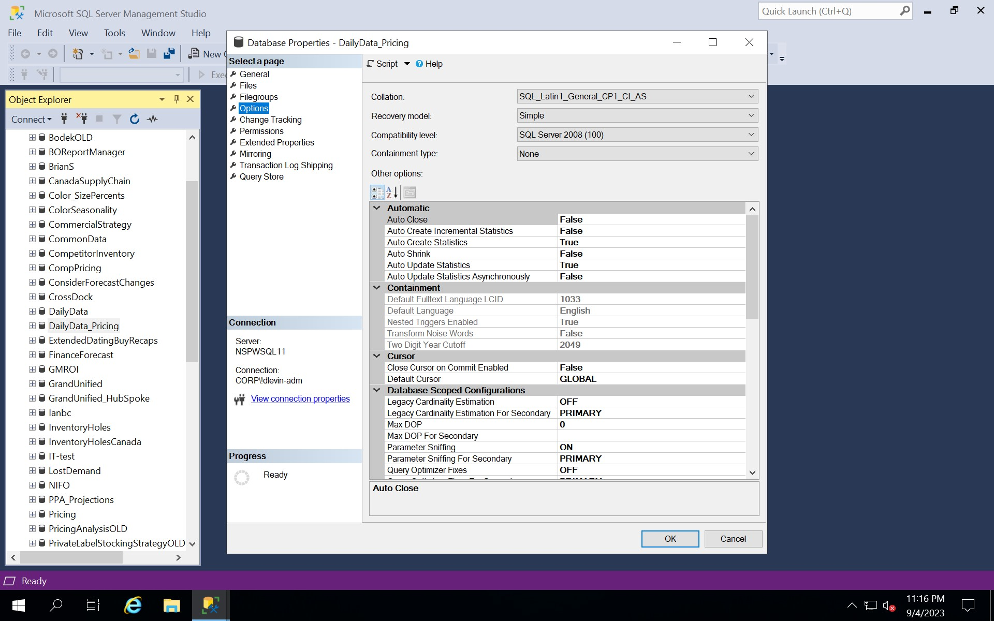

Slide 14
Logical Structure
Progress | Oracle | MSSQL
Area | Tablespace | Filegroups
System Area | System Tablespace | Primary Filegroup
Object | Segment | Object
Cluster 8,64,512 | Extent system managed | Extent 8 Pages of 8 KB each
Block 1,2,4 or 8K | Block 2,4,8,16,32 or 64K | Block 4,8,16,32,64 KB

Slide 15
Background Processes
Progress | Oracle | Description | MSSQL
APW | DBWn | Database Writer | LAZY and EAGER WRITERs
BIW, AIW | LGWR | Log Writer | LOG WRITER
AIMGT | ARCn | Archive Process | ARCHIVER
WDOG | PMON | Process Monitor | PROCESS MONITOR
 | SMON | System Monitor | SERVER MONITOR
 | CKPT | Checkpoint process | CHECKPOINT
 |  | Many other …. 170 at least | Many more… in total 77
Notes:
Log Writer, like BIW is only one.

Slide 16
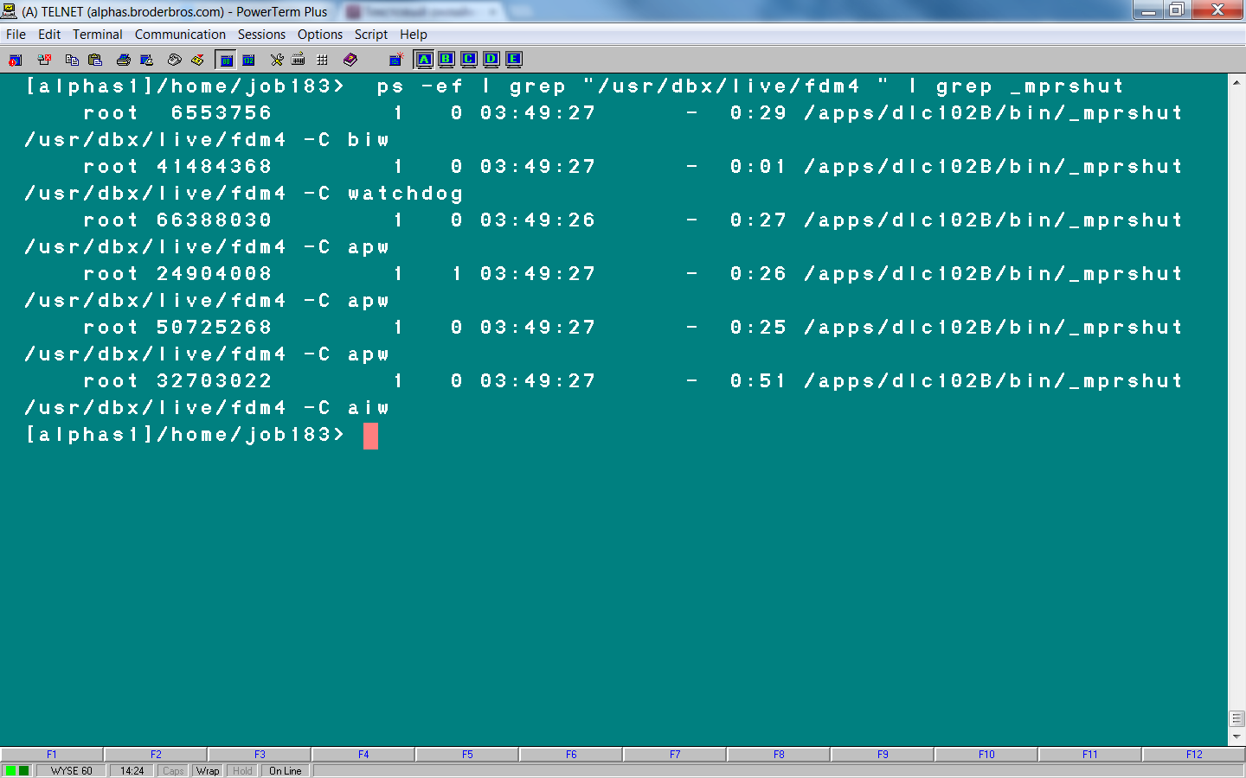
Progress: ps –ef | grep db_name| grep _mprshut

Slide 17
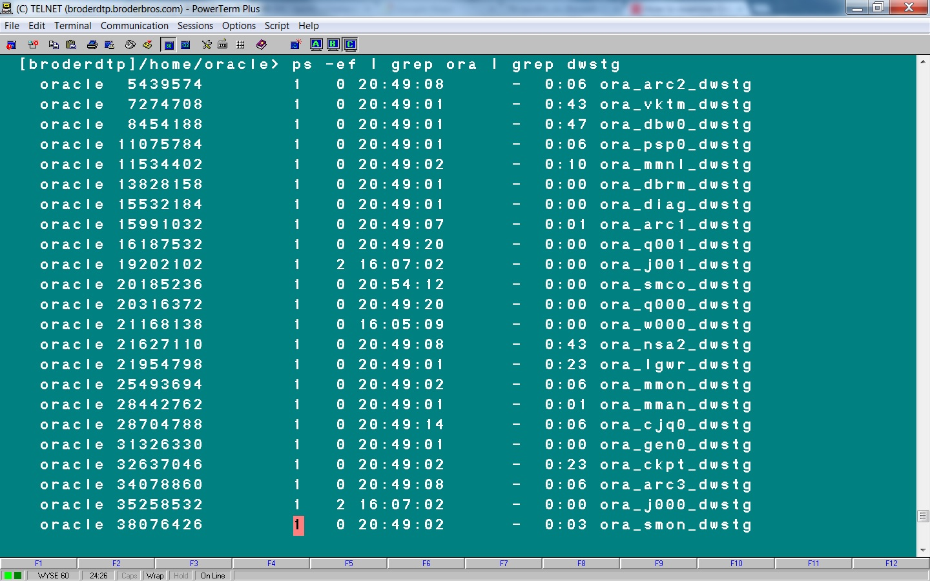
Oracle: ps –ef | grep db_name | grep ora

Slide 18
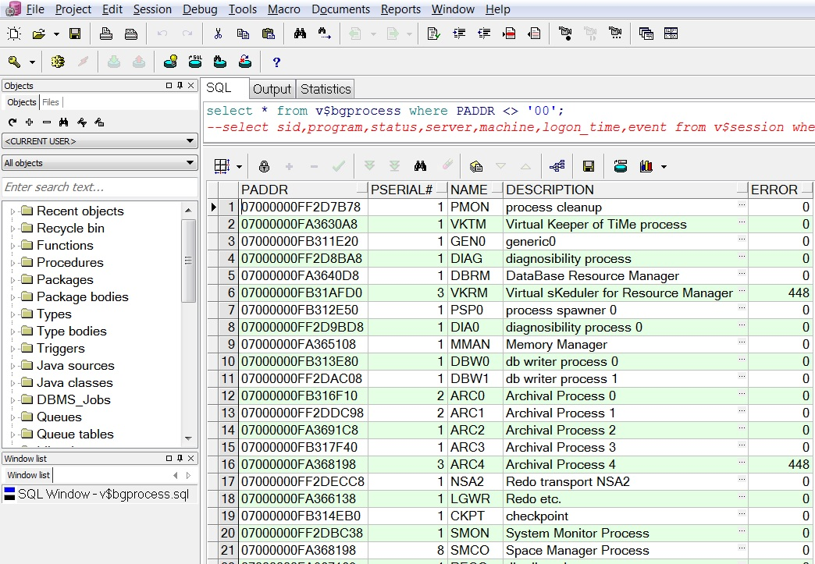
Oracle: select * from v$bgprocess;

Slide 19
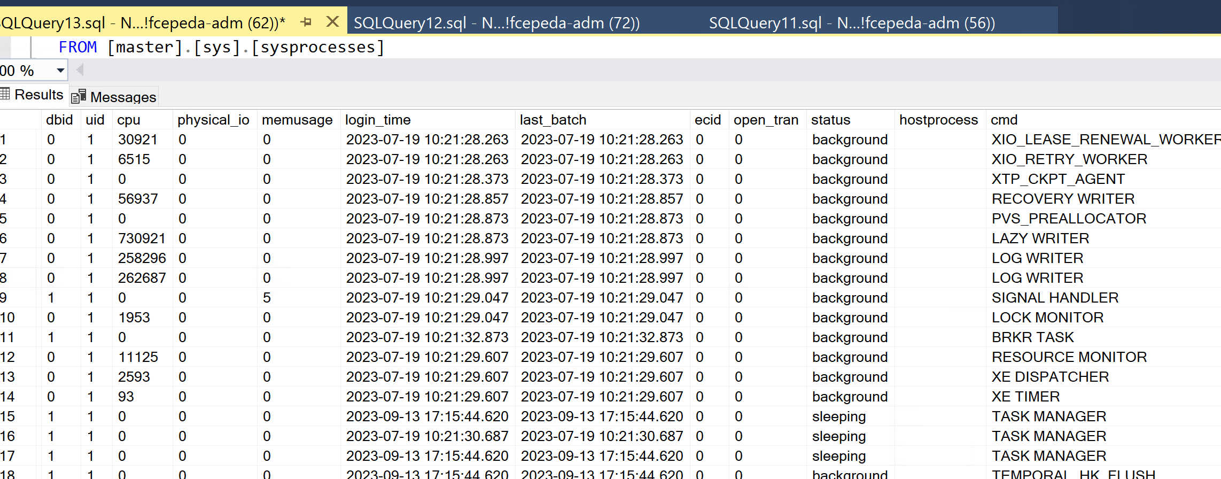
MSSQL: Select * from master.sys.sysprocesses

Slide 20
Meta-schema and VST
Progress Meta-schema tables -400 < _file-number < 0
Progress VST _file-number < -16384
Progress Table | Oracle View | MSSQL System Views
_Area | DBA_TABLESPACES | SYS.FILEGROUPS
_AreaExtent | DBA_DATA_FILES | MASTER.SYS.MASTER_FILES
_StorageObject | DBA_OBJECTS | SYS.OBJECTS
_File | DBA_TABLES | SYS.TABLES
_Field | DBA_TAB_COLUMNS | SYS.COLUMNS
_Index | DBA_INDEXES | SYS.INDEXES
_Index-field | DBA_IND_COLUMNS | SYS.INDEX_COLUMNS
_Sequence | DBA_SEQUENCES | SYS.SEQUENCES
Notes:
Every Progress table has _file record
Every Oracle view has DBA_VIEW record

Slide 21
VST/ Dynamic Performance/Management Views
Progress | Oracle | MSSQL
Virtual System Tables | Dynamic Performance Views Or V$ ( Vee dollar) Views | Dynamic System Views
_Connect | v$session, v$process | sys.dm_exec_sessions, sys.sysprocesses
_DbStatus | v$instance, v$sysstat | sys.databases, sys.stats , sys.dm_db_stats_properties
_Trans | v$transaction | sys.dm_tran_active_transactions
_Lock | v$lock | sys.syslockinfo
_Latch | v$latch | sys.dm_os_latch_stats
_AreaStatus | v$tablespace | sys.filegroups
_Filelist | v$datafile | sys.database_files, sys.sysfiles
_DbParams | v$parameter, v$spParameter | sys.dm_server_registry

Slide 22
Data Protection
Backup
Replication
Clustering
Flashback

Slide 23
Backup
Progress – simple | Oracle RMAN | MS SQL | MS SQL
probkup sports file_name
Online and Offline | Online backup only | Online backup only | Online backup only
All databases: Complete and Incremental/Differential
 | Oracle and MS SQL could be Full and Partial (some tablespaces or filegroups)
Notes:
Log backup necessary in Full Recovery Model

Slide 24
Compressed Backup
1528 GB Progress DB makes about 1038 GB probkup
1.7 TB Oracle DB makes either 1.4 TB regular backup or
300 GB RMAN compressed backup (BZIP2 is default).
Notes:
With compress backup CPU usage increases and I/O decreases. So it could be faster or slower then regular one.

Slide 25
Progress
Oracle RAC
Active - Passive
Active – Active
Server 1 Memory
Apw, Biw, Aiw, Wdog
Server 2
Server 1 Memory
DBWn, LGWR ARCn, SMON
Server 2 Memory
DBWn, LGWR ARCn, SMON
DB

Slide 26
Cluster db 2
Progress
Oracle RAC
Server 1
Server 2 Memory
Apw, Biw, Aiw, Wdog
Server 1
Server 2 Memory
DBWn, LGWR ARCn, SMON

Slide 27
Oracle Flashback
Flashback Database
Flashback Table
Flashback Drop
Flashback Query
Flashback Version Query
Flashback Transaction Query
Notes:
Six types of Flashback in 10g. They are designed to fix human errors.

Slide 28
Flashback Database
Oracle Flashback DB:
SQL> flashback database to timestamp sysdate-1;
SQL> flashback database to SCN 1234567;
Oracle Flashback Query:
SQL> select * from table_name
as of timestamp systimestamp - interval ‘30' minute;
MSSQL System Versioning Query:
select * from table_name for SYSTEM_TIME as of '2004-09-01 08:50:58'

Slide 29
Connecting to a database
Progress | Client Server -db db_name -H host -S service
 | Shared memory -db /full_path/db-name -1 single-user mode
Oracle SQL Server | Listener ( Client Server ) No single user mode, only restricted mode. -m Starts an instance of SQL Server in single-user mode. Only one user can connect to SQL Server in this mode.
Notes:
When listener is down existing users will be fine. New users will not be able to connect.
Server, Listener port, db name

Slide 30
Connecting to a database
S
-H host –S service1
SID
Host:port:SID
-H host –S service2
Host:port:SID2
SID2
Listener
Port 1521

Slide 31
Oracle Shutdown
Unconditional Shutdown
Emergency Shutdown
Shutdown Normal
Shutdown Transactional
Shutdown Immediate
Shutdown Abort

Slide 32
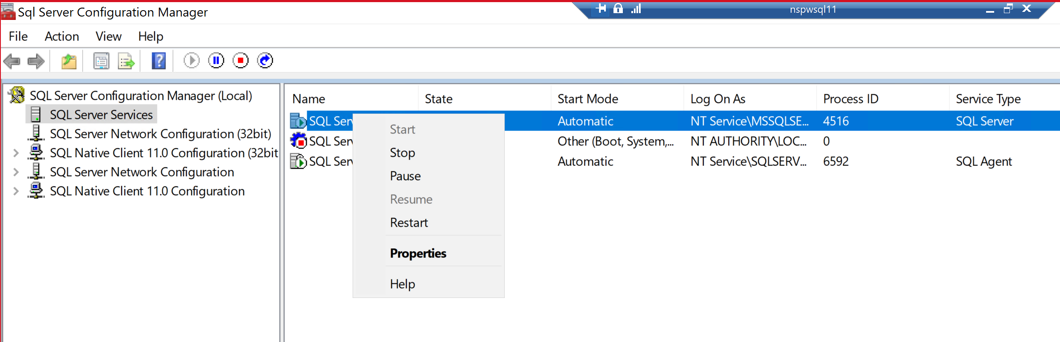
MSSQL Shutdown
SQL SERVER CONFIGURATION MANAGER:
SHUTDOWN;
SHUTDOWN WITH NOWAIT;
SQLCMD:

Slide 33
Startup
Shared Memory
Background Proc
Closed | Closed
 | Nomount mode
 | Mount mode
Open | Open
←Prorest
init*.ora
←Restore
.ctl

Slide 34

Questions
Web page | www.proora.com
Email | dlevin@alphabroder.com

