Slide 1
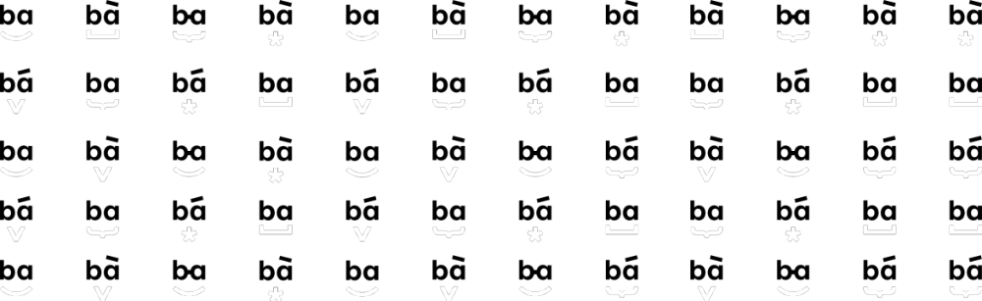

Using Apache Kafka for Modernizing OpenEdge Applications
ANDRIUS MARCIŠAUSKAS I a.marcisauskas@ba.lt
PUG CHALLENGE 2023

Slide 2

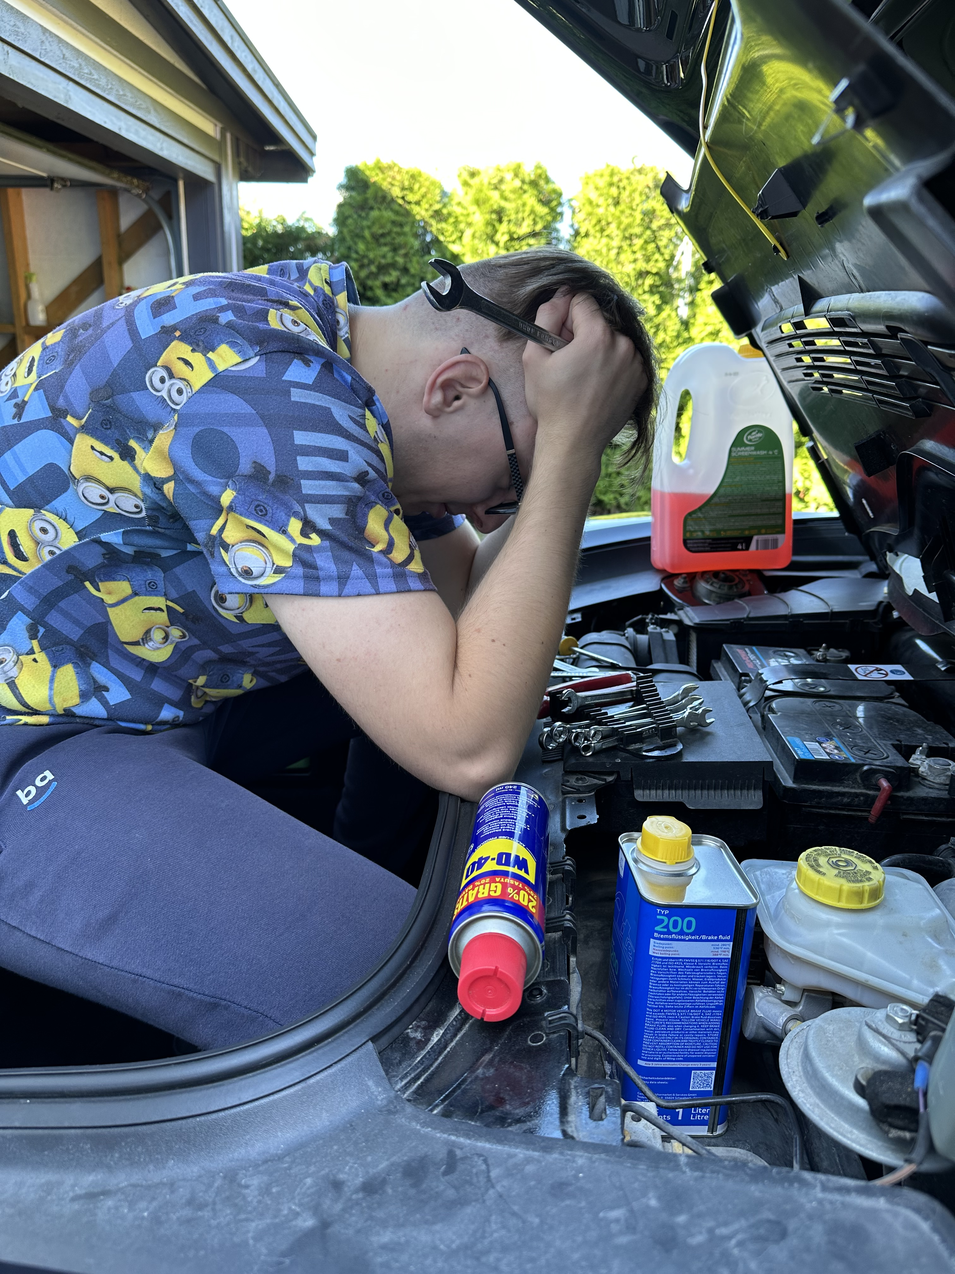

About me
Living with OE since 2020
Banking, medical billing and simple data administration projects
Curious about 3rd party integrations with OE
Main passion: cars and driving them (not fixing)

Slide 3







About Baltic Amadeus:
30+
250+
Banking &
finance
Energy
Years in business
IT talents
500+
2000+
Customers
Implemented projects
Healthcare &
Pharmacy​
Telecommunications
We focus on services such as:
Omnichannel platform
eCommerce platform
Marketplace platform
Progress OpenEdge
IT architecture
Managed cloud​
Information security
IT Due Diligence
Mobile banking
Data analytics
Insurance
IT &
consulting

Slide 4


Well-experienced team
Working with Progress since 2003;
40+ specialists and growing;
Av. Age – 32y old;
Av. Experience with Progress OE – 8y;
Progress SDP & License reseller;
Experienced with mission critical, legacy systems, ERP;
Helping customers with support, new development, modernization projects;
Working with all major frameworks and tools for Progress OE.
PUG CHALLENGE 2023
4

Slide 5
01
Intro to Modernization
Agenda
for today
02
PoC research and development
03
Demo
04
Conclusions

Slide 6

Intro to Modernization

Slide 7


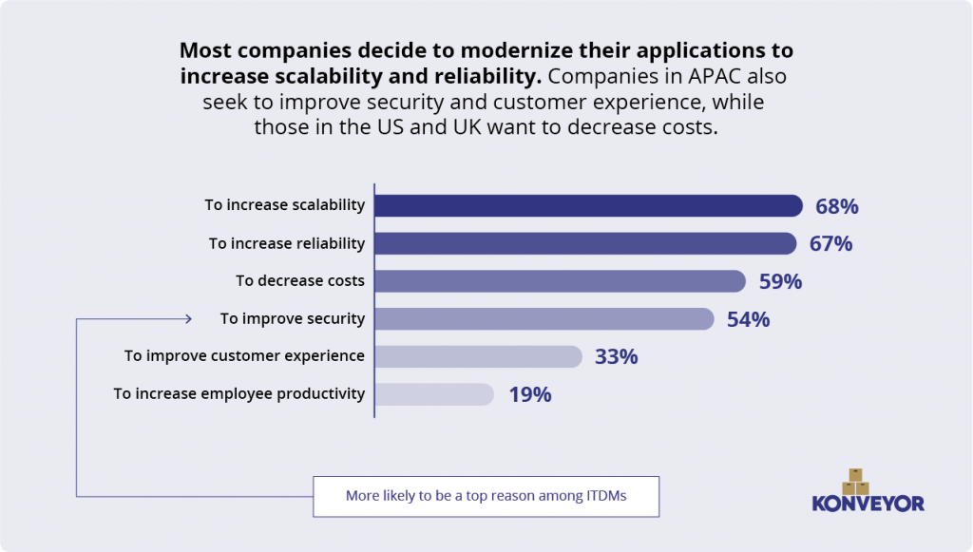
Why modernize?
Source: thenewstack.io (2022)
7

Slide 8

c
Considered
solutions
1.
2.
Big Bang approach
Incremental modernization
PUG CHALLENGE 2023 | Software Modernization
8

Slide 9
PoC research and development

Slide 10

Imitation of incremental modernization case between legacy and modern applications.
Our research idea
PUG CHALLENGE 2023 | poc Research and development
10

Slide 11
Research the possibility of the usage of Apache Kafka in our PoC scenario
Limitations for OE
Adjustments for OE
Main goal of the research
PUG CHALLENGE 2023 | poc Research and development
11

Slide 12
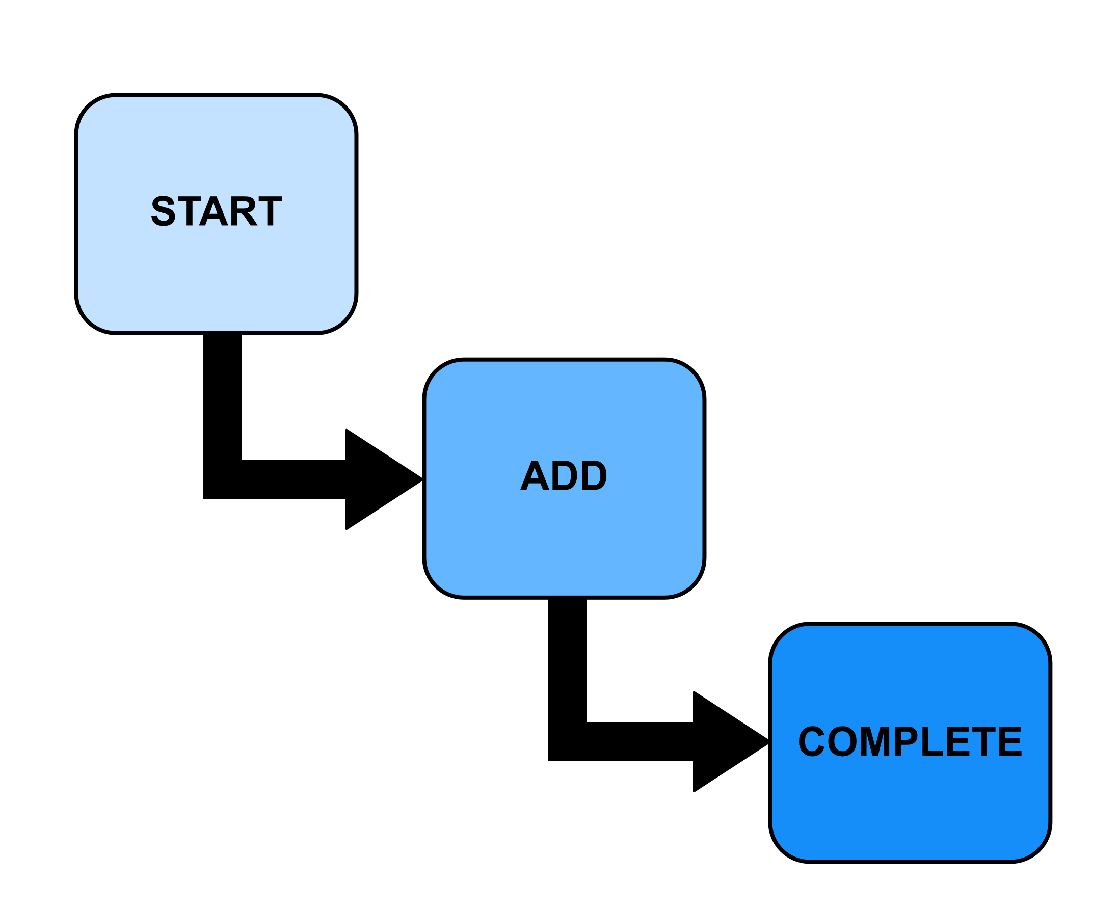
Research strategy
3 stages:
Implementation of one-way data flow from legacy to modern side for one table (START)
Addition of remaining tables to the flow (ADD)
Implementation of two-way data flow between applications (COMPLETE)
PUG CHALLENGE 2023 | poc Research and development
12

Slide 13
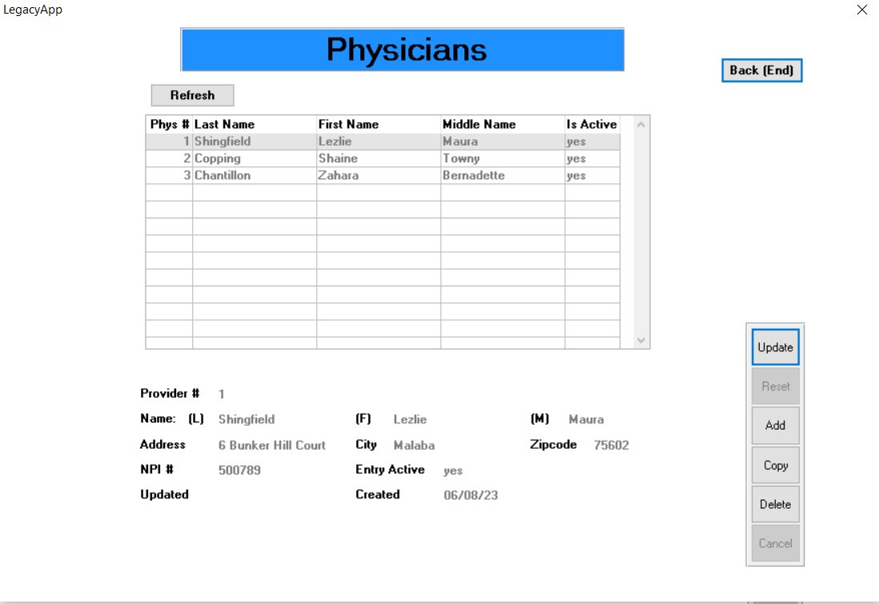
Legacy application
ADM based UI
5 tables
Simple CRUD operations
Progress OpenEdge version – 11.7
PUG CHALLENGE 2023 | poc Research and development
13

Slide 14
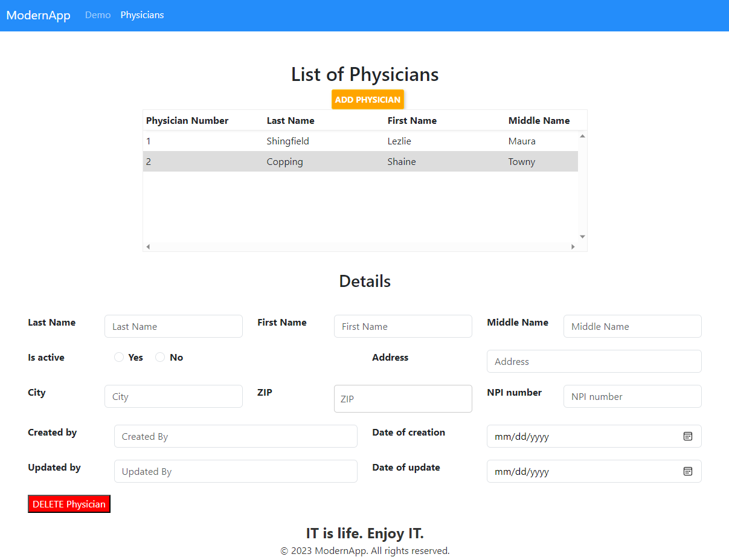
Modern application
PASOE with web transport
Node.js server for communication between web and PASOE
6 tables
Simple CRUD operations
Progress OpenEdge version – 12.2
PUG CHALLENGE 2023 | poc Research and development
14

Slide 15

Apache Kafka
Open-Source​
Distributed event streaming platform
Scalable
Supported by Progress from version 12.5
PUG CHALLENGE 2023 | apache kafka
15

Slide 16
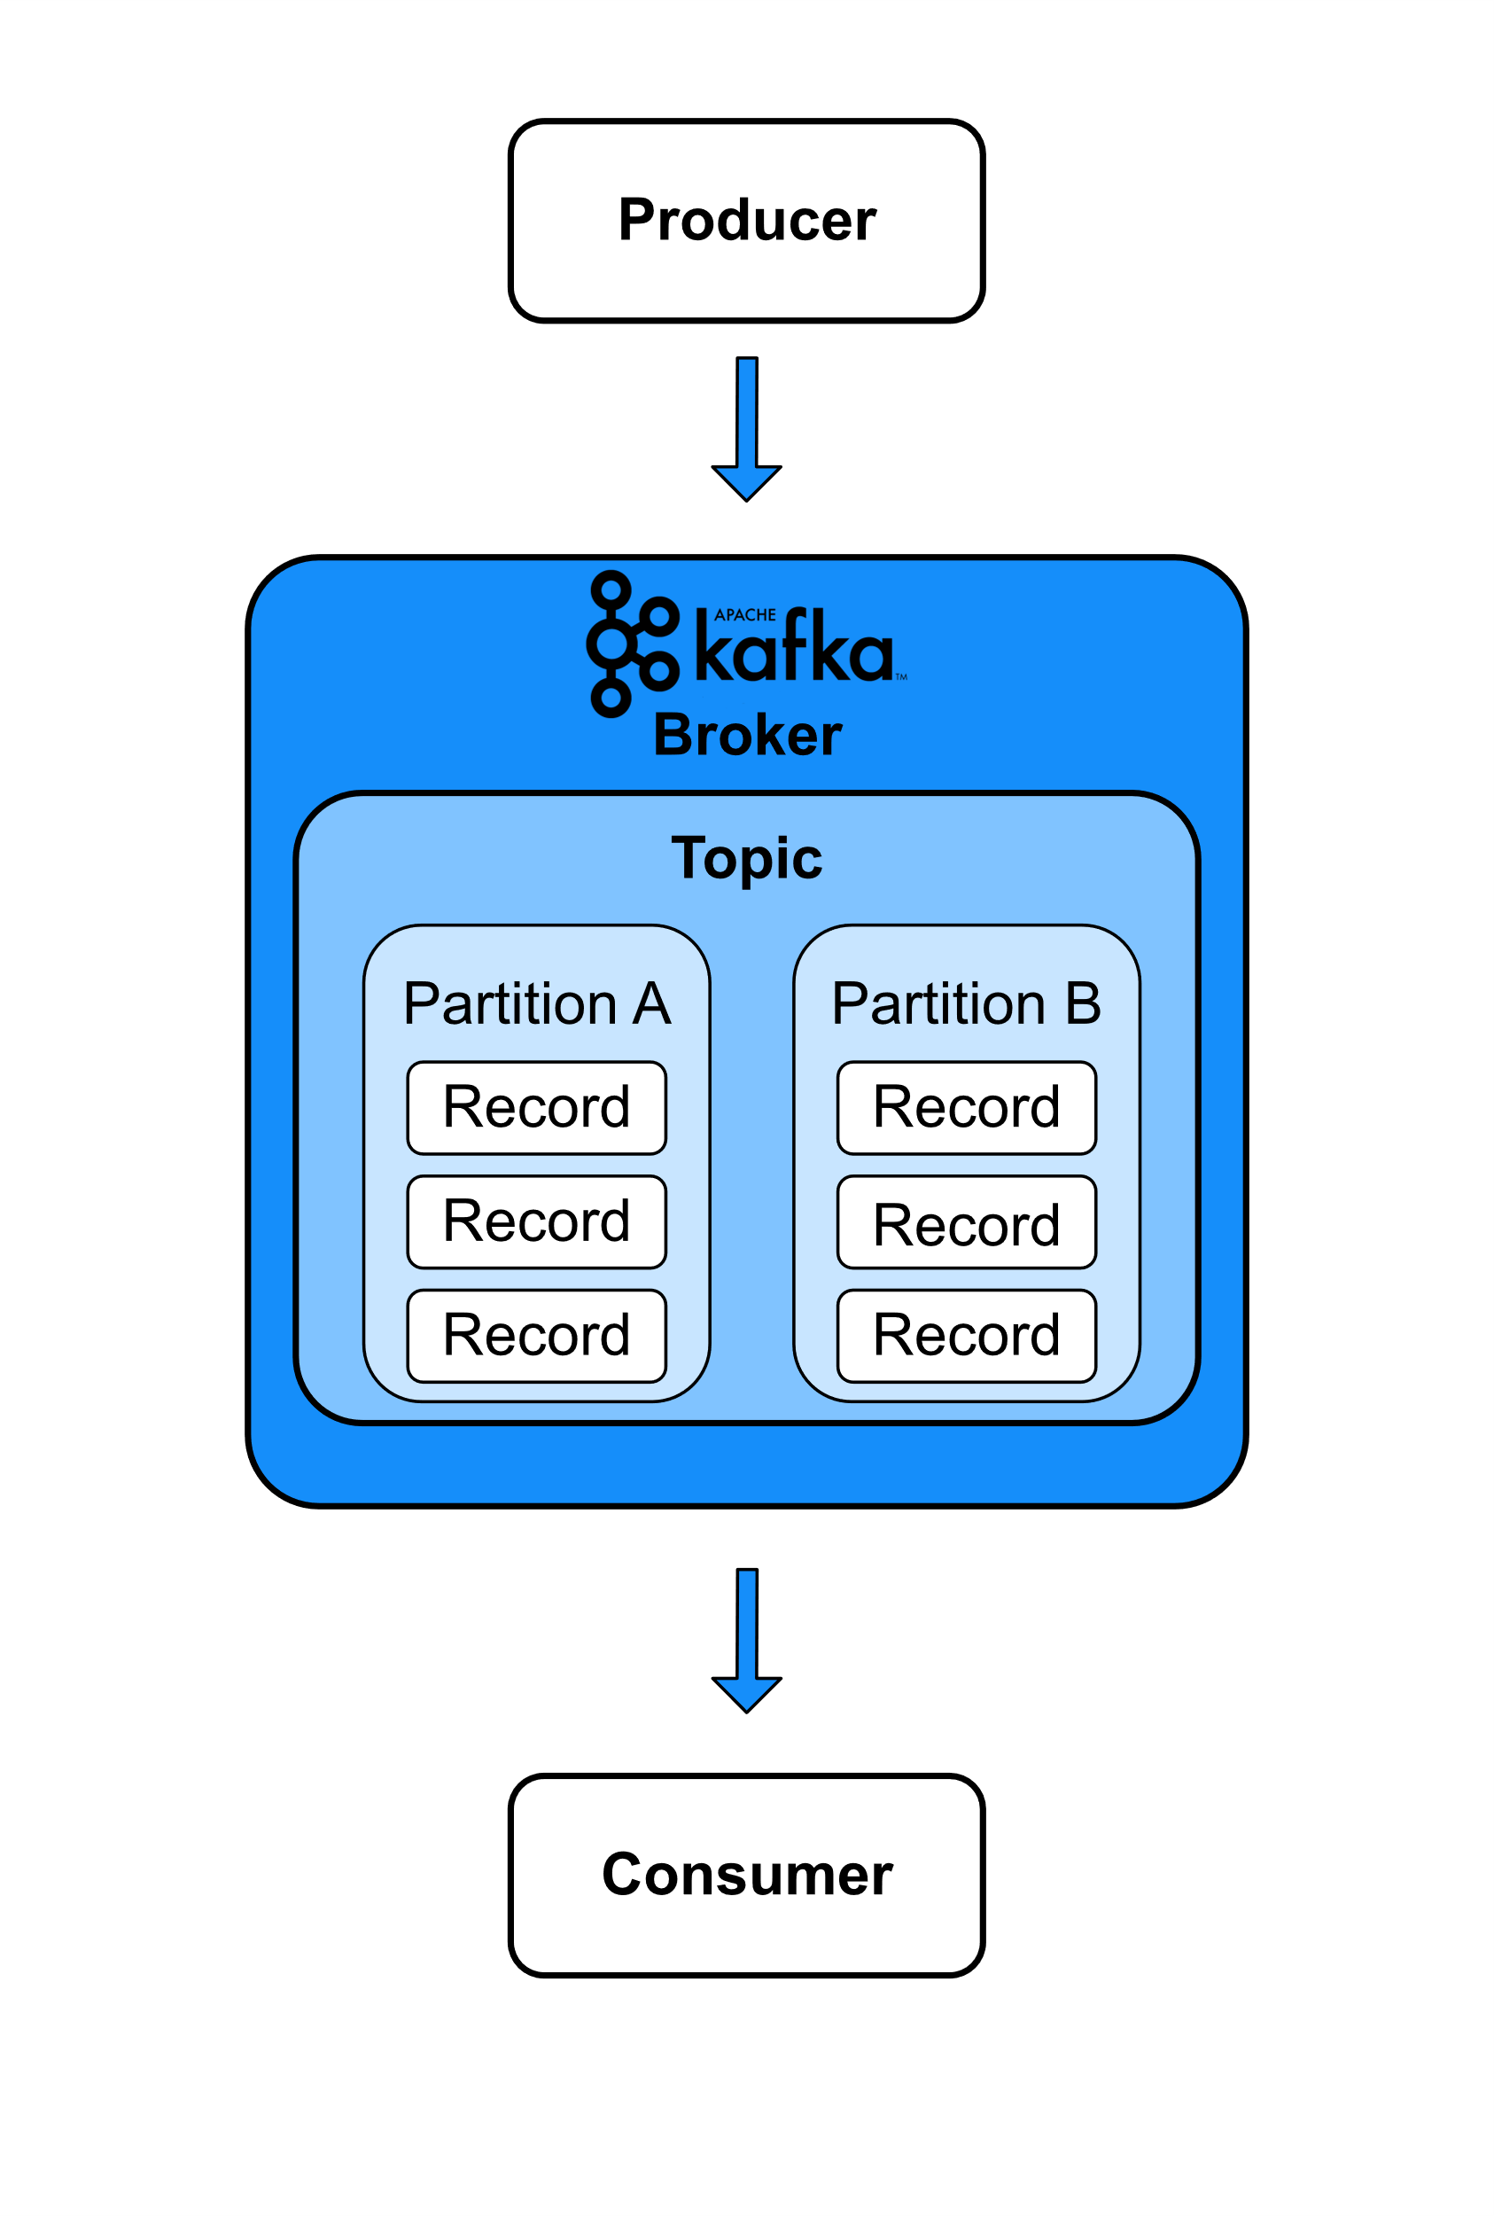
Apache Kafka
The producer writes data to Kafka
Broker runs the Kafka process and responds to requests from producers and consumers
The consumer is an application program reads records from a topic
PUG CHALLENGE 2023 | apache kafka
16

Slide 17
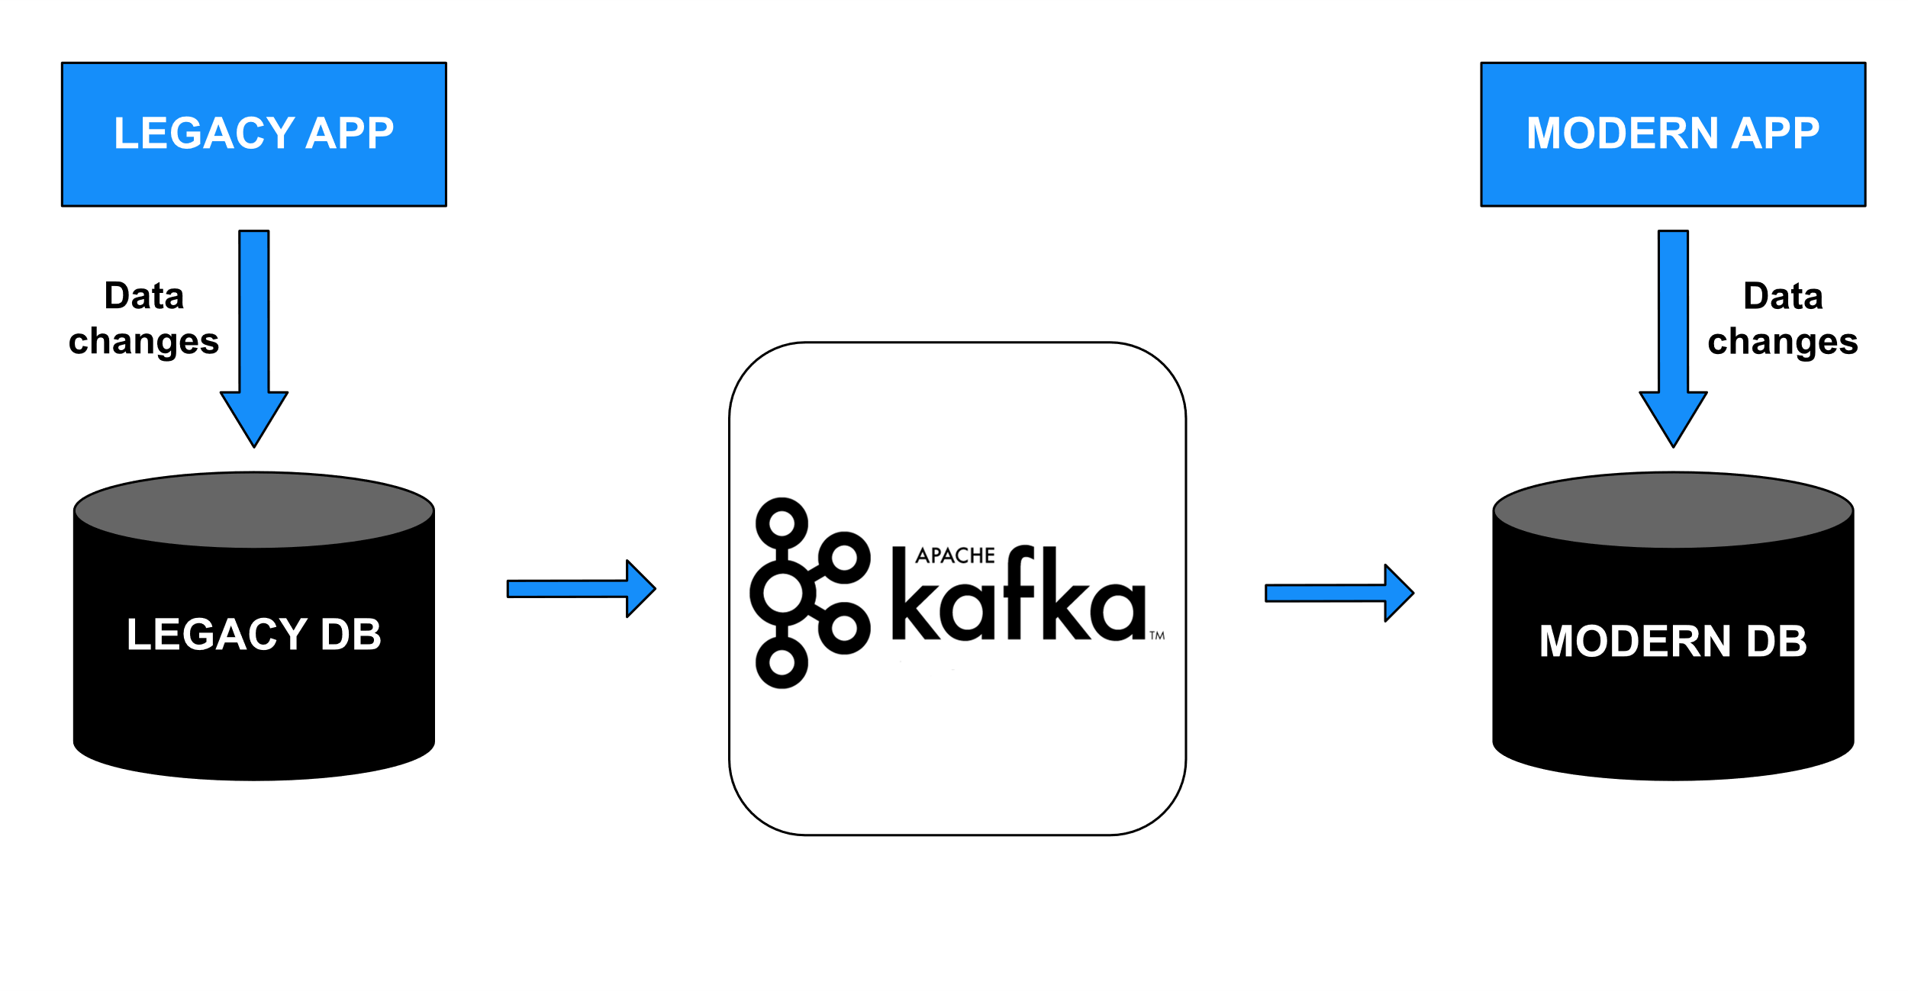
Initial modernization strategy
PUG CHALLENGE 2023 | poc Research and development
17

Slide 18
Initial .df and .d files for modern and legacy databases’ mockup
Initial Docker environment containers’ setup for modern and legacy applications as well as for Kafka
Enabling of Change Data Capture (CDC) with level 2 on legacy database
First steps
PUG CHALLENGE 2023 | poc Research and development
18

Slide 19
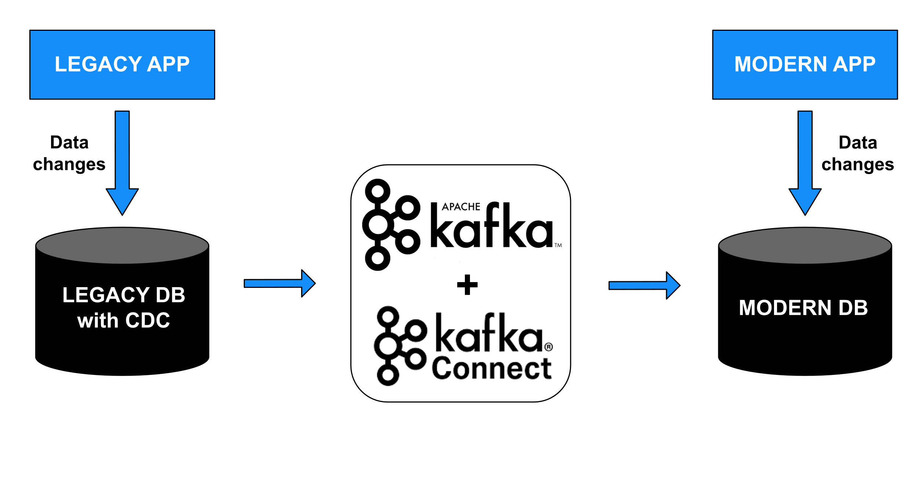
First steps
Research about communication between OE and Apache Kafka
Decision to use Apache Kafka Connect and JDBC connections
Confluent Kafka instead of only Apache Kafka
Testing of first Kafka Topic
PUG CHALLENGE 2023 | poc Research and development
19

Slide 20
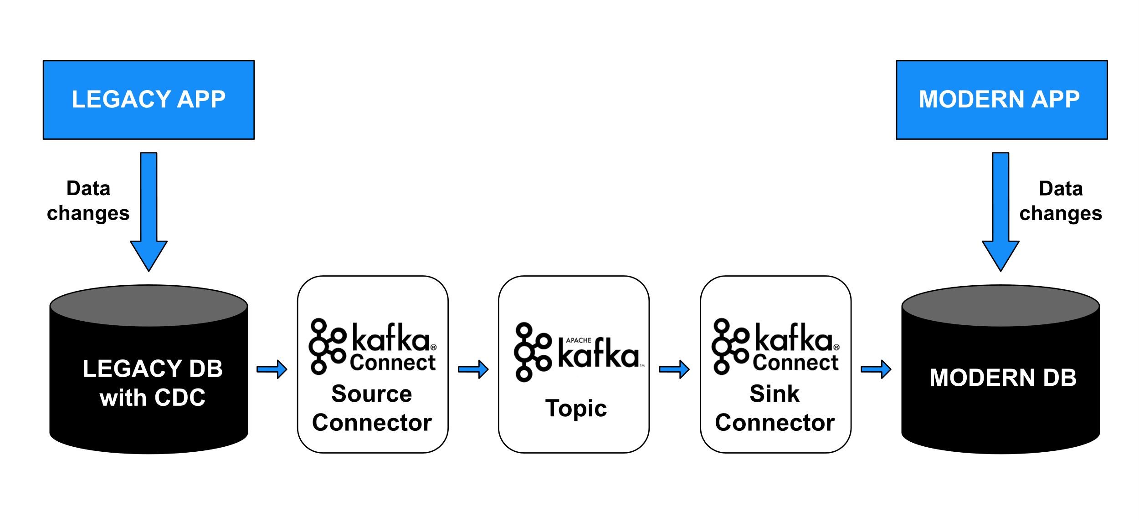
Kafka Connect
Component of Kafka, which serves as a centralized data hub for data integration between databases, search indexes and more
Used for connectors‘ creation and coordination of moving large data sets in and out of Kafka
PUG CHALLENGE 2023 | poc Research and development
20

Slide 21
Deletion only works when null value with non-null key is passed to the Connector
UPSERT mode is not supported by OpenEdge DB Generic dialect
Strict limitations on what can be customized
Decision – drop Sink Connector
Sink Connector
PUG CHALLENGE 2023 | poc Research and development
21

Slide 22
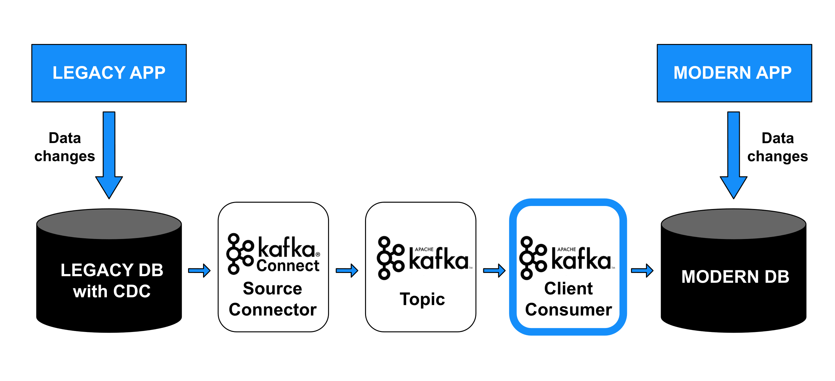
New decisions
ABL-Kafka Consumer API instead of Sink Connector
Update modern application to 12.6, for implementation of Kafka libraries for OE
Reduction of CDC tracking level to 0 (minimal)
PUG CHALLENGE 2023 | poc Research and development
22

Slide 23
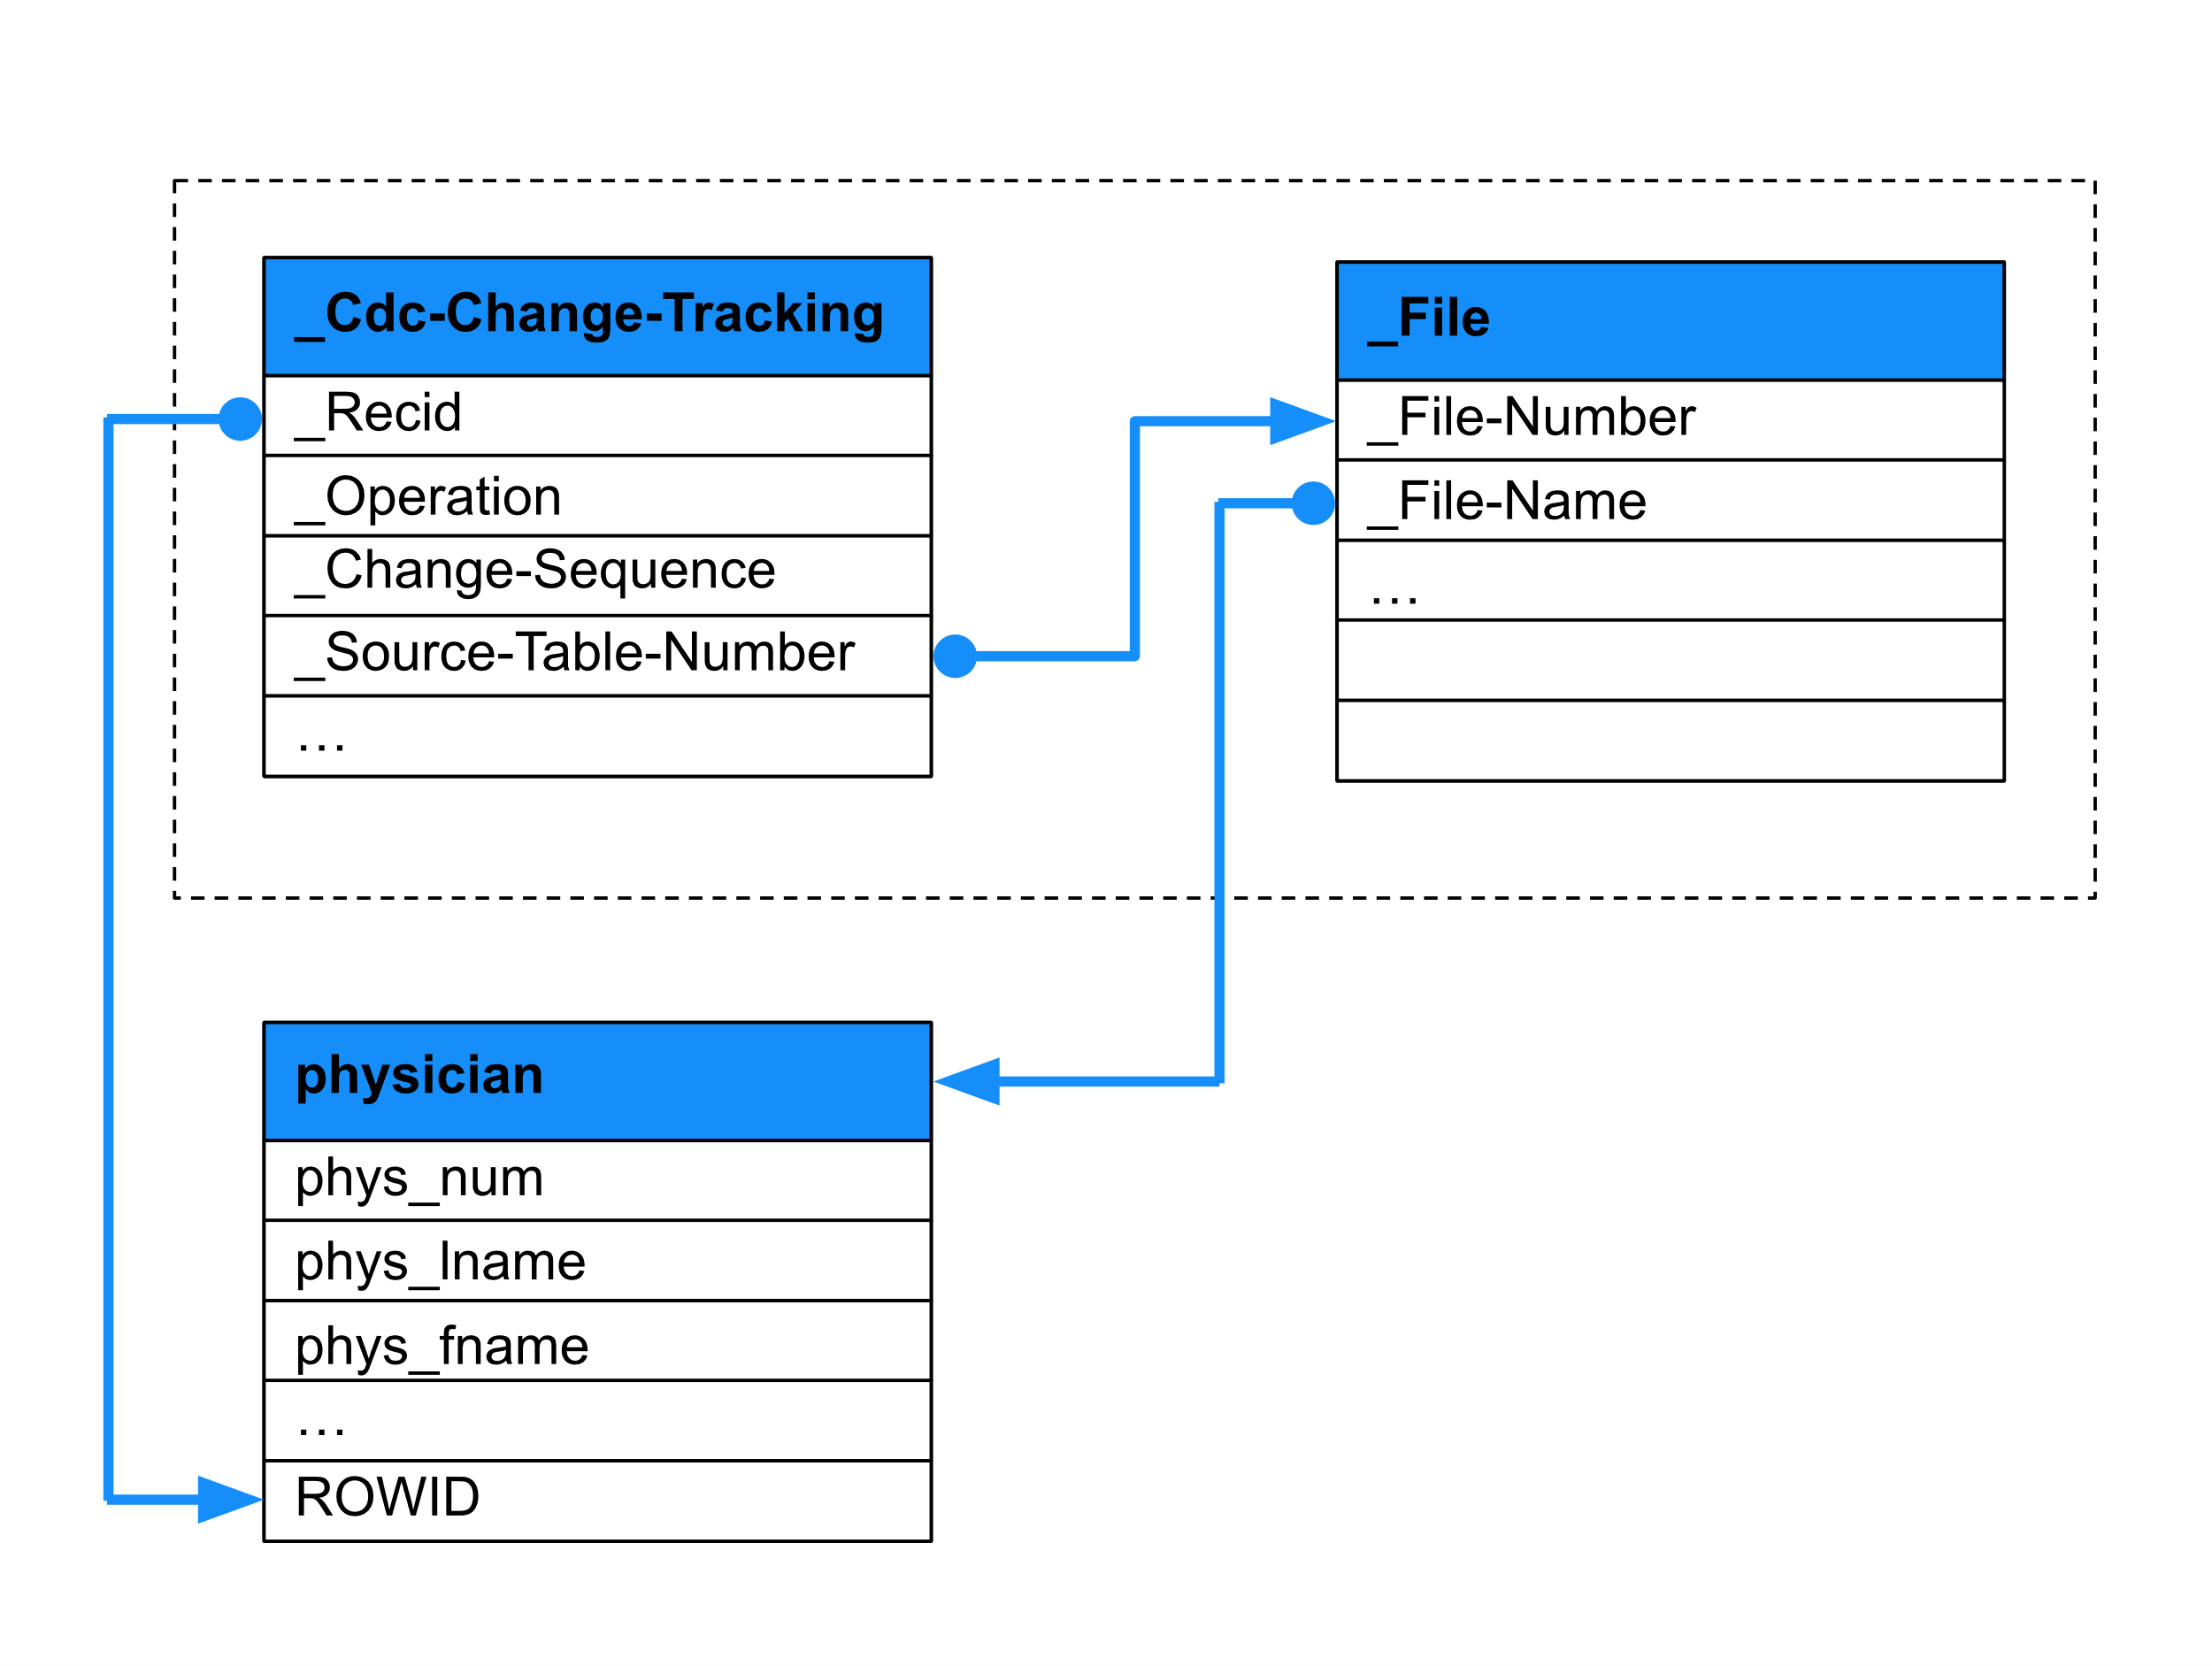
How do we fetch the data from CDC?
PUG CHALLENGE 2023 | poc Research and development
23

Slide 24
Correct placing of openedge.jar for successful JDBC connections
Characters “_” or “-” cause issues when Kafka JDBC Connector tries to fetch data from OpenEdge
When using incrementing mode, the Connector has to be able to append its own WHERE clause to create an incremental load
Issues and adjustments
PUG CHALLENGE 2023 | poc Research and development
24

Slide 25
Successful test run to update the record from legacy to modern application!
Next steps:
  Addition of remaining tables to the mix
  Research on how to sync data between two applications
  Adjustments for DELETE functionality
Light at the end of the tunnel...?
PUG CHALLENGE 2023 | poc Research and development
25

Slide 26
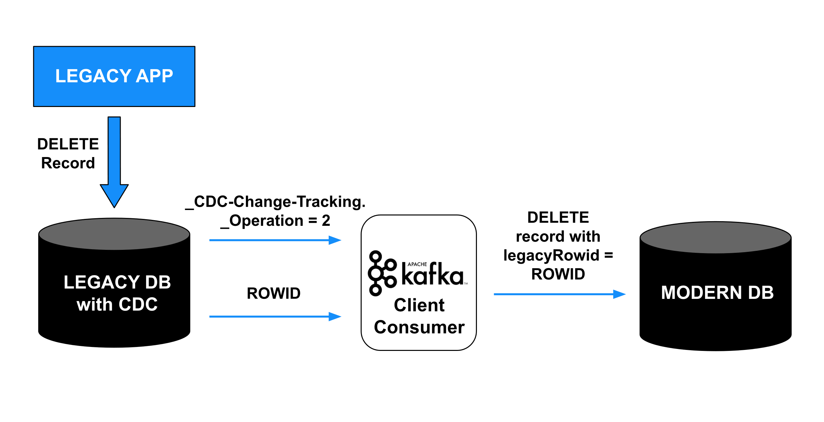
How does DELETE work?
PUG CHALLENGE 2023 | poc Research and development
26

Slide 27
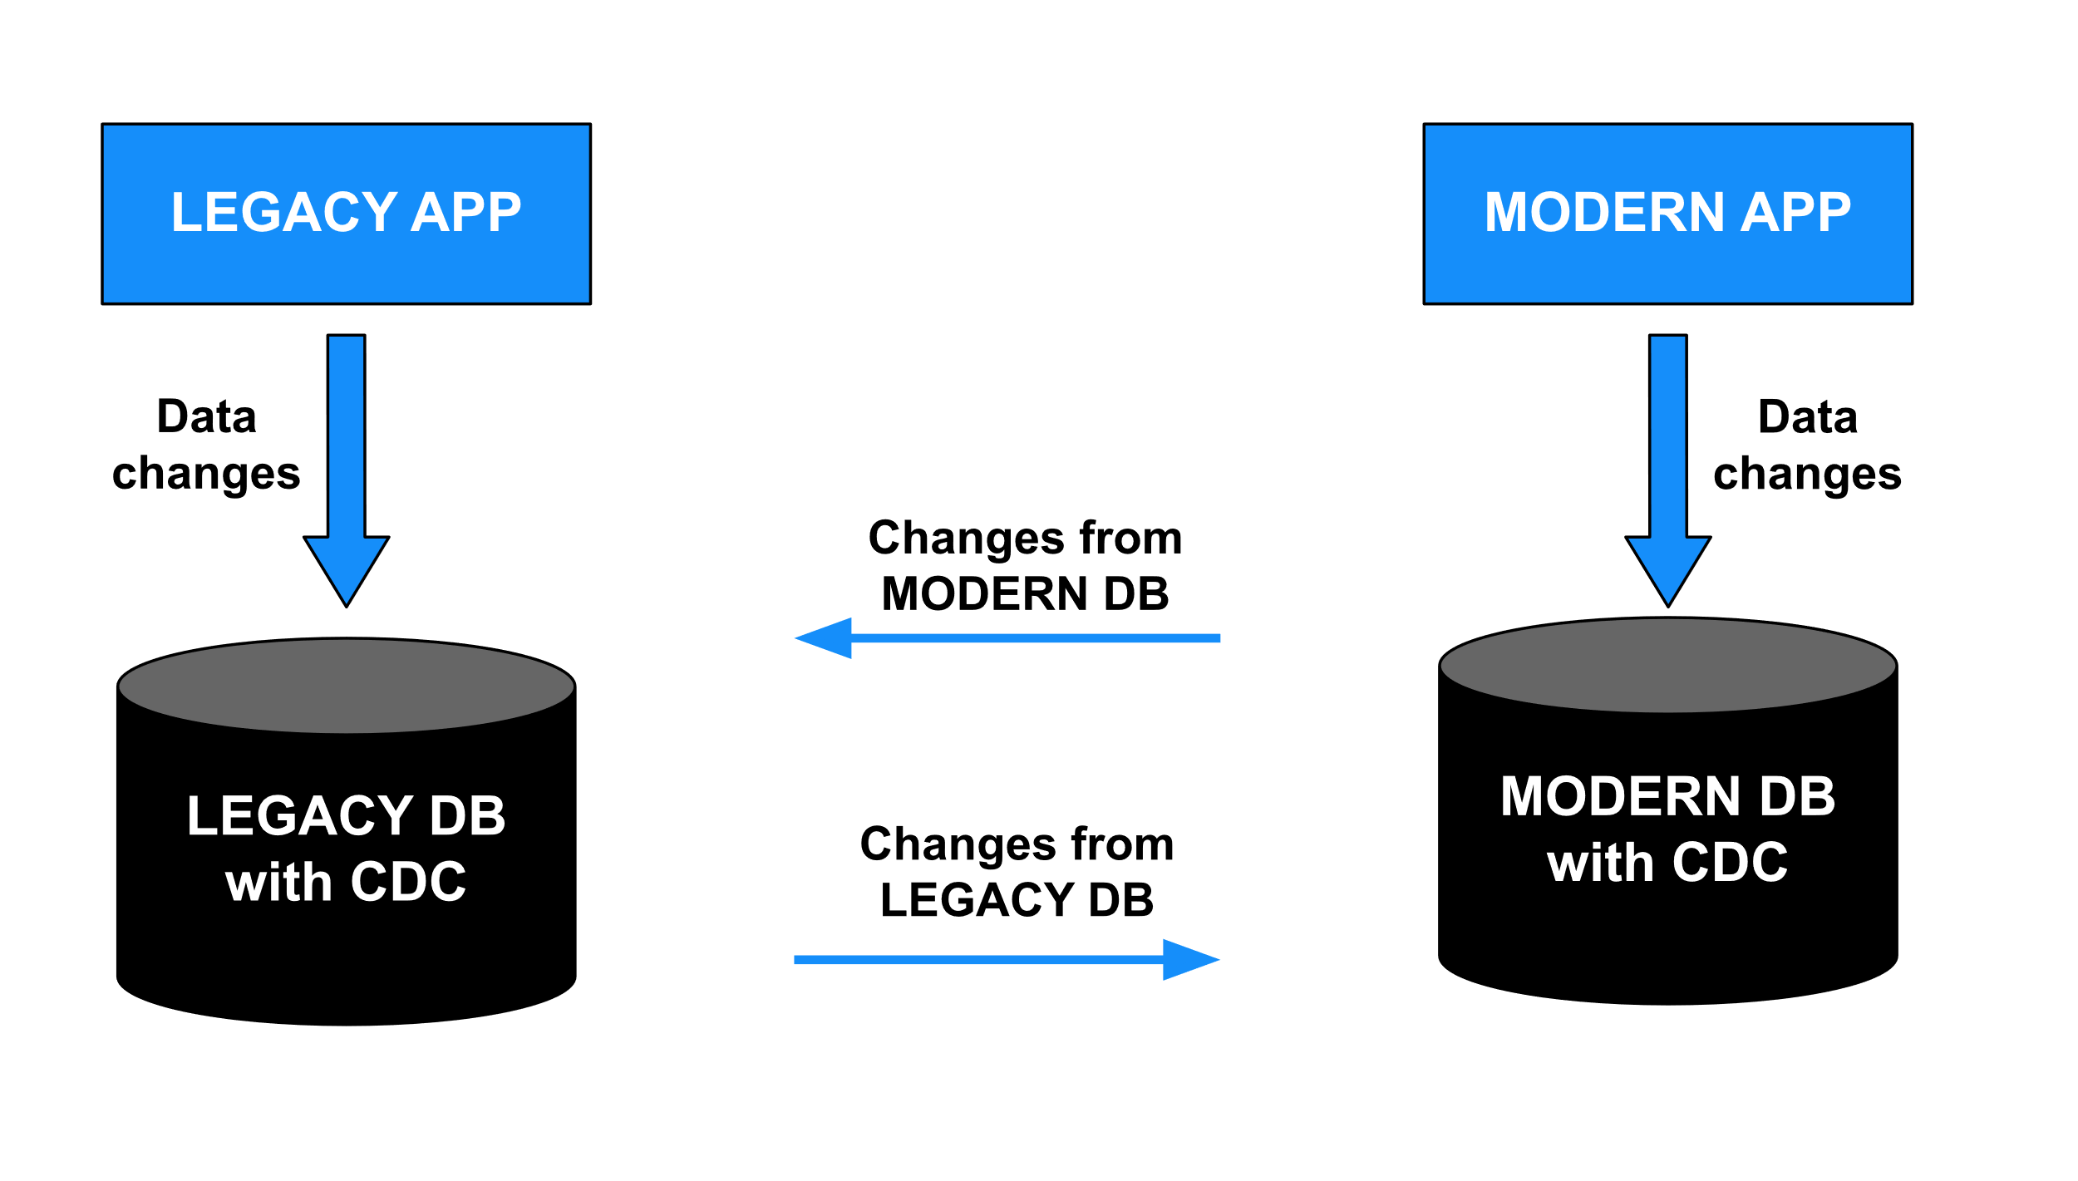
New implementations
Two-way streaming approach
Legacy application version to 12.6
CDC enable/disable to avoid looping of data
PUG CHALLENGE 2023 | poc Research and development
27

Slide 28
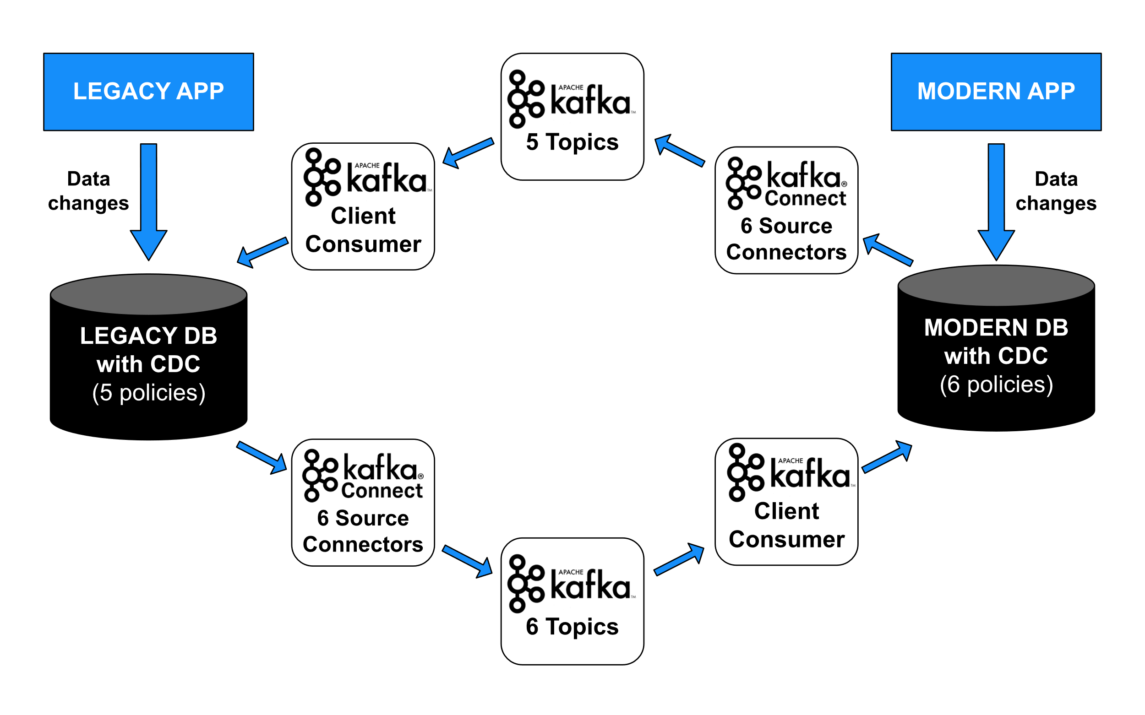
Final solution overview
PUG CHALLENGE 2023 | poc Research and development
28

Slide 29
Demo

Slide 30
Conclusions

Slide 31
Consumer implementation using Kafka libraries was relatively simple
When implementation of the full data flow was done, the other tables' addition was quick and smooth
No additional issues when the solution was finished, it was stable, no crashes or lost data was discovered when testing
What went okay?
31
PUG CHALLENGE 2023 | Conclusions

Slide 32
CDC activation/deactivation had to be adjusted for Consumer programs
DELETE functionality meant one additional field for ROWID in each table
Startup sequence had to be specific for initial bulk load and Consumer start
Need to update legacy application at least to 12.5
What things needed adjustments?
32
PUG CHALLENGE 2023 | Conclusions

Slide 33
Eglė Kazbaraitė – developer
Paulius Rašamavičius – developer
Artūras Birbalas – advisor
The Team
PUG CHALLENGE 2023 | The team
33
PUG CHALLENGE 2023 | The team

Slide 34
Thank you!

