Slide 1
OpenEdge
PUG Challenge 2023
The New Software Development
“DevOps”
Shelley Chase
Software Fellow, OpenEdge
schase@progress.com
Notes:
This session will cover the popular software development model where development (Dev) and operations (Ops) work together to deliver quality software.
I hope you are here because you are excited about the potential benefits of DevOps to improve the quality and productivity of the software you deliver.
I would like to introduce myself. I am Shelley Chase, a Software Fellow for the OpenEdge product line. I have been with Progress for 28 years and have worked on many parts of the language and tooling.

Slide 2
Agenda
What is DevOps?
What is CI/CD (Continuous Integration / Continuous Deployment or Delivery)
Adopting CI/CD
Notes:
In this session we will examine the DevOps process designed to automate software development and delivery.
DevOps is engineering and IT working together towards a single goal, the delivery of software.
A large part of DevOps is the build and testing pipeline referred to as CI/CD Continuous Integration and Continuous Deployment.
Once we cover the basics, we will look at how you can adopt CI/CD into your organization.

Slide 3
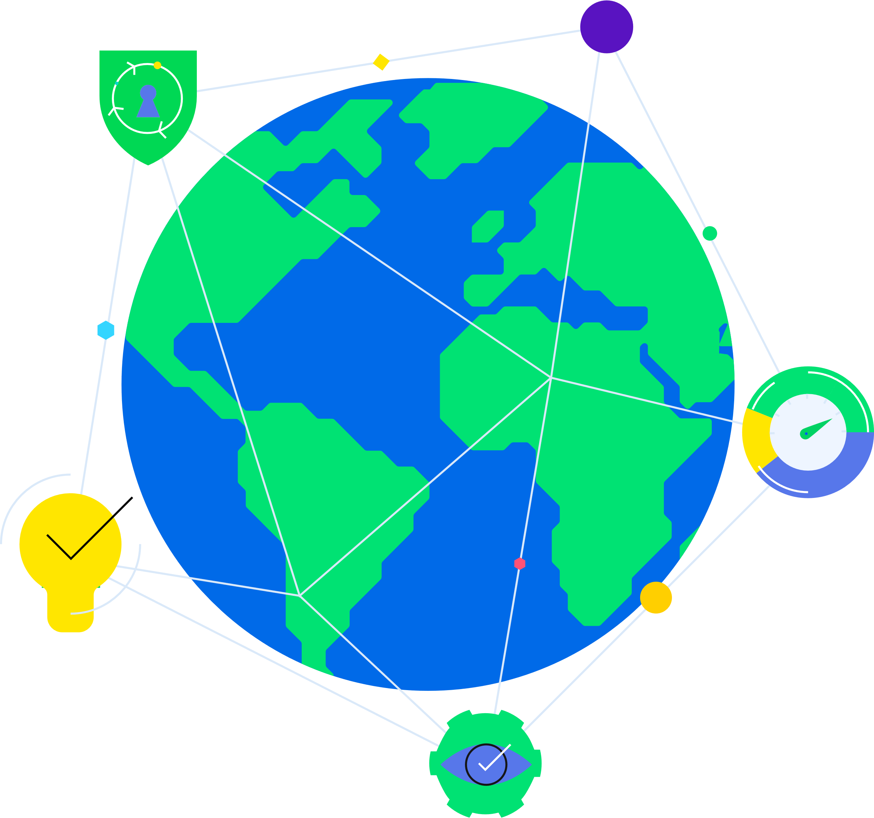
The New Software Development: DevOps
Where Are You?
Notes:
Ok, Lets do a poll…
I am sure that most of you have automated parts of your development pipeline. Certainly, source code control and scripted builds/makefiles.
But what are the processes are manual. Are the results the same every time?
- How many of you feel you have a formalized automated development process from check-in through delivery…?
- How many of you feel you have pieces of a formalized automated development process?
- and how many of you can’t ever spell DevOps ☺
Looks like about ??% have started down this journey!

Slide 4
What is DevOps?
Development and Operations working together towards a single goal.
Originated in 2007/2008; popular 2016
A well-defined process involving a set of practices and tools.
An automated, continuous development, testing and deployment process
Improve and shorten a product’s development life cycle.
Notes:
What is DevOps?
DevOps originated in 2007-2008 but really started to gain traction around 2016.
DevOps is a methodology where engineering (development) and IT (Operations) work together to delivery quality software in a fast and repeatable way. Similar to the old paradigm of developers throwing software over the wall to QA for testing, we know that teams working together towards a common goal have better results than working in silos.
The DevOps process brings agility to the whole build/deployment process, just like SCRUM and SAFe brought agility to software definition and development. There are many commercial and Open Source tools to help teams keep pace with accelerating customer demands.
It is an automated, repeatable, development, testing, and delivery process for fast delivery or quality software.
By moving from a manual build process, development teams can focus on meeting the needs of the customer and not the IT side. DevOps bridges the gap and facilitates automation for steps developers need to do manually ultimately shortening the time to product delivery.

Slide 5
Four Key Principles of DevOps
Automation
Iteration
Monitor
Collaborate
Automatic build and deployment process
Utilize Infrastructure as Code (IaC)
Reusable on-demand tests
Repeatable build and testing
“Shift left” to find issues earlier in the process
Continuous feedback and improvement
Review the metrics
Shorten feedback loop
Dev and operations teams must work together on the process and results
Provide a positive environment with no “blaming”
Notes:
There are four key principles in DevOps, all of which are designed to improve and shorten a product’s development and deployment life cycle.

Slide 6
Four Key Principles of DevOps
Automation
Iteration
Monitor
Collaborate
Automatic build and deployment process
Utilize Infrastructure as Code (IaC)
Reusable on-demand tests
Repeatable build and testing
“Shift left” to find issues earlier in the process
Continuous feedback and improvement
Review the metrics
Shorten feedback loop
Dev and operations teams must work together on the process and results
Provide a positive environment with no “blaming”
Notes:
Automation
This is the DevOps basic principle which allows companies to use machine powered and avoid repetitive work for employees.
Automation provides an uninterrupted development process with the least amount of manual work.
DevOps automation is accomplished by using third-party tools for your
- Agile planning
- Source code control (probably already have this)
- Software build processes (probably already have this)
- Automated testing – leverage Infrastructure as Code (IaC) to automate environment setup
- Security vulnerability scans
- Delivery to staging systems
- Repeatable system testing: load, performance, etc.
We will look at some of these automaton tools later on.

Slide 7
Four Key Principles of DevOps
Automation
Iteration
Monitor
Collaborate
Automatic build and deployment process
Utilize Infrastructure as Code (IaC)
Reusable on-demand tests
Repeatable build and testing
“Shift left” to find issues earlier in the process
Continuous feedback and improvement
Review the metrics
Shorten feedback loop
Dev and operations teams must work together on the process and results
Provide a positive environment with no “blaming”
Notes:
2. Iteration
DevOps must define is a repeatable process that is triggered automatically when new code is checked-in.
This provides immediate feedback on the quality of the code checked-in, rather than having to wait days or even weeks to get information on the impact of their code changes.
This automated, iterative process allows development organizations to “shift left”, finding issues early in the development cycle.

Slide 8
Four Key Principles of DevOps
Automation
Iteration
Monitoring
Collaborate
Automatic build and deployment process
Utilize Infrastructure as Code (IaC)
Reusable on-demand tests
Repeatable build and testing
“Shift left” to find issues earlier in the process
Continuous feedback and improvement
Review the metrics
Shorten feedback loop
Dev and operations teams must work together on the process and results
Provide a positive environment with no “blaming”
Notes:
3. Monitoring
Getting continuous feedback on software quality allow organizations to move quickly and address integration and systemic issues immediately
Many tools provide metrics than provide trending data to track improvement and identify areas of the process that are not working well.
With the goal of well-tested, secure software deployment, improvements to the process allow developers to fix issues, improve functionality and usability, and optimize the time of solution deployment.
.

Slide 9
Four Key Principles of DevOps
Automation
Iteration
Monitoring
Collaboration
Automatic build and deployment process
Utilize Infrastructure as Code (IaC)
Reusable on-demand tests
Repeatable build and testing
“Shift left” to find issues earlier in the process
Continuous feedback and improvement
Review the metrics
Shorten feedback loop
Dev and operations teams must work together on the process and results
Provide a positive environment with no “blaming”
Notes:
4. Collaboration
Let’s just say that DevOps will not work without clear and intentional collaboration between the development and operations departments.
They must work together on defining the requirements, assessing the output and improving the process.
No blaming environment

Slide 10
DevOps Process

Slide 11
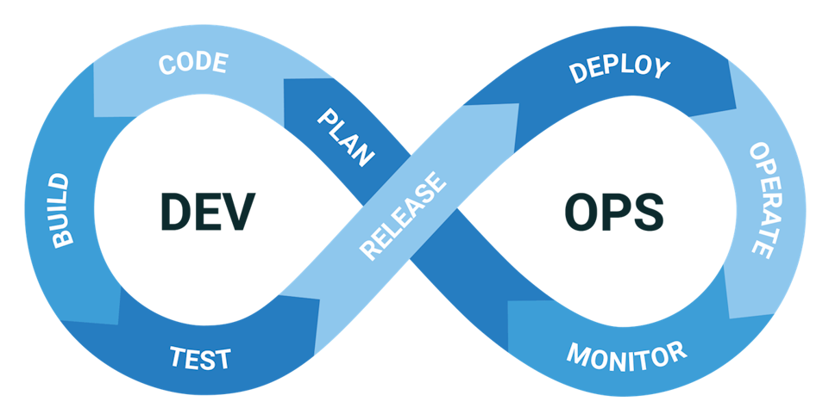
DevOps Process
Automated Process to manage product lifecycle
SEC
Notes:
You have probably seen this infinity symbol used to define DevOps. The key here is to note that it is a continuous, never-ending process.

Slide 12
DevOps Process + Security
Automated Process to manage product lifecycle
SEC
Notes:
It is also important to note that I have introduced a third concept into the process which is security.
As we all know, today’s world highlights everything security related including you DevOps practices. Security needs to be thought of at every step
Whether it’s a feature, a process or a testing model.
Let’s look at each step.

Slide 13
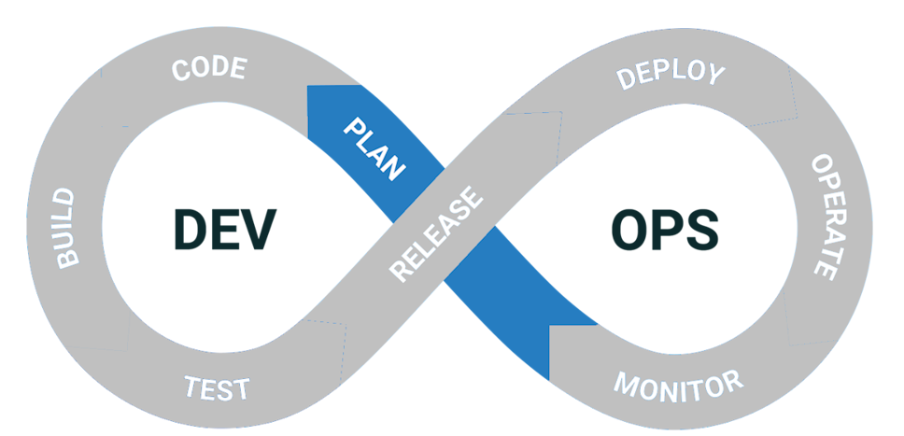
DevOps: Plan
Sprint planning: Features, Changes, Bug fixes, NFRs
SEC
Notes:
The Plan phase is where the enhancements, changes, or bug fixes are set up for the remainder of the process.
In an AGILE environment, this is where sprints would be set up and tasks assigned to the developers to work on
with the goal of releasing a new set of changes to the application.

Slide 14
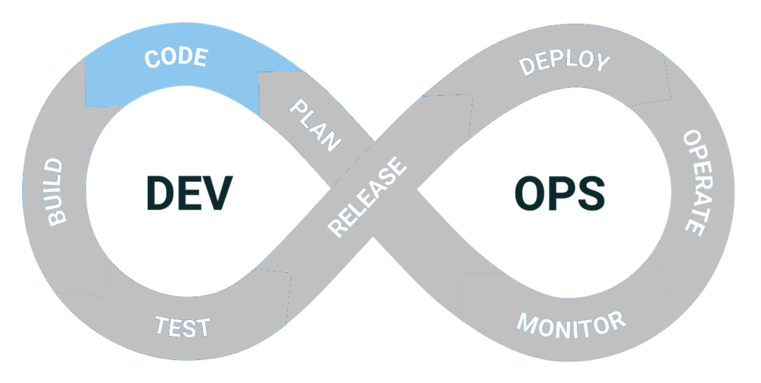
DevOps: Code
Developers write code; reviewed before check-in
SEC
Notes:
Once the work for the sprint has been agreed upon, developers can start writing code.
As features are completed and set up for testing, cards on the work board slowly move from the To Do state to Done.
Of course, bug fixes and enhancement might be part of this phase.
Before the code can be checked in, senior engineers or peers code review and approve the changes.
This is a very important step, especially in SCRUM teams. One person should not be solely responsible for the changes.
Code reviews can also be used to enforce consistency across the organization.

Slide 15
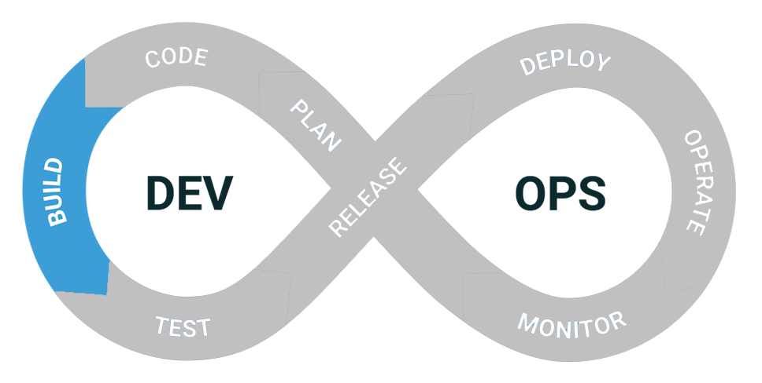
DevOps: Build
Code check-in and automated build of artifacts; Sanity gates
SEC
Notes:
Once the code is checked in, the build phase utilizes automation tools to build the components.
These components are called artifacts and are promoted to a location where they can be packaged for testing.
You might want to extend what you currently are doing here. Do you run unit tests? Are there security gates in place to avoid introducing vulnerabilities.
Ideally a set of fast running sanity tests are executed here to quickly validate if the build will pass or fail before the artifact is promoted into the larger build.

Slide 16
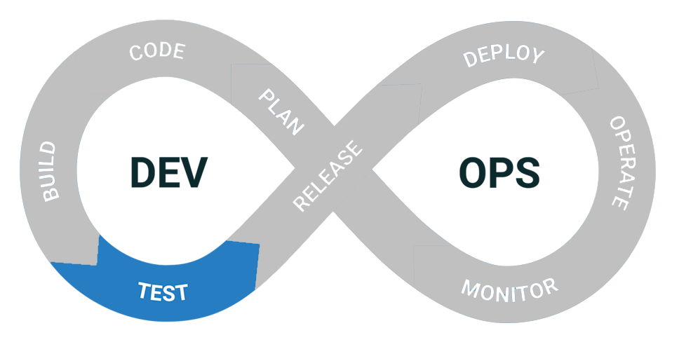
DevOps: Test
Automated/manual testing: IaC used to automate
SEC
Notes:
The test phase is where component and system tests are run to validate the quality of the new version.
Most of these tests are automated. This is where IaC can be used to automate the process of provisioning entire environments dedicated to testing the application.
IaC can be used to test a single version of the product on different operating systems or different system configurations. All done automatically during this testing phase.
There are some tests that might require someone to manually validate the behavior.
Complicated tests such as performance, stress testing, and integration tests need to also be considered.

Slide 17
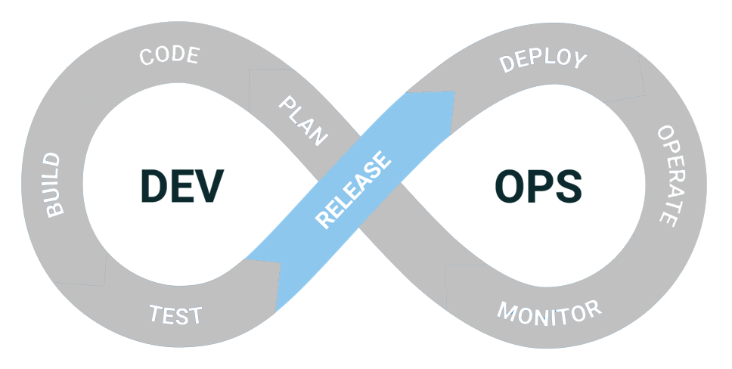
DevOps: Release
Gold Candidate made ready for deployment
SEC
Notes:
The release stage acts as a milestone in the entire DevOps process and is where the “Ops” part of the process begins.
By this point, all of the tests should have passed, and the product can be packaged for release.
Truthfully, the code, build and test steps are normally what is run on every check-in to get that immediate feedback.
Complex systems like OpenEdge runs these three steps many times throughout the day and continue the process at defined times.
I think of the release step as the packaging of the Gold candidate, which still must be further validated. For OpenEdge, we move the gold candidate to a special location where it can be further tested.
Including: load testing, performance degradations, long running stability tests, that we need to test before the software is made available to the customer.
Some of these can be automated by IaC but they are probably not run for every build since these tests require extensive system resources and take hours or days to complete. So, I include those in the release step.

Slide 18
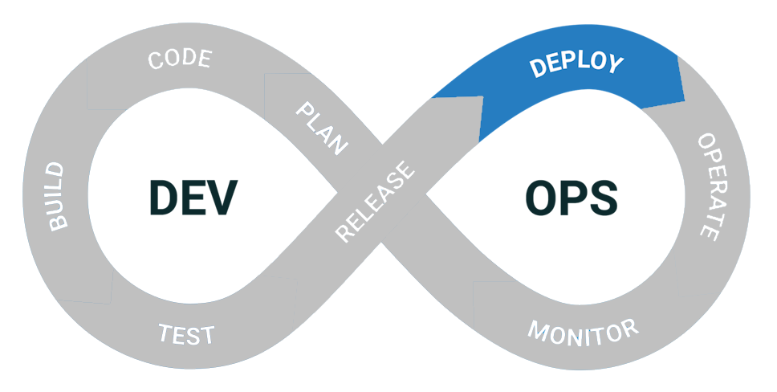
DevOps: Deploy
Release is deployed to customers
SEC
Notes:
This is the stage where the Gold candidate is deployed to production for use by your customers.
In true DevOps this is also automated but not many software companies want the product deployed without someone at the controls. We will talk about this more in the CI/CD section.

Slide 19
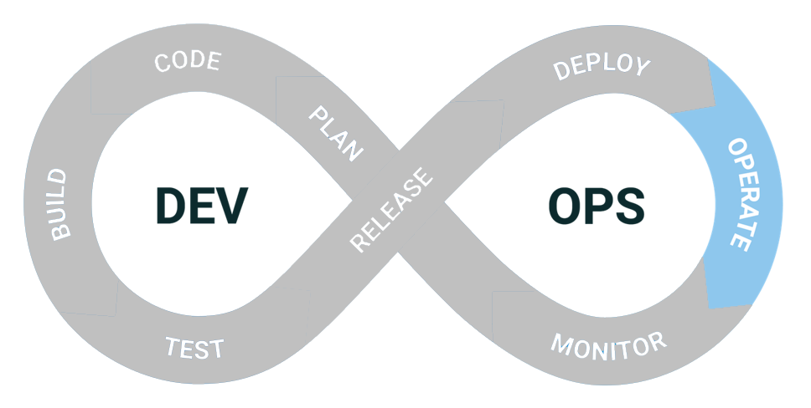
DevOps: Operate
Adjust infrastructure as needed based on build statistics
SEC
Notes:
The Operate step is where infrastructure changes can be made to accommodate the new product configuration or requirements.
This may mean scaling up or down as resources are needed.
Some environments simplify this by providing methods to monitor the load on your system and automatically spinning up new nodes to properly balance the work.
User feedback can also be gathered in this step to drive future development efforts.

Slide 20
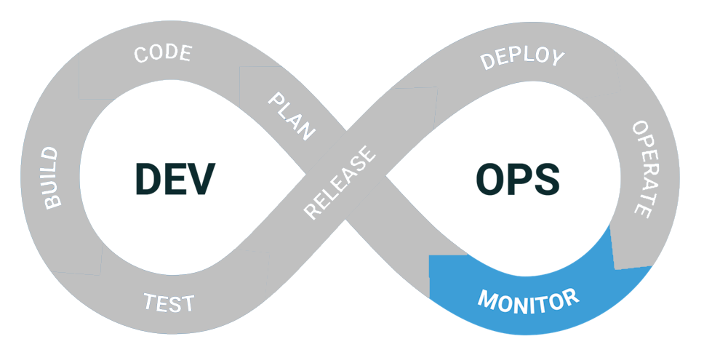
DevOps: Monitor
Retrospective on process with adjustments as needed
SEC
Notes:
Monitoring goes a step beyond just metrics and is critical to any system to ensure that the product and process are moving in the right direction.
This can be monitoring test failures, system failures or other process flaws.
This can also be gathering analytical data on how customers use the product can help provide a more holistic picture of what can be improved
This is another place where a retrospective can identify trouble spots and work to simplify procedures going forward, leading to a smoother flow overall.

Slide 21
DevOps – Plan (Repeat)
Sprint planning: Features, Changes, Bug fixes, NFRs
SEC
Notes:
REPEAT!! And we are back ready to start new work.

Slide 22






Benefits of DevOps
Developers
Automation allows focus for programming rather than repetitive tasks
Test Engineers
Consistent test results
Faster resolution with increased visibility
Product Managers
Faster turnaround for features
Predictable delivery schedule
Customer Service
Fewer bugs, focus on quality
Integrated into the process
System Administrators
Repeatable build process
Infrastructure as code (IaC)
Less complex to manage
End users
More stable software
Consistent deployment dates
Notes:
That’s a lot of steps to follow and is there really benefit of moving to an agile process?
Organizations say yes and here are the areas where they have seen benefits.
Developers
Automation allows focus for programming rather than repetitive tasks
Product Managers
Faster turnaround for features
Predictable delivery schedule
System Administrators
Repeatable build process
Infrastructure as code (IAC)
Less complex to manage
Test Engineers
Consistent test results
Faster resolution with increased visibility
Customer Service
Less bugs, focus on quality
Integrated into the process
End users
More stable software
Consistent deployment dates

Slide 23
Four Stages of DevOps Maturity
Notes:
Many of you might be saying, we already have a DevOps process in place. What can taking a second look do for me?
talk about the stages of DevOps Maturity and see where you process falls.

Slide 24
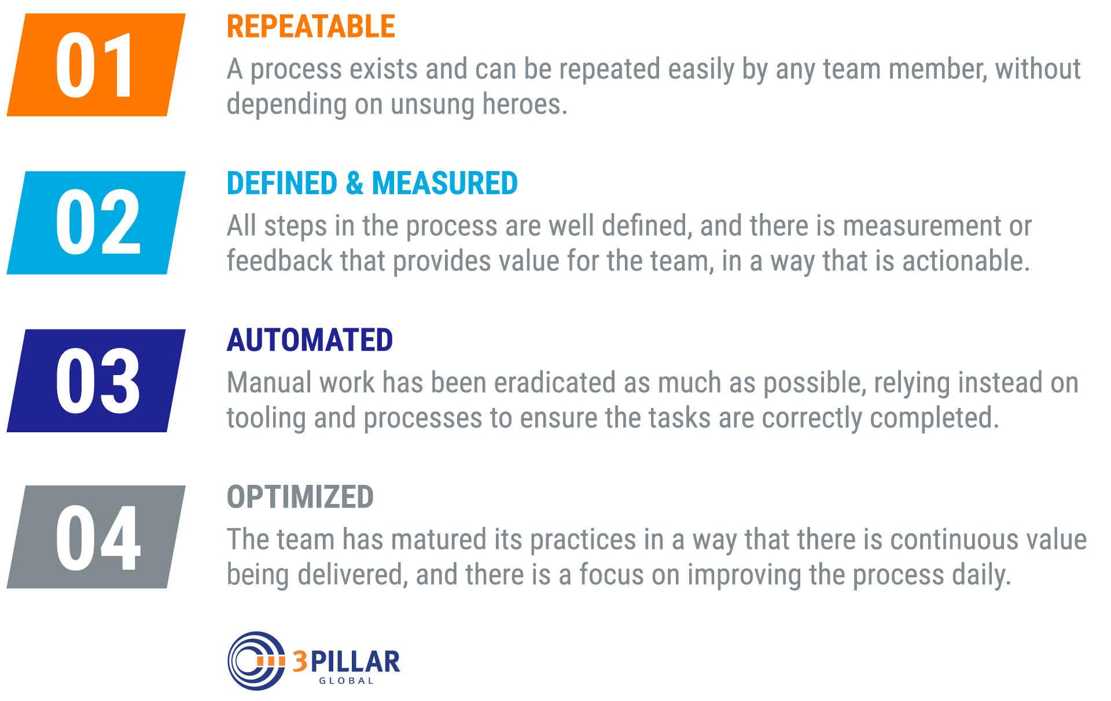
Four Stages of DevOps Maturity
Notes:
1. We all start with a shift from manual siloed processes to agility in the development teams and automation for operations. The process becomes REPEATABLE

Slide 25
Four Stages of DevOps Maturity
Notes:
2. Next is true collaboration and organizational transformation with well defined processes and automation. In this stage we can start to MEASURE the impact of DevOps

Slide 26
Four Stages of DevOps Maturity
Notes:
3. The process is fully AUTOMATED and understood. Continuous improvement is naturally part of the process iterations.
This is the step OpenEdge is working on. We want to have a truly automated pipeline up to actually delivery and we did a project called go green
The idea here is that builds and tests always succeed. This is the baseline. Then when there are failures, they are easy to identify and fix.
But this is not as easy as it sounds. You can put IaC in place but what if the network has a glitch, those tests will fail and give false negatives.
What about complex testing scenarios where many machines need to be configured and maybe you throw error conditions at it to see what the system can handle.
These scenarios and others keep full automation at bay.

Slide 27
Four Stages of DevOps Maturity
Notes:
And finally Optimized.
4. Benefits are seen, development and operations work seamlessly, and continuous value is delivered and improved daily.
Incrementally improving the processes over time and company-wide.

Slide 28
CI / CD
Continuous Integration/
Continuous Deployment/ Delivery
Notes:
I mentioned earlier that continuous integration/ continuous delivery are a major component of DevOps.
You can think of this as your build/delivery pipeline. It is where you will build, validate code quality, test and identify security threats in your product.
There are many terms used in this area so let’s start by trying to level set on terminology.

Slide 29
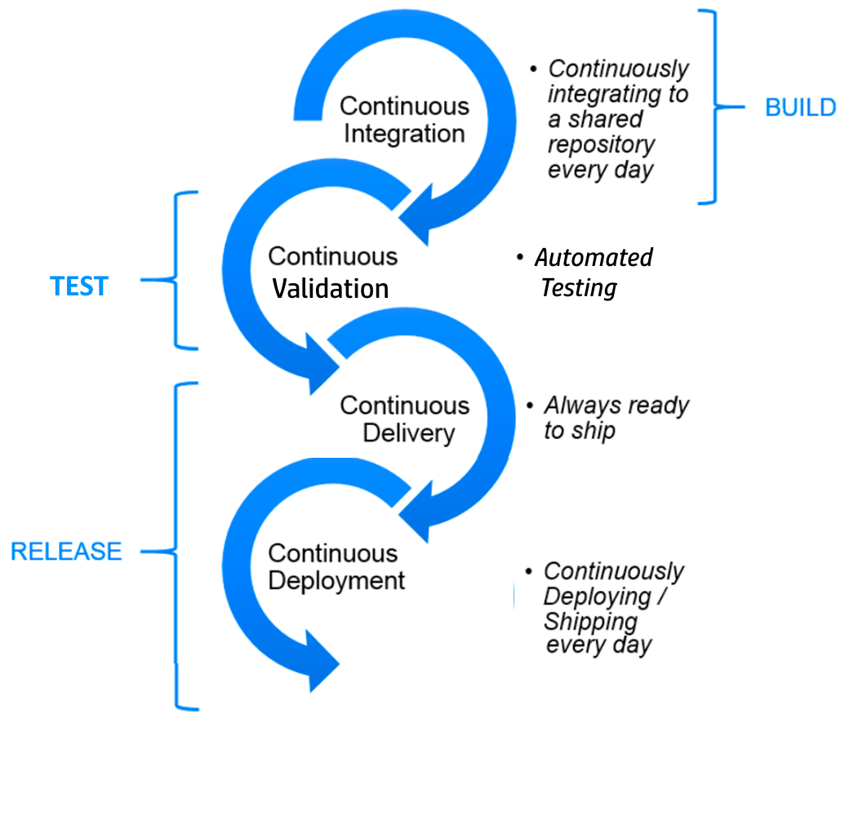
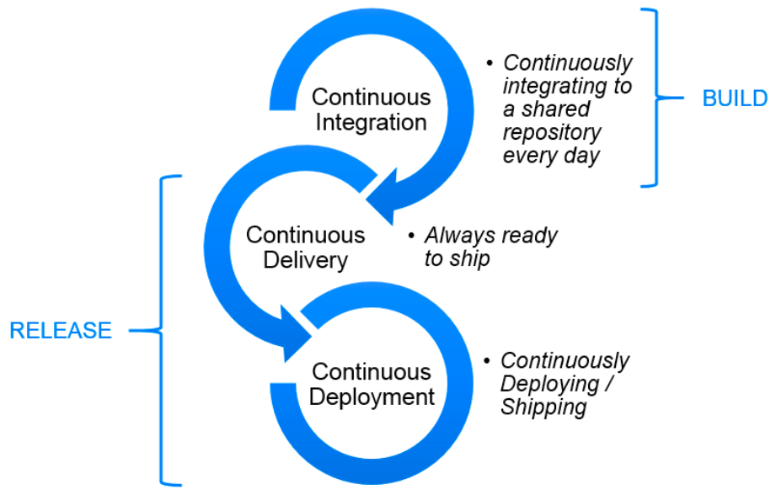
Continuous Integration /
Continuous Delivery / Deployment
Notes:
Continuous Integration is what we all think of as the build step. There is a Continuous Integration server that automatically builds and produces compiled artifacts when new code is checked in.
This is often where sanity and/or unit tests are done.
It quickly will identify build and basic test failures before the new code gets into the product. This is where developers spend most of their time.
Often this is further broken out into a Continuous Testing or Continuous Validation phase since it is responsible for ensuring the quality of the new code and its affect on the rest of the product.
This is where IaC really comes into play. Setting up the test environments, build systems and then running extensive component and integration tests can all be automated.
The output of this is a Gold Candidate.
Continuous Delivery takes the Gold candidate and gets it ready to ship. The focus is to ensure software is always release-ready but only deployed after further testing and manual approval.
Continuous Deployment automates the release process by taking the same Gold Candidate and deploying it to production automatically. This is often not desirable for complex, integrated systems since some system level and manual validation are required.
The go or no-go decision is often complex in modern software delivery teams and cannot just be pushed into production.
But continuous deployment does make sense in certain scenarios. It is a way to accelerate the feedback loop with your customers and release software when ready with no true "release day" anymore. Developers can focus on building software, and they see their work go live minutes after they've finished working on it.

Slide 30
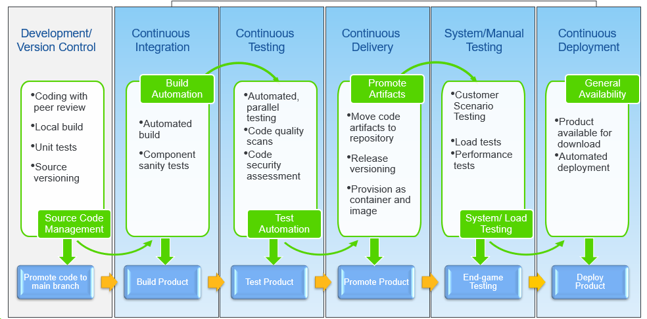
CI/CD Pipeline
Notes:
The full CI/CD pipeline defined an automated process that is kicked off when code is committed into the main development branch.
You will find many different variations on the steps needed for the pipeline and it really depends on your needs and your deployment models. On premise deployments might look different than hosted solutions. Customized products will have unique testing criteria. You need to find what works for your product.
In OE engineering, we use the steps shown here and I would like to go through each step and what happens there. All of the steps are automated but there are still some manual steps today. Since we always need to continue to support existing customers, we need to keep the business running while incrementally improving our processes.

Slide 31
CI/CD Pipeline
Notes:
Developers work in sandboxes where they can validate changes before committing those changes into the build pipeline. Developers are expected to build locally, run unit test, and any additional validation required for integration. Once completed, the developer asks for a peer review and checks in their new code to a version control system.
Most of us are already doing this.

Slide 32
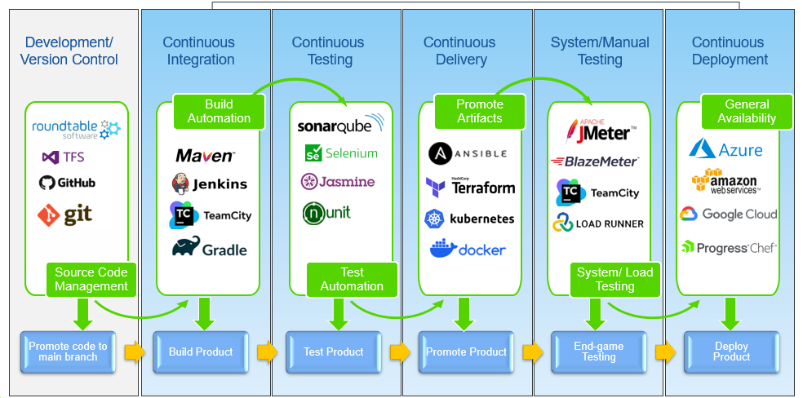
CI/CD Automation Tools
Notes:
Roundtable provides a complete system for tracking and managing ongoing changes to development projects, application source code and related files. This innovative solution delivers powerful team collaboration and parallel development tools at a very competitive price point.
GitHub is a cloud-based service for version control and collaboration. It helps teams store and manage their code, as well as track and control changes to their code. It lets teams work together on projects from anywhere using repositories, branches, commits, and pull requests.

Slide 33
CI/CD Pipeline
Notes:
Continuous Integration allows development teams to push new code changes as and when they write it. This process triggers automatically when code is integrated in to the main code base. Instead of developing in isolation and then integrating them at end of development cycle, continuous integration allow developers to integrate and test their code multiple times throughout the day.

Slide 34
CI/CD Automation Tools
Notes:
Apache Maven is an automation tool used to build and manage software development projects. It comes with pre-defined targets for performing certain well-defined tasks such as compilation of code and its packaging.
Jenkins is an open-source automation tool with plugins built for continuous integration. Jenkins is used to build and test your software projects continuously making it easier for developers to integrate changes to the project and making it easier for users to obtain a fresh build.
TeamCity is a CI server that allows developers to integrate, code, and is easier to configure with simple steps. On TeamCity parallel builds run simultaneously on different platforms and environments.
Gradle is a build automation tool for multi-language software development. It controls the development process in the tasks of compilation and packaging to testing, deployment, and publishing.

Slide 35
CI/CD Pipeline
Notes:
Continuous testing in DevOps is the process of executing automated tests as part of the pipeline when new code is checked-in. This can also be referred to as continuous validation.
Continuous testing/validation covers functional testing, both white box and black box along with non-functional requirements identified as additional validation criteria. Automated test tools help streamline the functional testing process and enable quick feedback, reducing the time and effort required for repetitive tasks.
Non-functional testing include code quality and security vulnerability scans. When functional bugs or quality issues are identified, instant feedback to developers ensures rapid fixes long before the final release.

Slide 36
CI/CD Automation Tools
Notes:
SonarQube is a Code Quality Assurance tool that collects and analyzes source code, It provides reports for the code quality of your project. It combines static and dynamic analysis tools and enables quality to be measured continually over time.
Selenium is an open-source, automated testing tool used to test web applications across various browsers.
Jasmine is one of the popular JavaScript unit testing frameworks which is capable of testing synchronous and asynchronous JavaScript code.
NUnit is a unit-testing framework for all .Net languages that was initially ported from JUnit.

Slide 37
CI/CD Pipeline
Notes:
Continuous delivery automates the software delivery process so that teams can easily deploy code into the required environments at any given time. Continuous delivery ensure high code quality as it comes once continuous integration is completed. Teams combine continuous delivery with continuous integration along with continuous testing to ensure high code quality as it comes once continuous integration is completed.
Continuous delivery leans heavily on the pipeline to automate the testing and promotion process. Newly built code from development runs through QA for continuous and automated testing. Reliable continuous integration setup is a pre-requisite to implement continuous delivery. This step also provide a place for provisioning and packaging of artifacts into candidate releases for real-world and manual testing that is required before the software is ready for release.
Continuous Delivery means that artifacts are built and made ready to be deployed. But they will not be deployed without a manual step by a human being.

Slide 38
CI/CD Automation Tools
Notes:
Ansible is an open-source suite of software tools that enables infrastructure as code for both Unix-like systems and Microsoft Windows. It includes software provisioning, configuration management, and application deployment
Terraform is an infrastructure as code tool that enables you to safely and predictably provision and manage infrastructure in any cloud.
Kubernetes, also known as K8s, is an open-source system for automating deployment, scaling, and management of containerized applications.
Docker is an open platform for developing, shipping, and running applications. Docker enables you to separate your applications from your infrastructure so you can deliver software quickly. With Docker, you can manage your infrastructure in the same ways you manage your applications. By taking advantage of Docker's methodologies for shipping, testing, and deploying code, you can significantly reduce the delay between writing code and running it in production.

Slide 39
CI/CD Pipeline
Notes:
System and manual testing verifies the software once the automated tests and quality scans have passed. This is the step where you can perform functional tests that are not automated and complex tests that require a complex system configuration.
Often these are tests are written to validate that components are working together as expected and End-to-End Tests which test the entire functionality of the product. Given the large area they cover, naturally these tests tend to be fairly large in volume and are not run on every check-in.
.

Slide 40
CI/CD Automation Tools
Notes:
Apache JMeter is open-source software designed to load test functional behavior and measure performance. JMeter can be used to simulate a heavy load on a server, group of servers, network or object to test its strength or to analyze overall performance under different load types.
BlazeMeter is an open-source platform for load and performance testing for all your apps, from web and mobile apps to microservices and APIs. Validate performance at every software delivery stage with advanced analytics, collaboration, and more.
TeamCity is used to build and test software products in an automated manner. It provides rapid feedback on every code change, reduces code integration problems, and leads to more effective teamwork.
Loadrunner can be used to test performance across a wide range of application types, different network conditions and varying service levels, LoadRunner Professional delivers an intuitive and versatile solution that saves you time, improves code coverage and provides accurate results.

Slide 41
CI/CD Pipeline
Notes:
Continuous deployment takes the software one step further than continuous delivery. With this model, every change that passes all stages of your production pipeline is released directly to your customers. There's no human intervention, and only a failed test will prevent a new change to be deployed to production.
Most organizations want a manual step where someone can push the button when the software is ready.
But continuous deployment does make sense in certain scenarios. It is a way to accelerate the feedback loop with your customers and release software when ready with no true "release day" anymore. Developers can focus on building software, and they see their work go live minutes after they've finished working on it.

Slide 42
CI/CD Automation Tools
Notes:
Microsoft Azure is a public cloud computing platform—with solutions including Infrastructure as a Service (IaaS), Platform as a Service (PaaS), and Software as a Service (SaaS) that can be used for services such as analytics, virtual computing, storage, networking, and much more. It can be used to replace or supplement your on-premise servers.
Amazon Web Services (AWS) is focused on being a broad-based provider of IT services, ranging from cloud-native and edge to ERP and mission-critical workloads. Amazon web service is an online platform that provides scalable and cost-effective cloud computing solutions.
AWS is a broadly adopted cloud platform that offers several on-demand operations like compute power, database storage, content delivery, etc., to help corporates scale and grow.
The Google Cloud Platform (GCP) is a suite of cloud services that offers server space on virtual machines, internal networks, VPN connections, disk storage, machine language SaaS (Software as a Service) applications, and even something called TPU (Tensor Processing Units).
Progress Chef can automate configuration management to define policies that are repeatable, consistent and reusable. The result is increased business agility and security because all systems and resources are continuously and automatically evaluated, corrected, and modified.

Slide 43
Adopting CI/CD

Slide 44

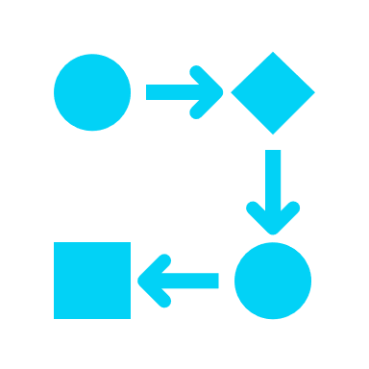
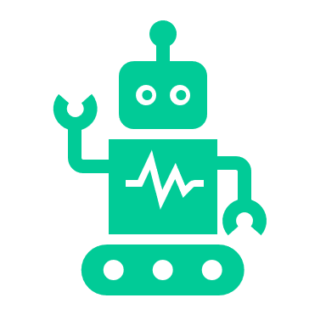

Bringing DevOps to Your Business
Adopt an agile development methodology
Get your procedures in line with a CI and CD workflow
Organize automated software testing
Utilize cloud computing
Use a continuous deployment DevOps strategy

Slide 45
Bringing DevOps to Your Business
Adopt an agile development methodology
Get your procedures in line with a CI and CD workflow
Organize automated software testing
Utilize cloud computing
Use a continuous deployment DevOps strategy

Slide 46
Bringing DevOps to Your Business
Adopt an agile development methodology
Get your procedures in line with a CI and CD workflow
Organize automated software testing
Utilize cloud computing
Use a continuous deployment DevOps strategy

Slide 47
Bringing DevOps to Your Business
Adopt an agile development methodology
Get your procedures in line with a CI and CD workflow
Organize automated software testing
Utilize cloud computing
Use a continuous deployment DevOps strategy

Slide 48
Bringing DevOps to Your Business
Adopt an agile development methodology
Get your procedures in line with a CI and CD workflow
Organize automated software testing
Utilize cloud computing
Use a continuous deployment DevOps strategy

Slide 49
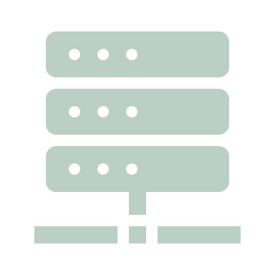
PASOE: Old vs New Deployment Models
Single Big Box
Databases
Multiple Boxes
Databases
WebSpeed
Classic AppServer
REST Manager
Web Services Adapter
PAS for OpenEdge
Load Balancer
Notes:
Example of ‘old’ style deployment architecture being replaced with ‘new’ style one.
Often part of a wider modernisation project
Single big box : common model, often with batch jobs and maybe character clients
Move to multiple machines:
Some corporates want app servers off the DB machines
Add resilience and scalability
PASOE straightforward to deploy, configure and update automatically
Not about re-writing the application, but redeploying existing code
Biggest stumbling block: switch from direct DB connection to client/server

Slide 50
PASOE: Old vs New Deployment Models
Single Big Box
Databases
Multiple Boxes
Databases
WebSpeed
Classic AppServer
REST Manager
Web Services Adapter
PAS for OpenEdge
Load Balancer
Notes:
Example of ‘old’ style deployment architecture being replaced with ‘new’ style one.
Often part of a wider modernisation project
Single big box : common model, often with batch jobs and maybe character clients
Move to multiple machines:
Some corporates want app servers off the DB machines
Add resilience and scalability
PASOE straightforward to deploy, configure and update automatically
Not about re-writing the application, but redeploying existing code
Biggest stumbling block: switch from direct DB connection to client/server

Slide 51
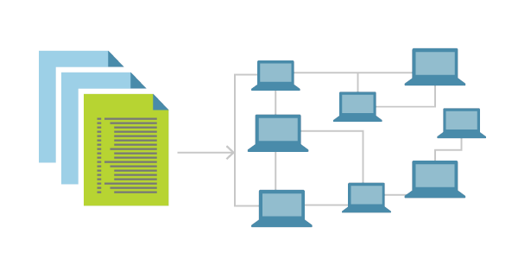
Infrastructure As Code (IAC)
Generate consistent environments for build and test
  System definition comes from engineering
  Ops automate system configurations
Key part of mature continuous delivery
Descriptions of infrastructure

Slide 52
OpenEdge DevOps Framework (OEDF)
Automate compilation, repository integration, testing, and packaging.
Built on Riverside Software PCT
Single set of scripts for development and production build processes.
The OpenEdge DevOps Framework comprises a set of Gradle plugins.
Notes:
compilation, repository integration, testing, and packaging. It also provides the convenience of sharing the CI pipeline configuration between the development and production build processes.
For ABL applications, the OpenEdge DevOps Framework is designed to help with implementing an efficient CI pipeline that handles compilation, repository integration, testing, and packaging. It also provides the convenience of sharing the CI pipeline configuration between the development and production build processes.
OEDF is a set of Gradle plugin that provide a command line interface to build and packaging

Slide 53

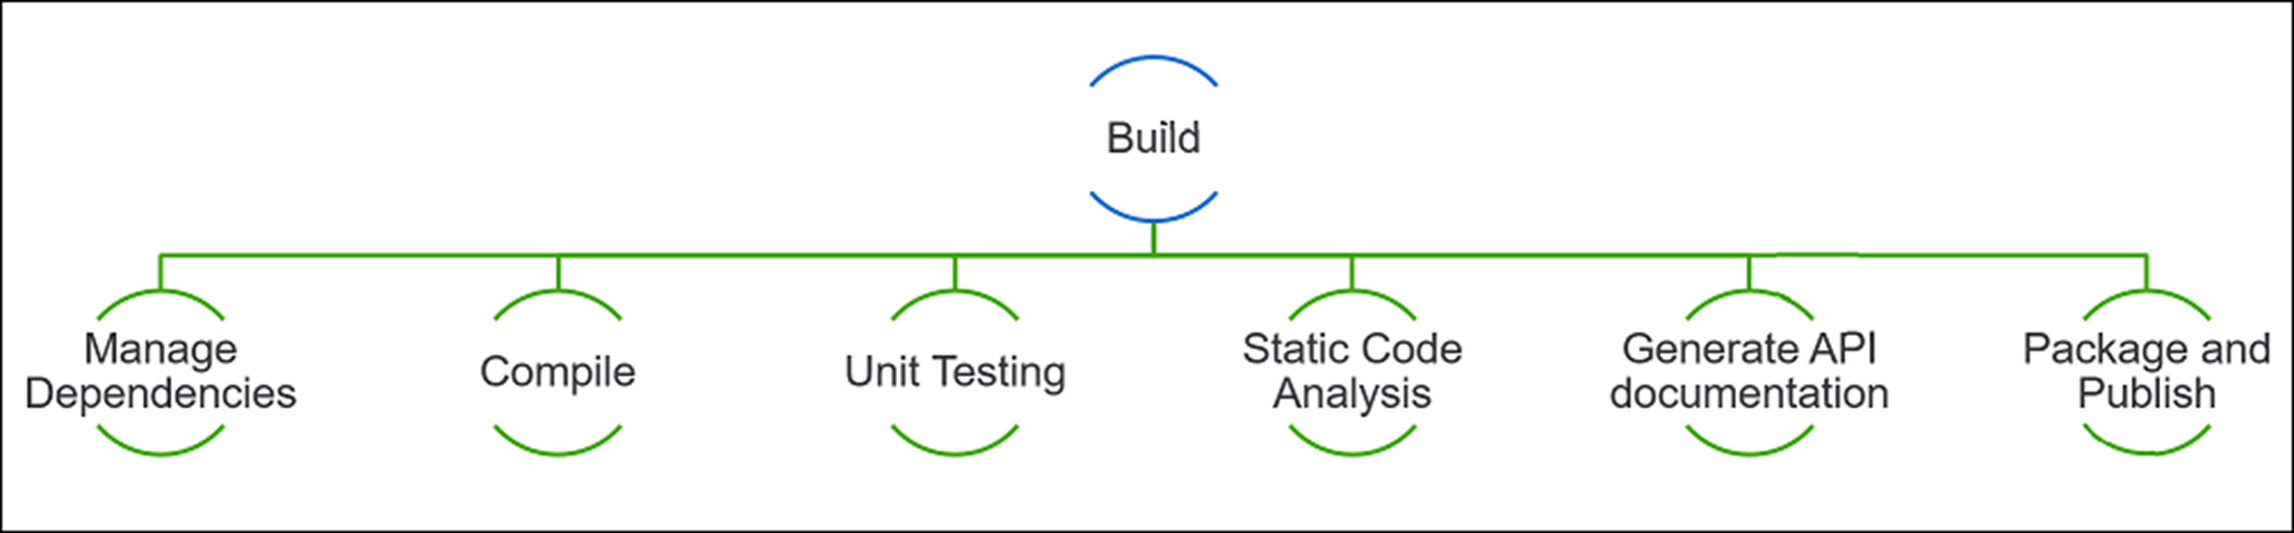
OpenEdge DevOps Framework Gradle Plugins
ABLCompile
ABLRun
ABLUnit
ExtractPL
PL
APL
Custom
DBConnection
LoadDBSchema
BackupDB
CreateDB

Slide 54
Software Packaging Options
ABL Applications
.oear - application archive
Web Applications
.war - web application archive
ABL Services
.oeds - Data service archive
.json - Data object service catalog
.wsm - SOAP service descriptors
.paar - REST service definitions

Slide 55
Summary

Slide 56
Importance of DevOps
Consistent Results
Quick Turnaround
Increased Productivity

Slide 57
DevOps is a cultural movement where both key stakeholder groups (software developers and IT operations) agree that software is not really adding any value until it is used by somebody – customers, clients, employees, etc,
Due to this, both teams are ensuring together that software is delivered with speed and quality.
Eveline Ohrlich
Chief Research Director, DevOps Institute

Slide 58
Q & A

