Slide 1



Monitoring Progress Application Server for OpenEdge
Roy Ellis (ellis@progress.com)
Director Professional Services Managed Database
Notes:
DO NOT SHARE THIS PRESENTATION AS A POWERPOINT, PDF ONLY

Slide 2
Agenda
Classic AppServer Monitoring
JMX
OEJMX
REST API
Iceberg
Health Scanner
New PASOE monitor for MDBA
Recommendations

Slide 3
Classic AppServer Monitoring

Slide 4

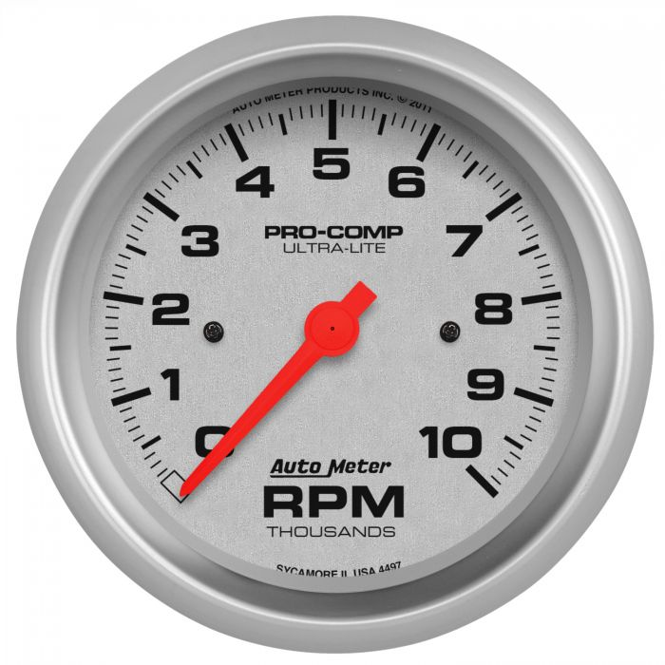
asbman -query
Notes:
Back to the tools to diagnose problems in our Classic Car/AppServer
Stethoscope
Timing Light
Vacuum gauge
Very primitive, like asbman –query
- Text output command, have to screen scrape to gather data

Slide 5

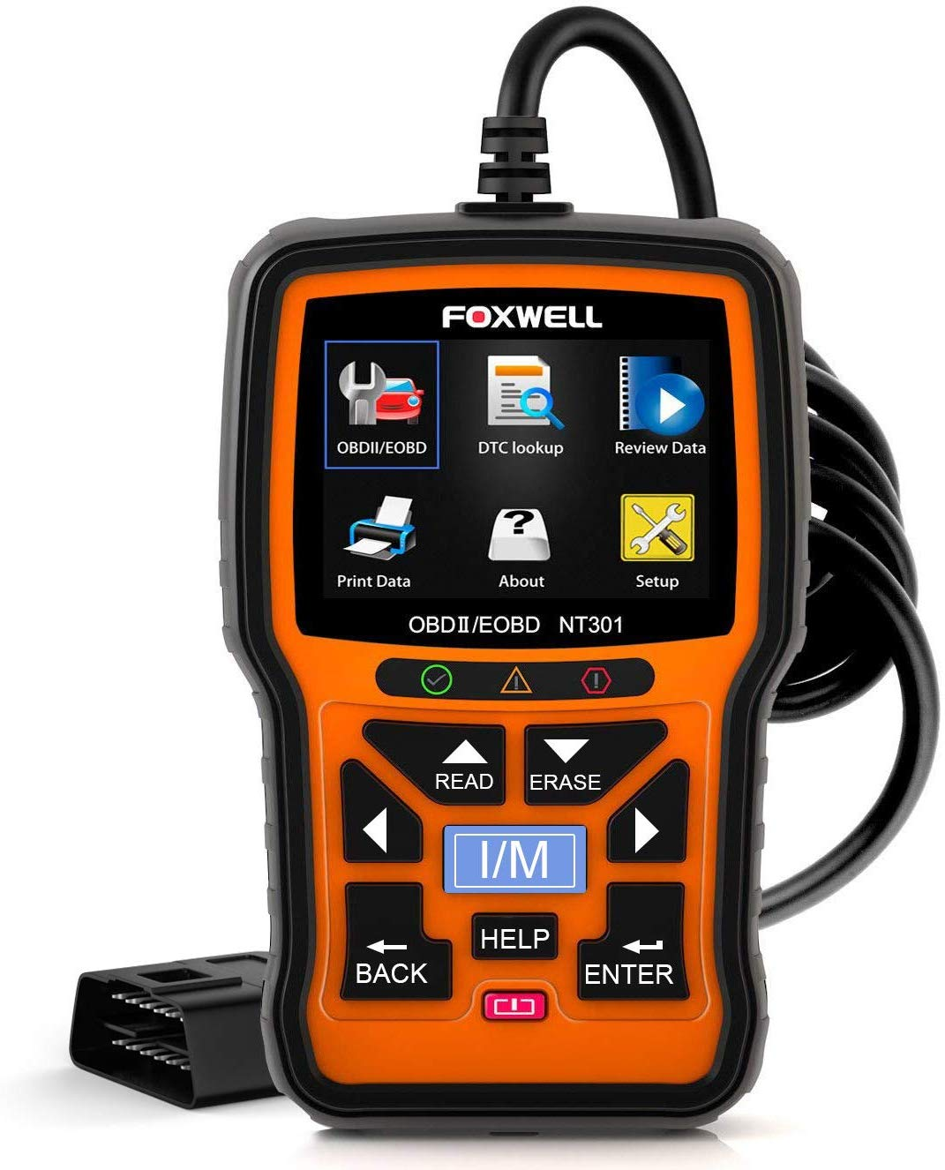

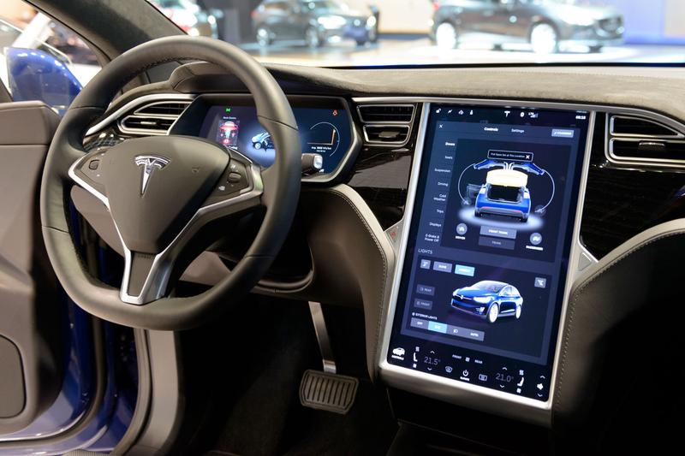
JMX supports
OEJMX
REST API
HealthScanner
Notes:
The newer tools:
JMX – all queries report via Mbeans using JMX
OEJMX – script to gather information
REST API – HTTP(S) to gather information
HealthScanner(12.0+) – Monitoring via JMX
Tesla tools
ODB2 tester
Access via computer
Has built-in diagnostics

Slide 6
Classic AppServer Monitoring
The Classic monitoring asbman –i(-name) asbroker1 –q(-query)
Broker Name : asbroker1
Operating Mode : State-reset
Broker Status : ACTIVE
Broker Port : 3090
Broker PID : 28482
Active Servers : 7
Busy Servers : 1
Locked Servers : 0
Available Servers : 6
Active Clients (now, peak) : (1, 21)
Client Queue Depth (cur, max) : (1, 21)
Total Requests : 1449080
Rq Wait (max, avg) : (100 ms, 2 ms)
Rq Duration (max, avg) : (1200 ms, 30 ms)

Slide 7
Classic AppServer Monitoring
Agent information
PID State Port nRq nRcvd nSent Started Last Change
09170 AVAILABLE 19101 144908 144908 144908 09-Apr-2022 06:18 12-Apr-2022 14:27
02158 AVAILABLE 19102 046299 046299 046299 11-Apr-2022 11:59 12-Apr-2022 14:27
02161 AVAILABLE 19103 046274 046274 046274 11-Apr-2022 11:59 12-Apr-2022 14:27
28412 AVAILABLE 19104 018443 018443 018443 12-Apr-2022 06:58 12-Apr-2022 14:27
28415 AVAILABLE 19105 018507 018507 018507 12-Apr-2022 06:58 12-Apr-2022 14:27
28418 AVAILABLE 19106 018434 018434 018434 12-Apr-2022 06:58 12-Apr-2022 14:27
28421 BUSY 19107 018330 018330 018330 12-Apr-2022 06:58 12-Apr-2022 14:27

Slide 8
JMX

Slide 9
Java Management eXtensions – JMX
JMX is a Java technology that supplies tools for managing and monitoring applications, system objects, devices (such as printers) and service-oriented networks.
Those resources are represented by objects called MBeans (for Managed Bean)
In the API, classes can be dynamically loaded and instantiated
Tomcat supports JMX
PAS for OpenEdge supports JMX
Always on
(source for the first 3 bullets – Wikipedia.com)

Slide 10
OEJMX

Slide 11
OEJMX script
OEJMX.sh(.bat) resides in the PAS for OpenEdge instance directory in “bin”
It reads a file (default extension .qry) that directs the specific JMX APIs to execute
The OEJMX script launches a JVM which connects to Tomcat/PAS for OpenEdge JVM running for that instance
Queries the JVM and writes and output file (by default in the instance-dir/temp) directory

Slide 12
OEJMX script
Pros
  Secure, can only be run on machine where PAS for OpenEdge is running
  Scriptable
  Can gather many different metrics in a single query
Cons
  Slow, must launch JVM and connect to PAS for OpenEdge JVM
      Should not be run in quick succession
  Sometimes need to make several calls to gather data
  Creating the .qry scripts takes some getting used to

Slide 13
OEJMX script
oejmx.bat -Q jmxqueries\getAgents.qry
# getAgents.qry
{"O":"PASOE:type=OEManager,name=AgentManager","M":["getAgents",”oepas1"]}
Query: Line 1. PASOE:type=OEManager,name=AgentManager, getAgents(oepas1)
Result: {"getAgents":{"agents":[{"agentId":"u9oyMfogQ1SnTC_XaqwyUA","pid":"1692","state":"AVAILABLE"}]}}

Slide 14
OEJMX script
oejmx.bat -Q jmxqueries\getAgentMetrics.qry
# getAgentMetrics.qry
{"O":"PASOE:type=OEManager,name=AgentManager","M":["getSessionMetrics",”1692"]}
Query: Line 1. PASOE:type=OEManager,name=AgentManager, getSessionMetrics(1692)
Result: {"getSessionMetrics":{"AgentSession":[
{"SessionState":"IDLE","ConnectionId":"org.codehaus.jettison.json.JSONObject$Null","SessionMemory":869908,"EndTime":"org.codehaus.jettison.json.JSONObject$Null","ThreadId":-1,"SessionExternalState":0,"StartTime":"2019-12-15T16:16:00.268","SessionId":4},
{"SessionState":"ACTIVE","ConnectionId":"org.codehaus.jettison.json.JSONObject$Null","SessionMemory":3613499,"EndTime":"org.codehaus.jettison.json.JSONObject$Null","ThreadId":4,"SessionExternalState":0,"StartTime":"2019-12-15T16:16:00.268","SessionId":7}]}}

Slide 15
Rest API

Slide 16
REST API calls
REST based API calls to the JMX
Pros
  Can be accessed remotely but can be limited to localhost (or specific hosts)
  Very fast
  Easy to use
  Swagger documents

Slide 17
REST API calls
Cons
  Can be accessed remotely – so considered a security risk
  Can only gather a single metric per call
  Must install the REST API manager application (oemanager.war)

Slide 18
REST API calls
http://oelxc76dev07:8080/oemanager/applications/oepas1/metrics
{"operation": "GET SESSION-MGR METRICS","outcome": "SUCCESS","result": {"requests": 500,"writeErrors": 0,"reads": 2000,"concurrentConnectedClients": 0,"writes": 2000,"maxConcurrentClients": 4,"readErrors": 0,"numReserveABLSessionTimeouts": 0,"numReserveABLSessionWaits": 0,"type": "OE_BROKER","startTime": "2022-08-17T17:04:39.969-04:00","accessTime": "2022-08-17T17:09:15.648-04:00"},"errmsg": "","versionStr": "v11.7.16 ( 2022-08-12 )","versionNo": 1}

Slide 19
REST API calls
http://oelxc76dev07:8080/oemanager/applications/oepas1/agents
{"operation": "GET AGENTS","outcome": "SUCCESS","result": {"agents": [{"agentId": "xPG7sVBMRO-GLLVsdiG2HA","pid": "29402","state": "AVAILABLE"}]},"errmsg": "","versionStr": "v11.7.16 ( 2022-08-12 )","versionNo": 1}

Slide 20
REST API calls
http://oelxc76dev07:8080/oemanager/applications/oepas1/agents/29402/requests
{"RequestProcName":"sports2kserver.p","SessionId":9,"ConnectionId":47,"StartTime":"2022-08-17T17:06:53.377","EndTime":"2022-08-17T17:06:53.380","RequestNum":92},{"RequestProcName":"sports2kserver.p","SessionId":9,"ConnectionId":47,"StartTime":"2022-08-17T17:06:53.390","EndTime":"2022-08-17T17:06:53.392","RequestNum":93},
{"RequestProcName":"sports2kserver.p","SessionId":9,"ConnectionId":47,"StartTime":"2022-08-17T17:06:53.402","EndTime":"2022-08-17T17:06:53.404","RequestNum":94},{"RequestProcName":"sports2kserver.p","SessionId":9,"ConnectionId":47,"StartTime":"2022-08-17T17:06:54.424","EndTime":"2022-08-17T17:06:54.427","

Slide 21
REST API calls
http://oelxc76dev07:8080/oemanager/applications/oepas1/agents/29402/sessions
{"operation": "","outcome": "SUCCESS","result": {"AgentSession": [{"SessionId": 4,"SessionState": "IDLE","StartTime": "2022-08-17T17:06:33.512","EndTime": null,"ThreadId": -1,"ConnectionId": null,"SessionExternalState": 0,"SessionMemory": 805071},{"SessionId": 7,"SessionState": "IDLE","StartTime": "2022-08-17T17:06:33.512","EndTime": null,"ThreadId": -1,"ConnectionId": null,"SessionExternalState": 0,"SessionMemory": 804959},{"SessionId": 8,"SessionState": "IDLE","StartTime": "2022-08-17T17:06:33.512","EndTime": null,"ThreadId": -1,"ConnectionId": -1,"SessionExternalState": 0,"SessionMemory": 805123},{"SessionId": 9,"SessionState

Slide 22
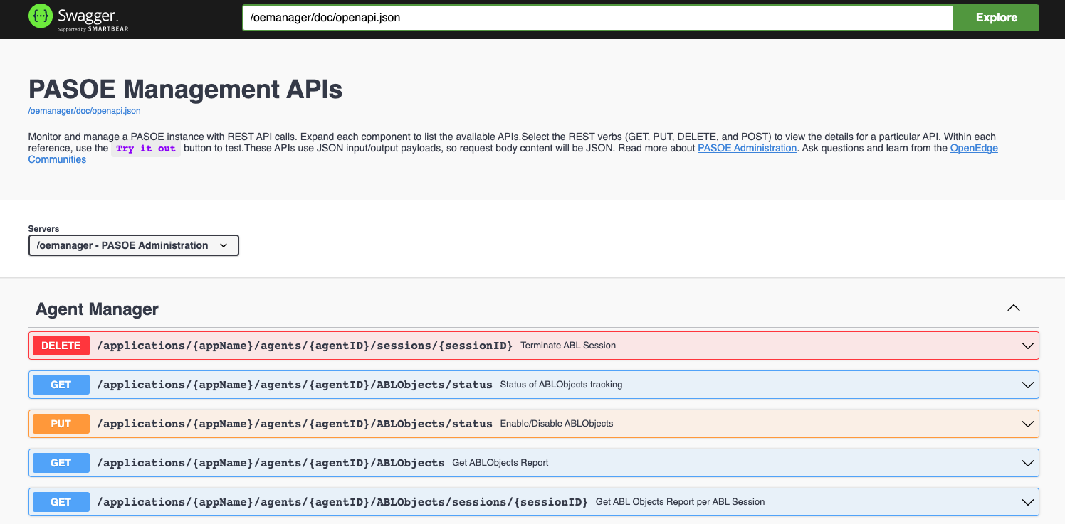
REST API calls

Slide 23
HealthScanner

Slide 24
Health Scanner
Designed for Load Balancing infrastructures
Allows you to remove an ailing VM from a load balanced array before it is unresponsive
Secondarily it can report system information not just the health of PAS for OpenEdge and the VM

Slide 25
Health Scanner
Pros
  Great for over all health of your PAS for OpenEdge machine
  Great for automatic Load Balancing integration
  Gathers system information as well as PAS for OpenEdge health
  Can be accessed remotely or by script (can disable remote access)
Cons
  Does not give the same detailed information as OEJMX nor REST API
  Must be enabled, both to gather information and to allow remote access
  Only in 12.0+ releases (not in 11.7)

Slide 26
Health Scanner
http://oelxc76dev07:8899/health
Returns 200 or 500
http://oelxc76dev07:8899/health?view=summary
{"health": 0,"timestamp": "2022-08-19T14:06:12.233681Z","interval": 60}

Slide 27
Health Scanner
http://oelxc76dev07:8899/health?view=details
{"name": "PASOE HealthScanner","color": "#F63538","timestamp": "2022-08-19T14:07:12.237416Z","result": {"health": 0,"value": 0,"marginal": true,"critical": true,"ignore": false,"failOnCritical": true,"failedBy": "OS Health"},"config": {"calculation": "sum of probes( health * weight ) / sum of probes( weight )","critical": 0.6,"probeID": 1,"name": "PASOE HealthScanner","marginal": 0.7,"description": "Composite weighted health of PAS for OpenEdge server metrics","weight": 1,"className": "com.progress.appserv.services.health.probe.CompositeHealthProbe","enabled": true,"failOnCritical": false},+

Slide 28
Health Scanner
http://oelxc76dev07:8899/health?view=dataset
{"HealthData": [{"probeid": 1,"health": 0,"marginal": true,"critical": true,"ignore": false,"failOnCritical": true,"failedBy": "OS Health","value": "0.0","lastpoll": "2022-08-19T14:10:12.252503Z"},{"probeid": 2,"health": 0,"marginal": true,"critical": true,"ignore": false,"failOnCritical": false,"failedBy": null,"value": "0.0","lastpoll": "2022-08-19T14:10:12.252503Z"},+

Slide 29
Health Scanner
linuxx86_64:122$ bin/oehealth.sh
{"Health":0.0}
linuxx86_64:122$ bin/oehealth.sh -D
{"getView":{"name":"PASOE HealthScanner","color":"#F63538","timestamp":"2022-08-19T14:14:12.266009Z","result":{"health":0.0,"value":0.0,"marginal":true,"critical":true,"ignore":false,"failOnCritical":true,"failedBy":"OS Health"},"config":{"calculation":"sum of probes( health ablapps bin common conf hcapps instances.unix instances.windows logs openedge temp webapps work weight ) / sum of probes( weight )","critical":0.6,"probeID":1,"name":"PASOE HealthScanner","marginal":0.7,"description":"Composite weighted health of PAS for OpenEdge server metrics","weight":1.0,”+

Slide 30
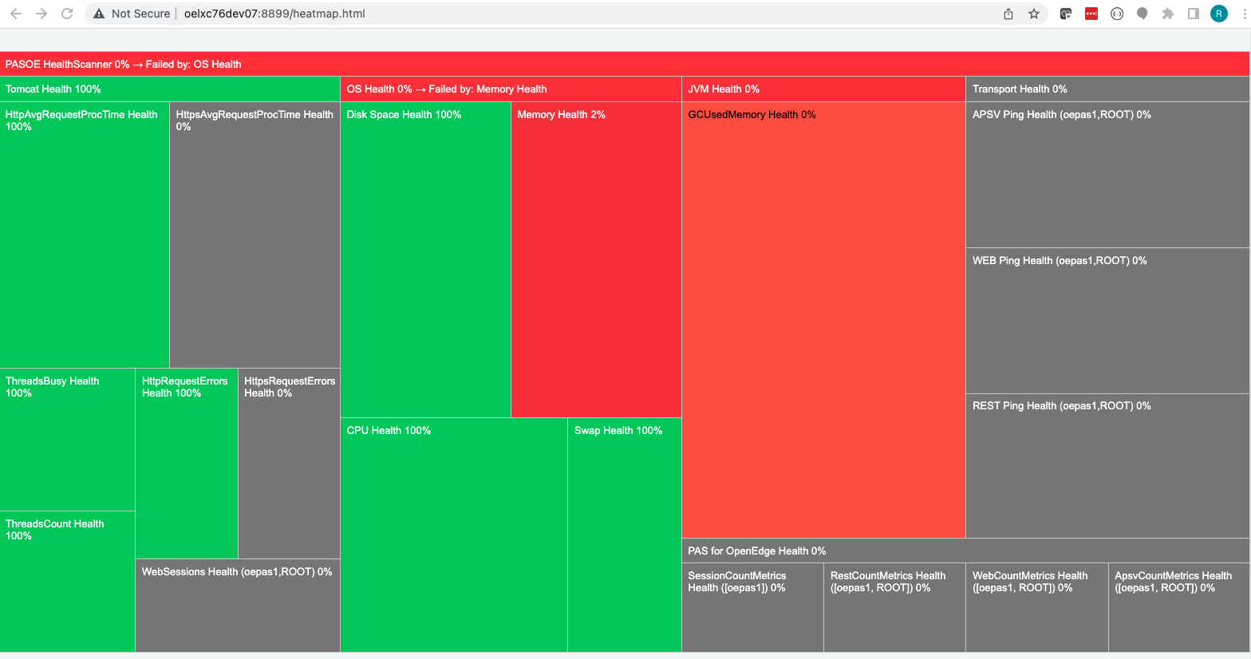
Health Scanner

Slide 31
Recommendations

Slide 32
Recommendations
REST API
  When you want fast requests
  When you are making many requests in a short period of time
  When you are looking to alert on issues

Slide 33
Recommendations
OEJMX
  When you want to gather many metrics at once
  When you are querying less frequently
  You don’t want to install the manager or oemanager applications

Slide 34
Recommendations
Health Scanner
  If you are load balancing (or not)
  If you want to the know system information not just PAS for OpenEdge
  When you want to trend data (view=dataset)

Slide 35
Recommendations
What should I monitor?
  PASOE accepting requests
      http(s)://host:port/rest/_oepingService/_oeping
      https://docs.progress.com/bundle/pas-for-openedge-management/page/ABL-application-PING-service.html
Tomcat incoming thread pool
      http(s)://host:port/manager/status
  Current and max sessions in Session Manager
      http(s)://host:port/oemanager/applications/metrics
  Current agent sessions
      http(s)://host:port/oemanager/applications/agents/<agent-id>/sessions

Slide 36
Recommendations
What should I monitor?
  Current agent sessions memory
      http(s)://host:port/oemanager/applications/agents/<agent-id>/sessions
  System health
      System tools
        Top, vmstat, iostat, task manager
      Health Scanner (12.0)

Slide 37
Summary
Better than Classic
Many monitoring tools
May want to use a combination
Monitor!

Slide 38


Customer
Validation
Program
© 2023 Progress Software Corporation and/or its subsidiaries or affiliates. All rights reserved.
Notes:
This is intended as a transition slide

Slide 39
Join the CVP
OpenEdge Customer Validation Program
Actively influence the developer experience and future enhancements of Progress OpenEdge!
Get Access to:
  Roadmap surveys Virtual open houses
  Usability reviews Quarterly objectives
  Pre-release software Sprint reviews
https://www.progress.com/openedge/customer-validation-program
6

Slide 40
Questions?

