Slide 1

Reporting in business applications, making sense of increasing data volumes
Marian Edu, ACORN IT
marian.edu@acorn.ro
PUG Challenge Americas 2023

Slide 2
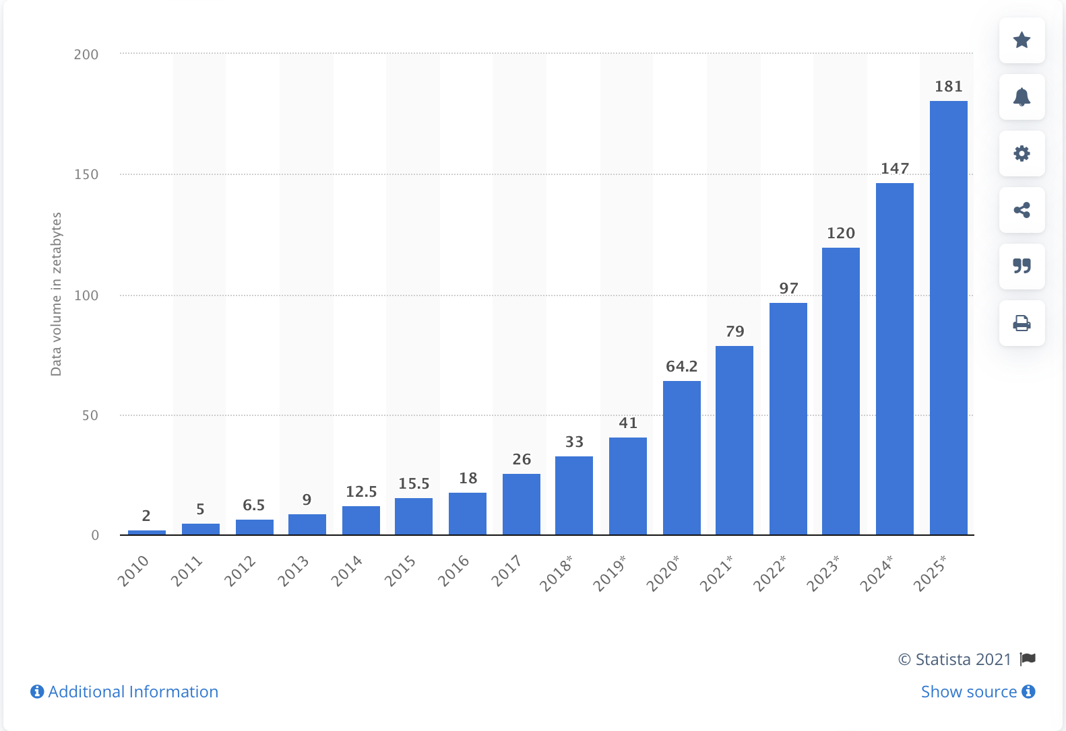
Data Is
The New Oil
Volume of data/information created, captured, copied, and consumed worldwide
Notes:
64.2 zetabytes (10^21), prediction exceeded due to covid-19

Slide 3
Business Applications
“Reporting”
Data presentation
(document formats)
Dashboards
(key performance indicators, snapshot)
Analytics
(rear-view, predictive)
Data mining
(slice & dice, trends, strategies)
BI, AI...
(machine learning)

Slide 4
OpenEdge Reporting
Report Builder (deprecated)
Not “core” (UI components anyone?)
Plenty of 3rd party solutions

Slide 5
Business Application Reporting
Embedded vs. Integrated
OS independence
Web/mobile interface
Ad-hoc
Analytics

Slide 6
Data Sources
ODBC, JDBC
ADO.NET
Flat files (structured, less structured)
SOAP/REST

Slide 7
Data Integration
Data ‘warehouse’
ETL (Extract/Transform/Load)
Business catalog
Dimensions and Facts

Slide 8
Popular Reporting Solutions
Tableau
https://www.tableau.com/
SAP Crystal Reports
    https://www.crystalreports.com
SAP Business Objects
    https://www.sap.com/products/bi-platform.html
Inmydata (DataPA)
    https://inmydata.com
Cyberquery
    https://www.cyberscience.com

Slide 9
Java Reporting Engines
Jasper Reports
http://community.jaspersoft.com/
Eclipse Birt (OpenText)
    http://www.eclipse.org/birt
Pentaho (Hitachi Vantara)
    https://sourceforge.net/projects/pentaho/

Slide 10
Jasper Reports
JasperReports Library (embeddable)
Report designer(s)
JasperReports Server
ETL (Talend)
Visualize.js
Absolute (pixel perfect) layout
Notes:
Visualize.js currently does not support JasperReports Server Community Edition or the TIBCO JasperReports® Library.

Slide 11
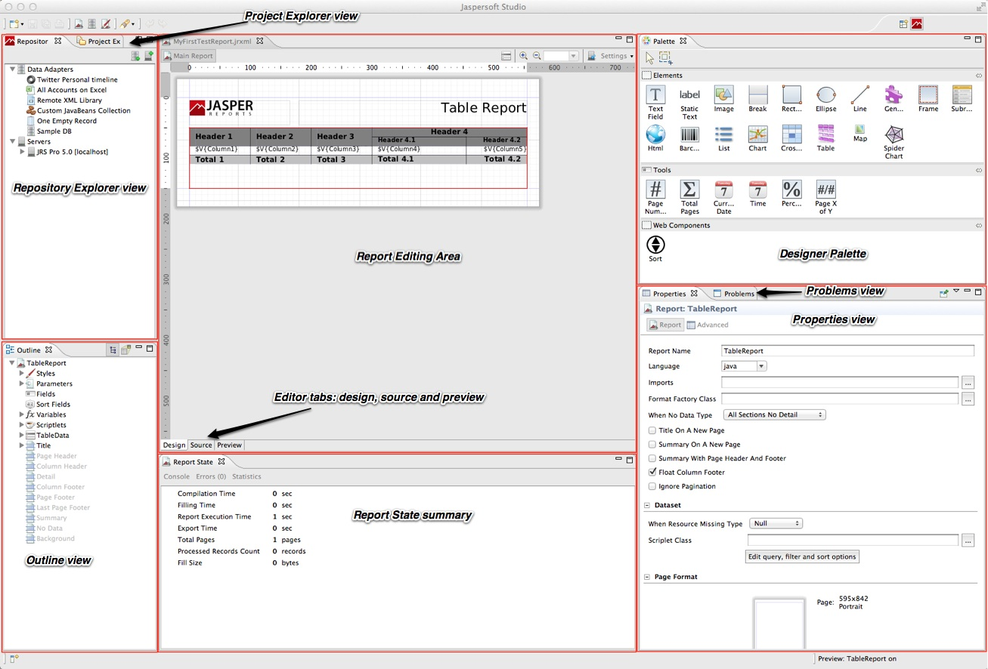
Jaspersoft Studio
Notes:
New report designer, Eclipse based.

Slide 12
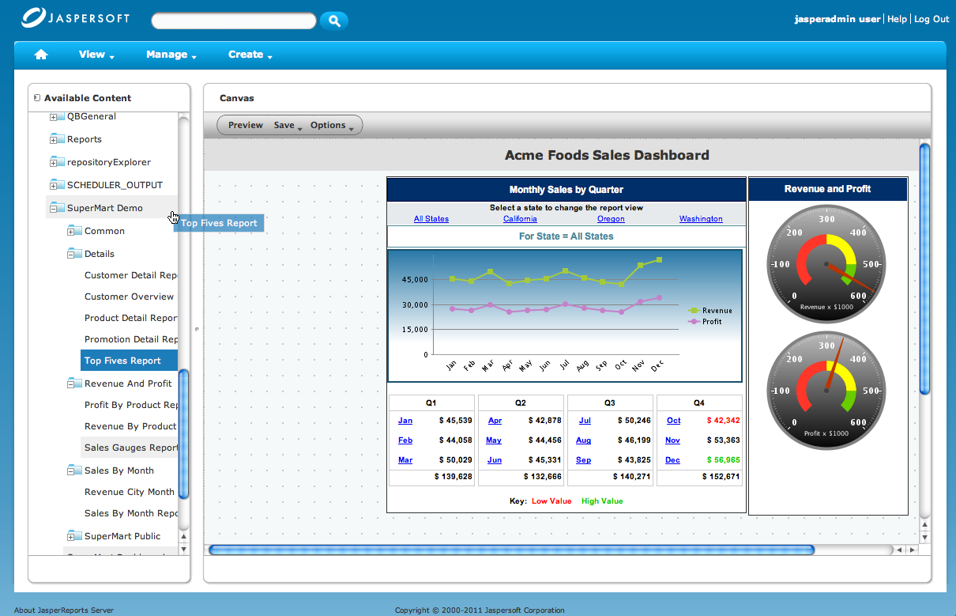
JasperReports Server
Notes:
Centralized Reporting, Dashboards, and Data Analytics
REST and SOAP-based web services and HTTP APIs for simplified integration with Applications and workflows
User and Role based access, multi-tenancy (commercial)
OLAP
Multi-dimensional Expression Language (MDX) support for complex analytic queries
Standard JPivot based analytic interface
Integrated Ad Hoc Analytic Interface supporting drill down, drill across, drill up, filtor, pivot, sort, and chart against OLAP and In-Memory data (Commercial Only)
Ad-hoc
Web-based, drag-and-drop designer for bringing multiple reports together into a single dashboard. (Commercial Only)

Slide 13
BIRT
Totally build on Eclipse & OSGi
Eclipse based graphical designer
Modular architecture, easily extensible
HTML/Grid Layout
No reporting server, roll your own

Slide 14
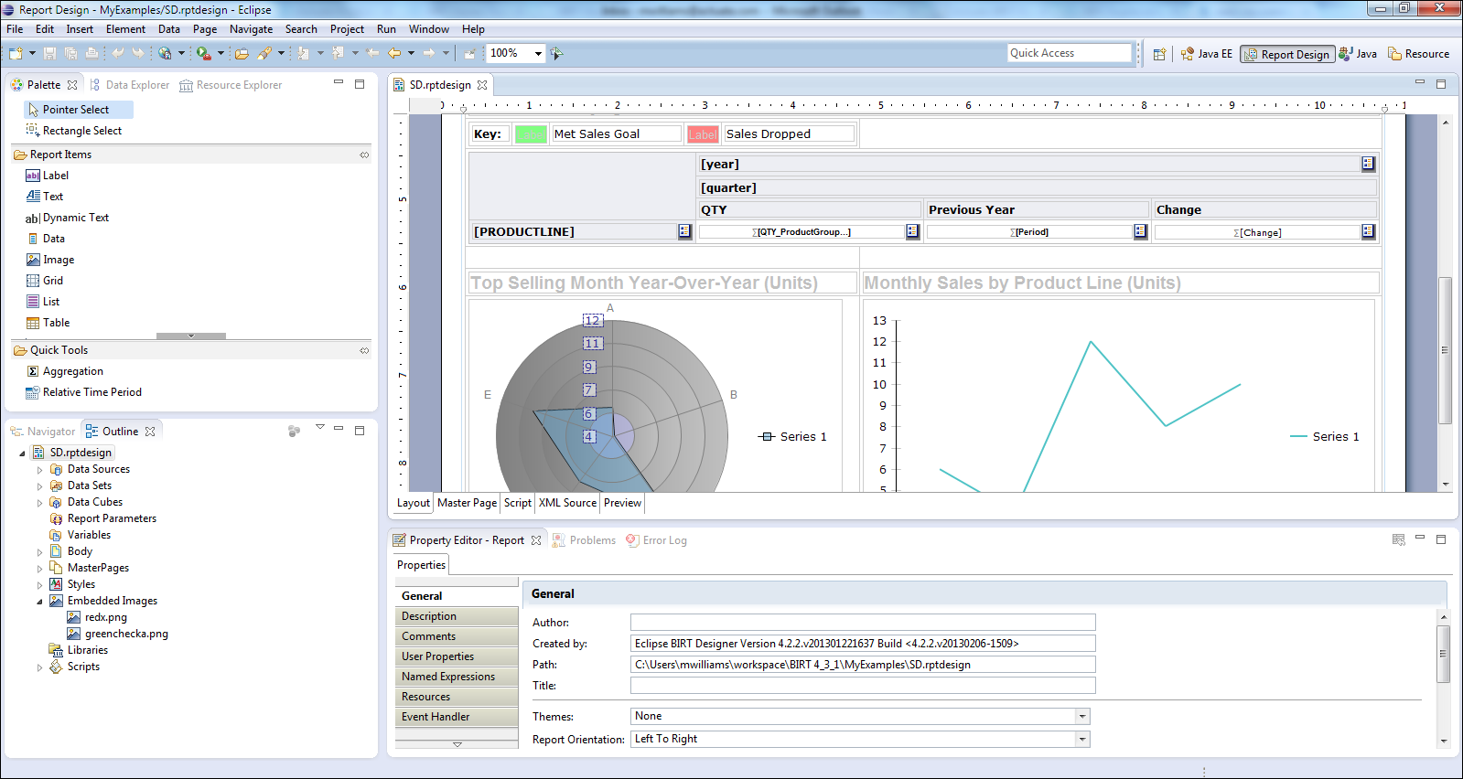
Birt Report Designer

Slide 15
Pentaho
Report Engine Library (embeddable)
Report designer
Pentaho BI Server
ETL Data Integration - Kettle
Absolute (pixel perfect) layout
Notes:
formally known as JFreeReport

Slide 16
Pentaho Report Designer

Slide 17
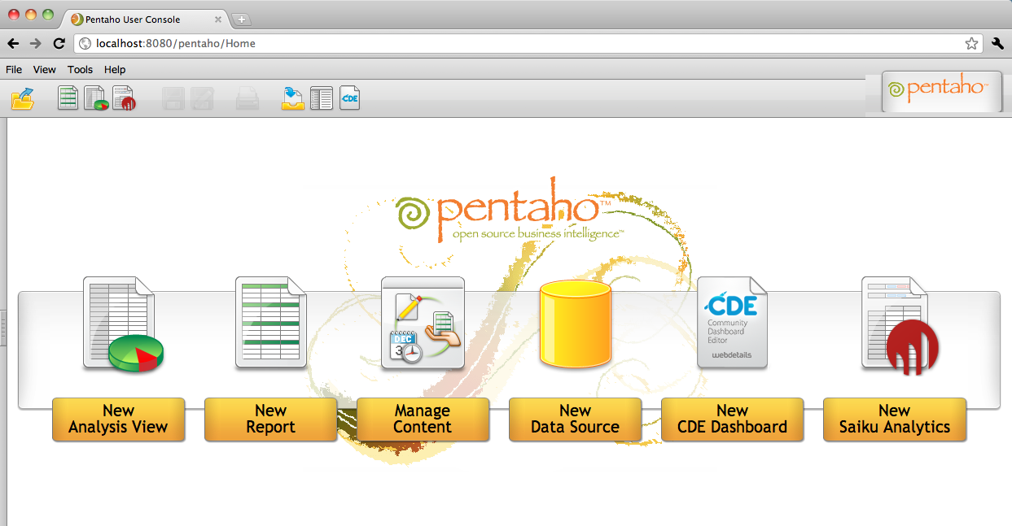
Pentaho BI Server

Slide 18
Progress Data Access - JDBC
Progress JDBC driver
V9.1+
(type 2: com.progress.sql.jdbc.JdbcProgressDriver)
V10+
(type 4: com.ddtek.jdbc.openedge.OpenEdgeDriver)
SQL Language
SQL Server Engine
Security (users, grant)
Cost Based Optimizer (update statistics)
SQL Width (character fields)
Triggers (does not fire)

Slide 19
Extras
ABL Business Logic JDBC Driver
ABL Bridge for Java Reporting Engine

Slide 20
Standard JDBC driver – type 4 driver
“Native connection” – Application Server
Expose business logic (stored procedures)
4GL/ABL “FOR EACH” syntax
Support multiple result-sets (dataset)
Full meta-data support
ABL Business Logic JDBC

Slide 21

ABL Bridge for Reporting Engine
Report Print, Export and Preview from ABL environment
JDBC data source (Progress, ABL Business Logic, Other RDBMS)
XML data source (including client temp-table and dataset)
Report parameters
Dynamic report generation, with template support

Slide 22
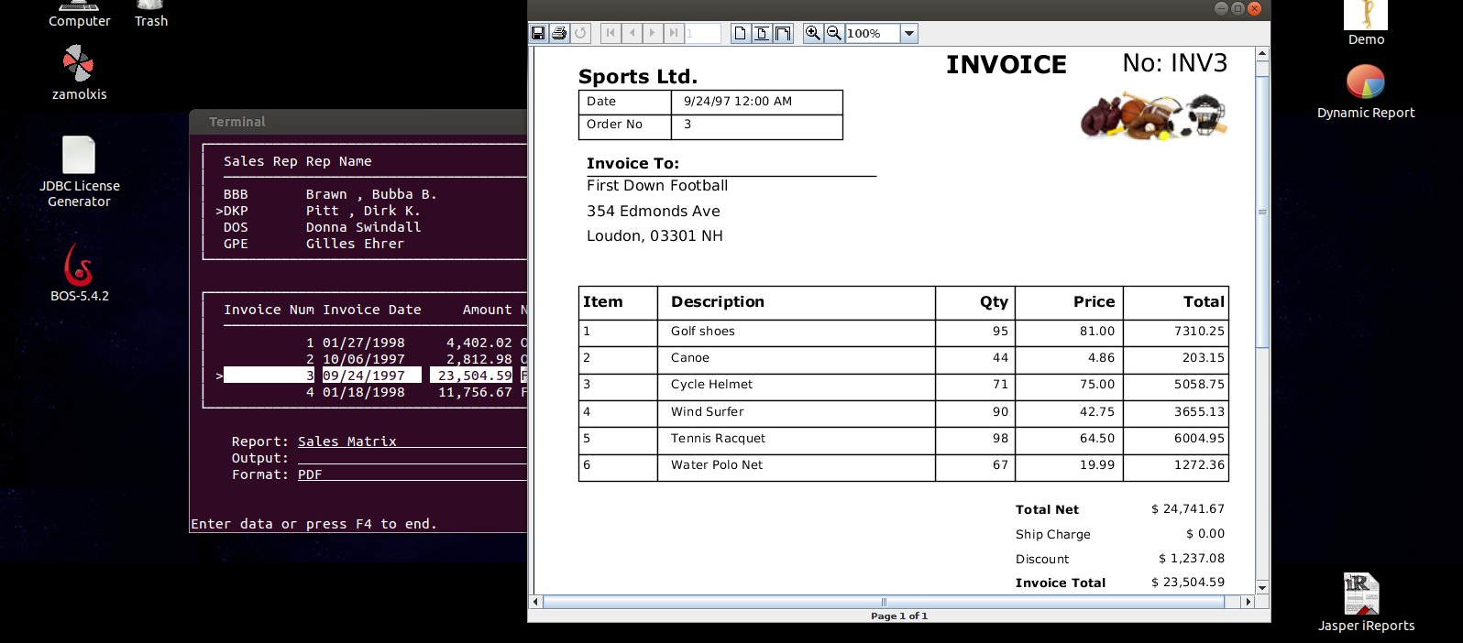
ABL Bridge for Reporting Engine

Slide 23
Things to consider…
Whatever your journey, start today
Integrated reporting (operational)
Role based dashboard & analytics (web)
Business catalog (metadata)
Warehouses does not need to be huge

