Slide 1


Model Driven Design
in an Agile World
Marian Edu, Acorn IT

Slide 2

MDSD
MDE
MDA (OMG)
MDD
UML(OMG)
Model Driven Design in an Agile world
acorn.ro
Notes:
Model driven software development… engineering, architecture, development
Open Management Group, Unified Model Language (1997)

Slide 3
MDA
Model Driven Architecture® is an approach to software design, development and implementation spearheaded by the OMG. MDA provides guidelines for structuring software specifications that are expressed as models.
MDA separates business and application logic from underlying platform technology.
Model Driven Design in an Agile world
acorn.ro
Notes:
While there are many vendors providing tools for MDA (UML, BPM) this is really more about the approach in software design, how software specifications are gathered, structured and eventually implemented using a platform technology of choice.

Slide 4
ABSTRACTION
LEVELS
CIM – Computational Independent Model
PIM – Platform Independent Model
PDM – Platform Dependent Model
Model Driven Design in an Agile world
acorn.ro
Notes:
CIM describes a system conceptually
the PIM describes the computational aspects of a system without reference to the technologies that may be used to implement it
and the PSM provides the technical details necessary to implement the system.

Slide 5
Modeling
Use cases
Structure diagrams: components, class
Interaction diagrams (behavior): state, flow
Model Driven Design in an Agile world
acorn.ro
Notes:
UML, it was supposed to be simple
Use cases should involve business users, most fails here before even starting ☺
Class diagrams, that is something developers can relate to
Interactions – that can be complex like hell… model interpretation vs transformation, aka everything is modeled
In any case, it was all about producing code from abstract, human-elaborated modeling diagrams
Architecture-Driven Modernization. The objective to produce standards for model-based reverse engineering of legacy systems

Slide 6
NOT Cool
Bad memories of UML Fever
CASE Tools, 4GL
Academia vs. real world
Managers don’t see any benefit
“Average developers” hate it
Model Driven Design in an Agile world
acorn.ro
Notes:
Many of the hailed technologies that didn’t deliver their promises, perceived failures and ancient/deprecated.
The managers see it as - yet another “technology” (methodology) introduced, so you’ll have to convince them of the gains (increase of productivity, longer-term reliability)
Most developers are often more interested in prolonging the usefulness of their current skill set than in acquiring new skills, and even more if the skill set isn’t a buzz word (Progress who?)

Slide 7
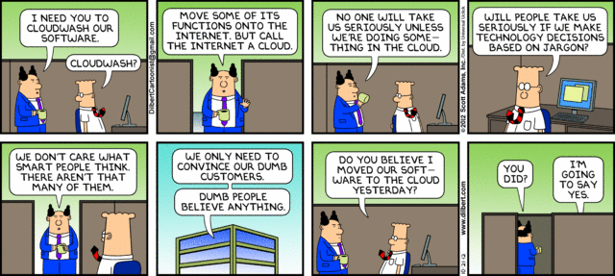
The Hype
Everybody feels the need to use it…
Your clients force you to use it…
No idea why you’re doing it…
Being COOL is enough!
Model Driven Design in an Agile world
acorn.ro

Slide 8
MDSD vs. Agile
Methodology vs. Technology
Rebranding (low-code, no-code)
Guerilla warfare
Tooling
Model Driven Design in an Agile world
acorn.ro
Notes:
If we think of MDSD as a top-down methodology (approach) then this has no place in an agile world and yes, last time I’ve check that was still on a hype. Modelling and documentation are nowadays perceived as less important, to put it more bluntly it’s a waste of time. Not knowing where you want to go is not too bad, one might eventually get there at times.

Slide 9
Guerilla
Warfare
“One of my most productive days was throwing away 1000 lines of code.”
Ken Thompson
Model Driven Design in an Agile world
acorn.ro
Notes:
Meinte Boersma (Dutch guy behind xtext), in an article “In the trenches: MDSD as guerilla warfare” contemplate the idea of ‘selling’ the MDSD to average developers by making their lives easier by doing it from the inside out – aim the low hanging fruits, introduce tooling for the tedious and boring job of generating boiler-plate code.
Ken Thompson, American pioneer of computer science. worked at Bell Labs for most of his career where he designed and implemented the original Unix operating system – B language, go.

Slide 10
OERA
Models
Data structures (temp-table, dataset)
Business Entities
Service Interface
Model (MVC)
View (abstract UI)
Model Driven Design in an Agile world
acorn.ro
Notes:
OpenEdge Reference Architecture – a blue print, an application-design methodology based on maximizing re-usability and ease of maintenance by keeping data access, business logic, and user interface code in separate components (PSM)
Tools for Business Logic (diagram – temp-table, dataset)

Slide 11
Root
Model
Database
Table definitions
Relations (yeah, we wish)
ERD
Model Driven Design in an Agile world
acorn.ro

Slide 12
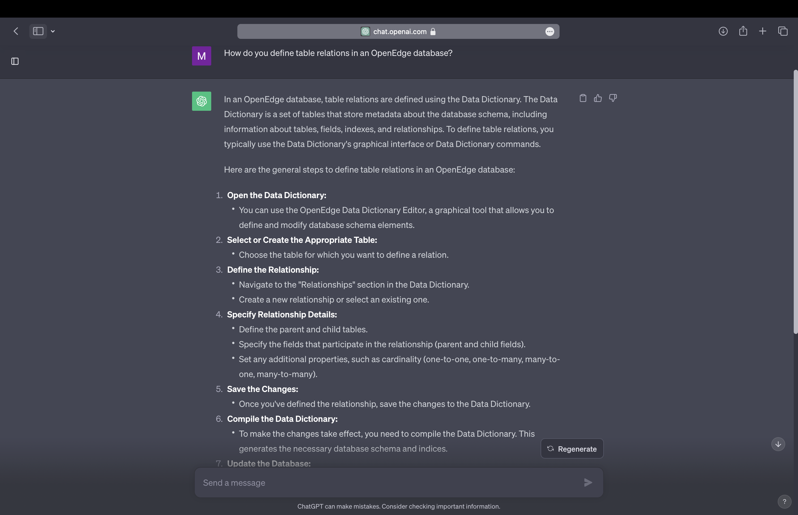
Foreign Keys
Model Driven Design in an Agile world
acorn.ro

Slide 13
Data Driven
Development
Start from data(base) model
Everything is derived from it
Business objects/entities
Service Interface
Model Driven Design in an Agile world
acorn.ro

Slide 14
Entity Relationship
Diagram
Data Driven Development in OERA world
acorn.ro

Slide 15
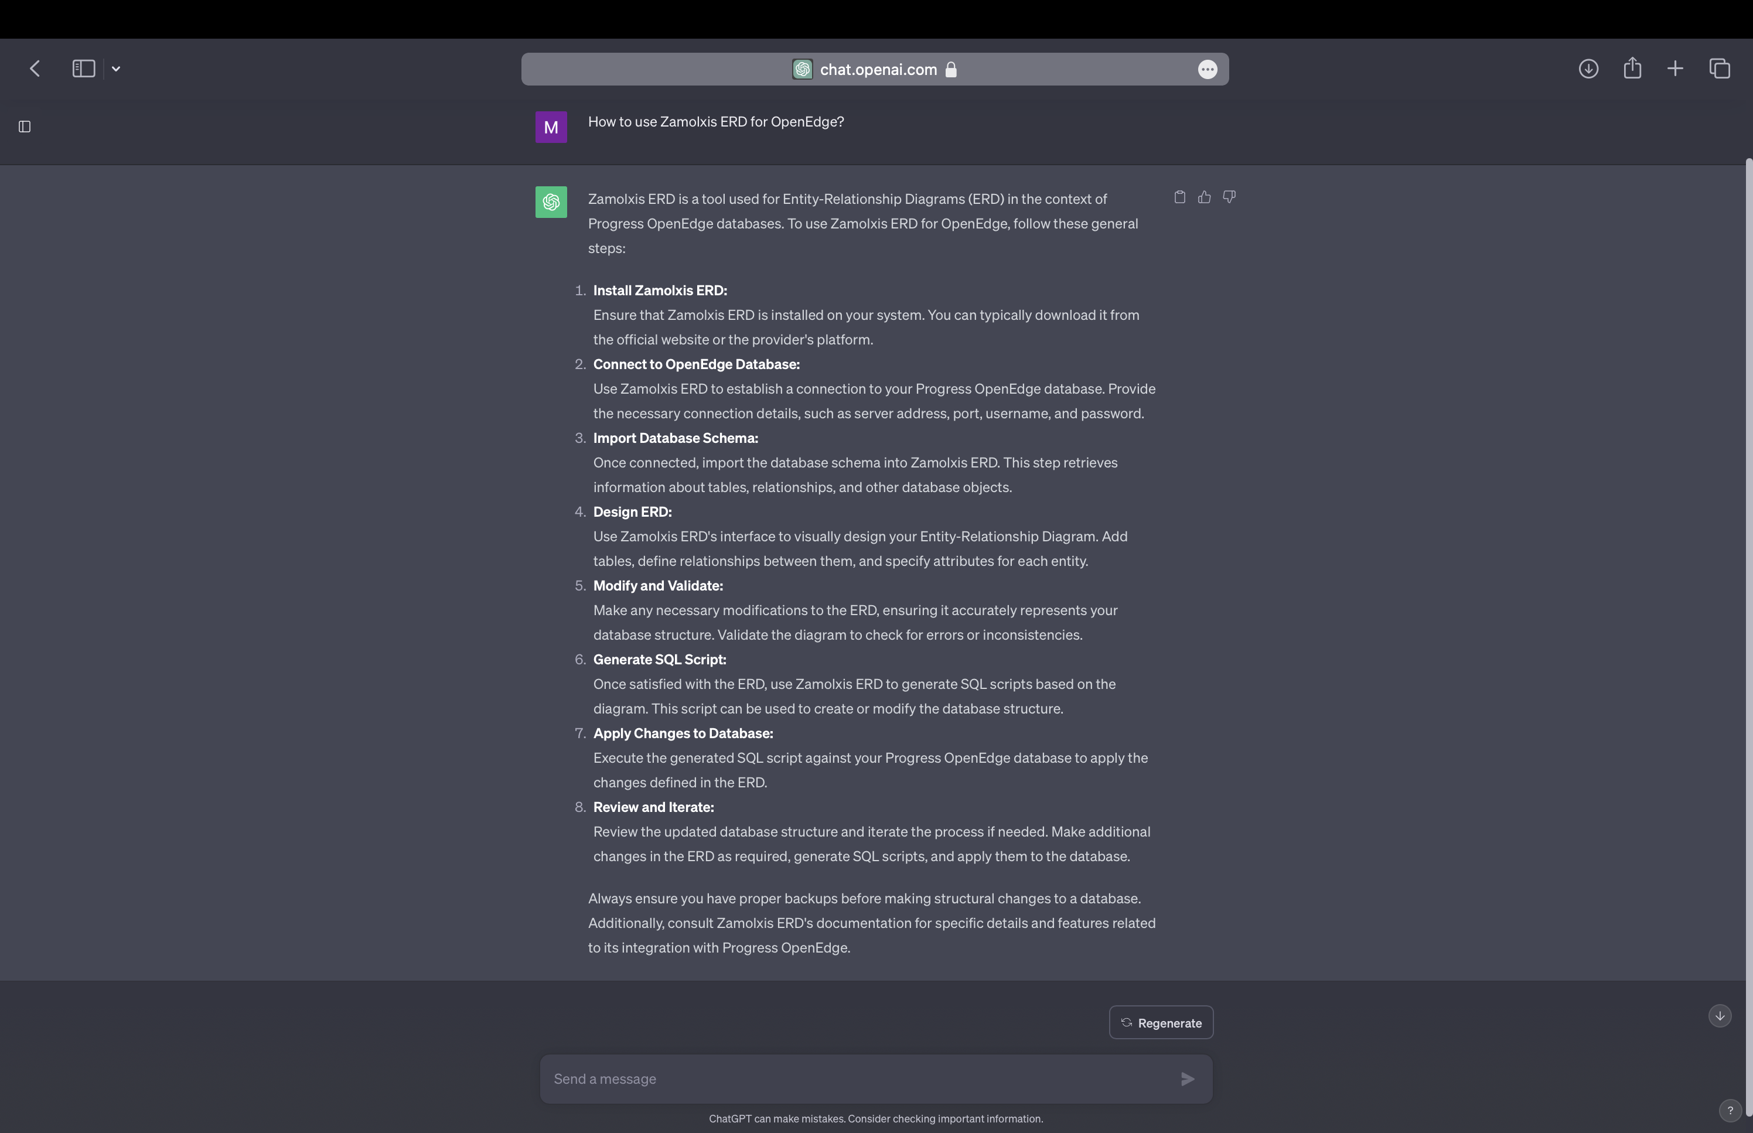
Zamolxis ERD
Data Driven Development in OERA world
acorn.ro

Slide 16
Domain Specific
Language
Designed for particular problem domain
Not a swiss-knife (general-purpose language)
Higher level of Abstraction
Intentional Programming
Language Oriented Programming
Model Driven Design in an Agile world
acorn.ro
Notes:
Limited form of computer language designed for a specific class of problems.
Intentional programming - concept introduced by long-time Microsoft employee Charles Simonyi, who led a team in Microsoft Research which developed an IDE that demonstrates these concepts - > Intentional Software.
Language Oriented Programming - the general style of development which operates about the idea of building software around a set of domain specific languages. (Martin Fowler)

Slide 17
Domain Specific
Language
External DSL
  written in a different language than the main (host) language of the application and are transformed into it using some form of compiler or interpreter.
Internal DSL
  morph the host language into a DSL itself.
http://martinfowler.com/articles/languageWorkbench.html
Model Driven Design in an Agile world
acorn.ro
Notes:
DSL it's suitable only for a very narrow purpose.
As a result the DSL is very simple - there's no facility for control structures or anything else. It's not even Turing complete. You couldn't write a whole application in this language - all you can do is describe one small aspect of an application
The DSL has to be combined with other languages to get anything done. But the simplicity of the DSL means it's easy to edit and translate.
Unix little languages: lex, yacc, awk
LISP: probably the strongest example of expressing DSLs directly in the language itself
XML Configuration Files: Java enterprise frameworks (Spring)
GUI Builders: these tools either store layout in a closed format, generating suitable code for execution; or they try to put all the necessary information in the generated code.

Slide 18
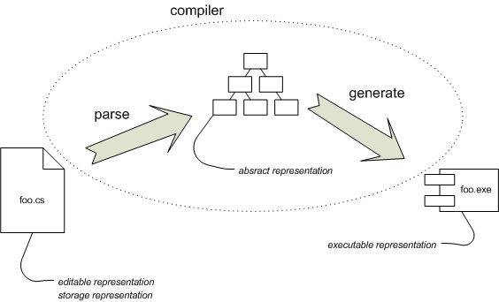
Conventional
Programming
Edit source text with editor
Compile the source code in executable
** Martin Fowler - Language Workbenches: The Killer-App for Domain Specific Languages?
Model Driven Design in an Agile world
acorn.ro

Slide 19
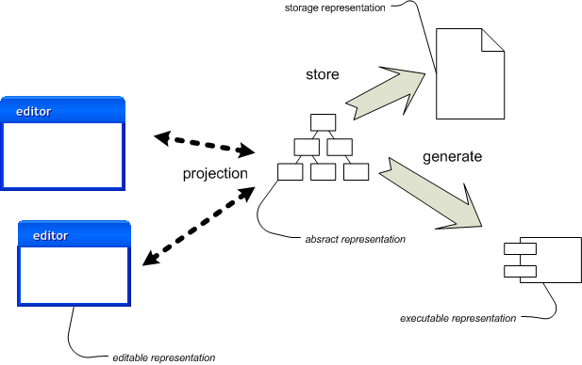
DSL
Software Factory
Edit abstract representation (DSL)
Generate source code (storage)
Compile the source code in executable
Model Driven Design in an Agile world
acorn.ro

Slide 20
Language cacophony
A particularly common objection to external DSLs is the language cacophony problem.
This concern is that languages are hard to learn, so using many languages will be much more complicated than using a single language.
To some extent this concern is based on a misconception about DSLs.
Model Driven Design in an Agile world
acorn.ro
Notes:
Those having the concern often imagine multiple general purpose languages, which indeed could easily result in cacophony. But DSLs tend to be limited and simple which makes them easier to learn. This is reinforced by their closeness to the domain. DSLs don't look like regular programming languages.

Slide 21
Sikuli
Visual Testing
Java + Sikuli API vs. DSL
DSL syntax – less than 200 lines of code (ANTLR)
All needed user interaction and only 3 ‘statements’
Test scripts created by 4GL developers, no Java knowledge
Model Driven Design in an Agile world
acorn.ro
Notes:
When we had to implement visual testing for a 4GL application the choice had to be made between writing the tests in Java using the API provided by Sikuli directly or write a simple DSL to allow 4GL developers to write the test scripts themselves.
WAIT – window, timeout
KEY – special key, modifiers, repeat…
MOUSE – move, click/dbclick, key modifiers, repeat

Slide 22
Eclipse Modeling Project
http://www.eclipse.org/modeling/
Eclipse Modeling Framework (EMF)
  a modeling framework and code generation facility for building tools and other applications based on a structured data model.
Graphical Modeling Project – GMF Tooling
  provides a model-driven approach to generating graphical editors in Eclipse.
Textual Modeling Framework - Xtext
  a powerful framework/tool for developing external textual DSLs based on EMF.
Model Driven Design in an Agile world
acorn.ro

Slide 23
Eclipse Modeling Framework
Model based (UML, ECORE)
XMI (XML Metadata Interchange)
Import XMI models
Generate model classes (Java)
Generate basic editor (reflective editor)
Model Driven Design in an Agile world
acorn.ro

Slide 24
Domain Specific
Language
Model Driven Design in an Agile world
acorn.ro

Slide 25
Data Driven
Development
Extend ERD
Add in memory data structures
Add business objects
Business catalog, service interface
Abstract user interface
Model Driven Design in an Agile world
acorn.ro

Slide 26
What that could give YOU?
Documentation
Technical and Business view
Traceability
Impact analysis
Code generation (model to code)
Model Driven Design in an Agile world
acorn.ro

Slide 27

Model Driven Design in an Agile world
acorn.ro

