Slide 1
Using OpenEdge TDE For Full-Database Encryption
Rob Fitzpatrick
rf@wss.com
White Star Software

Slide 2
About White Star Software
The Oldest and Most Respected Independent Progress OpenEdge Consulting Firm
4 of the top OpenEdge DBAs in the world: Adam Backman, Tom Bascom, Dan Foreman, Paul Koufalis
Our Performance, Monitoring and Alerting Tool, ProTop. An incredibly powerful single-pane-of-glass view of your entire OpenEdge ecosystems
Real World Training From Real World DBAs
info@wss.com | wss.com

Slide 3
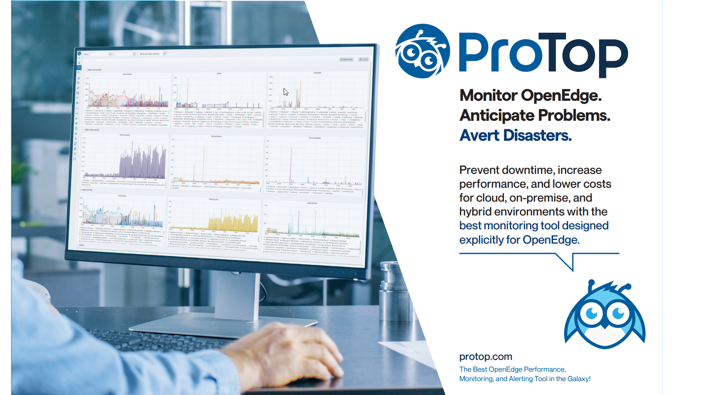

Slide 4
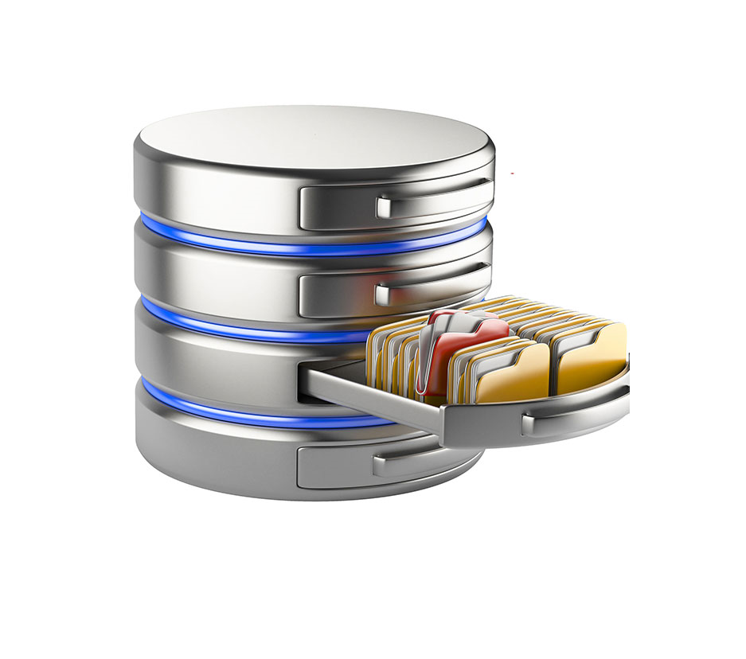

About Rob
WSS DBA Consultant / Software Architect (since 2020)
Senior Database Architect at a Canadian Progress Partner in Financial Services (2008 – 2020)
OpenEdge user since 2008
I ❤️

Slide 5
Abstract
There have been many TDE talks over the years.
Why do another?
I hope to tread some new ground and provoke thought about why you use TDE.
I believe there is a valid use case that hasn’t been discussed:
full-database encryption.

Slide 6
Agenda
Scope of this talk
The business case for full-database encryption
Mechanics of TDE
TDE Commands
Implementing at scale: automation
Ensuring compliance
Closing thoughts

Slide 7
1:
Scope of this talk

Slide 8
Scope of this talk
OpenEdge TDE is a big topic!
  Can’t cover it all in an hour
The focus here is full-database encryption
  The techniques here also apply to partial encryption
I won’t cover the basics:
  Initial setup of TDE
  Cipher selection
  Keystore Manual start vs. Autostart
Read the docs and KB!
  They cover the foundations well and are essential reading
  https://docs.progress.com
  https://knowledgebase.progress.com

Slide 9
Audience survey
You (or your customers) use TDE in production?
You are currently planning a TDE deployment?
You are thinking about using TDE in future?
None of the above?

Slide 10
2:
The business case for full-database encryption

Slide 11
The business case: why use TDE?
The purpose of TDE is not to encrypt your data
  Encryption is merely a means to an end
The purpose of TDE is to become compliant and be able to prove compliance with some security regime
  Prove to yourself
  Prove to others
The goal: business risk mitigation

Slide 12
The business case
First release of OpenEdge Transparent Data Encryption (TDE): 10.2B (2009)
Original use case: encryption at rest (on disk) for select sensitive data:
  Focused on regulatory compliance:
    Payment cards
    Health care data
    Personally-identifying information
Original deployment guidance:
  Don’t encrypt everything; avoid performance impacts
  Identify and encrypt only the most sensitive data

Slide 13
The business case
However: the threat landscape has changed significantly in the last 15 years
Rise of ransomware-as-a-service, network-access brokers, etc.
  Everyone is a target; not just high-profile companies
  Your database could be exfiltrated and uploaded to the web
  Huge reputational risk

Slide 14
The business case
Partial encryption example:
  500 GB database
  You have encrypted your 100 GB of sensitive data
  The other 400 GB is in the clear
What happens when you are hacked?
  The headline won’t be “Company X did protect all the important stuff”
  It will be “Company X: 400 GB unencrypted database stolen, on the web”
  At this point, you don’t control the narrative
  You are doing damage control with customers
Are you using a 2009-era threat model in 2023?

Slide 15
3:
Mechanics of TDE

Slide 16
Some quick TDE basics
TDE Licensing pre-requisites:
Enterprise RDBMS + OpenEdge TDE add-on (10.2B+)
  OR
Advanced Enterprise Edition RDBMS bundle (11.5+)
  OR
Enterprise RDBMS + OE Advanced Security (12.6+)

Slide 17
Some quick TDE basics: what is it?
Symmetric encryption of data at rest (on disk)
  Data blocks in memory buffers are in the clear
  Thus, encryption is transparent to ABL/SQL clients, utilities, etc.
  No application changes are required
  Keys are stored in dbname.ks
Object policy-based
  Object policy records stored in _sec-obj-policy in Encryption Policy Area
    You’re not allowed to access it! 😒
  Maximum of two policies per object: CURRENT and PREVIOUS; permits rekeying
Unit of encryption: database block
  Not files, records, or fields
Available ciphers vary by OpenEdge release
  The default is good: AES_CBC_128

Slide 18
What can be encrypted
Application Type 1 storage areas
Application objects in Type 2 storage areas
  Tables, indexes, LOBs
  Policy is on the logical object, not the physical (storage) object
Before Image area and After Image areas
  Enabled offline, or at next database start
Audit tables and indexes
Change Data Capture (CDC) data
Binary dump files

Slide 19
What can’t be encrypted
The database as a whole
  Thus this talk! 🙂
Type 2 storage areas
Control Area (dbname.db)
Schema Area
  So it should never contain application objects!
  Use proutil tablemove/indexmove or dump & load to relocate objects
Encryption Policy Area
  Obviously 😏
Sequence values
  Because the sequence blocks are in the schema area

Slide 20
When does encryption/decryption happen?
Encrypted blocks read from disk are decrypted before being copied into a memory buffer
Modified blocks in memory are encrypted before being written to disk
Performance implication:
  Improving your buffer pool hit ratio will reduce the encryption/decryption overhead cost
Caution!
  Don’t increase -B/-B2 so much that you incur other costs
  E.g. OS swapping or having database shared memory span NUMA nodes

Slide 21
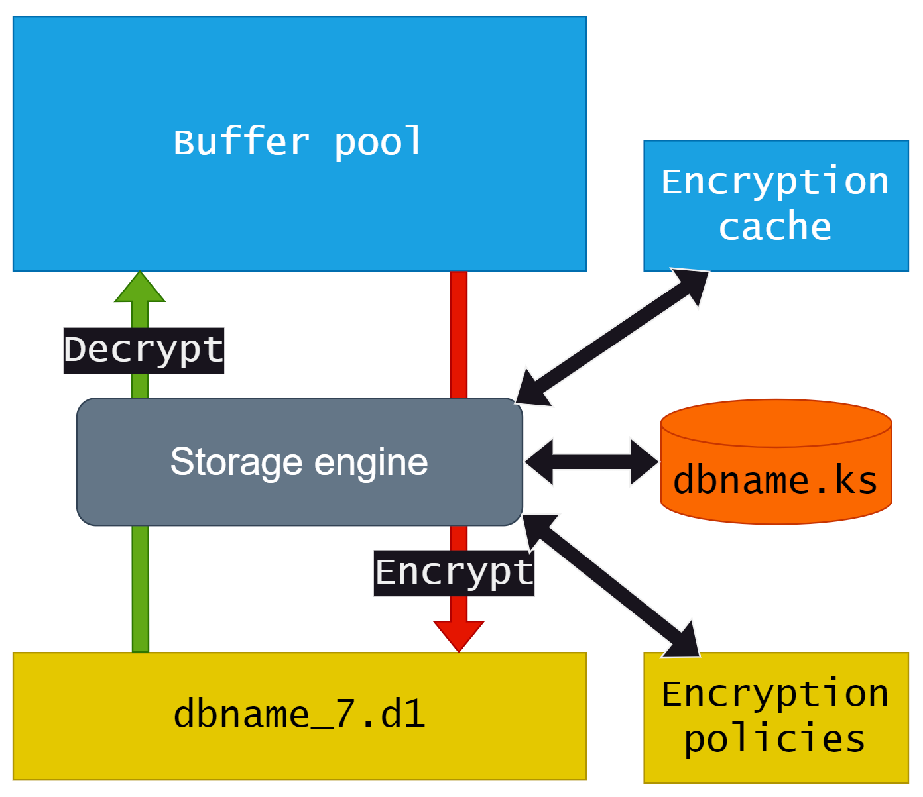
When does encryption/decryption happen?
Decrypt on disk read
Encrypt on disk write

Slide 22
Encryption cache (EC)
Similar to the OM cache
  Two caches: primary and secondary
  Secondary cache: for online additions; access is always latched
  12.1+: secondary size can be increased online via proutil -C increaseto
Memory utilization is roughly 215 bytes for every 1 increase
Size with -ecsize parameter
  Default value is 1000
Recommendation: more than 2x number of objects to encrypt
If the EC can be expanded, it increases by 1000.
If it cannot be expanded, the database shuts down.

Slide 23
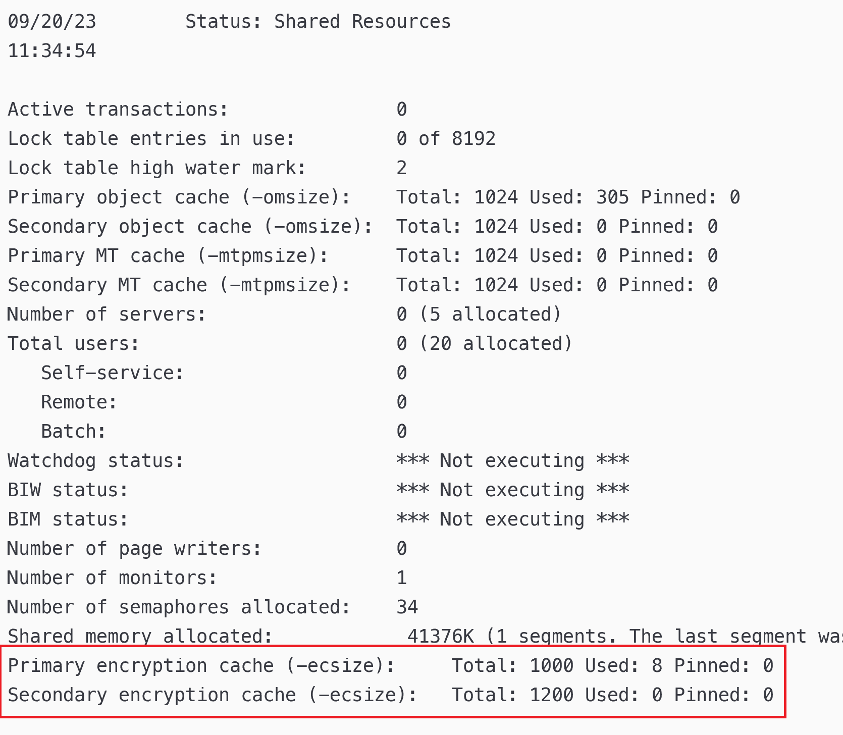
Encryption cache state in promon
promon R&D, 1, 13 (Shared Resources)

Slide 24
Which block types get encrypted?
bk_type | Description | bk_type | Description
1 | Master block | 12 | Object block
2 | Index block | 13 | Control block
3 | Record block | 14 | Object List block
4 | Free block | 15 | Cluster Allocation block
6 | Sequence block | 16 | Cluster List block
7 | Empty block | 17 | Object Allocation block
9 | Area block | 254 | Extent Header block
Does TDE encrypt entire Type 1 areas / Type 2 objects?
  No.
Only index and record blocks are encrypted
  Except for unused record blocks

Slide 25
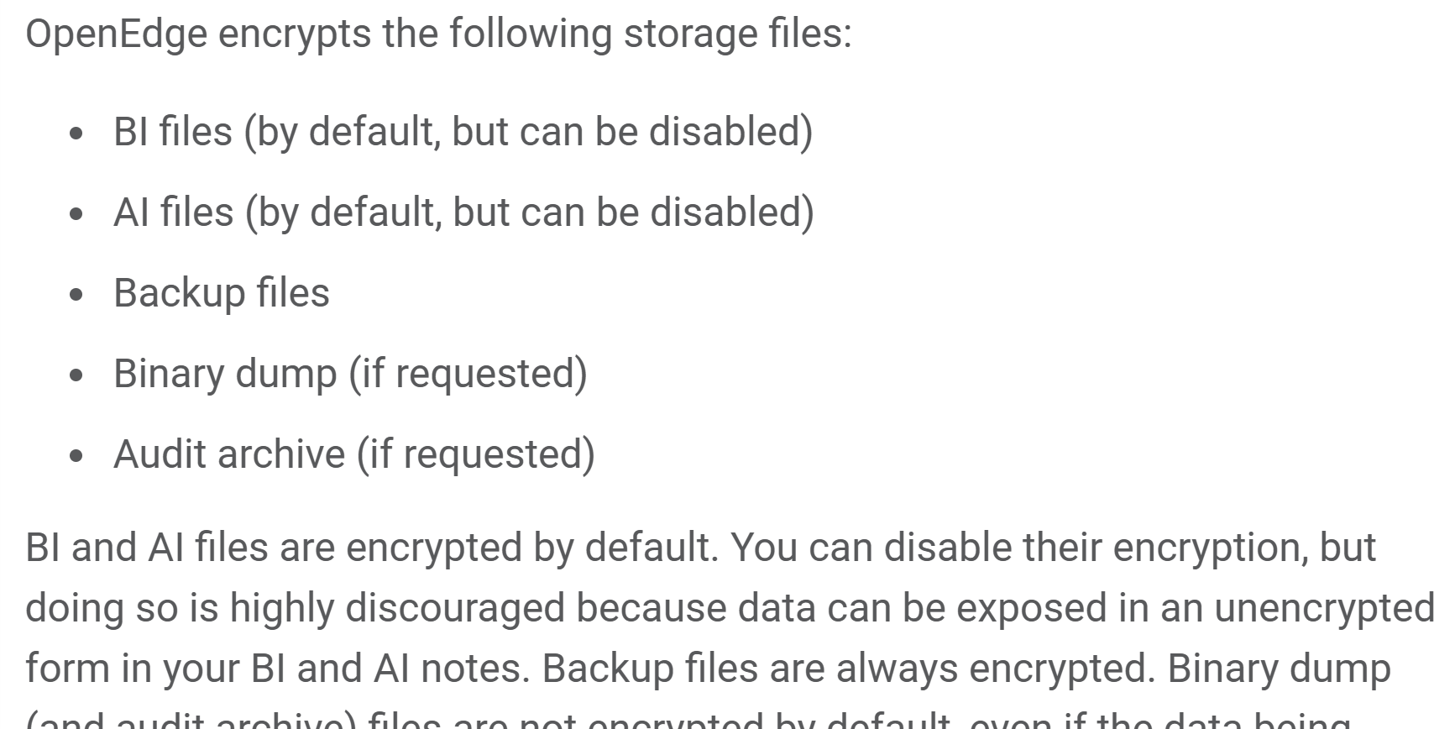
A word on TDE and backups… (more testing required)
Nope.
https://docs.progress.com/bundle/openedge-database-management/page/What-is-encryptable.html

Slide 26
TDE and probkup
Backup file encryption is block-based, not file-based
Objects/areas with encryption policies:
  Blocks are encrypted under the current policy in the backup file and the restored database
  Even if the blocks were unencrypted in the source database
Other blocks remain unencrypted
Better explanation in the docs:
  https://docs.progress.com/bundle/openedge-database-management/page/Database-backups.html
  “When you back up an encrypted database, the backup file contains encrypted blocks.”
Caveat: I haven’t yet tested this exhaustively across all TDE releases; YMMV

Slide 27
4:
TDE Commands

Slide 28

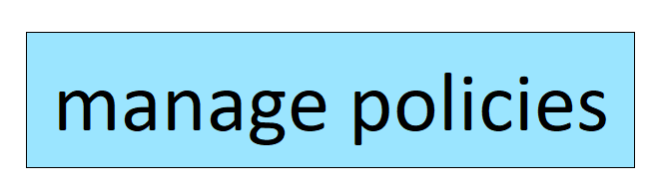

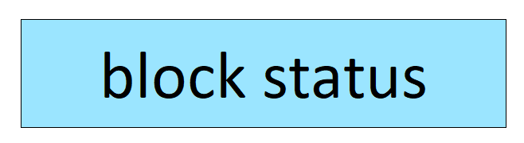

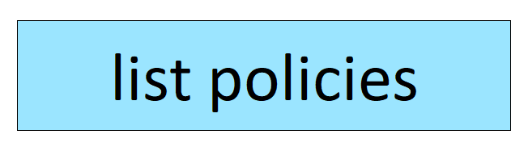

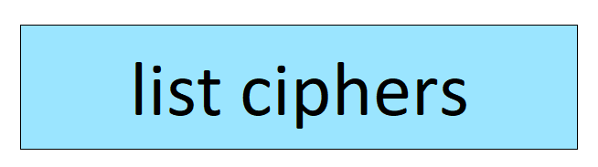
TDE on the command line
TDE is managed with the proutil -C epolicy commands:

Slide 29
Read/write
Common verbs:
  encrypt: create the initial policy
  update: encrypt existing blocks
  rekey: create new policy
    new key with existing cipher
  cipher: create new policy
    new key with new cipher
Note: encrypt does not encrypt data!
  It creates the initial policy record for an object, and a key
  It determines how future block writes are encrypted for that object

Slide 30
proutil db -C epolicy manage
proutil <db-name> -C epolicy manage [ <object-type>
{ encrypt | cipher | rekey | update } <object-name> ] |
[ dbpolicy { rekey { pending } {-Cipher <cipher-name>} | activate | retire } ] |
[ keystore { reconstruct | userphrase | adminphrase |
rebind [ { -HSMSlotID <slot-number> | -HSMLabel <label-name> } ] |
enablehsm kmk -HSMLibrary <library-path>
{ -HSMSlotID <slot-number> | -HSMLabel <label-name> } |
disablehsm kmk } ] |
[ autostart { admin | user | disable | refreshhsm } ]
[ [ -userid <userid> ] [ -password <password> ] ]
Note: Type 1 area encryption must be done offline

Slide 31
Reads every block in the object
  Note: potential I/O impact, if the object is large
Reports how many blocks are encrypted under each policy*
> proutil s2k20 -C epolicy scan table customer
OpenEdge Release 12.6 as of Wed Sep 21 09:48:14 EDT 2022
TABLE customer / 4 CURRENT AES_CBC_128 V:1 5 of 24 blocks encrypted
TABLE customer / 4 PREVIOUS DES_CBC_56 V:0 19 of 24 blocks encrypted
Notes:
The meaning of the asterisk:
This command is a little bit misleading. In some cases, it will tell you that a block is encrypted, even if it isn’t.
Specifically, it will do this when a block doesn’t need to be encrypted, e.g. if it is not a record/index block, or it is an empty record block.

Slide 32
Reads only the _sec-obj-policy table; less intensive than epolicy scan, which reads every block in the object
Shows data from the object’s policy records, if any
> proutil s2k20 -C epolicy view table customer
OpenEdge Release 12.6 as of Wed Sep 21 09:48:14 EDT 2022
TABLE PUB.Customer / 4 PREVIOUS DES_CBC_56 V:0
TABLE PUB.Customer / 4 CURRENT AES_CBC_128 V:1
> proutil s2k20 -C epolicy view table customer
OpenEdge Release 12.6 as of Wed Sep 21 09:48:14 EDT 2022
Epolicy / 1 : No encryption policies found for TABLE customer (15220)

Slide 33
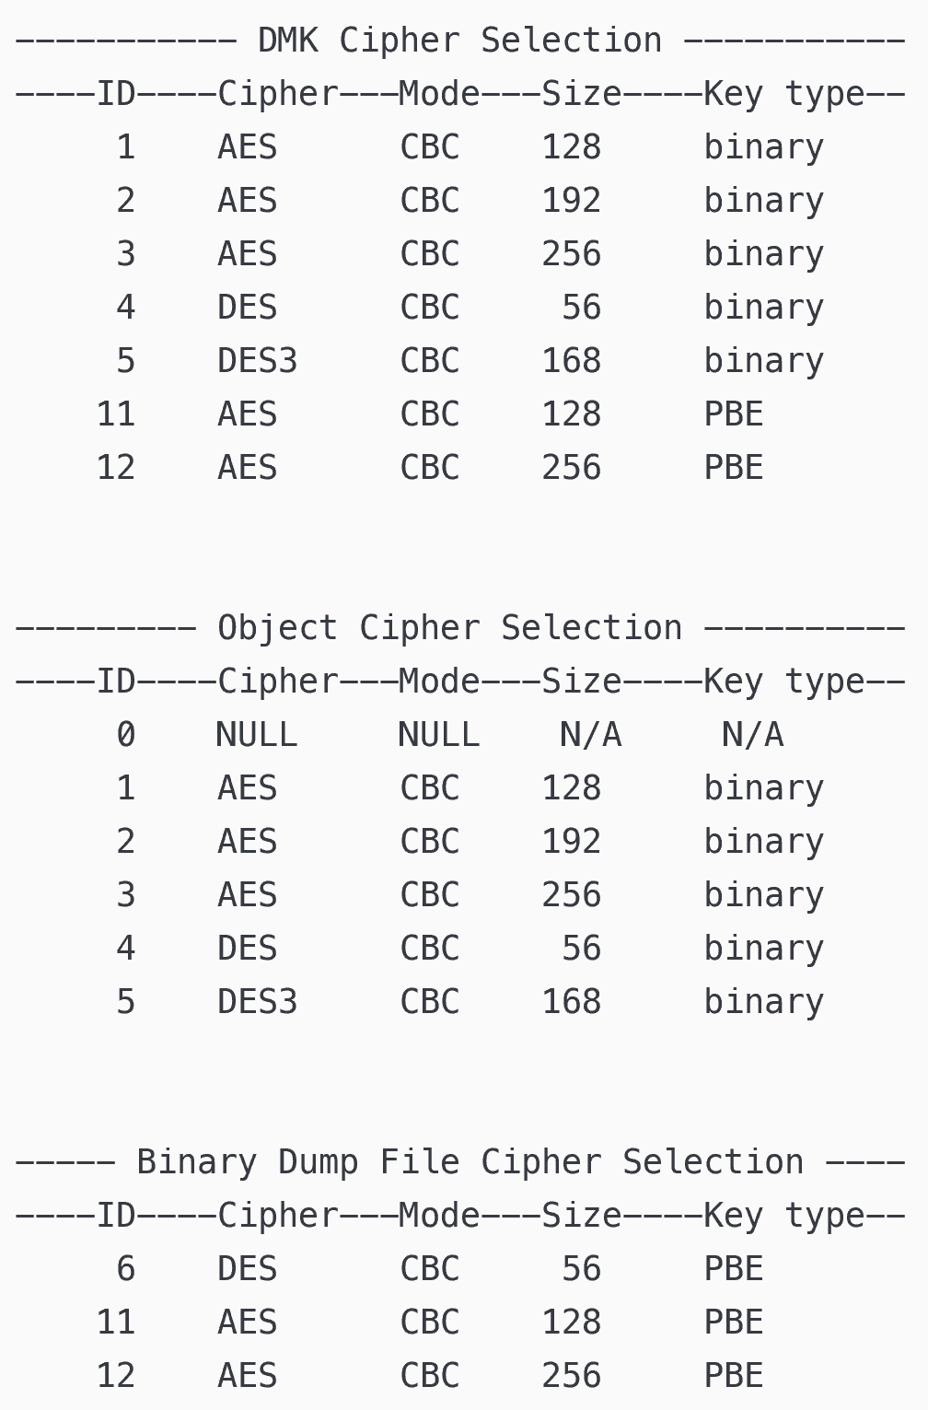
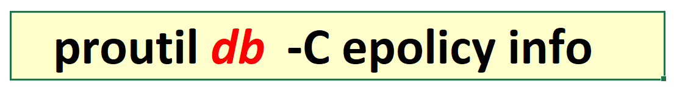
Just writes a cipher
list to stdout
You must supply a database name
  Why?

Slide 34
Security note
My demo is only a proof of concept
In production, you will likely have the keystore authentication configured to Autostart user or Manual
This means you will need to specify the admin Passphrase when using proutil -C commands
Hopefully this workflow will improve in a future release with Secrets Management System integration
cat AdminPP | proutil sports2020 -C epolicy manage table encrypt Customer -Passphrase
OpenEdge Release 12.7 as of Fri Apr 21 08:45:41 EDT 2023
Encryption policy setting for Table Customer in Area 10. (15629)
Cipher specification setting to AES_CBC_128 completed. (15491)

Slide 35
5:
Implementing at scale: automation

Slide 36
Example: encrypting/verifying a single object
> proutil sports2020 -C epolicy manage table encrypt Customer
OpenEdge Release 12.7 as of Fri Apr 21 08:45:41 EDT 2023
Encryption policy setting for Table Customer in Area 10. (15629)
Cipher specification setting to AES_CBC_128 completed. (15491)
> proutil sports2020 -C epolicy manage table update Customer
OpenEdge Release 12.7 as of Fri Apr 21 08:45:41 EDT 2023
TABLE Customer / 4 CURRENT AES_CBC_128 V:0 20 of 24 blocks encrypted
> proutil sports2020 -C epolicy scan table Customer
OpenEdge Release 12.7 as of Fri Apr 21 08:45:41 EDT 2023
TABLE Customer / 4 CURRENT AES_CBC_128 V:0 24 of 24 blocks encrypted
Three commands to fully encrypt one object
Even with selective encryption, manual execution quickly becomes impractical; automation is essential

Slide 37
6:
Ensuring compliance

Slide 38
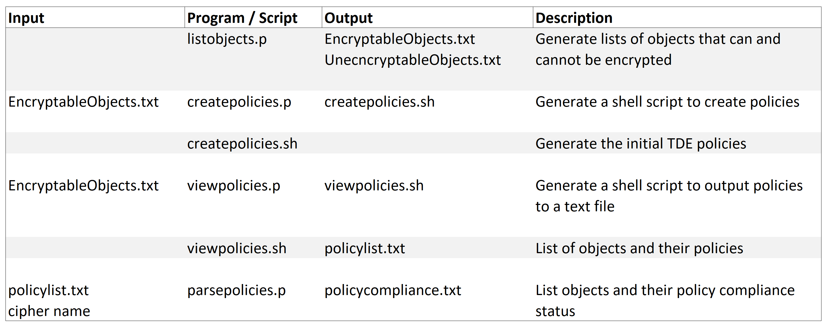
Program inputs & outputs

Slide 39
7:
Closing thoughts

Slide 40
Is TDE evolving?
Selected changes to TDE in OE releases
  10.2B: TDE introduced
  12.0: old ciphers retired
    RC4 for objects; DES for binary dumps
  12.1: increase -ecsize online
  12.4: Online Transparent Data Encryption database policy management (DB feature 29)
  12.6: HSM-based authentication of TDE keystore (two-factor)
The takeaway:
  TDE is strategically important for Progress; they continue to re-evaluate and invest in the product
  You can use it with confidence

Slide 41
Important: RC4 and upgrade to 12.x
You cannot upgrade to 12.x with RC4-encrypted objects
  It is possible to upgrade with an RC4 DMK
$ proutil sports -C conv1112
OpenEdge Release 12.7 as of Fri Apr 21 08:45:41 EDT 2023
You must have your database backed up before running the conversion. (1024)
Have you done this (y/n) ?
y
Found Encryption policies with deprecated cipher of RC4_ECB_128. (19348)
Database needs stronger encryption ciphers. Conversion requires return to prior release. (19349)
Use epolicy manage to select another cipher and use epolicy update encrypt all data up to the new cipher. (19350)

Slide 42
Prepare and beware
TDE uses industry-standard symmetric encryption ciphers
As with any symmetric encryption platform, the security is all in the keys
  Protect your keystore and passphrases appropriately
  If you lose them, no one can help you. There is no back door!
  Read all of the TDE documentation before attempting a deployment

Slide 43
Rob’s take on OpenEdge TDE
TDE is a great product
If you require database encryption at rest, there is no alternative
Customers would benefit from future usability enhancements
  Better compliance tools
    Better Data Dictionary reports (e.g. include Type 1 area info, AI/BI info)
    Easier access to encryption policies and object state
  Full-database encryption
  Task-based documentation
    E.g. how to dump and load a TDE-enabled database

Slide 44
Closing thoughts
You don’t use database encryption because you want to
You do it because someone made you:
  Internal policy
  Industry regulation
  Legal requirement
At some point, they will require you to prove it!
  Be prepared to prove compliance
  Applications evolve over time:
  you must have a plan for maintaining compliance across schema changes

Slide 45
Closing thoughts
Implementing TDE is not a one-time task
It is an ongoing process:
Schema change
Data assessment
Policy creation
Data encryption
Compliance verification

Slide 46
Closing thoughts
The technology is a means to an end, not a full solution
The keys to ensuring proper implementation and compliance:
  Policy: well-designed, well-written
  Procedure: correctly implementing the policy
  People: educated about policy, trained on procedure

Slide 47
E-mail me for the TDE-automation ABL code
E-mail : rf@wss.com
Subject: TDE automation code

Slide 48
Questions?
rf@wss.com

Slide 49

Bonus slides!

Slide 50
Useless TDE Trivia
We encrypt data at the object/area level, but encryption is implemented, incrementally, at the block level
Therefore, for some period of time, a partially-encrypted object is in a transitional state
  Some blocks are encrypted, and the rest are not; or
  Some encrypted under current policy, remainder under previous policy
How does the storage engine know what to do with a block being paged into the buffer pool?
Notes:
Some trivia to entertain the audience, in case I finish my presentation early.
Not bloody likely! ☺

Slide 51
Useless TDE Trivia
Is it encrypted or not?
  1 bit of information (“Encrypted” bit)
If encrypted: under the current policy or previous?
  1 bit of information (“Policy” bit)
This information must be stored on a per-block basis
It must be stored in a structure that is common to both Type 1 and Type 2 storage architectures
  The Type 1 block header

Slide 52
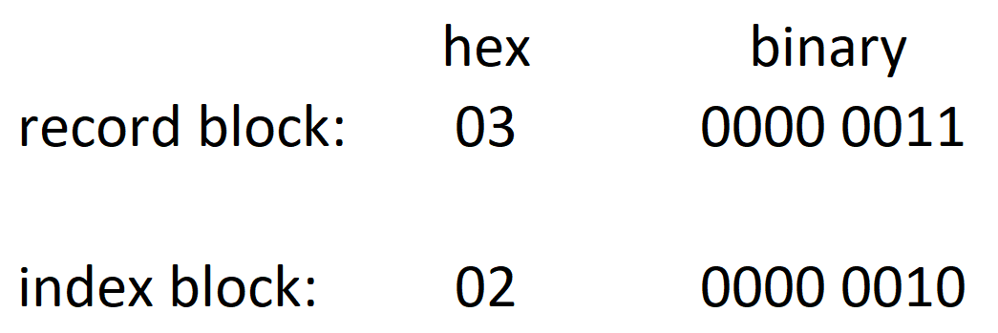
Useless TDE Trivia
Type 1 block header layout:
Block type: 1-byte field
Block type value:

Slide 53
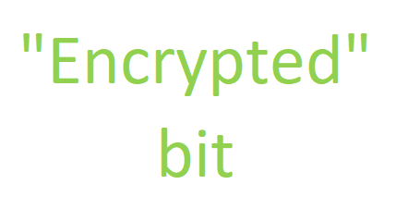
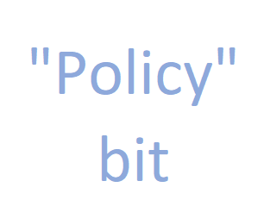
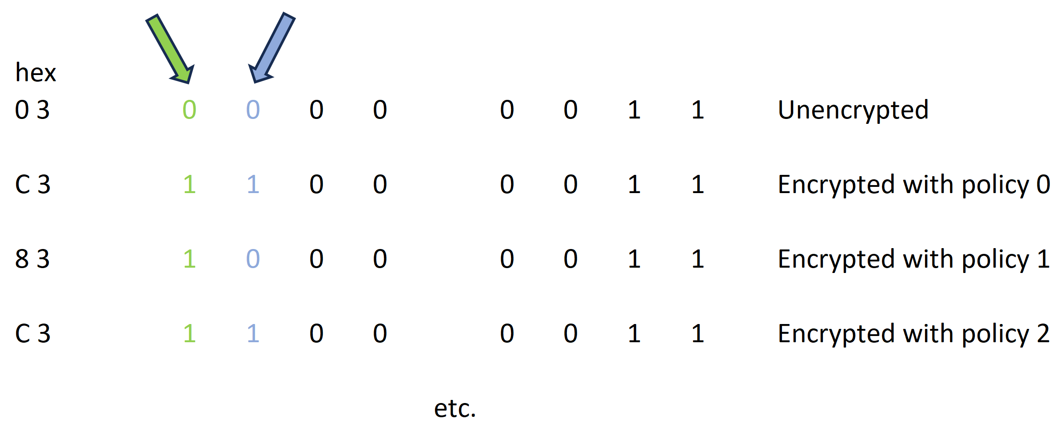
Useless TDE Trivia
The evolution of a record block’s block type (bk_type) value in its block header

Slide 54
Useless TDE Trivia
How does this help you as a DBA?
It doesn’t.
But learning new things is its own reward. 😊

Slide 55
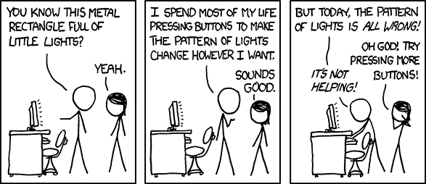
https://xkcd.com/722
Notes:
My life in three panels. ☺

Slide 56
Staying Informed
Each release has a “What’s New” manual
  They are cumulative in v12 👍
Check out the new documentation portal: https://docs.progress.com
  Online docs for LTS releases only (and the Active release) ☹
  Downloadable PDFs for all releases
Join the CVP for
  info about new features in planned releases
  early access to pre-release code
  access to a private Community group to interact directly with product teams as they are designing new features
  https://www.progress.com/openedge/customer-validation-program

Slide 57
You Can Improve OpenEdge!
Share your ideas for OpenEdge product enhancements in the Ideas portal
https://openedge.ideas.aha.io
Several of the features you have seen today were submitted by the community

