Slide 1
Back to Basics: Keeping Your Database, and the Server It Runs On, Healthy
Tom Bascom, White Star Software
Abstract: If you're a newly-minted OpenEdge DBA, you may be wondering what tasks you should be performing on a daily, weekly, or monthly basis to keep your database healthy and the server running in tip-top condition. With so many questions and potential pitfalls, it can be difficult to know where to start.
In this session, we will show you the way through the challenges that lie ahead and help bring peace to your weekends and evenings. You'll learn about best practices for maintaining your OpenEdge database, including tasks like monitoring database growth, identifying and addressing performance bottlenecks, ensuring data integrity, and how to manage system resources such as memory, disk, CPU and network.
Join us to learn how to effectively maintain your OpenEdge database server environment and avoid common pitfalls. By the end of this session, you'll have a clear understanding of what tasks you should be performing on a regular basis to keep your database healthy and ensure optimal server performance. Don't miss this opportunity to reduce stress and improve your database management skills!

Slide 2

Back To Basics
Keeping Your Database,
and the Server It Runs On,
Healthy
Tom Bascom, White Star Software
tom@wss.com

Slide 3
Start With a Good Configuration
At White Star we have hard data on the performance of thousands of OpenEdge databases and the servers that they run on
We collect and evaluate BILLIONS of data points every day
Notes:
Other options stand out as ”maybe you shouldn’t have done that”

Slide 4

Start With a Good Configuration
At White Star we have hard data on the performance of thousands of OpenEdge databases and the servers that they run on
We collect and evaluate BILLIONS of data points every day
Certain configuration options stand out as best practices!
Notes:
Other options stand out as ”maybe you shouldn’t have done that”

Slide 5
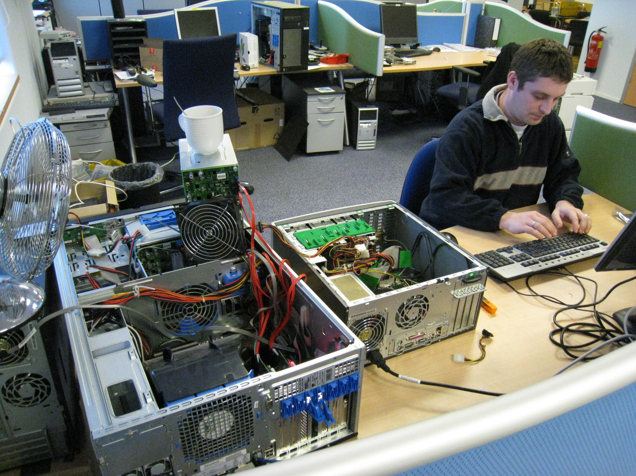
← Coffee Warmer
← Tertiary Cooling
Auxiliary
Power Source
← SSD
Secondary Cooling→
← IO Expansion
Production Server
(Really)

Slide 6
OE DB Server Configuration Best Practices
More is not always better
Virtualization has a cost
There is no such thing as a “high performance SAN”
Keep your friends close and your clients closer
After-imaging is not optional

Slide 7
This slide is intentionally left blank!

Slide 8
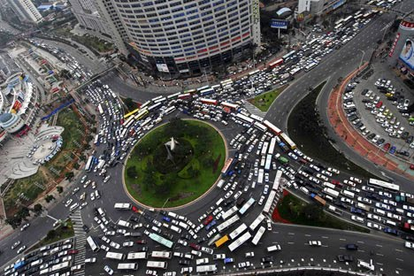
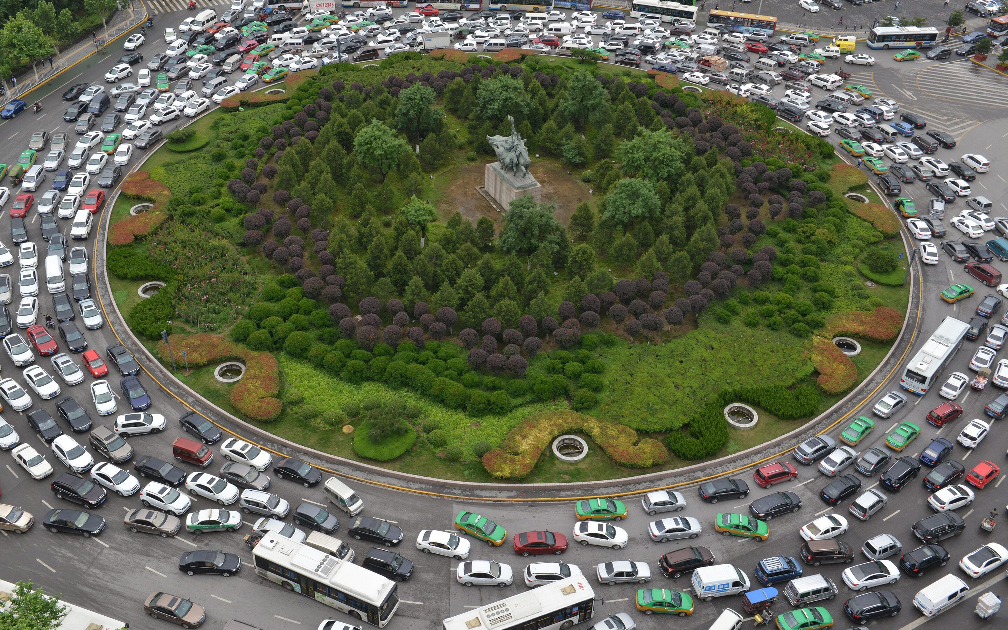
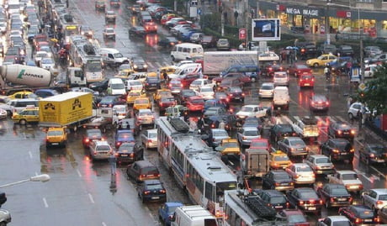
More Is Not Always Better
Especially when it comes to cores in a database server!
The database engine is multi-threaded BUT synchronization and locking operations are protected by “latches”
Latches are single-threaded choke points
Latch throughput is dictated by core SPEED, not core COUNT

Slide 9
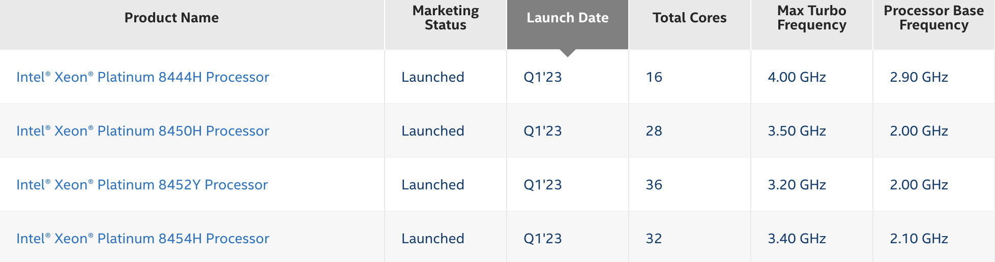
More Is Not Always Better – part 2
In manufacturing there is a trade-off of speed vs core count
As the core count goes UP the clock speed goes DOWN:

Slide 10
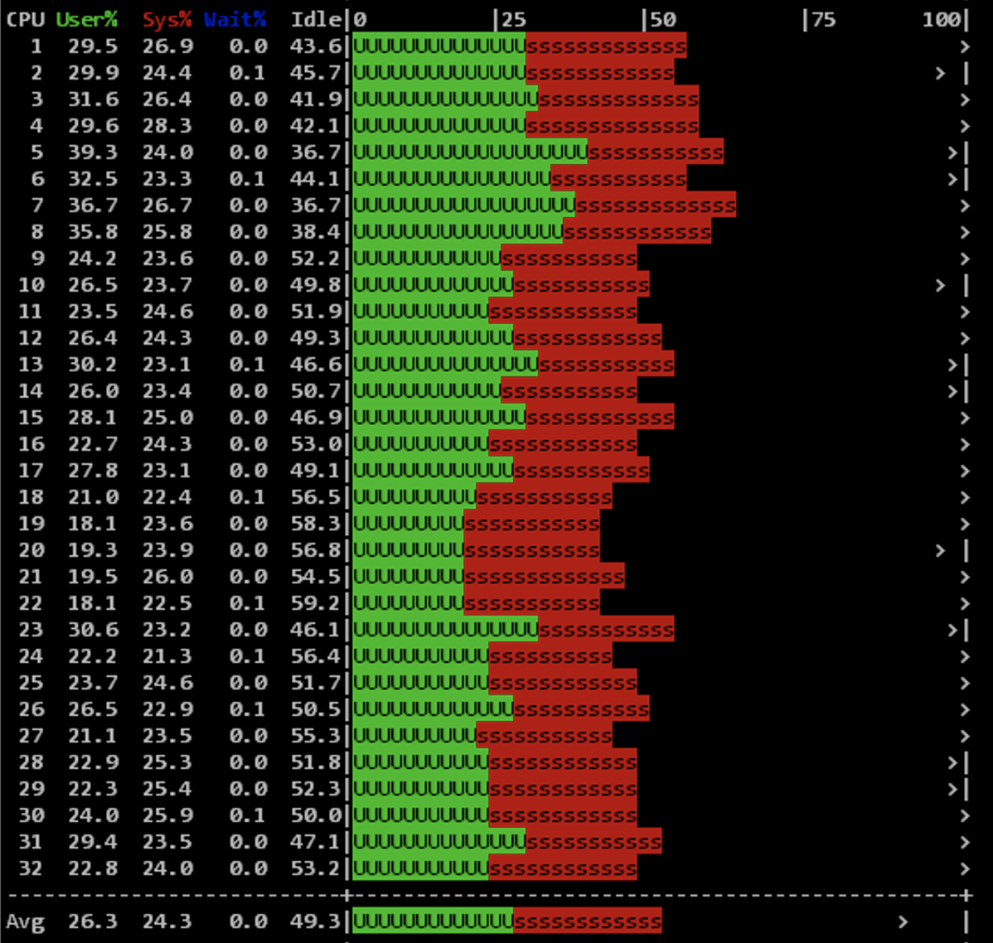
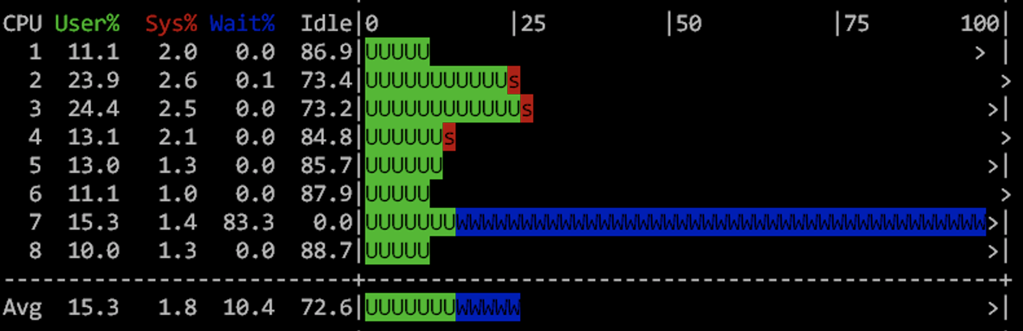
More Is Not Always Better – part 3
And you cannot ”fix” it with NUMA:
Notes:
In terms of “getting stuff done” the 8 core configuration gets two to three times as much real work done – in spite of seemingly using less of the capability of the server.
In large part this is because “instructions per cycle” is much more efficient (fewer stalls waiting for far memory)

Slide 11
This slide is intentionally left blank!

Slide 12

Virtualization Has A Cost
Do NOT overprovision your servers
  Do not define more VMs than can possibly run all at once
  Leave some capacity free!
Do NOT exaggerate your need
  Plan for your peak
  But not a crazy amount more
If the scheduler has to find resources for your VM:
  From inside the VM it will look as if there is a lot of inactivity
  But most of your time is spent sleeping
  In some recent testing the penalty was as high as 50%!
And “hyper converged” is even worse (“software defined” everything, what could possibly go wrong with that?)
Notes:
There are good reasons to virtualize – but if you become the victim of an over-provisioned server your performance will be really bad

Slide 13
This slide is intentionally left blank!

Slide 14

There Is No Such Thing…
… as a “high performance SAN”
With a SAN, data has to pass through myriad physical and logical layers on its way to the user
The more layers your data has to pass through the slower everything becomes (that also includes virus scanners, deep packet inspection, and stuff of that ilk)
The speed of light is 1 nanosecond per foot – having storage at the wrong end of a cable is SLOW!!!
Notes:
Speaking of lying salesmen…
And the speed of light in fiber is 2/3 the speed of light in vacuum

Slide 15
This slide is intentionally left blank!

Slide 16

Keep Your Friends Close And Your Clients Closer
The only thing slower than a SAN is a network cable…
Your application probably uses a LOT more FIND statements than FOR EACH NO-LOCK “queries”
FIND statements require at least 3 “network
messages”:
  Request a record
  Response
  Release the cursor
If locks are involved there are even more messages!
Notes:
The only thing slower than a SAN is a network cable…

Slide 17
Client/Server Scenarios
0.017
0.058
0.069
Notes:
Shared memory is obviously much, much faster…
The two LAN options are down to differences in ping time – in this example localhost is 3.5x to 4x faster than the LAN connections
EXCEPT for that interesting FEJTS example ;)

Slide 18
Client/Server Scenarios
!?
0.017
0.058
0.069
Notes:
EXCEPT for that interesting FEJTS example ;)
That is showing what happens when you can STREAM data between two processes, the impact of the initial latency is overcome by streaming. But you need a big hunk of data to make that effective a FIND statement doesn’t do that.
Another thing that is (slightly) *slower* with shared memory is using a FIELDS list.

Slide 19
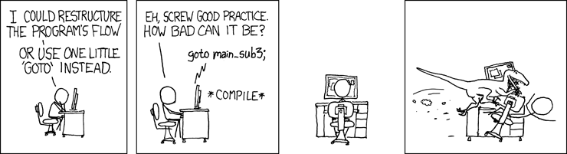
How Bad Can It Be?
Bad, really bad…
Notes:
WAN client/server test… ping time 33ms, FIND NO-LOCK dropped to 33 rec/sec, test suite didn’t finish running and was killed after 18 hours
10,000 FIND NO-LOCK scenario localhost = 0.2 seconds, WAN = 306 seconds = OUCH!

Slide 20
Solutions for FIND latency
Use Shared Memory Clients:
  Good old character terminal interfaces
  Classic Appservers
  PASOE
Keep Your Clients Close To The Server (Minimize PING Time)
  1ms is (roughly) a round trip to a server 100 kilometers away (not counting handoffs)
  Within the same data center
  Azure “proximity placement group”
  AWS “local zones”
Notes:
Light travels 300,000 meters in 1 millisecond. 1 millisecond is 1/1000 of a second. 300,000 meters is 300 kilometers, which is just over 186 miles. However – that is in a vacuum, the speed of light in fiber is only 2/3rds that so 200km or 120miles. Thus the target for a 1ms ping is 100km or 60 miles away. Best case with no additional latency due to repeaters, switches, routers, network cards, firewalls, etc…
https://stackoverflow.com/questions/50653230/difference-between-azure-availability-sets-and-placement-groups#:~:text=Availability%20sets%20are%20used%20with,even%20across%20multiple%20availability%20zones.
https://aws.amazon.com/about-aws/global-infrastructure/localzones/faqs/#:~:text=Q%3A%20How%20are%20AWS%20Local,full%20array%20of%20AWS%20services.

Slide 21
This slide is intentionally left blank!

Slide 22
After-Imaging Is Not Optional
In 2023 NOBODY can afford to “re-key” a day’s work
Roll-forward recovery covers transactions that occurred after the most recent backup
This means that your exposure to data loss is reduced to how often you switch after-image extents (or less if you are able to recover the active extent or if you use replication)
Your VM/SAN/Whatever “snapshots” will almost certainly not work when you really need them to – the vendors cannot spell “Progress” and do NOT support OpenEdge

Slide 23
After-Imaging Isn’t Just Fancy Crash Recovery
Fire, Flood, Earthquake, and Malfeasance Of All Sorts
Servers get stolen
Protects against human error:
  rm –rf *
  FOR EACH ORDER-LINE WHERE LINENUM = 1: DELETE ORDER. END.

Slide 24
The Ideal Database Server Is Not Alone…
You need at least one replication target…
… and some sort of offsite depot for backups and archived ai logs
Where are your DR servers?
Plus a full-sized test server! (That really ought to be replicated…)

Slide 25
The Ideal Database Server
A relatively small number of very fast cores
  At least two, but probably less than 8
  I have yet to see a database server that needs 48 cores…
Plenty of Memory
  64GB is an after-thought in 2023, 1TB is starting to look like it will be the low end soon
  Plan to use about 25-50% for -B
Internal SSD
  At least 100x faster than “all flash SAN”
  Everything grows! If you have no better idea 10x your current db size is a good start
Two fast NICs
  One for users, another for “admin” (replication, backups, etc)
Dual Power Supplies
  Don’t plug them in to the same incoming power!
  Handy if you need to move the server…
Notes:
Lots of cores works great for a terminal server or a web server – applications that do not need to provide concurrent access to volatile shared resources

Slide 26
This slide is intentionally left blank!

Slide 27
How to Keep it That Way

Slide 28
Ensure That You Are Recoverable!
Verify successful backup
Verify that after-imaging is enabled and properly switching extents
Take note of how long the backup phases and ai copies take to complete and know what is “normal” for you
Verify Replication Status ON EACH SERVER!
[2023/06/08@01:15:02.971] ... (5459) Begin backup of Before Image file(s).
[2023/06/08@01:16:30.186] ... (5461) Begin backup of Data file(s).
[2023/06/08@03:24:59.766] ... (1364) Full backup successfully completed.
[2023/06/08@08:15:43.449] ... (3777) Switched to ai extent /db/dbname.a3.
[2023/06/08@08:15:55.152] ... (13199) AI extent /db/dbname.a2 has been copied to /ailogs/…dbname.a2.
proenv> dsrutil dbname –C status –verbose
6021: Normal Processing

Slide 29
Verify Offsite Backups and Archived AI Logs
proenv> ls –lh /offsite/backup/dbname
26G /offsite/backup/dbname
-rw-rw-rw-. 1 wssdba wssdba 1637 Apr 1 2021 dbname.repl.properties
-rw-r--r--. 1 wssdba wssdba 2111 Jun 8 00:15 dbname.st
-rw-r--r--. 1 wssdba wssdba 27081562112 Jun 8 00:22 dbname.pbk
proenv> ls –lh /offsite/ailog/dbname
175M /offsite/ailog/dbname
-rw-r--r--. 1 wssdba wssdba 1048576 May 27 11:16 db~dbname~dbname.20200120.092935.00101362.dbname.a2
-rw-r--r--. 1 wssdba wssdba 1048576 May 27 12:16 db~dbname~dbname.20200120.092935.00101363.dbname.a3
-rw-r--r--. 1 wssdba wssdba 1048576 May 27 13:16 db~dbname~dbname.20200120.092935.00101364.dbname.a4
-rw-r--r--. 1 wssdba wssdba 1048576 May 27 14:16 db~dbname~dbname.20200120.092935.00101365.dbname.a5
-rw-r--r--. 1 wssdba wssdba 1048576 May 27 15:16 db~dbname~dbname.20200120.092935.00101366.dbname.a6
...
-rw-r--r--. 1 wssdba wssdba 1048576 Jun 8 09:15 db~dbname~dbname.20200120.092935.00101647.dbname.a7
-rw-r--r--. 1 wssdba wssdba 1048576 Jun 8 10:16 db~dbname~dbname.20200120.092935.00101648.dbname.a8

Slide 30
You Are Recoverable, Let’s Keep It That Way!
Check bi file size and bi filesystem free space
Check free space in ai archive filesystem
Check free space in backup filesystem
Check offsite depots for sufficient space
Check fixed extent free space (if you are managing fixed extents)
Refresh “prostrct list” nightly

Slide 31
Logs…
Review db log file for worrisome overnight messages
  Check -diagDir for any new diagnostic events
Check monitored metrics for trends that are approaching actionable thresholds
Don’t forget appserver log files

Slide 32
Is Anything Going Wrong Right Now?
Check for overnight processes that may still be running (but should not be)
Check for long open transactions
Check for unusual high activity processes
Check long running jobs for memory leaks

Slide 33
Mornings – OS and Server
Even if this is someone else’s job…
  Review OS logs
  Review OS free memory
  Review summary of previous day’s CPU and disk utilization
  Check OS configuration for unwelcome changes
You will be glad that you know what is normal when things go wrong!

Slide 34
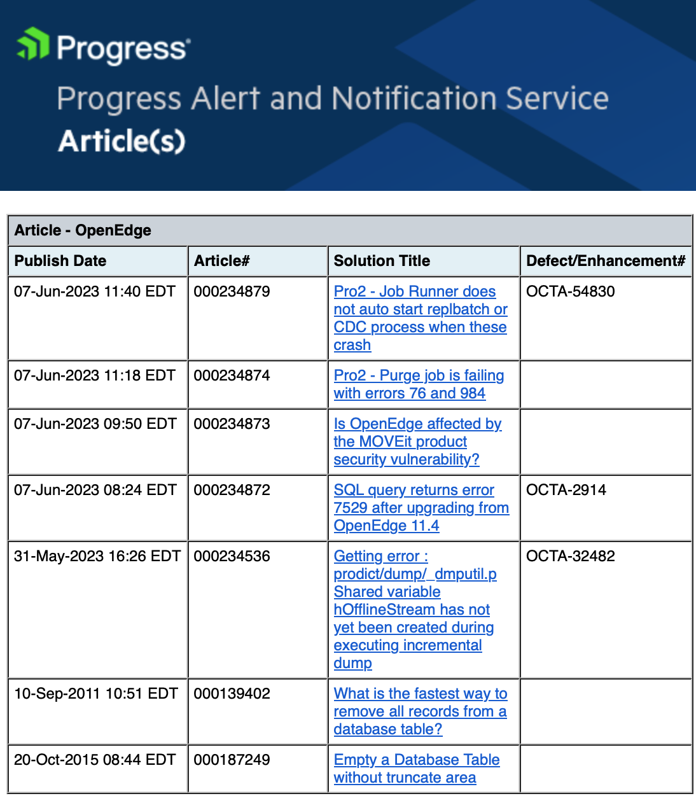
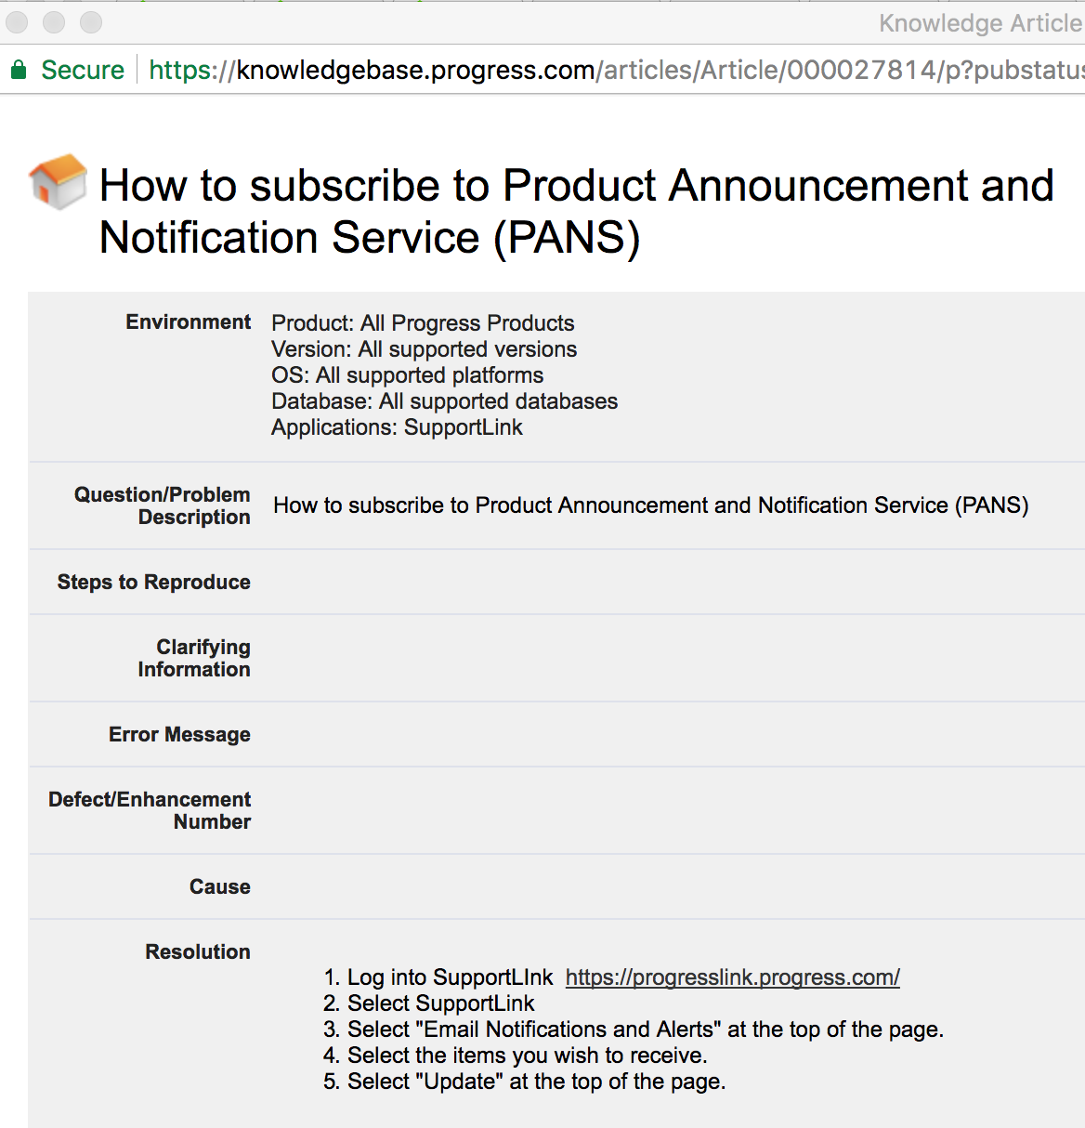
PANS – Daily Technical Bulletins
Step 1: Exercise your knowledgebase search skills:

Slide 35
During the Day
Long open TRX & BI file growth
  Find the oldest transaction (usually a code problem)
Blocked users/connections
  REC = record locking, coding issue
  BK*, TX* etc indicate system resource constraints
Excessively active connections or “rapid readers”
  What are they doing?
  Is it legitimate?
  Is there a better way?
Use the “client statement cache” or “proGetStack” to identify specific code causing a problem.
  Work with development to get it fixed.

Slide 36
Weekly
Rotate/Truncate the .lg file
Cleanup trash in db directories
  protrace, leftover scratch files, core files, etc
  Don’t forget –T!
Refresh dbanalys (or nightly)
Refresh DEV/TEST/QA/Training etc.
  This may involve restoring a PROD backup which will verify that backups are good.

Slide 37
Weekly
After refreshing dbanalys review:
  Index utilization, identify idxcompact targets
  Check rows per block settings
  Check RM chains
  Fragmentation
  Scatter
  Table/Index/LOB & Storage Area Growth
Schedule appropriate remediation activities

Slide 38
Quarterly
Review all startup parameters and config options
Review storage area configuration
If allowing SQL-92 connections:
  Run dbtool to adjust SQL-width
  Run “update statistics” for the optimizer
If using SSL etc – review certificate validity & expiration
Review OS configuration, kernel parameters etc.
  Test IO throughput: random reads & synchronous writes
Review Progress release level
Review monitored metrics and alerts
Review any new business growth plans

Slide 39
Annually
DR Test
License review & “true-up”
Review HW landscape and potential upgrades
Review business growth plans & projections
PUG Challenge/Exchange

Slide 40
This slide is intentionally left blank!

Slide 41
Questions?
Notes:
And now we have some time for questions…

Slide 42
Thank You!

Slide 43

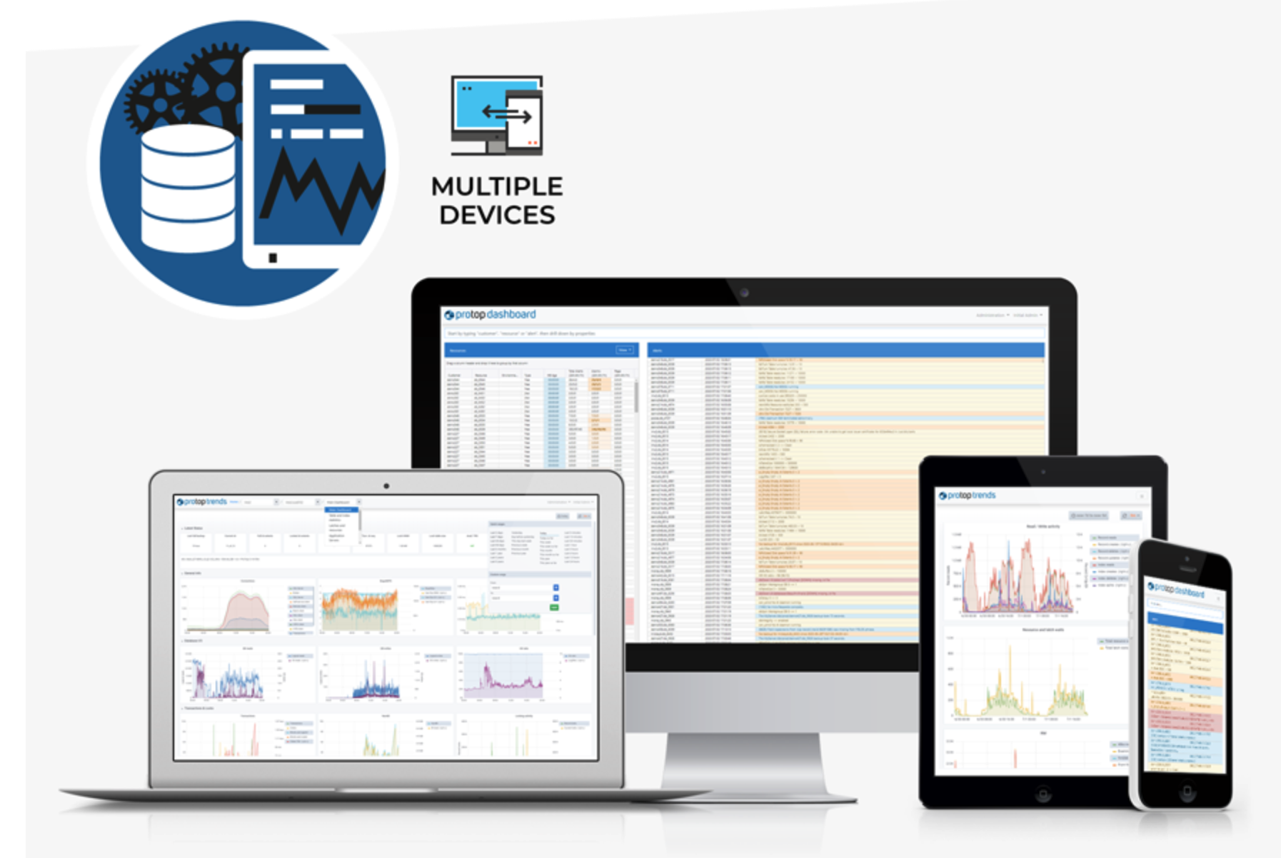
Real time monitoring and detailed drill-down
Historical trending, zoom in or out across years of data at will
Insightful alerting – the information needed to act on alerts
Routine “health checks”
A single pane of glass dashboard
It’s not just the database!
  App servers
  Pro2
  CODE behaviors and profiling
  User defined, application specific metrics
Notes:
We examine more than 50,000 data points per sample, 4 billion real-time status checks per day – on just the main production db, replication targets and app servers result in 3x to 5x more

