Slide 1


Application Performance
Useful Tools and Practices
Claudiu Spac
Notes:
Good morning and welcome to my session
We’ll be going over application performance, how to improve it (hopefully), and a couple useful tools and practices to help with that
Now for some quick introductions ->

Slide 2


ABOUT ME
  Tech Lead at Wayfare​
  Started working at Wayfare in 2014
  Worked on several projects
  Performance always came up
  Never proactively done
Notes:
My name is Claudiu Spac
Started working with OE and Wayfare in 2014
Worked on a couple projects and performance always came up sooner or later
So far it was never a proactively approached subject, it was only looked at when it started becoming a big enough issue
Obviously we still caught some of the bigger issues through peer review or by just seeing things dramatically slow down, but that’s not enough.
That’s a bit of a shame, since you never know how bad performance is until you actively start looking into it
->

Slide 3
ABOUT WAYFARE
WE CREATE VALUABLE SOLUTIONS for our partners that drive their business forward and help them reach their significant goals, supporting the entire life cycle of software applications by offering our expertise in:
10+
YEARS EXPERIENCE
  CONSULTANCY
  APPLICATION DEVELOPMENT, TESTING & UX/UI DESIGN
  PROJECT DELIVERY
  APPLICATION MAINTENANCE & SUPPORT
50+
SATISFIED CUSTOMERS
100+
PROFESSIONALS
PROGRESS
WEB TECHNOLOGIES
OpenEdge, CorticonJS, Sitefinity
Angular, React, Vue.JS, NodeJS, JS, TypeScript, Java, .Net
React Native
CLOUD
OUR EXPERTISE
MOBILE
AWS, Azure, Google Cloud Platform
Docker, Kubernetes, Jenkins
UI/UX
DEVOPS
Figma, XD, Zeplin, Illustrator
MANUAL AND AUTOMATION TESTING
LOW CODE/ NO-CODE FRAMEWORKS

Slide 4
SUMMARY
1. How performance issues are identified (badly)
2. Case study details
3. The process we went through & the tools used
4. Some miscellaneous findings

Slide 5
IDENTIFYING PERFORMANCE ISSUES
  Slow actions
  Noticeably slower after a change
  Subjectively perceived to be slow
  A customer calls you at 3 AM
Notes:
If you’re not actively looking at performance, there are a couple main ways you’ll start to look at it
Slow Actions
By this I mean any kind of action that takes a long time to finish, but it shouldn’t
For example if loading some piece of UI takes 10s it’s an issue
Slower after a change
This depends on how much slower things are, but if something was near instant and now it takes 2s people will notice
Subjectively perceived to be slow
This is more of a process issue. You might be doing something that just takes a very long time and there’s no other way around it.
If the user needs to wait for this process to finish, you will start getting some messages saying that X is slow and should be faster.
For this case imagine a report that takes 2m to finish because it needs to look at 20 tables with data going back 10 years
A customer calls you at 3AM
This is the one situation you really don’t want to deal with. If you got to this point it means that you either missed some issue with piece of functionality when testing,
Or you simply hit some performance issues that only come up in production, on that customer’s server, etc.
Now I’ll go over some of the caveats
->

Slide 6
SLOW ACTIONS
  Defining slow
  Fixing the issue imperfectly
  Leaving ticking time bombs behind
Notes:
Defining slow
Someone needs to define what “slow” is
That definition isn’t going to be constant across people, or even across the same person
The amount of time something takes to be considered slow is inversely correlated to how close the end of the sprint (or the weekend) is
0.2s isn’t going to be considered slow, but if a single find takes that long it probably is
Fixing the issue imperfectly
At this point the issue was most likely noticed during testing, or during development, or during peer review.
All the code is already in place and working, albeit slowly
A fix might take something from 5s -> 1s but there’s a chance it’s still not as performance as it should be
Leaving ticking time bombs behind
If you’re relying on something to become an issue, you might be making some architectural decisions that will be hard to fix in the future
Maybe it’s not a problem with the amount of data currently in place, but what about the amount of data that will be in place 5 years from now?
What about increasing the number of users?
All in all using this approach you’re never going to have good performance, and you’re likely to leave behind some work for your future self anyway.
It’s always fun to git blame and see your own name
->

Slide 7
NOTICEABLY SLOWER AFTER A CHANGE
  “Noticeably” is the key word here
  Compounding minor issues
  Low priority
Notes:
Noticeably slower relies too much on the human factor
This is by far the biggest issue with this approach. You might catch something if performance deteriorates by 5s, but you’re never going to catch a 0.1s difference
Compounding minor performance issues
These .1s differences will add up over time, and eventually you’ll end up with an application that’s slow (especially for new users since they aren’t already used to it) and you’ll have no clear change that can be blamed for this slowness
Next when it comes to fixing these issues you’ll also be in a hard place, since everything is equally slow, there won’t be any outliers to focus on
Low Priority
Generally speaking, these issues will be a low priority. Everything works, it’s just that it works slightly slower than it should. Is this minor fix more important than some new feature?
->

Slide 8
SUBJECTIVELY PERCEIVED TO BE SLOW
  Usually not a performance issue
  Potentially easy to fix
  Eats into development time regardless
Notes:
This is one of the nicer ways to be notified about performance issues.
It might not even be an issue; it might just be something that’s slow because it can’t be fast.
Depending on what exactly is slow, there might be some workarounds that can be used.
Maybe some caching can be implemented, or maybe this whole process can be offload to a different appserver.
The biggest issue here is that this will eat into development time, especially if we’re not talking about recent features. Someone might have known that this can’t be fast 10 years ago when it was first implemented, but someone else will have to look at it now and come to the same conclusion.
In situations like these clear guidelines are the most helpful tool. If there’s a project wide guideline that processes liable to be slow, or down other parts of the application, should be offloaded you will get ahead of a lot of these issues.
(reports. generating pdf documents, doing something using an external API, etc.)
->

Slide 9

A CUSTOMER CALLS YOU AT 3AM
  Bad for the company’s image
  Time crunch
  Replication issues
Notes:
Bad image
A call at 3AM usually means that something important is broken. If this happens a couple more times, customers aren’t going to be happy.
Time Crunch
Because it’s so important now you might need to wake up some developers at 3AM so they can look into some issue. The developers aren’t going to be happy either if this happens a couple more times.
Replication issues
Something might have been missed up to this point, maybe because of some different config, a different amount of data, etc.
These are simple enough to narrow down so you can work around it, either by changing your setup to match, or creating a lot of test data.
The bigger problem is when you have the same setup, a similar amount of data, but things are just fine for you. If you don’t have any load testing in place, this is where you go in blind, look through all the changed lines of code in the release, and try to figure out what might be causing the issue. Not exactly the best way to spend your early 3AM morning.
->

Slide 10
SUMMARY
  Relying on humans is a bad idea
  Various tools are needed instead
Notes:
Human factor is unreliable.
Need to use various tools.
Next we’ll go over some basic details on the application used for this session.
->

Slide 11
A REAL-LIFE EXAMPLE
  E-commerce platform
  Long lived, used a lot of legacy code
  One app used by staff (managers, front desk, etc.)
  Another app used by the end customers
  Load spikes heavily at some known times
Notes:
Some basic details about the platform
The basic flow to purchase an item
Should be noted that this is a legacy application, and it has quite a long history,
Not quite amazon, but enough people use it that load testing became important very quickly

Slide 12
HOW IT ALL STARTED
  Performance issues under heavy load
  A Jira issue that now needs to be looked at
  An adventure throughout the codebase looking for issues to fix
Notes:
This is how this whole dive into performance started.
Things were generally fine, but under load some growing pain were starting to show, especially for bigger customers. When some events rolled around, performance would just tank. The application was essentially suffering from success.
Now you have a new Jira issue that can be boiled down to “performance is bad when thousands of people try to use the application at the same time”. Initially you can just go through some of the recent changes trying to figure out what might be causing issues, but it’s not feasible to manually identify issues in all your code. You can look at some of the more commonly used source files, but even that has its limits.
After you’ve gone through the recent changes and the more commonly used files, a more serious investigation needs to happen. This is where tools start to come into play.
->

Slide 13
INITIAL INVESTIGATION - TOOLS
if ProfilerEnabled then
assign
profiler:file-name = “filename.out”
profiler:description = “Description”
profiler:directory = “/path/to/dir”
profiler:enabled = true
profiler:listings = true
profiler:profiling = true.
/* Ideally all executed code*/
if ProfilerEnabled then
profiler:write-data().
  Tools used
  Profiler
  Basic log files
  Load testing
  Profiler extras
Notes:
The first tool used was the profiler. Enabling the profiler is trivial. To start with you’ll only need a couple lines of code, and a feature flag of some kind so you can easily enable/disable the profiler. Once that’s done whenever the code is executed data is collected, and at the end you will get an output file containing details about the execution of that code. This shows you how long each piece of code took to run, how many times it was called, etc. You can open profiler output files directly in Developer Studio, or there’s an unofficial profiler app out there on the web. Using this information, we identified a couple problem areas, and we started working on some changes.
We didn’t have any serious load testing in place, so that had to be added. Luckly it was a web app, so we could quickly add some load testing for common scenarios. Once we had some load testing, we enabled profiling for the load test as well and got some new results. While in this case the problem areas we identified were the same between dev and load test profiler files, there were significant differences in the execution time. While load testing those problem areas took ~30% of the execution time, but when testing locally it only amounted to ~10%. Other areas showed similar discrepancies.
Without these tools it was going to be extremely hard to make any significant improvements because
How do you find what you need to change?
How do you measure the effect of those changes?
Is whatever change you made in your dev environment going to have a similar impact in production?
Depending on how you do your profiling, you might need some extra tools. In our case we created a profiler output file for every request. That made it impossible to look at profiler output since looking at 100k files one by one wasn’t an ideal way to spend your week. To deal with that we created a small tool to merge a bunch of profiler files together. We also added some filtering for profiler files, so you can merge all the profiler files that called a specific procedure. The profiler handle also provides a user-data method allowing custom data to be added to the enc of the profiler output so if you have some custom scenario in mind, or you’d want some extra information to be included in the output you can do that quite easily as well.

Slide 14
INITIAL INVESTIGATION – CHANGES
  Spot fixes & miscellaneous changes
  Logging improvements
  Cache mechanism changes
  Remove unnecessary procedure calls
  Looked into other performance analysis tools
Notes:
As part of this initial step we made a couple changes.
First off there were some spot changes to various places in the application. This included some rewrites so fewer records were fetched, some index changes, etc.
Added some logging around interesting areas so we’d have more data.
Various small changes to reduce the number of function calls, etc.
Cache mechanism changes
We had some data that had to be calculated. Depending on some configuration each user could potentially need to load different data. To deal with that a caching mechanism was used where the data was kept in a blob on a DB record. When a request ran we would fetch the appropriate blob and read from it into a temp-table.
This is one of those changes that just goes to show how important properly measuring performance is. Turns out that doing it that way was a significant performance issue. We tried a couple of things, and the one that worked the best was changing the caching mechanism. Instead of reading into a TT from a blob, we simply created a DB table with ~ the same schema as the TT and buffer-copy(ed) those records into the TT.
On a slightly related note, that same cached data mentioned in the previous point, was always being read at the start of a request. Instead of doing that we simply did that only when the data was needed. Essentially just lazy loading. We also found some other parts of the process that were executing even when it made no sense.
New performance tools – in comes XREF

Slide 15
INITIAL INVESTIGATION - TAKEAWAYS
  Matching test and production environments
  Match real-world usage
  Maintain a stable test environment
  Don’t rely on development environment data
  Store historical performance and profiler data
Notes:
Matching environments is incredibly important. If they don’t match you can’t be sure that the results you get in one will be the same as in the other. A seemingly minor performance difference might result in a huge performance drop. You might also miss out on some easy to fix, high impact problems.
Making sure that the tests reflect the real-world usage is just as important when it comes to load testing. If the tests are overly simple you might not identify some problems. If the application is setup differently, you might get inconsistent results. An easy example is caching. If that’s disabled when load testing, you’ll be pointed in the direction of some code that’s potentially run only a couple times a day, but you’ll see it running thousands of time.
The test environment should be stable. That way test results can be compared across different versions. If configuration options are changed haphazardly, or if the number of agents changed, or if the hardware it’s running on changes, test results can no longer be compared against each other.
Dev environment profiler data is useful, but it’s only useful for some initial investigation, or for dev work. While it is fine to make changes based on dev data, they need to be validated through load testing before they can be pushed out.
Finally, you should store historical performance and profiler data. It’s an easy step to take, but if it’s missed, you’ll quickly find that you need to see how things performed 2 releases ago, or how the execution of some procedure changed across releases.

Slide 16
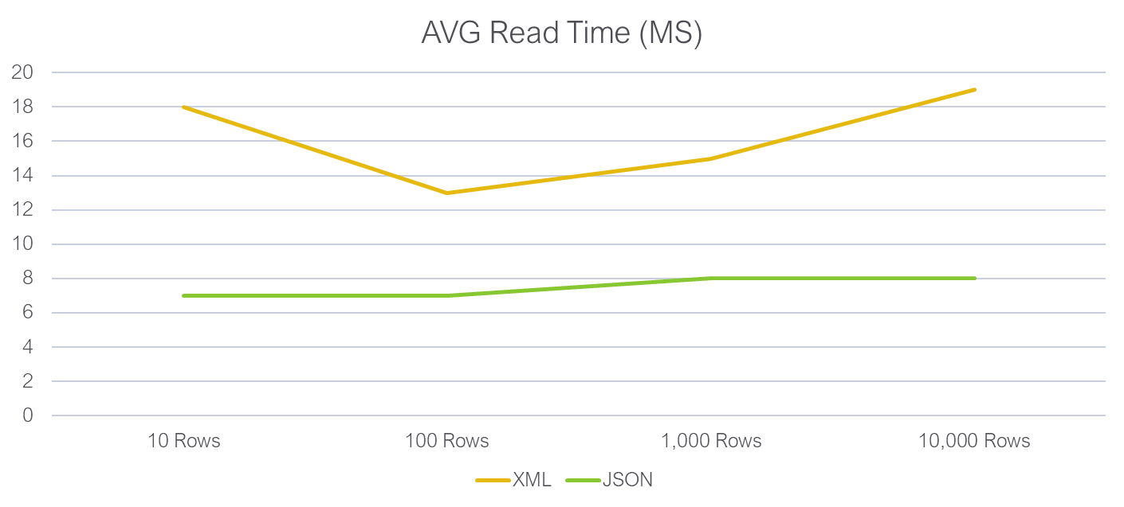

READ-JSON VS. READ-XML

Slide 17
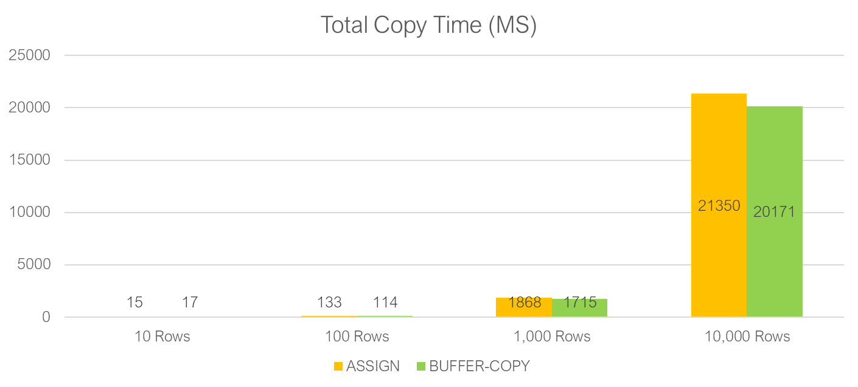
BUFFER-COPY VS. ASSIGN
Performance improvement from 6% - 15% depending on record number

Slide 18
ONGOING INVESTIGATION – TOOLS
  XREF files
  Index data
compile /path/to/proc.p
save into “/build/dir"
xref “/path/to/xref.xref".
Notes:
If you’ve gone all out making performance changes, all of the things that stood out in the profiler were improved. Things should look a lot better now, but now we start getting into the more annoying problems.
If nothing stands out in the profiler output, it becomes a lot harder to identify changes that need to be made. Right now, the performance issues that are left will be very small, but they will be spread out across all your codebase.
To find new issues we started looking at XREF files. You can generate an XREF file when compiling files, and you get some output containing more details about what’s happening in your code. What we were interested in here was query data since DB activity makes up a good chunk of the execution time. While individual improvements would be small, an index change might have a big payoff depending on the number of queries that would use it.
For every for each, find, etc. you get some information on what fields are accessed by the query, the indexes used, whether you’re looking at a whole index search, whether there’s no suitable index that can be used for a sort (sort-access).
Based on the XREF output you can change either the queries used to more efficiently use indexes, or you can add new indexes that better match your use case. One thing to keep in mind is that you can’t add 100 indexes to a table so it covers all your queries, but you should have indexes in place for the more commonly used queries.
By index data we refer to the DB schema rather than the index stat tables. Simply put we need to know what indexes are available for a table, that way we can create some automation that lets you know if you can make some changes to a query.

Slide 19
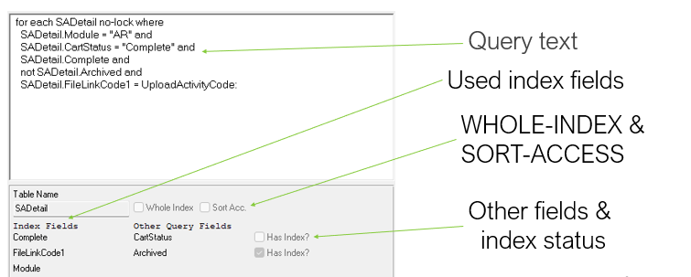
ONGOING INVESTIGATION – TOOLS
Performance improvement from 6% - 15% depending on record number
Notes:
Based on the data we have from index files, and the various VST tables describing the DB schema we build a small tool that automatically goes through all our codebase and finds potential issues.
You can use this to suggest using a particular index or make other changes. For the one shown you can instead use SADetail.Archived = no so that field can be properly used for indexing.
Because you have enough knowledge of the application, you can start making other suggestions. If a query is looking at fields X and Y it should also include field Z.
While for this project we just created what essentially is a POC tool, this can be taken further and be integrated in the normal workflow. If you work on a file, you look at it in this tool, and fix a couple of issues. It’s easy to integrate with dev studio so you can go to the particular line in the code with a single click making the whole process somewhat painless. Once you make a change, you’ll only need to recompile with XREF and process the particular file again, and you’ll see whether your changes helped or broke things further.
You can probably do something similar with Sonar Lint since it also looks at DB schema and XREF files, but I’ve never investigated it properly.

Slide 20
ONGOING INVESTIGATION – CHANGES
  FIND -> FOR
  Index changes for hot tables
  Fixed a lot of small issues
Notes:
We made a lot of changes where we moved away from FIND statements. Our indexes were a bit of a mess so a lot of queries would use more than 1 index. FIND statements can only use one which was a big issue.
We had a couple of tables that were particularly important. We made some index changes for those, so they better matched the queries we were using.
Finally, we fixed a lot of small issues. Changing field order, bracket changes, no longer using NOT in front of logical fields, etc.

Slide 21
ONGOING INVESTIGATION - TAKEAWAYS
  Check your queries
  Don’t trust in just your eyes
  Many small changes add up
Notes:
While it’s easy to think that “our queries are probably ok” you should properly check that. You might be surprised at how many issues you’ll manage to find.
You can’t rely on peer reviews to catch these issues. People won’t have a complete DB schema in memory, and even if they do, they are liable to make mistakes. One field in the wrong order and there goes query performance.
These changes will be minor in most cases. It will feel like a thankless job with no rewards, but enough of these changes will add up to make a significant difference. Prioritize some of the bigger or most often accessed tables to get the quickest return.
This was an ongoing process so we were looking for some other improvements.

Slide 22
FINAL INVESTIGATION - TOOLS
  DB Analysis
  Table stats
  Index stats
  Process changes
  proutildbanalysis
  -basetable -tablerangesize
  -baseindex -indexrangesize
Notes:
When it comes to DB analysis I won’t go into too much detail since I’m not that familiar with it. There is a lot of valuable data that’s available but it more or less falls under DB administration and it could use it’s own talk.
For some very simple data you can just run proutil dbanalysis against the DB, and you can get some information on the number of records in a table, the amount of space the records and the indexes use, etc.
You can use this is a very simple orphaned data check. If the number of records in a table just doesn’t make sense it might be worth cleaning up orphaned data. Depending on the queries used this cleanup might have a big impact.
Table and index stats are recorded for a given number of tables based on some DB startup parameters. You’ll have access to the number of CRUD operations per table and index. Using this you’ll have an idea of what your application is doing DB wise.
Weird spikes in table/index activity could indicate some issues that should be looked at. Overall you’ll have a better idea of the tables on which you should focus your query optimizations.
When it comes to process changes, it’s going to depend entirely on the application. If a certain flow can be broken down into N individual steps, are there any steps that don’t need to happen instantly?
For example, if you’re trying to buy something getting the receipt by email after 5 minutes won’t be that big of a deal, but you’re essentially removing all the time it takes to create the receipt from that flow.
Other potential areas of interest are things like housekeeping tasks where you cleanup some data, or updating some statistics, etc.
The more things you can offload the better the user experience will be.

Slide 23
FINAL INVESTIGATION – CHANGES
  Architectural for highly used table
  More index & schema changes
  Added some timeouts on the UI
  Adding “multithreading”
Notes:
We found a couple of tables that had way too much DB activity. One of those resulted in a architectural change since we were doing a lot of read/writes for a context table with every request. We ended up using read/write-json to deal with the context instead, essentially going from hundreds of operations per request to less than 10. The performance benefit from this wasn’t as big as we expected, but I think we got ~10% from it so it was a big enough improvement. We also got a lot of bugs from it, thankfully nothing too bad.
We also found some tables that had way too many reads. That was an issue with what we had available for a query on the table. We ended up adding some new fields and indexes so we could search more efficiently. In a sense we moved from looking at a single field to looking at 3.
We noticed that some tables were seeing high usage when they really shouldn’t have. There were no normal situations that would use those tables that heavily. We coupled that with some analytics data and it turns out it was an UI issue. An autocomplete was going through a table using just a begins as the where clause. The problem was that the user entered the input on letter at a time, so it was spamming requests that would go through way too many records. A simple timeout and minimum number of characters that had to be entered before it would try to autocomplete fixed that issue.
The last one is a bit of a misnomer, but we had some situations where people would buy thousands of items. And by that I don’t mean a single record with a quantity in the thousands, but thousands of separate records that all had to go through the entire purchase process. This took a significant amount of time and it wasn’t the best experience. To deal with this we added some “multithreading”, mainly on the UI side. Instead of relying on a single request to do the work for thousands of items, we split that processs up into chunks. Then we started multiple requests from the UI, keeping 5 requests running at once, to make the experience better. We also made some UI changes so you wouldn’t be stuck waiting for the process to finish before you could do anything else. Now it’s more of a fire and forget, come back when it needs some user input, then fire and forget again.

Slide 24
OTHER FINDINGS
  WebSpeed & cookies
  Profiler and pause statements
  Waiting for locks
  User input
  Profiler tracing data
  Dynamic queries and reflection
Notes:
We were using webspeed for the project, and there were some intermittent issues for developers where performance would tank. In the end this was happening because we were reading all cookie data being sent, even those we didn’t need to, for every request.
Couple that with a process that created some big cookies to keep some UI state, and the very long time it takes to read cookie data, you could essentially stop an agent for a couple of minutes if you maliciously crafted your cookies.
The profiler doesn’t play nicely with pause statements. They are effectively ignored, so if you have some code that relies on pauses to try and lock a record, or to retry some API call, you should probably add some logging around that otherwise there’s no easy way of knowing how much time agents are spending doing nothing.
In various areas we were using FOR EACH EXCLUSIVE-LOCK. This came up as part of our multithreading changes, but the data we were changing belonged to the receipt rather than a particular request. In this case we just had to rewrite the query so it would only look at data for the current request. We had a similar issue happen when searching for items. We were creating some search data and caching it as part of the request. This worked fine, but when thousands of people were searching at once and the cache expired, you had thousands of people creating the search data, and then getting into arguments about who could save their changes to the DB. This ended up being offloaded quite successfully.
Users in general were a bit too trigger happy when searching. They were essentially providing no filters, so the search ended up going through more records than necessary. This is related with the way in which we did searches where a search would find all the records, and storing the results. That way you wouldn’t have to wait when moving to the next page of results, but unfortunately this caused the issue we were seeing where a search would look at way more than it should.
Looking at tracing data is a work in progress. Right now the profiler outputs the tracing data if it’s enabled, but you can't look at it using the existing UI. You’ll need to do a bit of parsing to get things to work, but the idea is you can find outliers in the execution of a particular piece of code. Over 10k executions a line takes 1ms on average, but there are 10 times when it takes 10 seconds (think waiting for a lock, disck IO, etc.) Those 10 times where it took 10s are a performance issue, but it’s not easily apparent from the profiler UI.
This falls under the general situation where a FOR EACH is going to be faster than using a dynamic query. Reflection was also used in some of our OOP code to dynamically assign values to all properties on a class from DB tables and it was significantly slower than a normal assign. Try not to use dynamic queries or reflection, unless necessary or you can afford the performance hit.

Slide 25
Q&A

Slide 26
THANK YOU
www.wayfare.ro

