Slide 1



Progress and Oracle in the world of other databases
Dmitri Levin
Progress, Oracle, SQL Server DBA
Alphabroder Co
Philadelphia PA

Slide 2






Databases

Slide 3
Databases
RDBMS
Oracle
MySQL
MS SQL Server
PostgreSQL
IBM DB2
MariaDB
AWS Aurora
Progress
Key-Value Store
Redis
AWS DynamoDB
Memcached
MS Azure Cosmos
Oracle No-SQL Db
Document Databases
MongoDB
Couchbase
CouchDB
Google Cloud
PostgreSQL (EDB)
AWS DocumentDB
FounaDB
Search Engines
Elasticsearch
Splunk
AWS CloudSearch
MS Azure Search
Time Series DBMS
InFluxDB
AWS Timestream
Graph Databases
Neo4j
MS Azure Cosmos
Oracle Spatial and Graph
AWS Neptune
In-Memory DB
IBM dashDB/DB2
Oracle Times Ten
SAP HANA
AWS
Wide Column Store
Cassandra (FB)
HBase
Most popular
Open Source

Slide 4
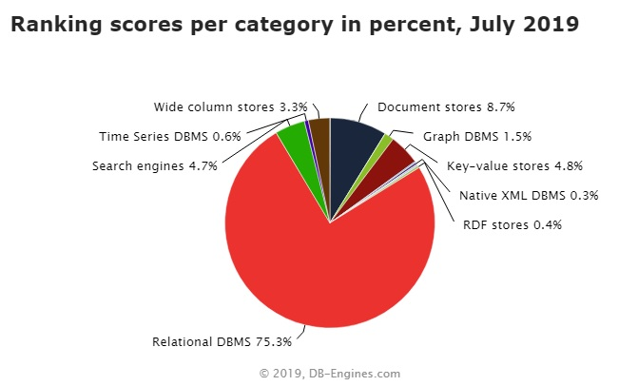
Notes:
There is a recent trend to provide a merged database solution. i.e. both SQL and NOSQL in one box.

Slide 5
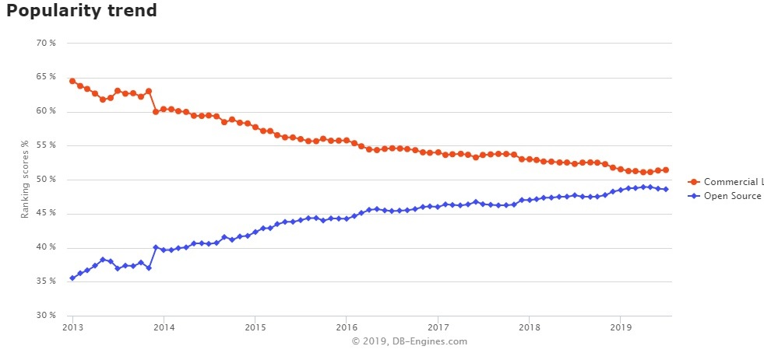
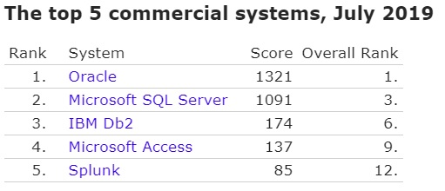
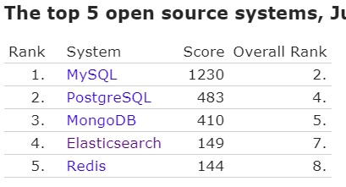

Slide 6
Prorgess vs Oracle
-pf file | initSID.ora or spfileSID
anywhere | ORACLE_HOME ( aka DLC )
proutil db-name -C increaseto
VST _DbParams find _DbParams where _DbParams-Name = "-spin". assign _DbParams-value = "2000". | V$ V$PARAMETER

Slide 7
Prorgess vs Oracle
After-imaging | Archiving
By default turned off | By default turned on
Does not remove old AI files | Does remove old archive files
Progress
Oracle
MS SQL Server
PROD
With After-images
W/O After-images
ARCHIVELOG Mode
NOARCHIVELOG Mode
FULL Recovery Model
SIMPLE Recovery Model
Bulk-logged Recovery Model
DEV

Slide 8
Physical Structure (data files)
Progress |  | Oracle
Database File | sports.db | Control File(s) | control01.ctl
Structure file | sports.st | N/A
System Area | sports.d1 | System Tablespace | system.dbf
D Files | sports_7.d | Datafiles | tablespace.dbf
Before-Image File + After-Image File | sports.b1 + sports.a1 | Undo tablespace + Redo Log | undotbs.dbf + redo01.log
Copy of After-Image File | sports.date_time_etc | Archive Log | sports.date_time_etc
Log File | sports.lg | Alert Log | alert_sports.log
Parameter File | sports.pf | pfile (or spfile) | initsports.ora
Notes:
Progress and Oracle are quite different in transaction processing. No direct map of .bi and .ai
Oracle alert Log: All startup parameter, but no user connect/disconnect
SQL Server keeps by default 6 ERRORLOGs: ERRORLOG, ERRORLOG.1, etc.
C:\Program Files\Microsoft SQL Server\MSSQL.n\MSSQL\LOG\ERRORLOG

Slide 9
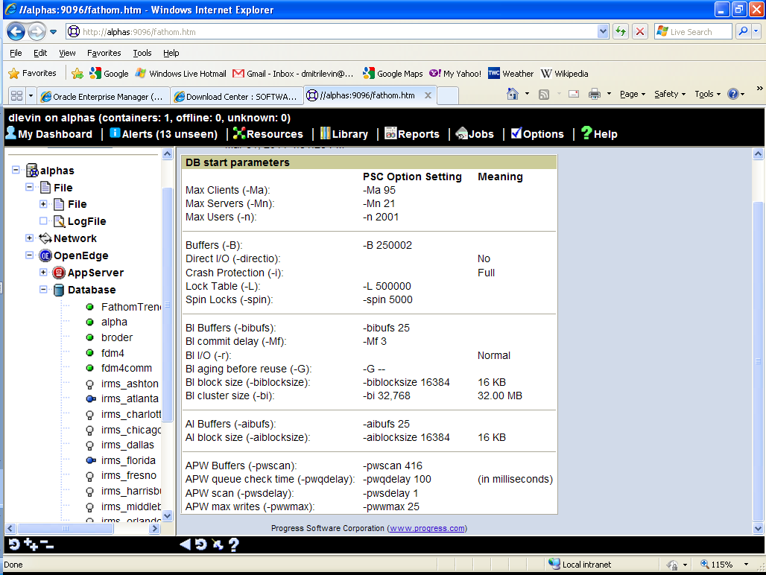
Notes:
proutil db-name -C increaseto -B n -L n -bibufs n -aibufs n

Slide 10
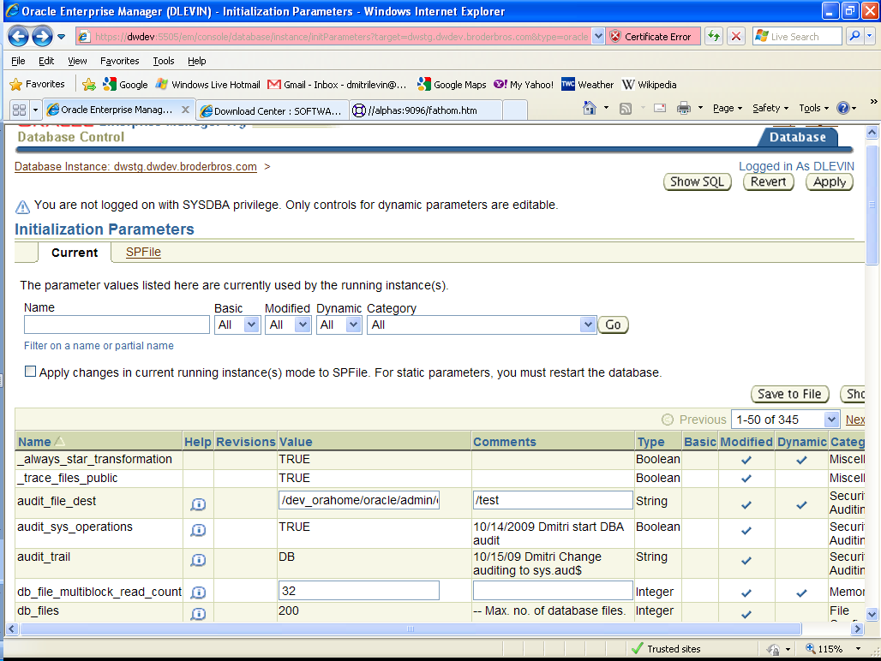
OEM parameters
Notes:
Static and dynamic parameters

Slide 11
Logical Structure
Progress | Oracle
Area | Tablespace
System Area | System Tablespace
Object | Segment
Cluster 8,64,512 | Extent system managed
Block 1,2,4 or 8K | Block 2,4,8,16,32 or 64K

Slide 12
Background Processes
Progress | Oracle | Description
APW | DBWn | Database Writer
BIW, AIW | LGWR | Log Writer
AIMGT | ARCn | Archive Process
WDOG | PMON | Process Monitor
 | SMON | System Monitor
 | CKPT | Checkpoint process
 |  | Many other …. 80 at least
Notes:
Log Writer, like BIW is only one.

Slide 13
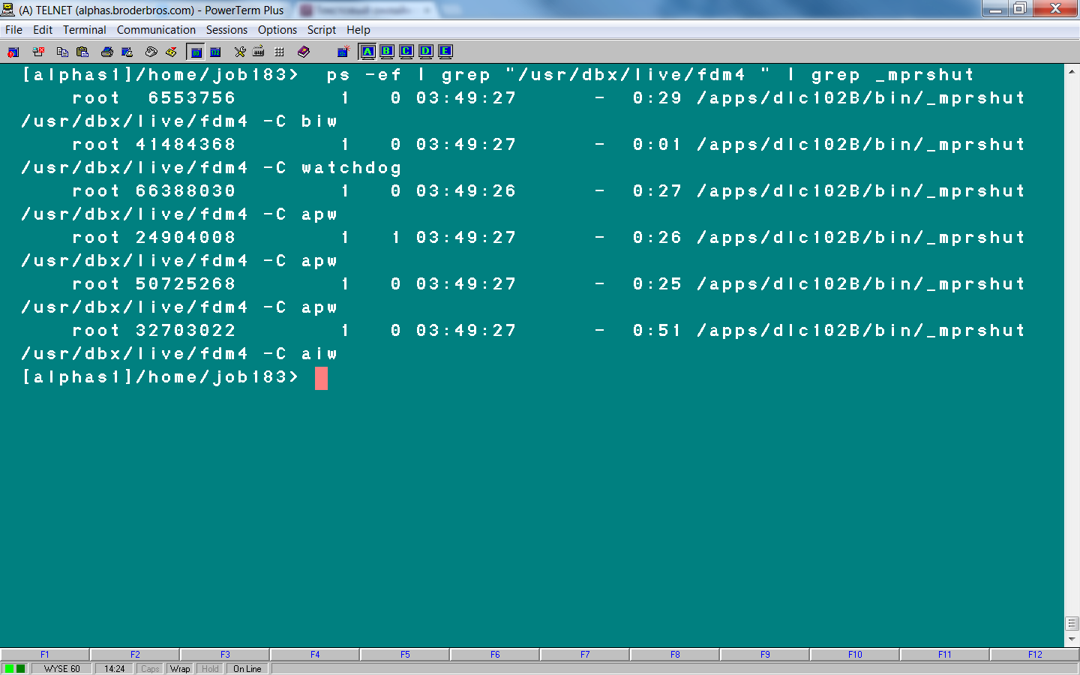
Progress: ps –ef | grep db_name| grep _mprshut

Slide 14
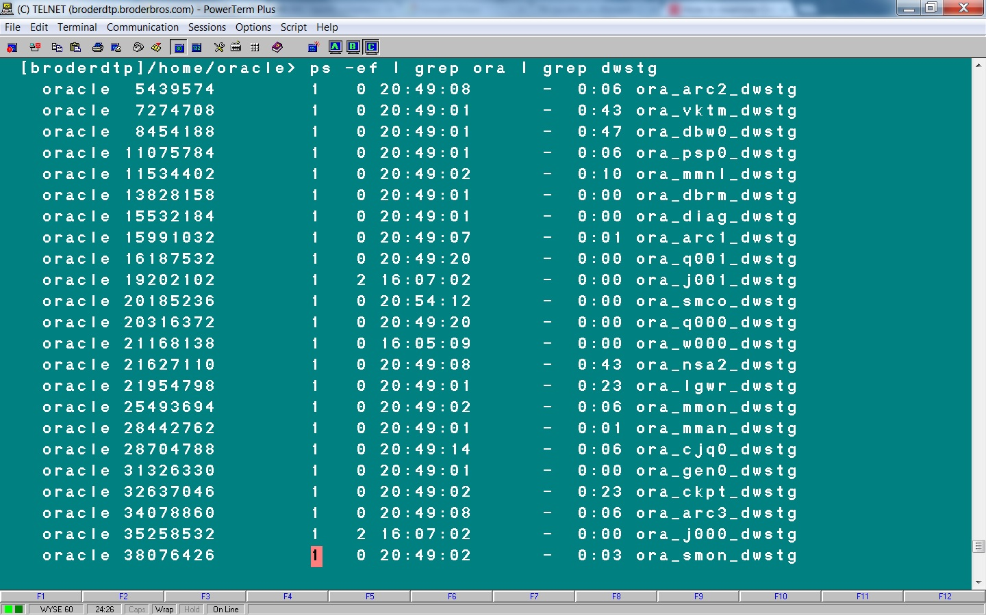
Oracle: ps –ef | grep db_name | grep ora

Slide 15
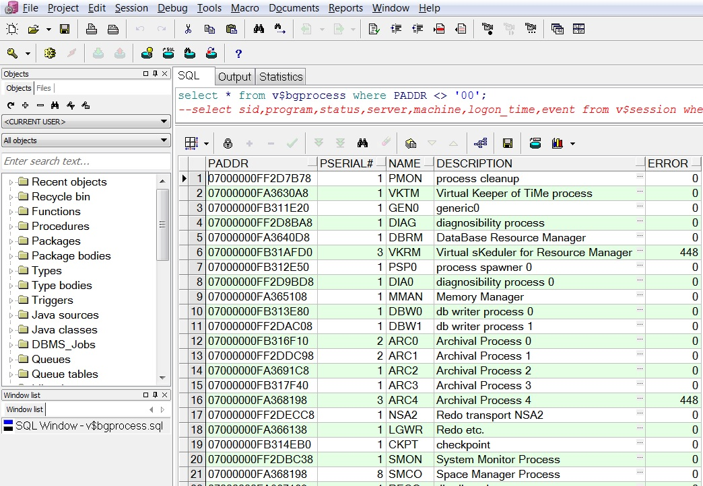
Oracle: select * from v$bgprocess;

Slide 16
Meta-schema and VST
Progress Meta-schema tables -80 < _file-number < 0
Progress VST _file-number < -16384
Progress Table | Oracle View
_Area | DBA_TABLESPACES
_AreaExtent | DBA_DATA_FILES
_StorageObject | DBA_OBJECTS
_File | DBA_TABLES
_Field | DBA_TAB_COLUMNS
_Index | DBA_INDEXES
_Index-field | DBA_IND_COLUMNS
_Sequence | DBA_SEQUENCES
Notes:
Every Progress table has _file record
Every Oracle view has DBA_VIEW record

Slide 17
VST/ Dynamic Performance/Management Views
Progress | Oracle
Virtual System Tables | Dynamic Performance Views Or V$ ( Vee dollar) Views
_Connect | v$session, v$process
_DbStatus | v$instance, v$sysstat
_Trans | v$transaction
_Lock | v$lock
_Latch | v$latch
_AreaStatus | v$tablespace
_Filelist | v$datafile
_DbParams | v$parameter

Slide 18
Data Protection
Backup
Replication
Clustering
Flashback

Slide 19
Backup
Progress – simple | Oracle RMAN – More complicated
probkup online sports file_name
All databases : Online and Offline (Hot and Cold)
All databases: Complete and Incremental/Differential
Oracle and SQL Server | could be Full and Partial (some tablespaces or filegroups)
Notes:
Log backup necessary in Full Recovery Model

Slide 20
Compressed Backup
1528 GB Progress DB makes about 1038 GB probkup
1.7 TB Oracle DB makes either 1.4 TB regular backup or
300 GB RMAN compressed backup (BZIP2 is default).
Notes:
With compress backup CPU usage increases and I/O decreases. So it could be faster or slower then regular one.

Slide 21
Progress
Oracle RAC
Active - Passive
Active – Active
Server 1 Memory
Apw, Biw, Aiw, Wdog
Server 2
Server 1 Memory
DBWn, LGWR ARCn, SMON
Server 2 Memory
DBWn, LGWR ARCn, SMON
DB

Slide 22
Cluster db 2
Progress
Oracle RAC
Server 1
Server 2 Memory
Apw, Biw, Aiw, Wdog
Server 1
Server 2 Memory
DBWn, LGWR ARCn, SMON

Slide 23
Oracle Flashback
Flashback Database
Flashback Table
Flashback Drop
Flashback Query
Flashback Version Query
Flashback Transaction Query
Notes:
Six types of Flashback in 10g. They are designed to fix human errors.

Slide 24
Flashback Database
Oracle Flashback DB:
SQL> flashback database to timestamp sysdate-1;
SQL> flashback database to SCN 1234567;
Oracle Flashback Query:
SQL> select * from table_name
as of timestamp systimestamp - interval ‘30' minute;

Slide 25
Connecting to a database
Progress | Client Server -db db_name -H host -S service
 | Shared memory -db /full_path/db-name
Oracle | Listener ( Client Server )
Notes:
When listener is down existing users will be fine. New users will not be able to connect.
Server, Listener port, db name

Slide 26
Connecting to a database
S
-H host –S service1
SID
Host:port:SID
-H host –S service2
Host:port:SID2
SID2
Listener
Port 1521

Slide 27
Shutdown
Unconditional Shutdown
Emergency Shutdown
Shutdown Normal
Shutdown Transactional
Shutdown Immediate
Shutdown Abort

Slide 28
Startup
Shared Memory
Background Proc
Closed | Closed
 | Nomount mode
 | Mount mode
Open | Open
←Prorest
init*.ora
←Restore
.ctl

Slide 29

Questions
Web page | www.proora.com
Email | d_levin@hotmail.com

Slide 30


