Slide 1
Getting Started: DBA Basics
Congratulations! You're Our New Progress DBA! Now What?
Tom Bascom, White Star Software
Abstract: People often ask what tasks a newly minted OpenEdge DBA should be performing? What should my daily, weekly, monthly etc checklist have on it? What's good? What's BAD? Where do I even look to find out? What do I need to pay attention to? What can I ignore? What should I lose sleep over? When should I update my resume? Who can help me? In this hands on workshop we will show you the way through the challenges that lie in front of you and help bring peace to your weekends and evenings!
Wifi: Hilton Honors Meeting
Password: PUGAMER19
RDP Login: Administrator
RDP Password: DB@Wsh0p

Slide 2
Getting Started: DBA Basics
What A Newly Minted OpenEdge DBA Needs to Know
Tom Bascom, White Star Software
tom@wss.com

Slide 3
Agenda
proenv: proutil describe, prostrct list, dbanalys, prolog, (333), conmgr.properties
Starting & stopping a db: exploder, dbman, proserve/proshut
Backup (online) & restore
Tweaking: ai/bi block & cluster size
Setting params: *range – dangers of exploder (-hash…)
Enabling after imaging (online)
Add extents (online)
Install ProTop
Setup SQL
Dump .df, create .st, build an empty db
Obtain delta .df
Apply .df (online)
idxactivate
Monitor db, with protop, find problems
tablemove improperly placed tables and indexes, omsize, -B, -Mm
proGetStack, disconnect a usr
dbtool (sql width)
Update stats
Update to new release
Idxcompact

Slide 4
The Workshop Environment
AWS t3.medium instance with:
  2 cores at 2.5GHz
  4GB of RAM
  7 filesystems, 20GB each
Windows Server 2012
OpenEdge 12.0
A copy of “bigsports”, a 1GB slightly tweaked version of the standard sports2000 db

Slide 5

Lab: Fixing PROENV
proenv>

Slide 6
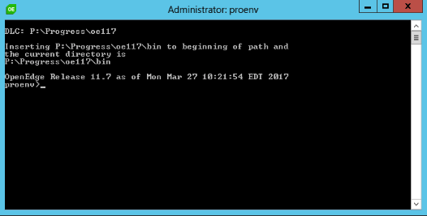
proenv
Notes:
By default you get a window the size of a postage stamp with really ugly font and color selections.

Slide 7
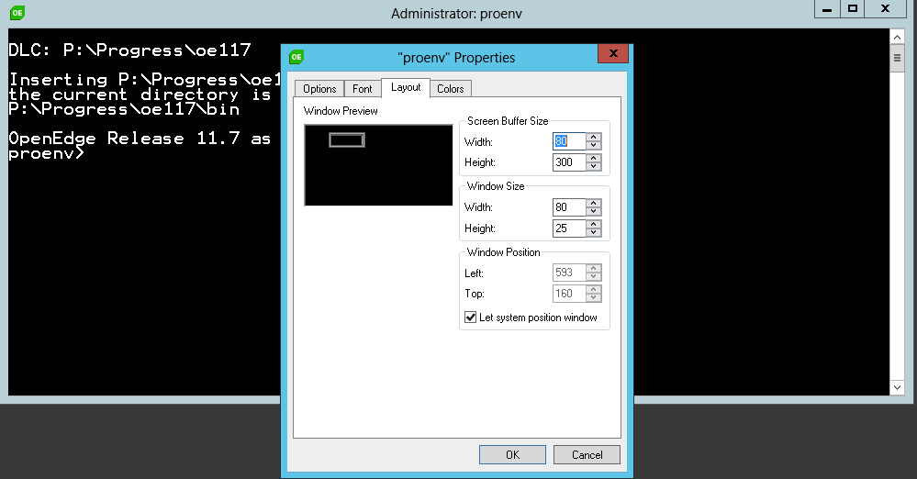
proenv
Notes:
But there is no reason to settle for that!

Slide 8
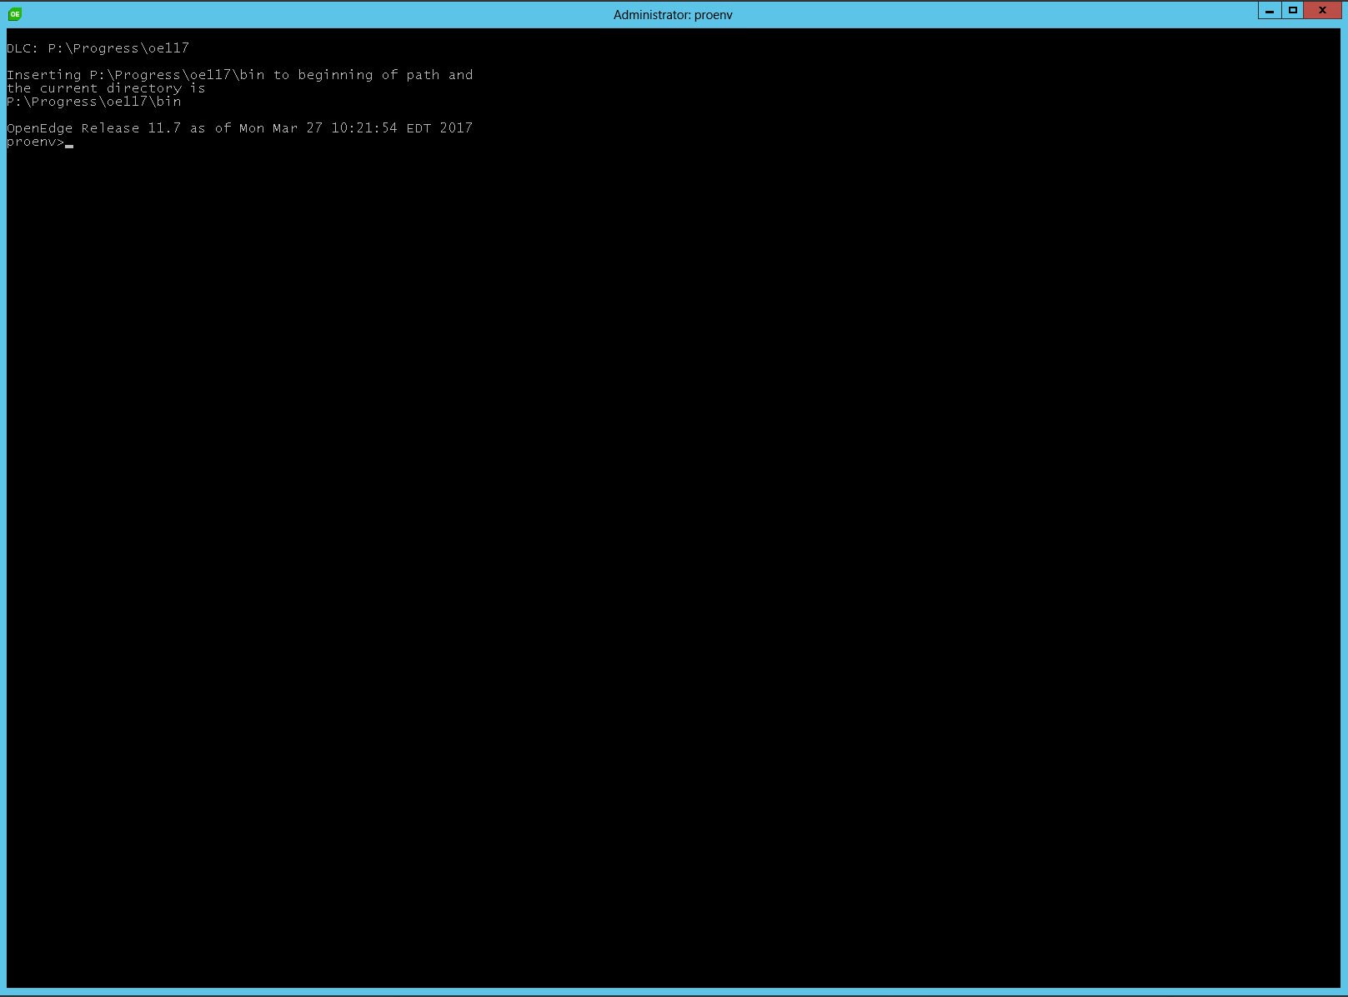
proenv
Notes:
First give yourself a suitable amount of real estate to work with.
Pick a nice font while you’re at it – Lucida 16 for instance.

Slide 9
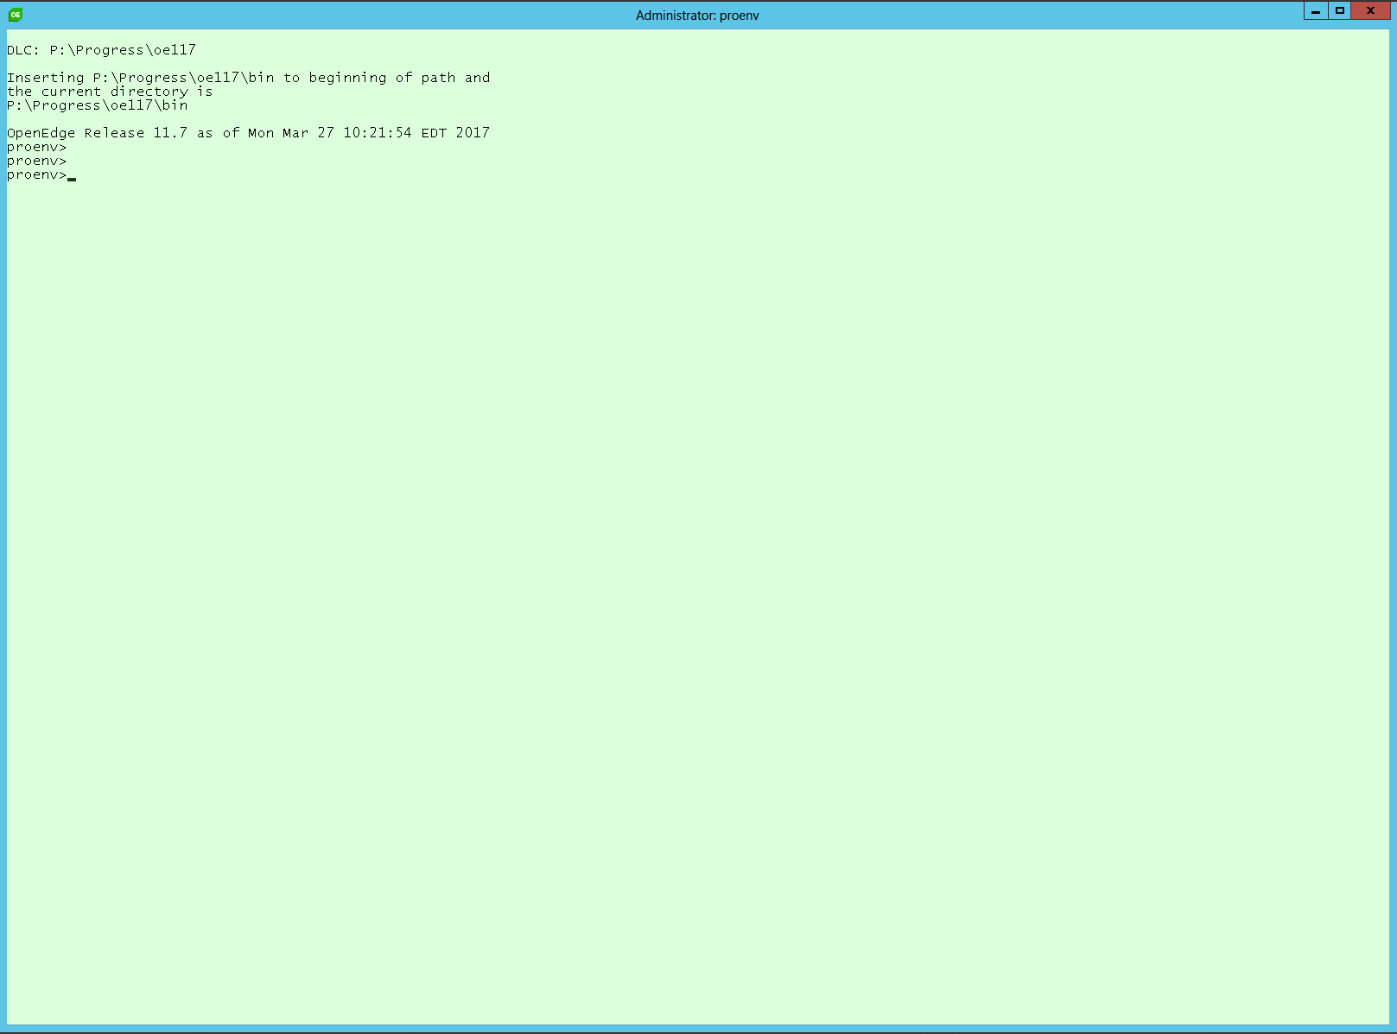
proenv
Notes:
And it you are really brave pick some nice colors!
proenv>color /t
Sets the default console foreground and background colors.
COLOR [attr]
attr Specifies color attribute of console output
Color attributes are specified by TWO hex digits -- the first
corresponds to the background; the second the foreground. Each digit
can be any of the following values:
0 = Black 8 = Gray
1 = Blue 9 = Light Blue
2 = Green A = Light Green
3 = Aqua B = Light Aqua
4 = Red C = Light Red
5 = Purple D = Light Purple
6 = Yellow E = Light Yellow
7 = White F = Bright White
If no argument is given, this command restores the color to what it was
when CMD.EXE started. This value either comes from the current console
window, the /T command line switch or from the DefaultColor registry
value.
The COLOR command sets ERRORLEVEL to 1 if an attempt is made to execute
the COLOR command with a foreground and background color that are the
same.
Example: "COLOR fc" produces light red on bright white
proenv>color 80
### you can tweak the colors in properties->colors, for instance change color 8 to be 224,255,224 to get cool mint green as above…

Slide 10
proenv
proenv> mode con cols=160 lines=72
proenv> color c0
Notes:
And it you are really brave pick some nice colors!
proenv>color /t
Sets the default console foreground and background colors.
COLOR [attr]
attr Specifies color attribute of console output
Color attributes are specified by TWO hex digits -- the first
corresponds to the background; the second the foreground. Each digit
can be any of the following values:
0 = Black 8 = Gray
1 = Blue 9 = Light Blue
2 = Green A = Light Green
3 = Aqua B = Light Aqua
4 = Red C = Light Red
5 = Purple D = Light Purple
6 = Yellow E = Light Yellow
7 = White F = Bright White
If no argument is given, this command restores the color to what it was
when CMD.EXE started. This value either comes from the current console
window, the /T command line switch or from the DefaultColor registry
value.
The COLOR command sets ERRORLEVEL to 1 if an attempt is made to execute
the COLOR command with a foreground and background color that are the
same.
Example: "COLOR fc" produces light red on bright white
proenv>color 80
### you can tweak the colors in properties->colors, for instance change color 8 to be 224,255,224 to get cool mint green as above…

Slide 11
Lab: Checking Out Your Database
proenv>
finding your databases…
  Windows Explorer / find
  taskmgr / ps
  dbman
  Open Edge Exploder
proutil describe, prostrct list, dbanalys, prolog, (333), conmgr.properties

Slide 12
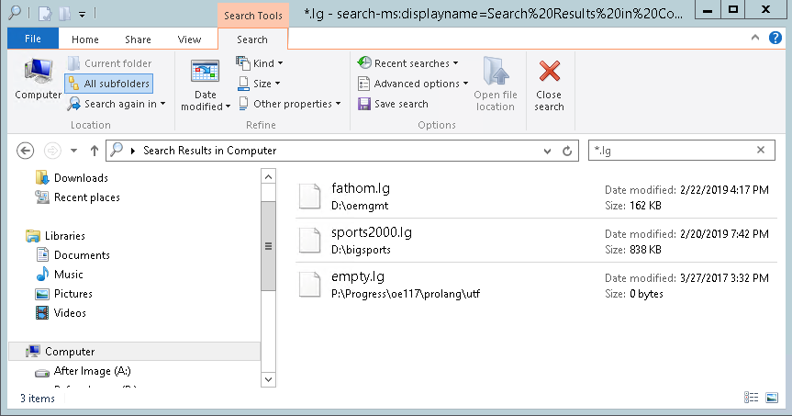
Finding Databases with Windows Explorer

Slide 13
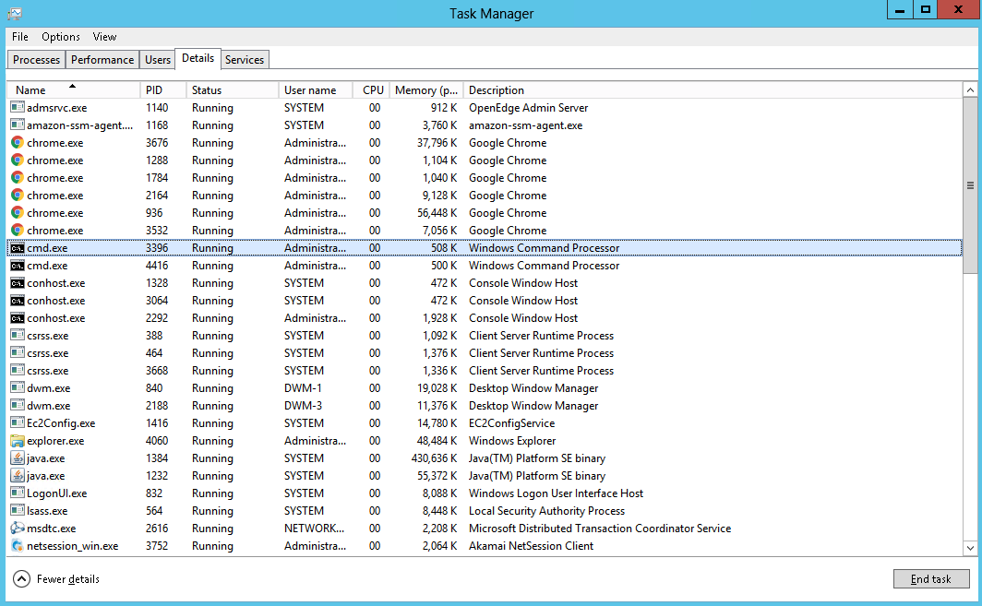
Taskmgr – fairly useless out of the box…
Notes:
But why settle for out of the box?

Slide 14
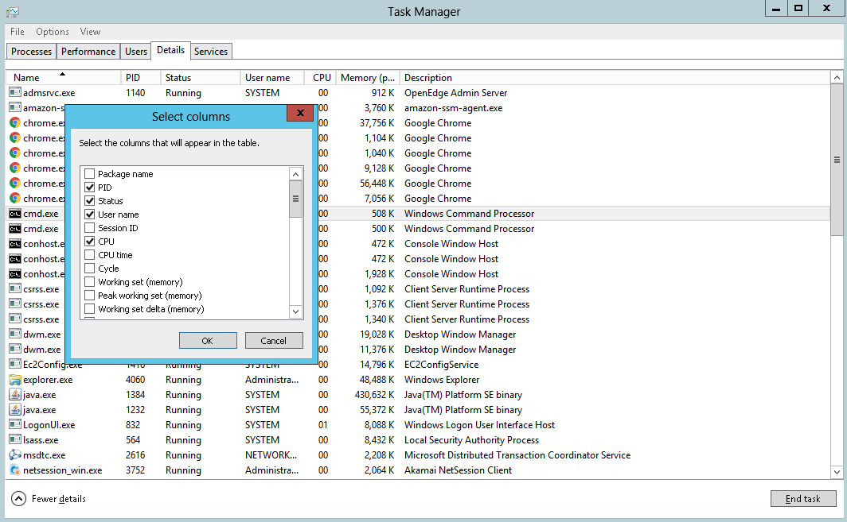
Taskmgr – customize the columns!

Slide 15
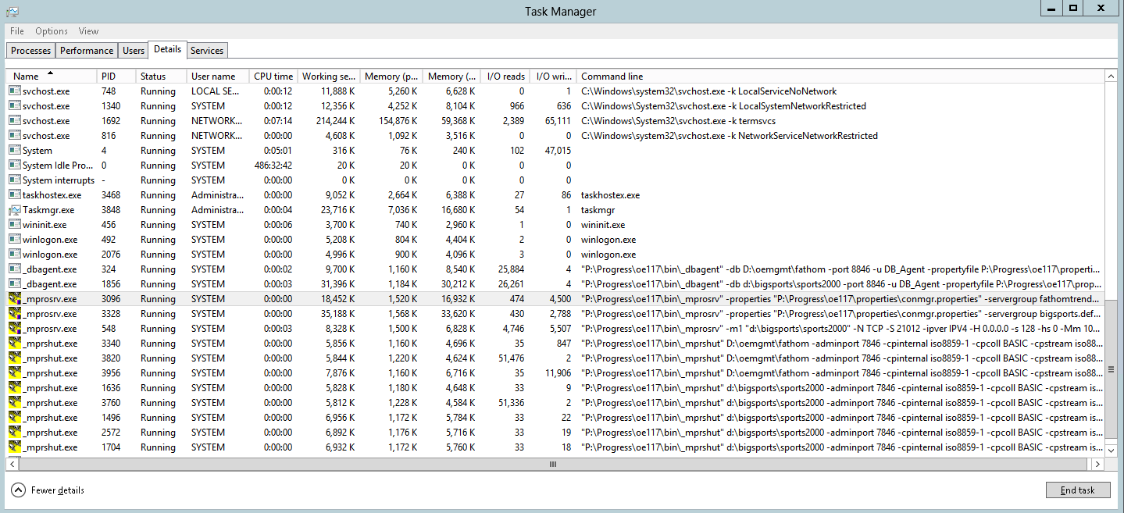
Taskmgr – much more useful!

Slide 16
Mysterious Errors
proenv> dbman –query -all
ERROR: Unable to locate database plugin: ensure AdminServer is running and is properly configured (DBMan023)

Slide 17
AdminServer not alive!
proenv> dbman –query -all
ERROR: Unable to locate database plugin: ensure AdminServer is running and is properly configured (DBMan023)
proenv> proadsv -query
AdminServer not alive. (8543)
proenv> proadsv -start

Slide 18
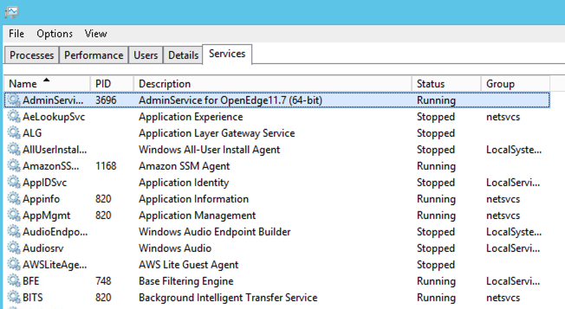
Admin Server
Notes:
The Progress AdminServer is conveniently at the top of the list!

Slide 19
DBMAN
proenv> dbman -query -all
Database Name: BigSports
database path: d:\bigsports\sports2000
database is running: Running Uptime: 1-23:38:12
default configuration: defaultConfiguration
running configuration: defaultConfiguration
valid configurations: defaultConfiguration
Database BigSports agent: Running
Database BigSports auxiliary processes:
AI Writer: Not Running
APW: Running: 3
BI Writer: Running
Watchdog: Running

Slide 20
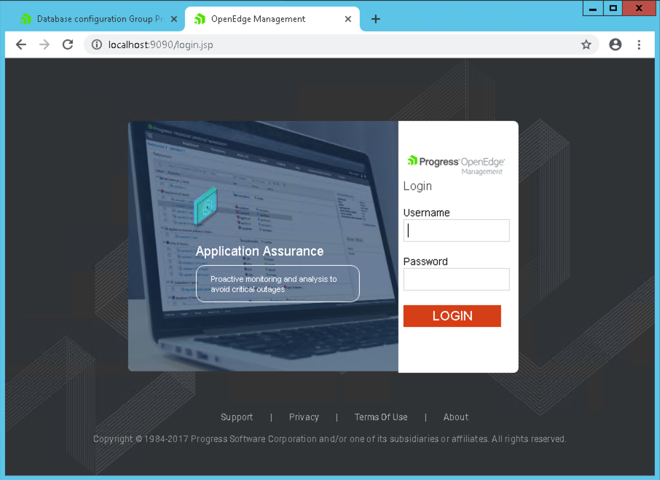
OE Exploder

Slide 21
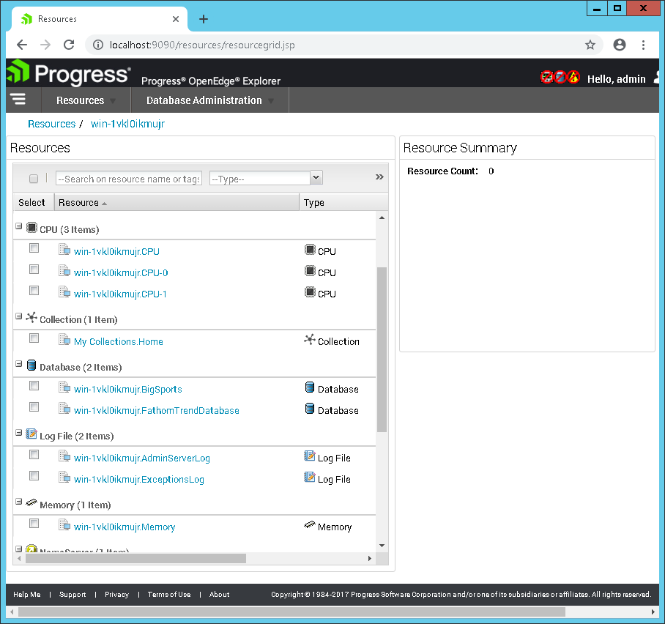
Finding Databases with OE Exploder

Slide 22
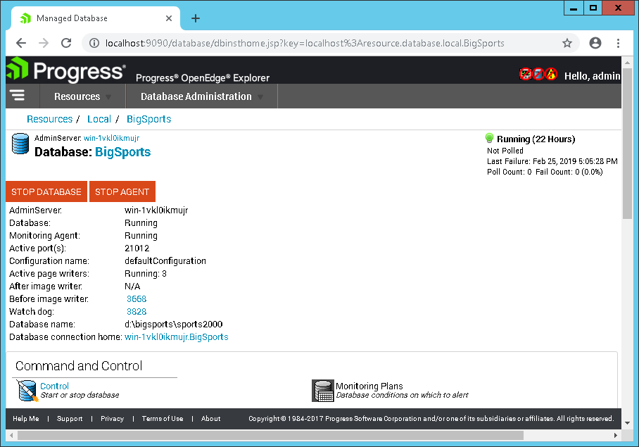
Finding Databases with OE Exploder

Slide 23
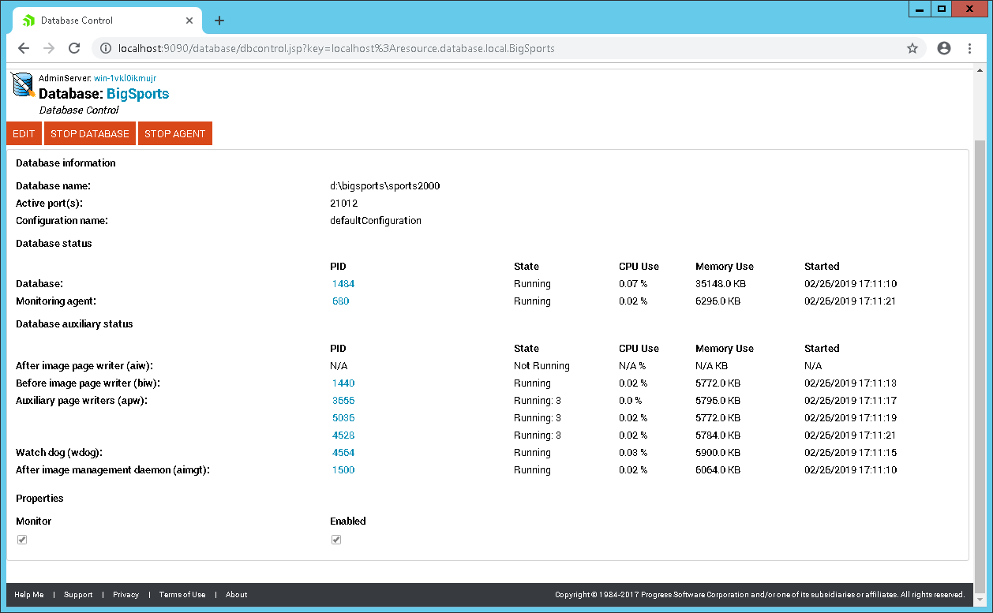
Exploder

Slide 24
Poking around…
proutil describe
prostrct list
dbanalys
conmgr.properties
db.lg (333)

Slide 25
PROUTIL dbName –C describe
proenv> cd /d d:\bigsports
proenv> proutil sports2000 –C describe
Database Name : D:\bigsports\sports2000
Version : 173.0
Block Size : 8192
Largest Cluster : 64
Create Date : Wed Feb 6 15:39:34 2019
Last Open Date : Mon Feb 25 18:46:18 2019
Prior Open Date : Mon Feb 25 18:46:18 2019
Schema Change Date : Wed Feb 20 19:05:57 2019
Before Imaging information
Block Size : 8192
Cluster Size (16K Units) : 32
Last Open Date : Mon Feb 25 18:46:17 2019
. . .
. . .
Backup Information
Last Full Backup Date : Mon Feb 25 19:55:20 2019
Last Incremental Backup : *** Not yet performed ***
Database Features
ID Feature Active Details
---- --------------------------------- ------ -------
5 Large Files Yes
9 64 Bit DBKEYS Yes
10 Large Keys Yes
11 64 Bit Sequences Yes
23 New VST Tables Yes

Slide 26
PROSTRCT list dbName
proenv> cd /d d:\bigsports
proenv> prostrct list sports2000
Warning: another user is using this database in update mode.
Accessing the database with -RO may give unexpected results. (1531)
Area Name: Control Area, Type 6, Block Size 8192, Extents 1, Records/Block 64, Cluster Size 1
Ext # 1, Type VARIABLE, Size 640 KByte, Name: D:\bigsports\sports2000.db
Area Name: Primary Recovery Area, Type 3, Block Size 8192, Extents 1
Ext # 1, Type VARIABLE, Size 2176 KByte, Name: B:\bigsports\sports2000.b1
Area Name: Schema Area, Type 6, Block Size 8192, Extents 1, Records/Block 64, Cluster Size 1
Ext # 1, Type VARIABLE, Size 3200 KByte, Name: D:\bigsports\sports2000.d1
Area Name: Data, Type 6, Block Size 8192, Extents 1, Records/Block 32, Cluster Size 8
Ext # 1, Type VARIABLE, Size 891520 KByte, Name: D:\bigsports\sports2000_7.d1
Area Name: Index, Type 6, Block Size 8192, Extents 1, Records/Block 32, Cluster Size 64
Ext # 1, Type VARIABLE, Size 88576 KByte, Name: D:\bigsports\sports2000_8.d1
Area Name: Lobs, Type 6, Block Size 8192, Extents 1, Records/Block 2, Cluster Size 64
Ext # 1, Type VARIABLE, Size 2560 KByte, Name: D:\bigsports\sports2000_9.d1

Slide 27
PROUTIL dbName –C dbanalys
proenv> cd /d d:\bigsports
proenv> proutil sports2000 –C dbanalys > sports2000.dba
OpenEdge Release 11.7 as of Mon Mar 27 10:21:54 EDT 2017
PROGRESS Database Analysis
Database: d:\bigsports\sports2000
Blocksize: 8192
RecSpaceSearchDepth: 5
Options: chanalys ixanalys tabanalys
Date: Fri Feb 22 20:24:05 2019
[Warning] database in use - reported statistics are approximations. (2486)
. . .
. . .
DATABASE BLOCK ANALYSIS:
-----------------------
1 master block(s) found in the database.
3 area block(s) found in the database.
1 control block(s) found in the database.
2 object block(s) found in the database.
89 cluster list block(s) found in the database.
89 cluster allocation block(s) found in the database.
89 object block(s) found in the database.
3 object list block(s) found in the database.
89 object allocation block(s) found in the database.
3472 free block(s) found in the database.
1 sequence block(s) found in the database.
127 empty block(s) found in the database.
123307 total blocks found in the database.
[Warning] database in use - reported statistics are approximations. (2486)
Database analysis complete Fri Feb 22 20:24:07 2019

Slide 28
%DLC%\properties\conmgr.properties
proenv> cd /d %DLC%\properties
proenv> copy conmgr.properties conmgr.properties.save
proenv> write conmgr.properties
. . .

Slide 29
conmgr.properties
#
# Connection Manager Properties File
#
%% Juniper Properties File
%% version 1.1
%% Feb 26, 2019 5:20:04 PM
[configuration.bigsports.defaultconfiguration]
afterimageprocess=false
alternatebufferpool=10000
archivaldir=a:\bigsports
asynchronouspagewriters=3
beforeimageprocess=true
blocksindatabasebuffers=10000
database=bigsports
displayname=defaultConfiguration
monitored=true
otherargs=-pf D:\bigsports\bigsports.pf
servergroups=bigsports.defaultconfiguration.defaultservergroup
watchdogprocess=true
. . .

Slide 30
Parameter File
# bigsports.pf
#
-B 100000
-spin 10000
-lruskips 50
-basetable -361
-tablerangesize 436
-baseindex -1610
-indexrangesize 2753

Slide 31
Editing %DLC%\properties\conmgr.properties
proenv> cd /d %DLC%\properties
proenv> copy conmgr.properties conmgr.properties.save
proenv> write conmgr.properties
. . .
proenv> dbconfig
OpenEdge Release 11.7 as of Mon Mar 27 10:21:54 EDT 2017
Validating property file P:\Progress\oe117\properties\conmgr.properties (CMNMsg017)
Validation successful (CMNMsg019)

Slide 32
Startup Parameters and Configuration
Tue Feb 26 17:05:42 2019
[2019/02/26@17:05:42.723+0000] P-5100 T-2320 I BROKER 0: (333) Multi-user session begin.
[2019/02/26@17:05:42.727+0000] P-5100 T-2320 I BROKER 0: (5326) Begin Physical Redo Phase at 0 .
[2019/02/26@17:05:42.739+0000] P-5100 T-2320 I BROKER 0: (7161) Physical Redo Phase Completed at blk 8 off 2909 upd 303.
[2019/02/26@17:05:42.740+0000] P-5100 T-2320 I BROKER 0: (13547) At end of Physical redo, transaction table size is 128.
[2019/02/26@17:05:42.757+0000] P-5100 T-2320 I BROKER 0: (452) Login by SYSTEM on batch.
. . .
[2019/02/26@17:05:42.779+0000] P-5100 T-2320 I BROKER 0: (4250) Before-Image Cluster Size: 524288.
[2019/02/26@17:05:42.780+0000] P-5100 T-2320 I BROKER 0: (4251) Before-Image Block Size: 8192.
[2019/02/26@17:05:42.782+0000] P-5100 T-2320 I BROKER 0: (17555) Starting index number for statistics range (-baseindex): 1
[2019/02/26@17:05:42.782+0000] P-5100 T-2320 I BROKER 0: (17554) Starting table number for statistics range (-basetable): 1
[2019/02/26@17:05:42.783+0000] P-5100 T-2320 I BROKER 0: (4252) Number of Before-Image Buffers (-bibufs): 20
[2019/02/26@17:05:42.783+0000] P-5100 T-2320 I BROKER 0: (6552) BI File Threshold Stall (-bistall): Disabled.
[2019/02/26@17:05:42.784+0000] P-5100 T-2320 I BROKER 0: (9238) BI File Threshold size (-bithold): 0.0 Bytes
[2019/02/26@17:05:42.784+0000] P-5100 T-2320 I BROKER 0: (6573) Database Blocksize (-blocksize): 8192
[2019/02/26@17:05:42.784+0000] P-5100 T-2320 I BROKER 0: (12812) BIW writer delay (-bwdelay): 0
[2019/02/26@17:05:42.784+0000] P-5100 T-2320 I BROKER 0: (12813) Allowed index cursors (-c): 84
[2019/02/26@17:05:42.785+0000] P-5100 T-2320 I BROKER 0: (4264) Character Set (-cpinternal): ISO8859-1
[2019/02/26@17:05:42.785+0000] P-5100 T-2320 I BROKER 0: (4235) Physical Database Name (-db): d:\bigsports\sports2000
[2019/02/26@17:05:42.791+0000] P-5100 T-2320 I BROKER 0: (4238) Direct I/O (-directio): Not Enabled
[2019/02/26@17:05:42.793+0000] P-5100 T-2320 I BROKER 0: (4244) Crash Recovery (-i): Enabled
[2019/02/26@17:05:42.797+0000] P-5100 T-2320 I BROKER 0: (17560) Number of LRU force skips (-lruskips): 0
. . .

Slide 33
Lab: Starting and Stopping a DB
exploder
dbman
proserve/proshut

Slide 34
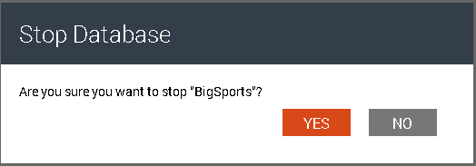
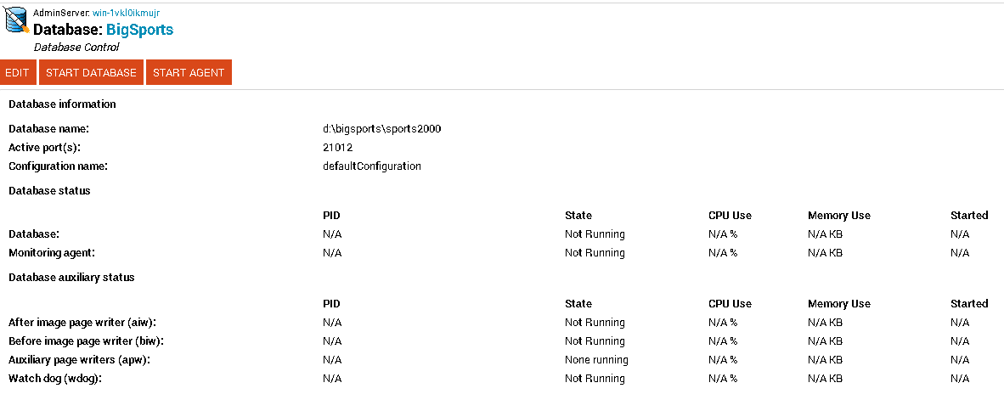
Exploder – Stopping method 1

Slide 35
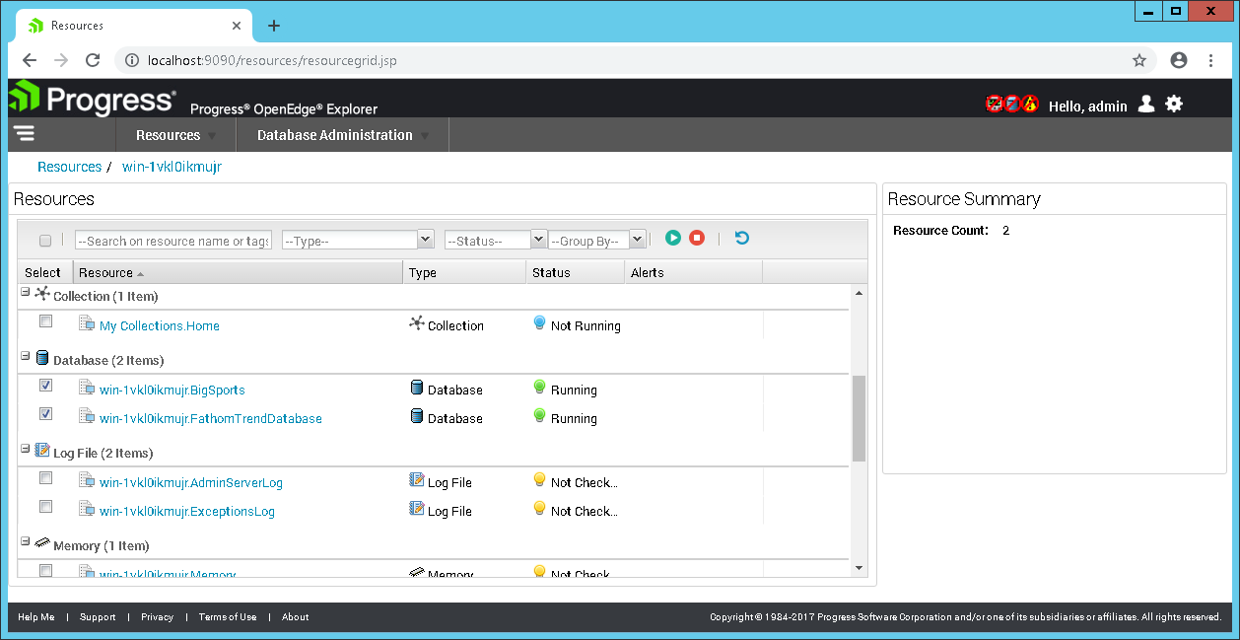
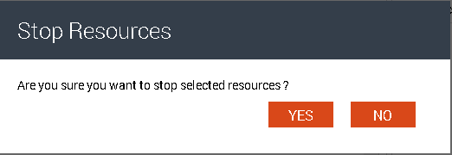
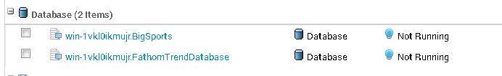
Exploder – Stopping method 2

Slide 36
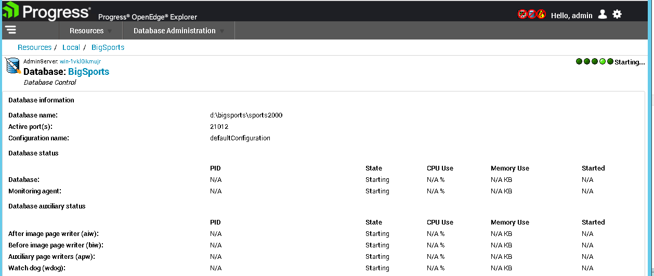
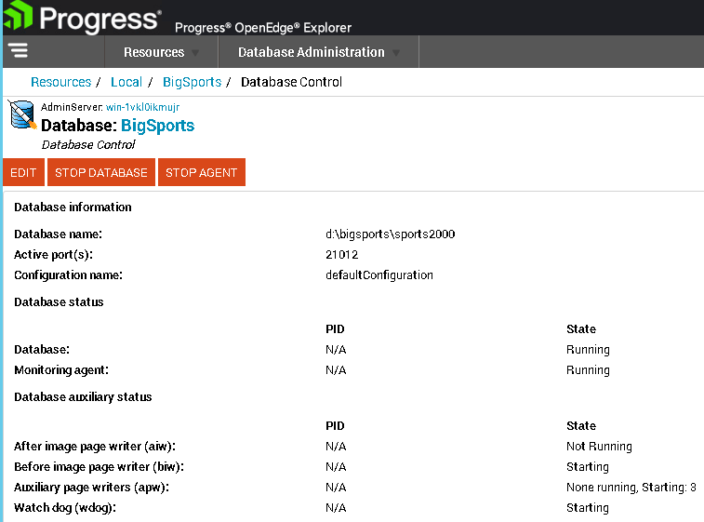
Exploder – Starting method 1

Slide 37
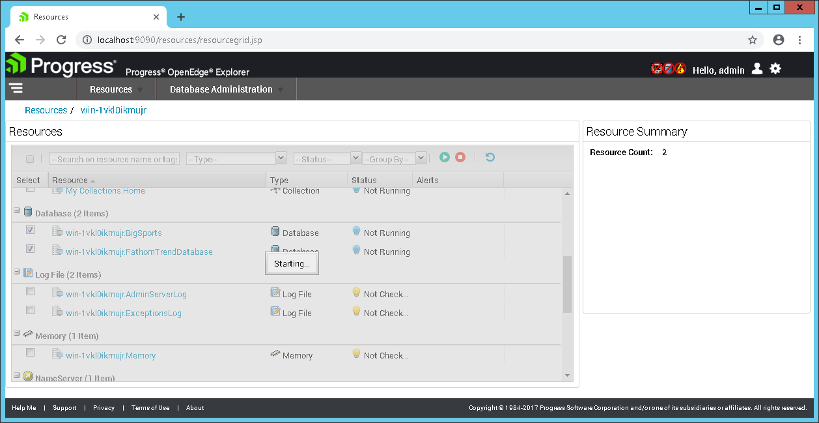
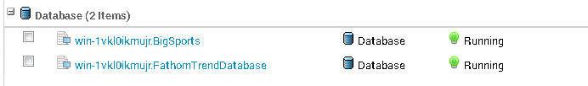
Exploder – Starting method 2

Slide 38
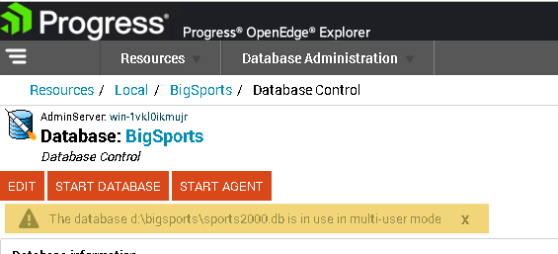
Exploder – Starting too soon after stop

Slide 39
DBMAN -query -db
proenv> dbman -query –db sports2000

Slide 40
DBMAN -query -db
proenv> dbman -query –db sports2000
ERROR: Unable to locate database sports2000 (DBMan005)

Slide 41
DBMAN -query -all
proenv> dbman -query -all
Database Name: BigSports
database path: d:\bigsports\sports2000
database is running: Running Uptime: 1-23:38:12
default configuration: defaultConfiguration
running configuration: defaultConfiguration
valid configurations: defaultConfiguration
Database BigSports agent: Running
Database BigSports auxiliary processes:
AI Writer: Not Running
APW: Running: 3
BI Writer: Running
Watchdog: Running

Slide 42
DBMAN -query -db
proenv> dbman -query -db bigsports
Database Name: BigSports
database path: d:\bigsports\sports2000
database is running: Running Uptime: 4-21:24:54
default configuration: defaultConfiguration
running configuration: defaultConfiguration
valid configurations: defaultConfiguration
Database BigSports agent: Running
Database BigSports auxiliary processes:
AI Writer: Not Running
APW: Running: 3
BI Writer: Running
Watchdog: Running

Slide 43
DBMAN -stop
proenv> dbman -stop -db bigsports
Database BigSports, configuration defaultConfiguration stopping... (18058)
Database BigSports, configuration defaultConfiguration stopped (DBMan021)
Database BigSports agent: Not Running
Database BigSports auxiliary processes:
AI Writer: Not Running
APW: None running
BI Writer: Not Running
Watchdog: Not Running

Slide 44
DBMAN -start
proenv> dbman -start -db bigsports
Database BigSports, configuration defaultConfiguration starting... (18054)
Database BigSports, configuration defaultConfiguration started (DBMan028)
Database BigSports agent: Running
Database BigSports auxiliary processes:
AI Writer: Not Running
APW: Running: 3
BI Writer: Running
Watchdog: Running

Slide 45
PROSHUT
proenv> cd /d d:\bigsports
proenv> proshut -by sports2000
Shutdown is executing. (1613)
Shutdown complete. (1614)

Slide 46
PROSERVE
proenv> proserve sports2000
16:31:01 BROKER This broker will terminate when session ends. (5405)
16:31:01 BROKER The startup of this database requires 29Mb of shared memory. Maximum segment size is 1024Mb.
16:31:01 BROKER 0: Multi-user session begin. (333)
16:31:01 BROKER 0: Before Image Log Initialization at block 7 offset 3810. (15321)
16:31:01 BROKER 0: Login by Administrator on CON:. (452)

Slide 47
PROSERVE & DBMAN
proenv> dbman -query -db bigsports
Database Name: BigSports
database path: d:\bigsports\sports2000
database is running: Not Running
default configuration: defaultConfiguration
running configuration: defaultConfiguration
valid configurations: defaultConfiguration
Database BigSports agent: Not Running
Database BigSports auxiliary processes:
AI Writer: Not Running
APW: None running
BI Writer: Not Running
Watchdog: Not Running

Slide 48
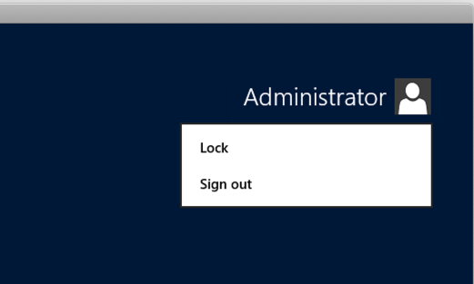
PROSERVE is NOT a “Service”!

Slide 49
PROSERVE & logging out…
proenv> cd /d d:\bigsports
proenv> mpro sports2000
┌────────────────────── Error ───────────────────────┐
│ There is no server for database sports2000. (1423) │
│ │
│ ────────────────────────────────────────────────── │
│ <OK> │
└────────────────────────────────────────────────────┘

Slide 50
Windows Console Logouts
[2019/02/25@17:04:21.595+0000] P-3280 T-592 I ABL 11: (452) Login by Administrator on CON:.
[2019/02/25@17:04:21.602+0000] P-3280 T-592 I ABL 11: (7129) Usr 11 set name to .
[2019/02/25@17:05:05.962+0000] P-3260 T-4080 I ABL 12: (452) Login by Administrator on CON:.
[2019/02/25@17:05:05.969+0000] P-3260 T-4080 I ABL 12: (7129) Usr 12 set name to .
[2019/02/25@17:05:27.501+0000] P-4496 T-1980 I WDOG 6: (2523) User 11 died with 1 buffers locked.
[2019/02/25@17:05:27.501+0000] P-4496 T-1980 I WDOG 6: (2527) Disconnecting dead user 11.
[2019/02/25@17:05:27.520+0000] P-3968 T-1328 I BIW 5: (2520) Stopped.
[2019/02/25@17:05:27.520+0000] P-3968 T-1328 I : (453) Logout by SYSTEM on batch.
[2019/02/25@17:05:27.564+0000] P-4940 T-2572 I APW 8: (453) Logout by SYSTEM on batch.
[2019/02/25@17:05:28.502+0000] P-4496 T-1980 I WDOG 6: (2527) Disconnecting dead user 12.
[2019/02/25@17:05:28.503+0000] P-2300 T-4612 I BROKER 0: (15192) The database will complete shutdown…
[2019/02/25@17:05:28.504+0000] P-2300 T-4612 I BROKER 0: (2249) Begin ABNORMAL shutdown code 2
[2019/02/25@17:05:29.503+0000] P-4496 T-1980 I WDOG 6: (2520) Stopped.
[2019/02/25@17:05:29.503+0000] P-4496 T-1980 I : (453) Logout by SYSTEM on batch.
[2019/02/25@17:05:29.506+0000] P-2300 T-4612 I BROKER 0: (453) Logout by SYSTEM on batch.
[2019/02/25@17:05:30.511+0000] P-2300 T-4612 I BROKER : (16869) Removed shared memory with segment_id: …
[2019/02/25@17:05:30.512+0000] P-2300 T-4612 I BROKER : (334) Multi-user session end.

Slide 51
Lab: Backup and Restore
probkup (online), prorest
BAD IDEAS: backup strategies that will get you fired!
Safely automating backups

Slide 52
PROBKUP
proenv> probkup online sports2000 e:\pbkup\sports2000.pbk -com -Bp 10
123175 active blocks out of 123228 blocks in sports2000 will be dumped. (6686)
256 BI blocks will be dumped. (6688)
Backup requires an estimated 965.3 MBytes of media. (9285)
Restore would require an estimated 123558 db blocks using 964.3 MBytes of media. (9286)
Backed up 123431 db blocks in 00:00:03
Wrote a total of 1010 backup blocks using 268.3 MBytes of media. (13625)
Backup complete. (3740)
proenv> dir e:\pbkup\sports2000.pbk
Volume in drive E is Backup
Volume Serial Number is F48F-F64E
Directory of d:\bigsports
02/25/2019 06:47 PM 281,320,448 sports2000.pbk
1 File(s) 281,320,448 bytes
0 Dir(s) 18,475,999,232 bytes free

Slide 53
PROREST
proenv> prorest s2k e:\pbkup\sports2000.pbk
This is a full backup of D:\bigsports\sports2000.db. (6759)
This backup was taken Mon Feb 25 18:47:12 2019. (6760)
The blocksize is 8192. (6994)
Start of extending target DB to needed size... (9432)
It will require a minimum of 123452 blocks to restore. (6763)
Start of restoring the target DB... (9433)
Read 123431 db blocks in 00:00:03
Notes:
Notes:
- the restore db name is not the same as the original db name
- there is an s2k.st already in the directory that has two fixed extents defined

Slide 54
PROREST - Notes
Restored db does not need to have the same name as the source
If there is an existing db it will be over written!
If there is a structure file (dbName.st) it will be used
  The structure must have the same logical storage areas
  The physical extents can be differently sized and on different paths
  This can be helpful when you want to change the physical structure
Notes:
Notes:
- the restore db name is not the same as the original db name
- there is an s2k.st already in the directory that has two fixed extents defined

Slide 55
”Backups” That Will Get You Fired
Virtual Machine Snapshots
SAN Snapshots
3rd Party Backup Tools
OS Level Copy Commands
Untested Scripts
Deleting old backups before you have a new backup

Slide 56
Copying Files
┌──────────────────────────────────── Error ────────────────────────────────────┐
│ T:\tmp\sports2000.db is a copy of D:\bigsports\sports2000.db. Database cannot │
│ be opened. (598) │
│ │
│ ───────────────────────────────────────────────────────────────────────────── │
│ <OK> │
└───────────────────────────────────────────────────────────────────────────────┘
┌─────────────────────────────── Error ───────────────────────────────┐
│ ** Cannot find or open file t:\tmp\sports2000_8.d1, errno = 2. (43) │
│ │
│ ─────────────────────────────────────────────────────────────────── │
│ <OK> │
└─────────────────────────────────────────────────────────────────────┘

Slide 57
Copying Files
┌───────────────────────────────── Error ──────────────────────────────────┐
│ Last open date mismatch. (9215) │
│ Extent t:\tmp\sports2000.b1 has a different last opened date Mon Feb 25 │
│ 18:46:17 2019, (9213) │
│ Control Area has a last open date of Mon Feb 25 18:58:08 2019. (9217) │
│ Probable backup/restore error. (605) │
│ Database is damaged, see documentation. (1486) │
│ │
│ ──────────────────────────────────────────────────────────────────────── │
│ <OK> │
└──────────────────────────────────────────────────────────────────────────┘

Slide 58
Safely Automating Backups
If you are on Windows and using Task Scheduler:
  Do NOT use a real user (or Administrator)
  Use a userid that NEVER LOGS IN
  Use a userid that does not have an expiring password
Windows does not like to overwrite old backups ☹
3rd Party tools need to:
  First use probkup to disk
  Or shutdown db
  Or properly script a quiet point
    MUST wait for confirmation in the .lg file, return of proquiet is NOT sufficient
  MUST backup ALL files (it is easy to miss some, especially if they are added later)

Slide 59
What is After-Imaging?
The Key to a robust recovery strategy.
Similar to other database’s “REDO LOG”.
ROLL FORWARD RECOVERY:
  Restore a backup – even a very old backup.
  Roll forward archived after-image logs.
  Until you have recovered to a point in time or a specific transaction.
Protects your database from:
  Hardware errors
  Human errors (much more common)
  Malfeasance of all sorts

Slide 60
Lab: After-Imaging
add extents (online)
probkup online … enable after-imaging
process some transactions…
restore and roll-forward, check the results

Slide 61
Add After-Image Extents
proenv> dbman –start –db bigsports
proenv> type ai.st
a a:\bigsports\
a a:\bigsports\
a a:\bigsports\
a a:\bigsports\
proenv> prostrct addonline sports2000 ai.st -validate
The structure file format is valid. (12619)
Device: a:, KBytes needed: 512, KBytes available: 20378253 (12616)
There is sufficient free space to initialize the defined extents. (12618)
proenv> prostrct addonline sports2000 ai.st
Formatting extents:
size area name path name
16 After Image Area 1 a:\bigsports\sports2000.a1 00:00:00
. . .

Slide 62
Enable After-Imagining with PROBKUP
proenv> probkup online sports2000 e:\pbkup\s2k_aiinit.pbk enableai enableaiarchiver
-aiarcdir e:\ailogs -aiarcinterval 120 –com –Bp 10
123175 active blocks out of 123228 blocks in sports2000 will be dumped. (6686)
256 BI blocks will be dumped. (6688)
Backup requires an estimated 965.3 MBytes of media. (9285)
Restore would require an estimated 123558 db blocks using 964.3 MBytes of media. (9286)
After-image block size set to 8 kb (8192 bytes). (644)
After-image has been enabled online successfully. (13781)
The After-image Archiver has been enabled. (13918)
The After-image Management Daemon will begin in a few moments. (13920)
Backed up 123431 db blocks in 00:00:09
Wrote a total of 3534 backup blocks using 938.7 MBytes of media. (13625)
Backup complete. (3740)
proenv> rfutil sports2000 –C aimage list
Extent: 1
Status: Busy
Type: Variable Length
Path: a:\bigsports\sports2000.a1
. . .
Notes:
Size: 120
Used: 1
Start: Mon Feb 25 19:55:20 2019
LastOp: N/A
Seqno: 1
Extent: 2
Status: Empty
Type: Variable Length
Path: a:\bigsports\sports2000.a2
Size: 120
Used: 0
Start: N/A
LastOp: N/A
Seqno: 0
Extent: 3
Status: Empty
Type: Variable Length
Path: a:\bigsports\sports2000.a3
Size: 120
Used: 0
Start: N/A
LastOp: N/A
Seqno: 0
Extent: 4
Status: Empty
Type: Variable Length
Path: a:\bigsports\sports2000.a4
Size: 120
Used: 0
Start: N/A
LastOp: N/A
Seqno: 0

Slide 63
Update Some Data
proenv> mpro sports2000 –p putfirstcust.p –param “New Name”

Slide 64
Restore and Safely Check Data Values
proenv> cd /d t:\tmp
proenv> prorest sports2000 e:\pbkup\s2k_aiinit.pbk
This is a full backup of D:\bigsports\sports2000.db. (6759)
This backup was taken Mon Feb 25 19:55:20 2019. (6760)
The blocksize is 8192. (6994)
Start of extending target DB to needed size... (9432)
It will require a minimum of 123452 blocks to restore. (6763)
Start of restoring the target DB... (9433)
Read 123431 db blocks in 00:00:05
After-image Extent Management has been disabled for the database. (13292)
proenv> pro sports2000 -RO -p getfirstcust.p
┌────────────────────────────────── Error ───────────────────────────────────┐
│ WARNING: Before-image file of database sports2000 is not truncated. (1552) │
│ │
│ ────────────────────────────────────────────────────────────────────────── │
│ <OK> │
└────────────────────────────────────────────────────────────────────────────┘
┌───────────────────────────────────────┐
│Cust Num Name │
│──────── ──────────────────────────────│
│ 1 Lift Tours │
└───────────────────────────────────────┘

Slide 65
Roll Forward
proenv> dir e:\ailogs
Directory of e:\ailogs
02/25/2019 08:15 PM <DIR> .
02/25/2019 08:15 PM <DIR> ..
02/25/2019 08:15 PM 131,072 d!~bigsports~sports2000.20190225.195520.00000001.sports2000.a1
1 File(s) 131,072 bytes
2 Dir(s) 20,867,198,976 bytes free
proenv> rfutil sports2000 -C roll forward -a e:\ailogs\d!~bigsports~sports2000.20190225.195520.00000001.sports2000.a1
After-image dates for this after-image file: (1633)
Last AIMAGE BEGIN Mon Feb 25 19:55:20 2019 (1640)
This is aimage file number 1 since the last AIMAGE BEGIN. (1642)
This file was last opened for output on Mon Feb 25 19:55:20 2019. (1643)
20:38:25: 10% of aimage file processed (1 notes processed)... (17060)
1 notes were processed. (1634)
0 in-flight transactions. (3785)
0 transactions were started. (1635)
0 transactions were completed. (11138)
At the end of the .ai file, 0 transactions were still active. (1636)

Slide 66
Roll Forward
proenv> rfutil sports2000 -C roll forward -a e:\ailogs\d!~bigsports~sports2000.20190225.195520.00000001.sports2000.a1
OpenEdge Release 11.7 as of Mon Mar 27 10:21:54 EDT 2017
Expected ai file number 3 but file specified is 1 in sequence. (8019)
** The database was last changed Mon Feb 25 20:27:28 2019. (831)
** The after-image file expected Mon Feb 25 19:32:57 2019. (832)
** Those dates don't match, so you have the wrong copy of one of them. (833)
roll forward open e:\ailogs\d!~bigsports~sports2000.20190225.195520.00000001.sports2000.a1 error: -1. (11014)

Slide 67
Safely Check Data Values
proenv> pro sports2000 -RO -p getfirstcust.p
┌────────────────────────────────── Error ───────────────────────────────────┐
│ WARNING: Before-image file of database sports2000 is not truncated. (1552) │
│ │
│ ────────────────────────────────────────────────────────────────────────── │
│ <OK> │
└────────────────────────────────────────────────────────────────────────────┘
┌───────────────────────────────────────┐
│Cust Num Name │
│──────── ──────────────────────────────│
│ 1 New Name │
└───────────────────────────────────────┘

Slide 68
Wrap-Up Comments About After-Imaging
The DBA’s Best Friend.
Easy to implement, easy to manage.
Running a database without after-imaging is grossly irresponsible.
Without after-imaging your data, and the business that depends on that data, is at risk!
After-imaging prevents DBA self-unemployment!

Slide 69

Lab: Tweaking Settings & Parameters
bi cluster size, bi & ai blocksizes, large files, etc.
-*rangesize, -omsize, -B, -L, -spin
proutil increaseto (online changes)
Notes:
point out that online changes are not persistent

Slide 70
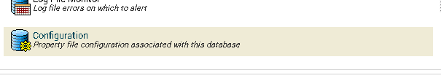
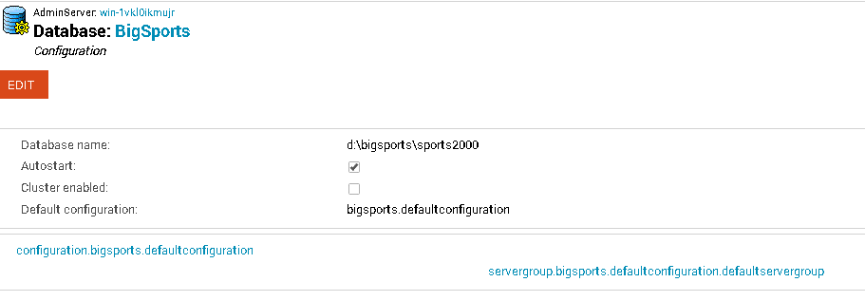
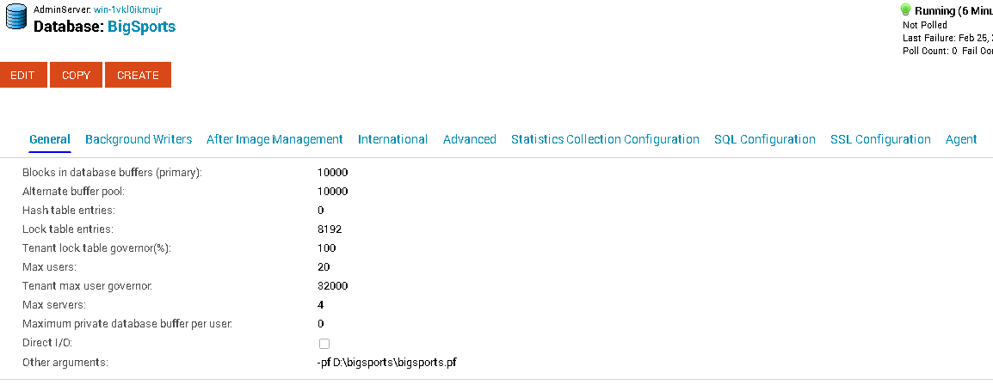
Tweaking Settings & Parameters
Broker
Database

Slide 71
Change -B with a PF file
proenv> type bigsports.pf
# bigsports.pf
#
-B 100000
-spin 10000
-lruskips 50
-basetable -361
-tablerangesize 436
-baseindex -1610
-indexrangesize 2753
proenv> write bigsports.pf
. . .

Slide 72
Change the BI Cluster Size
proenv> proutil sports2000 -C truncate bi -bi 16384
Before-image cluster size set to 16384 kb. (1620)
proenv> proutil sports2000 -C describe
Database Name : D:\bigsports\sports2000
Version : 173.0
Block Size : 8192
Largest Cluster : 64
Create Date : Wed Feb 6 15:39:34 2019
Last Open Date : Wed Feb 27 18:03:03 2019
Prior Open Date : Wed Feb 27 18:03:03 2019
Schema Change Date : Wed Feb 20 19:05:57 2019
Before Imaging information
Block Size : 8192
Cluster Size (16K Units) : 1024
Last Open Date : Wed Feb 27 18:02:52 2019
. . .

Slide 73
Lab: The Care and Feeding of SQL
Many 3rd party tools require SQL
SQL is very different from OpenEdge
SQL is often not configured or is poorly configured
The default SQL DBA user is “sysprogress”
Notes:
By default you probably need to add the “sysprogress” user and password to _user

Slide 74
SQLEXP – It Is Always Available
proenv> sqlexp -user sysprogress -password sysprogress -db sports2000 -H localhost -S 21012
OpenEdge Release 11.7 as of Mon Mar 27 10:21:54 EDT 2017
Connecting user "sysprogress" to URL "jdbc:datadirect:openedge://localhost:21012;databaseName=sports2000"... (8920)
SQLExplorer> select count(*) from customer;
=== SQL Exception 1 ===
SQLState=42S02
ErrorCode=-210083
[DataDirect][OpenEdge JDBC Driver][OpenEdge] Table/view/synonynm "SYSPROGRESS.CUSTOMER" cannot be found. (15814)

Slide 75
SQLEXP
proenv> sqlexp -user sysprogress -password sysprogress -db sports2000 -H localhost -S 21012
OpenEdge Release 11.7 as of Mon Mar 27 10:21:54 EDT 2017
Connecting user "sysprogress" to URL "jdbc:datadirect:openedge://localhost:21012;databaseName=sports2000"... (8920)
SQLExplorer> select count(*) from customer;
=== SQL Exception 1 ===
SQLState=42S02
ErrorCode=-210083
[DataDirect][OpenEdge JDBC Driver][OpenEdge] Table/view/synonynm "SYSPROGRESS.CUSTOMER" cannot be found. (15814)
SQLExplorer> select count(*) from pub.customer;
count(*)
--------------------
201120
SQLExplorer> quit
proenv>
. . .

Slide 76
DBTOOL and SQL Width
proenv> dbtool sports2000
DATABASE TOOLS MENU - 11.7
---------------------------
1. SQL Width & Date Scan w/Report Option
2. SQL Width Scan w/Fix Option
. . .
Q. Quit
Choice: 2
The option will process all records including template records in the specified range.
<connect>: (0=single-user 1=self-service >1=#threads)? 1
Padding % above current max: 25
<table>: (Table number or all)? all
<area>: (Area number or all)? all
<display>: (verbose level 0-4)?
Total records read: 3561171
SQLWidth errors found: 7, Date errors found: 0
SQLWidth errors fixed: 7
proenv>

Slide 77
Update SQL Statistics
proenv> mbpro sports2000 -p d:\protop\util\genUpdateSQL.p
proenv> more updSQLStats.sql
UPDATE TABLE STATISTICS AND INDEX STATISTICS AND ALL COLUMN STATISTICS FOR PUB."Benefits";
commit work;
UPDATE TABLE STATISTICS AND INDEX STATISTICS AND ALL COLUMN STATISTICS FOR PUB."BillTo";
commit work;
UPDATE TABLE STATISTICS AND INDEX STATISTICS AND ALL COLUMN STATISTICS FOR PUB."Bin";
commit work;
UPDATE TABLE STATISTICS AND INDEX STATISTICS AND ALL COLUMN STATISTICS FOR PUB."Country";
commit work;
UPDATE TABLE STATISTICS AND INDEX STATISTICS AND ALL COLUMN STATISTICS FOR PUB."Customer";
commit work;
UPDATE TABLE STATISTICS AND INDEX STATISTICS AND ALL COLUMN STATISTICS FOR PUB."Department";
commit work;
UPDATE TABLE STATISTICS AND INDEX STATISTICS AND ALL COLUMN STATISTICS FOR PUB."Employee";
commit work;
UPDATE TABLE STATISTICS AND INDEX STATISTICS AND ALL COLUMN STATISTICS FOR PUB."Family";
commit work;
. . .
proenv> sqlexp -db sports2000 -S 21012 -user sysprogress -password sysprogress -infile updSQLStats.sql -outfile updSQLStats.log

Slide 78
Applying Service Packs
Download SP from progress.com and unzip
Shutdown
Truncate BI
Install service pack
updatevst, updateschema
Take advantage of the downtime to adjust startup parameters
Restart

Slide 79


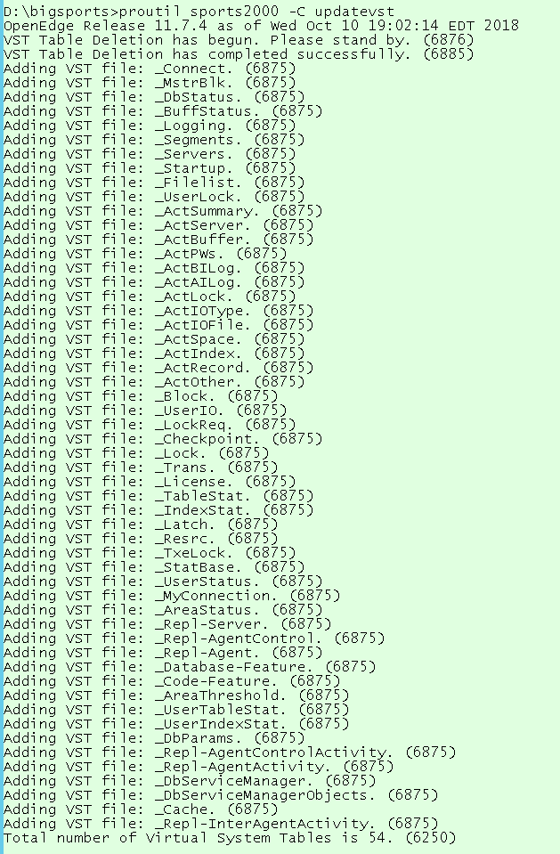
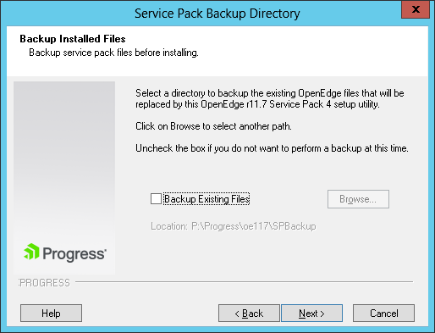
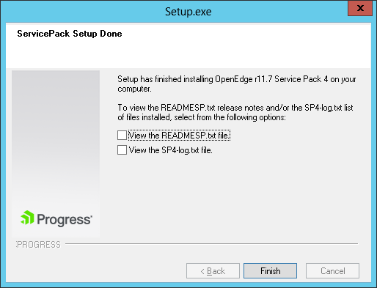
Lab: Installing a Service Pack
"P:\Download\Service Pack\PROGRESS_OE_11.7.4_WIN_64\setup.exe"

Slide 80
Production Support

Slide 81
Lab: Solving Problems with ProTop
Blocked user
Rapid reader
Long transaction
Lots of Locks in use
proGetStack
Disconnecting a user

Slide 82
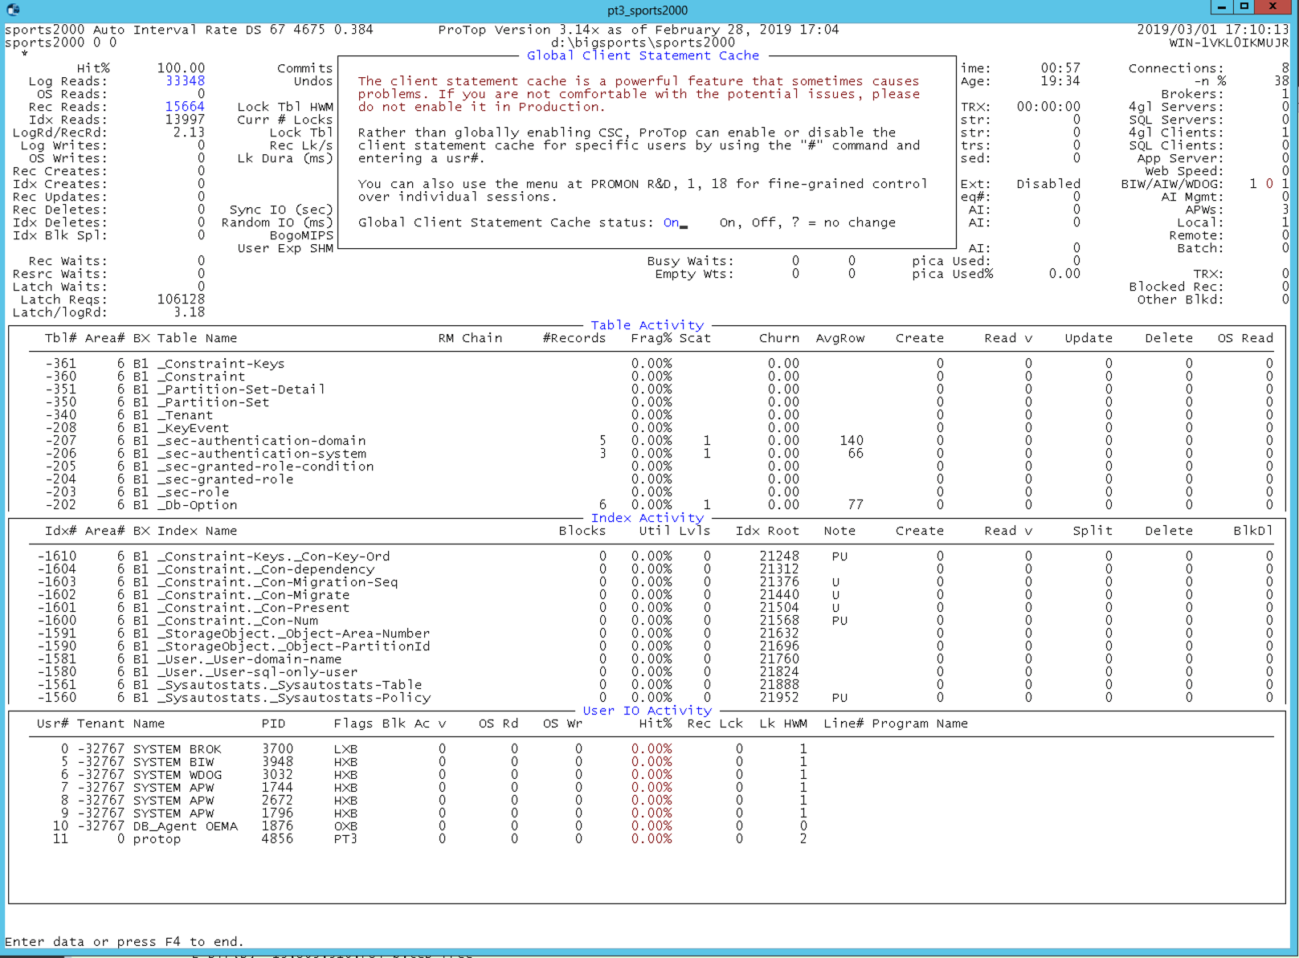
ProTop – Enable Client Statement Cache
“*” to bring up the dialog, “on” to enable

Slide 83
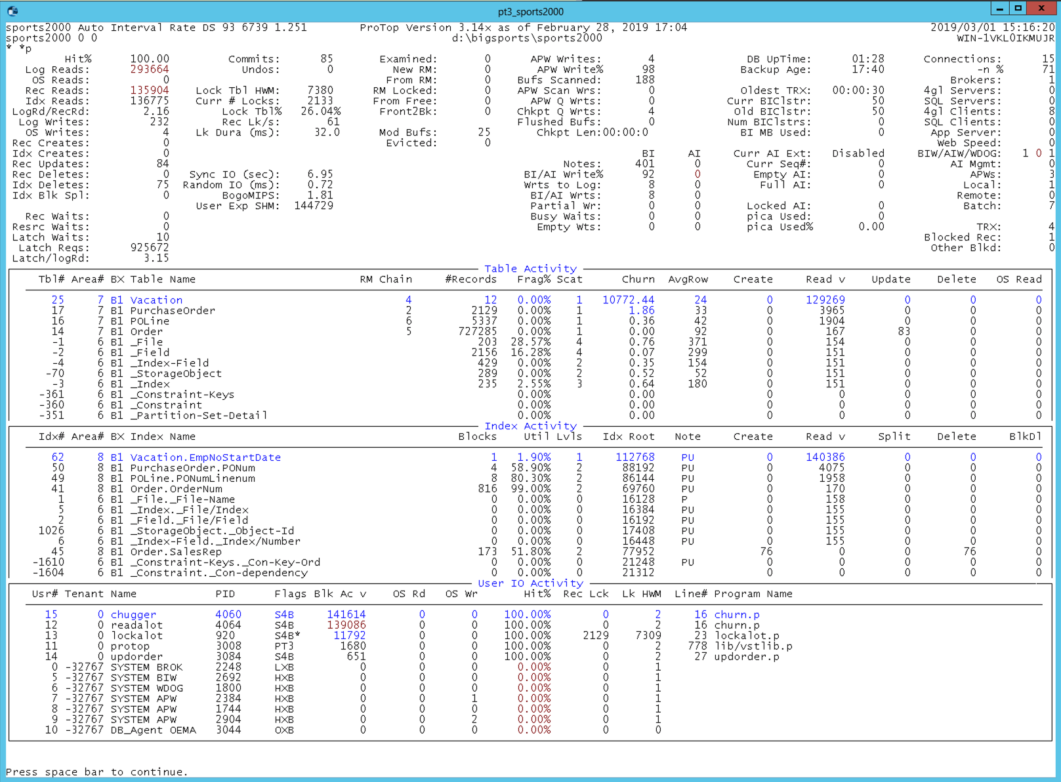
ProTop – Find Problems
Notice:
Roughly 130k record reads per second.
1 user blocked on a record lock.
Enormous “churn” on vacation (12 records).
A session with quite a few record locks.

Slide 84
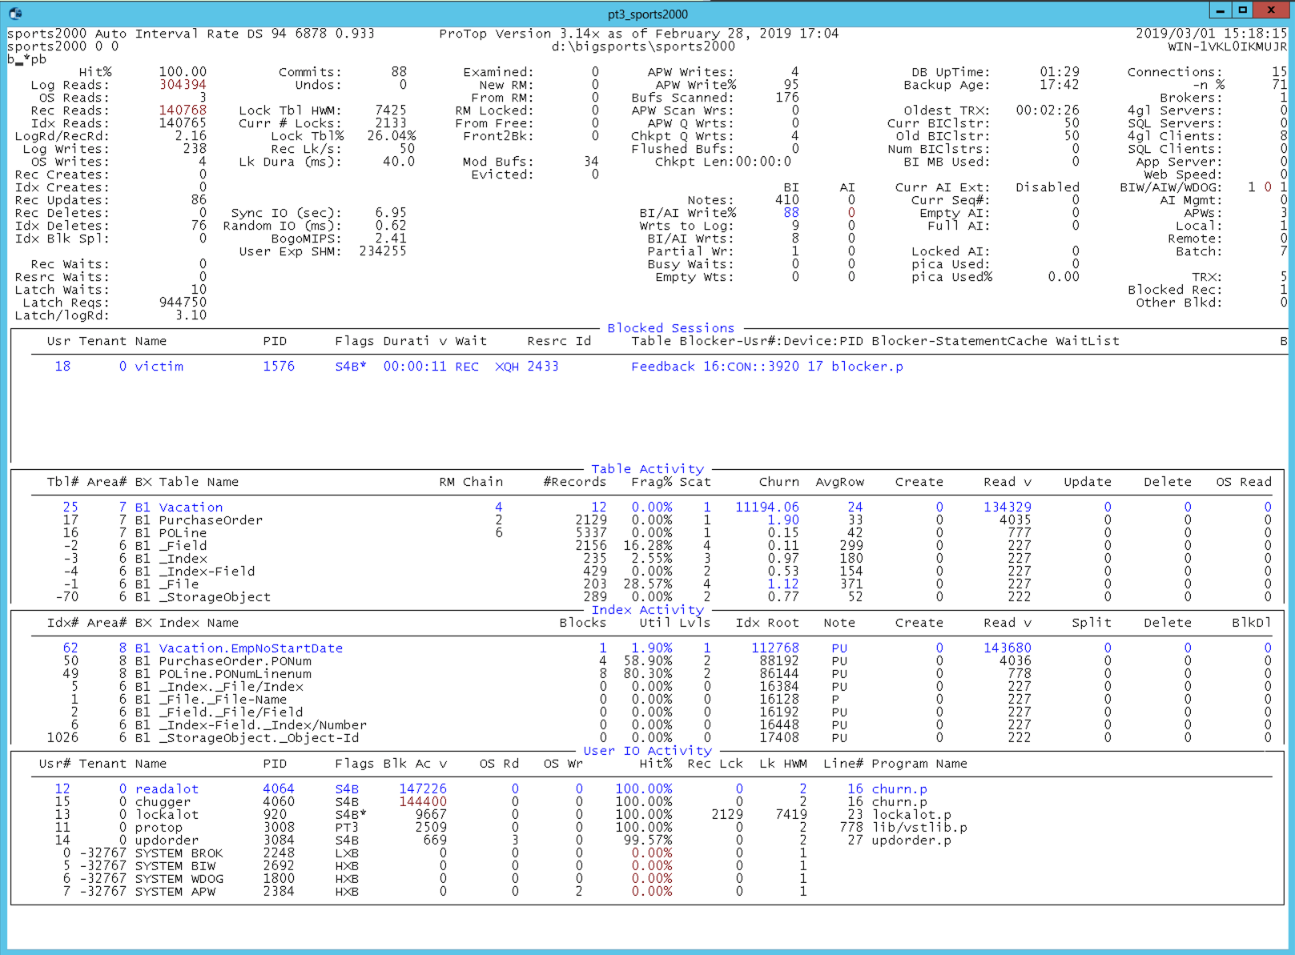
ProTop - Blocked Sessions
“b” to bring up “blocked sessions”
User 18 (aka “victim”) is blocked, waiting for an exclusive-lock on RECID 2433 of FeedBack which is currently being held by user 16 who is executing line 17 of blocker.p.

Slide 85
Disconnect a User
proenv> proshut sports2000 -C disconnect 16
OpenEdge Release 11.7 as of Mon Mar 27 10:21:54 EDT 2017
User 16 disconnect initiated. (6796)

Slide 86
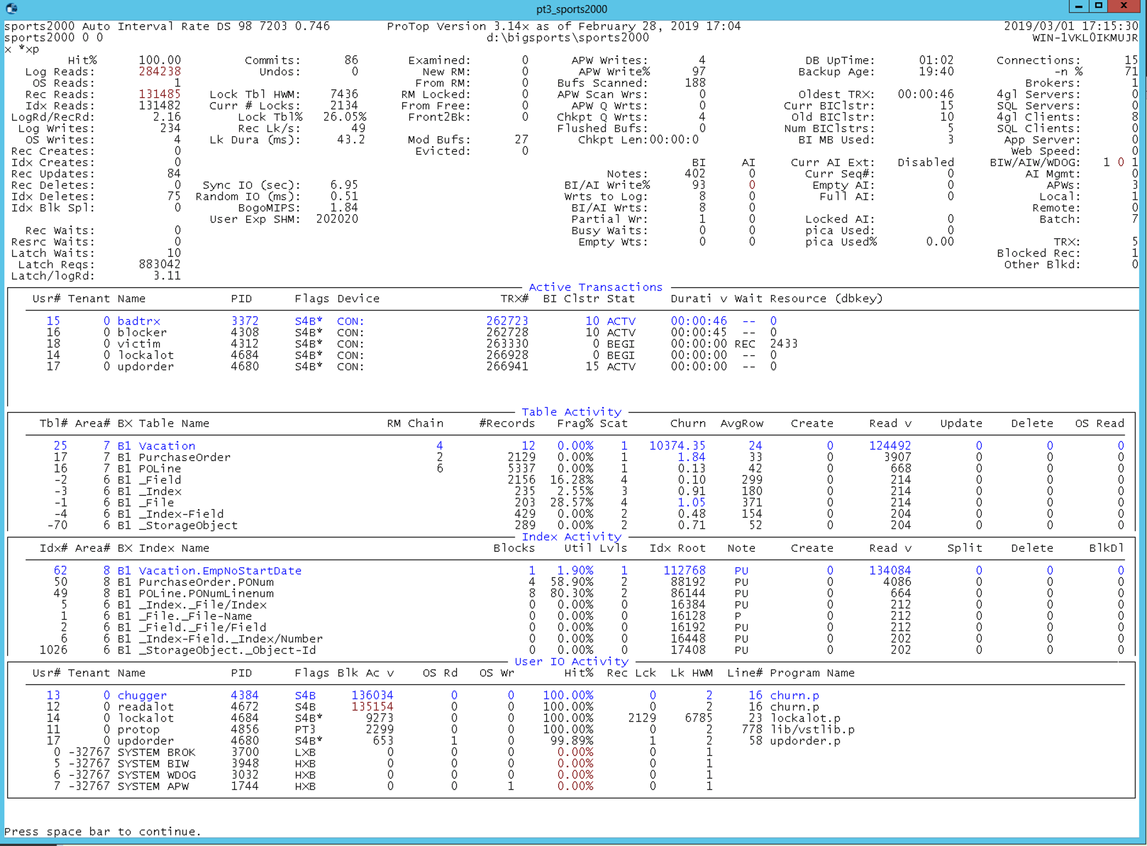
ProTop - Long Transaction
“x” to bring up “Active Transactions”
Notice:
Oldest TRX is 46 seconds
Gap of 5 bi clusters
3MB of BI in use
Oldest TRX is not actually doing anything…
TRX that is really updating records

Slide 87
proGetStack - Client Stack Trace
proenv> proGetStack 1576
proenv> type \protop\s2k_demo\protrace.1576
=====================================================
PROGRESS stack trace as of Fri Mar 1 15:46:49 2019
=====================================================
Startup parameters:
-pf P:\oe117\startup.pf,-cpinternal ISO8859-1,-cpstream ISO8859-1 . . . (end .pf),-b,-db d:\bigsports\sports2000,-rand 2,-p updorder.p
** ABL Stack Trace **
--> updSalesRep updorder.p at line 67 (.\updorder.p)
updorder.p at line 29 (.\updorder.p)
** Persistent procedures/Classes **
** PROPATH **
.,P:\oe117\tty,P:\oe117\tty\adecomm.pl,P:\oe117\tty\adecomp.pl,P:\Progress\oe117\tty\prodict.pl,P:\Progress\oe117,P:\Progress\oe117\bin
** Databases (logical/type/physical) **
sports2000 PROGRESS d:\bigsports\sports2000
** End of Protrace **

Slide 88
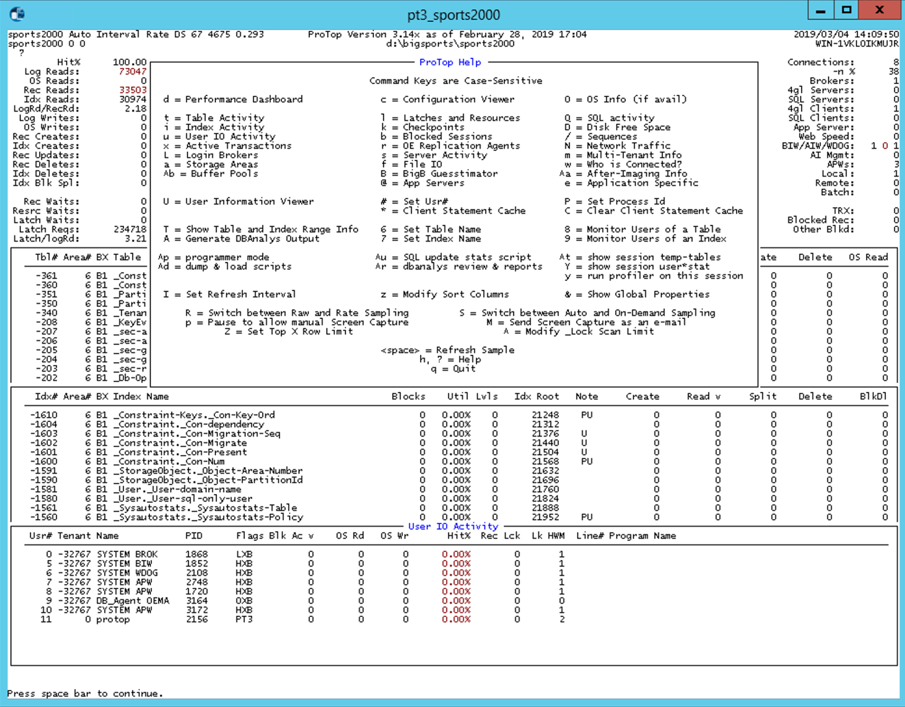
ProTop – User Drill Down
Select user # or PID
“U” to drill down to user info

Slide 89
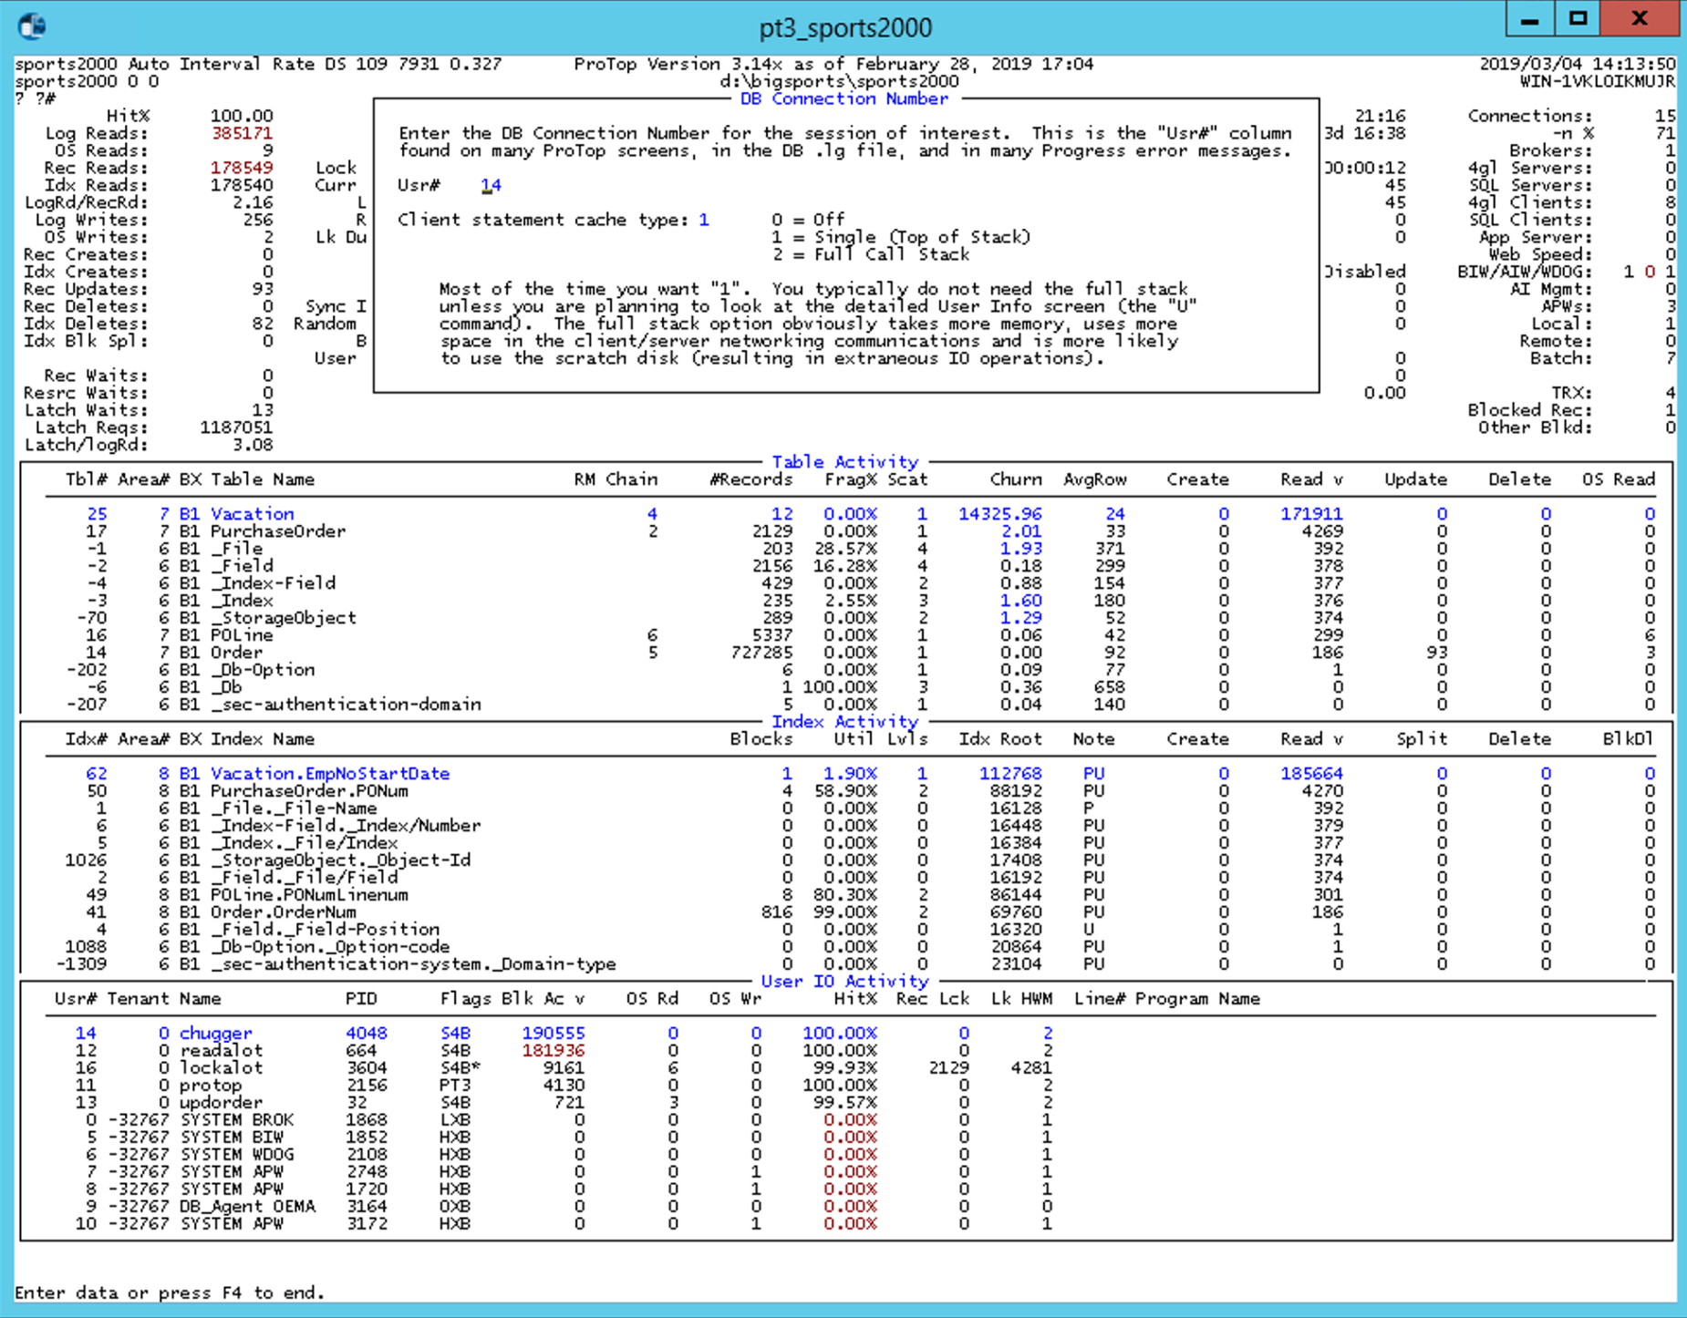
ProTop – User Selection
Specify user#…
Optionally enable Client Statement Cache (if relevant)

Slide 90
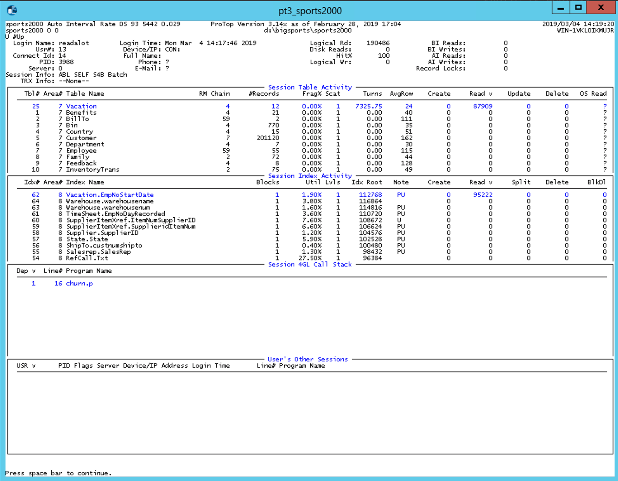
ProTop – User Drill Down Details
General Session Info
Connection specific table and index usage
Client Statement Cache
Other Sessions logged in with this user name.

Slide 91
ProTop – Reports
dbanalys first…
“control-r” to generate reports

Slide 92
ProTop - Reports
Within ProTop: Control-R to generate reports…
proenv> dir d:\protop\rpt

Slide 93
ProTop – sports2000.dict.rpt
Table Indexes Field Order Type Extent Format
--------------------------------------------------------------------------------------------------
Benefits U EmpNum 10 integer 0 zzzzzzzzz9
HealthCare 20 character 0 x(8)
LifeInsurance 30 integer 0 $>>,>>>,>>>
Pension401K 40 integer 0 >>,>>9
StockPurchase 50 integer 0 >>,>>9
MedicalSpending 60 integer 0 >>,>>9
DependentCare 70 integer 0 >>,>>9
BillTo U CustNum 10 integer 0 >>>>9
U BillToID 20 integer 0 zzzzzzzzz9
Name 30 character 0 x(30)
Address 40 character 0 x(35)
Address2 50 character 0 x(35)
City 60 character 0 x(25)
State 70 character 0 x(20)
PostalCode 80 character 0 x(10)
Contact 90 character 0 x(30)

Slide 94
ProTop – sports2000.tbl.rpt
Table Summary Report for sports2000 d:\bigsports\sports2000
Suggested
Table Nam Size Records Reads/sec Upd/sec Avg Rec RPB Ord
=================== ============= =========== ============ ========== ======= === ===
Customer 32610714 201120 0 0 162.15 64 64 [Data]
Item 8192 69 0 0 118.72 64 64 [Data]
Employee 6349 55 0 0 115.43 64 64 [Index]
RefCall 2458 13 0 0 189.05 64 64 [Data]
Salesrep 1331 9 0 0 147.91 64 64 [Data]
Supplier 1126 10 0 0 112.64 64 64 [Data]
Feedback 1024 8 0 0 128.00 64 64 [Data]
BillTo 221 2 0 0 110.50 64 64 [Lobs]
OrderLine 115553075 2619963 0 0 44.10 128 128 [Data]
Order 67004006 727285 0 0 92.13 128 128 [Data]
InventoryTrans 3686 75 0 0 49.15 128 128 [Data]
Family 3174 72 0 0 44.09 128 128 [Data]
Warehouse 1331 14 0 0 95.09 128 128 [Data]
TimeSheet 1126 25 0 0 45.06 128 128 [Data]
Notes:
Country 762 15 0 0 50.80 128 128 [Data]
LocalDefault 724 10 0 0 72.40 128 128 [Data]
ShipTo 311 3 0 0 103.67 128 128 [Data]
POLine 222720 5337 0 0 41.73 256 256 [Data]
PurchaseOrder 70246 2129 0 0 33.00 256 256 [Data]
Bin 26829 770 0 0 34.84 256 256 [Data]
Invoice 5632 147 0 0 38.31 256 256 [Data]
State 1741 51 0 0 34.13 256 256 [Data]
SupplierItemXref 1126 56 0 0 20.11 256 256 [Data]
Benefits 848 21 0 0 40.38 256 256 [Data]
Vacation 288 12 0 0 24.00 256 256 [Data]
Department 211 7 0 0 30.14 256 256 [Data]

Slide 95
ProTop – sports2000.area.rpt
Existing Storage Area Summary for sports2000 d:\bigsports\sports2000
Area Name Data Size Num Recs Avg Rec Blk CSZ RPB Frag Scat %MaxRecs Tbls Idxs LOBs
================ ============== ======== ======= === === === ===== ===== ======== ==== ==== ====
Data 215522683 3557221 60.59 8 8 32 0.00% 1.00 0.17% 24 3 0
Table Name
------------
Benefits 848 21 40.38 256* 0.00% 1.00 0.00%
Bin 26829 770 34.84 256* 0.00% 1.00 0.00%
Country 762 15 50.80 128* 0.00% 1.00 0.00%
Customer 32610714 201120 162.15 64* 0.00% 1.00 0.01%
Department 211 7 30.14 256* 0.00% 1.00 0.00%
Family 3174 72 44.09 128* 0.00% 1.00 0.00%
Feedback 1024 8 128.00 64* 0.00% 1.00 0.00%
InventoryTrans 3686 75 49.15 128* 0.00% 1.00 0.00%
Invoice 5632 147 38.31 256* 0.00% 1.00 0.00%
Item 8192 69 118.72 64* 0.00% 1.00 0.00%
. . .

Slide 96
ProTop – sports2000.idxcompact.rpt
Index Compaction Summary for sports2000 d:\bigsports\sports2000
Table.Index Name Blocks Util%
-------------------- -------------- ------------
OrderLine.itemnum 1164 51.20%

Slide 97
Developer Support

Slide 98
Lab: Build a Fresh Database
Structure File
Prostrct create, prodb etc…
Load .df

Slide 99
Lab: Working with .df Files
Dump .df
Create incremental .df
Load .df
  Online
Idxactivate

Slide 100
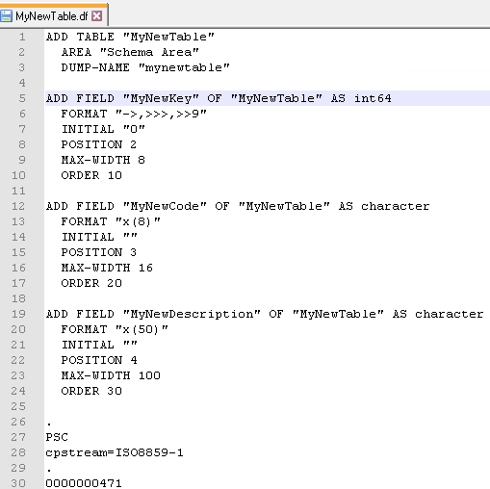

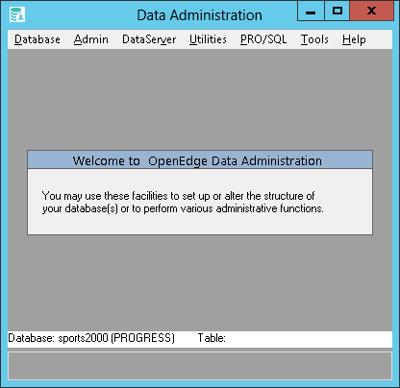
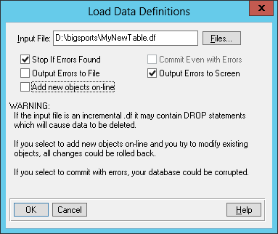
Lab: Load a .df
Notes:
prowin -1 sports2000 –p _admin.p

Slide 101
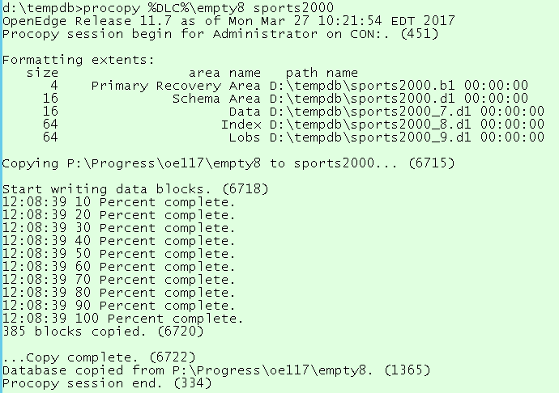
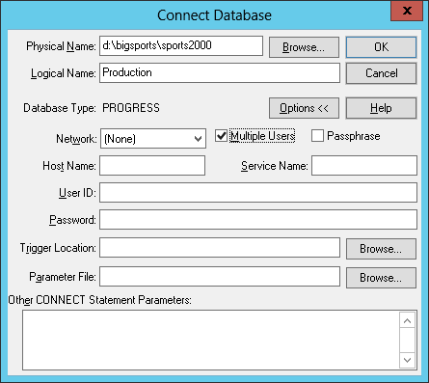
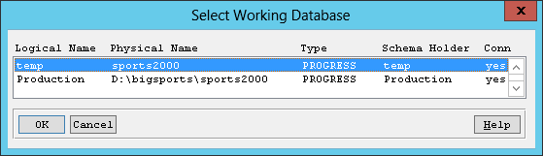
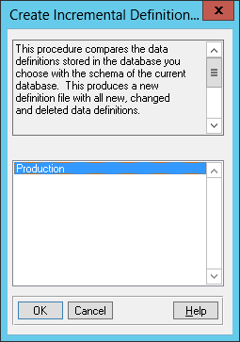
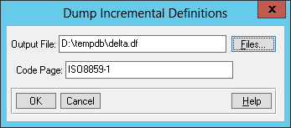
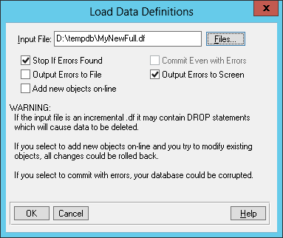
Lab: Make an incremental .df
OOOPS! I gave you the wrong file! Here’s a full .df from my system!

Slide 102
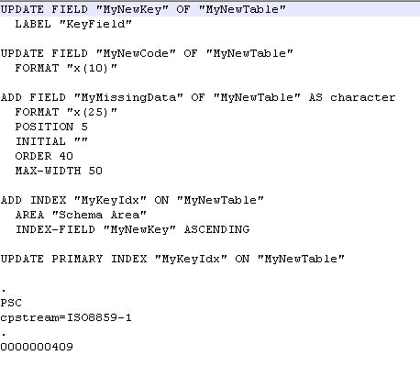
Lab: Make an incremental .df

Slide 103
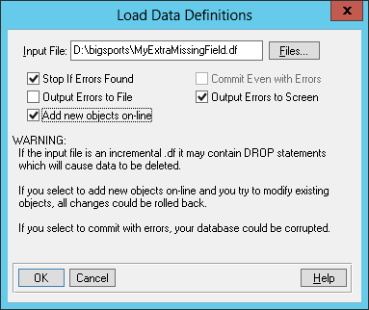
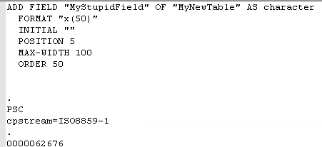
Lab: Add Schema Object Online

Slide 104
Thank You!

