Slide 1
Wireless Primer
Bob Brennan
IMS, Inc

Slide 2
Disclaimer
There is nothing specific in this talk to Open Edge
No matter how good your code, you will not make up for poor network design.
Wifi in the air is similar to Light in a fiber optic cable
This talk is contains partial truths

Slide 3
Shared Medium
2.4 Ghz and 5 Ghz
It’s just energy
Everything in the spectrum counts not just WiFi

Slide 4
Conclusions and Take Aways
Wireless is a Shared Medium, play well with your neighbors
Try and stick to 5 GHz if possible
Avoid 2.4 GHz if possible
Match equipment to task at hand
Used the most capable equipment

Slide 5
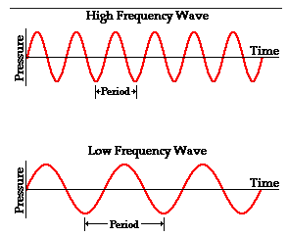
Day At the Beach
Frequency (Period)
Amplitude
Crest/Peak
Trough
Hz = Frequency per Second

Slide 6
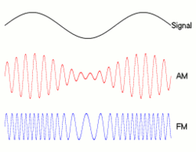
Modulation Methods

Slide 7
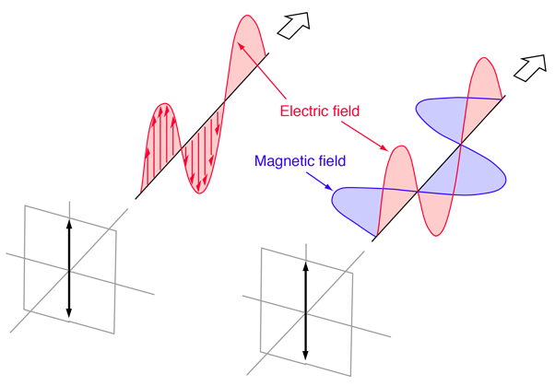
Radio Waves
Energy leaves the antenna on a plane perpendicular to the antenna
It travels in a wave
The wave is Polarized

Slide 8
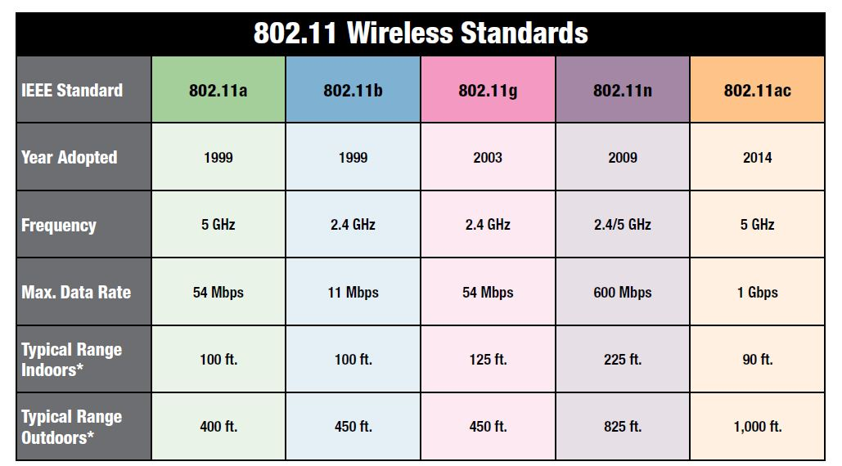

Slide 9
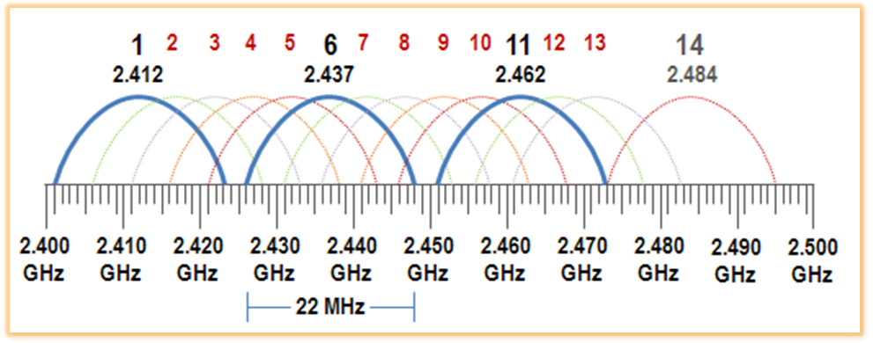
2.4 GHz

Slide 10
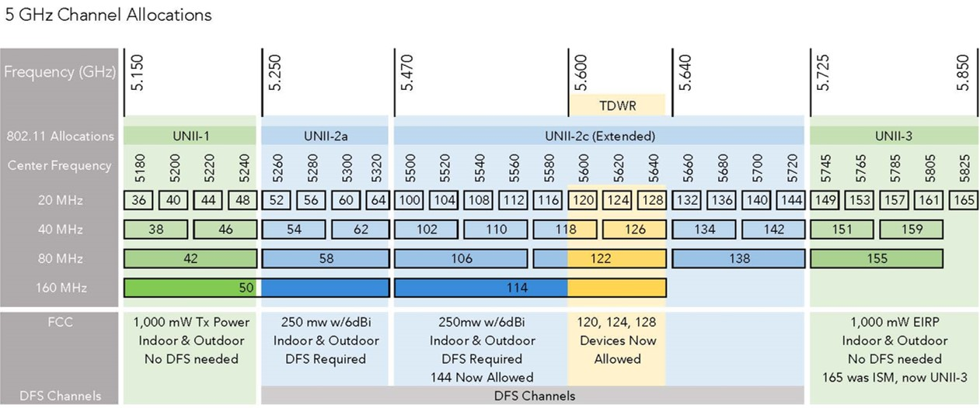
5 GHz

Slide 11
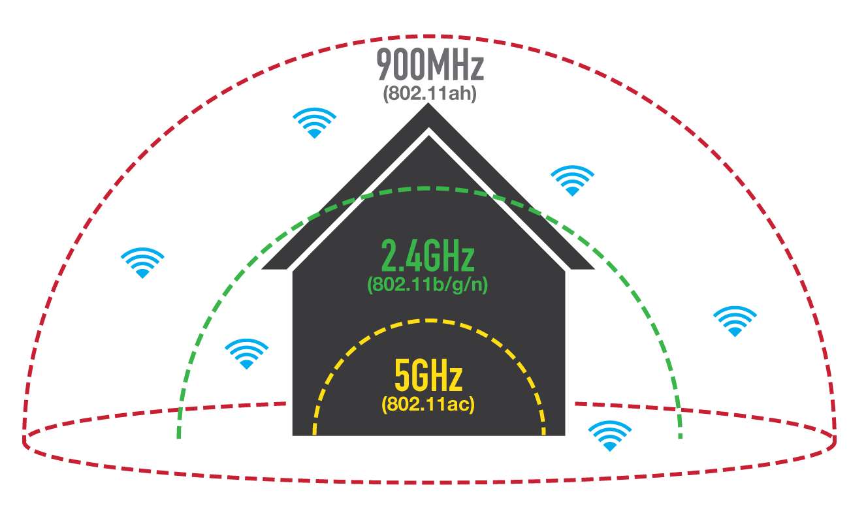

Slide 12
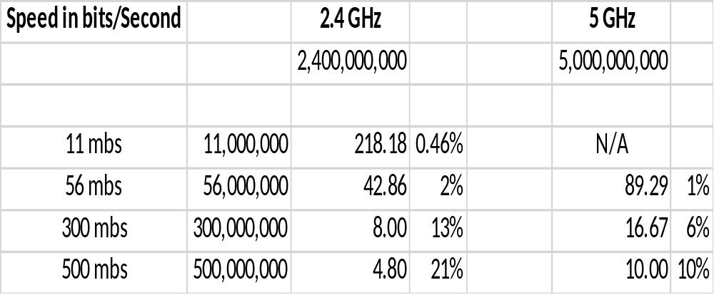
Capacity Versus Use = Efficiency

Slide 14
High School Physics
Speed of Light(m/s) = Frequency(cycles/s) * Wavelength(m/s)
Or restated
Speed of Light(m/s) / Frequency(cycles/s) = Wavelength(m/s)
Speed of Light is 299,792,458 meters per second (300,000 m/s)
Wave Length
  2.4 Ghz is 12.5 cm or 4.92 inches
  5 Ghz is is 6.25 cm or 2.46 inches

Slide 15
Attenuation
Absorption of a wave as it travels through different medium
Sound Wave through a house

Slide 16
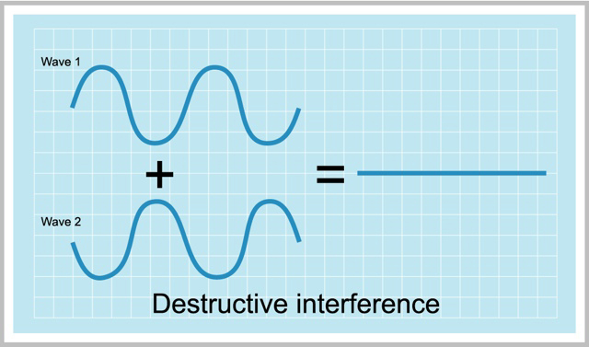
Interference and Collisions

Slide 17

Cocktail Party

Slide 18
Power Limits
Radio Power is Regulated by the FCC in the USA
By Rule, WIFI can only broadcast at a limited Power Setting

Slide 19
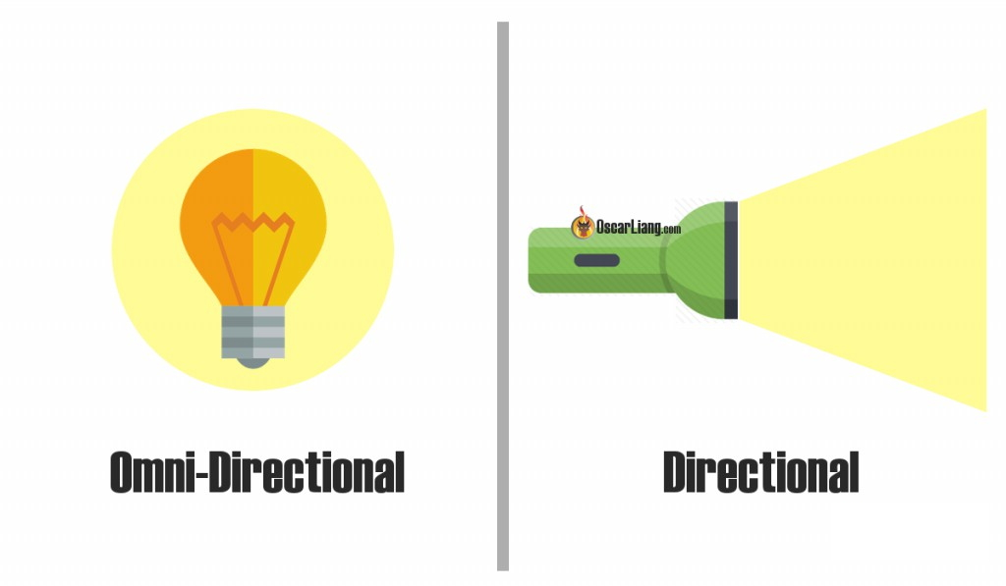
Antenna Pattern

Slide 20
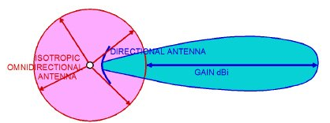
Gain

Slide 21
Polarity
Based on the orientation of the antenna
Vertical and Horizontal
Matching the sender and receiver
The more they match, the more efficient the communication

Slide 22
How to get more done ?
More Users
More requests
Get clients on and off the medium as quickly as possible while maximizing their time slice.
Doing More Per Request

Slide 23
Driving Efficiencies
Make things go faster – limited by frequency
Do more with the available bandwidth – multiplex
Do more in parallel – multiple radios, multiple streams
Reduce/Remove things that slow you down – collisions, contention

Slide 24
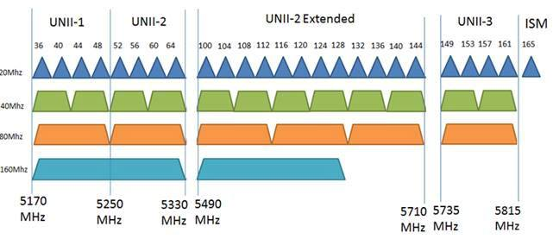
5 GHz Options

Slide 25
Importance
As we rely more and more on wireless as the standard method of networking, we need to make sure it works and remains performant.
Great Code will run poorly on a poor wireless network.
You can not always dictate the environment since it is a shared medium.

Slide 26
Conclusions and Take Aways
Wireless is a Shared Medium, play well with your neighbors
Try and stick to 5 GHz if possible
Avoid 2.4 GHz if possible
Match equipment to task at hand
Used the most capable equipment

Slide 27
Thank You!

