Slide 1
Making Good Checklists
Adam Backman
Checklist Maker
Cat Herder
DBAppraise
adam@dbappraise.com

Slide 2
About White Star Software
The Oldest and Most Respected Independent Progress OpenEdge Consulting Firm
5 of the top OpenEdge DBAs in the world: Adam Backman, Tom Bascom, Dan Foreman, Paul Koufalis and Nectarios Daloglou
Our Performance, Monitoring and Alerting Tool, ProTop. An incredibly powerful single-pane-of-glass view of your entire OpenEdge ecosystems
Real World Training From Real World DBAs
info@wss.com | wss.com

Slide 3
Agenda
Why make checklists?
Complicated vs. complex
Types of checklists
Roles
What makes an effective checklist?
What to avoid

Slide 4
Why Make Checklists?
To reduce human error
Rote processes tend to breed forgotten steps
To reduce missed or out of sequence steps
  Ready, Fire, Aim – Bad
  Ready, Aim, Fire – Good
Reduce interruptions

Slide 5
Complicated vs. Complex
Complicated – consisting of many interconnected parts
Complex – consisting of many different and connected parts
So, Who cares?

Slide 6
Complicated vs. Complex
Checklists are most effective with complicated processes
Complex processes with their different parts are generally not good candidates for checklists because of the less limited avenues to completion
Most technical problems are complicated not complex

Slide 7
Types of checklists
Normal procedures
  Report checks
  Backup
  Performance checks
Non-normal
  Disk failure
Emergency
  Database/Application interruption

Slide 8
Examples of Industries that depend on checklists
Aviation
  Pilot preflight check
  Maintenance
    Checklists
    Procedures
Medical
Technology

Slide 9
Types of Checklists
Procedural
  Technical
  Aviation
Procedural with discussion
  Medical (proving problematic)
Non-procedural (simple)
  Shopping list
Notes:
Medical checklists with discussion are proving to be problematic for the medical profession as it encourages interruptions to the process

Slide 10
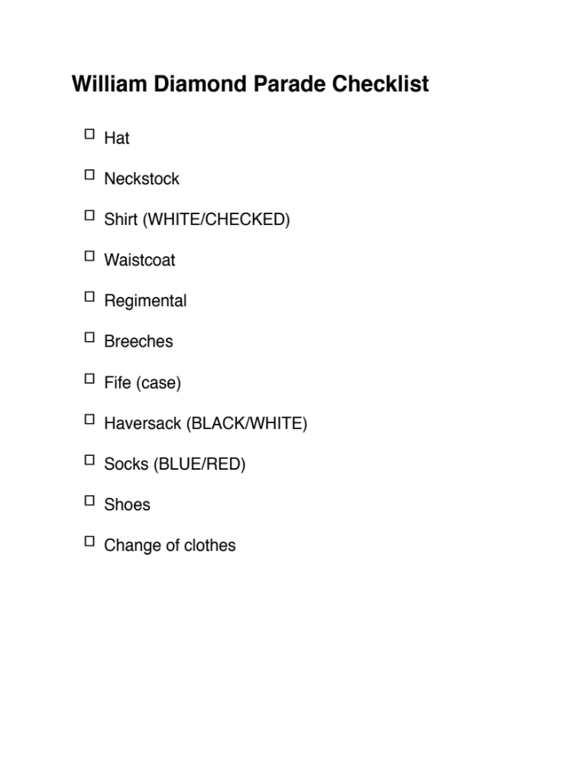
Simple checklist (Thanks Jake)

Slide 11
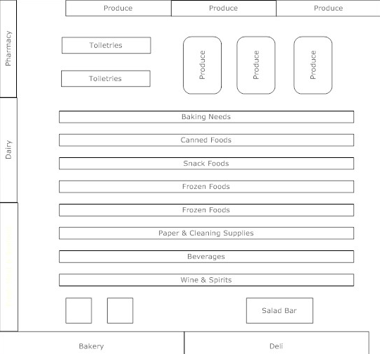
Example: Over designed shopping list (Thanks Dad)

Slide 12
Example: Tech Procedural
Truncate BI on the old machine
  proenv (START --> Progress --> proenv)
  proutil hfc_fis -C truncate bi -G 0
Backup database on old machine
  proenv (START --> Progress --> proenv)
  probkup hfc_fis hfc_fis.bck
Transfer to new machine
  Use Windows Explorer to copy hfc_fis.bck to D:\db\hfc\production
Restore to new machine
  proenv (START --> OpenEdge --> proenv)
  d:
  cd \db\hfc\production
  set DLC=c:\progress\openedge\bin\101_dbutils
  set PATH=%DLC%;%PATH%
  101_dbutil prorest hfc hfc_fis.bck
Conv1011
  proenv (START --> OpenEdge --> proenv)
  d:
  cd \db\hfc\production
  proutil hfc -C conv1011

Slide 13
The process of creating checklists
Two people. One who knows the process very well and another that has little or no experience with the task.
The expert writes down exactly what happens to the keystroke (Why not the novice?)
Once the procedure has been done once or twice by the initial team a third person (the worst case scenario) executes the list exactly to determine if the instructions are correct

Slide 14
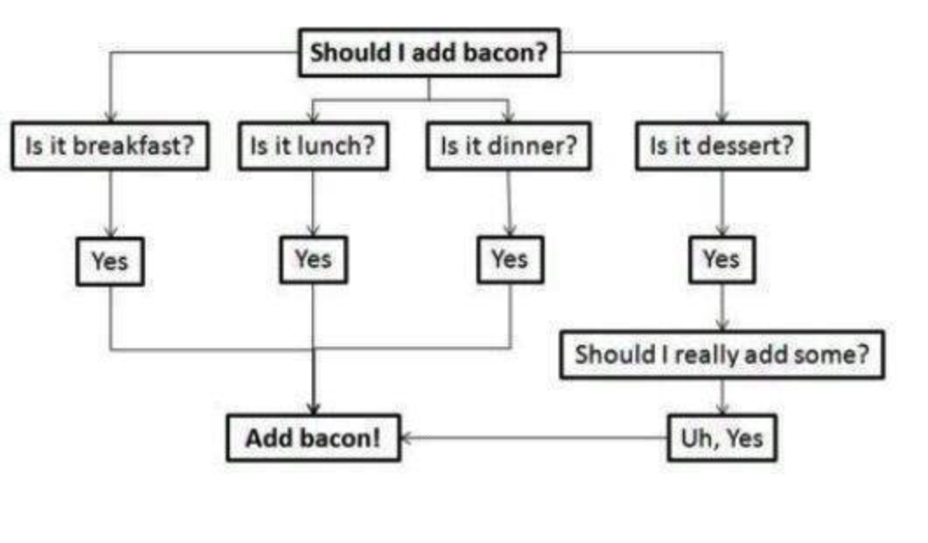
Decision Tree
Notes:
There need to be a finite number of questions and each question should have a finite number of answers

Slide 15
Simple Decision Tree
Bacon?

Slide 16
Important Checklist Features
Having it accessible (part of the process)
Using numbers for procedural items
Using bold and underline for critical items
Having actual boxes ◻︎ to check, yes it sounds dumb but it improves compliance

Slide 17
Technical Procedural
Audience is someone who is not technical
Find the person with the least technical experience
Find the person who refers to applications and things. “I can’t open that thing”
Really, a knuckle dragger
Oh, yeah, your boss is always handy and never busy, so there is your worst case scenario

Slide 18
Example: Tech Procedural
Truncate BI on the old machine
  proenv (START --> Progress --> proenv)
  proutil hfc_fis -C truncate bi -G 0
Backup database on old machine
  proenv (START --> Progress --> proenv)
  probkup hfc_fis hfc_fis.bck
Transfer to new machine
  Use Windows Explorer to copy hfc_fis.bck to D:\db\hfc\production
Restore to new machine
  proenv (START --> OpenEdge --> proenv)
  d:
  cd \db\hfc\production
  set DLC=c:\progress\openedge\bin\101_dbutils
  set PATH=%DLC%;%PATH%
  101_dbutil prorest hfc hfc_fis.bck
Conv1011
  proenv (START --> OpenEdge --> proenv)
  d:
  cd \db\hfc\production
  proutil hfc -C conv1011

Slide 19
Roles – Always Determined in Advance
Who does what
  Who executes and who is the second set of eyes
Who make decisions
  The people executing the checklist will make some/all of the decisions but only with very clear guidelines
  ALL data loss vs. downtime decisions should have high-level clearance BEFORE moving forward
What happens if someone is missing
  Primary and backup with call tree

Slide 20
Roles
Important to have a primary and secondary on all items
Call tree for notification and decision support
Data owners (usually not tech staff) need to be in recovery process

Slide 21
Goals of Effective Checklists
Should be part of normal workflow
Should not impose additional burden or workload
Perceived as something that makes the task easier (Remove pressure)
Eliminate decision making during stressful events

Slide 22
Location and completeness is important
There should be a procedure for maintaining extra copies of checklists so you do not run out
If the checklist is not there then it will be ignored because it broke the workflow rule
If checklists are incomplete them users will stop using them as they will not make the process easier!

Slide 23
Points to remember
Checklists are important
  To ensure processes are standardized
  To eliminate missed or out of sequence steps
  To make the process easier/less stressful
Checklist types
  Shopping list (non-procedural)
  Procedural
  Decision tree

Slide 24
Questions
Questions?
Comments?
Personal problems?

Slide 25
Thank you very much for your time
Any follow-up questions:
Adam Backman
adam@wss.com
+1.603.661.5581

Slide 26
Questions?

