Slide 1
Lions and Tigers and Bears, Oh My!
Adam Backman – Head Punkhawallah
White Star Software

Slide 2
About White Star Software
The oldest and most respected independent Progress OpenEdge consulting firm
The top OpenEdge DBAs in the world
Our performance, monitoring and alerting tool, ProTop. An incredibly powerful single-pane-of-glass view of your entire OpenEdge ecosystems
Mentoring and skills transfer from real world DBAs
info@wss.com | wss.com

Slide 3
About Adam Backman
Worked for Progress when there were only 80 employees worldwide (Yes, he is old)
Wrote a book for Progress Software about database administration and OpenEdge management
Loves solving problems with a focus on the operation of the business

Slide 4
Recovery planning
We will discuss
  Who
  What
  Where
  When
  Why
Of recovery planning

Slide 5
Why do recovery planning?
The best answer is so it works when you need it
To establish an understanding of what is possible
To define what you care about and what you don’t
To eliminate second guessing after the fact
To look to the outside world as if business is as usual

Slide 6
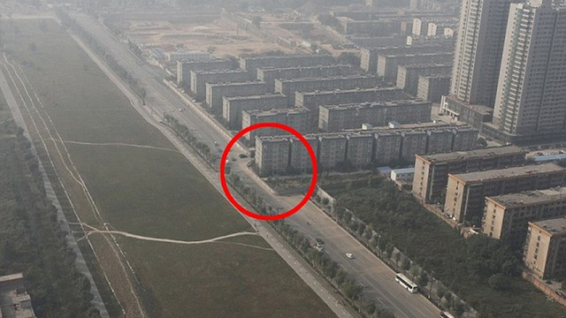
Planning is the key to success

Slide 7
Security
Perceived security
  This is how you feel
Actual security
  This is what will actually work
Both are important but it is important to understand the difference

Slide 8
Lucky person?

Slide 9
Now what do you see?

Slide 10
Who do you involve in the planning phase
Be inclusive
You don’t own the data the users own the data
People to involve
  End users
  Management – you need funding
  Technical people – multiple silos
  More people can provide a complete view of your environment

Slide 11
Who is responsible
For backup
For recovery
For decision making during recovery
For contacting people
  Status reporting during incident
  Contacting staff after major incident

Slide 12
What is important?
High probability risks
High impact risks
High cost risks

Slide 13
Sources of problems
Human errors
More human errors (really)
Application code
Hardware/software system failures
Man-made disasters
Natural disasters

Slide 14

The REAL source of system problems

Slide 15
High impact issues
Loss of environment
  Fire may only impact a portion of the building
  Earthquake may impact entire region
Loss of infrastructure
  Network
  Client machines
  Phones
  Chairs

Slide 16
Cost impact of downtime
Cost of lost business
Cost of additional employee time
Cost to rekey/lost data
Cost to switch to other (manual) system
Cost to reputation

Slide 17
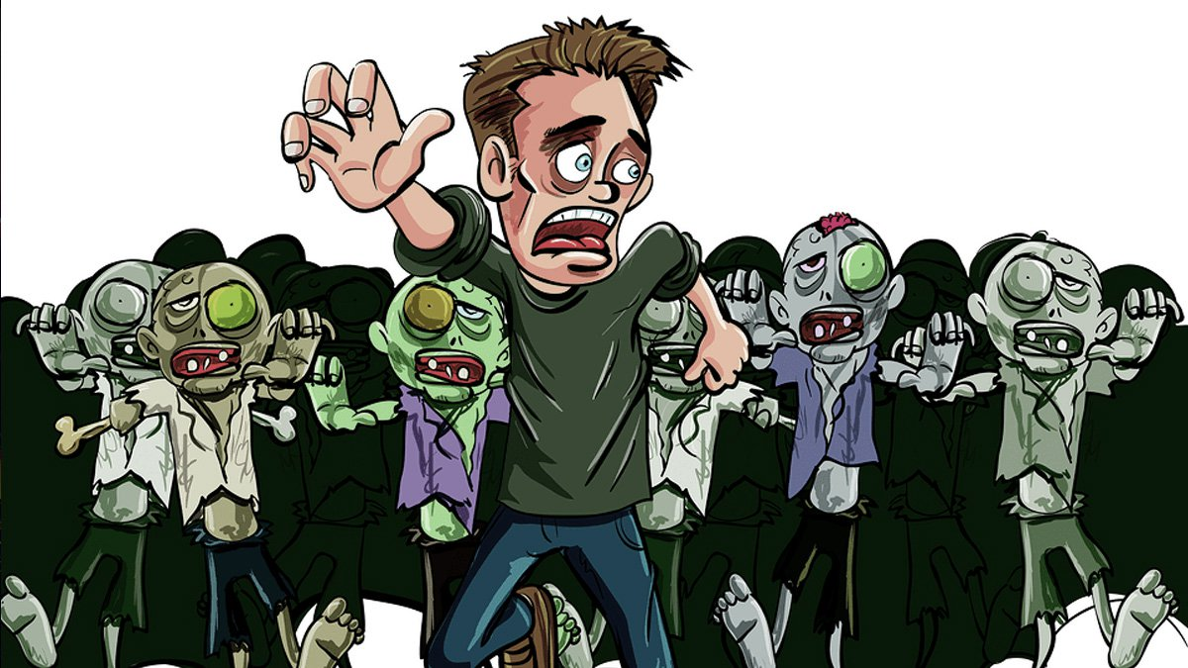
Don’t worry about things that are unlikely to happen
People in Hawaii really don’t need to worry about blizzards
People on the east coast don’t really need to worry about earthquakes
Zombie Apocalypse

Slide 18
Don’t build a solution that costs more than the problem
This underscores the importance of knowing the cost of downtime
A daily backup is fine for many businesses
Using after imaging is cheap and easy to archive off site frequently
Some people need a second set of hardware with replication to keep downtime to a minimum

Slide 19

Cost of solution vs. probability of problem

Slide 20
Building a good recovery plan
Create your plans based on recovery
Do not focus on the process until the end
Understand the cost of losing each portion of your business and infrastructure
Recovery planning is way more than just data

Slide 21
What to include in your planning
Data
Application(s)
Hardware
  Compute
  Network
  Client machines
  Phones and other supporting hardware
What happens if you lose a/the building

Slide 22
Creating recovery plans
Focus on the likelihood of the issue
Most common failures first
Not having to recover is always best
Humans are always the weak link so start there
  Deletion of files/database
  Security for the system (internal and external threats)

Slide 23
Eliminate the human element
Automation of all tasks
Reporting on all outcomes
Alerting on all variances

Slide 24

Eliminate the human element

Slide 25
Building reliable solutions (software)
Standards
  Naming standards
  Source code control
Standard release process
  Separate development, test and production environments
Testing
  Manual and automated testing

Slide 26
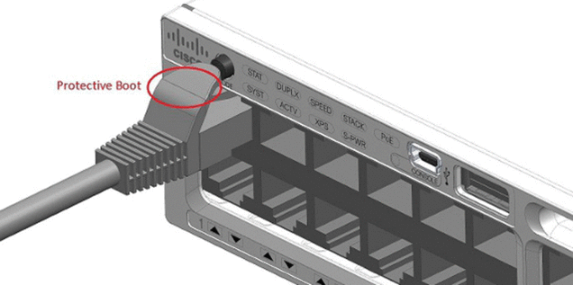
Importance of peer review

Slide 27
Where?
Where does the backup go?
  Second machine – where
  Tape – then where
Where is the replica machine?
Where do people go if there building is not there?
Where is the backup hardware?

Slide 28
When?
When to backup
When to try a workaround
When to recover
When to test your recovery plan

Slide 29
Building a good recovery plan
Who – involve many in the initial planning
What – remember that you application is more than just data and application code
Where – second sites or the cloud can act as repositories for your backups/AIs/replica DBs
When – full backup daily and test at least annually
Why – look to the outside world as if nothing is wrong

Slide 30
Questions?

