Slide 1
Progress System Tables
Dan Foreman
Progress Wackaloon

Slide 2
Introductions – Dan Foreman - Progling
Progress User since 1984 (V2, there never was a commercial V1)
Presenter @ Progress Conferences Worldwide since 1988

Slide 3
Introductions – Dan Foreman - Progling
Author of:
  Progress Performance Tuning Guide
  Progress Database Administration Guide
  Progress System Tables
  Progress DBA Best Practices
  ProMonitor – used by the Progress Managed DBA Practice to monitor over 1,000 databases worldwide
  Pro Dump&Load – used to dump & load the worlds largest DB (12TB) with only 2 hours of downtime

Slide 4
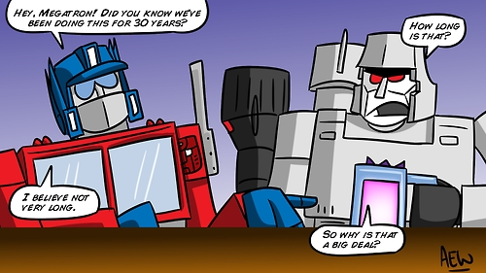
Dan Foreman Intro
Progress guy since 1984

Slide 5
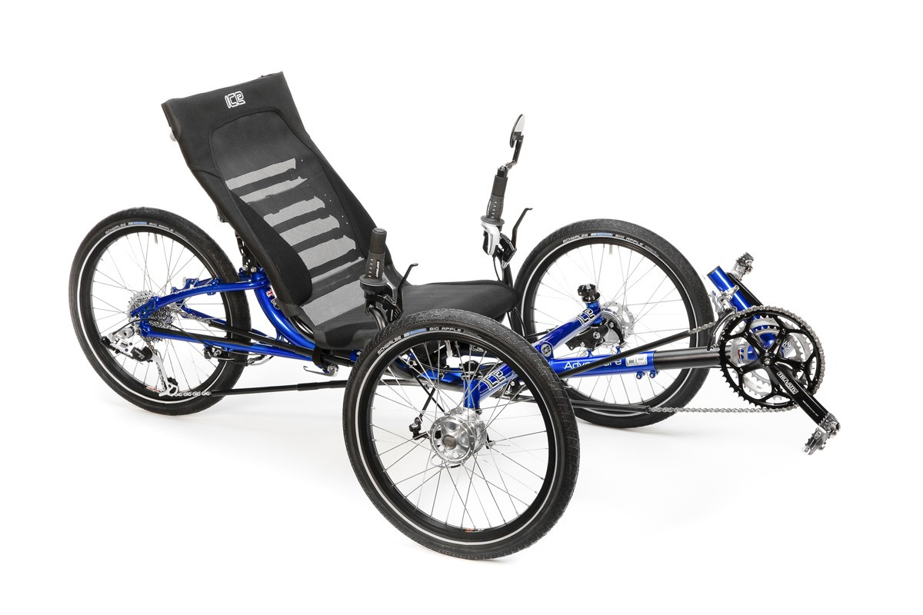

Introduction: Dan Foreman
Dan Forema Intro
I enjoy cycling & basketball (not @ the same time)

Slide 6


Introduction: Dan Foreman
I used to be a Super Frequent Flier
  3.4 million miles on United Airlines (31 years)
  3.5 million miles on American Airlines (28 years)

Slide 7
Let’s Get Started

Slide 8
System Table Categories
Schema Table# -1 to -4
SQL Table# -80 to -129
Virtual Table# -16385 and lower
System Info Everything else that’s negative

Slide 9
Schema Tables
In all versions of Progress
  _File
  _Field
  _Index
  _Index-Field

Slide 10
_File._Category
Added by Gus in V11
Value | Description | Examples
AUDIT | Auditing | _Client-Session
AUTH | Authentication | _User, _Tenant, _Sec-Role
DS_SCHEMA | Data Server Schema | _Constraint
LOG | Event Logging | _KeyEvent
PHY_ST | Physical Storage | _Area, _AreaExtent, _StorageObject, _Partition*
SCHEMA | Meta Schema | _File, _Field, _Index, _Db, _Sequence
SQL89 | Old (Deprecated) SQL89 | _View
SQL_* | SQL92 Tables | _SysDbAuth, _SysProcedures
VST | Virtual System Tables | _Connect, _Trans, _Lock

Slide 11
Schema Tables - Latecomers
_Db V5 or V6
_Sequence V7
_File-Trig V7
_Field-Trig V7

Slide 12
Practical Use – Find Redundant Indexes
Index A: Fld1 + Fld2 + Fld3
Index B: Fld1 + Fld2 + Fld3 + Fld4
Index A or B might be redundant

Slide 13
Practical Use – Find Tables with No Defined Indexes
FOR EACH_index NO-LOCK WHERE _index-name = “default”,
_file OF _index NO-LOCK :
DISPLAY _file-name.
END.
This is important because the “default” index is stored in the Schema Area (by default) and the Schema Area is a Type 1 Storage Area
Also it’s generally a good idea to store nothing related to the application in the Schema Area

Slide 14
SQL Tables
Permissions (GRANT, REVOKE)
Constraints
Views
Stored Procedures
Query Optimizer Data

Slide 15
System Info Tables
_Area V9
_AreaExtent V9
_StorageObject V9

Slide 16
Practical Use – Table/Index Mixing
_storageobject
Also
  -B2 Objects
  LOBs

Slide 17
Virtual System Tables
First introduced in V8.2
Each VST represents a snapshot of various Shared Memory structures
VSTs are Schema Tables
They do not interfere with Application tables and Indexes
Starting in V9 VSTs are included in the empty Database
Can be seen in the Dictionary (must view ‘Hidden’ tables)

Slide 18
Virtual System Tables - Enabling
Some new tables and fields are not in the “native” empty DB unless the VST structure is updated with:
  proutil –C updatevst
Example: New fields were added to existing VSTs in V10.2B SP6
Best practice to run updatevst after Progress Upgrade
You can also go “backwards” with:
proutil <db> -C disablenewvsttables

Slide 19
Virtual System Tables - Enabling
A particular feature must be enabled:
  Auditing: proutil enableauditing V10
  TDE (Data Encryption) V10
  Multi-Tenancy V11
  Table Partitioning V11
  OE Replication V9
  Change Data Capture V12

Slide 20
Virtual System Tables - Limitations
promon and the VSTs are not always in sync; Examples:
  _TableStat & _IndexStat (V8.3)
  _AreaStatus (V9 and later)
VSTs can lag behind:
  _Startup
Some data isn’t available in Shared Memory (i.e. visible to promon and VSTs)…for example most of the info reported by rfutil aimage list

Slide 21
VST Performance & Overhead
For most VSTs there is no performance penalty for accessing VSTs
There are a couple exceptions that will be covered later
VSTs take up no additional disk space except for the VST schema which is trivial
But….. See next slide

Slide 22
VST Performance & Overhead
VSTs normally only take up a small amount of memory to cache the additional schema
But –tablerangesize & -indexrangesize can increase the amount of Shared Memory allocated by the DB Broker by a surprising amount if you have a large Connect Table (-n)
 | With *rangesize | Default
-B 1000 -L 1000 -Mn 100 -n 500 -tablerangesize 1000 -indexrangesize 3000 | 117mb | 12mb
-B 1000 -L 1000 -Mn 100 -n 1000 -tablerangesize 1000 -indexrangesize 3000 | 208mb | 15mb
-B 1000 -L 1000 -Mn 100 -n 2000 -tablerangesize 1000 -indexrangesize 3000 | 390mb | 22mb
-B 1000 -L 1000 -Mn 100 -n 4000 -tablerangesize 1000 -indexrangesize 3000 | 754mb | 36mb

Slide 23
VST Performance & Overhead
To help reduce the impact in V11.7 the following parameters were added:
  -baseuserindex
  -userindexrangesize
  -baseusertable
  -usertablerangesize
The idea is to keep these numbers low IF you don’t care about Client level table & index CRUD statistics (but you can change these parms @ run time for a quick check)

Slide 24
VST Performance & Overhead
Remote Client Performance is slower when Statement Caching is enabled

Slide 25
VST Access
Whenever a record is requested, the table is checked to see if it’s a VST table
VSTs have table numbers starting at -16385 and lower
The check is simple arithmetic so it’s very efficient
If a requested record is a VST record, the fields are populated from shared memory structures instead of from a database record

Slide 26
VST Schema
Each VST has one, unique “index” on the ‘Id’ field which is a ‘virtual’ RECID (with some exceptions)
  The index doesn’t really act like a normal index
  VST Data is accessed by walking the shared memory structure in what ever order it happens to be
Each VST record is numbered starting at 1 and continues sequentially (with some exceptions)
It is not possible to add new indexes, fields, or triggers to the VSTs

Slide 27
VST Record Counts
Some VST Record Counts are controlled by startup parameters
_connect -n + -Mn + 2
_LockReq -n + -Mn + 2
_UserIO -n + -Mn + 2
_UserLock -n + -Mn + 2
_UserStatus -n + -Mn + 2
_Trans Varies based upon Progress version
_Servers -Mn + 1
_Lock -L rounded to a multiple of 32

Slide 28
VST Record Counts
_tablestat -tablerangesize
_indexstat -indexrangesize
_usertablestat (-tablerangesize * (-n + -Mn + 2))
_userindexstat (-indexrangesize * (-n + -Mn + 2))

Slide 29
VST Record Counts
The tables on the previous slide are created at Database Broker startup time
The empty slots/records typically have “?” values
To avoid displaying the empty slots:
  FOR EACH _connect WHERE _connect-usr <> ?
The <> operator doesn’t cause a performance problem since VSTs are not really ‘indexed’

Slide 30
VSTs and Multiple Database Connections
If a Progress Client is connected to multiple Databases, the VST data will be based upon the Current Working Database

Slide 31
VST Potential Performance Problems - _Lock
Semi-Workaround:
FOR EACH _lock WHILE _lock-recid <> ?
But even this “workaround” can miss Locks
Performance is much better in V11.4 (see next slide)
Don’t use the WHILE trick in V11.4 and above; go back to using “WHERE _lock-recid <> ?” or similar

Slide 32
VST Potential Performance Problems - _Lock
Measurement | V11.3 | V11.4
Time to Read _Lock (-L 100,000) | 175 seconds | .2 seconds
LKP Latches | 2,612,600,022 | 22
Lock Hash Table (LHT) Latches | 1,306,400,064 | 128
Total Lock Table Related Latches | 3,919,000,086 | 150

Slide 33
VST Quirks
_UserLock
  Several arrays of 512 entries
  Overhead of DO loops of 512 iterations for (potentially) each record
_Block (V8)
  Useless VST in V9/V10/V11/V12
  Had the potential to be used to populate the –B cache for specific records (Sort of like what the Alternate Buffer Cache can be used for now)

Slide 34
Other Miscellaneous Issues
Too Much Data for One Window
  _Block-block x(1024)
  _UserLock-* Several arrays of 512
Stale Data
  _Lock (total # of locks) compared to _DbStatus-NumLocks
“Missing” Record (on rare occasions)
  _DBStatus
Numeric VST fields were typically defined as INTEGERs which limits the maximum value to about 2 billion prior to V10.1B
Documentation is sparse which is why I wrote the Progress System Tables Guide

Slide 35
New VSTs in V11.5
_DbParams
This is a huge improvement!
Makes the always-out-of-date _Startup VST Obsolete!
One record per parameter
Many can be updated online

Slide 36
New VSTs in V11.6
New Tables:
  _DbServiceManagerObjects
  _DbServiceManager
  _Repl-AgentActivity
  _Repl-AgentControlActivity

Slide 37
New VSTs in V11.7
_Repl-InterAgentActivity
_Cache

Slide 38
New VST’s in V12.0
_Repl-AgentAIStreaming
_LOB-Stat

Slide 39
Practical Use – Index Analysis
Use _IndexStat to identify unused indexes
COMPILE/XREF is only good for finding indexes that are defined but not used in the code; COMPILE/XREF isn’t very helpful for Dynamic Queries
COMPILE/XREF can falsely report (or not report)
WHOLE-INDEX

Slide 40
Practical Use – Locks & Transactions
Can view the lock status for an individual record
_Lock VST shows all active locks and who has the lock
We can easily find the Table name of the record being locked by doing a join to the _File table
_Trans VST shows all active transactions as well as transactions that are in BEGIN (V11.4+) or ALLOCATED (pre-V11.4) state

Slide 41
Practical Use – Locks & Transactions
Deadly Embrace (Deadlock) Detection
  _Lock
  _Connect
“Delinquent” Active Transactions that grow the BI File to an abnormally large size or cause record locking problems
  _Connect
  _Trans

Slide 42
Practical Use – Code Efficiency
Improve code efficiency by measuring:
  Client DB Accesses, Reads, etc.
    _UserIO
  Reads, Updates, Creates, Deletes (CRUD) by Table
    _TableStat
    _UserTableStat

Slide 43
Practical Use – Code Efficiency
Improve code efficiency by measuring:
  Unused indexes; Logical Scatter Factor
    _IndexStat
  Candidates for the Alternate Buffer Cache (ABC)
    _ActBuffer

Slide 44
Practical Use – Before Image Size
Monitoring the BI High Water Mark
_DbStatus._dbstatus-bisize
Available in V8.3 and later
Warning – the reported value isn’t exactly what you might expect
  V8: BI Size in Bytes (made sense to me!)
  V9 & later: BI Size divided by BI Block Size

Slide 45
Practical Use – Database Growth
Monitoring Database Size
promon doesn’t have the High Water Mark info for individual Storage Areas
_AreaStatus
  _AreaStatus-AreaName
  _AreaStatus-HiWater
  _AreaStatus-TotBlocks
  _AreaStatus-LastExtent
  _AreaStatus-Extents

Slide 46
Practical Use – Record Fragmentation
Record Fragmentation (records split into multiple pieces)
  _Record._Record-RecRead
  _Record._Record-FragRead
dbanalys/tabanalys only shows how many Fragments exist, not how often the Fragments are accessed
Unfortunately these numbers don’t make sense sometimes

Slide 47
Practical Use – What Program is Running Now
Called Client Statement Caching (CSC)
What Client is running what Program
_Connect-Cache* fields in the _Connect Table
Also the Line# for 4GL Code
For SQL Clients the actual SQL Statement is reported
Added in V10.1C but has some significant bugs until very, very recent versions
Recommend not specifying the entire Stack but just the current statement (1-Single instead of 2-Stack)

Slide 48
Practical Use – Table I/O for a Client
_UserTableStat
CRUD Activity
  Create
  Read
  Update
  Delete
Since V10.1B
Typically requires –tablerangesize on DB Startup to be useful

Slide 49
Other Resources
Rich Banville did a good VST presentation with additional info in 2017
https://www.pugchallenge.eu/docs/default-source/presentations-2017/progress---new_vsts.pdf?sfvrsn=91765b3_2

Slide 50
Thanks
If you are enjoying the conference, please take a moment and give some appreciation to the organizers….it’s a thankless job with hundreds of details that can derail a session or worse
I would like to say thanks for not scheduling this years conference on my birthday as it has been for the past several years!

Slide 51
Questions?
danf@prodb.com
+1 541 908 3437
UTC/GMT -8 (when I’m home)

