Slide 1
How to quickly reduce the haystack
Adam Backman – Just one of the guys
White Star Software

Slide 2
About White Star Software
The Oldest and Most Respected Independent Progress OpenEdge Consulting Firm
The top OpenEdge DBAs in the world
Our Performance, Monitoring and Alerting Tool, ProTop. An incredibly powerful single-pane-of-glass view of your entire OpenEdge ecosystems
Mentoring and skills transfer from Real World DBAs
info@wss.com | wss.com

Slide 3
About Adam Backman
Worked for Progress when there were only 80 world wide (Yes, he is old)
Wrote a book for Progress Software about database administration and OpenEdge management
Loves solving problems with a focus on the operation of the business

Slide 4
Reducing the haystack
First, determine what is important
Determining the nature of the problem
What tools are available
  Free
  Not free
Examples
Review, rinse repeat

Slide 5
What is important
Differs per operating environment
Differs per business
Differs per person (but we know who is important)
General rules for importance
  Operations that happen many times a day
  Time critical operations (must be run before shift change)
  The closer to the “customer” the more important

Slide 6
Determine the nature of the problem
System issue
  Network
  Disk
  Memory
  CPU
Database issue
Application issue
Operational issue

Slide 7
Tools available
Free
  promon
  profiler
  ProGetStack
  Virtual System Tables (VSTs)
  ProTop real-time
Not Free (tools included with services)
  ProTop portal (ProTop monitoring and alerting service)
  ProMonitor (available with OpenEdge MDBA service)

Slide 8
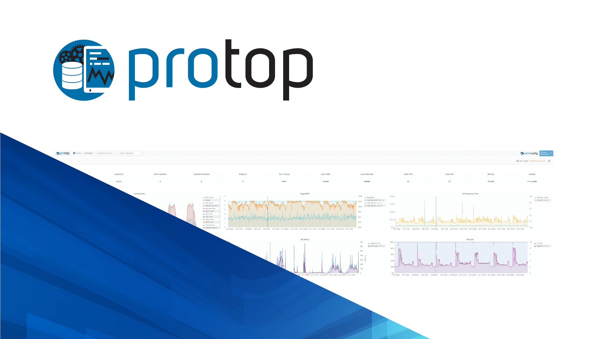
The Best OpenEdge Performance, Monitoring, and Alerting Tool in the Galaxy! | wss.com/protop
Detect and correct
issues before they affect
your critical business processes

Slide 9
Questions?

