Slide 1

iGenesis Modernization Journey

Slide 2
Agenda
Genesis Background and Overview
Planning and Discovery
User Journey
URI and REST
Framework and Tooling
Execution and Current Status
Q & A

Slide 3
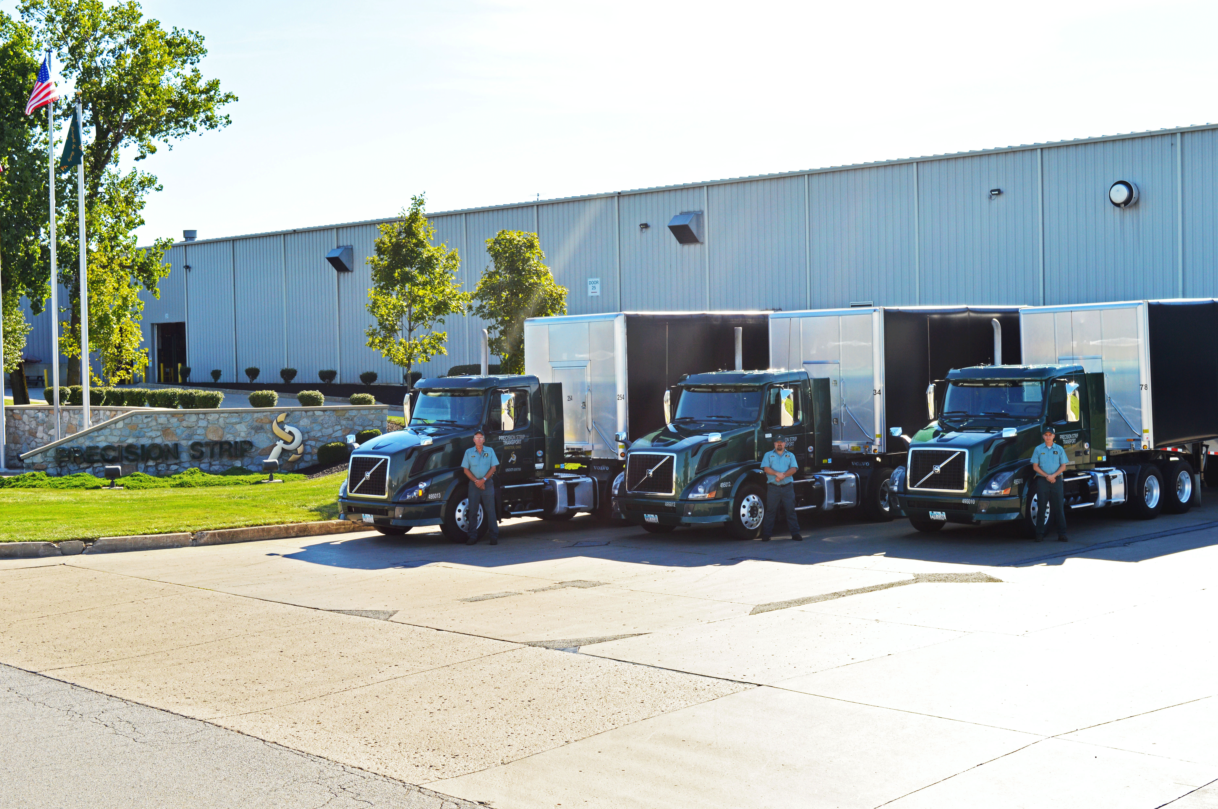

Precision Strip, Inc.

Slide 4
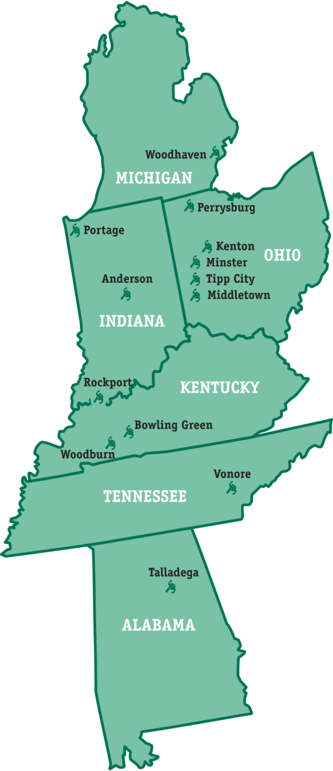

About Precision Strip
Founded in 1977
Acquired by Reliance Steel & Aluminum in 2003
Largest toll processor in the U.S.
  No ownership of inventory
13 processing locations, across 6 states
1,300 (+) associates
54 processing lines
220 tractor-trailer units
Over 5.2 million tons of metal processed in 2018
A total of 3.4 million square feet of facilities

Slide 5









What is a toll processor?
We take large coils that are provided to us by Steel and Aluminum Mills

Slide 6




















Where does it go?
Turn them into blanks, oscillate bundles or slit material for end customers such as

Slide 7
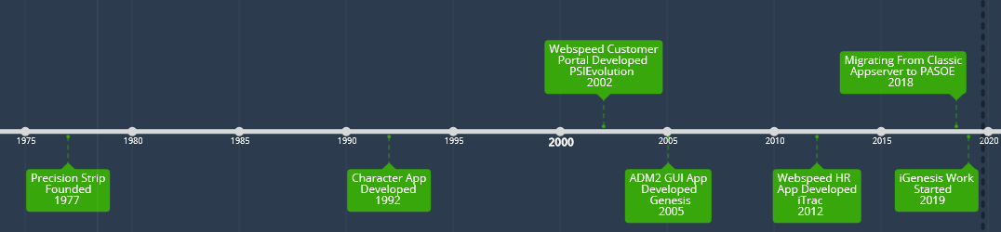
Precision Strip Genesis Timeline

Slide 8
iGenesis Benefits
Browser based
Easier to move to cloud in future
Modern Controls and New Functionality
API-Centric
Integrate with other systems easier
Easier Deployments
Improve UI/UX
Easier finding developers with web experience

Slide 9
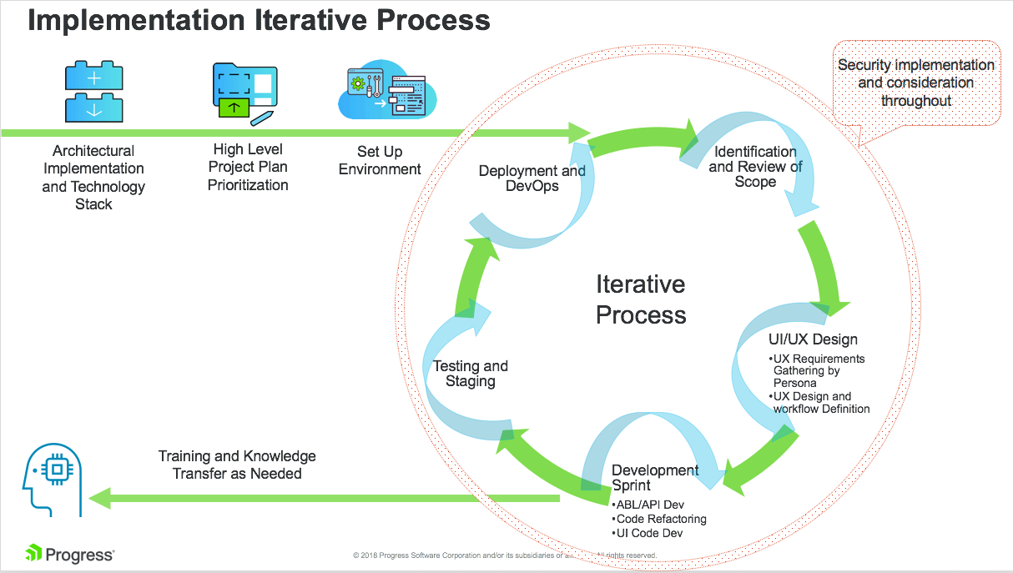
Planning a Modernization Project
Discovery
Design
Develop
Deploy

Slide 10
Discovery - Understand the needs of the Business
What does Modernization mean to the customer?
    Improved User Experience?
    REST API?
    Mobile?
    Integration to other Apps?
How does a modernization help to fulfill those needs?
What does success look like?
How do we measure ROI?
    This is important because modernization is an investment.

Slide 11

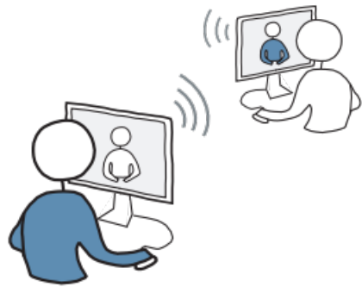

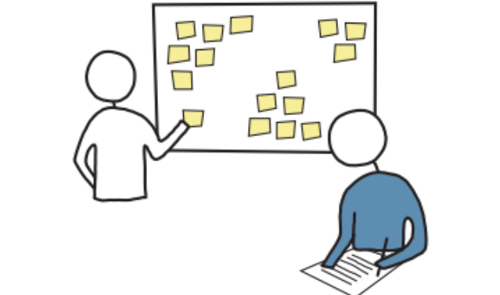
Discovery – Understand the Current Application
Who uses the application?
Identify Personas
  Execution of the project may be done by persona.
Discover
Know Your Users
Measure Success
Test
Define
Design

Slide 12
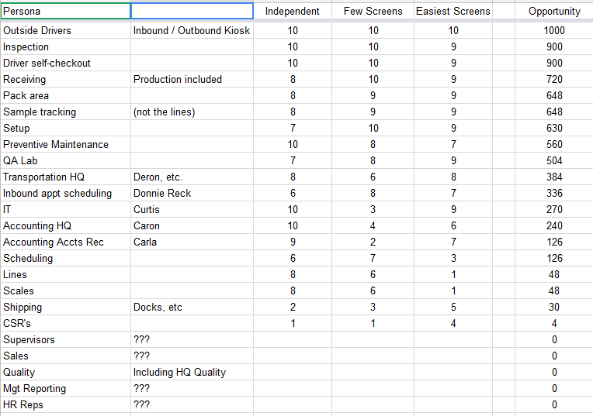
Discovery - iGenesis Personas

Slide 13
Discovery – Understand the Current Application
Survey Existing Application
  Code
  Framework
  Integration Points
  Authentication
  Authorization

Slide 14
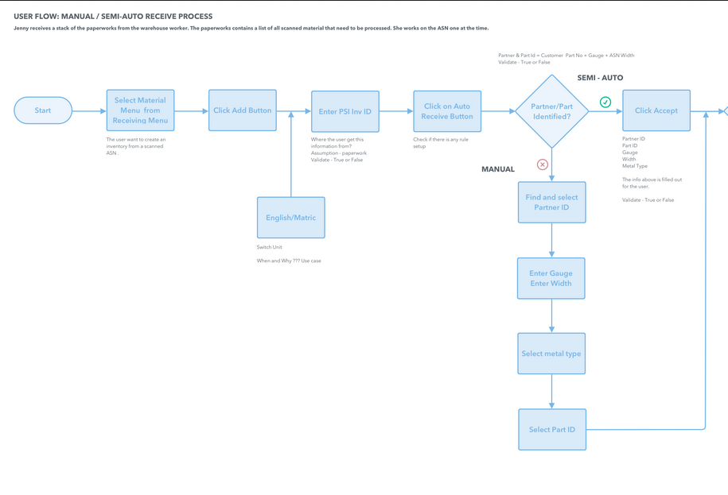
Planning and Design
User Journey
Workflow
  What currently works?
  What needs to Change
Responsive Design
Target Devices

Slide 15
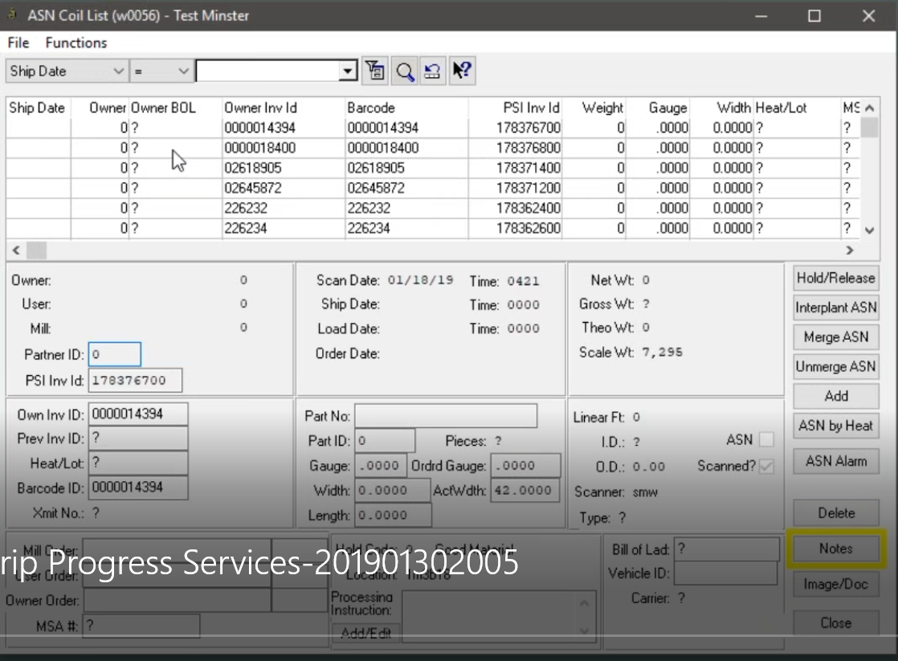
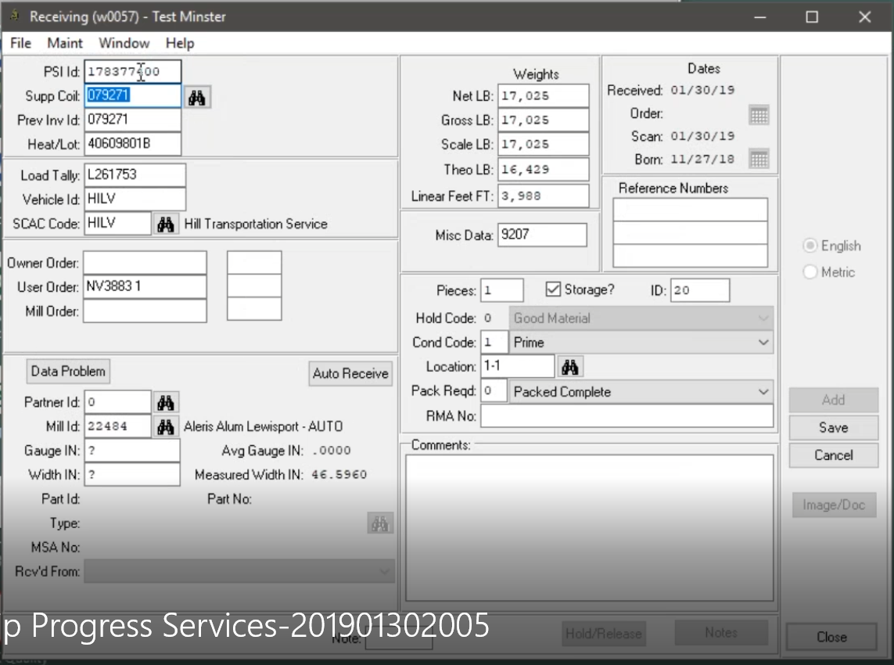
Planning and Design – Genesis GUI

Slide 16
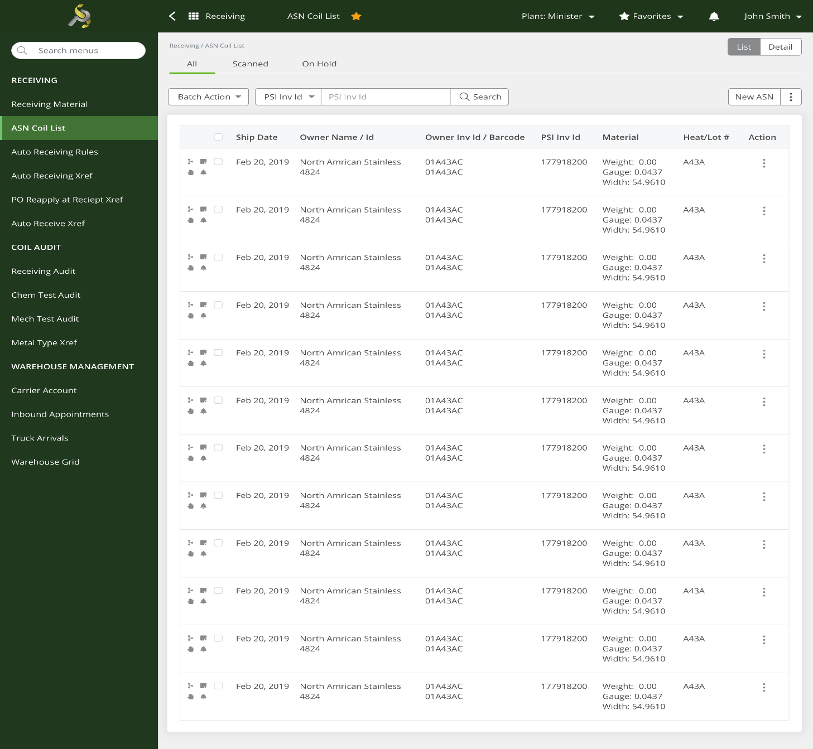
Design -Web

Slide 17
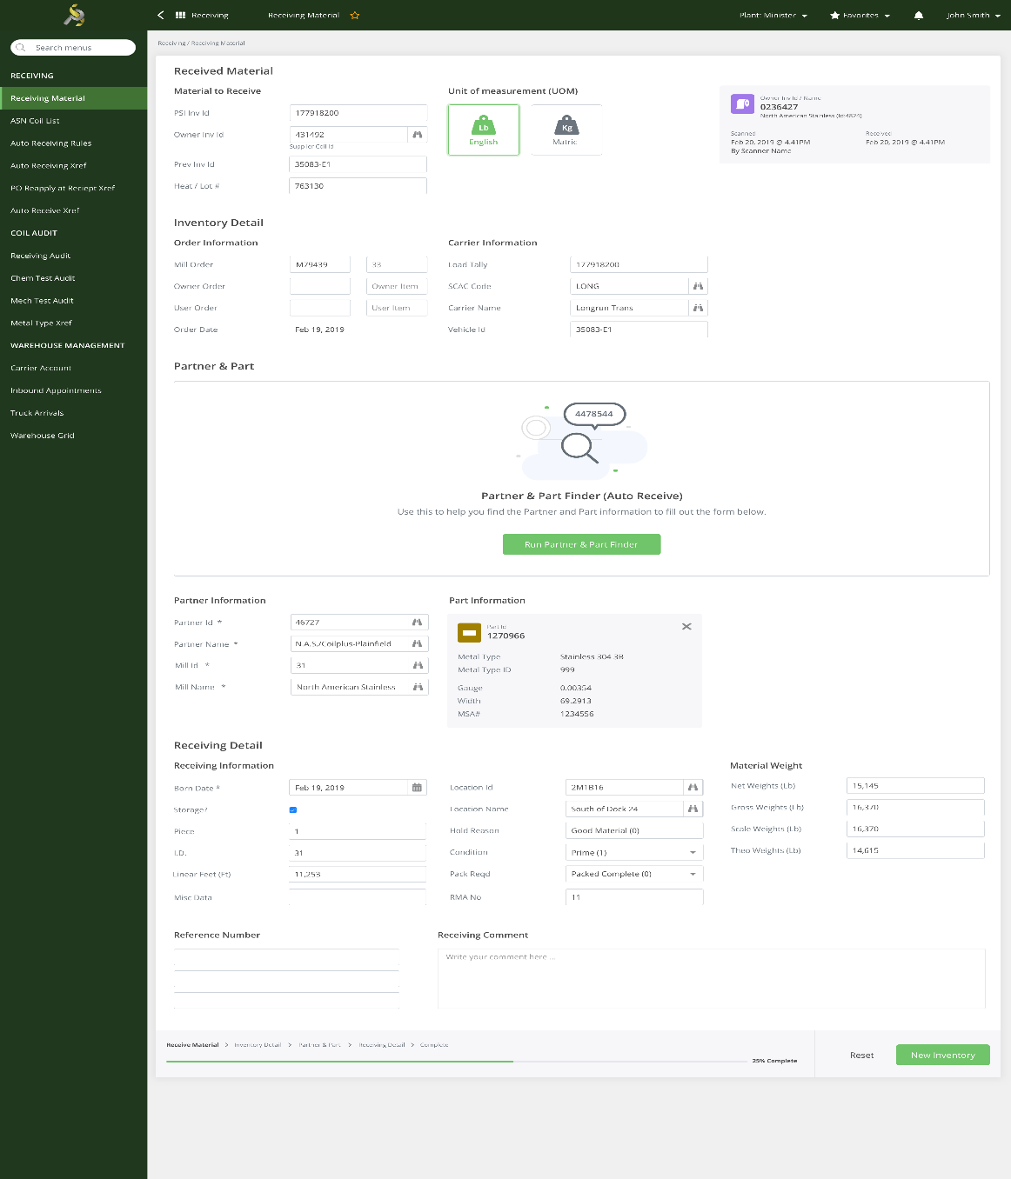
Design -Web

Slide 18





Planning and Design – UI Stack
Angular
Vue
React
Native Script
Kendo UI

Slide 19
Application Considerations
Application Fundamentals – Functionality required to support all personas
  Authentication
  Authorization
  Session Management
  Context Management
  URL Strategy and Routes
  REST API – Webhander
  Server-side Paging and Sorting
  JSDO

Slide 20
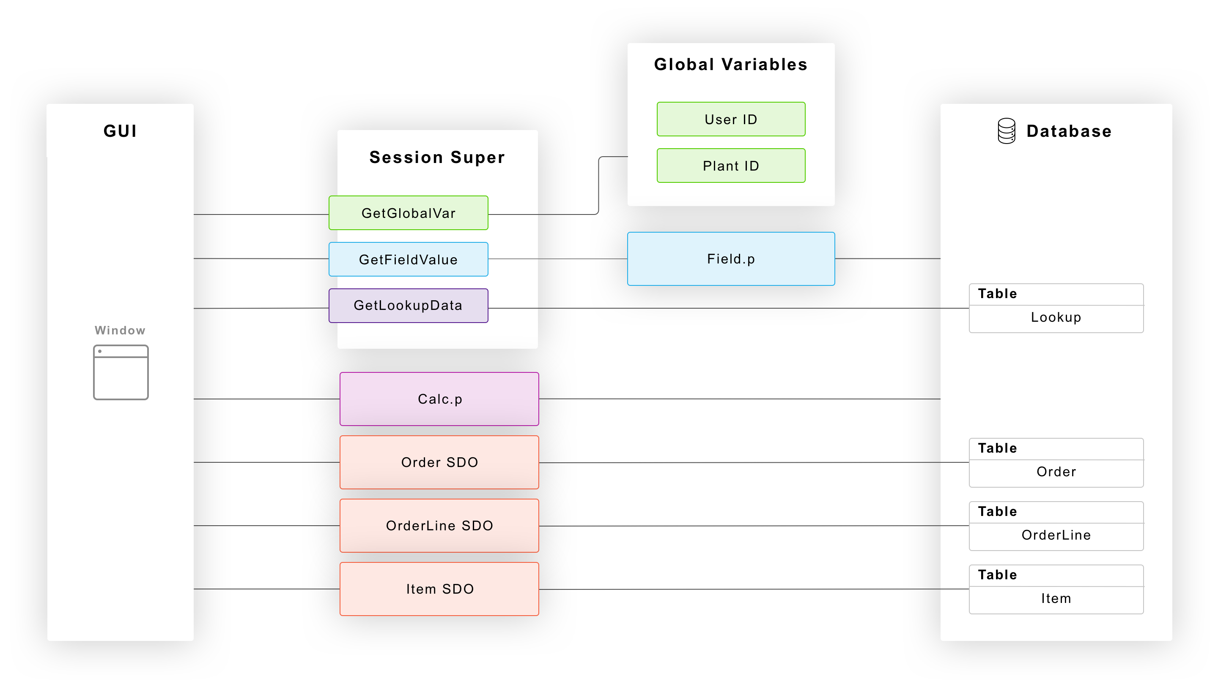
Legacy

Slide 21
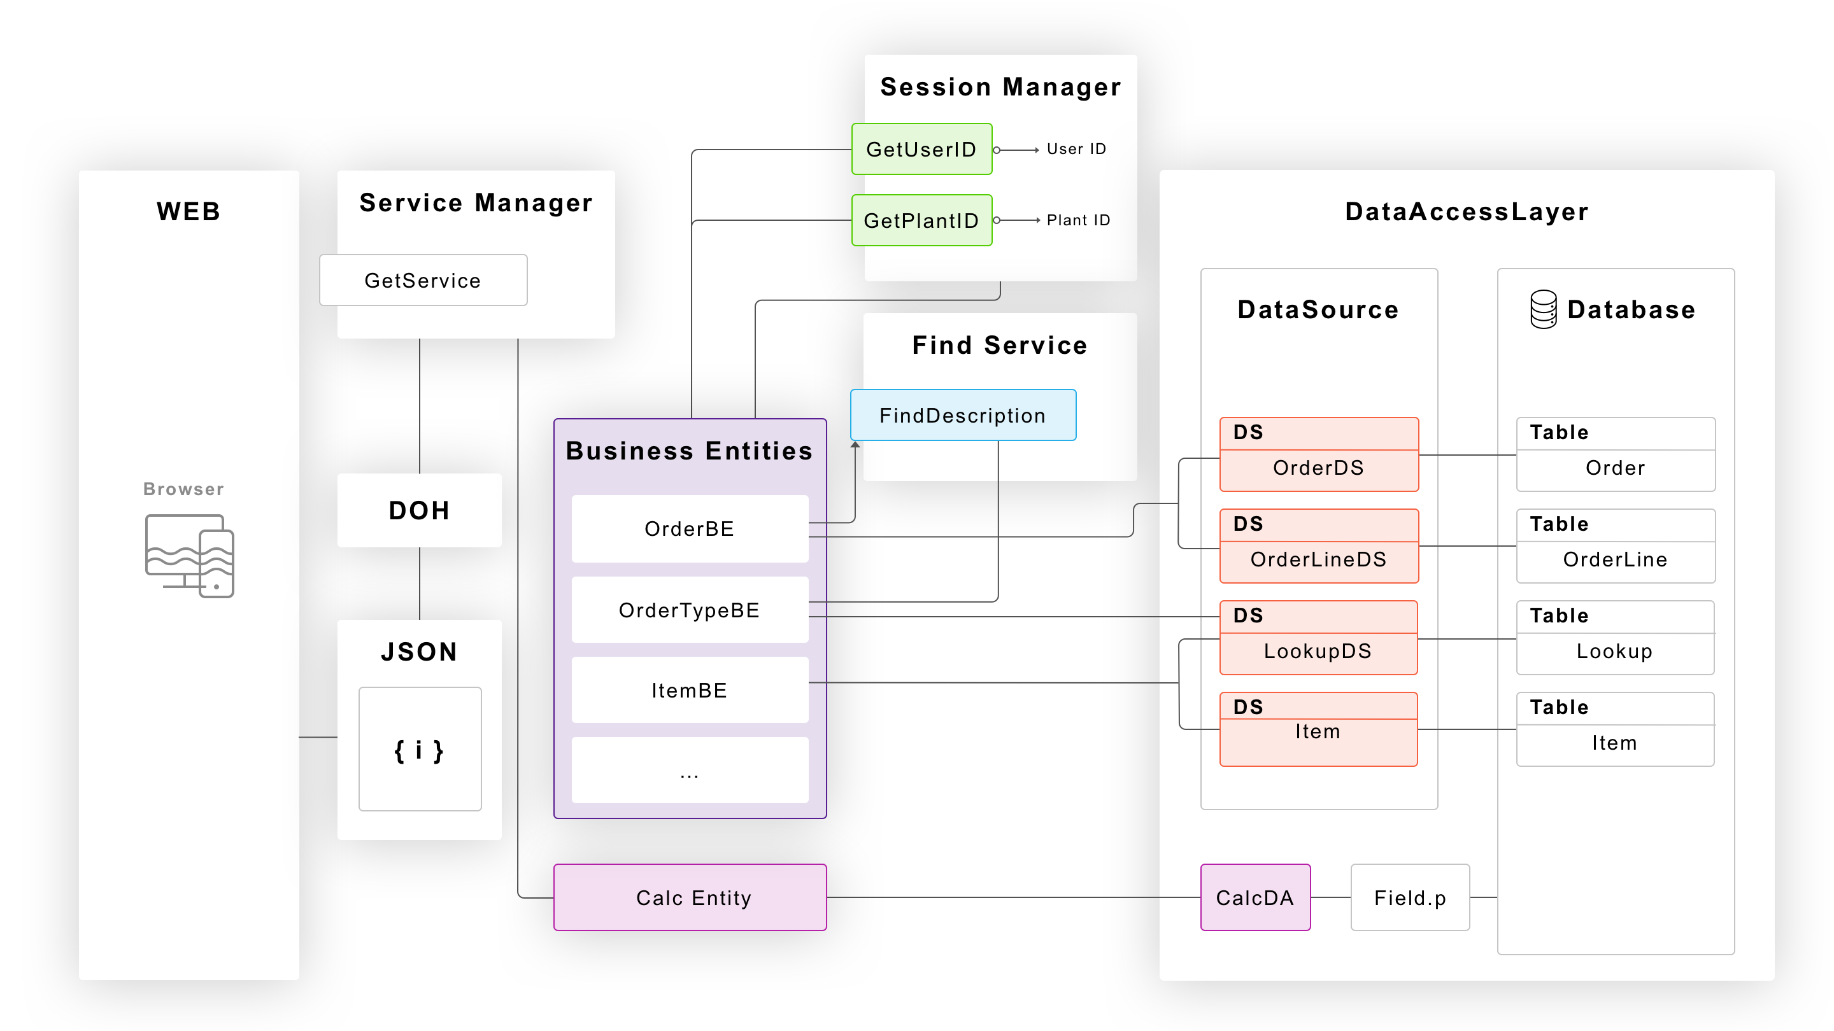
Modernized
Data Access Layer
Calc.p

Slide 22
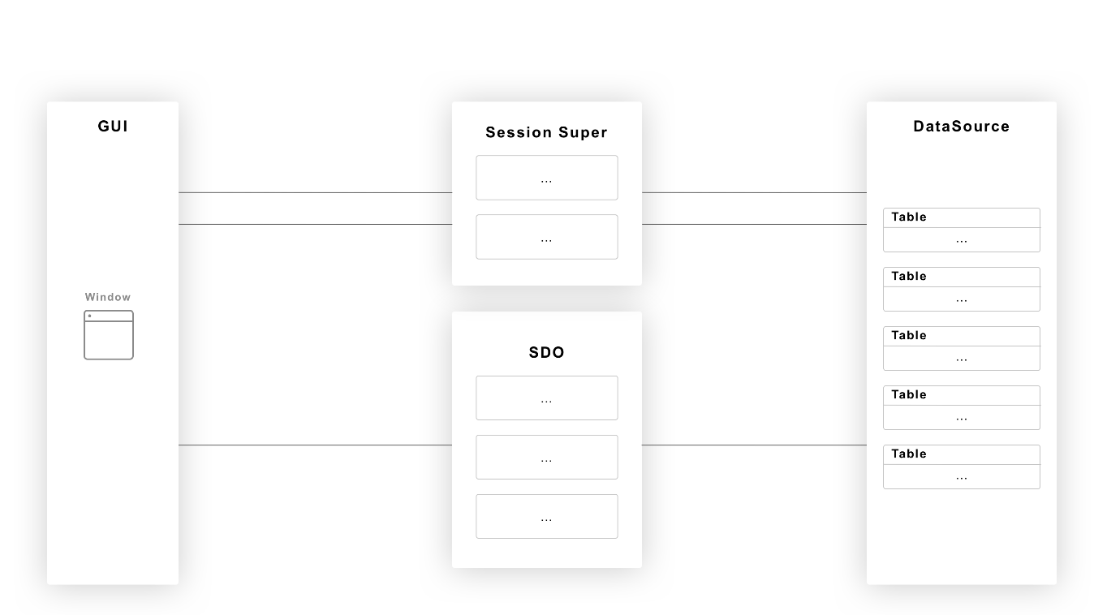
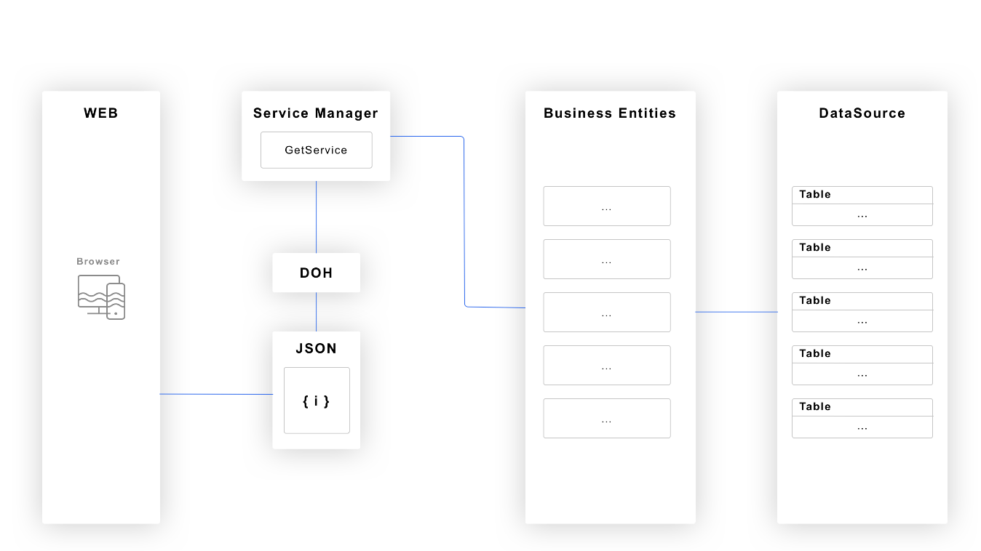
Legacy VS Modernized

Slide 23
URI and REST
Technology
  JSON
  PAS
  Web transport
  DataObjectHandler
    No Json .gen or .map config (yet)
    defaultHandler in openedge.properties

Slide 24
URI and REST Requirements
URI
  Resource identification
  Separate single row and query requests
  Resource navigation path
  Methods with parameters
URI Query
  Request a subset of properties
  Batching, filtering and sorting
Service Interface Contract
  Catalog

Slide 25
Request and Response Body Requirements
Request
  Before-image data in some requests
  Create, delete and update of multiple rows of multiple entities in one request
Response
  Hypermedia as the engine of application state (HATEOAS)

Slide 26
Resource Identification - URI Segments
http://host:port/webapp/transport/service/resource
  Webapp – One per plant
  Transport – web
  Service – genesis
    Only one
  Resource – ABL Entity
http://host:port/minster/web/genesis/plants
  Returns all plants

Slide 27
Resource Identification – Single Row - Key Alternatives
Key as segment
  http:…/customers/12
Key in parenthesis
  http:…/customers(12)

Slide 28
Key as Segment
Scoping Issue
  http:…/customers/Andersen - key
  http:…/customers/Calculate – operation
Multiple keys adds complexity
  http:…/orderlines/1/2

Slide 29
Request for Single Row - Key in Parenthesis
Primary key
http:…/customers(12)
http:…/salesreps(‘BBB’)
Alternate Key
http:…/customers(name=‘Acme Corp’)
Multiple Keys
  http:…/asns(plantId=1,ownerId=31,ownerInvId='00559737',barcodeId='00559737',invId=null)

Slide 30
Resource Navigation Path in Request
http…/receipts
http…/receipts(100005)
http…/receipts(100005)/inventories
http…/receipts(100005)/inventories(100217)
http…/receipts(100005)/inventories(100217)/holds
http…/receipts(100005)/inventories(100217)/holds(3415773)

Slide 31
Methods
Parameters in URI
Functions
  GET Request that cannot be resolved with filter
Actions
  POST or PUT Requests that cannot be resolved from the body
Scoping
  Bound
    Single Row
  Unbound
    Array
    Dedicated Entity

Slide 32
GET Function
Returns entity data
  ../metalTypes/GetByPartnerId(partnerId=15,gauge=0.0234,width=1.2334)

Slide 33
POST or PUT Action
Submit body with entity data
  No changes
  Optimistic Locking
Response body
  Data may have changes
  Records may have been added
  Records may have been deleted
../asns(invId=293982800)/ReleaseHolds(holdReleaseCode=5,rewrap=true,claimFaultCode=3,rewrapReasonCode=5)

Slide 34
URI Query- Request for a Subset of Properties
Query option select with list of properties
http…/plants?select=plantId,name
Only for read-only
  Conflicts with ABL optimistic-locking

Slide 35
URI Query - Batching of Data
Paging
  Requires count (ABL preselect)
Paging with count as asynchronous request
  Dedicated PAS instance for count
Infinite Scrolling
  Same behavior as ABL browser
  Cannot show count (5 of 43009)
  Cannot support LAST if forward only
Bidirectional Infinite Scrolling
  Same behavior as ADM2 Browser

Slide 36
URI Query – Paging
Query Options top, count and/or skip
Count can be used on first or all requests
Response has next page link with context
http:…/partners?top=20&count=true&select=partnerId,name
  {
  "response": [<partner data>],
  "@count": 12364,
  "partners@nextPageLink": “…/partners?top=20&select=partnerid,name&skip=20"
  }
http:…/partners?top=20&select=partnerId,name&skip=20
  {
  "response": [<partner data>],
  "partners@nextPageLink": “…/partners?top=20&select=partnerid,name&skip=40"
  }

Slide 37
URI Query – Infinite Scrolling
Query option top (without count and/or skip)
Response has next batch link with startId and context
http:…/partners?top=20&select=partnerId,name
  {
  "response": [<partner data>],
  "partners@nextBatchLink": “…/partners?top=20&select=partnerid,name&startId=13"
  }

Slide 38
URI Query – Filter
Query option filter with query expression
filter=partnerId eq 29321 and (modDate gt '2019-09-09’ or createDate gt '2019-09-09')
  Operators
    eq, ne, ge, gt, le, ne, contains, startsWith, endsWith
  Value
    Scalar
    Single quotes for string and dates
    No function or expression
    Null = ?

Slide 39
URI Query – Sorting
Query option orderBy
http//...customers?top=4&orderBy=ShipToEntity desc,name

Slide 40
Hypermedia as the engine of application state
Edit and navigation links in response
  "@editLink": "http…/ genesis/receipts(100005)",
  "partners@navigationLink": "http…/genesis/partners(30023)",
  "parts@navigationLink": "http…/genesis/parts(923767)",
  "rewraps@navigationLink": "http…/genesis/receipts(100005)/inventories(100005)/rewraps",
  "holds@navigationLink": "http…/genesis/receipts(100005)/inventories(100005)/inventoryHoldCodes",
Business Entity Code
  method override public void Initialize( ):
  AddManyToOneLink("partners","partner-id").
  AddManyToOneLink("parts","part-id").
  AddOneToManyLink("rewraps", "inv-id", "inv-id").
  AddOneToManyLink("inventoryHoldCodes", "inv-id", "inv-id").
  end method

Slide 41
Framework and Tools
Framework
  Managers
  Services
  Utilities
  Data Objects
  Support Objects
Tools
  Code Generator

Slide 42
Framework – Managers – Common Infrastructure Services (OERA)
Required Managers
  ServiceManager
    Public Service Interface Component
    Internal factory
  SessionManager
    Information per session, user, connection
  StartupManager
    Manages other managers
Custom Managers
  LoggingManager
  ContextManager

Slide 43
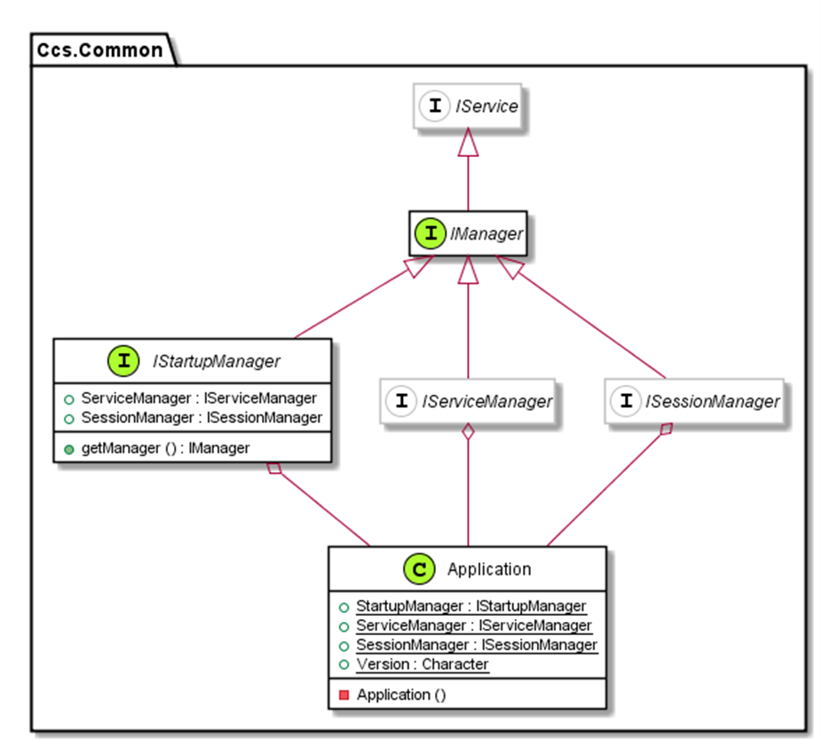
Managers – Bootstrap – Ccs.Common.Application
Static properties for required managers
  ServiceManager
  SessionManager
  StartupManager
    GetManager(interface)
Bootstraps the application
  PAS startup
  Unit testing

Slide 44
Framework – Utilities
Classes with static methods
Language Extensions
  Array
    ToArray(comma separated values of all data types)
  BufferUtil
    GetKey(buffer)
  DatasetUtil
  FileUtil
  JsonUtil
  StringUtil
Convenience Factory
  QueryUtil

Slide 45
Framework - Services
General purpose classes with reusable methods
Different from Managers
  Ad-hoc usage
Different from Utilities
  Sub class by application
define protected property FindService as IFindService no-undo
get():
return cast(Application:ServiceManager:getService(get-class(IFindService)),IFindService).
end.

Slide 46
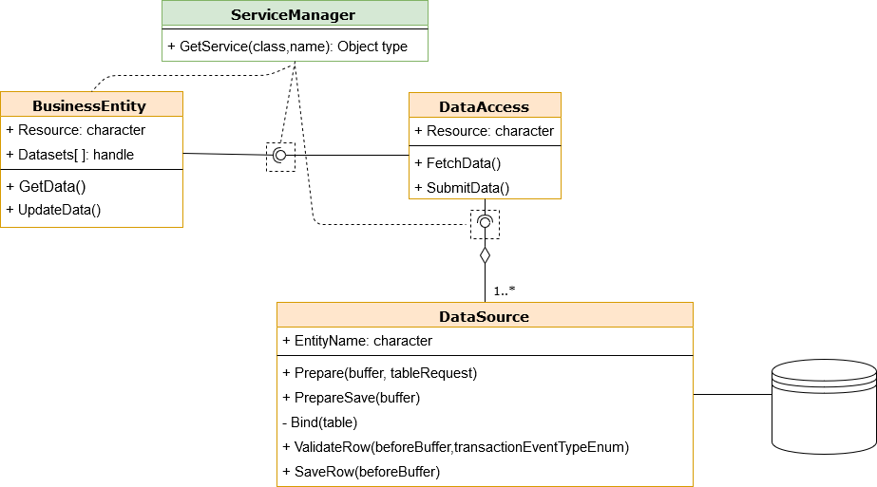
Framework – Data Objects
BusinessEntity
DataAccess
DataSource

Slide 47
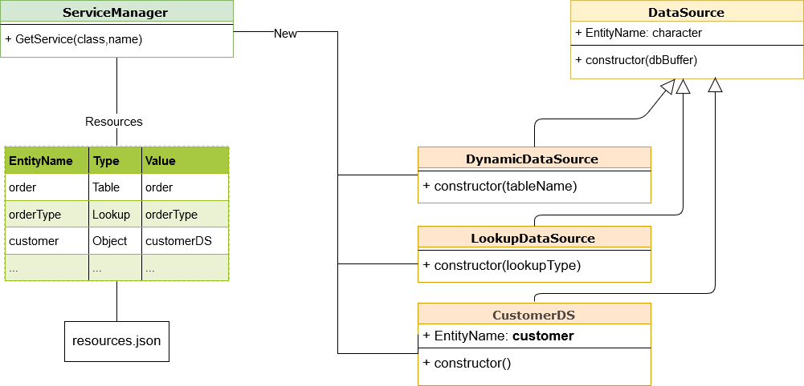
DataSource – Concrete Classes

Slide 48
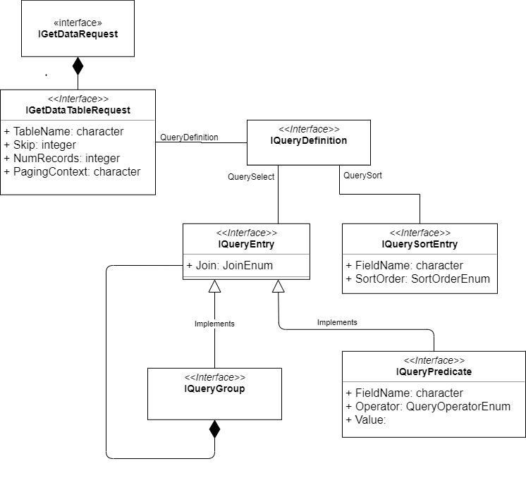
Framework – Request Objects - Implements Ccs Interfaces
Request Objects
  GetDataRequest
  GetDataTableRequest
  UpdateDataRequest
Query Objects
  QueryDefinition
  QueryGroup
  QueryPredicate
  QuerySortEntry

Slide 49
Framework – Response Objects – Implements Ccs Interfaces
Response Objects
  GetDataResponse
  GetDataTableResponse
    NumResults
    PagingContext

Slide 50
Business Logic Hooks
BusinessEntity
Static code against temp-tables
Override without super call
method protected void BeforeFetchData(input-output poRequest as IGetDataRequest, input-output dataset-handle phDataset):
method protected void AfterFetchData(input-output pResponse as IGetDataResponse, ` input-output dataset-handle phDataset):
method protected void BeforeSubmitData(input-output poRequest as IGetUpdateRequest, input-output dataset-handle phDataset):

Slide 51
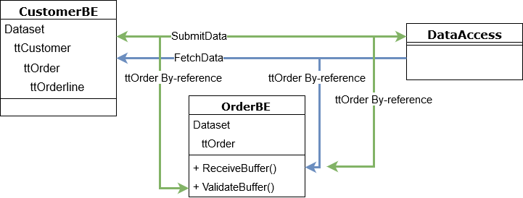
Business Entity Table Hooks
Business Entity where Resource name = Temp-table serialize-name
  ReceiveBuffer
  ValidateBuffer

Slide 52
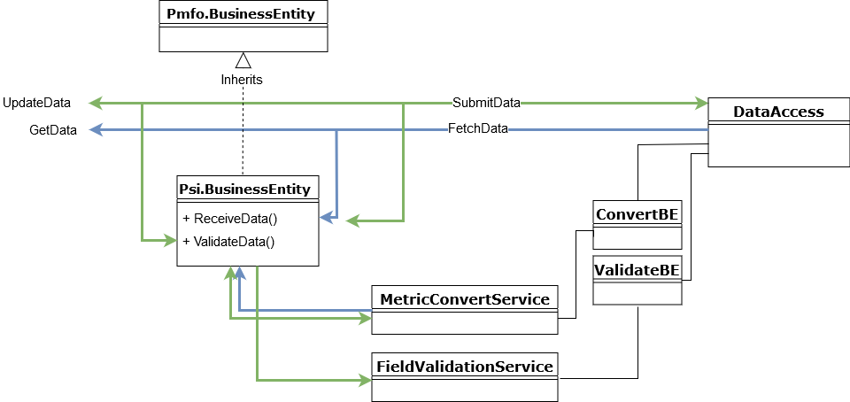
Customer Specific Common Business Logic
Metric Conversion - Stored in database
Field Validation - Stored in database

Slide 53
Data Source Hooks
Static code against temp-tables and database tables
Override without super call
12 Row level hooks (Same as SDO)
Both before-image and after-image record is available
  4 Event Types
    Pre – Outside of transaction
    Begin – In Transaction
    End – In Transaction
    Post – Outside of transaction
  3 Operations
    Create
    Write (create and modify)
    Delete

Slide 54
Framework – Other Support Objects
Parsers
  URI Keys → Query Objects
  URI Query Filter → Query Objects
  URI Query StartId → Query Object
  Function and Action Parameters → ABL Parameters
QueryBuilder
  Transform and inject
    Request and Query Objects → DataSource BaseQuery
TransactionManager
  Support Ccs CommitScopeEnum
    All, Table, Row, Nested
  ValidationManager
    Calls all hooks

Slide 55
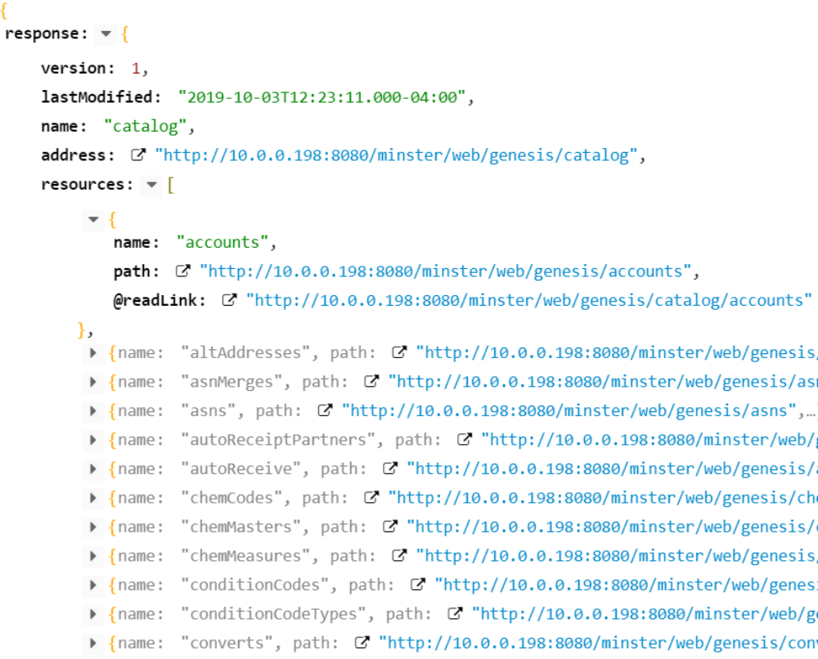
Catalog – All Resources
Name
Path
@readLink

Slide 56
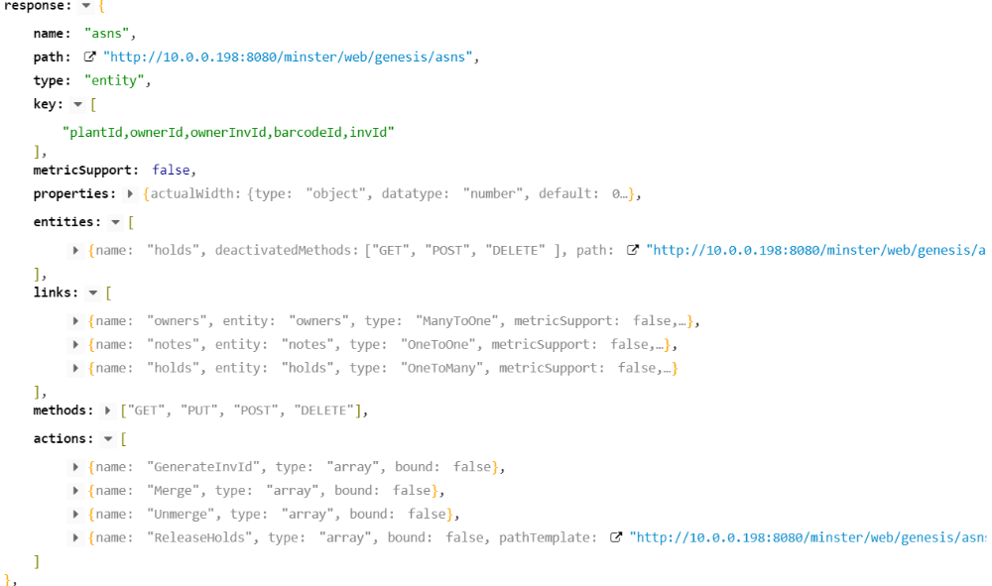
Catalog - Resource
Name
Path
Type
Key
MetricSupport
Properties
Links
Methods (Web)
Actions
Functions

Slide 57
Tools
Code Generator
  Reads
    Database Tables
    ADM2 SDOs and DLPs
    Lookup Table Records and Data
  Uses Naming Service
    INameUtil implemented per customer
  Generates
    Temp-table definitions
    Business Entities
    Data Sources
      Migrates and renames temp-tables in SDO Hooks
    Updates Catalog - resources.json

Slide 58
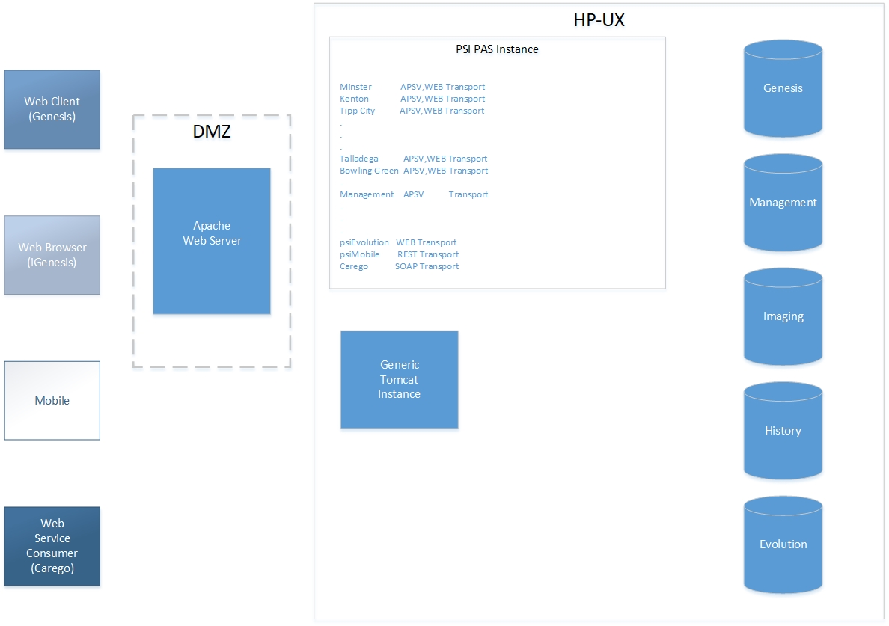
Design
Application Topology

