Slide 1
Reduce Downtime with the PAS for OpenEdge HealthScanner
David Cleary
PAS for OpenEdge Product Owner
October 9, 2019

Slide 2
Agenda
What is the HealthScanner and why do I want one?
How the HealthScanner work
HealthScanner in Action

Slide 3
What is the HealthScanner and why do I want one?

Slide 4
As DevOps, I want to efficiently check the health of my Server VM to decide if it needs to be taken out of service and replaced before my users are impacted

Slide 5


Slide 6


Slide 7
HealthScanner Requirements
Provide an overall score of a VM that reflects server health
  OS resources and metrics
  Tomcat resources and metrics
  OpenEdge resources and metrics
Run efficiently in the background without affecting application
Provide an answer immediately
Allow sufficient tuning of score based on application and resources
Allow custom extension points for customer use
Provide data useful for storing, trending and predictive maintenance

Slide 8
Primary Use Case
Provide a whole server health score between 0 and 1
When my server health score drops below a specified level, start up a replacement server and take this one out of service
VM taken out of service can be examined forensically to identify the issues leading to poor server health.

Slide 9
Secondary Use Case
Provide a mechanism to push health data to a collector that will be responsible for analyzing and trending data, and eventually predictive maintenance

Slide 10
Not a Use Case
Provide health information at a level to take action to on specific parts of a server to keep it healthy
We are not looking to fix the car at first sign of trouble, we are looking to replace it.

Slide 11
How the Health Check Service works

Slide 12
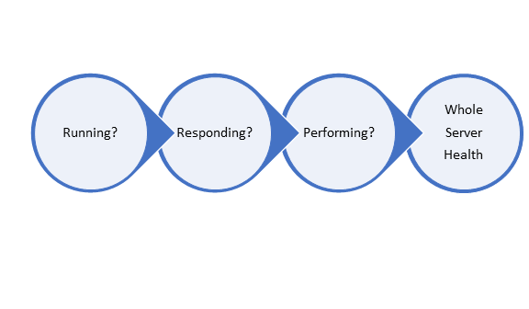
Whole Server Health

Slide 13
Server Running Health
Are the correct processes running?
  Tomcat
  Agent[s]
  Database
Running metrics are binary
  Any required process that isn’t running – Health Score = 0

Slide 14
Server Responding Health
Are enabled transports accessible externally?
  A localhost ping has limited value
  A better metric is tracking pings initiated externally
Track via a valve and URL
  When the specified PING URL is executed, capture HTTP status and response time
  Health score calculated based on HTTP status (200 = 1.0)

Slide 15
Server Performing Health
Performance factor comprised of two parts
  Performance – weighted composite of metrics
  Resources – weighted composite of measures
Performing = performance – resource penalty

Slide 16
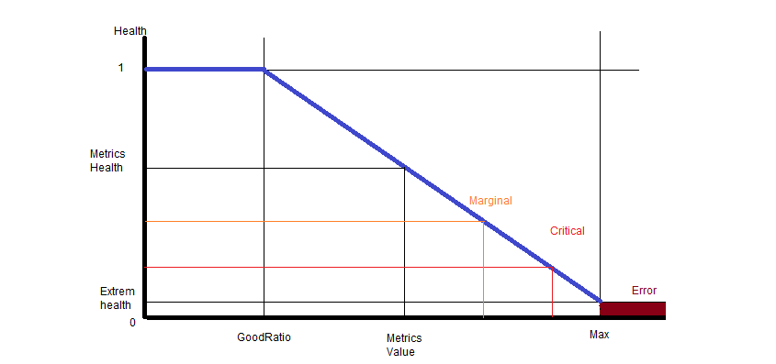
Value Analysis

Slide 17
Probe Types
Resource Probes
  Is a particular resource becoming constrained?
  OS Level
    Memory, disk space, CPU
  Tomcat
    Java memory, executor threads
  OpenEdge
    ABL sessions
    Errors
    Response time

Slide 18
Probe Types
Timing probes
  Examines response timings
  Health reduced if average time degrades past thresholds
Error probes
  Examines error rates
Ping probes
  Examines accessibility from outside
  Requires external driver
Application probes
  Custom probes written in ABL where you decide health

Slide 19
Probe Configuration
Full Health
  Threshold where health starts becoming marginal
Critical Health
  Threshold where health requires some action
Weight
  Value from 0 to 1
  Determines probes contribution to overall health score

Slide 20
Composite Probes
Related probes are grouped together as a composite probe
Composite probes have their own weight and thresholds
Composite probes role up into Server Health calculation
sum of probes( health * weight ) / sum of probes( weight )

Slide 21
















VM
ABL
Client
REST
Client
SOAP
Client
WebSpeed
Client
Load Balancer
Health Service
APSV
Transport
REST
Transport
SOAP
Transport
WEB
Transport
Session Manager
Session Manager
PAS for OpenEdge Instance
Agent
Multi-Session Agent
Collector
Database

Slide 22
Health Check Service in Action

Slide 23
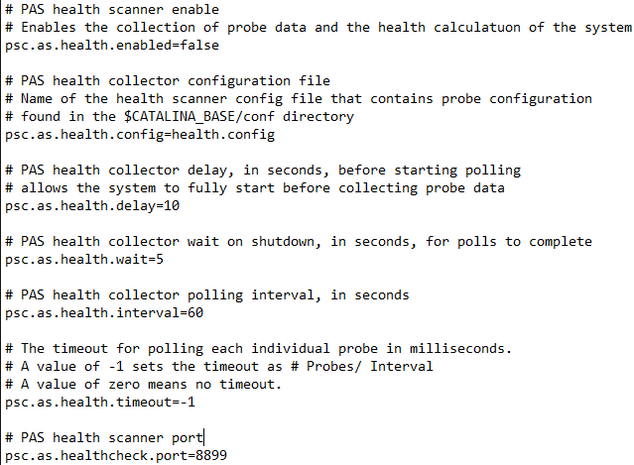
Configuring the HealthScanner
Configuration properties
  Enable the collector
  Polling delay
  Shutdown delay
  Timeout
  Port

Slide 24
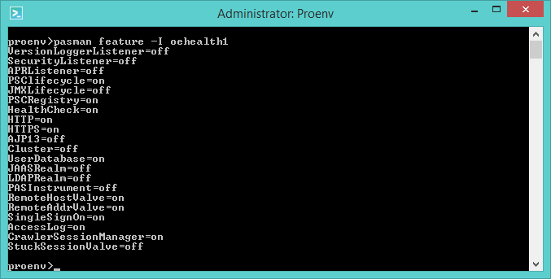
Enabling the HealthScanner
Collector runs independently of HealthScanner service
  Can access results via oehealth script locally (JMX)
HealthScanner Service enabled via feature command
  tcman feature HealthCheck=on
Securing the HealthScanner Service
  Optionally configure Remote Address Filter or Remote Host Filter

Slide 25

Configuring Probes
Properties in conf/oehealth.confg
Probes are grouped by parent
  JVM
  Tomcat
  Transport
  OS health
  PASOE Health
Important settings
  Enabled
  Weight
  Marginal/Critical
  Fail on Critical

Slide 26
Configuration Example
, {
"name" : "OS Health"
, "description" : "Composite weighted score of operating system metrics"
, "comments" : "contains an array of probe definitions"
, "calculation" : "sum of probes( health * weight ) / sum of probes( weight )"
, "className" : "com.progress.appserv.services.health.probe.CompositeHealthProbe"
, "weight" : 0.3
, "marginal" : 0.7
, "critical" : 0.6
, "enabled" : true
, "probes" :
[
{
"name" : "Disk Space Health"
, "description" : "Free disk space probe"
, "comments" : ""
, "calculation" : "(disk size - disk used) / disk size"
, "className" : "com.progress.appserv.services.health.probe.OSDiscSpace"
, "fullHealth" : 0.85
, "extremalHealth" : 0.0
, "weight" : 0.4
, "marginal" : 0.7
, "critical" : 0.6
, "failOnCritical" : false
, "enabled" : true
}

Slide 27
Accessing the Health Score
Am I Healthy?
  http://host:port/health
  Returns 200 if healthy, 500 if not
Summary results
  http://host:port/health?view=summary
  { "health": 0.9738912442605149, "interval": 60, "timestamp": "2019-04-26T18:27:17.200Z" }
Detailed results
  http://host:port/health?view=details
All results returned as JSON

Slide 28

Demo

Slide 29


You might also like to attend
Beyond the Code: Securing a Cloud Application
David Moloney
Wednesday, May 8
2:45 – 3:30 PM
Thank You!
Deploying Applications with the Docker Container for Progress Application Server for OpenEdge
Edsel Garcia
Wednesday, May 8
3:45 – 4:30 PM
David Cleary
davec@progress.com
Mastering OpenEdge Problem Diagnosis
Paul Koufalis
Wednesday, May 8
4:45 – 5:30 PM

