Slide 1



All types of data replication with OE databases
Dmitri Levin
Progress, Oracle, SQL Server DBA
Alphabroder Co
Philadelphia PA

Slide 2
All types of data replication
After-Image (Log based) Replication
OpenEdge Replication
Pro2 Replication
Custom Replication
Notes:
We will mostly talk about the first 3 methods that are provided by PSC.
Custom replication could be written by any company or service provider.

Slide 3
All types of data replication
After-Image Replication
Version 5 (late 80-es)
$DLC/bin/rfutil db-name –C roll forward –a ai-name
$DLC/bin/rfutil db-name –C roll forward retry –a ai-name
$DLC/bin/rfutil db-name –C roll forward oplock –a ai-name
(10.1C)
Notes:
Retry is a very important addition. Now it is not a problem if sysadmin will shutdown the server during roll forward process. I can always re-start it from the moment it was interrupted with a retry option.
Oplock is an other useful option. It protects the warm spare database from accidental startup or entry (pro). See the following slide. I use it for all of our after-image replication needs.

Slide 4
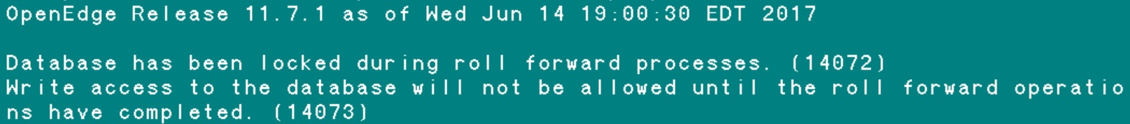
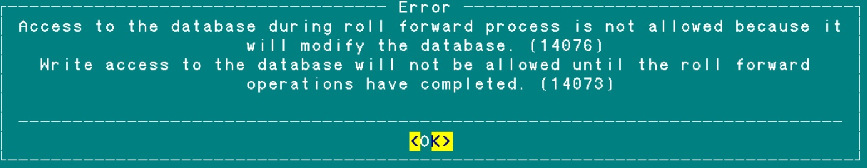
Roll forward oplock
Notes:
Here you see the message OE rfutil displays when the first roll forward oplock is executed. The consequent roll forward oplock will ignore the oplock option. So oplock option could be used all the time with each after-image roll forward.
Next you see the Error that OE displays when someone try to connect to the oplock protected database with “pro”. Similar error will be produced when we attempt to start the server with “preserve” on a locked database.
Same message goes to the log file db_name.lg
[2018/09/13@17:35:02.391-0400] P-13959364 T-1 I RFUTIL : (14072) Databas
e has been locked during roll forward processes.

Slide 5
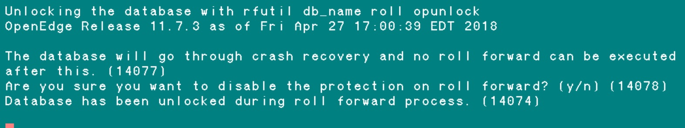
Roll forward oplock
$DLC/bin/rfutil db-name –C roll opunlock
Notes:
After rfutil roll opunlock the database becomes normal database that can be used.

Slide 6
All types of data replication
OpenEdge Replication
Fathom Replication 1.0 (Since Progress v9 in 2001)
Fathom Replication 2.0
OpenEdge Replication
Oracle Data Guard
OpenEdge Replication Plus – part of Advanced Enterprise License
Notes:
OE Replication Plus is add-on to OE Replication. It allows to start the server against the replication Target Database. And users can query that Target database with ABL and SQL.
It is also part of Advanced Enterprise License that also includes: Table Partitioning, Multi-Tenacy, OE Management, CDC and TDE.

Slide 7
All types of data replication
Pro2 Replication
BravePoint product
Pro Dump & Load (Dan Foreman and Co)
pro2pro pro2sql pro2ora
Pro2 Version 5 introduced CDC. We have version 4.6.7
Notes:
Pro2 is a BravePoint product. It was based on Pro Dump & Load developed in early 2000s. It comes in three flavors: pro2pro, pro2sql and pro2ora. The last two require an OE DataServer ( for SQL Server or Oracle respectively ).
Pro2 Version 5 includes a CDC license for use with Pro2 only.
The Pro2 product can be purchased and implemented yourself, however 99% of the implementation are done by the Progress Support team ( per Mike Furgal ).

Slide 8


All types of data replication
Custom Replication
Export data from Progress. Create .txt files. Daily.
Import data into Oracle. Using Oracle External Tables.
Notes:
We export data from Progress database into text files ( pipe delimited ) each night. Then load them into Oracle database using Oracle External Tables. That is a very fast way to load data. It is kind of once a day snap shot of everything done on a previous day. It takes 4 hours to dump data with Progress export. And 1 hour to load into Oracle. The we use SAP Business Objects to create reports for company upper management from our Oracle Decision Support Database.

Slide 9
All types of data replication
Oracle
After-Image (Log based) Replication
Redo Log Shipment
OpenEdge Replication
Oracle Data Guard
Pro2 Replication
Oracle Golden Gate
Custom Replication
Custom Replication
Notes:
Oracle has very similar options, tools and licenses. OpenEdge Replication works better than Oracle Data Guard for me, i.e. less problems encountered during last 2-3 years.

Slide 10
After-Image
OE Replication
Pro2
Whole / Partial | Whole Database | Whole Database | Partial / Table by Table
Unit | AI-Block | AI-Block | Record
Notes:
The possibility to replication only some tables ( Partial replication ) is very important feature of Pro2. It brings some other differences then.
Let’s look closer at After-Image Blocks on the next slide.

Slide 11
After-Image Block
DB Block ( record )
DB Block ( index )
Recovery note
Recovery note
Recovery note
Recovery note
_StorageObject._Object-number ???
Notes:
Each recovery note describes the change of one particular database object ( table, record, sequence). The fact is that this recovery note does not have information about Object ID it is related to. They only describe the changed to the database block, not knowing which object those changes are for.

Slide 12
After-Image
OE Replication
Pro2
Whole / Partial | Whole Database | Whole Database | Partial / Table by Table
Unit | AI-Block | AI-Block | Record
Can use for DR/backup | Yes | Yes | No
Can use for data reorganization | No | No | Yes
Throughput | Fast | Faster | Slower
Instant replication | No | Yes | Yes
License | No | Yes | Yes
Access to Target DB | No | Yes (OE Repl Plus) | Yes
How difficult to setup | Very easy | Easy | More difficult / PSC help
Possibility of delay | Yes | No | May be
Notes:
Unlike After-Image and OE Replications Pro2 is not designed for data protection (DR or run backups on Target). It is either for replication to different database vendor (SQL Server, Oracle) or pro2pro to do data reorganization like D&L or move from one type (HP, IBM) to a different type (Linux, Win).
By “Throughput” I mean how fast the data changes from Source DB could be replicated to Target DB. How much data changes we can get through that type of replication, While After-Image and OE Replications rare have speed bottleneck if configured appropriately, the pro2 limits the load by itself. The default Pro2 version 4 has 5 replication threads. That is a limit by itself. It is increased in version 5.
By “Instant replication” I mean do the changes instantly go to the Target database. Obviously for AI replication they are not.
The possibility to set up a delay in replication is also an important feature described on a later slides

Slide 13
Possibility to delay replication using After-Image replication
Physical Corruption
Corruptions leading to errors with standard operations:
Reading, back out of a transaction, crash recovery
Logical Corruption
“Hand made corruptions” – deleting or wrongly changing important data
Both Corruptions could be fixed by delayed replication
Notes:
In some rare cases a corrupted recovery note will be created in Source database. That damaged note will be transferred to the Target database by roll forwarded and corrupting the bi file on the Target.
This can be fixed by restore of the whole database from backup and roll forward, but that is a lengthy process. So it will be faster to recover using a warm spare database with a delayed after-image roll forward.
Sometimes user deletes important data.

Slide 14
Possibility to delay replication using After-Image replication
How long to delay? That is a question.
Time more than the longest transaction
Time when we expect to discover a physical or logical corruption
That is a very practical question.
Time to bring replication to current.
So it is a compromise between possibility of discovering corruption and
time to transfer warm spare into live production database.
Notes:
Why the time should be more than the longest transaction? Because the recovery note has both information about play forward the block changes and also play back – transaction back out. And a corruption could be in either parts. If the corruption is in the recovery part we can see it only during crash recovery, way after the transaction started. Thus delay should be longer than max transaction length.
I keep my warm spares with a 6 hours delay. On one hand if corruption is not discovered in 6 hours it is likely to be fine for some considerable time and it is more then the time we expect to discover corruption. Also I can rather quickly ( in and hour or so ) bring the replication to current state, i.e. apply all AI for 6 hours in 1.5 hours aprox.

Slide 15
Possibility to delay replication using After-Image replication
Replication delay helps in investigation of issues
$DLC/bin/rfutil empty -C aimage truncate -aiblocksize <your_db_ai_block_size>
$DLC/bin/rfutil empty -C aimage scan verbose -a ai_file > some_file.txt
Any database with the same after-image block size
Notes:
We had an issue when a user deleted important accounting data that prevented all accounting transactions. We first restored the record using a delayed replication. Data was not deleted in warm spare with 6 hour delay. Then we used scans of After-Image files with rfutil –C aimage scan. We store after-images for 10 days. We found a transaction ( the user name, the exact time of a transaction where deletion happened ) using RECID of a record that was deleted. We “grep” DBKEY over scans of AI files. We new the approximate time when it was deleted.
Geroge Potemkin has programs AiScanStat.p and grepAiScan.p that work with scans of after-image files. And using those programs you can get some very useful information.

Slide 16


Slide 17
Demo slides (in case demo does not work)
(S-Source) proutil /home/job183/demo/sports -C enableSiteReplication source
(S) probkup online /home/job183/demo/sports /home/job183/demo/sports.bkp –REPLTargetCreation
(S) ftp.sh – FTP backup created in previous step from Source to Target
(T-Target) prorest /home/job183/demo/sports sports.bkp –verbose
(T) proutil /home/job183/demo/sports -C enableSiteReplication target
(T) proserve -pf /home/job183/demo/sports_target.pf
(S) dsrutil /home/job183/demo/sports -C restart server
--------------------------------- Monitoring ---------------------------------------------
(S/T) dsrutil /home/job183/demo/sports –C status
(S/T) dsrutil /home/job183/demo/sports –C status –verbose
(S/T) dsrutil /home/job183/demo/sports -C monitor

Slide 18
Demo slides (in case demo does not work)
Sample of sports.repl.properties file
[server]
control-agents=sportsagent1
database=sports
transition=manual
agent-shutdown-action=recovery
transition-timeout=600
defer-agent-startup=5760
[control-agent.sportsagent1]
name=sportsagent1
database=sports
host=<Server-name>
port=65016
connect-timeout=120
replication-method=async
critical=0
[agent]
name=sportsagent1
database=sports
listener-minport=30003
listener-maxport=30100
[transition]
transition-to-agents=sportsagent1
database-role=reverse
auto-begin-ai=1
auto-add-ai-areas=0
source-startup-arguments=-DBService replserv -S
demosports -pica 8192
target-startup-arguments=-S 65016 -DBService
replagent
restart-after-transition=0
Transition →
Transition →
Transition →
Transition →
Transition →
Transition →
Transition →
Transition →
Transition →
Transition →
Notes:
Make sure the following is set
[server]
agent-shutdown-action=recovery
The agent-shutdown-action must be set to recovery (from PKB 18310)
[transition]
transition-to-agents=agent1
To make a transition failover a definition of what agent(s) to transition to must be stated in the <sourcedb>.repl.properties file. (from PKB 18400)

Slide 19
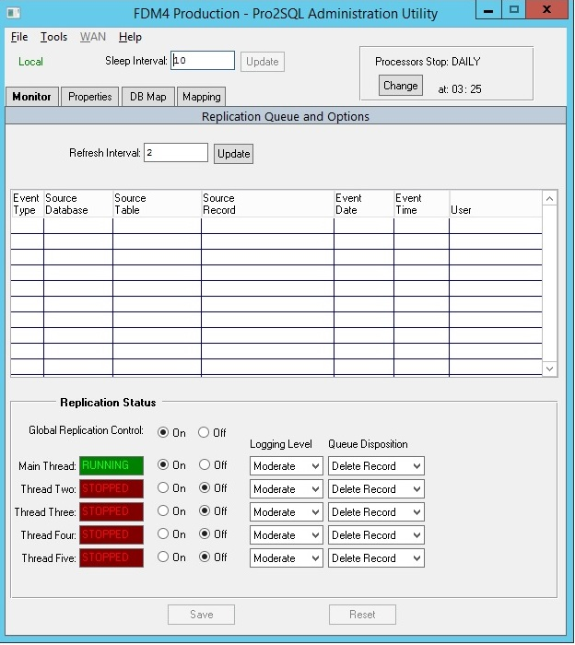
Demo slides (in case demo does not work)
Notes:
V5 shows all threads, where v4 and below show just the first 5. You could always have more than 5 threads, it’s just that the tool never showed or managed more than 5.

Slide 20
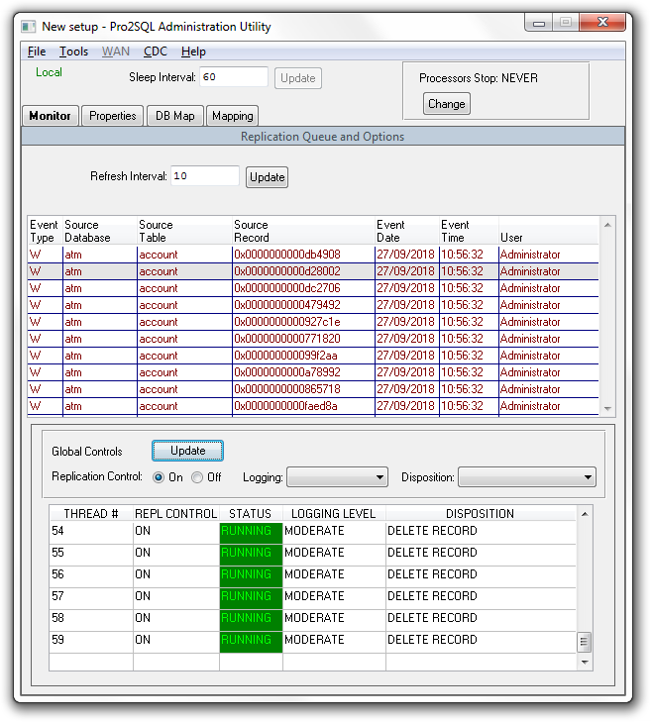
Demo slides
Pro2 Version 5
Notes:
Pro2 version 5 shows all threads, where version 4 and below show just the first 5 threads. You could always have more than 5 threads, it’s just that the tool never showed or managed more than 5 threads before Pro2 version 5.

Slide 21
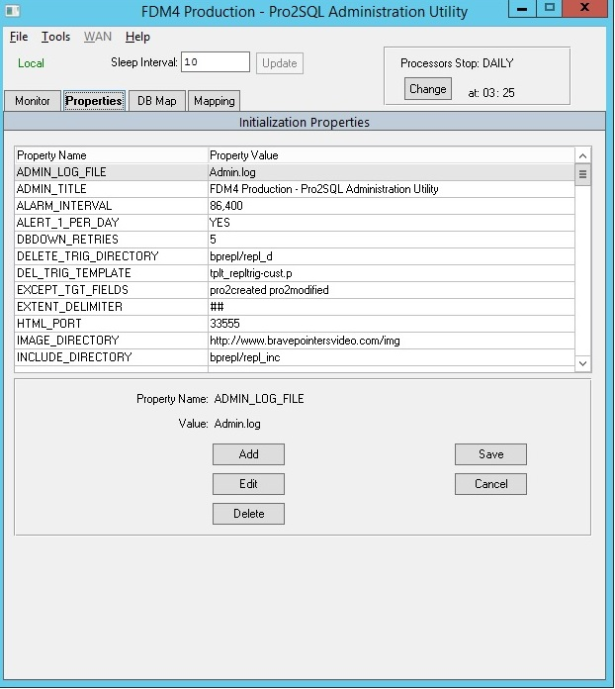
Demo slides (in case demo does not work)

Slide 22
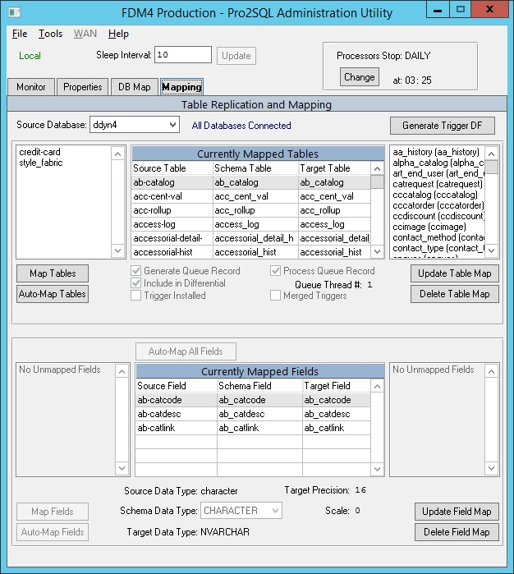
Demo slides (in case demo does not work)

Slide 23
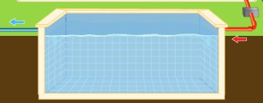
Parameter -pica (Communication queue)
Database Service Manager Queue
-pica is just a buffer for AI messages to be sent from source to target
Notes:
This buffer has information about AI blocks, not the blocks themselves but messages. Each message is 112 bytes = 14 8-byte pointers.
If the target database cannot keep up, the source will be affected and users will complain.
-pica is essentially a FIFO (first in first out) queue.

Slide 24
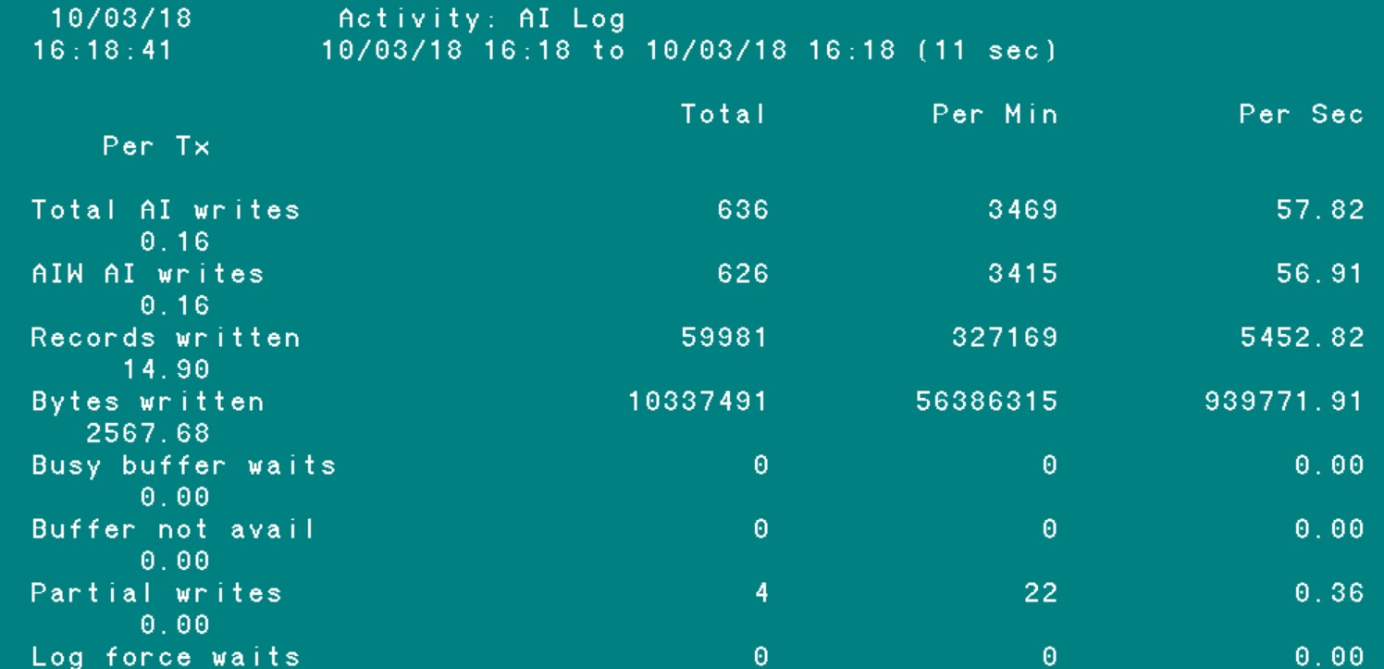
Parameter -pica (Communication queue)
How to measure “in-pipe”?
Promon / R&D / 2 / 6
_ActAILog VST
AI writes per sec * after-image block size
57.82 * 16,384 = 947,322
Notes:
If we want to be more accurate, the true –pica “in-pipe” through put is the difference between Total AI writes and Partial AI Writes.
So in my case it is ( 57.82 – 0.36 ) * 16,384 = 941,434. But the Partial AI Writes are usually much smaller then Total Ai Writes and so we can ignore them.

Slide 25
Parameter -pica (Communication queue)
Database Service Manager Queue
-pica is just a buffer for AI messages to be sent from source to target
AIW
RPLS
process
Notes:
It is a kind of like Lock Table. And it’s overflow is also bad, though not as bad as Lock Table overflow. When Lock Table overflow happens all transaction processing freezes. Here it does not freeze completely, but it will be rather limited by Replication Server (RPLS) throughput ( blue pipe here )

Slide 26
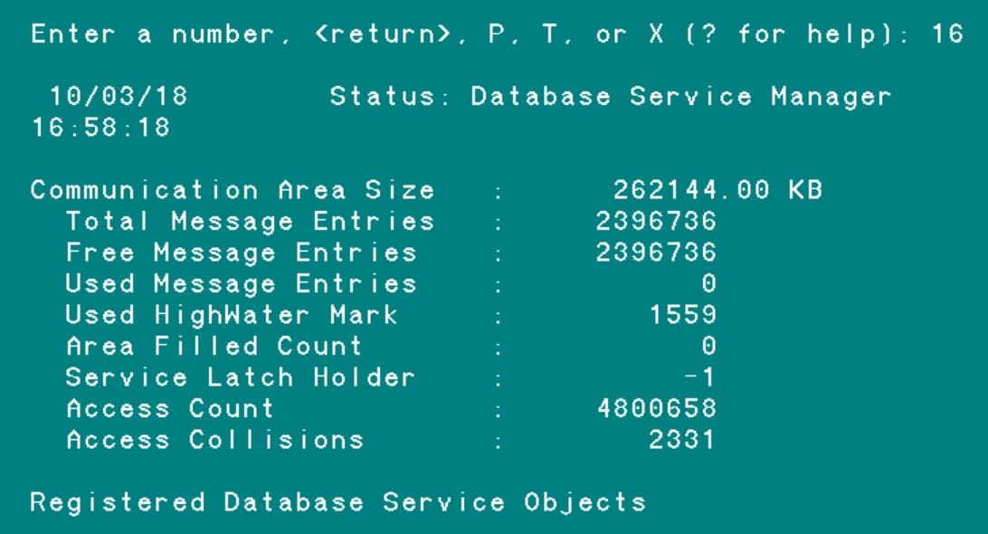
Parameter -pica (Communication queue)
_dbservicemanager
VST
pool ?
How to measure “out-pipe”?
Promon / R&D / 1 / 16
-pica 262144
Pool Size
Air
Water
2x AI blocks proc
Total Message Entries 2,396,736 * 112 = 262143 KB
Notes:
Here Total Message Entries = 2397636. Each message is 112 bytes.
2397636 * 112 = 262143 KB
Progress uses not the exactly all the memory provided by –pica, but some rounding mechanism to allocate memory designated to pica pool according to –pica parameter value. In the above example we see 1 KB less then –pica value.
For other values of –pica the result will be different.
Area Filled Count – how many times Free Message Entries became zero, which is bad. Zero indicates no problems with OE Repl occurred.
Service Latch Holder – user number that is holding the latch. -1 means nobody is holding the latch
Access Count – twice the number of after-image blocks that went through the queue. One access by AIW to put message (in) and one by Replication Server to process it (out).
Access Collision – collision between those two processes (AIW in and RPLS out attempting simultaneous access to PICA queue). When they both trying to access PICA at the same time one process has to wait. And that wait is 10 milliseconds. That is not a lot. I ignore that access collisions count.

Slide 27

Parameter -pica (Communication queue)
What pica abbreviation mean ?
Why pica is needed ?
Notes:
Why pica queue is needed is not clear. The AI blocks in AI-file are applied by RPLS consequentially. PICA message is only a pointer to the AI block that has to be applied (16 bytes in 112 pica message). The last AI block that was applied is all that is needed for the process.

Slide 28
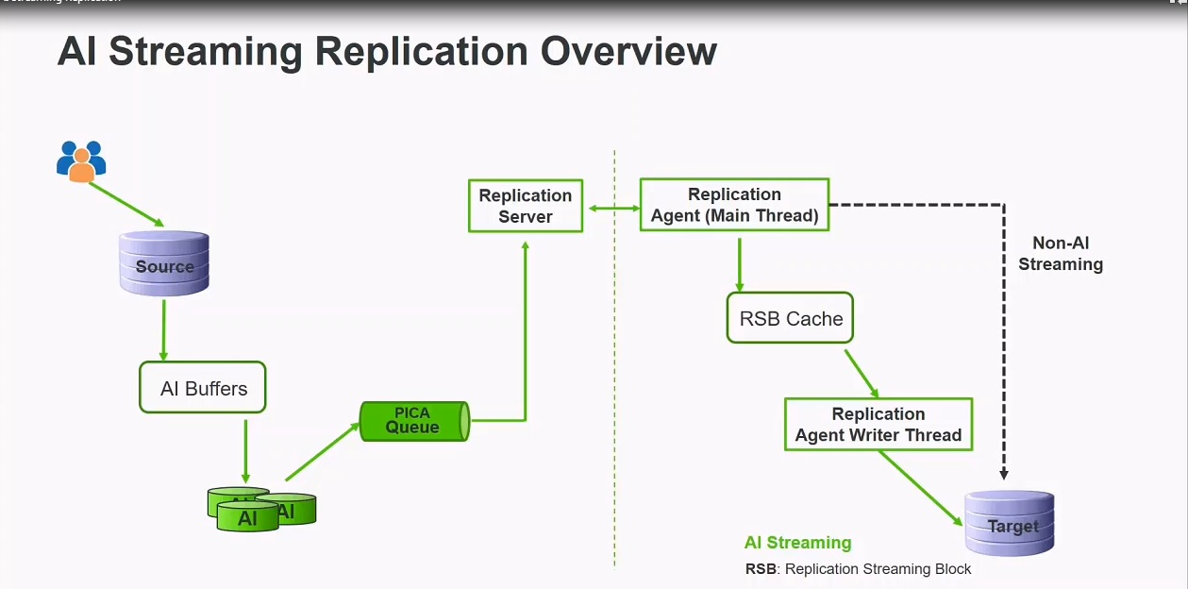
OE version 12 new feature – AI Streaming

Slide 29
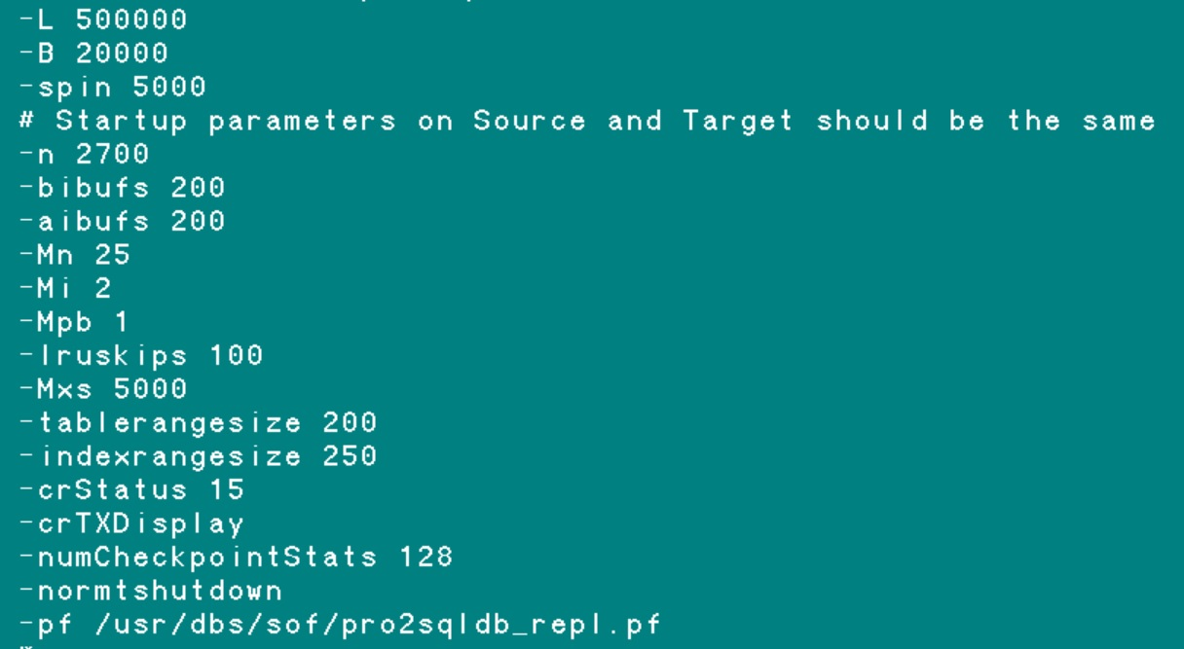
Startup parameters
Startup parameters on Source and Target should be the same
Notes:
Parameters like -n, -Mn, -L definitely affect replication. Other parameters may not affect replication. I developed a habit to keep parameters on Source and Target exactly the same. That way I do not worry if parameter affects replication or not.

Slide 30
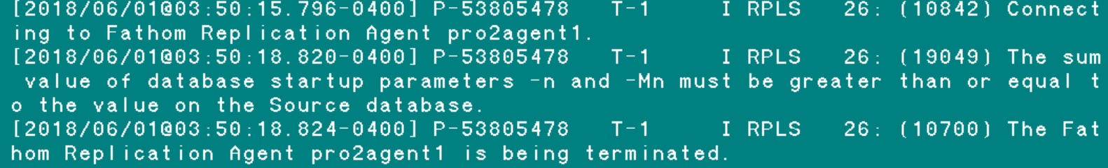
Startup parameters
When Source and Target parameters do not match
Source_DB: status code 6060: Server is ended
Target_DB: status code 1063: Agent is Ended
Notes:
Print screen from the Source DB log

Slide 31
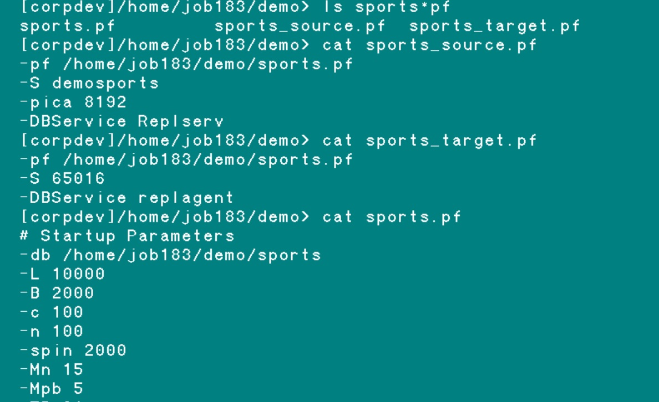
Startup parameters
replication related parameters we put into a separate .pf
Notes:
For each database I put replication specific parameters, such as –pica, -DBService, -S into a separate .pf file. As you can see for sports.pf that is sports_repl.pf. The depending on which role the database has, Source or Target I overwrite that replication .pf file with either repl_source.pf or repl_target.pf. That way I can quickly change roles of multiple databases with one script.

Slide 32
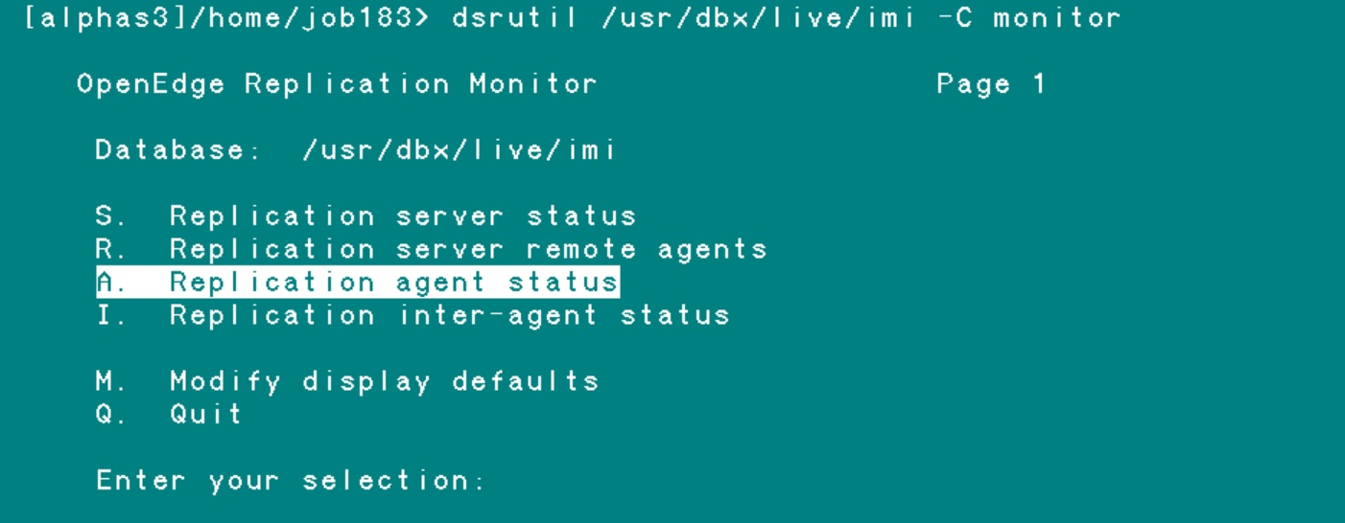
Startup Synchronization

Slide 33
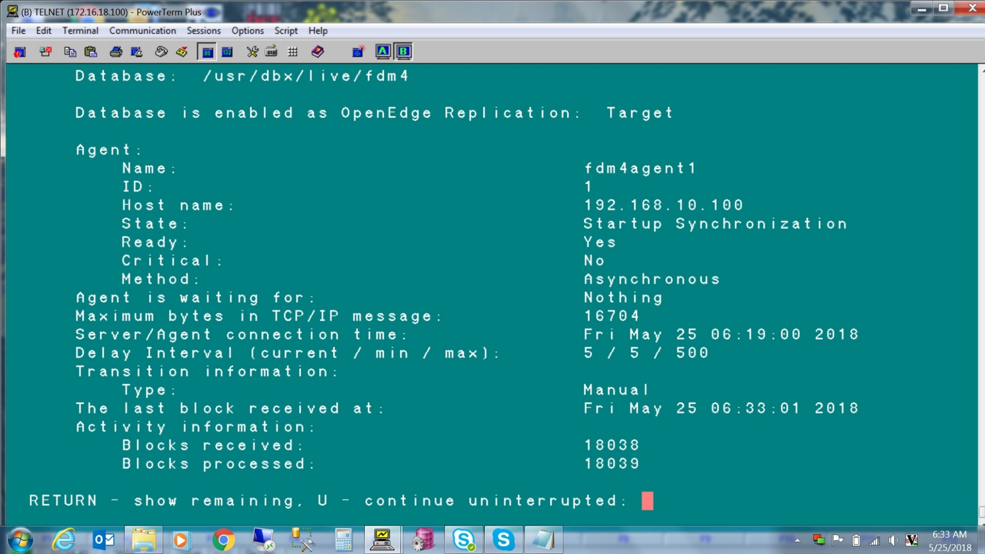
Startup Synchronization

Slide 34
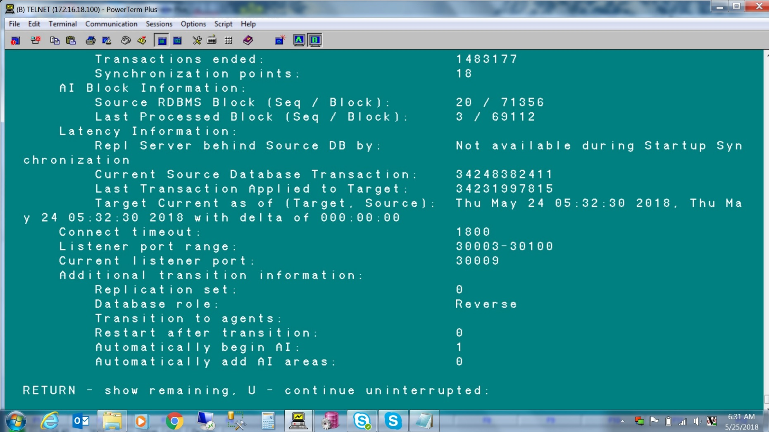
Startup Synchronization

Slide 35
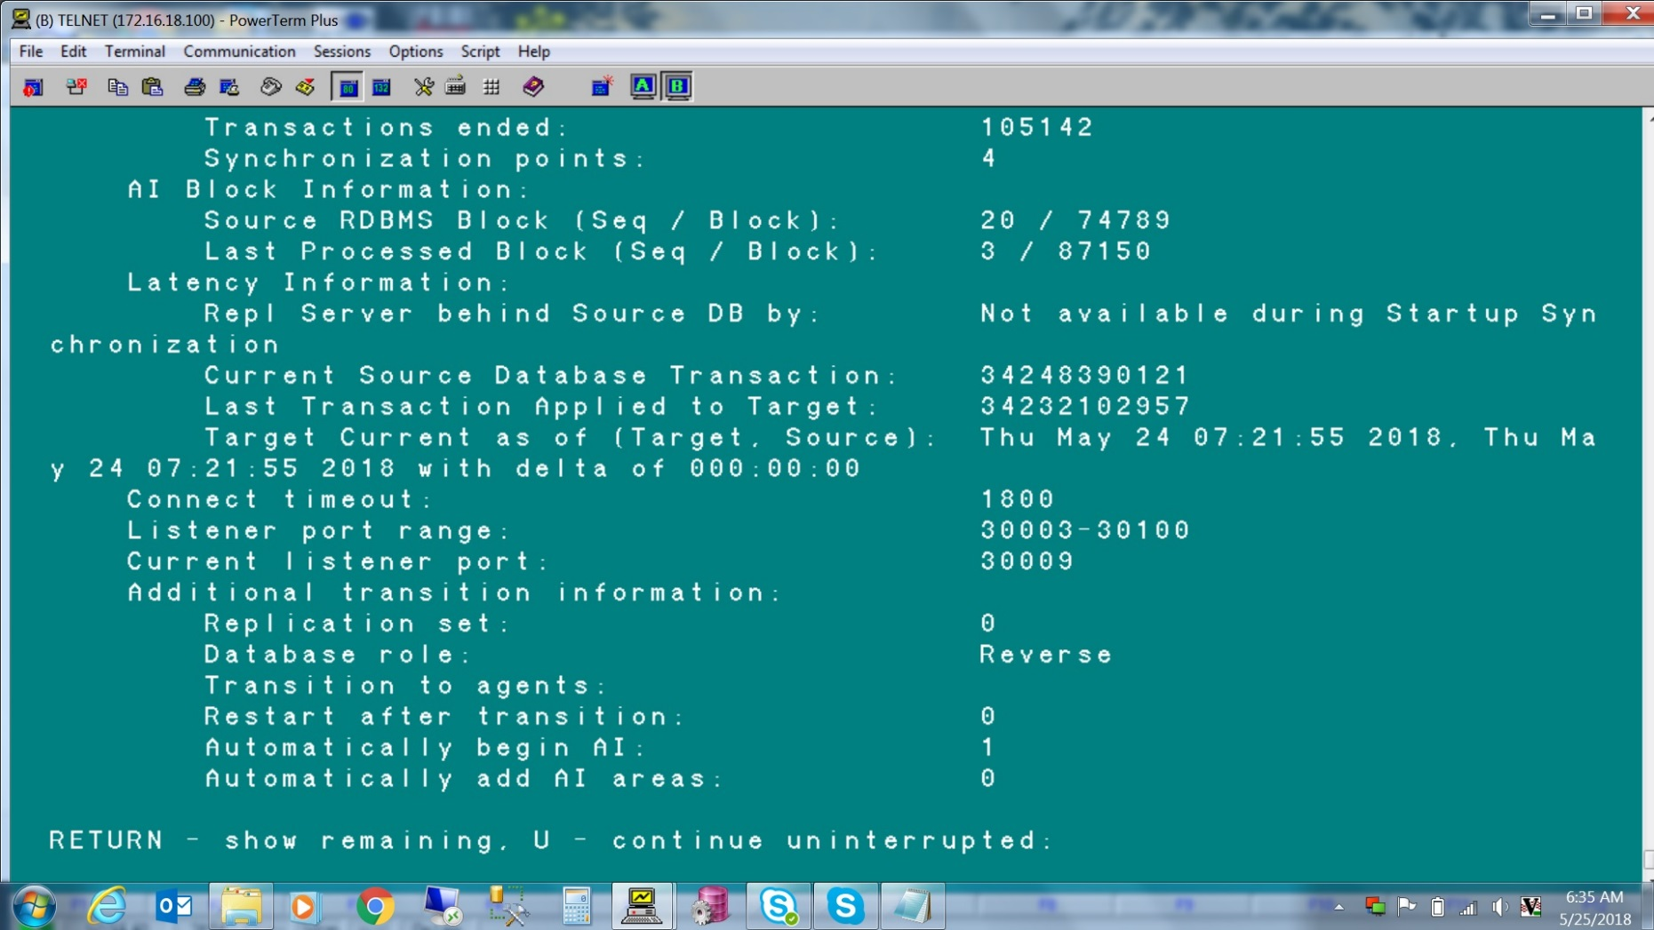
Startup Synchronization

Slide 36
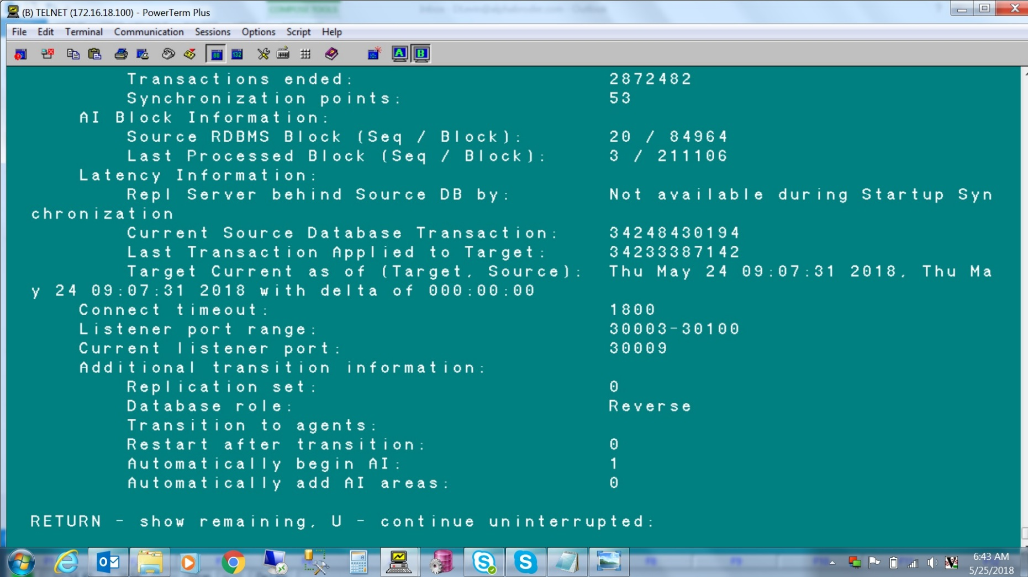
Startup Synchronization

Slide 37
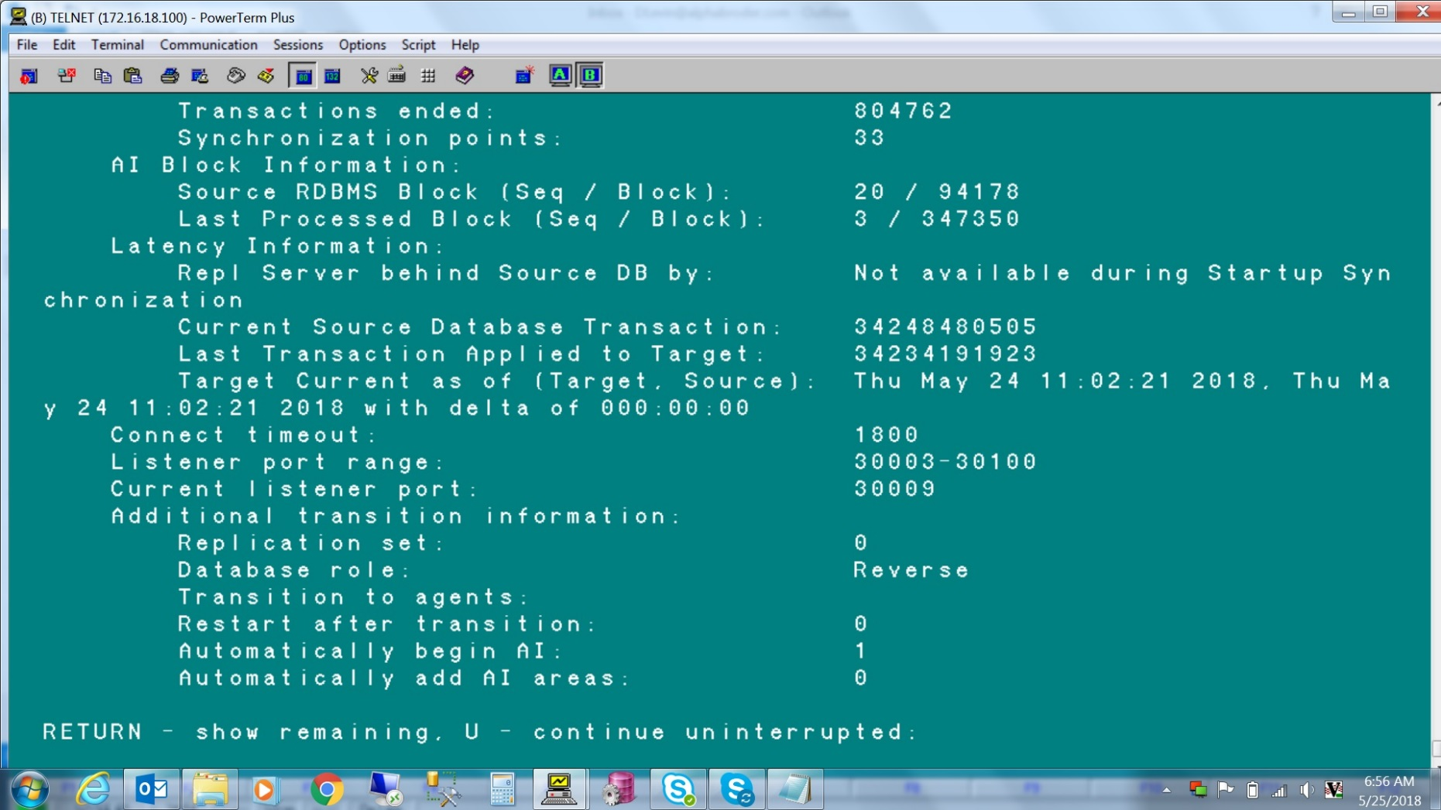
Startup Synchronization

Slide 38
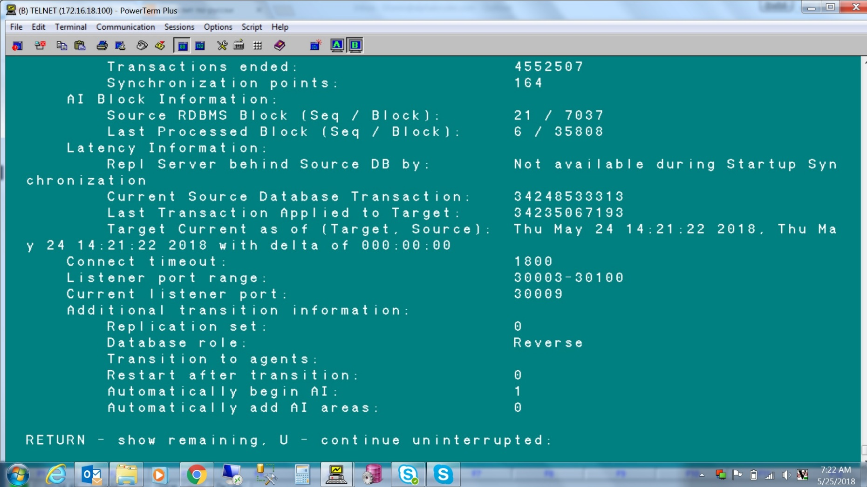
Startup Synchronization

Slide 39
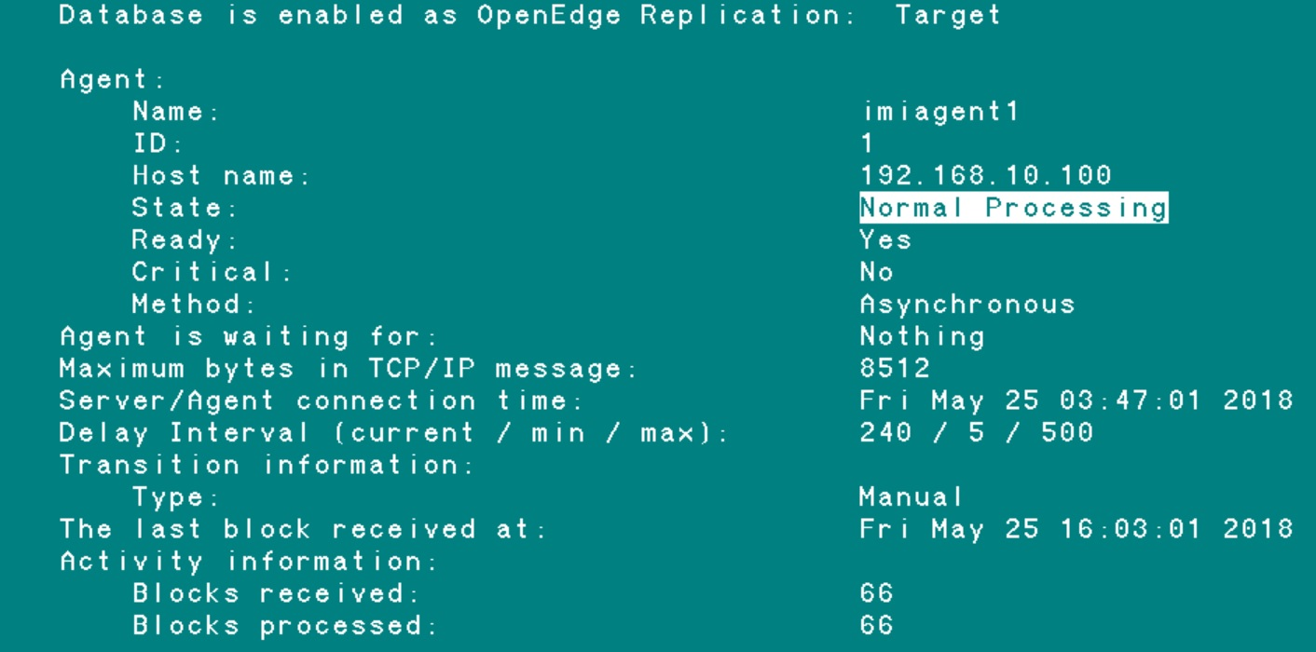
Startup Synchronization

Slide 40
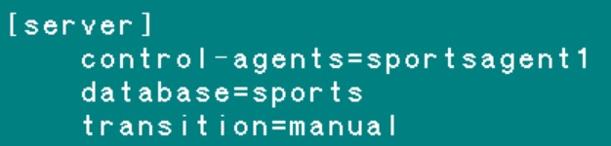
A couple OE Replication advices
After switch database roles do not forget to turn off AI or run archiver on Target (that was Source at some point in time)
The agent name has a limit of 15 characters
Do not run backup before synchronization started
If you disabled replication, delete the repl.recovery files
Notes:
When agent name is 16 characters of more Replication will not work, the startup of the database will hand and will give some misleading errors.
-- “Of course the startup should not hang due to this” Libor
If you disabled replication, delete the repl.recovery files were it was disabled Source and Target

Slide 41
A couple OE Replication advices
When repl.properties is changed in order the changes to take affect
Terminate and restart replication to bring those new settings into effect
dsrutil sourceDB -C terminate server
dsrutil targetDB1 -C terminate agent
dsrutil targetDB2 -C terminate agent
dsrutil targetDB1 -C restart agent
dsrutil targetDB2 -C restart agent
dsrutil sourceDB -C restart server
Notes:
The correct order of restarting server and agent(s) from PKB 86271

Slide 42
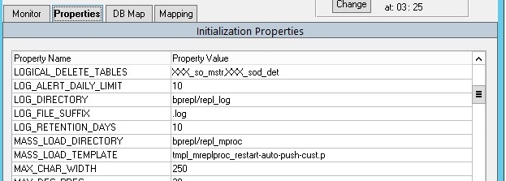
A couple Pro2 notes
1) Pro2 version 4 has a “slow start” for the initial Bulk Load. It is improved in version 5.
2) There is a Pro2 property MAX_CHAR_WIDTH which has default value of 250.
When the target schema is generated (Generated Code->Target Schema), any character
fields that have MAX_WIDTH set to higher than this value will be varchar(max) on target side.
This is done to keep the target data within the SQL Server max row size of 32k.
SQL Server will not allow index on varchar(max), like on CLOB in Progress.
So you may want to manually change varchar(max) to varchar( some_number ).

Slide 43


