Slide 1
The Ins and Outs of Performance Profiling and Debugging
Srinivas Kantipudi, Sanjeva Reddy

Slide 2
Software maintenance typically consumes 40 to 80% (60% average) of software costs
Source: "Frequently Forgotten Fundamental Facts about Software Engineering" by Robert L. Glass, (an article in IEEE Software May/June 2001)

Slide 3
Agenda
Part 1: Profiling tools
  To improve the performance
Part 2: Debugging tools
  To correct faults

Slide 4
Part 1: Profiling
The real problem is that programmers have spent far too much time worrying about efficiency in the wrong places and at the wrong times; premature optimization is the root of all evil (or at least most of it) in programming.
- Donald Knuth

Slide 5
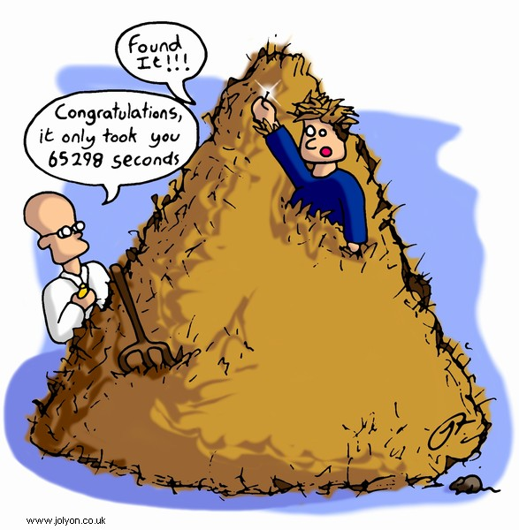
Looking for needle in haystack!

Slide 6
Profiling Agenda
Types of profiling
ABL Profiler
PDS Profiler
Other tools
Demo

Slide 7
Types of Profiling
Profiling
CPU
Time/Calls
Execution tracing
Memory
Usage
Allocation
ABL Profiler
PDS Profiler
DynObjects log entry

Slide 8
ABL Profiler
Introduced in 9.0 (-profile)
Execution time of modules with micro second precision
Complete tracing information of entire session
Per-Line execution times
PROFILER handle : to focus on particular modules
Profiler Controller tool to analyze the data

Slide 9
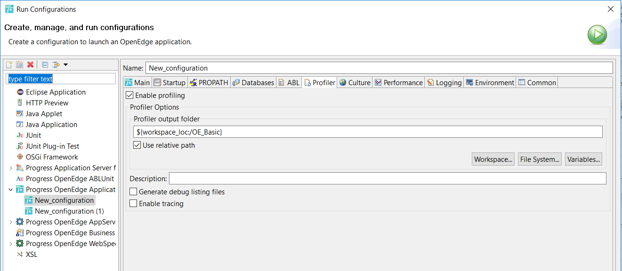
Progress Developer Studio Profiler

Slide 10
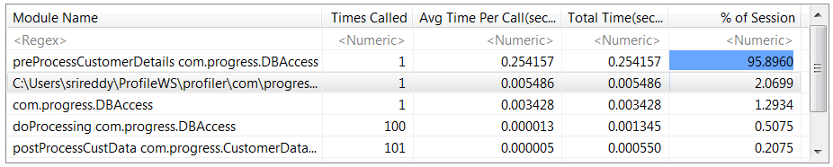
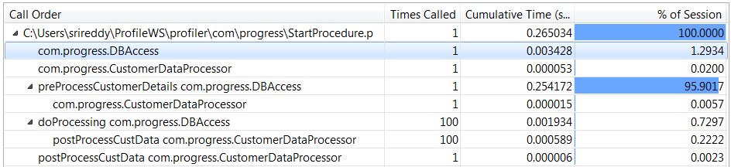
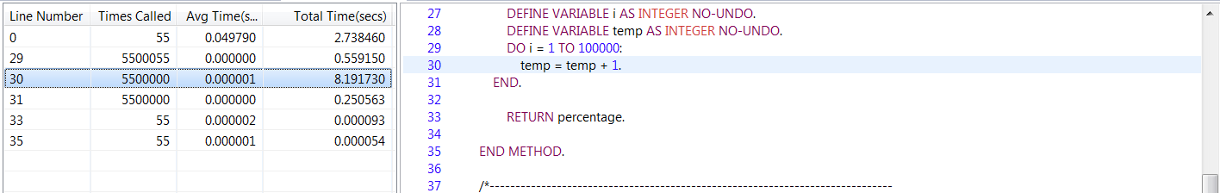
What does PDS OE Profiler tell you?
where is the time being spent?
  which method takes the most time?
  which method is called the most?
Program flow (“hierarchical” profiling)
  do calls to method A cause method B to take too much time?
Per-line information
  which line(s) in a given method are the most expensive?

Slide 11
Other tools
DynObjects log entry type
  Find memory leaks caused by ABL dynamic objects
  LogRead and other utilities can be used to analyze
etime()

Slide 12
What’s new in recent releases
11.7.4:
  Support for overloaded methods
  Use relative path for Profiler output folder
12.0
  Call tree improvements
  Propath info under AVM information tab
  Includes time spent on OS calls, PAUSE and WAIT-FOR
Disclaimer: This slide is for informational purposes only. You are cautioned that any information contained in this slide may change in the course of product development. This presentation may not be interpreted as any commitment on behalf of Progress, features or functionality described in this slide remains at the sole discretion of Progress.

Slide 13
Lets see a short demo

Slide 14
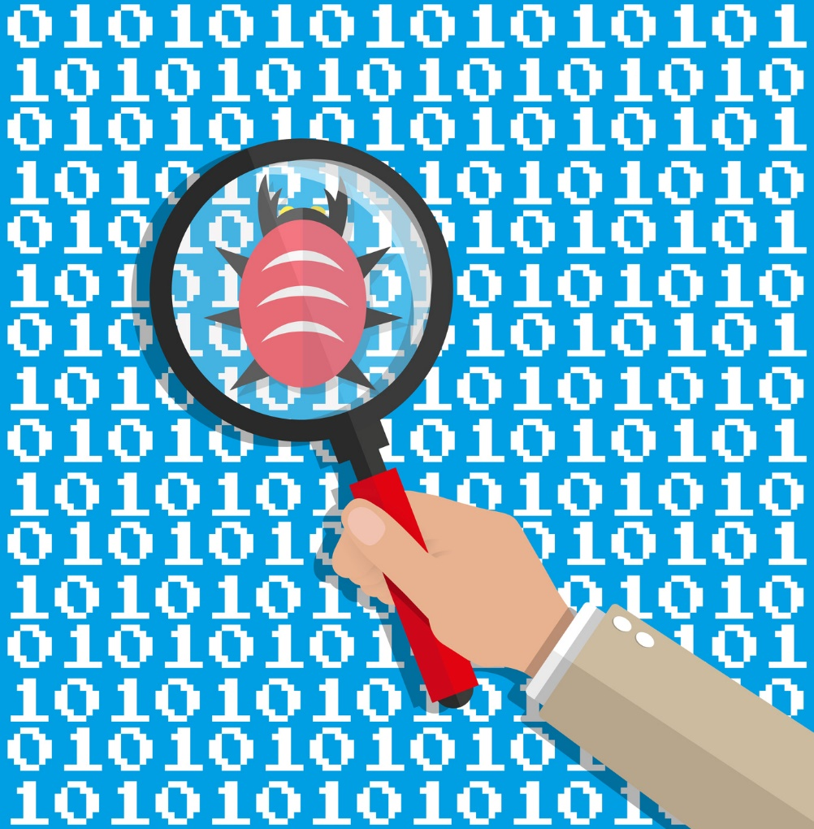
Part 2: Debugging tools
Tools available
Why PDS Debugger
Basics of PDS Debugger
Debugging Servers
Demo

Slide 15
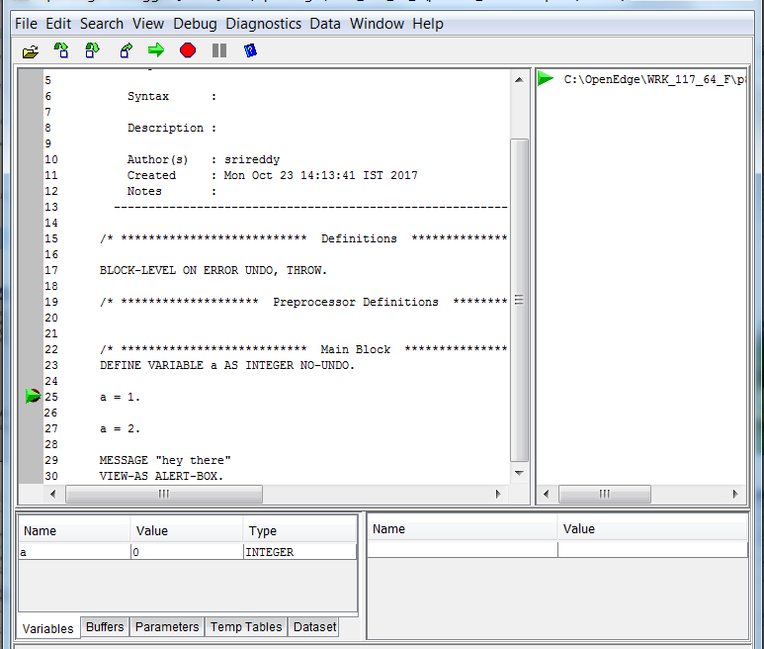
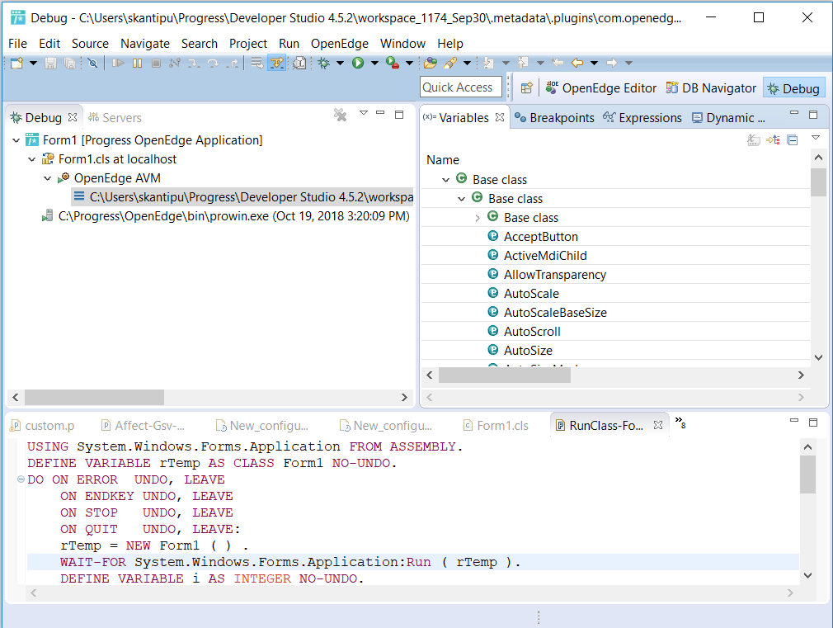
Debugging: Tools available
PDS
Debugger
Standalone Debugger
Standalone Debugger
PDS Debugger

Slide 16
Why PDS Debugger
Battle tested Eclipse tooling
Supports debugging client, servers, unit testcases
Concurrent debugging sessions
Persists breakpoints & configurations
Inspecting complex objects
SSL debugging

Slide 17
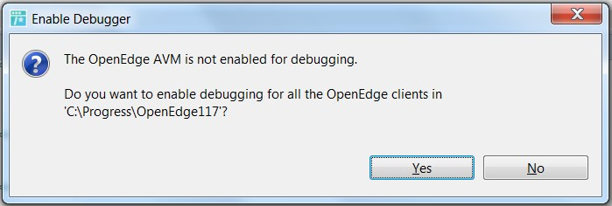
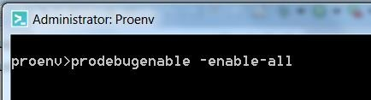
Basics of PDS Debugger (Client debugging)
Enable debugging

Slide 18
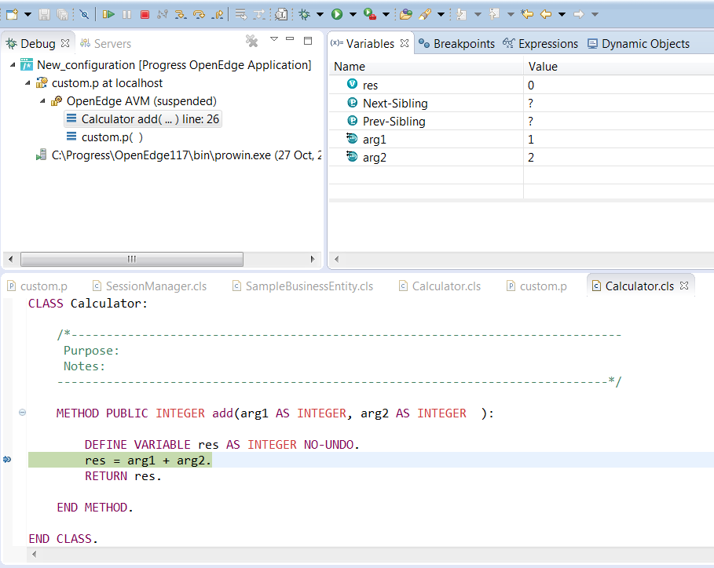
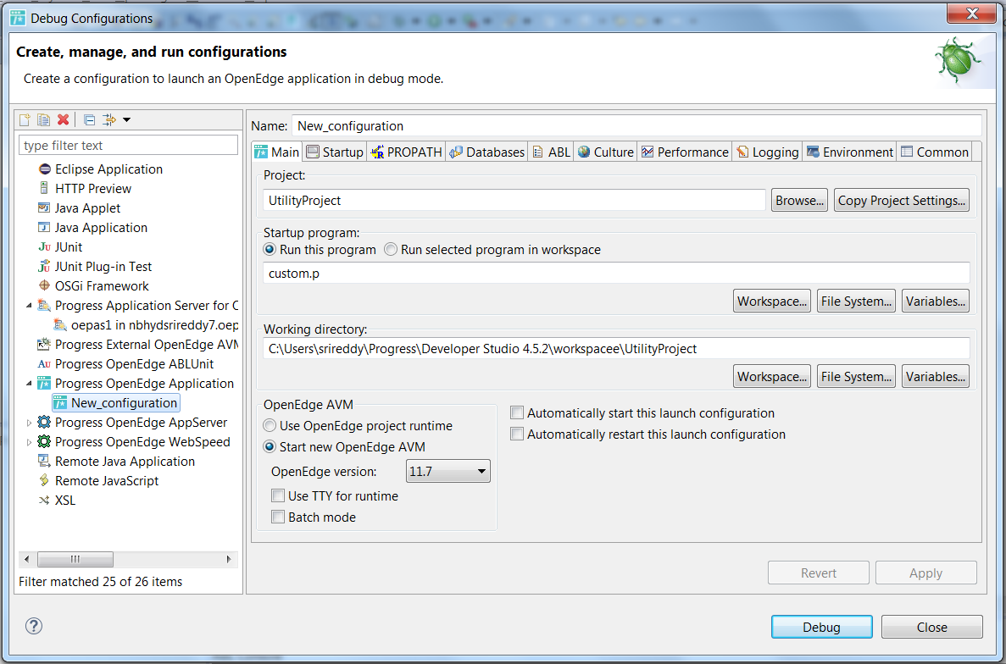
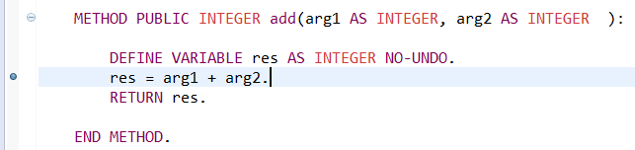
Client Debugging
Breakpoints
Debug Configuration
Debug

Slide 19
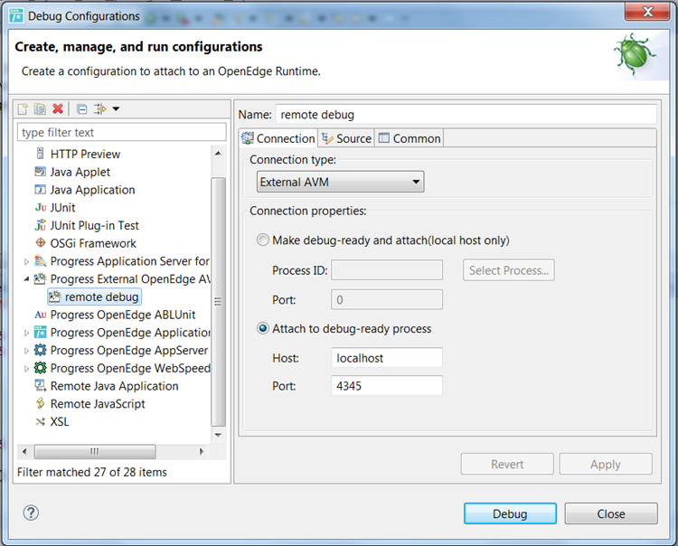
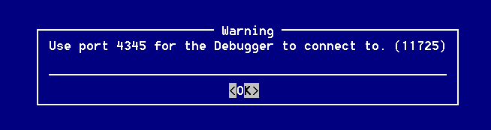
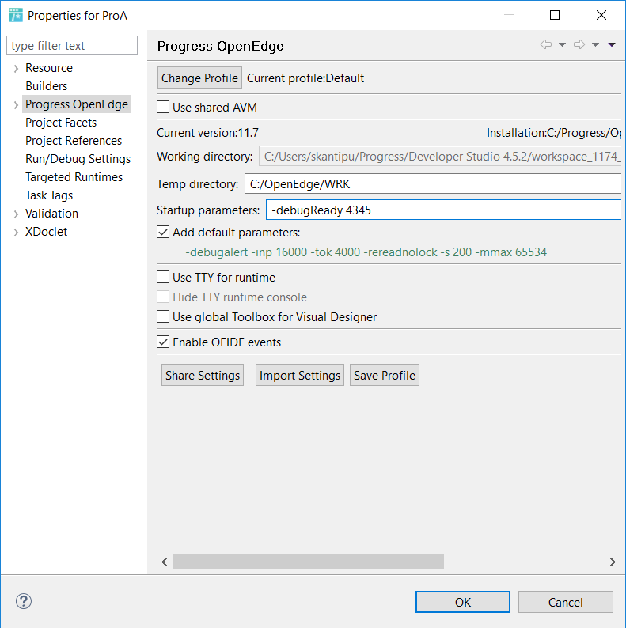

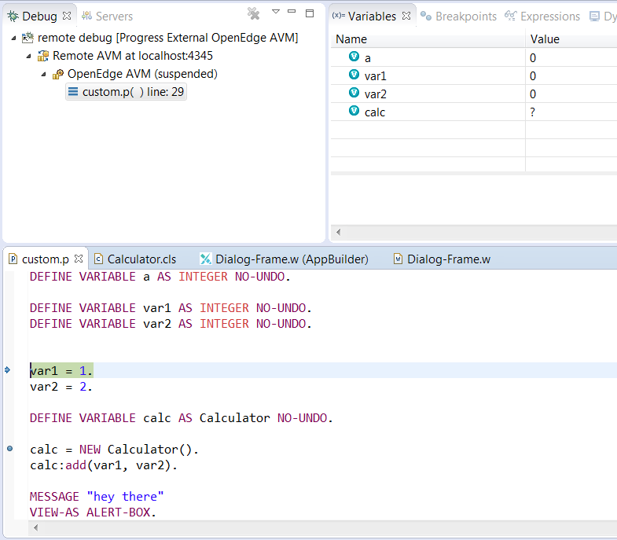
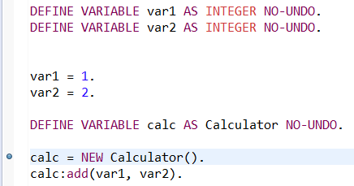
Debugging remote files
Debug
Make AVM Debug ready
Remote debug launch
Breakpoints

Slide 20
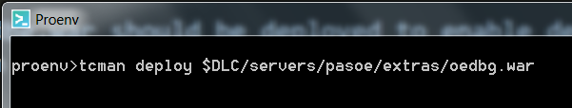
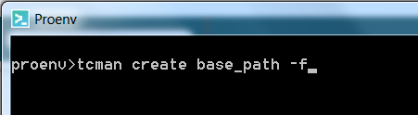
Progress Application Server (PAS) debugging
oedbg.war should be deployed to enable debugging
  Location: $DLC/servers/pasoe/extras/oedbg.war
Can be deployed onto existing PAS instance
Created in new instance with oedbg.war with –f option

Slide 21
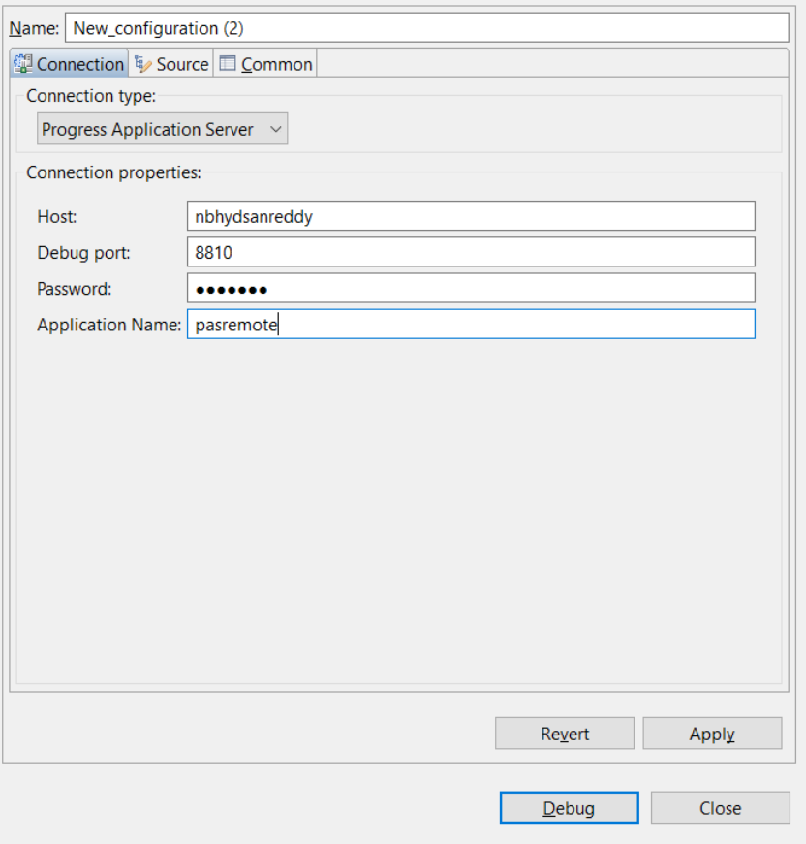
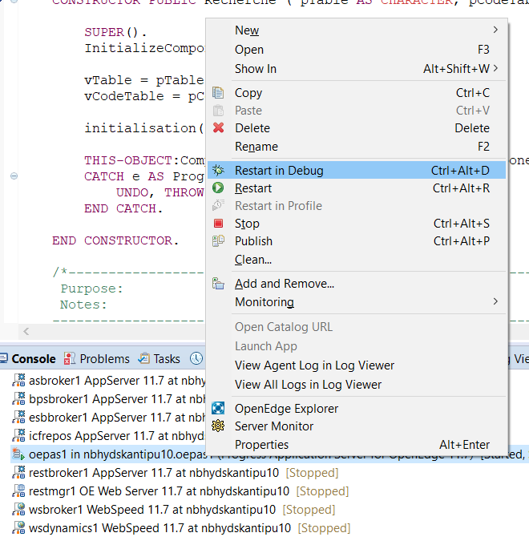
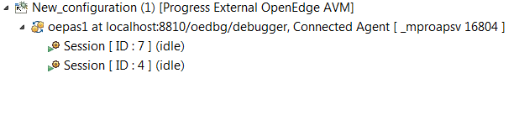
PAS Local vs Remote
Remote
Local

Slide 22
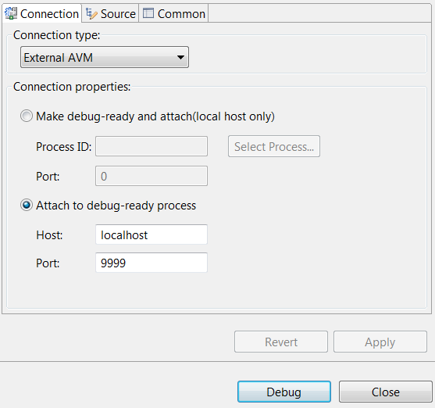
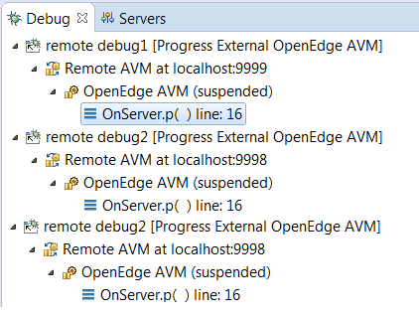
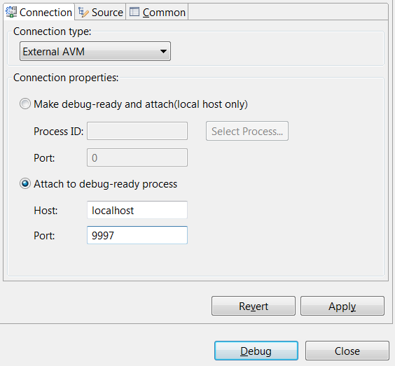
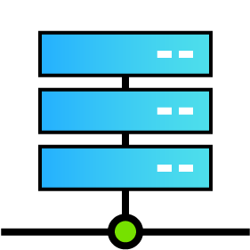
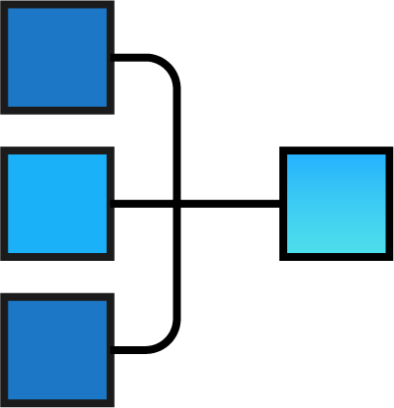


Classic AppServer debugging
Remote machine
A1
A2
A3
Agents
AppServer

Slide 23
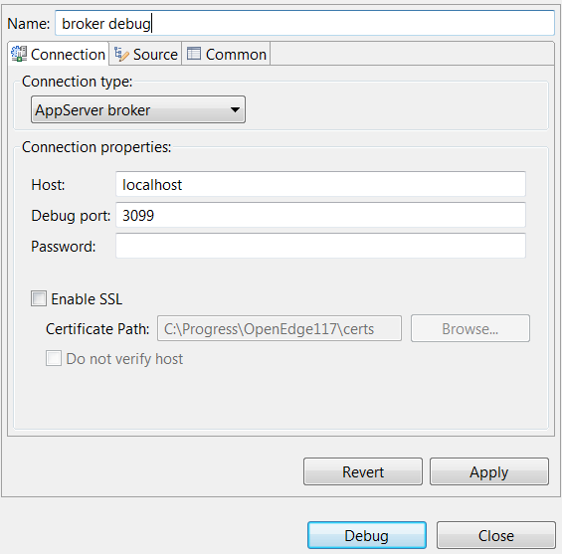
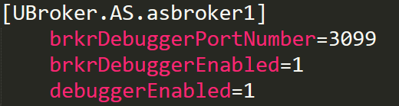

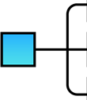

Classic AppServer debugging
Remote machine
Broker debugger
ubroker.properties
3099
Agents
AppServer

Slide 24
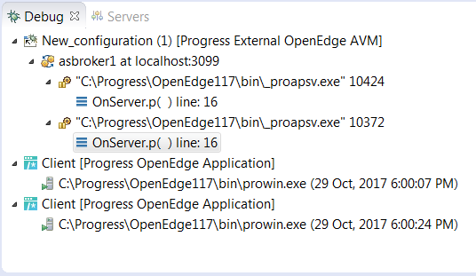
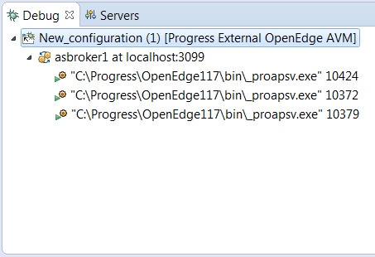
Classic AppServer debugging
Remote machine
3099
Agents
AppServer

Slide 25
Recap of Debugger
Local Debugging
Enable debugging from proenv
Remote Debugging
Enable debugging from proenv
Enable debugging for remote server
PASOE Debugging
Deploy oedbg.war file
Configure PAS in local machine for remote debug
AppServer Debugging
Make remote files available
Debug
Debug
Start/Restart server in Debug mode
Agents can be debugged through “External AVM” option
Broker debugging will be lot more convenient
Set debuggerEnabled property to true in ubroker.properties

Slide 26
Lets see a short demo

Slide 27
Questions?

