Slide 1
Leave the driving to Us with the
Progress Managed Database Service
Mike Furgal
Director – Database and Pro2 Services
October 26, 2018

Slide 2

Progress MDBA
Database Administration
With Peace of Mind
Comprehensive database expertise at your service from the people who helped build it.
Notes:
Overview Slide.

Slide 3
Operation Evolution – On Premise
Benefits
You have control of the application and data
Tried and True
Infrastructure exists already
Drawbacks
Need to maintain Infrastructure
Need to have resources to maintain the application and data
May be difficult to find talent
Notes:
On-premise computer has been around for decadses. It is for the moist part how people operate, but with it comes expenses and skills.
You need to maintain the hardware and infrastructure
You need to have the skills to makage the application environment

Slide 4
Operation Evolution - Cloud
Benefits
Lower cost than on-premise
No longer need to worry about Infrastructure
No longer need to find talent
A growing trend
Drawbacks
Data Security
WAN Infrastructure
FUD
Notes:
The move to the cloud is a recent development. It takes the costs of infrasructure and application management and puts them on the cloud provider.
However, there is Fear Uncertantly and Doubt that prevents customer from adopting the cloud. It just may be too big of a leap for some companies.

Slide 5
Operation Evolution
Notes:
The largest barrier to a move to the cloud is Fear Uncertainty and Doubt (FUD)

Slide 6
Operation Evolution
Notes:
Enter the Hybrid solution

Slide 7
Operation Evolution
Benefits
You have control of the application and data
Tried and True
Infrastructure exists already
No need to find talent
Lower cost than traditional on-premise
Drawbacks
Need to maintain Infrastructure
Notes:
You get the application management benefit of the Cloud without making any changes to your existing on premise deployment

Slide 8
Managed Database Administration
Software based solution
  Sampling and monitoring software installed
  Sends email alerts to on-call DBA
  Each database has it’s own thresholds
Each customer has a Primary DBA
  Clear documentation for on-call rotation
On-call
  No level 1 support – DBA Team is on-call
On-boarding Service
  Install the management software
  Document the environment
  Make stability and tuning recommendations
  A Mini DB Health Check
Web based monitoring dashboard
Monthly Reports
All for a value-based monthly Subscription
Notes:
PROGRESS MDBA has been in practice for over 10 years.

Slide 9
What the service includes
Included
  Any Reactive Service for business critical issues
    Normal billing rates start after the 1st hour
  Web Based Dashboard
  Proactive Analysis
  Monthly Reports
    Provide 6 month trend
    Capacity planning forecast for next 6 month period
    Identifies upcoming maintenance items
  Technical Advice
Not Included
  Planned Maintenance
  Non-production Issues
  Project work
  Database Health Checks
  Disaster Recovery

Slide 10

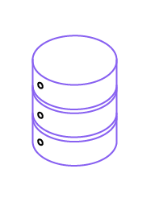




The Heartbeat Process
Heartbeat process
runs every minute
Thresholds are tested and
alerts are sent out to the team by email
mfgprod
admprod
Appserver
Monitoring
cusprod
Daily upload of metrics to PSC for Dashboards and Reporting
Webspeed
hipprod
Periodic Sampling
Every 15 minutes
Monitoring
Notes:
Thresholds are tested and alerts are sent out to the team by email. Both local DBA support
and Progress DBA team
Daily metrics are uploaded to the backend database at Progress.
This is where reporting takes place. There is also an external dashboard
based on this data

Slide 11


The Managed Database Services Team
17 DBAs worldwide, each with 20+ years of experience
Follow the Sun support
  US Support
    9 DBAs, a mix of developers of the OpenEdge technology and support staff.
  Australia Support
    3 former PSC Tech. Support reps
  EMEA Support
    5 former PSC Tech. Support reps
      Familiar Names
95% of surveyed businesses using
Progress Managed DBA describe
the knowledge and experience of their
Progress consultants as really great or
“off the charts amazing!”
Notes:
SOURCE: TechValidate

Slide 12
Managed Database Metrics
Started in 2006
Customers | 140+
Number of Databases | 2000+
Total Database Size | 123+Terabytes
Total Connected Users | 170,000+
Metrics as of October 1, 2018
Notes:
Over the past 5 years the number of customers using MDBA has grown from 37 customers to 125.

Slide 13














Progress MDBA Customers
Direct Customers and End-users of Application Partners
MANUFACTURING
HEALTHCARE
WAREHOUSING & DISTRIBUTION
FINANCIAL
SERVICES

Slide 14
Operating Models
Direct
  We work directly with the end user.
  Contract is with the end user.
Application Partners
  Referral
    We work directly with the end user.
    Contract is with the end user.
  White Label
    We work directly with the end user.
    Contract with the Application Partner

Slide 15
Success Stories
QAD End User
Very Large deployment on 9.1E
  500 Users
  Unstable – DB crashes daily
Implemented Pro2 to remove all the reporting from the production database
Upgraded Progress to OE 10.2B
Result
  Better Performance
  Better Reliability – No unplanned outages!

Slide 16
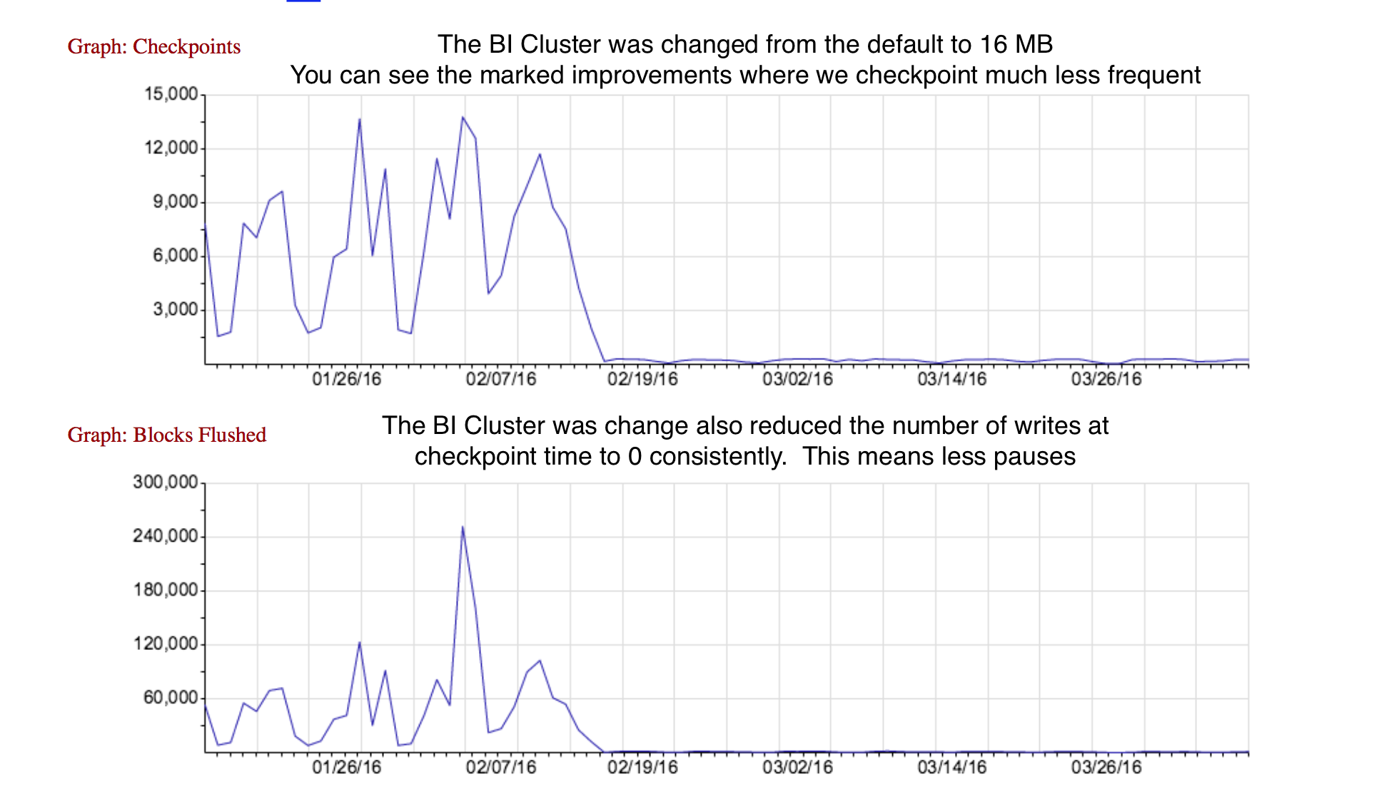
Success Stories

Slide 17
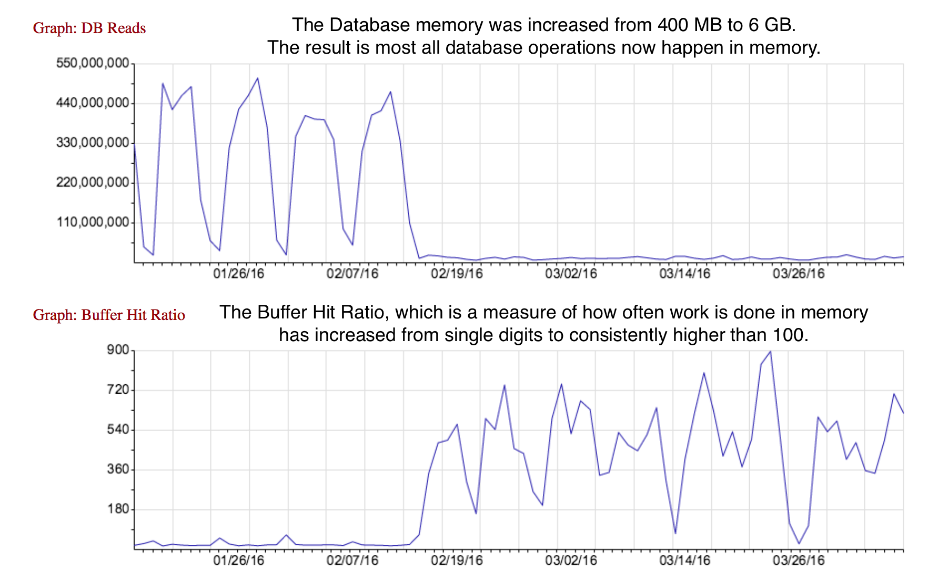
Success Stories

Slide 18

Database Consulting
OpenEdge Feature Implementation
  OpenEdge Management
  OpenEdge Auditing
  Transparent Data Encryption
  Table Partitioning
  OpenEdge Replication
  OpenEdge Multi-tenancy
  OpenEdge SSL
  etc
DBA team is available for database projects
Platform Migration
  We do this once a month for a customer
Dump and Loads
  We do this every weekend
OpenEdge Version Upgrades

Slide 19

MDBA Services
Comprehensive Database Management
  Extension of the existing team
  Alerting, Trending, Planning
Database Health Checks
  Complete Analysis
  Educational
Largest and Strongest team in the industry
  Includes follow the sun support
www.progress.com/mdba

Slide 20


Thank You!
Mike Furgal
mfurgal@progress.com
@progress
@ProgressSW

