Slide 1
Minimize Unplanned Downtime and Data Loss with OpenEdge
Mike Furgal
Director – Database and Pro2 Services
Rodney Sassaman
Sales Engineer

Slide 2
This will be the year where Disaster Recovery is scrutinized higher than years before. In addition to the increased exposure to Natural Disasters, Hacker Attacks are the new disasters that need to be accounted for.
Having a solid Disaster Recovery Plan will be the key to survival

Slide 3
Terms
Recovery Time Objective (RTO)
  The targeted duration of time and a service level within which a business process must be restored after a disaster in order to avoid unacceptable consequences associated with a break in business continuity
Recovery Point Objective (RPO)
  It is the maximum targeted period in which data might be lost from an IT service due to a major incident.
From Business Continuity Planning

Slide 4
In Simpler Terms
Recovery Time Objective (RTO)
  How long it takes to recover from a disaster
  The less time you can be down, the higher the cost of the implementation
Recovery Point Objective (RPO)
  How much data are you willing to lose
  The less data you are willing to lose, the higher the cost of the implementation

Slide 5
Rodney

Slide 6
Start with the basics
Backups
  Offline
  Online
  Full
  Incremental
When was the last time you tested your backups?
When was the last time you had to restore a backup for a reason?

Slide 7
Backup
Backup
Backup
Sun
Mon
Tue
Wed
Timeline

Slide 8
RPO
High
RTO
The time to recover is reasonably quick,
depending on the database size, so the
RTO is low, but the amount of data loss
could be a day or more depending on the
frequency of backups
Low
Daily Backups
Level 1

Slide 9
Mike

Slide 10
After Imaging
Enables you to track all the database updates in a “redo” log
The last good backup plus all the After Image files brings you to the point of the failure
Simple to Enable
Simple to Manage
No performance penalty

Slide 11
After Imaging tracks changes between backups
Backup
Backup
Backup
Sun
Mon
Tue
Wed
Timeline

Slide 12
ATM Benchmark
Clients Tps |--------|---------|---------|---------|---------|
150 2417.0 ************************
150 2335.2 ***********************
150 2417.5 ************************
150 2383.2 ************************
150 2335.4 ***********************
150 2273.4 ***********************
Clients Tps |--------|---------|---------|---------|---------|
new BL 2409 ************************
average 2360 tps, 98 %
The performance cost of After Imaging vs no After Imaging

Slide 13
The time to recover is longer since you need
to restore the backup and apply AI files.
The amount of potential data loss goes down
dramatically, however the risk is still there.
RPO
High
RTO
After Imaging
Low
Level 2
Daily Backups

Slide 14
Things to think about
Where are the backups stored?
Where are the After Image files stored?
How often are the AI files switched to move the data from being an active part of the database to being archived data?
How long do I keep the backups and AI files?

Slide 15
RPO
High
RTO
The time to recover is longer since you need to retrieve
the files from Iron Mountain or other offsite storage vendor
Offsite Storage of Backups and AI
Level 3
After Imaging
Low
Daily Backups

Slide 16
Things to think about
Where are the backups stored?
Where are the After Image files stored?
How often are the AI files switch to move the data from being an active part of the database to being archived data?
How long do I keep the backups and AI files?
How long do I keep the files locally?
How long do I keep the files remote?

Slide 17
RPO
High
RTO
Low
How can we get a lower RPO and lower RTO?

Slide 18
Rodney

Slide 19
Warm Standby Database
Restore a copy of the database to a different location or machine
Roll forward the After Image files as they fill up
Recovery time is reduced to the time is takes to roll forward the last After Image file.

Slide 20
RPO
High
RTO
RPO stays the same
Moves the RTO Needle
Low

Slide 21
Warm Standby Database
RPO (data loss) is still possible
  If the production machine is not available
Database
Data Files .d1 .d2 … .dn
Database Backups
Before Image .b1 .b2 … .bn
Archived AI Files
After Image .a1 .a2 … .an

Slide 22

Warm Standby Database
Have no access to the last live AI data
  Typical AI switch rates is 15 minutes
Database
Data Files .d1 .d2 … .dn
Database Backups
Before Image .b1 .b2 … .bn
Archived AI Files
After Image .a1 .a2 … .an

Slide 23
Warm Standby Database
May not have access to the last live After Image data
  Typical AI switch rates is 15 minutes
Needs a Disaster Recovery License to be able to be licensed to do this
You need to write scripts to keep the warm standby database current by applying the After Image files

Slide 24
Warm Standby Database
May not have access to the last live After Image data
  Typical AI switch rates is 15 minutes
Needs a Disaster Recovery License to be able to be licensed to do this
You need to write scripts to keep the warm standby database current by applying the After Image files
There must be a better way

Slide 25
OpenEdge Replication
Real time database replication for Disaster Recovery
Includes the Disaster Recovery License
No need for scripting
Small Performance Penalty
There is now another server to manage
More processes to monitor

Slide 26
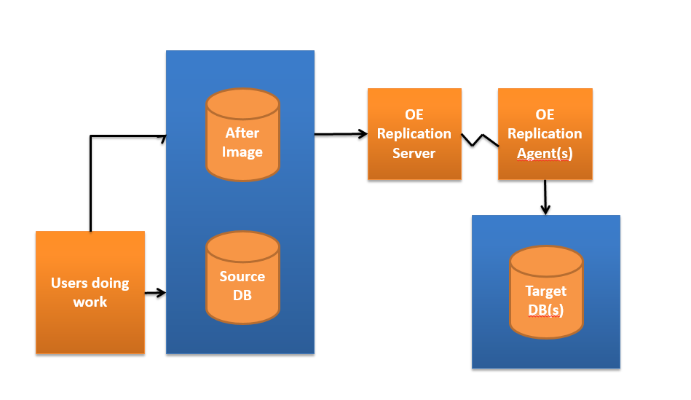

Slide 27
OpenEdge Replication
Many configuration options
Multiple Target Databases
Target Databases can be used for reporting
  Requires OpenEdge Replication Plus
Can keep a DR target when in a fail-over situation
  No single point of failure

Slide 28
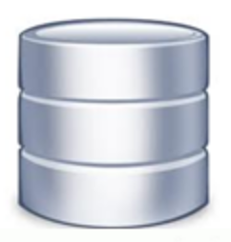
OpenEdge Replication – 2 Targets
Target A
Source
Target B

Slide 29
OpenEdge Replication – 2 Target Failover
X
Source
Source
Target

Slide 30
ATM Benchmark
1000 2000 3000 4000 5000
Clients Tps |--------|---------|---------|---------|---------|
150 2226.0 **********************
150 2015.2 ********************
150 2197.4 **********************
150 2127.2 *********************
150 2174.0 **********************
150 2080.4 *********************
Clients Tps |--------|---------|---------|---------|---------|
BL w ai 2360 ***********************
average is 2136 tps or 91%
The performance cost of OE Replication – 9%

Slide 31
RPO
High
RTO
Disaster Recovery with
OpenEdge Replication
Level 4
Offsite Storage of Backups and AI
After Imaging
Low
Daily Backups

Slide 32
RPO
High
RTO
RPO
High
RTO
RPO
High
RTO
RPO
High
RTO
Low
Low
Low
Low
Daily Backups
After Imaging
Offsite storage
OE Replication

Slide 33
Mike

Slide 34
Replication Technologies
OpenEdge Pro2 Replication
  Replicates to a MSSQL, Oracle, or OpenEdge database for Reporting
  NOT FOR DR
SAN Based Replication Technologies
  EMC SRDF is tested and supported
  Others MAY work
  Must Adhere to the Write Ahead Logging protocol

Slide 35
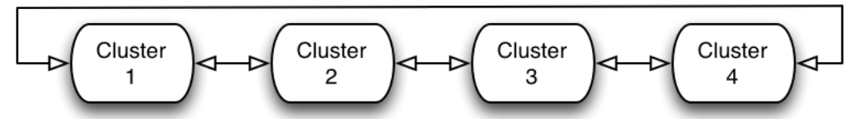
Write Ahead Logging
Allows Crash Recovery to work
3 Phases of Crash Recovery
  Before Image Cluster Fix up
  Physical Redo
  Transaction Undo
Before Image Cluster Fix up
  Rebuilds the Before Image Cluster Ring

Slide 36
Write Ahead Logging
Physical Redo
  Each DB block has a version number
  A Before Image Note describes a change to a block
    Find block 1234 change the name “Mike” to “Rodney”, change the version from 10 to 11
  Redo make sure all the block version are up to date
  For each note in the Before Image file
    Find the DB block
    If the Block version is higher then the one this note describes then skip it
    If the Block version matches this note, then redo the work and change the Block version

Slide 37
Write Ahead Logging
Transaction Undo
  For each OPEN transaction read the Before Image file backwards looking for notes for this transaction
  Read the block. If the note for Block 1234, version 11, then create a new note changing the Block 1234 from version 11 to 12 and apply the change
    The new note describes the undo action: Name “Rodney” to “Mike”
    This makes Crash Recovery Recoverable
  What happens if Bock 1234 has version 14, and our note says it knows about version 11?
    Write Ahead Logging Protocol was not enforced.

Slide 38
Replication Technologies
EMC SRDF is supported
Others may seem to work. BEWARE
Technology that are known not to work with running databases
  Zerto
  VMWare VMotion
  VMWare Snapshots
  Veeam

Slide 39
It’s not just the data
Other things to consider
  Application Files
  Printers
  Users Accounts
  Users Files
  etc

Slide 40
Best Practice
Use OpenEdge Replication for Database Replication
Use SAN based replication for all other data
/database
/bi
/ai
OE Replication
/database
/bi
/ai
/aisave
/bbackup
/app
/home
/aisave
/bbackup
/app
/home
SAN Replication

Slide 41
Test and Re-Test
A fail-over test needs to be run periodically
  Annually
  Anytime there is an application change
  Anytime there is an environmental change
There is no need to have a solid DR plan if there is no guarantee that it works.

Slide 42
Rodney

Slide 43
Looking Ahead – Continuous Operations

Slide 44
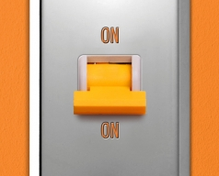
Continuous Operations Vision
There is no reason for your ABL application to ever stop running

Slide 45
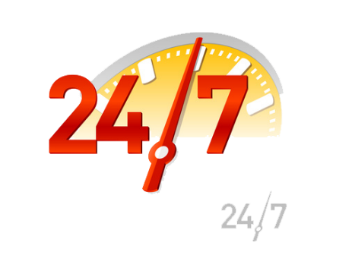
OpenEdge 12 – Continuous Operations
Keep the system running 24x7x365
Many companies need to achieve 5 9’s of availability in order to meet business requirements
Cloud and mobile, particularly with self-service initiatives, are driving the desire for continuous operations
Inability to meet uptime SLAs can impact partner perception by end users, or worse, cause them to pay penalties
Notes:
The long-term strategy is to enhance the OpenEdge environment so that it can operate as close to 24x7x365 as possible. This touches on a number of elements:
Resiliency to failure – if the OpenEdge database fails, the system can automatically and transparently fail over to a backup system. Users would continue operating the application without direct knowledge of the failure. Once the issue is resolved, the system can then fail back transparently.
Online Maintenance – various OpenEdge database operations and overall system settings are accomplished/modified while the system is up and running. Whenever possible, have the system self-monitor and self-maintain itself.
Online business logic and schema changes – there should be no need to bring the system down to update the business logic or schema. This includes updates to the OpenEdge infrastructure itself.

Slide 46
Continuous Operations Overview
Resiliency to Failure
  If a serious software error occurs, the application responds appropriately
  If the OpenEdge database fails, the system automatically and transparently transitions to a backup system (and can transparently transition back)
  If PAS for OpenEdge fails, new Server instances are created automatically
  Users continue operating the application without direct knowledge of any failure
Online Maintenance
  Various operations (e.g. database) and overall system settings are accomplished/modified while the system is up and running
  Whenever possible, the system self-monitors and self-maintains itself
Online Business Logic and Database Schema Changes
  There is no need to bring the system down to update the business logic or schema, including updates to the OpenEdge infrastructure itself

Slide 47
Summary
Application Availability is Critical
Plan for the Unexpected
Gain Confidence by Testing
OpenEdge Continues to Deliver
  Helping with unplanned downtime
  Eliminating the need for planned downtime

