Slide 1


PrimeNG
an open source Web UI library for Angular.
Marian Edu, Acorn IT

Slide 2

About me
Working with Progress since 1998
4GL & OO, AppServer
Architecture & Integration
Java, .NET
node.js, javascript, typescript
angular, nativescript
PrimeNG - an open source UI library for Angular.
acorn.ro

Slide 3
PrimeNG
A collection of rich UI components for Angular.
All widgets are open source and free to use under MIT License.
Developed by PrimeTek Informatics, a vendor with years of expertise in developing open source UI solutions.
https://www.primefaces.org/primeng/
PrimeNG - an open source UI library for Angular.
acorn.ro
Notes:
For those of you familiar with Angular we’re talking about Angular version 2 and above - the development only started on 2016.

Slide 4




Highlights
A complete set of native widgets featuring 80+ easy to use components for all your UI requirements.
Hosted at GitHub, all widgets are open source and free to use under MIT license.
Choose from a variety of themes including material and flat design.
Professionally designed highly customizable native Angular CLI application templates.
PrimeNG - an open source UI library for Angular.
acorn.ro
Notes:
There are a number of themes included in the suite (last time I’ve checked there were 17 of them), many others available either premium or free. The application templates are pre-built applications layouts that includes dashboards, charts, a large number of templates, most of them responsive.

Slide 5


Key Users
Used all around the world by 1M+ developers in Fortune 500 companies, corporations, government and educational institutions.
PrimeNG - an open source UI library for Angular.
acorn.ro

Slide 6
Get Started
Installation & Setup
Styles
App Module Setup
Using the Components
Services
PrimeNG - an open source UI library for Angular.
acorn.ro
Notes:
There are a number of themes included in the suite (about 16 or so), many others available either premium or free. The application templates are pre-built applications layouts that includes dashboards, charts, a large number of templates, most of them responsive.

Slide 7
Install
  $ npm install primeng font-awesome
  $ yarn add primeng font-awesome
PrimeNG - an open source UI library for Angular.
acorn.ro
Notes:
There are a number of themes included in the suite (about 16 or so), many others available either premium or free. The application templates are pre-built applications layouts that includes dashboards, charts, a large number of templates, most of them responsive.

Slide 8
Styles
  angular-cli.json
  "styles": [
  "styles.css",
  "../node_modules/font-awesome/css/font-awesome.min.css",
  "../node_modules/primeng/resources/primeng.min.css",
  "../node_modules/primeng/resources/themes/darkness/theme.css"
  ],
  17 style themes included
  Lots of premium ones available
  Build your own - ThemeRoller CSS Framework / Sass
PrimeNG - an open source UI library for Angular.
acorn.ro
Notes:
Since PrimeNG uses the ThemeRoller CSS Framework you can just build your own with a simple online theme builder and include the resulting style sheet file – no need of CSS knowledge for that, alternatively you can go all the way and use Sass.

Slide 9
Styles - Sass
  variables.scss
  // Header
  $headerGradientStart: #fffcfc;
  $headerGradientEnd: #f0a9df;
  theme.scss
  @import 'variables';
  .ui-widget-header {
  background: linear-gradient(to bottom,
  $headerGradientStart 0%,
  $headerGradientEnd 100%);
  }
PrimeNG - an open source UI library for Angular.
acorn.ro
Notes:
If you want to go all the way then use Sass which is like a template engine for CSS so the theme will be more maintainable, you must have (I would say intimate) knowledge of CSS for that, the template engine in really not much to be bothered with. When you run the Sass compiler it will take the theme.scss as input and will simply replace the variables with the values set to build up the final css file.

Slide 10
Module Setup
  Include the UI components you want:
  app.module.ts
  Include PrimeNG modules needed
  Make sure to include ‘BrowserAnimation’ module used by many PrimeNG components
  Since forms are the mainstay of business applications do include ‘FormsModule’ upfront.
PrimeNG - an open source UI library for Angular.
acorn.ro
Notes:
Animation provides the illusion of motion: HTML elements change styling over time. Angular's animation system is built on CSS functionality, which means you can animate any property that the browser considers animatable. This includes positions, sizes, transforms, colors, borders, and more. The W3C maintains a list of animatable properties on its CSS Transitions page.
Angular template-driven forms module includes framework support for two-way data binding, change tracking, validation, and error handling.

Slide 11
Module Setup
app.module.ts
  import { AccordionModule } from 'primeng/primeng';
  import { PanelModule } from 'primeng/primeng';
  import { ButtonModule } from 'primeng/primeng';
  import { BrowserAnimationsModule } from '@angular/platform-browser/animations’;
  import { FormsModule } from '@angular/forms’;
  @NgModule({
  imports: [
  AccordionModule,
  PanelModule,
  ButtonModule,
  ..
  })
PrimeNG - an open source UI library for Angular.
acorn.ro
Notes:
There’s one caveat however with the above Angular module setup: all PrimeNG’s components will be imported. This can bloat your bundle size unnecessarily. The solution is to import each module using the full path instead.

Slide 12
Module Setup
app.module.ts
  import {PanelModule} from 'primeng/components/panel/panel’;
  import {PanelModule} from 'primeng/components/panel’;
  import {PanelModule} from 'primeng/panel';
PrimeNG - an open source UI library for Angular.
acorn.ro
Notes:
Be specific, it unlikely you will use all components so better include only what you really use.

Slide 13
Sampling
  <p-accordion>
  <p-accordionTab header="Salads">
  Salads...
  </p-accordionTab>
  <p-accordionTab header="Pasta">
  Pasta...
  </p-accordionTab>
  <p-accordionTab header="Pizza" [selected]="true">
  <p-radioButton
  label="Double cheese"
  name="pizza"
  value="double-cheese"
  [(ngModel)]="pizzaSelection">
  </p-radioButton><br>
  ...
  </p-accordionTab>
  </p-accordion>
PrimeNG - an open source UI library for Angular.
acorn.ro
Notes:
All PrimeNG component uses the prefix ‘p’, then is normally the component name that follows using a camel case notation. Do check PrimeNG documentation for all available properties of each components – apart standard Angular ones of course (ngModel, *ngIf).

Slide 14
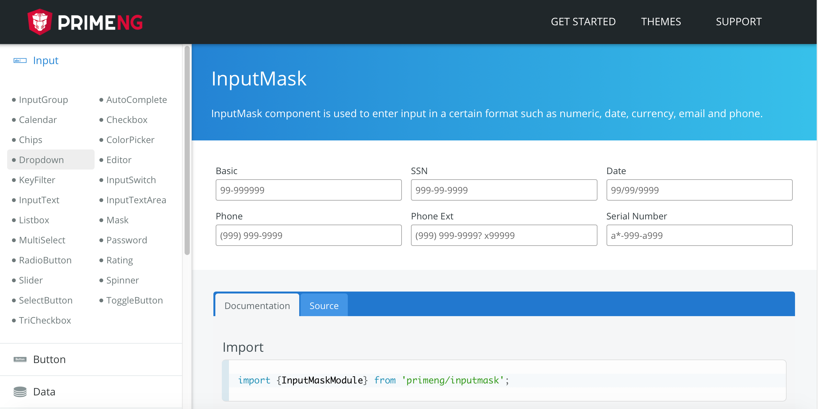
Components
PrimeNG - an open source UI library for Angular.
acorn.ro
Notes:
All PrimeNG component uses the prefix ‘p’, then is normally the component name that follows using a camel case notation. Do check PrimeNG documentation for all available properties of each components – apart standard Angular ones of course (ngModel, *ngIf).

Slide 15
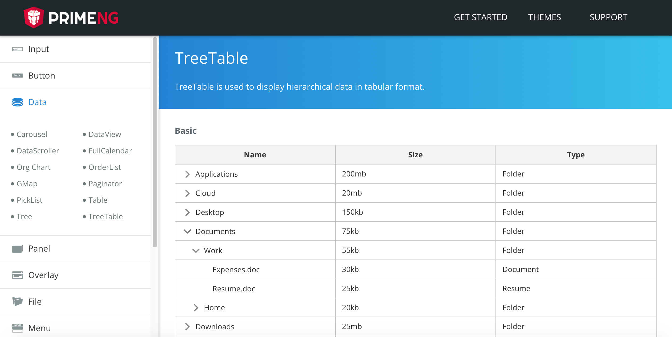
Components
PrimeNG - an open source UI library for Angular.
acorn.ro

Slide 16
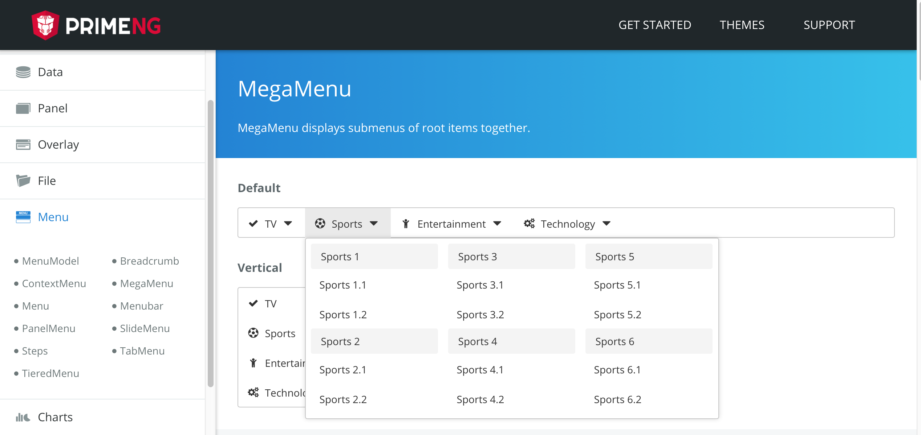
Components
PrimeNG - an open source UI library for Angular.
acorn.ro

Slide 17
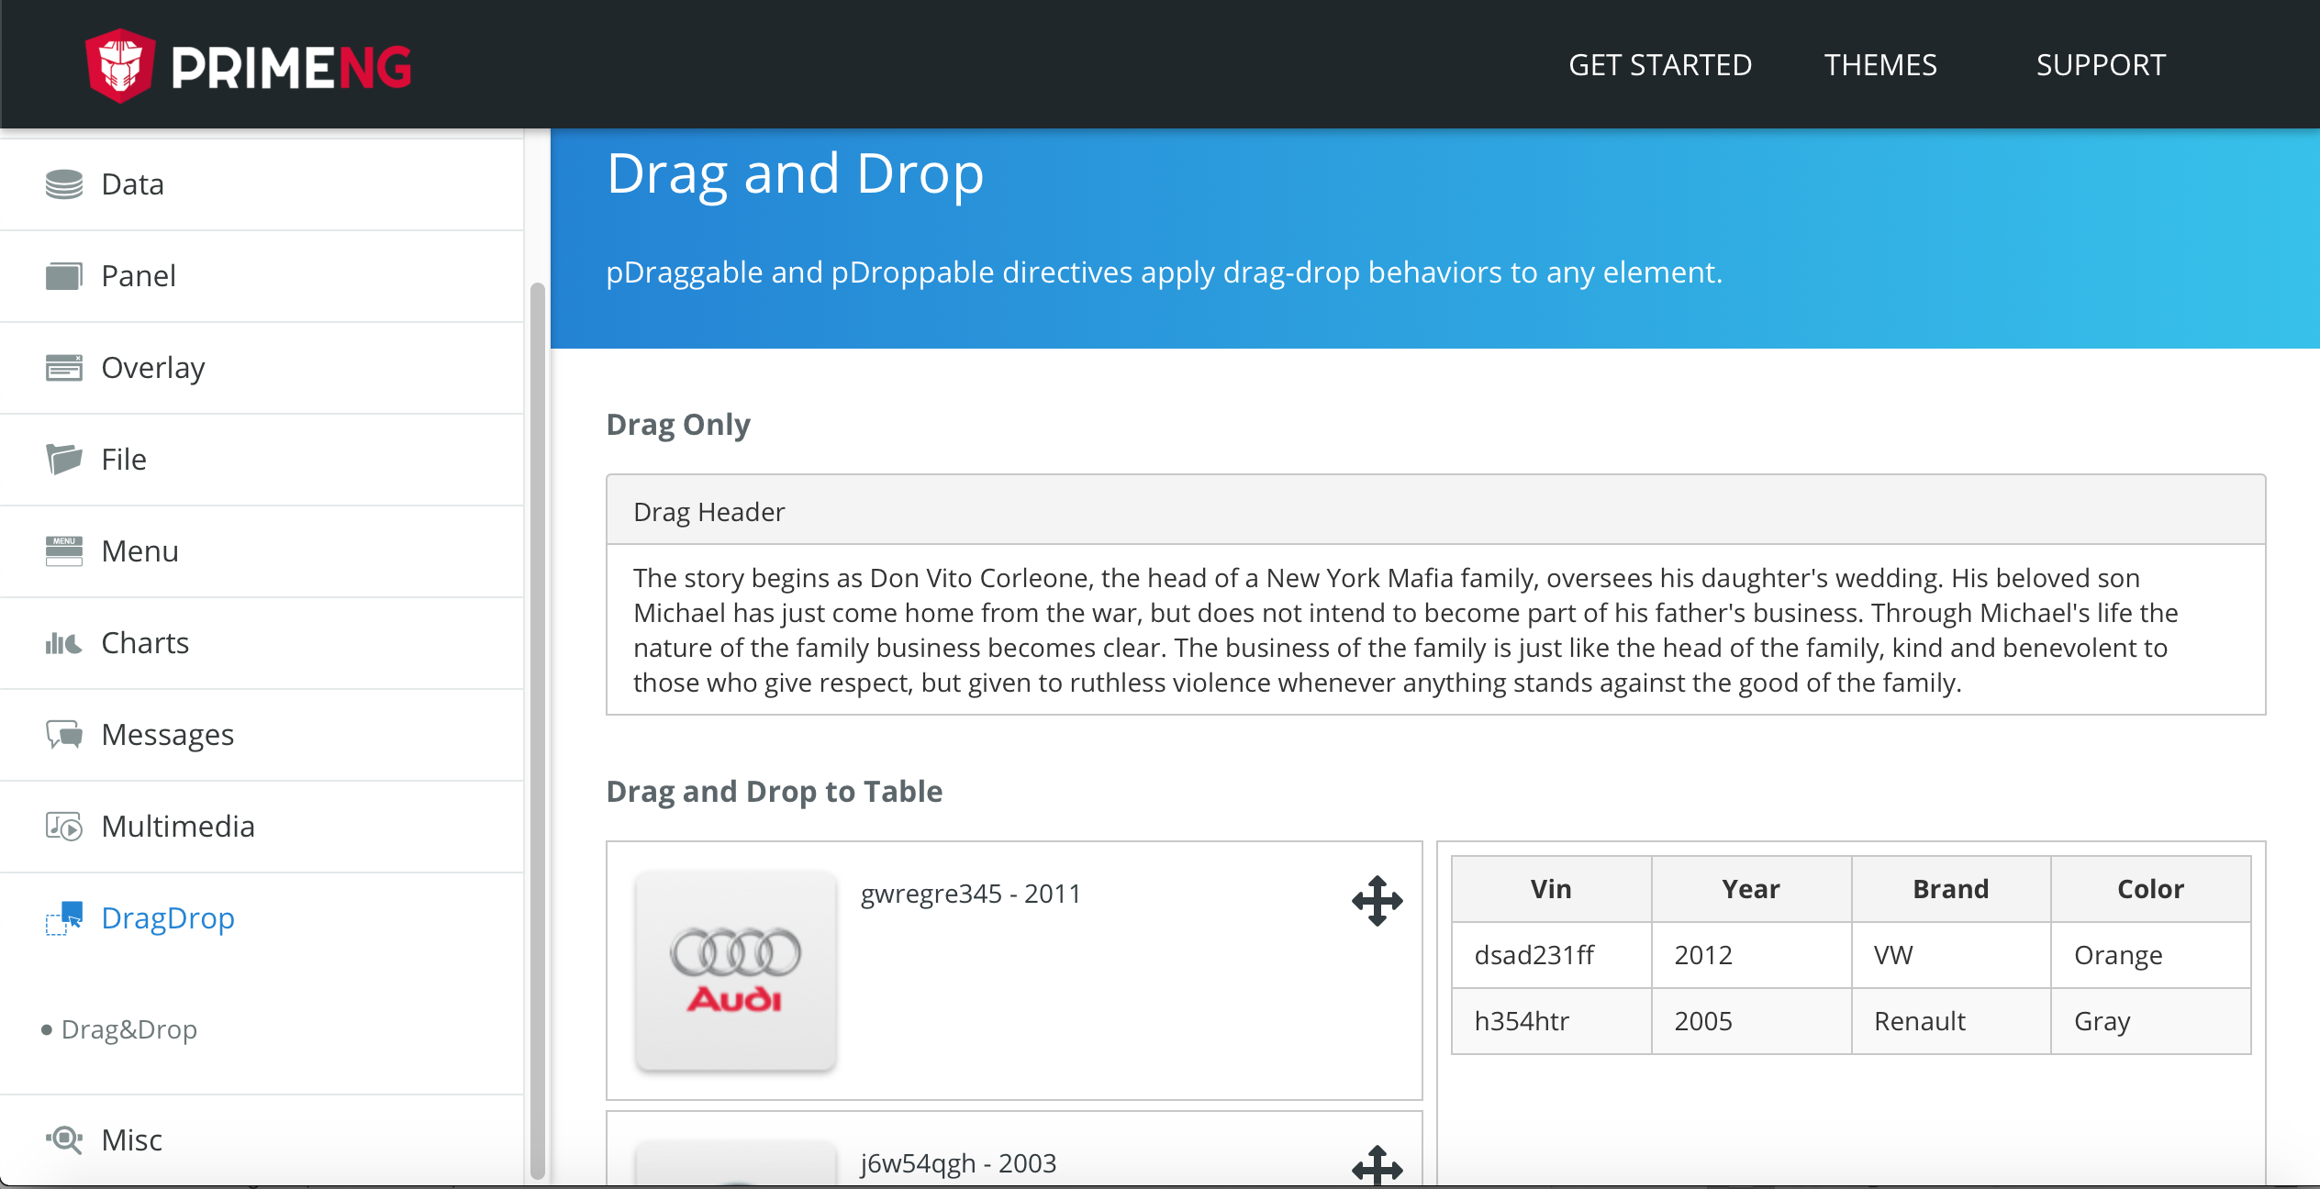
Components
PrimeNG - an open source UI library for Angular.
acorn.ro

Slide 18
Angular Puzzle
PrimeNG - an open source UI library for Angular.
acorn.ro

Slide 19
Data Services
  For data or logic that isn't associated with a specific view, and that you want to share across components, you create a service class.
  @Injectable() decorator.
  Dependency injection (DI)
  Delegate data access
PrimeNG - an open source UI library for Angular.
acorn.ro
Notes:
As a personal preference I always create a service for each business entity even if it’s only used in one component. A service class definition is immediately preceded by the @Injectable()decorator. The decorator provides the metadata that allows your service to be injected into client components as a dependency. A component can delegate certain tasks to services, such as fetching data from the server.

Slide 20
OpenEdge
Integration
REST
What kind of flavour?
JSDO
akera.io – we’re just happy with node.js
PrimeNG - an open source UI library for Angular.
acorn.ro
Notes:
This is a web framework the only way to get to your data and business logic is through micro services, so some flavor of REST. Which one exactly it might depend on your taste, who you’ve been listening to and what tooling do you have around. It can be REST mapped services, Web Handlers or use the JSDO interface.
I for one like the services to be mean and lean, the KISS approach (keep it simple, stupid) – basic CRUD data access API for simple things like lookups, call business logic – like any .p you have already at hand – for more complex data services.

Slide 21
Entity Model
  export interface Customer {
  CustNum: number;
  Country: string;
  Name: string;
  Address: string;
  State: string;
  City: string;
  Phone: string;
  SalesRep: string;
  CreditLimit: number;
  Balance: number;
  Terms: string;
  EmailAddress: string;
  }
PrimeNG - an open source UI library for Angular.
acorn.ro
Notes:
Since we’re working with Typescript and we need to define the data structure of the entities we’re going to work with, this can be done in a separate file or simply where the service class in defined.

Slide 22
Data Service
Fetch
  @Injectable({ providedIn: 'root’ })
  export class CustomersService {
  public customers = new Subject<Customer[]>();
  constructor(httpClient: HttpClient) { }
  getCustomers(top: number, rows: number): void {
  this.httpClient.get(baseUrl, params)
  .pipe(map(data => {
  return data as Customer[];
  })).subscribe(customers => {
  this.customers.next(customers);
  });
  }
  }
PrimeNG - an open source UI library for Angular.
acorn.ro
Notes:
Remember to annotate the service with the @Injectable annotation to make it visible for Angular DI.
Since we’re going to fetch data in an asynchronous mode always use an observable subject – Reactive Extensions (RXJS).
We know we’re going to receive an array of Customers so then we just have to let everyone subscribed to our observable that we have fresh data – the equivalent of a 4GL publish statement.

Slide 23
Data Service
Update
  addNewCustomer(newCustomer: Customer) {
  this.httpClient.post(baseUrl, newCustomer)
  .subscribe(response => {
  })
  }
  deleteCustomer(id: number) {
  this.httpClient.delete(`${baseUrl}/${id}`)
  .subscribe(response => {
  });
  }
PrimeNG - an open source UI library for Angular.
acorn.ro
Notes:
Update operations are similar – POST = Add, PUT = Update, DELETE = delete.

Slide 24
Data Service
Invoke
  getTopCustomers(salesRep: string): Observable<CustomerSales[]> {
  const body = {
  procedure: 'demo/sports/topCustomers.p',
  parameters: [{ value: salesRep }, { type: 'output’, dataType: 'table' }]
  };
  return this.httpClient.post<CustomerSales[]>(apiUrl, body, {
  headers: httpHeaders, observe: 'body',
  responseType: 'json’})
  .pipe(map(data => {
  return data['parameters'][0] as CustomerSales[];
  }));
  }
PrimeNG - an open source UI library for Angular.
acorn.ro
Notes:
Need some more complex data processing, prepare the data in 4GL business logic and call that though an ‘invoke’ rest api call. Any procedure, including internal entries or classes can be used. Temptable and dataset parameters are supported as output, for input is not that easy since we can’t infer the data structure from a JSON object but using JSON input as LONGCHAR works just fine.

Slide 25
DEMO
Notes:
Need some more complex data processing, prepare the data in 4GL business logic and call that though an ‘invoke’ rest api call. Any procedure, including internal entries or classes can be used. Temptable and dataset parameters are supported as output, for input is not that easy since we can’t infer the data structure from a JSON object but using JSON input as LONGCHAR works just fine.

Slide 26
DYI
  Mobile devices - It’s responsive.
  Want to go native(script), you can share code.
  Don’t like Angular, go ahead and try REACT.
  It really isn’t that hard.
  We’re here to help ;)
PrimeNG - an open source UI library for Angular.
acorn.ro

Slide 27


