Slide 1


Database Model
does OpenEdge applications even need one?
Marian Edu, Acorn IT

Slide 2

About me
Working with Progress since 1998
4GL & OO, AppServer
Architecture & Integration
Java, .NET
node.js, javascript, typescript
angular, nativescript
Zamolxis – The ERD for OpenEdge
acorn.ro

Slide 3
Database Model
A database model shows the logical structure of a database, including the relationships and constraints that determine how data can be stored and accessed.
Zamolxis – The ERD for OpenEdge
acorn.ro

Slide 4
Types
Hierarchical
Relational
Network
Object-oriented
Entity-relationship
Document
Star schema
Zamolxis – The ERD for OpenEdge
acorn.ro

Slide 5
Hierarchical
Tree-like structure, each child record has only one parent, whereas each parent record can have one or more child records.
Zamolxis – The ERD for OpenEdge
acorn.ro
Notes:
First database model, created by IBM in 1960s.
In order to retrieve data from a hierarchical database the whole tree needs to be traversed starting from the root node.

Slide 6
Network
A flexible way of representing objects and their relationships. Its distinguishing feature is that the schema, viewed as a graph in which object types are nodes and relationship types are arcs, is not restricted to being a hierarchy.
Zamolxis – The ERD for OpenEdge
acorn.ro
Notes:
Bachman diagram, the network model allows each record to have multiple parent and child records, forming a generalized graph structure.
Although the model was widely implemented and used, it failed to become dominant for two main reasons. Firstly, IBM chose to stick to the hierarchical model with semi-network extensions in their established products such as IMS and DL/I. Secondly, it was eventually displaced by the relational model, which offered a higher-level, more declarative interface.

Slide 7
Relational
A structure consistent with first-order predicate logic, first described in 1969 by Edgar F. Codd, where all data is represented in terms of tuples, grouped into relations.
Zamolxis – The ERD for OpenEdge
acorn.ro
Notes:
Codd issues his paper "A Relational Model of Data for Large Shared Data Banks” in 1970, after an internal IBM paper one year earlier.
IBM eventually implemented the model as SEQUEL, Larry Ellison ‘copied’ that in it’s Oracle Database and renamed SQL.

Slide 8
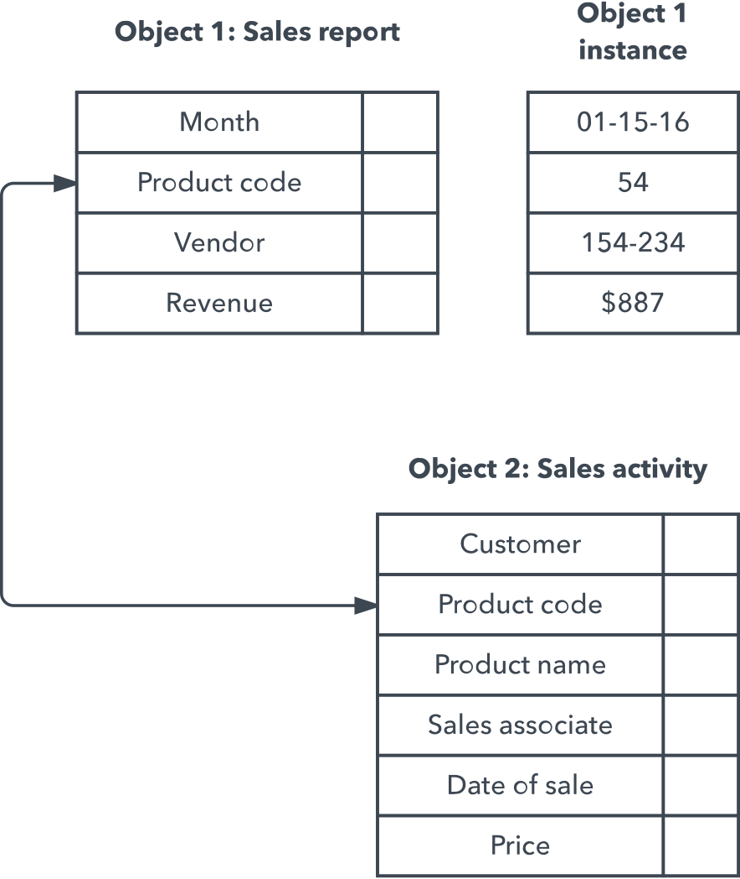
Object Oriented
A collection of objects, or reusable software elements, with associated features and methods. Any object to link to any other object. It’s useful for organizing lots of disparate data.
Zamolxis – The ERD for OpenEdge
acorn.ro
Notes:
The object-oriented database model is the best known post-relational database model, since it incorporates tables, but isn’t limited to tables.
Such models are also known as hybrid database models.

Slide 9
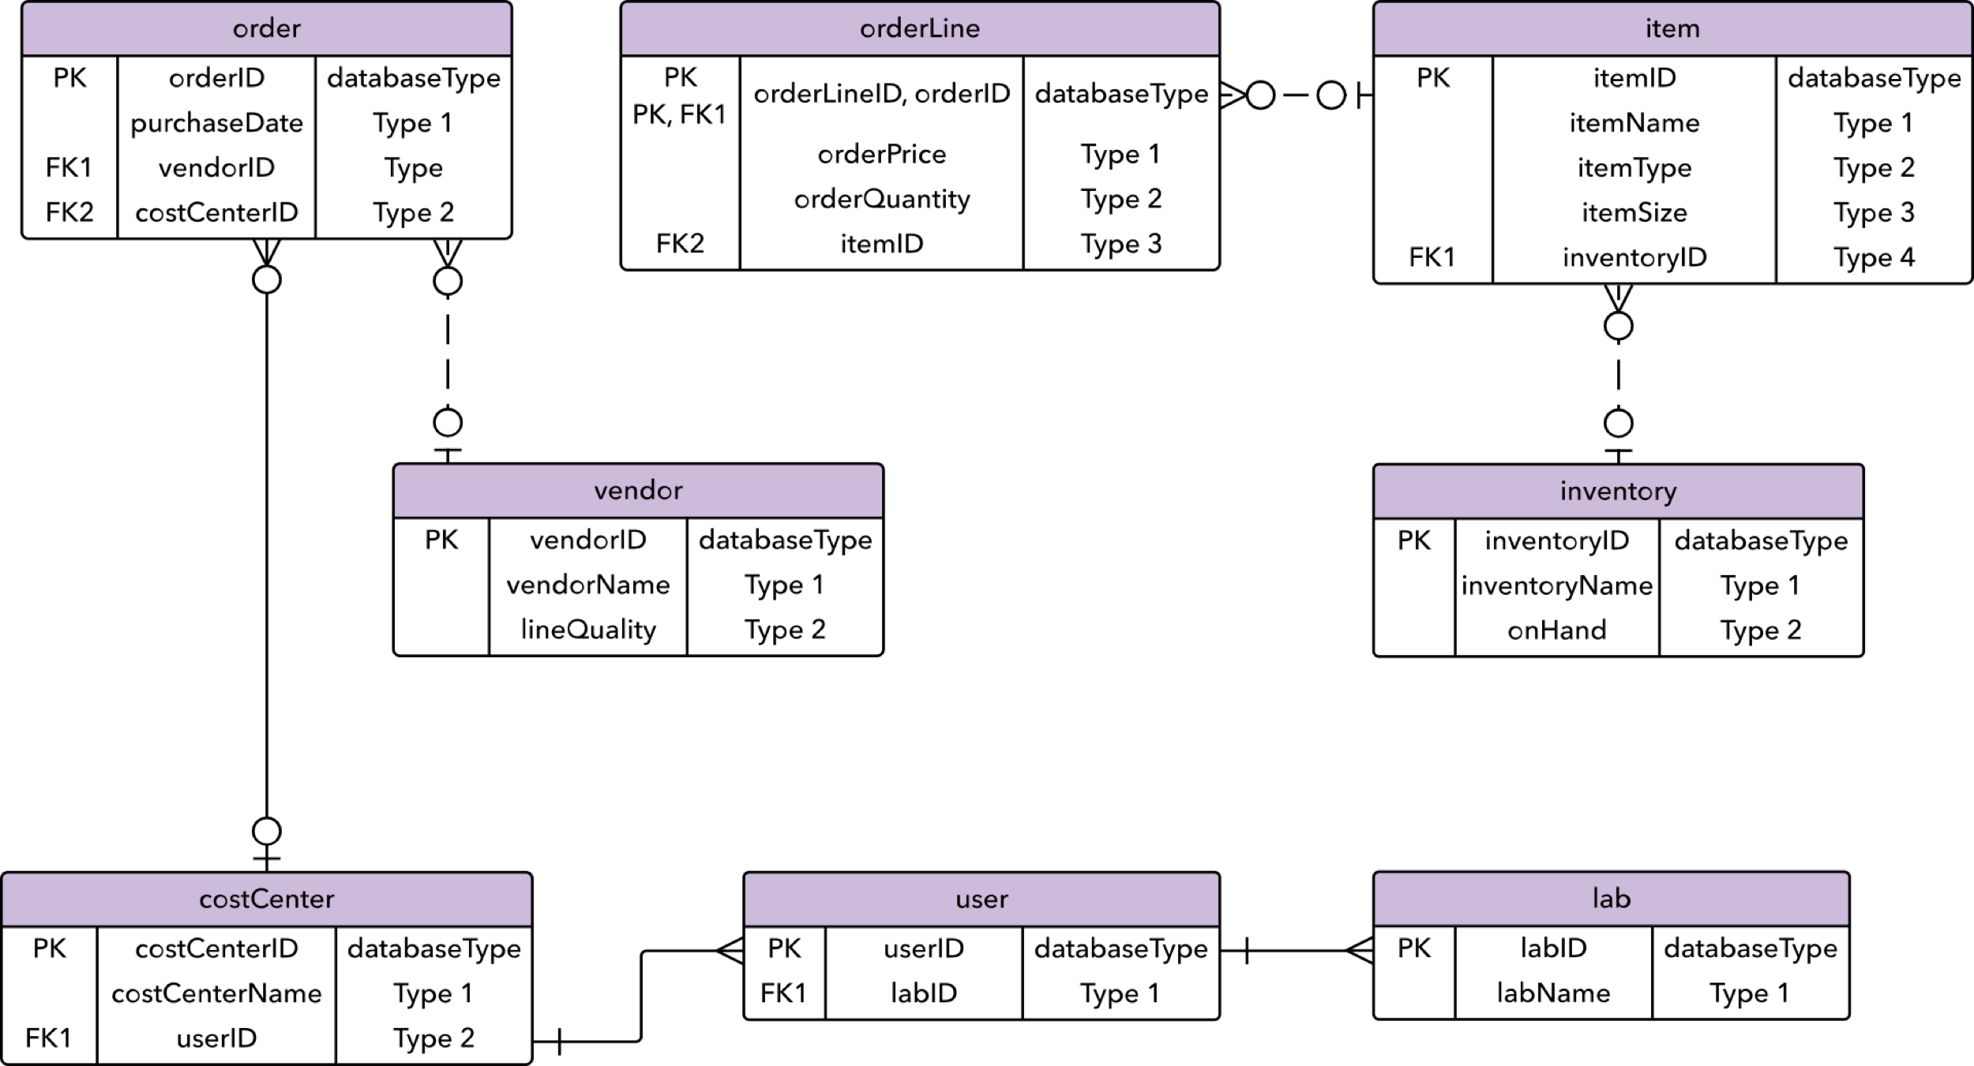
Entity Relationship
Captures the relationships between real-world entities much like the network model, but it isn’t as directly tied to the physical structure of the database. Instead, it’s often used for designing a database conceptually.
Zamolxis – The ERD for OpenEdge
acorn.ro
Notes:
The things about which data points are stored are referred to as entities, each of which has certain attributes that together make up their domain.
The cardinality, or relationships between entities, are mapped as well.
A common form of the ER diagram is the star schema, in which a central fact table connects to multiple dimensional tables.

Slide 10
OpenEdge
(R)DBMS
OLTP
Relational (well, almost)
Normalization (3NF)
No formal foreign-key support
Triggers
Zamolxis – The ERD for OpenEdge
acorn.ro

Slide 11
Normalization
Edgar Codd proposed the theory of normalization with the introduction of First Normal Form, and he continued to extend theory with Second and Third Normal Form.
Later he joined with Raymond F. Boyce to develop the theory of Boyce-Codd Normal Form.
Zamolxis – The ERD for OpenEdge
acorn.ro
Notes:
Theory of Data Normalization in SQL is still being developed further. For example, there are discussions even on 6th Normal Form.
However, in most practical applications, normalization achieves its best in 3rd Normal Form.

Slide 12
1NF
Each table cell should contain a single value.
Each record needs to be unique.
Zamolxis – The ERD for OpenEdge
acorn.ro
Notes:
This is probably the hardest level to achieve in OpenEdge database models, developers finds the oddest separators to pack a bunch of non-related information in the same column – not to mention extent fields :)
If you think the second rule is an easy one, think about primary keys with non-mandatory fields (hint, multiple ‘unknown’ values are permitted for an unique index).

Slide 13
What is a KEY?
A KEY is a value used to identify a record in a table uniquely.
A KEY could be a single column or combination of multiple columns.
Zamolxis – The ERD for OpenEdge
acorn.ro

Slide 14
Primary KEY
A primary key value cannot be NULL
A primary key value must be unique
The primary key values cannot be changed
The primary key must be given a value when a new record is inserted
Zamolxis – The ERD for OpenEdge
acorn.ro
Notes:
There is always a debate whether or not a primary key can be a natural key or surrogate (guid) – most of the time the value for a natural key can and eventually will change, but not always.

Slide 15
2NF
Be in 1NF
Single Column Primary Key
Zamolxis – The ERD for OpenEdge
acorn.ro
Notes:
So, this is an upgrade of 1NF – the additional requirement being all primary keys are single fields – aka not composed, each record can be identified by the value of a single column.

Slide 16
Foreign KEY
Foreign Key references the primary key of another Table
It helps connect database tables (relations)
It ensures rows in one table have corresponding rows in another (parent)
Unlike the Primary key, they do not have to be unique. Most often they aren’t
Can be null even though primary keys can not
Zamolxis – The ERD for OpenEdge
acorn.ro

Slide 17
3NF
Be in 2NF
Has no transitive functional dependencies
Zamolxis – The ERD for OpenEdge
acorn.ro
Notes:
Again, this builds upon 2NF and adds a single new rule as a requirement.
A transitive functional dependency is when changing a non-key column, might cause any of the other non-key columns to change - a column value might depend on another column value (ex: customer name, salutation, address).

Slide 18
What is a
Data Model?
Data Model is an abstract representation of an aspect of real world in the form of a list of data elements and their relationships.
Data may be modeled using various techniques - Entity-Relationship Diagrams in relational modeling, UML Class Diagrams in object-oriented modelling, Data Dictionaries, Dimensional Modeling, to name a few.
Zamolxis – The ERD for OpenEdge
acorn.ro

Slide 19
Data Dictionary
Data Dictionary is a list of data elements (entity/table and attribute/column) with their attributes and descriptions. It has a form of a set of tables.
Zamolxis – The ERD for OpenEdge
acorn.ro

Slide 20
Data Dictionary
Pros
May include many data attributes (e.g. default values, scale/precision, etc.)
Includes detailed descriptions of each element (table, column)
Easily searchable
Cons
Less visually appealing
More difficult to read
Zamolxis – The ERD for OpenEdge
acorn.ro

Slide 21
Entity Relationship
Diagram
ER Diagram is a graphical representation of a data model using entities, their attributes and relationships between those entities. It has a form of a diagram.
Zamolxis – The ERD for OpenEdge
acorn.ro

Slide 22
Entity Relationship
Diagram
Pros
Easier to see the big picture
Easier to understand table relations
Possible to use visual cues to communicate information
Cons
Doesn't work with large data models due to space constraints and clutter
Supports limited amount of details
May contain very little descriptions (as notes on a diagram)
Requires careful layout and fitting into canvas
Hard to search
Zamolxis – The ERD for OpenEdge
acorn.ro

Slide 23
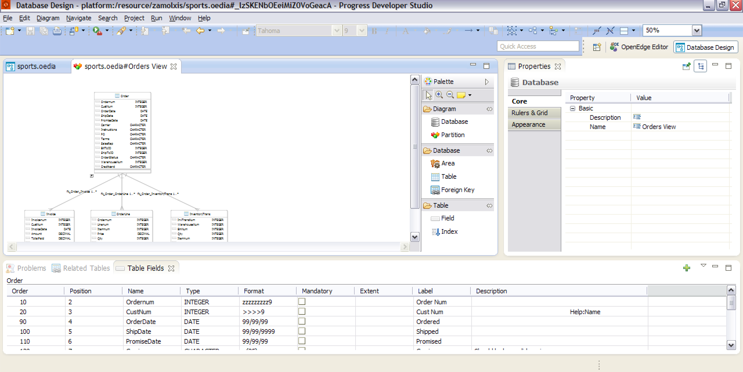
Why not
best of both?
Zamolxis – The ERD for OpenEdge
acorn.ro
Notes:
Neither is strictly better. Which one is better for you depends on what you want to achieve and the required level of detail. In my opinion you should use both.
Use ERDs for showing key tables and top level design. Use it to communicate ideas.
Don't add too many elements and details. Instead use multiple diagrams to explain different functional areas of a database.
Use Data Dictionaries for detailed documentation of each table and column. Use it as a reference documentation.
Add as many details as required. Data dictionaries can contain detailed description of each data element and the table form can handle this without losing readability.

Slide 24

Zamolxis
Entity Relationship Diagram designer for OpenEdge
Eclipse based
OpenEdge Data Definition Editor (DSL)
Integrated with PSDOE
Import/export data definition/project database
Model base compare (diagram, definition file)
Incremental data definition
Zamolxis – The ERD for OpenEdge
acorn.ro
Notes:
For large data models the diagram soon starts to be very hard to read.
Partitioning is one of the main features of Zamolxis, one can group tables in physical partitions (database areas) or simply logical views of a specific area of interest.

Slide 25
Database Objects
Database(s)
Areas
Sequences
Tables
Fields
Triggers
Relations
Zamolxis – The ERD for OpenEdge
acorn.ro
Notes:
For large data models the diagram soon starts to be very hard to read.
Partitioning is one of the main features of Zamolxis, one can group tables in physical partitions (database areas) or simply logical views of a specific area of interest.

Slide 26
Properties
Supports all OpenEdge properties (area, table, sequence, field, index)
Even extended properties (schema holder, misc)
Grouped by category (or not)
Lists (data type, code page, collation)
References (areas)
Complex (triggers, sequences, index fields)
Zamolxis – The ERD for OpenEdge
acorn.ro
Notes:
We support all properties available for OpenEdge database elements, up to version 11.2, constantly updating it for new releases.
Support for schema holder and extended/miscellaneous properties exists (by default hidden).

Slide 27
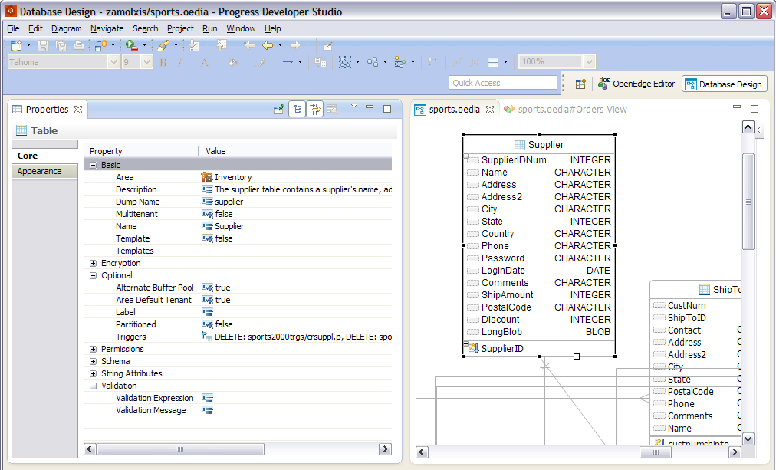
Properties
Zamolxis – The ERD for OpenEdge
acorn.ro

Slide 28
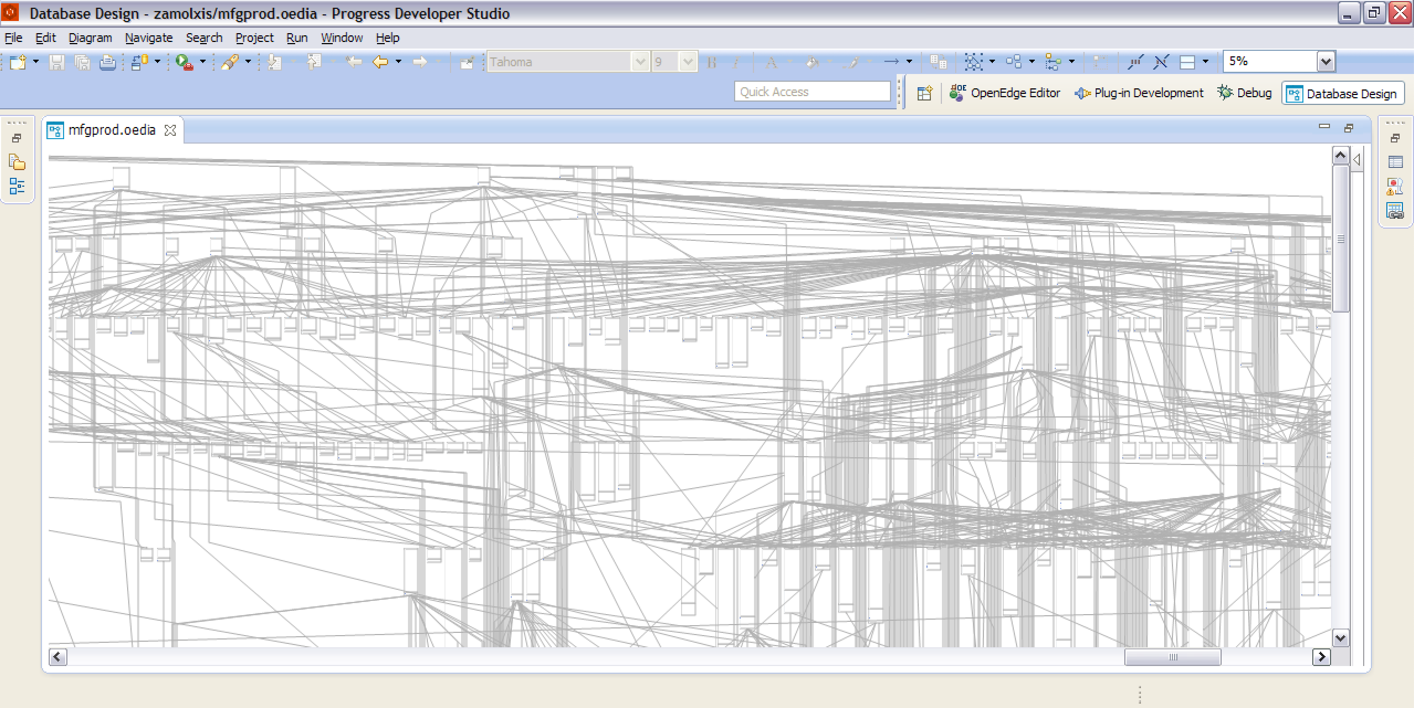
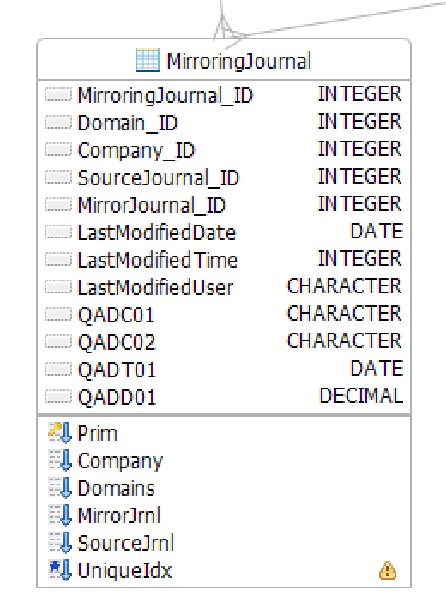
Can you see
the forest?
Zamolxis – The ERD for OpenEdge
acorn.ro
Notes:
Doesn't work with large data models due to space constraints and clutter… well, hard to argue with that, can’t really see the forest for the trees.

Slide 29
Partitions
Split large data models
Create ‘Views’ as needed
Physical or Logical
Can be nested
Import ‘Shortcuts’
  Related tables (parent, child)
  Even from different model
Zamolxis – The ERD for OpenEdge
acorn.ro
Notes:
For large data models the diagram soon starts to be very hard to read.
Partitioning is one of the main features of Zamolxis, one can group tables in physical partitions (database areas) or simply logical views of a specific area of interest.

Slide 30
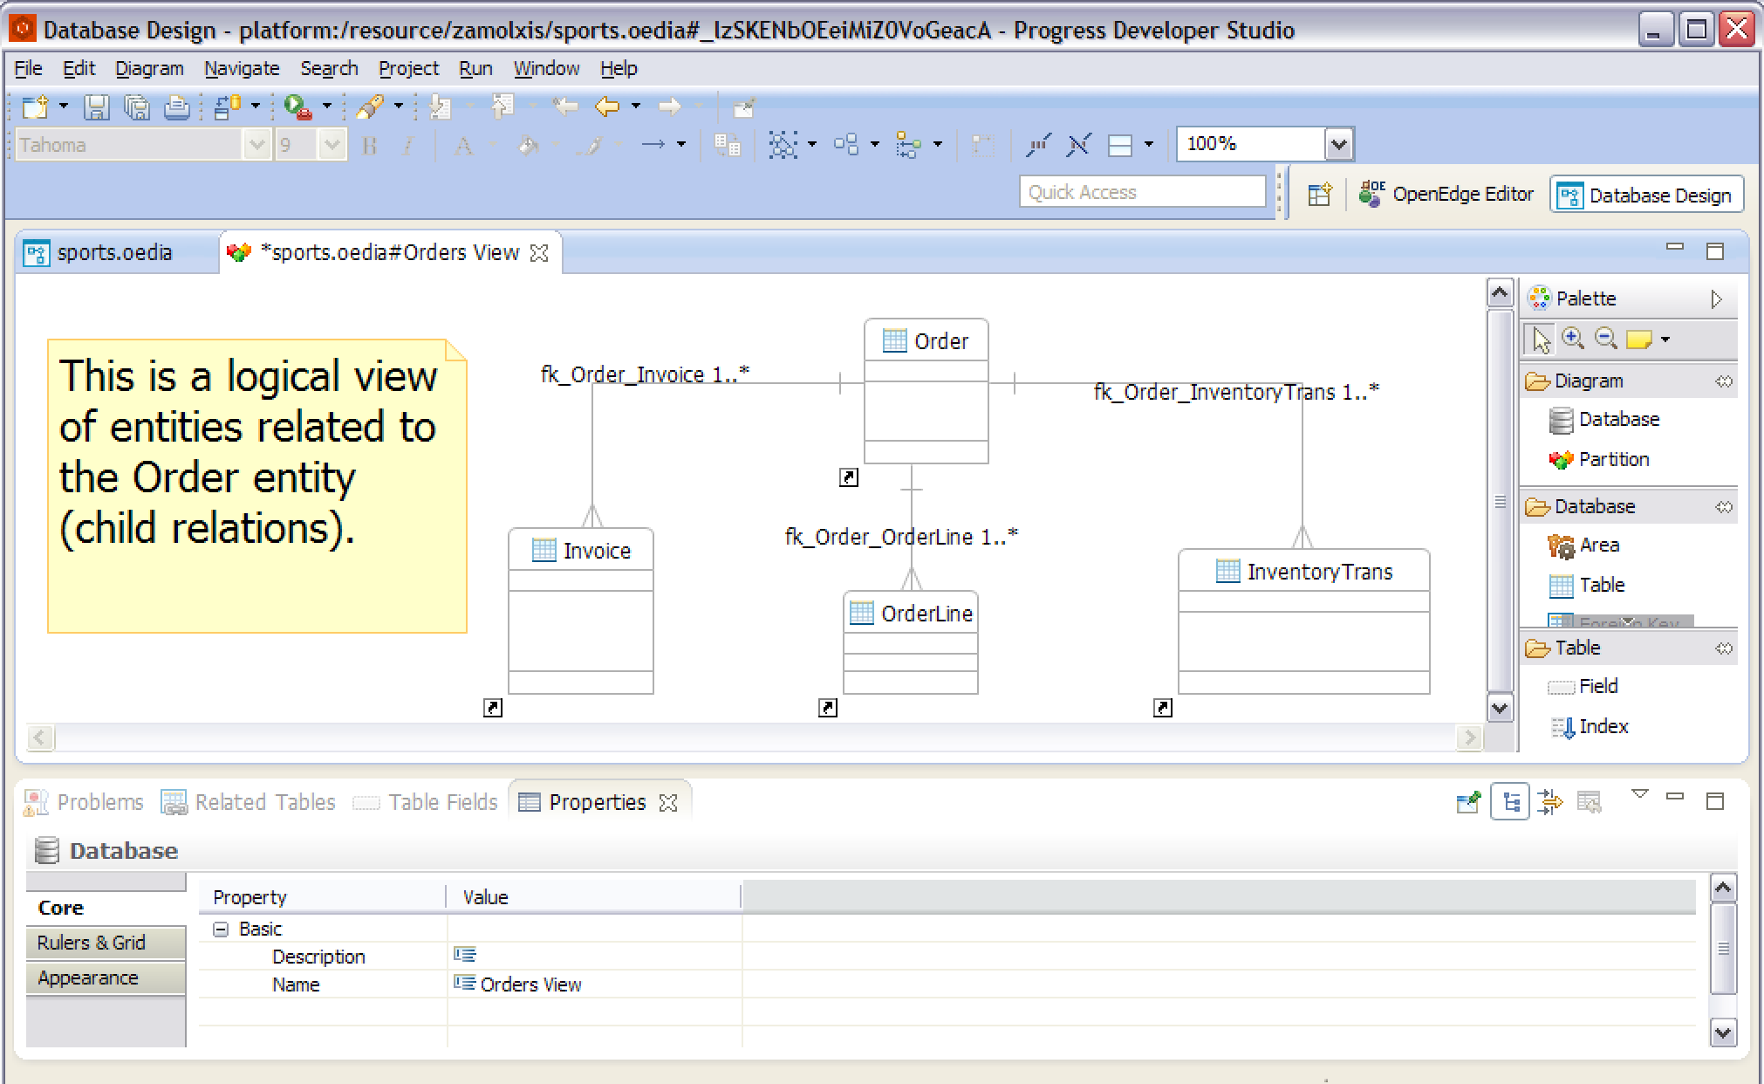
Partitions
Zamolxis – The ERD for OpenEdge
acorn.ro

Slide 31
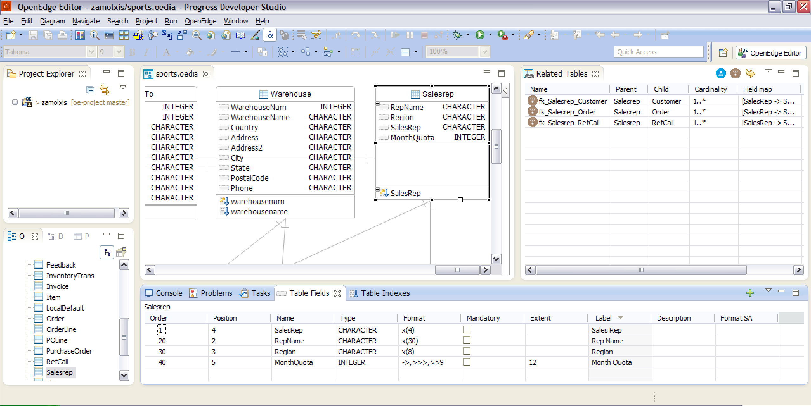
Data Dictionary
Views
View data in more details, select properties of interest, sort order.
Zamolxis – The ERD for OpenEdge
acorn.ro

Slide 32
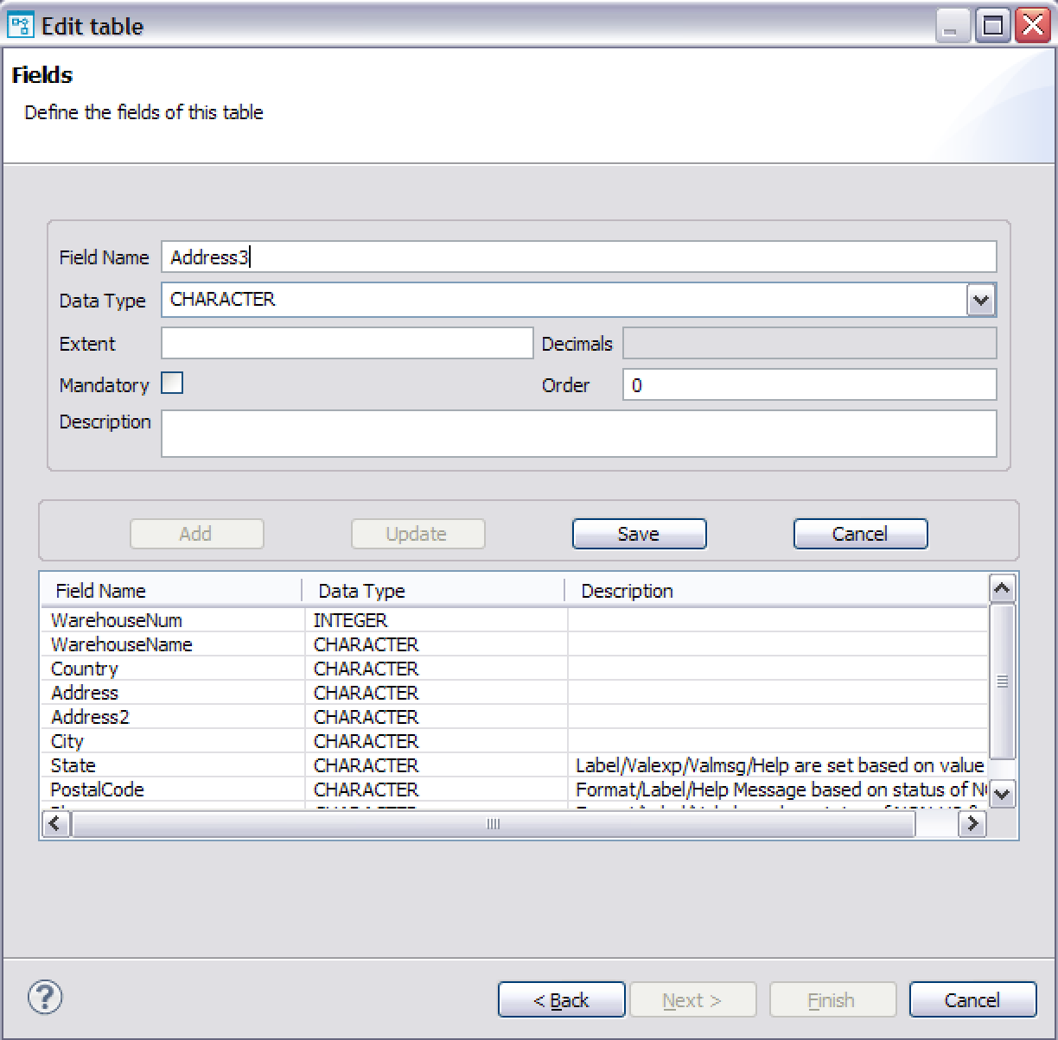
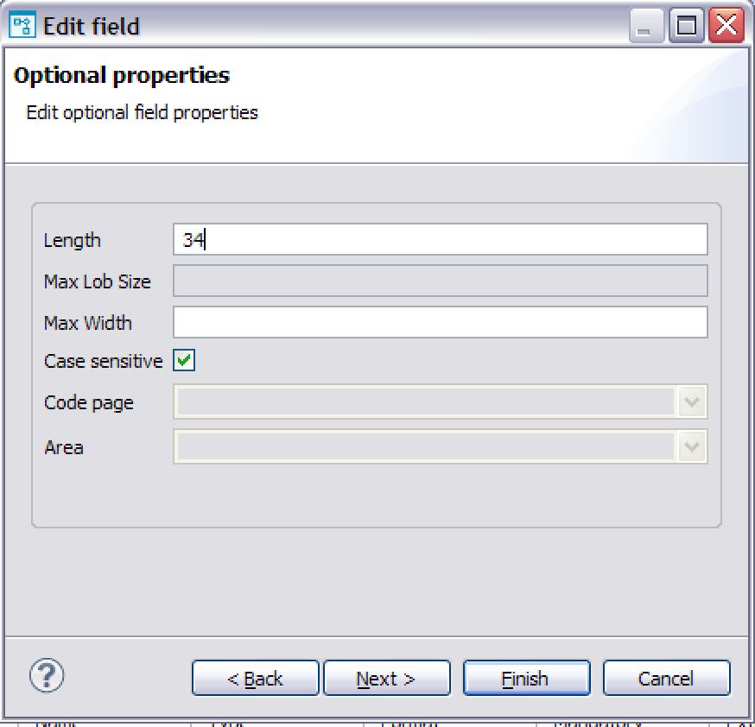
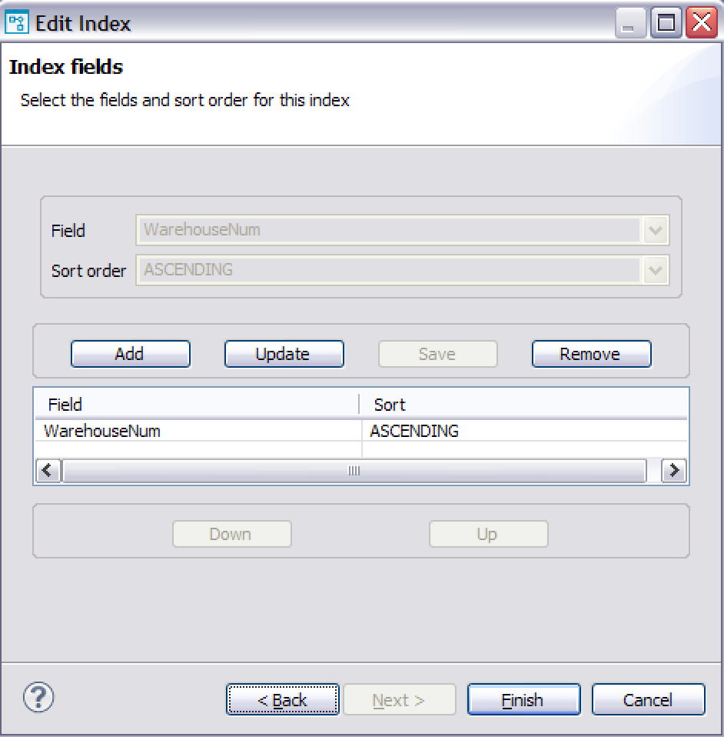
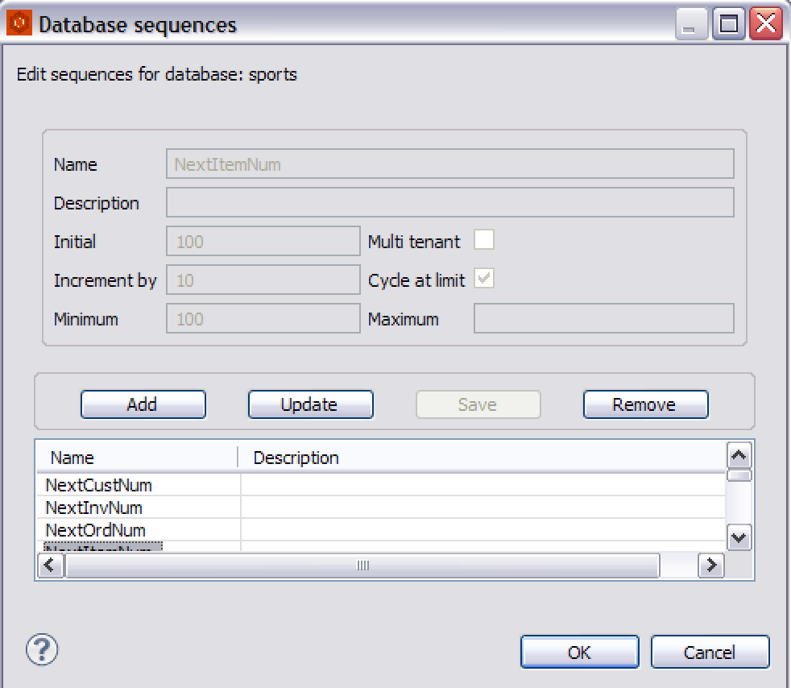
Wizards
Wizards for quickly adding/editing database elements.
Zamolxis – The ERD for OpenEdge
acorn.ro
Notes:
When adding multiple database elements (like in the model discovery phase) using properties view can be time consuming, a flag in the editor preferences fire a wizard when a new element is added to set most common properties and those wizards usually can go on in a loop for adding multiple elements of the same type.

Slide 33
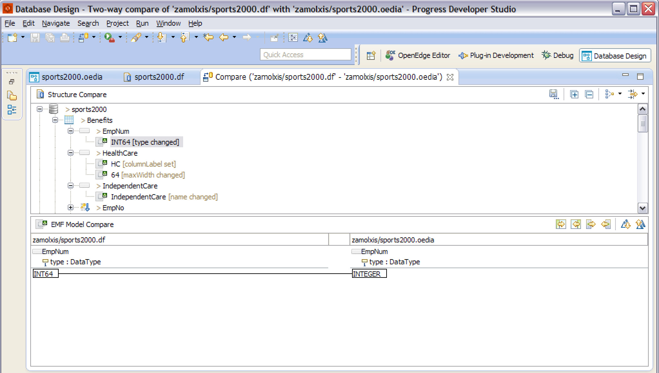
Model Compare
Visualize model differences – diagram, data definition, project database, versioning.
Synchronize or create incremental definition file.
Zamolxis – The ERD for OpenEdge
acorn.ro
Notes:
You can compare differences between database models, either between diagram/data definition file or project database or between different versions of a model through the standard Eclipse compare interface.

Slide 34
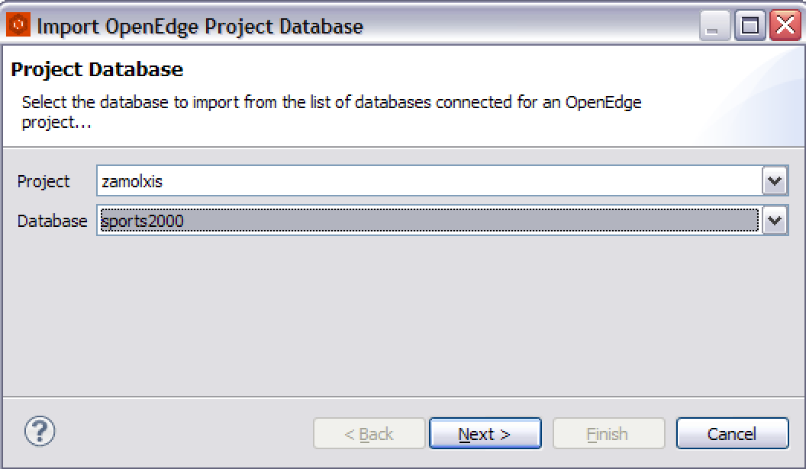
PSDOE
Integration
Import from project’s connected database(s)
Sync with project’s connected database(s)
Create and load incremental data definition
Zamolxis – The ERD for OpenEdge
acorn.ro
Notes:
Import diagrams directly from connected project databases in PSDOE, no need to go through the process of exporting data definition that can later on be loaded.
Applying changes done on the database model to the connected databases can be done right from the PSDOE environment – might fail for multi-user databases if schema lock can’t be attained.

Slide 35
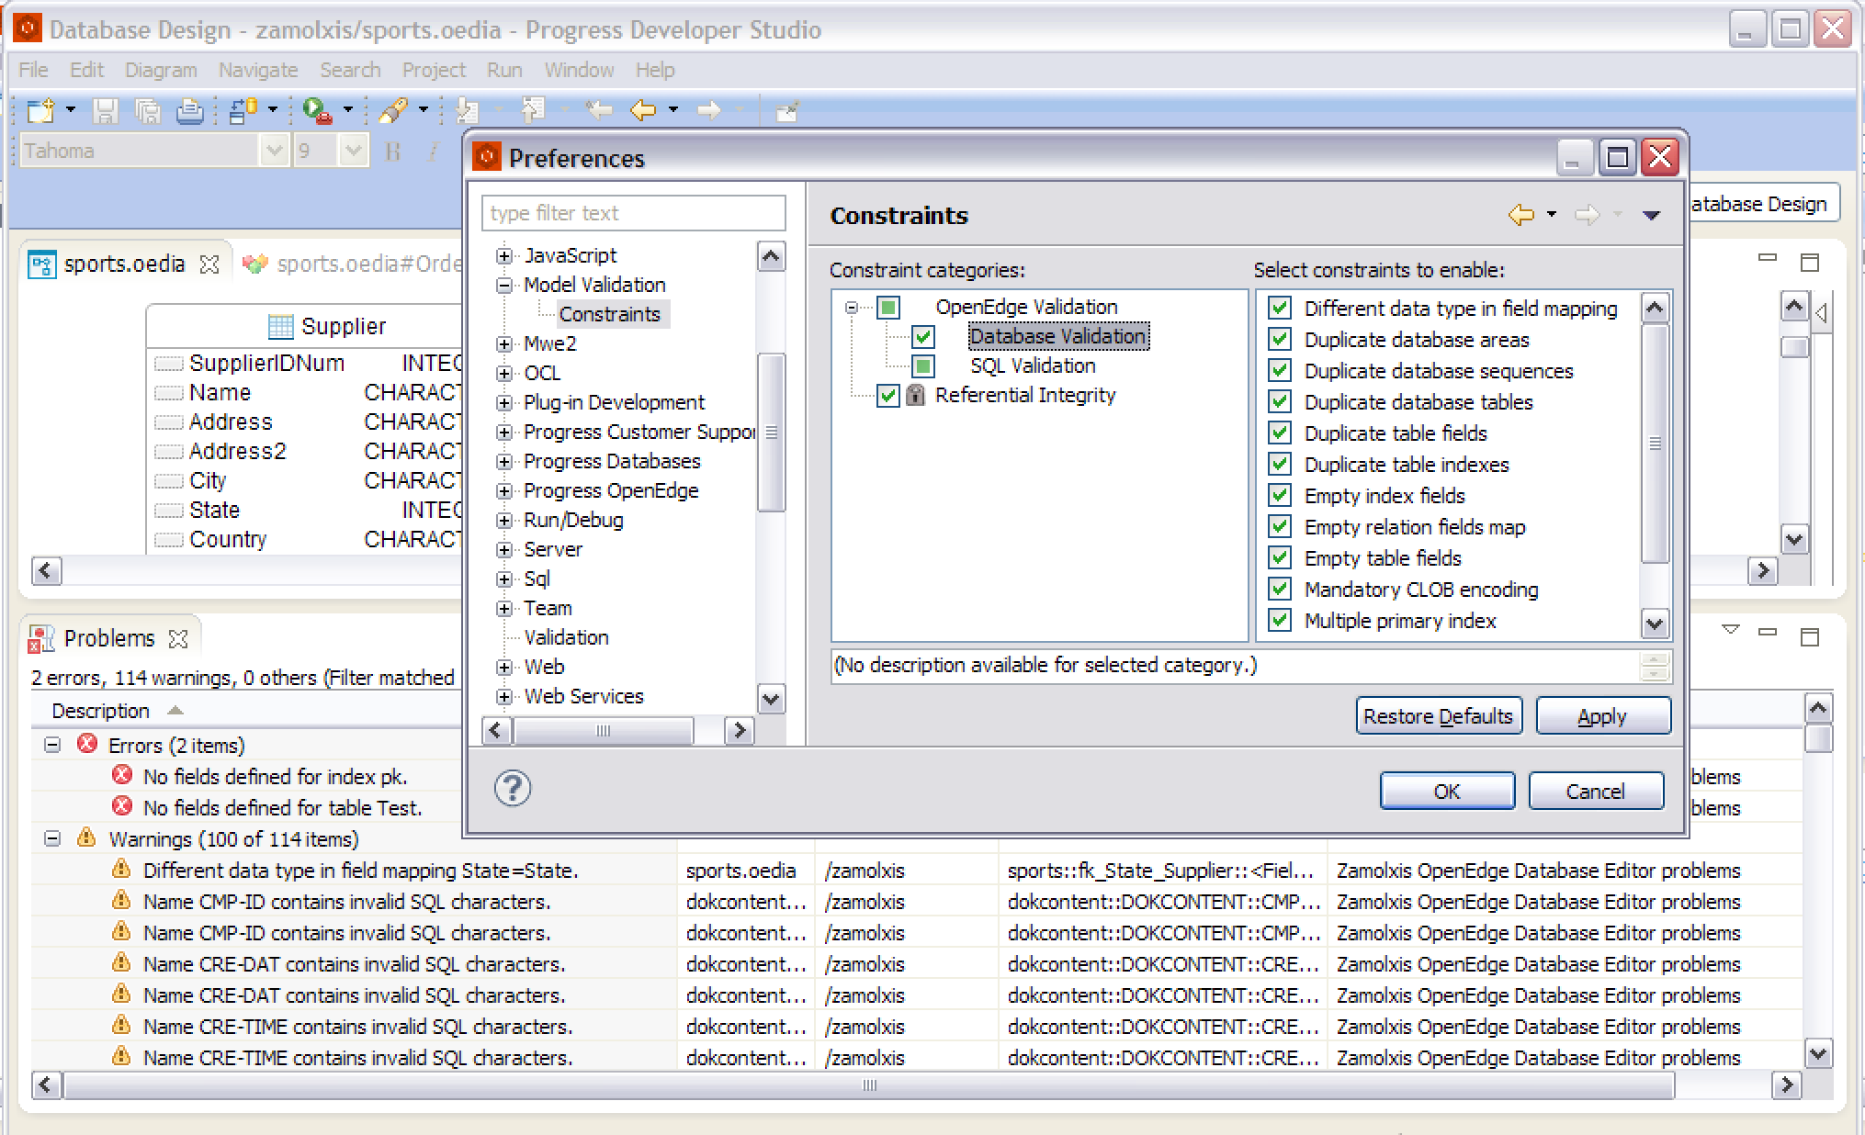
Model Validation
Basic validation rules to help with most common design flows.
Zamolxis – The ERD for OpenEdge
acorn.ro
Notes:
Sadly this won’t be able to spot the violation of 1NF – table field holding multiple values (comma separated).
Rules can be enabled or disabled as needed.

Slide 36
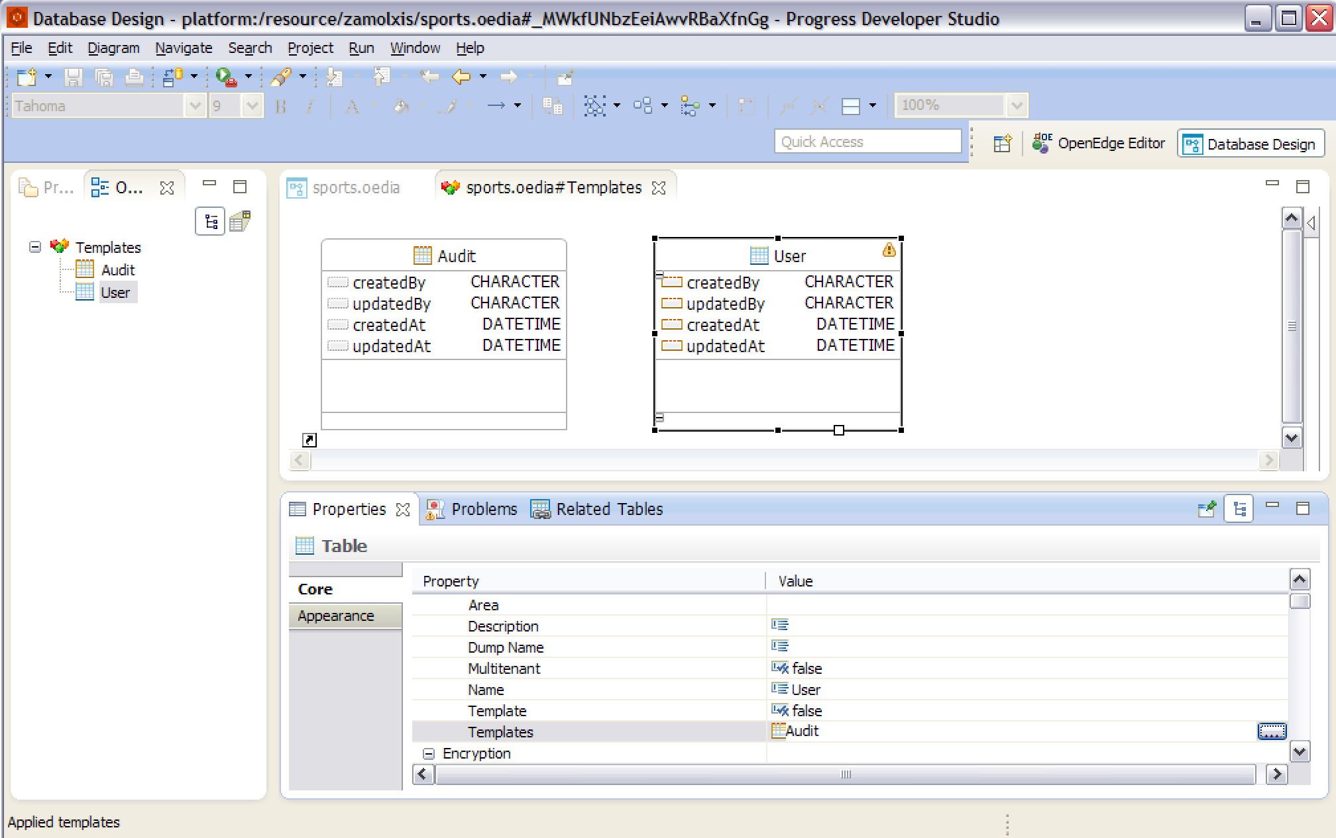
Templates
Define reusables ‘template’ tables with common fields.
Zamolxis – The ERD for OpenEdge
acorn.ro
Notes:
Templates ca be used as ‘base’ objects, any number of templates can be applied to a table.
Template tables can’t have indexes and are not exported in the data definition.
Template fields are ‘linked’ to the ones in the template, changes done in template are propagated (unless locally overridden).

Slide 37

Zamolxis
﻿http://zamolxis.acorn.ro/update/

