Slide 1
What’s New in OpenEdge 11.7?
June 5, 2017
Martha Lynch, Marie Candela, Evan Bleicher
Notes:
By now you’ve heard that OpenEdge 11.7 was released earlier this year in March. 11.7 represents the last release in the 11 family, other than Service Packs. We are now focusing efforts on 12.0.
From the Abstract:
By now youve heard that there has been a new release of OpenEdge, and you’re asking what’s in there for me?. The simple answer: Plenty.
Come to this session to get an overview of the major features that youll find in OpenEdge 11.7. Hear about:
how you can track changes in your database to easily enable ETL;
why you have even more reasons to try out the Progress AppServer for OpenEdge (PASOE);
the latest development and deployment tooling improvements;
plus those ABL enhancements you’ve been asking for.
And much much more.

Slide 2
OpenEdge 11.7 Delivers
Notes:
You’ll find that OpenEdge 11.7 Delivers a lot of functionality to enable you to create mission critical business applications.

Slide 3
OpenEdge 11.7 Delivers
Security, Scalability, High Availability
Notes:
We have raised the security capabilities of the platform in several areas.
We introduced features that enable you to scale your application and interoperate with a greater ecosystem of business processes.
And we have added fundamental building blocks and features to enable operations to happen truly online, reducing your downtime.

Slide 4
Agenda
All Things DataBase , featuring CDC and Replication
Security, Servers, Management and Development Tools
ABL and Kendo UI Builder
Notes:
PASOE

Slide 5
OpenEdge Database
OpenEdge Change Data Capture
Replication Target Synchronization
Database enhancements

Slide 6
OpenEdge Change Data Capture
Notes:
We have a new Database feature in 11.7 – OpenEdge Change Data Capture
It is about data in the database that has changed - create, update, delete – and being able to use information about the change elsewhere.

Slide 7




Using OpenEdge Change Data Capture
Data Warehouse
Operational Data Store
Analytics
Financial Systems
OpenEdge
Change
Data
Capture
Data Extraction
Notes:
A common use for this information is to E-T-L into an enterprise system ->
Data warehouse, financial systems, analytics and business intelligence.

Slide 8
OpenEdge Change Data Capture
Enable CDC on source table
Source Table (Customer)
User Data
Record operations:
create, update, delete
_Cdc-Table-Policy, _Cdc-Field-Policy
CDC Policies Cache
CDC Internal Database Triggers
Change Tracking Table
(_Cdc-Change-Tracking)
Change Table – (Customer)
CDC_Customer(captured data)
Extract
Transform
Load
Staging Area
Data Warehouse
Notes:
Take a look at how we’ve implemented it in OpenEdge
this is high level overview of how progress change data capture works.
The CDC feature has already been enabled on the database.
User wants to track and capture changes against source table customer.
Enable CDC on source table.
This is done by creating CDC policies against the source tables.
CDC policies are stored in CDC cache.
When a user does create/update/delete record operation on this source table,
internal DB triggers consult with CDC cache to see if an active current policy exist against the source table,
if it does trigger is fired and
as a result a record is written to change tracking table and change table.
Once a trigger is fired , change data is captured in change tables and ETL can be run to populate data warehouse.

Slide 9
OpenEdge Change Data Capture
Core functionality implemented in the database engine
OpenEdge Management and OpenEdge Explorer to configure and manage CDC
Subset of management options available in Data Administration and the Data Dictionary
Alternate method to configure and manage CDC is to use ABL
Extract CDC information from the database using either SQL or ABL
Available with Enterprise, Work Group, and Advanced Enterprise Edition licensing
Notes:
Implemented in the database, plus…

Slide 10
Feature Highlights
Flexibly configure the scope of data changes captured, just the fact that the record changed to the tracking of the actual data changes
Easy to change what is being captured
Store data in a change table with the same data type as the source table without conversion to a character field
Zero application changes required
Alternative to approaches using Auditing or ABL replication triggers
395: Introducing OpenEdge Change Data Capture
Notes:
Existing approaches and some challenges – those features were not designed specifically for this purpose
Our OpenEdge Pro2 product, recently released version 5, has included an implementation using CDC, available to you on 11.7.0.
In many cases, CDC will show improved performance over auditing and replication triggers.

Slide 11
OpenEdge Replication
Notes:
In 11.7, we have two areas of focus, with a source and 2 target replicas:
Reduce the need to recreate target databases
Remove the single point of failure vulnerability in the Disaster Recovery scenario
Let’s go through a recovery transition to show the improvements

Slide 12


Transition for Recovery
A source database fails - a target replica changes its role to become the source
existing
Target Brown
Source
Single point of failure
Target Brown
Target Blue
Source

Slide 13
Transition for Recovery
A source database fails - a target replica changes its role to become the source
existing
with 11.7
Target Brown
Source
Target Brown
Target Blue
Source
Source
Notes:
In recovery transition, the original source is lost. So the two targets must rely on the inter-agent comm. to coordinate the transition.
--------------------------------
During the failover transition, the inter-agent comm. is not actually used.
It’s not used because in FO, everything is driven by the original source.
Therefore, First, inter-agent communication is paused
failover happens
source/target1 switch roles,
the new source reconnects to the two targets
eventually inter-agent comm. is reestablished after the transition.

Slide 14
Replication Target Synchronization
A Replication Set is a replication environment that contains a source replica and two target replicas
Inter-agent Communication enables the targets to transition together if the source database is gone
Three-pronged failover
Targets communicate their location relative to source
Configure automatic or manual transitions for planned or unplanned downtime
Reduces the number of instances when have to recreate target databases
Removes the single point of failure in the production environment
372: What’s New in OpenEdge Replication?
Notes:
There are several characteristics of Replication Sets:
AI enabled and running for each target replica
The ability for agents to communicate with each other
A property to identify the priority for target replicas to transition
A property to enable Replication Set functionality
The Transition Failover command causes two replica databases to “switch roles”
Useful for maintenance operations
Both database replicas must be online
When completed:
The original target becomes the new replication source
The original source becomes a replication target
Source and Target(s) restart
Normal replication processing resumes, the replication set is maintained

Slide 15
Other Database enhancements

Slide 16
Online index activation
Certain database utilities require ABL clients to disconnect before the utility will execute
For example, the client index schema needs to include the new index before it can be activated
Database client notification is a new mechanism in OpenEdge 11.7
  Create the index and activate it
  Clients that need to refresh their schema do so
  Index activation proceeds
Utilities able to use client notification in 11.7.0:
  Index activate
  Multi-tenant index build
  Partitioned table index build
  Binary load with build indexes option
To use: enable notification with server startup parameter, initialize polling frequency

Slide 17
Database Diagnostics 11.7.1
Capture diagnostic data at time of “incident”
  DBA generally cannot capture all needed data at the time of certain incidents
    BI threshold exceeded
    System Error
    Lock table overflow
  Capture automatically or on-demand
Data to capture
  Incident applicable and configurable
  Centralized and easily consumed
  Disparate data correlated to incident
Fully configurable at startup and at runtime
470: Database Diagnostics
Notes:
Available in 11.7.1
This Database enhancement is targeted for specific triggering events such as
a system error,
lock table overflow or
bi space exhaustion.
The database will automatically report
critical runtime statistics at the exact time the problem occurred
in an easy to consume way.
The flexible architecture can be used for much more than just reporting statistics.

Slide 18
Mark Database as Backed Up, online
For system level backups, performed using a quiet point
The database can now be marked as backed up as part of a quiet point while the database is online
proquiet <dbname> –C disable markbackedup
If the option is specified when ending the quiet point,
    the database will be marked as having been backed up,
      regardless if a hardware or OS backup actually occurred or not
Notes:
Requested functionality is to be able to mark a database as backed up while it is on-line.
A database can now be marked as backed up as part of a quiet point while the database is online.
A new option to PROQUIET disable has been added to better facilitate an online copy backup of a database.
This allows DBAs that use system level backups, in conjunction with a quiet point, -
to mark a database as having been backed up and to be reported in Promon and PROUTIL DESCRIBE
It is not a required parameter and is not enabled by default.
If the new option is not specified the database will not be marked as having been backed up.
If the new option is specified when ending a quiet point, the database will be marked as having been backed up, regardless if a hardware backup actually occurred or not.

Slide 19
Virtual System Table enhancements
Many enhancements to existing VSTs
Better information available to monitor a running database. From our collection of comments, requests, and suggestions… from internal sources and customers.
proutil updatevst
Database with the new VST schema run with an older version of OpenEdge?
The new fields will not be populated
All of the enhancements were made to both VSTs and in Promon
541: What’s new with the VSTs?
Notes:
There are several enhancements to the OpenEdge Virtual System Tables (VSTs).
A central theme was to have better information through programmatically monitoring a running database
to gather information on tuning, diagnostics, and checking on the health of the system.

Slide 20
Security, Servers, Management and Development Tools

Slide 21
Security, Servers, Management and Dev Tools
Progress Application Server for OpenEdge
Security and the OpenEdge Authentication Gateway
Progress Developer Studio for OpenEdge
OpenEdge Business Process Management
OpenEdge Management and OpenEdge Explorer
OpenEdge SQL and DataServers
Installation
Notes:
I’ll take you through the changes that we’ve made in several areas of the product, starting with the Progress Application Server for OpenEdge, which we often refer to as PASOE, and the major new security feature: OpenEdge Authenticaton Gateway; all the way through to Installation features as well as our Platform support.

Slide 22


Progress Application Server for OpenEdge – your AppServer of the Future
From Pacific to Progress Application Server
Tomcat, Java 8, Spring Security upgrades
  SSLv3 Support deprecated
Ease of Configuration and Management
  oeablSecurity.properties simplifies configuration
  genspringpwd utility for encrypting passwords
  pasoestart action for tcman and pasman
  New tcman create options for uname/passwd & security model
  Deployment Architecture: New instance-name/ablapps directory
HTTP Client Single Sign-On (SSO) Support
  Implemented through the web server framework
  Executes in a protected environment that the web application code can’t provide.
Notes:
Some of you might be saying ‘what happened to the Pacific Application Server? We have dropped the name Pacific…
The core Apache Tomcat server was upgraded to Version 8.5.x in the 11.7 release of PAS for OpenEdge.
The Management enhancements include adding a new command-line utility encapsulates PAS for OpenEdge startup tasks into a single command with pasoestart action for tcman and pasman. We also added new options to tcman create. The -m option allows you to specify a username and password to access
Tomcat container-level security. The -Z option which allows you to specify a security model for web application during their development.
We added a new multisession startup parameter No Common Language Runtime
We’ve added a new instance-name/ablapps directory where you can optionally deploy your web applications for development and deployment.
The Security section includes some enhancements that are a direct result of the Java Upgrade. For example, support for SSLv3 and other
cipher suites (MD5 and RC5, for example) has been retired. Support for TLS has been updated
and replaces those retired technologies.
• HTTP Client Single Sign-On (SSO) Support — SSO support in the web server framework allows a user
to log into the full business application once and transparently pass verifiable proof their login identity to
each distributed web application (or service). While SSO can be implemented in the web application itself, the better choice is to implement the SSO through the web server framework. Using the web server framework for SSO has the benefit of executing the necessary security measures in a protected environment that the
web application code cannot provide. Using web server framework SSO services also affords high
availability and scalability support missing from web application implemented solutions.

Slide 23

Making it easier to Secure your OpenEdge Application
Why Security Matters
  Compliance – Increased industry or government compliance
  A security breach is expen$ive and damaging to future business
Notes:
Let’s just take a moment to talk about Security. I’m probably preaching to the choir here. We’ve been hearing more and more from customers who must meet certain security requirements, including audits of their entire system, in order to operate in certain markets. So business opportunities will depend on how secure your application is.
If a security breach does happen it will be expensive to recover from and additionally hurt your reputation as a trusted vendor.

Slide 24
Making it easier to Secure your OpenEdge Application
Why Security Matters
  Compliance – Increased industry or government compliance
  A security breach is expen$ive and damaging to future business
OpenEdge Authentication Gateway
  Ensures Trusted Identity Management:
  The right users get the right access to the right information
  Supports Compliance Regulation Requirements
Notes:
These are some of the reasons why we introduced the OpenEdge Authentication Gateway in OE 11.7. the Authentication Gateway provides trusted identity management, to ensure the only people gaining access to your data are those you know and authorize. It Supports compliance regulation requirements.

Slide 25










Use the Authentication Gateway to Lockdown your OpenEdge Database
ABL Clients
OpenEdge Authentication Gateway
Application
Server
STS
OpenEdge Database
OpenEdge SQL Server
Authentication Provider
(e.g. LDAP, Active Directory)
ODBC
JDBC
Notes:
Without the OpenEdge Authentication Gateway, ABL and SQL database security is handled by the clients.
ABL and SQL clients would directly connect to an OpenEdge database PRIOR to the client code enforcing authentication and authorization.
provide greater control over ABL and SQL client connections to OpenEdge databases
The OEAG is a secured PASOE instance where the OESTS web application (oests.war) is deployed.
“Hardened” for Security; remote administration web applications removed, specially purposed for running the STS
Each STS client holds a key (aka credentials) established by an administrator, that authorize their access to the STS

Slide 26
The OpenEdge Authentication Gateway in 11.7
Supported throughout the product
  Utilities to configure OpenEdge databases
  Tools to maintain and monitor OpenEdge database activity
  ABL functions, handle attributes and methods, and class properties
  Full ABL and SQL support
Separate control code
  Bundled with the Progress Application Server for OpenEdge
  Available as a stand alone product
Notes:
The OpenEdge Authentication Gateway is a key component of a centralized authentication and authorization service for database connections. I
Redirects all initial access requests to a Security Token Service
Provides Components to support Centralized Authentication service for DB connections
Leverages a Security Token Service, built on Progress AppServer for OpenEdge
Requires an authentication provider – e.g. OS local, LDAP, KEON
Creates and seals client-principal tokens
501: OpenEdge Authentication Gateway Workshop – Roy Ellis

Slide 27
General Security Enhancements
  OpenSSL Upgrade
    Transport Layer Security (TLS) and Secure Sockets Layer (SSL), cryptography library
  Enhanced SSL Certificate Support
    Manage multiple domains with a single certificate using the wildcard character ‘*’
    Manage multiple alternative host names to be included within a single SSL certificate
  Server Name Indication (SNI)
    Server with single IP address support multiple domain names
    Clients indicate the target hostname it wants to connect to
    Server presents correct certificate
Notes:
Wildcard: one could use *.progress.com as the to represent all sub domains of progress.com.
Alternative host: allows users to specify a list of host names to be included in a single SSL certificate. For example, one could specify both example.com and example.org or .net
Server Name Indication (SNI) Support for ABL Clients - a server with a single IP address covers a group of domain names. The client will give an indication of the domain name, so the server knows which certificate to present to the browser

Slide 28
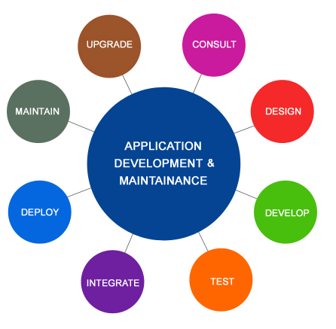
Progress Developer Studio for OpenEdge makes you more Productive
New Project Creation Wizard
  Simplifies Project Creation based on Project Type
Improvements to working with Progress Application Server for OpenEdge
  Log viewer
  Ant tasks
  Migration of security files
  Startup timeout default is 120
Notes:
New OpenEdge Project wizard—The interface for the OpenEdge Project wizard has changed. The Create an OpenEdge Project page now displays Server, Client, and General categories for project type selection. Note: If you do not select a category (Client, Server, or General) and click Finish, a basic OpenEdge project without any specialization is created.
Progress Application Server for OpenEdge
• Log Viewer—The Log Viewer helps you to view and monitor the log files of a PAS for OpenEdge server instance from the Servers view. There are multiple log files for a server, you can choose to go to the directory where the log files are saved and manually search for errors, or view from Developer Studio using the Log Viewer.
• ANT tasks for Progress Application Server for OpenEdge—You can write custom ANT tasks to package ABL Web App and Web UI projects and to generate a Data Object Service Catalog file.
• Migration of Spring Security files—If you imported an ABL Web App project from OpenEdge 11.6 to the current release in the Developer Studio, you can also migrate the Spring Security files.
• Debugger support—You can now use the Debug Configurations wizard to debug ABLUnit and Progress Application Server for OpenEdge.

Slide 29
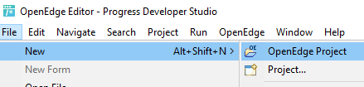
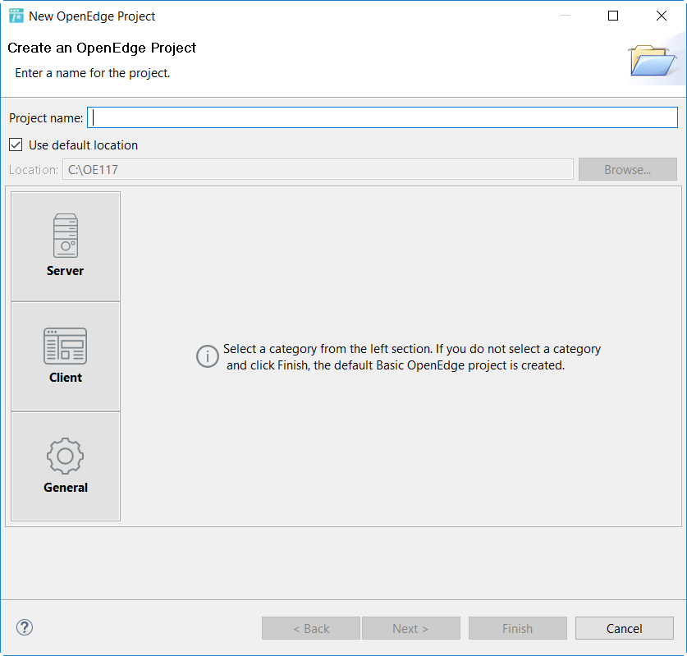
Reorganizing OpenEdge Project wizard
Notes:
The interface for the OpenEdge Project wizard has changed. When you select File > New > OpenEdge Project shown at the top.
[Click 1] The create an OpenEdge Project page now displays Server, Client, and General categories for project type selection.
To make it easier to read let’s expand the 3 options and text. [Click 2] As the texts states if you do not select a category a Basic OpenEdge project is created. In the next few slides we’ll compare this process to the 11.6 release.

Slide 30
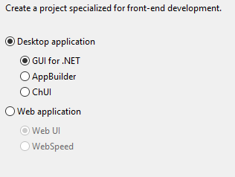
Project Wizard Options based on Project Type
Client

Slide 31
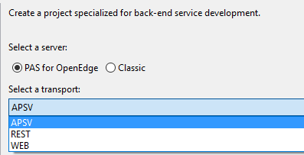
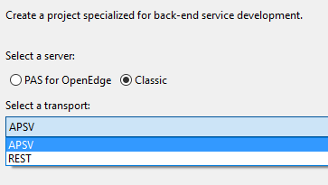
Progress Developer Studio for OpenEdge makes you more Productive
Client
Server

Slide 32
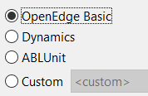
Progress Developer Studio for OpenEdge makes you more Productive
Client
Server
General
363: What’s New in PDS for OE…
Notes:
To create a project for the back-end development of the application, select the Server category from the left section of the page. Select the server type that you want to deploy the services to and the transport type that you want to use for deploying the application. Notice that the drop down list for the transport type is different depending on the Server selections.
PAS for OpenEdge supports APSV, REST, and WEB. While the Classic AppServer supports APSV and REST. Again, there is no change to the options just a better presentation of the choices.
363: What’s New in Progress Developer Studio for OpenEdge 11.7 and Sneak Peek into Future (Cloud) IDEs
Nischal Reddy

Slide 33

OpenEdge Business Process Management Improvements
Removal of the Form editor
Integration of Kendo UI Builder
  Create BPM forms
    Use in-built templates of Kendo UI Builder to create new BPM forms
  Semantic Annotations for JSDO catalog
    Validate the dataslots supported by the JSDO catalog used with Kendo UI Builder
New samples
  JSDO Service (Classic & PAS for OpenEdge)
  KUIB
Notes:
Now use Kendo UI Builder to create new forms in OpenEdge 11.7 using in-built templates to create customized interface
Semantic Annotations for JSDO catalog - You can now use semantic annotations to validate the dataslots supported by the JSDO catalog that is used with the Kendo UI Builder components.
Get to the samples from the Welcome page in PDSOE
OEBPM JSDO Service (Classic & PASOE) - A Data Object service implementation of OpenEdge BPM
OEBPM KUIB Sample - A sample app to create new BPM forms.

Slide 34

Improved Monitoring and Management
Landing page preferences
Support for hosting and managing third-party Web applications
New resource type, Batch Program*
New Progress Application Server rules
New diagnostic pages for reporting
  * OpenEdge Management Only
Notes:
You can now choose various options as the landing page you want to view after you log into your management console, either a default view or a customized view you create yourself.
Third-party Web application support — OpenEdge Management supports custom third-party Web
applications to accommodate management capabilities for Web applications beyond the OpenEdge
environment.
With support for third-party Web applications, you can:
• Extend existing OpenEdge Management functionality
• Host your own Java Web applications in the OpenEdge Management Web server.
• Integrate your own web pages.
Monitoring Batch Program resources – designed for longer running programs – ability to create/start/stop/monitor delete
New diagnostic pages added to OpenEdge Management for reporting.
New Progress Application Server rules added to OpenEdge Management.
Allows you to poll a PAS for OpenEdge instance according to a your specified time interval specified and trigger
alerts when the instance performs outside the defined threshold values
Support for hosting and managing third-party Web applications in OpenEdge Management.
New resource type, Batch Program, added to OpenEdge Management.
Configuration pages for REST and SOAP transport runtime properties.

Slide 35

OpenEdge DataServers
Oracle DataServer
Optimized ABL Cross Join as JOIN-BY-SQLDB
Compatibility Multi-tenant Foreign Databases
Microsoft SQL Server DataServer
Statement Level Lock Upgrade for JOIN Query
Microsoft SQL Server 2016 Certification
ODBC DataServer RETIRED
Documentation:
OpenEdge® Getting Started: Core Business Services - Security and Auditing - SSL Security
Data Management: DataServer for Microsoft SQL Server
Data Management: DataServer for Oracle
392: “JOIN” us on a DataServer Journey
Notes:
The Oracle DataServer enhanced to provide stability to serve side JOIN capabilities.
There is an enhancement in the Oracle DataServer to offload CROSS JOIN as server side join.
The Oracle DataServer has been certified with Oracle 12c multi-tenant configuration.
The Microsoft SQL Server DataServer has been certified with Microsoft SQL Server 2016.
Architectural changes have been made internally for the Microsoft SQL Server DataServer –
to support additional types of joins being done on server instead of on the client.
And, the OpenEdge DataServer for ODBC has been retired as of OpenEdge 11.7.
392: "JOIN" us on a DataServer Journey – Sachin Garg and Vara Prasad

Slide 36
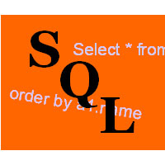
OpenEdge SQL Enhancements
User Defined Functions
Customize JVM parameters in db_name.oesql.properties
Enhanced SQL logging
Extensions to Authorized Data Truncation feature
  Dealing with ‘overstuffed fields’
Documentation:
OpenEdge Data Management: SQL Development
OpenEdge Data Management: SQL Reference
OpenEdge Development: Internationalizing Applications
Notes:
With each new release of OpenEdge we continue to enhance our SQL capabilities to ensure we adhere to the latest in SQL standards.
OpenEdge SQL for 11.7 introduces support for User Defined Functions.
User Defined Functions enable developers to extend SQL functionality with their own application logic to achieve modularity and code reuse.
A User Defined Function, written in JAVA, contains the logic, accepts the input parameters,
and returns a scalar value as the result
Customization of JVM parameters for SQL.
OE SQL uses a JVM to execute stored procedures, triggers and user defined functions.
Extensions to Authorized Data Truncation.
The ABL allows variable length data to be written to character fields, which may exceed the defined SQL width definition. This can cause SQL query failures and limit the ability to obtain complete result sets. Starting in 11.5.1, we added options to help SQL deal with these ‘overstuffed fields’:
Authorized Data Truncation can prevent queries from failing when the large column values are read.
database administrators can authorize the truncation of data that exceeds the defined column width in the schema.
In 11.7, we provide the option to only truncate data on output to the application; any internal operations use non-truncated data, actual, full size.
Autonomous Schema Update (ASU) helps resolve the SQL width problem It updates the SQL column width in the database schema automatically when Authorized Data Truncation occurs for data in a column

Slide 37
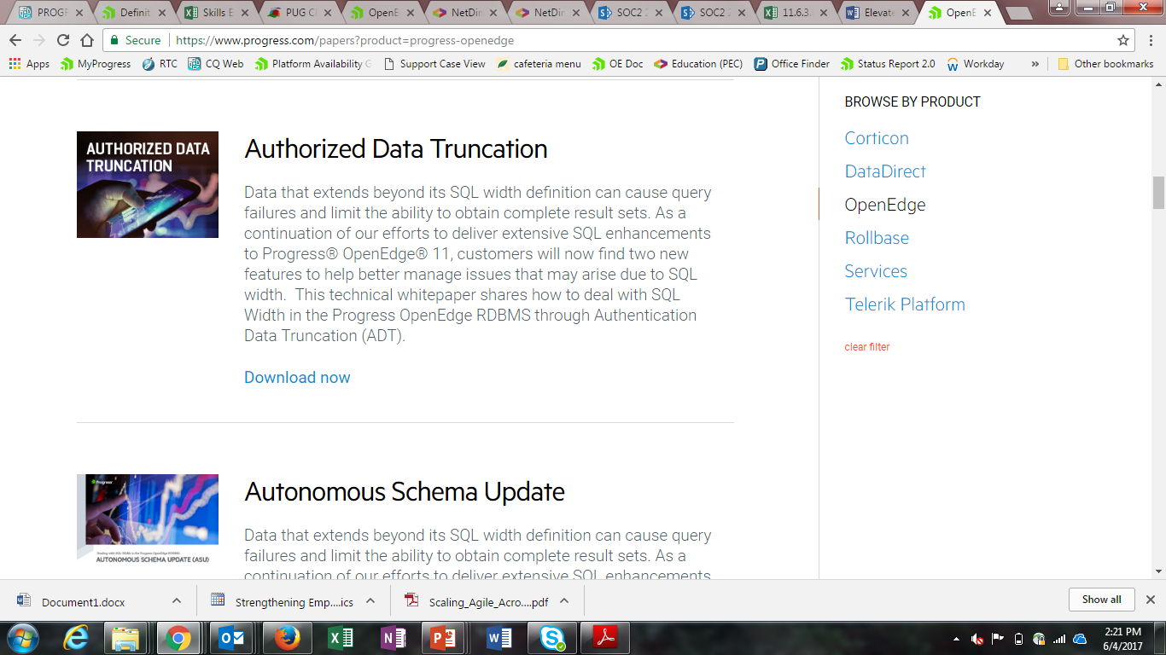
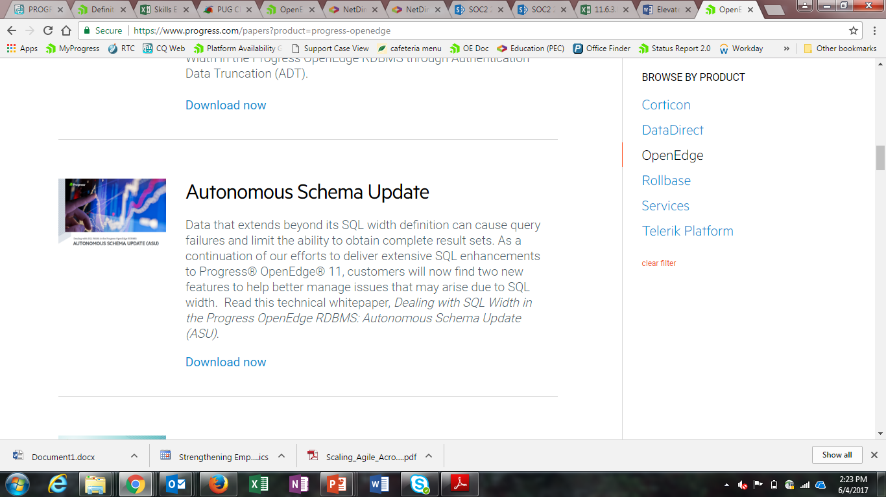
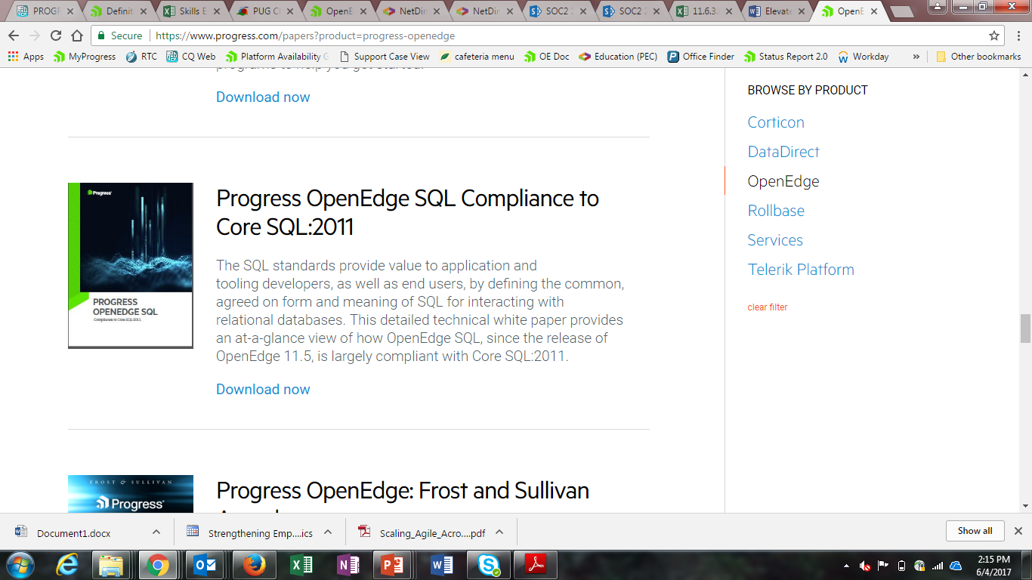
OpenEdge SQL White Papers
Documentation:
OpenEdge Data Management: SQL Development
OpenEdge Data Management: SQL Reference
OpenEdge Development: Internationalizing Applications

Slide 38
Improving your Installation Experience
Configuration Utility - configutil
  exports the source installation configurations and imports them to a different OpenEdge installation on the same or different machine
Notes:
After installing OpenEdge, you may have customized the configuration files, such as adding new servers, changing ports, and changing logging levels. All these customizations are typically stored in some configuration files such as .properties, .xml, and .pf files, or in the Window's registry.
The configutil utility export the configurations from one installation and import them to a different OpenEdge installation on the same or different machine.
Avoid doing full installs (time & effort) just to generate the needed .cfg file

Slide 39
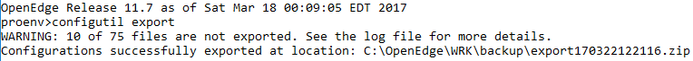
Improving your Installation Experience
Configuration Utility - configutil
  exports the source installation configurations and imports them to a different OpenEdge installation on the same or different machine
Notes:
After installing OpenEdge, you may have customized the configuration files, such as adding new servers, changing ports, and changing logging levels. All these customizations are typically stored in some configuration files such as .properties, .xml, and .pf files, or in the Window's registry.
The configutil utility export the configurations from one installation and import them to a different OpenEdge installation on the same or different machine.
Avoid doing full installs (time & effort) just to generate the needed .cfg file

Slide 40
Improving your Installation Experience
Configuration Utility - configutil
  exports the source installation configurations and imports them to a different OpenEdge installation on the same or different machine
Notes:
After installing OpenEdge, you may have customized the configuration files, such as adding new servers, changing ports, and changing logging levels. All these customizations are typically stored in some configuration files such as .properties, .xml, and .pf files, or in the Window's registry.
The configutil utility export the configurations from one installation and import them to a different OpenEdge installation on the same or different machine.
Avoid doing full installs (time & effort) just to generate the needed .cfg file

Slide 41
ABL Enhancements &
Kendo UI Builder

Slide 42

Agenda
Making it easier to develop
Handling errors
Kendo UI Builder

Slide 43
Making it easier to develop
Procedure Editor and the AppBuilder Section Editor improvements
Handle-based object validation
JSON improvements
Temp-table improvements
Class-based object improvements
Asynchronous request improvements
Startup parameter defaults

Slide 44
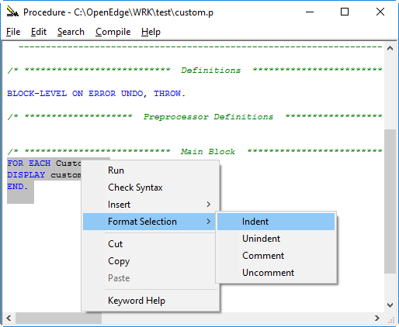
Procedure Editor and the AppBuilder Section Editor Improvements
Added support for:
  Syntax color coding
  Syntax expansion
  Alias
  Auto-casing of keywords
  Code reformatting
  Configuration dialog boxes
Improves developer productivity by providing tools for auto formatting and syntax completion on NT64 platform

Slide 45
Handle-based object validation
VALID-OBJECT function includes the ability to check an ABL handle-based object
VALID-OBJECT (object-reference | handle-reference)

Slide 46
JSON improvements
Enhancing the WRITE-JSON()method to serialize objects in Temp-Tables
Enhancing WRITE-JSON and SERIALIZE-ROW method with new targets:
  JsonArray or JsonObject
DEFINE TEMP-TABLE foo NO-UNDO
FIELD foochar AS CHAR
FIELD fooObj AS PROGRESS.LANG.OBJECT EXTENT 4
FIELD fooint AS INTEGER.
TEMP-TABLE ttfoo:WRITE-JSON("file", “ttfoo.json", TRUE).
USING Progress.Json.ObjectModel.*
DEFINE VARIABLE myJsonObject AS JsonObject.
myJsonObject = NEW JsonObject ().
TEMP-TABLE myTT:WRITE-JSON (“JsonObject”, myJsonObject, …).

Slide 47
Temp-Table improvements
Create a BEFORE-TABLE for a dynamic temp-table
Invoke EMPTY-TEMP-TABLE( ) on a temp-table handle
  Previously required using the buffer handle
DEFINE TEMP-TABLE myTT
…
BEFORE-TABLE myBeforeTT.
TEMP-TABLE-PREPARE ( temp-table-name-exp [ , before-table-exp])
hTTCust:EMPTY-TEMP-TABLE ()

Slide 48

Support for the NON-SERIALIZABLE option to class members
Added the ability to mark class members as NON-SERIALIZABLE recording less data during object serialization
Sends less data across the wire to an AppServer or when serializing objects to a file using Progress.IO.BinarySerializer and Progress.IO.JsonSerialer
CLASS statement
DEFINE VARIABLE ….
DEFINE VARIABLE … NON-SERIALIZABLE
DEFINE PROPERTY….
DEFINE PROPERTY … NON-SERIALIZABLE
DEFINE TEMP-TABLE ….
DEFINE TEMP-TABLE … NON-SERIALIZABLE
DEFINE DATASET …
DEFINE DATASET … NON-SERIALIZABLE
….

Slide 49
Added the SERIALIZE-NAME phrase to class variables and properties
Developers can use this option if the ABL name will result in invalid JSON when serialized out or if the serialized name either contains invalid characters for an ABL name or the serialized name is an ABL keyword
CLASS statement
DEFINE VARIABLE … SERIALIZE-NAME name1
DEFINE PROPERTY … SERIALIZE-NAME name2
JSON

Slide 50
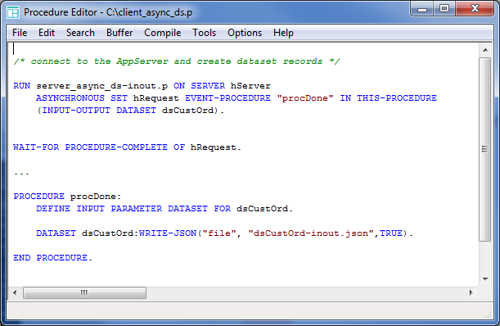
ProDataSet parameter support
Can now call procedures asynchronously that have DATASET output parameters

Slide 51
Increased default startup parameter values
Increased –D default
  The Directory Size -D startup parameter is used to change the number of compiled procedure directory entries
  Increased the default from 100 to 1000
Increased –s default
  The –s startup parameter sets the size of the stack (an internal memory area used by ABL program modules)
  Increased the default from 40 to 128

Slide 52
Agenda
Making it easier to develop
Handling errors
Kendo UI Builder

Slide 53
Handling errors
Support debugging the Progress Application Server for OpenEdge
Debugger breakpoint on error improvements
Allow WebClient applications to continue offline
Enhancements to compilation
Tech preview – Improvements to handling STOP conditions

Slide 54
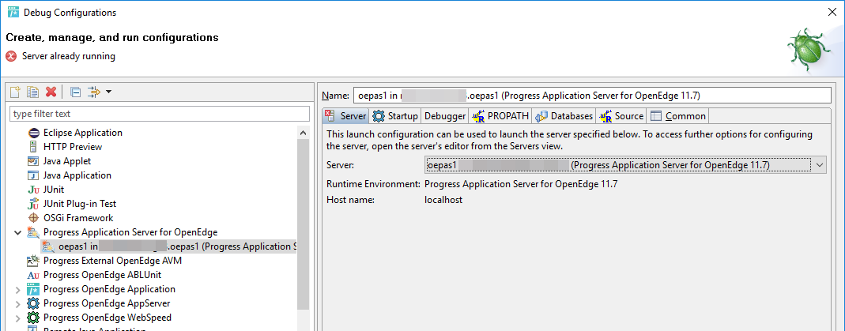
Support debugging the Progress Application Server for OpenEdge
Support for remote debugging of the Progress Application Server for OpenEdge
Provides same debugging capabilities as the AppServer

Slide 55
Debugger breakpoint on error improvements
Break on error now breaks at the line where the error occurred
In addition, all error breakpoints now recognize and break on errors thrown using the ABL UNDO, THROW statement

Slide 56
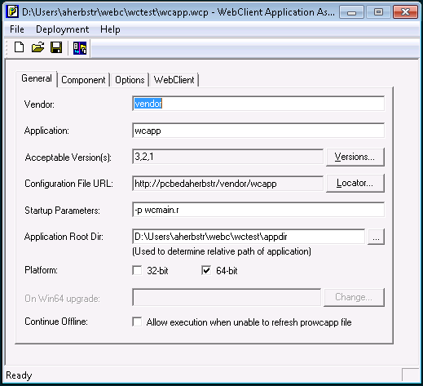
Allow WebClient applications to continue offline
Added option to allow execution when unable to refresh prowcapp file
New checkbox for Continue Offline on the General tab for the prowcappmgr.exe
Allows deployed applications to continue execution when it is unable to access the current online configuration file from the server using the last downloaded local copy

Slide 57
Enhancements to compilation
Enhancement to the compiler to enforce one or more rules during compilation
New phrase specifies comma separated values or a file containing specified rules
Can be set via COMPILER system handle and startup parameter
COMPILE { procedure-pathname | VALUE ( expression ) }
| { class-pathname | VALUE ( expression ) }
[ OPTIONS options-list
| OPTIONS-FILE { options-file | VALUE ( expression ) }
]
...

Slide 58
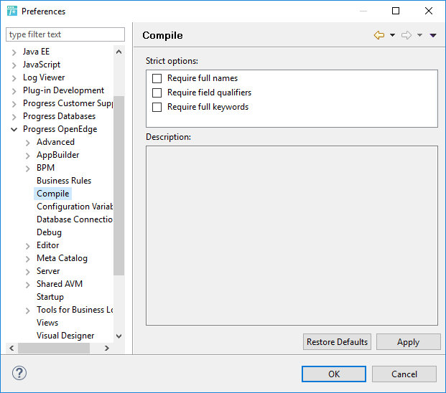
Supporting COMPILE statement new options for the workspace
Window > Preferences
  Progress OpenEdge > Compile
    Require full names
    Require field qualifiers
    Require full keywords

Slide 59
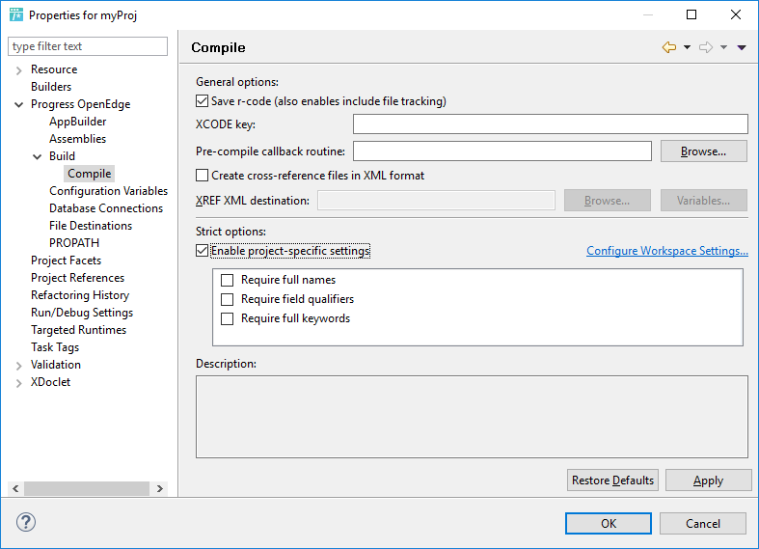
Supporting COMPILE statement new options for the project
Select a project
Right click to select Properties
Select Progress OpenEdge > Build > Compile
  General Options
  Strict options:
    New support for Compile options

Slide 60
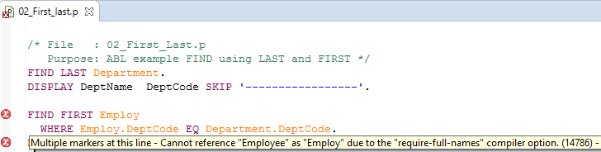
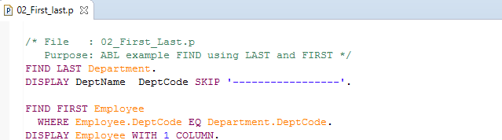
require-full-names
Use full names

Slide 61
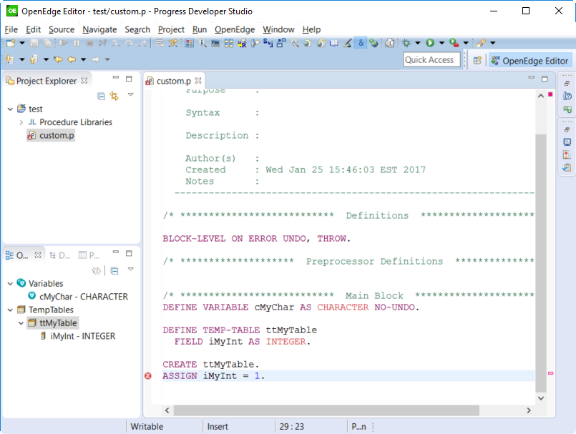
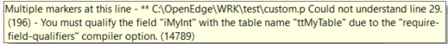

require-field-qualifiers
Qualify the field to resolve

Slide 62
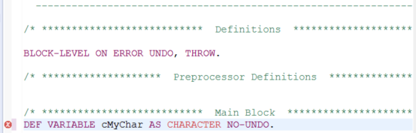
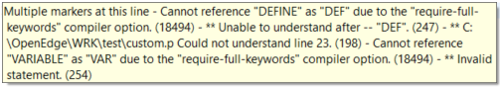
require-full-keywords
Use full keywords to resolve

Slide 63
Tech preview - Improvements to handling STOP conditions
CATCH stop conditions
  Trap any error messages associated w/ the STOP condition
Distinguish between the stop types
  For example, STOP-AFTER
New supporting classes for STOP conditions
  Progress.Lang.StopError
    Inherits from Progress.Lang.SysError
    Implements Progress.Lang.Error
  Progress.Lang.Stop
    Inherits from Progress.Lang.Object
    Progress.Lang.LockConflict
    Progress.Lang.StopAfter
    Progress.Lang.UserInterrupt
STOP

Slide 64
New Startup parameter -catchStop
New switch for ABL session
  For 11.7, there is a startup switch to enable this behavior
  For 12.0.0 it will be the default
Gives you control over enabling this feature

Slide 65
Tech preview - Example:
Trapping a STOP condition with an error message
You will see:
  Caught ** “Foobzr.p” was not found. (293)
  Progress.Lang.StopError
DO ON ERROR UNDO, LEAVE:
RUN VALUE(procName).
CATCH err AS Progress.Lang.Error:
MESSAGE "Caught" err:getMessage(1) SKIP
err:GetClass():TypeName
VIEW-AS ALERT-BOX.
END.
END.

Slide 66
Tech preview - Example:
Using Progress.Lang.LockConflict to catch errors with properties TableName, User, Device
DO ON ERROR UNDO, LEAVE:
FIND customer WHERE custnum = 1 EXCLUSIVE-LOCK
NO-ERROR.
MESSAGE “Shouldn’t get here because it’s STOP not ERROR” VIEW-AS ALERT-BOX.
CATCH err AS PROGRESS.Lang.LockConflict:
MESSAGE “Caught Lock Conflict” SKIP
“Table: “ err:TableName SKIP
“User: “ err:User SKIP
“Device: “ err:Device
VIEW-AS ALERT-BOX.
END.
END.

Slide 67
Tech preview - Example:
New object which uniquely identifies STOP-AFTER condition
DO ON ERROR UNDO, LEAVE STOP-AFTER 4
ON STOP UNDO, LEAVE:
<long-running code>
CATCH err AS Progress.Lang.StopAfter:
MESSAGE “STOP was due to STOP-AFTER”
VIEW-AS ALERT-BOX.
END.
END.

Slide 68
New attributes of the asynchronous request object handle
ERROR-OBJECT — This attribute returns an object reference which implements Progress.Lang.Error that is thrown from an asynchronous request.
STOP-OBJECT — This attribute returns an object reference to any instance of the Progress.Lang.Stop class, or one of its built-in subclasses, that is thrown from an asynchronous request
IF VALID-OBJECT(SELF:ERROR-OBJECT)
MESSAGE SELF:ERROR-OBJECT:GetMessage(1) VIEW-AS ALERT-BOX.
ELSE IF VALID-OBJECT(SELF:STOP-OBJECT) THEN DO:
IF TYPE-OF(SELF:STOP-OBJECT, PROGRESS.Lang.StopAfter) THEN
...
END.

Slide 69
Agenda
Making it easier to develop
Handling errors
Kendo UI Builder

Slide 70

Modernize with Kendo UI Builder for OpenEdge
Drag and Drop application for building Browser Based User Interfaces
Leverage your existing OE business logic
Based on JSDO
Automate generation of 80% of screens in a business application
KUIB 1.0 Released September 2016
  Core set of editor types
KUIB 1.1 Released November 2016
  Blank View
KUIB 2.0 Expected Release June/July 2017

Slide 71
What’s New in KUIB 2.0
Single Page Application (SPA) Dev Environment
Predefined templates
  Editable Data Grid
  Hierarchical Data Grid
  Stacked Data Grid
Rich set of Kendo UI controls
  Charts
  Calendar, etc
Support for Foreign Keys
Electron Shell container

Slide 72
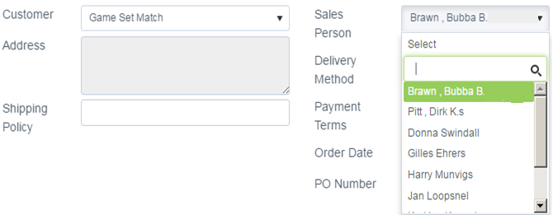
Foreign Key Support
Placeholder field
Semantic Type is ‘Lookup’
Editor Types
  Combo-box
  Drop-down list

Slide 73
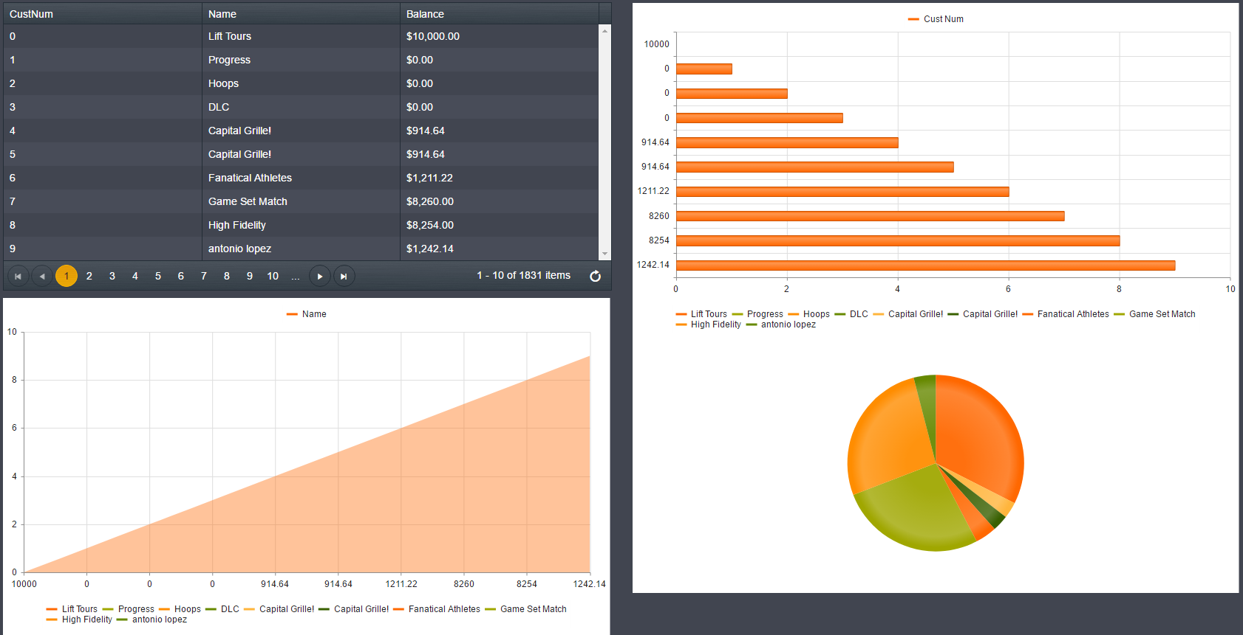
The Power of KUIB Charts !!!

Slide 74
Hierarchical and Stacked Data Grid
Parent/Child data represented in different forms in KUIB webapp
Multiple editing modes
  Inline
  Popup
  Incell
Allows CRUD operations on child table data
Single relation or multi-relation(s) among tables
Both parent and child tables should be in single resource

Slide 75
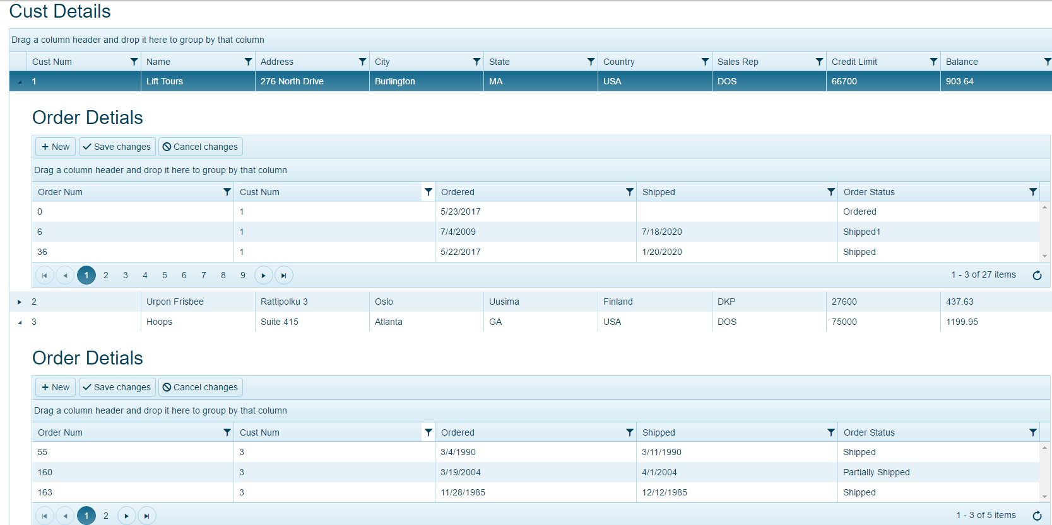
Glimpse of Hierarchical Data Grid

Slide 76
OpenEdge 11.7 Delivers

Slide 77
OpenEdge 11.7 Delivers
Security, Scalability, High Availability

