Slide 1
We’re gonna script the *BLEEP* out of this!
*BLEEP*
Dustin Grau, Progress Services NA
June 2017

Slide 2

What’s with that title?
“So, in the face of overwhelming odds, I’m left with only one option:
I’m going to have to science the s*** out of this.” – Mark Watney
“The Martian”, 20th Century Fox
Notes:
Matt Damon’s character, Mark Watney, is stranded on Mars.
He must creatively use what he has to survive and await rescue.

Slide 3
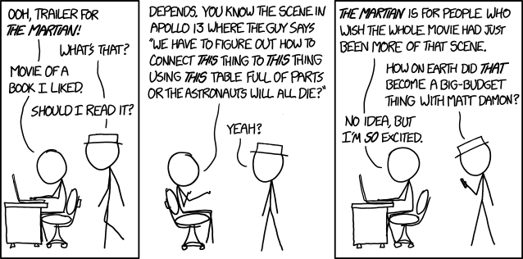
Obligatory XKCD

Slide 4
Agenda
Why scripting?
What can we script?
Usable Examples
Additional Resources

Slide 5
Why scripting?

Slide 6
Why a focus on scripting?
Time – You did have other things to do, right?
Predictability – Each step only has a pass/fail result.
Performance – Let the computers do the repetitive tasks!
Memory – Can you recall this process 2 years from now?
Familiarity – We’re software developers, are we not?
Understanding – A bit of “learning to fish” as it were…
Notes:
Basically, you shouldn’t need to remember a ton of steps to perform some action if you can automate it.

Slide 7
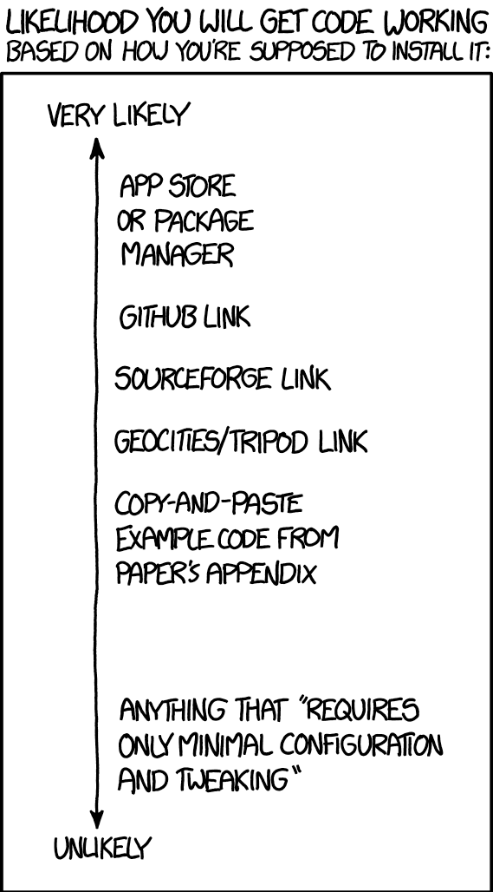
“Will it work?”
I have sample code!
Let’s eliminate the last case ☺

Slide 8
What can we script?

Slide 9
Things I have scripted, so far…
Security setup for a customer with a complex multi-tenant environment
  Manage database domains (SSO) for application security (PAS)
  Manage database tenants and their domains for multi-tenancy
  Generate user accounts for database and/or application security
  Create domain registries for Spring Security Framework (PAS)
Automate creation and deployment process for continuous integration
  Create PAS instances, consistently across multiple environments
  Prepare a PAS instance for use with multiple ABL Applications
  Merge configuration changes to the openedge.properties file
  Deploy WebApps to non-development PAS instances
  Enable and disable PAS features

Slide 10
What do we use to write our scripts?
1
Command Line Programs
2
Internal Code Libraries
3
RESTful Interfaces
4
Third-party Tools

Slide 11
Usable Examples

Slide 12
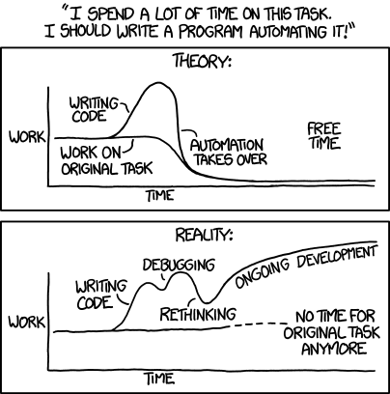
Notes:
Some caution still applies, but these examples should get you started quickly.

Slide 13
Command Line Programs

Slide 14
Common PAS Commands
pasman
  Exists in the DLC/bin directory, available anywhere via PROENV session
  Create a new PAS instance, tailoring it to the given parameters (name, path)
oeprop
  Exists in each CATALINA_BASE/bin directory, tailored to instance
  Merge any default or common options to openedge.properties
tcman
  Exists in each CATALINA_BASE/bin directory, tailored to instance
  Can do the same things pasman does, but for just this instance
  Deploy any WebApps to the PAS instance, tailors openedge.properties
  Enable or disable PAS features, as needed (eg. tcman feature AJP13=on)
Notes:
Why? These are programs that are ALWAYS available to your OpenEdge environment.

Slide 15
Combined with ANT
As of OE 11.7, ANT comes standard within the DLC directory!
Create portable scripts for starting/rebuilding PAS instances with the same options
Reusable for non-development environments (using pasman), great for QA, PROD, etc.
Create instance-specific property tailoring (using oeprop) without a text editor
Output domain info to CSV file, execute “gendomreg” to encrypt for Spring Security
New in OE 11.7: package ABL Web App, REST, and Web UI projects; generate catalog files
Notes:
Again, all the tools you need are now available right out of the box.

Slide 16
Examples: pasman
pasman help
pasman help <command>
pasman [-v -f] /
-p <http> -P <https> -j <ajp13> -s <shutdown> /
-N <instance_alias> <full_path_to_instance> /
[<alternate_abl_app_name>]
-f copies the oemanager and tomcat manager webapps to the instance
ALWAYS override the default port options (default == DLC, same as oepas1)
The -N option alters the name used by OEM and the -I option with pasman
Undocumented Feature: if you add a parameter after the path, that will be used as the internal name of your default ABL Application (default == alias, last path folder)
Notes:
Why? Because PASMAN is always available in DLC/bin, you can rely on this for any script.
Creating an instance via the command line is nearly fool-proof and works on any OS.

Slide 17
<exec dir="${dlc.bin}”
executable="pasman.${scriptSuffix}”
output="create_${alias}.txt”
failonerror="true">
<arg value="create"/>
<arg value="-v"/>
<arg value="-f"/>
<arg line="-p ${http}"/>
<arg line="-P ${https}"/>
<arg line="-j ${ajp}"/>
<arg line="-s ${shut}"/>
<arg line="-N ${alias}"/>
<arg value="${pas.path}"/>
<arg value="${ablapp}"/>
</exec>
Notes:
Using the ANT “exec” command to run a command with options/parameters.

Slide 18
Examples: oeprop
oeprop –f <filename>
Recommended use is to merge a file with the –f option
Merges changes with the instance’s openedge.properties file
Properties file follows standard INI format: ubroker.properties, etc.
  [AppServer.Agent.<abl_app_name>]
    Property=Value
  [AppServer.SessMgr.<abl_app_name>]
    Property=Value
You can use replacements, with caveats…
  Agent: ${CATALINA_BASE} ${DLC} – Environment variables from OS startup
  SessMgr: ${catalina.base} – Properties from Java environment
Notes:
Why? Many processes update the openedge.properties file, and sometimes you need to quickly reset an option or apply multiple changes at once.
This program allows you to specify a small number of critical changes, but not hunt through the config file to locate the appropriate line by hand.

Slide 19
Examples: tcman
tcman help
tcman help <command>
tcman deploy [-a <webapp_alias>] <path_to_war_file> [<abl_app_name>]
If no alias (-a) option given, the deployed WebApp will match the name of the WAR file
By default, the WebApp will be deployed under the default ABL Application
Similar to pasman, if passing a parameter after the WAR file path, it will associate the WebApp with the named ABL Application by that name (undocumented prior to 11.7)
  https://documentation.progress.com/output/ua/OpenEdge_latest/index.html#page/pasoe-admin/tcman-reference.html#
Notes:
Why? This program is already tailored to the PAS instance, so any commands are immediately isolated.

Slide 20
Internal Code Libraries

Slide 21
Data Admin Service Interface
  OpenEdge.DataAdmin.DataAdminService
Available in ABL by USING the following:
  OpenEdge.DataAdmin.*
  OpenEdge.DataAdmin.Error.*
  OpenEdge.DataAdmin.Lang.Collections.*
Access connected database by number or logical name
  No need for DICTDB alias, or to read meta-schema tables
Typical uses might include…
  Inspect database options
  Create tenants and domains
  https://documentation.progress.com/output/ua/OpenEdge_latest/index.html#page/dvpin/database-administration-entity-interface-referen.html#

Slide 22
Initial Setup
define variable oService as DataAdminService no-undo.
define variable iDB as integer no-undo.
do iDB = 1 to num-dbs:
assign oService = new DataAdminService(ldbname(iDB)).
if valid-object(oService) then do:
/* Do Something Cool */
delete object oService.
end. /* valid-object */
end. /* do iDB */
Notes:
Why? Instead of attempting to remember the proper metaschema table names, you can use a programmatic interface.
Auto-completion and syntax hinting is available when developing in PDSOE.

Slide 23
Great, so now what?
Create (or Update) tables, domains, tenants, users, etc. according to ABL documentation
Sample customer use case (preparing for multi-tenancy):
  Create a default domain (un-tenanted) and default user for initial DB connections
  Check if necessary DB areas exist for a new tenant; create new tenant if not already present
  Check if tenant domain exists; create domain (with passcode) for tenant, or just update passcode
Use iterators to access items in a set of something (aka, collection)
  Iterator Interface [Iiterator]
  oService:GetTables() [ITableSet of ITable’s]
  oService:GetFields() [IFieldSet of IField’s]
  oService:GetAreas() [IAreaSet of IArea’s]
  oService:GetDomains() [IDomainSet of IDomain’s]
  oService:GetTenants() [ITenantSet of ITenant’s]
  oService:GetUsers() [IUserSet of IUser’s]
Notes:
This is not a comprehensive list, but should give some very common examples of items you may interrogate/change.

Slide 24
Iterator Example
define variable oTables as ITableSet no-undo.
define variable oTable as ITable no-undo.
define variable oTableIter as IIterator no-undo.
/* Get the tables as an ITableSet (collection). */
assign oTables = oService:GetTables().
/* Get the Iterator for this ITableSet. */
assign oTableIter = oTables:Iterator().
do while oTableIter:HasNext():
/* Treat the Iterator-returned value as an ITable interface. */
assign oTable = cast(oTableIter:Next(), ITable).
message oTable:Name. /* Or, just do more cool stuff :) */
end. /* do while */
Notes:
Assume setup and use of the oService object shown previously.

Slide 25
RESTful Interfaces

Slide 26
The oemanager WebApp
Notable features/limitations
  Responds to (secured) REST requests
  Normally on non-production environments
  Deployed by use of “pasman –f” option at creation
  Can be deployed via tcman (DLC/servers/pasoe/extras)
Access by REST requests (AJAX, OEHttpClient, etc.)
Obtain environment information
  ABL Application configuration options
  Transport status (enabled/disabled)
Stop or Start: Agents or Sessions
https://documentation.progress.com/output/ua/OpenEdge_latest/index.html#page/pasoe-admin/rest-api-reference-for-oemanager.war.html
Notes:
Why? You may need to obtain information about a PAS instance on an environment where you cannot use the OEM.

Slide 27
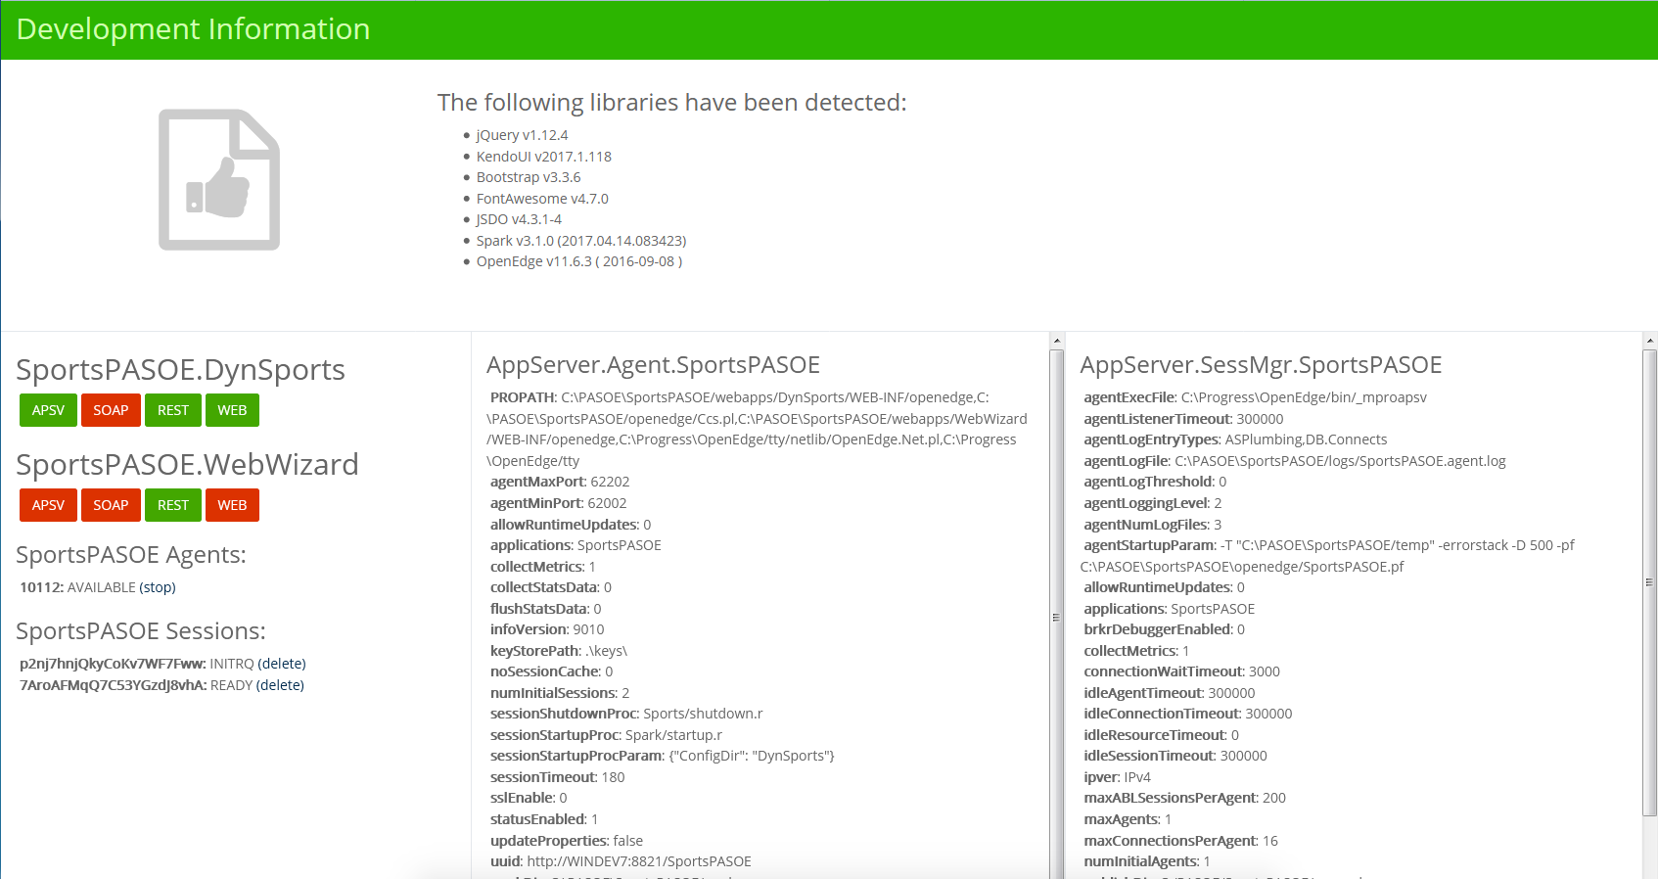
Notes:
Example web page made with jQuery that accesses oemanager data.

Slide 28
Basic Usage via jQuery
// Get info about all ABL Application in this PAS instance.
$.ajax({
contentType: "application/vnd.progress+json",
dataType: "json",
url: "http://tomcat:tomcat@localhost:8810/oemanager/applications"
});
{
outcome: “SUCCESS”,
result: {
Application: [{
name: "oepas1", . . .
}]
}
}
Notes:
Here we obtain the list of ABL Applications associated with a PAS instance.

Slide 29
Get OpenEdge Properties
// Get all Agent properties of an ABL Application.
$.ajax({
contentType: "application/vnd.progress+json",
dataType: "json",
url: " http://tomcat:tomcat@localhost:8810/oemanager/applications”
+ “/oepas1/agents/properties”
});
// Get all SessMgr properties of an ABL Application.
$.ajax({
contentType: "application/vnd.progress+json",
dataType: "json",
url: " http://tomcat:tomcat@localhost:8810/oemanager/applications”
+ “/oepas1/properties”
});
Notes:
Returns essentially the same data that can be found in the openedge.properties file, without locating it on disk.

Slide 30
Get Agent/Session Info
// Get agent information (PID) for an ABL Application.
$.ajax({
contentType: "application/vnd.progress+json",
dataType: "json",
url: " http://tomcat:tomcat@localhost:8810/oemanager/applications”
+ “/oepas1/agents”
});
// Get session information (ID’s) for an ABL Application.
$.ajax({
contentType: "application/vnd.progress+json",
dataType: "json",
url: " http://tomcat:tomcat@localhost:8810/oemanager/applications”
+ “/oepas1/sessions”
});
Notes:
Obtains runtime information about available OS processes or internal sessions.

Slide 31
Stopping Agents/Sessions
// Kill an agent of a PAS instance.
$.ajax({
contentType: "application/vnd.progress+json",
dataType: "json", method: “delete”,
url: " http://tomcat:tomcat@localhost:8810/oemanager/applications”
+ “/oepas1/agents/” + agentID
});
// Trim a session of an MSAS agent.
$.ajax({
contentType: "application/vnd.progress+json",
dataType: "json", method: “delete”,
url: " http://tomcat:tomcat@localhost:8810/oemanager/applications”
+ “/oepas1/sessions/?sessionID=” + sessionID + “&terminateOpt=0”
});
Notes:
Allows you to kill a specific Agent PID or end a runaway session (since killing an agent kills all sessions).

Slide 32
Advanced Topic: OEM REST API’s
OpenEdge Management REST API’s
You know, that website you get at http://localhost:9090 ☺
  Essentially act as a front-end to the AdminServer
Found reference/use via KB article
  http://knowledgebase.progress.com/articles/Article/How-to-trim-and-restart-Appserver-Agents-by-REST-API
  Mentions a starting point for API requests: http://localhost:9090/oem/api
  Because it was mentioned, I started digging deeper…
Can utilize OEHttpClient features to make REST requests via ABL
  Requires Basic Authentication: new OpenEdge.Net.HTTP.Credentials()
  Base URL: http://localhost:9090/oem/containers/localhost/pas
  GET returns JSON, contains array of available PAS instances and their status
  Each instance has a key and url property for further investigation

Slide 33
Notable Response Items (Base URL)
{
"success": true,
"instances": [{
"key": "localhost:resource.openedge.pas.oepas1",
"status": {
"status": 5,
. . .
},
"url": "/oem/containers/windev7/pas/localhost:resource.openedge.pas.oepas1",
. . .
}
]
}
Notes:
A status code of 5 means “passed” which typically means “running”.
All other status codes should imply a “not running” state.

Slide 34
Usage Examples
GET of the returned Instance URL directly returns true status:
  http://localhost:9090/oem/containers/windev7/pas/localhost:resource.openedge.pas.oepas1
Response has an “instance” object with boolean property “running”
PUT via Base URL + Instance Key and JSON body allows changing running state:
  http://localhost:9090/oem/containers/localhost/pas/localhost:resource.openedge.pas.oepas1
  Send {“running”: true} to start
  Send {“running”: false} to stop
  This is more or less how PDSOE manages server instances
  Useful when access rights to manage PAS are restricted, or requires “headless” operation
All of this comes with some BIG caveats…
Notes:
With great power comes great responsibility…

Slide 35
Disclaimers: OEM REST API’s
OpenEdge uses them for lots of stuff in PDSOE and OEM
They are there to satisfy OEM needs and PDSOE needs, first
OE reserves the right to change them to suit needs of the product
Not “official” as the individual services are not tested enough to say they are production ready, completely usable, and quirk free (some services may have been better tested than others)
Not officially supported through tech support, considered need-to-know for above reasons
Notes:
Danger Will Robinson, Danger!

Slide 36
Warnings: OEM REST API’s
Some of these are destructive
They can create/delete services
They have full read/write access to OS files
AdminServer often runs with elevated privileges
Credentials must be protected in your scripts!
Notes:
The good news is that we can address most of these concerns quite easily…

Slide 37
Mitigation: OEM REST API’s
If using in production, turn on HTTPS with a proper certificate, and…
Disable the HTTP connector in OEM to prevent unsecured access
Create an OEM user with the “Operator” role
Grant operator minimum permissions necessary (eg. PAS start/stop)
Use the operator login information within any scripts
Avoid using the administrator account!
Notes:
Why? This isolates the risk that we open by exposing account credentials to our AdminService.

Slide 38
Third-party Tools

Slide 39
Additional Resources
ANT
  https://ant.apache.org/manual/
  https://documentation.progress.com/output/ua/OpenEdge_latest/index.html#page/pdsoe/using-apache-ant-tasks.html
  https://documentation.progress.com/output/ua/OpenEdge_latest/index.html#page/pdsoe%2Fgenerating-abldoc-using-apache-ant.html
PCT
  Requires ANT (1.8+)
  https://github.com/Riverside-Software/pct/wiki
    https://github.com/Riverside-Software/pct/wiki/ClassDocumentation
    https://github.com/Riverside-Software/pct/wiki/HtmlDocumentation
Free Samples!
  https://www.dropbox.com/s/7g6efbijjk7ni1o/Scripting.zip?dl=0
Notes:
Note: Under OE11.6 the ABLDoc libraries were not included with Unix installations. Have not confirmed this for 11.7, yet.

Slide 40
What’s in the Samples?
  https://www.dropbox.com/s/7g6efbijjk7ni1o/Scripting.zip?dl=0
createDomain.p – Update or create an EXTSSO domain on all connected databases
manageInstance.p – Execute OEM REST API’s via OEHttpClient requests
trimAgents.p – Trim all sessions on a PAS instance via oemanager
clean.bat – Executes a “pasman clean –A” on oepas1 (archive and remove logs)
Copy of PCT.jar
manage-pas.xml + build.properties
  ANT tasks for managing oepas1
  Provides build targets for most of the above actions
  Uses PCTRun to execute ABL code with parameters
  Useful for incorporating into PDS as External Tasks

Slide 41

“The Martian”, 20th Century Fox
Notes:
Just remember, it’s not rocket surgery ☺

Slide 42
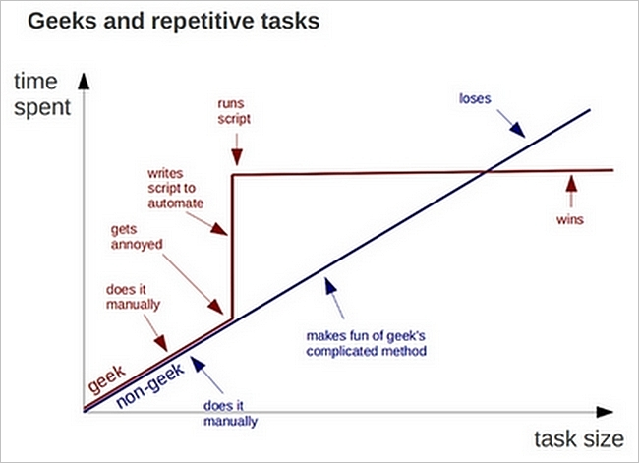
Notes:
Hopefully you see some new options you didn’t know about previously, and can discover a few new uses of your own.
As of 11.7 nearly everything you need is ALREADY IN THE BOX!

Slide 43

Questions?
“The Martian”, 20th Century Fox
Notes:
You mostly have what you need to survive already, you just need to use it appropriately.

